Slide 1
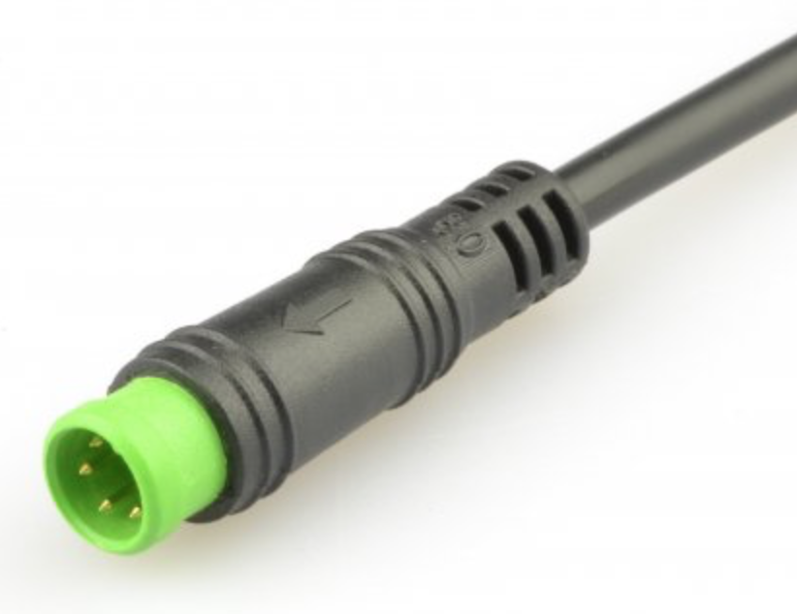
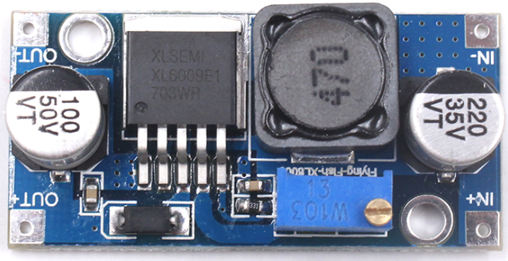
Higo Mini B Male
Output voltage
potentiometer adjuster
Remove bridge between
TX and Rx
CH340G
To USB port
on PC
XL6009
Bridge to
5 volt pin

