Slide 1

DDSAnalytics: Request For Proposal – Project TalentHold
Overview of the Project: This case study aims to demonstrate our team’s ability to deliver efficient and advanced analytical capabilities that will drive the Frito Lay Talent Management Initiatives forward.
Objectives and Goals: The primary objectives are to understand the factors influencing employee attrition, develop predictive models to forecast attrition, and provide actionable insights to reduce turnover.
Photo by Octavian Dan on Unsplash

Slide 2
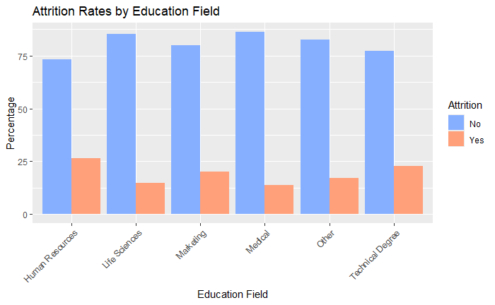
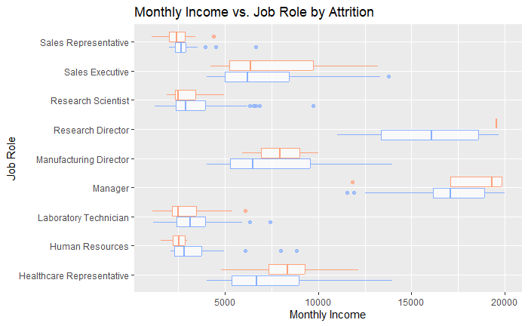
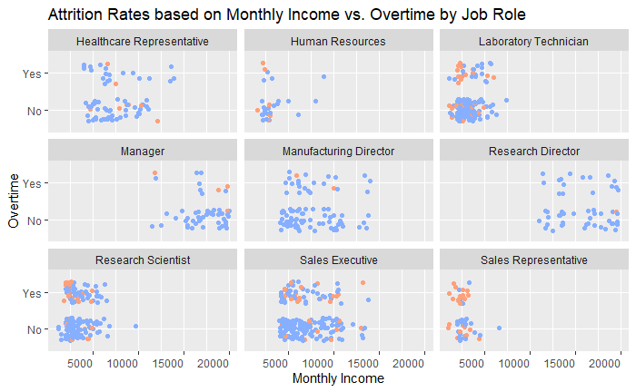
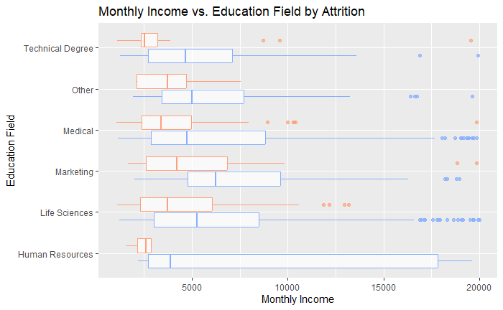
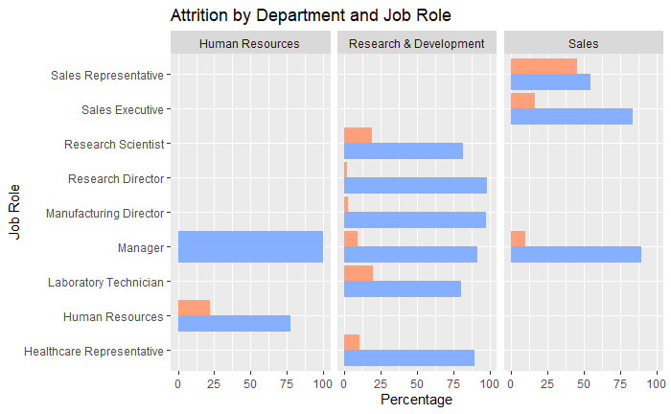
Exploratory Data Analysis
The Initial Exploration: Visualizing Multivariate Relationships.
Education Field by Attrition:
- Fairly equal across the board, but the highest turnover is in employees holding human resources and technical degrees.
Monthly Income vs Education Field by Attrition:
- The boxplot indicates a likely massive disparity in monthly income between the highest and lowest earners in Human Resources.
Monthly Income vs Job Role by Attrition:
- Human Resources Job Role appears to be more fairly distributed than the Education Field would lead one to expect.
- Management likely accounts for outliers across departments.
- There are several fields with very wide spreads in the data
Attrition by Department and Job Role:
- Managers in Human Resources are the only role that have no turnover on record.
- Sales Representatives have incredibly high turnover.

Slide 3
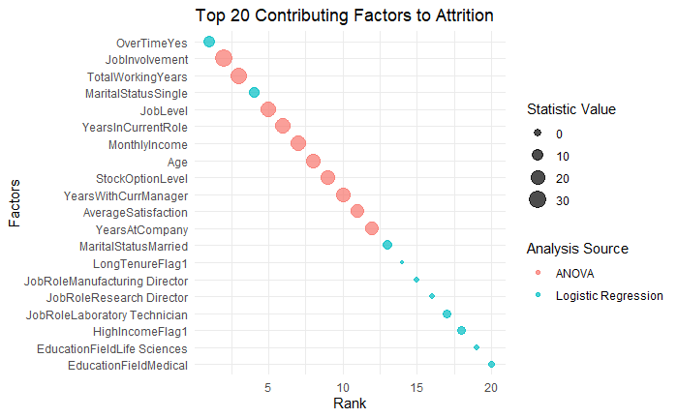
Exploratory Data Analysis
k-Nearest Neighbors (k-NN): A non-parametric method used for classification. It works by finding the k closest data points in the training set to make predictions.
Naive Bayes: A probabilistic classifier based on Bayes' theorem. It assumes independence between predictors, making it computationally efficient.
K-NN (Over-sample) | Reference |  | Additional Stats
 | Attrition (N) | Attrition (Y) | Sensitivity: 0.58
Attrition (N) | 89 | 19 | Specificity: 0.91
Attrition (Y) | 64 | 193 | Accuracy: 0.77
Analysis of Numeric Values: ANOVA models assess differences in means among multiple groups for a continuous dependent variable. It helps determine if at least one group mean is statistically different from the others.
Analysis of Categoric Values : Logistic regression provides insights into the relationship between categorical dependent variables and continuous or categorical independent variables.
Evaluation Criteria: Models were primarily evaluated based on sensitivity and specificity.
Naive Bayes: Selected due to its simplicity, speed, and performance on the re-balanced data.
Performance: Naive Bayes showed higher overall performance in predicting employee attrition compared to k-NN.
Naïve-Bayes (Under-sample) | Reference |  | Additional Stats
 | Attrition (N) | Attrition (Y) | Sensitivity: 0.72
Attrition (N) | 21 | 5 | Specificity: 0.83
Attrition (Y) | 8 | 24 | Accuracy: 0.78

Slide 4

Business Implications
Interpretation of Results: The analysis revealed that factors such overtime, job role, and monthly income significantly impact employee attrition. High levels of monthly income and extensive working years are associated with lower attrition, while overtime and certain job roles contribute to higher turnover rates.
Recommendations Based on Findings:
1. Enhance job involvement through employee engagement programs.
2. Monitor and manage overtime to prevent burnout.
3. Focus on retention strategies for high-risk job roles.
4. Develop career development plans to leverage employees' extensive working years.
Photo by Sincerely Media on Unsplash

