Slide 1

Making ExtJS Perform
How to avoid speed impact
Presented by Brandon Ryall

Slide 2

Question: What types of things can impact our speed?

Slide 3
Question: What types of things can impact our speed?
Network latency
A slow network can have a major impact on our usability, many things such as rendering to data load.

Slide 4
Question: What types of things can impact our speed?
Network latency
A slow network can have a major impact on our usability, many things such as rendering to data load.
CSS Selectors
Improper selectors can slow down our DOM traversal

Slide 5
Question: What types of things can impact our speed?
Network latency
A slow network can have a major impact on our usability, many things such as rendering to data load.
CSS Selectors
Improper selectors can slow down our DOM traversal
Dom Manipulation
Creating panels within panels create unnecessary DOM nesting

Slide 6
Question: What types of things can impact our speed?
Network latency
A slow network can have a major impact on our usability, many things such as rendering to data load.
CSS Selectors
Improper selectors can slow down our DOM traversal
Dom Manipulation
Creating panels within panels create unnecessary DOM nesting
Slow JavaScript Execution
Unoptimized javascript can make the app sluggish and create a terrible user-experience

Slide 7
Network Issues
One of the
biggest
issues we run into when using libraries and frameworks are
slow
load times.

Slide 8
Network Issues
Why?
We’re loading tons of JavaScript files at once
We’re loading tons of CSS at once
We’re loading tons of images at once

Slide 9
Network Issues
So then if we have all of these slow loading issues, why do we continue to use it?

Slide 10
Network Issues
So then if we have all of these slow loading issues, why do we continue to use it?
The simple answer is that it works. And it works well.

Slide 11
Network Issues
So then if we have all of these slow loading issues, why do we continue to use it?
The simple answer is that it works. And it works well.
The problem is that we’re just
doing it wrong.

Slide 12

Network Issues
Really really really wrong.
Like really.

Slide 13
Network Issues
But we can fix it!

Slide 14
Network Issues
But we can fix it!
How?
Use the bootstrap, it is your friend

Slide 15
Network Issues
But we can fix it!
How?
Use the bootstrap, it is your friend
Reduce the number of JS files needed to be loaded by using the Ext.Loader and Ext.require

Slide 16
Network Issues
But we can fix it!
How?
Use the bootstrap, it is your friend
Reduce the number of JS files needed to be loaded by using the Ext.Loader and Ext.require
Compress and obfuscate the files into a single cacheable file

Slide 17
Network Issues
But we can fix it!
How?
Use the bootstrap, it is your friend
Reduce the number of JS files needed to be loaded by using the Ext.Loader and Ext.require
Compress and obfuscate the files into a single cacheable file
Use SASS to compress and compile that CSS into a single file

Slide 18
Network Issues
But we can fix it!
How?
Use the bootstrap, it is your friend
Reduce the number of JS files needed to be loaded by using the Ext.Loader and Ext.require
Compress and obfuscate the files into a single cacheable file
Use SASS to compress and compile that CSS into a single file
Turn all of those images you’re loading into a sprite

Slide 19
Network Issues
A real word example
When the wizard v2 was created, one of the things done was introduce compression/obfuscation
The results were pretty noticeable:

Slide 20
Network Issues
A real word example
When the wizard v2 was created, one of the things done was introduce compression/obfuscation
The results were pretty noticeable:
Uncompressed development version
All JS loaded: ~3.2 seconds
Total load: ~9 seconds

Slide 21
Network Issues
A real word example
When the wizard v2 was created, one of the things done was introduce compression/obfuscation
The results were pretty noticeable:
Uncompressed development version
All JS loaded: ~3.2 seconds
Total load: ~9 seconds
Compressed/Light Obfuscation version
All JS loaded: ~400 milliseconds
Total load: ~6 seconds

Slide 22
CSS Selectors
Question: How will the browser handle the selector below?
div.nav > div[title=boo] span

Slide 23
CSS Selectors
Question: How will the browser handle the selector below?
div.nav > div[title=boo] span
CSS selectors read right to left, so span would be our key selector.

Slide 24
CSS Selectors
Question: How will the browser handle the selector below?
div.nav > div[title=boo] span
CSS selectors read right to left, so span would be our key selector.
Is our key selector efficient?

Slide 25

CSS Selectors
Question: How will the browser handle the selector below?
div.nav > div[title=boo] span
CSS selectors read right to left, so span would be our key selector.
Is our key selector efficient?

Slide 26
CSS Selectors
So what is the point of having a key selector?

Slide 27
CSS Selectors
So what is the point of having a key selector?
Key selectors help the browser quickly filter out a mismatched result to your selector

Slide 28
CSS Selectors
So what is the point of having a key selector?
Key selectors help the browser quickly filter out a mismatched result to your selector
So why is our key selector of span bad?

Slide 29
CSS Selectors
So what is the point of having a key selector?
Key selectors help the browser quickly filter out a mismatched result to your selector
So why is our key selector of span bad?
We’re essentially hitting every single span in the DOM.
It’s like trying to find your best friend Greg, when all Gregs in the world have no middle name nor last name.
It’s going to take a long time and slow you down.

Slide 30
CSS Selectors
So key selectors are pretty important.
“This is the key to dramatically increasing performance.
The fewer rules required to check for a given element,
the faster style resolution will be.”
David Hyatt, Mozilla

Slide 31
CSS Selectors
So which selectors are most efficient?
id (#myID)
class (.myClass)
tag (div, span, h1)
adjacent sibling (div + p)
child (ul > li)
descendant (li a)
universal (*)
attribute (a[title=booger])
pseudo-class & pseudo-element (a:hover, li:first)
(ordered best to worst)
For ExtJS, we should try to use a class for most of our components since we do not use IDs.

Slide 32
A Better DOM
Question: What is wrong with the Ext structure below?
...
{
xtype: ‘panel’,
anchor: ‘100%’,
layout: ‘hbox’,
items: [
{
xtype: ‘panel’,
flex: 1,
html: ‘Panel 1’
},
{
xtype: ‘container’,
flex: 2,
html: ‘Panel 2’
}
]
}
...

Slide 33
A Better DOM
Question: What is wrong with the Ext structure below?
...
{
xtype: ‘panel’,
anchor: ‘100%’,
layout: ‘hbox’,
items: [
{
xtype: ‘panel’,
flex: 1,
html: ‘Panel 1’
},
{
xtype: ‘container’,
flex: 2,
html: ‘Panel 2’
}
]
}
...
Why use a panel with extra overhead we don’t need?

Slide 34
A Better DOM
Question: What is wrong with the Ext structure below?
...
{
xtype: ‘panel’,
anchor: ‘100%’,
layout: ‘hbox’,
items: [
{
xtype: ‘panel’,
flex: 1,
html: ‘Panel 1’
},
{
xtype: ‘container’,
flex: 2,
html: ‘Panel 2’
}
]
}
...
Why use a panel with extra overhead we don’t need?
When we have no need for extra features (ie: docking bars, extra event listeners, title) then we should be using a simple container. Containers are essentially a single div and free up a lot of the overhead a panel creates.

Slide 35
A Better DOM
It’s important that we always remember to reduce our container/component nesting to the shallowest level possible to prevent redundant layout runs.

Slide 36
A Better DOM
It’s important that we always remember to reduce our container/component nesting to the shallowest level possible to prevent redundant layout runs.
Remember:

Slide 37
A Better DOM
It’s important that we always remember to reduce our container/component nesting to the shallowest level possible to prevent redundant layout runs.
Remember:
Layout calls are
expensive!

Slide 38
A Better DOM
Question: What is wrong with this Ext structure?
…
{
xtype: ‘tabpanel’,
items: [
{
title: ‘Tab 1’,
items: [
{
xtype: ‘grid’,
...
}
]
}
]
}
...

Slide 39
A Better DOM
Question: What is wrong with this Ext structure?
…
{
xtype: ‘tabpanel’,
items: [
{
title: ‘Tab 1’,
items: [
{
xtype: ‘grid’,
...
}
]
}
]
}
...
Do I really need this panel?

Slide 40
A Better DOM
Question: What is wrong with this Ext structure?
…
{
xtype: ‘tabpanel’,
items: [
{
title: ‘Tab 1’,
items: [
{
xtype: ‘grid’,
...
}
]
}
]
}
...
Do I really need this panel?
Nope.

Slide 41
A Better DOM
Question: What is wrong with this Ext structure?
…
{
xtype: ‘tabpanel’,
items: [
{
title: ‘Tab 1’,
items: [
{
xtype: ‘grid’,
...
}
]
}
]
}
...
So how do I fix this guy then?

Slide 42
A Better DOM
Question: What is wrong with this Ext structure?
...
{
xtype: ‘tabpanel’,
items: [
{
xtype: ‘grid’,
title: ‘Tab 1’,
...
}
]
}
...
So how do I fix this guy then?
- Remove the panel
- Move our title to our grid

Slide 43
A Better DOM
“But Brandon, why is this important!”
- all of you right now.

Slide 44
A Better DOM
“But Brandon, why is this important!”
- all of you right now.
This is very important because we have to remember, each component has to render itself and run the layout manager. Having these nested structures is expensive and time consuming.

Slide 45
A Better DOM
Things to remember and avoid:
shrink wrapping (auto sizing based on content) where possible
size constraints (minHeight, maxHeight, minWidth, maxWidth) where possible

Slide 46
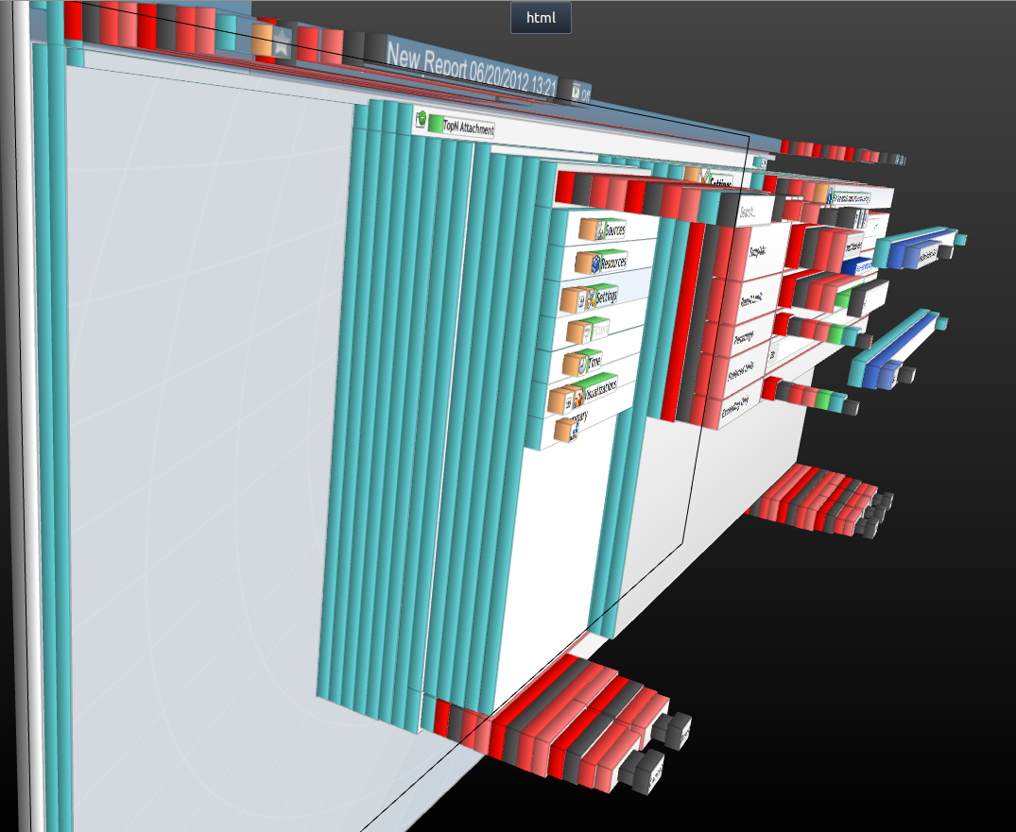
A Better DOM
How about a real world example?
Here is our wizard version 1, using ext3.

Slide 47
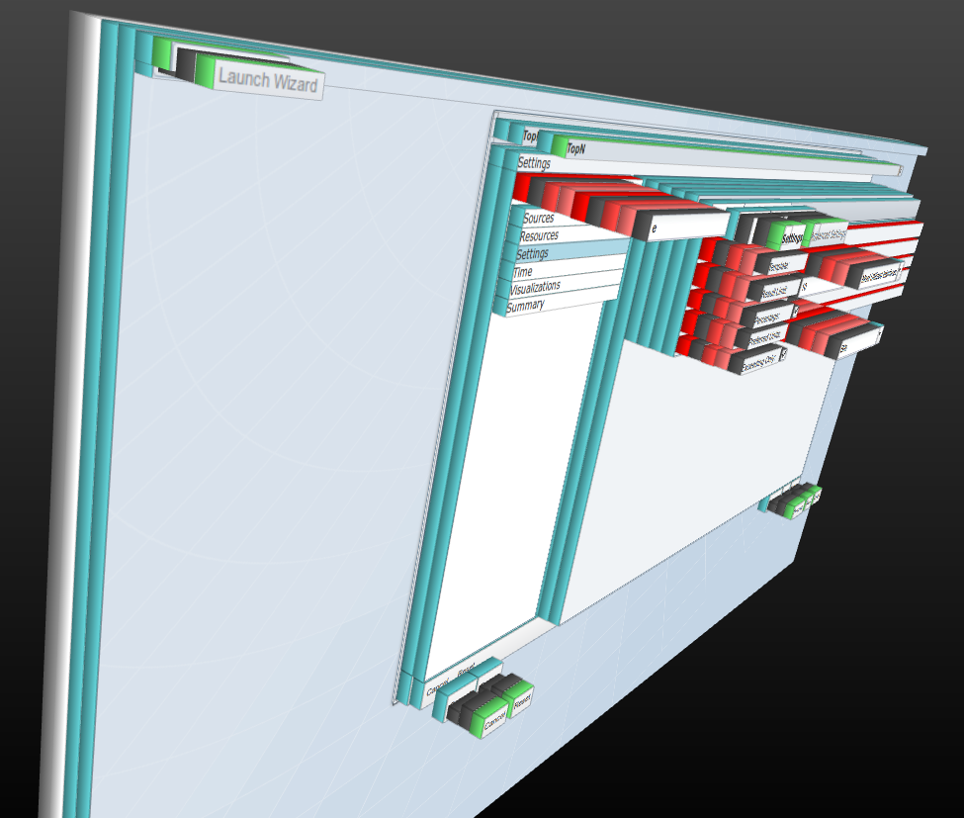
A Better DOM
How about a real world example?
And here we are in ext4 using goodness

Slide 48

A Better DOM
Awesome sauce, now we’re in business!

Slide 49
Optimizing JavaScript
Question: When would be the best time to optimize our JavaScript?

Slide 50
Optimizing JavaScript
Question: When would be the best time to optimize our JavaScript?
When methods are repeated frequently

Slide 51
Optimizing JavaScript
Question: When would be the best time to optimize our JavaScript?
When methods are repeated frequently
When a method is executed during render or layout time

Slide 52
Optimizing JavaScript
Question: When would be the best time to optimize our JavaScript?
When methods are repeated frequently
When a method is executed during render or layout time
...Although it’s probably best to not do extra activity during render

Slide 53
Optimizing JavaScript
Question: When would be the best time to optimize our JavaScript?
When methods are repeated frequently
When a method is executed during render or layout time
...Although it’s probably best to not do extra activity during render
Cache variables when possible

Slide 54
Optimizing JavaScript
Question: When would be the best time to optimize our JavaScript?
When methods are repeated frequently
When a method is executed during render or layout time
...Although it’s probably best to not do extra activity during render
Cache variables when possible
Avoid using Ext.each

Slide 55
Optimizing JavaScript
Question: When would be the best time to optimize our JavaScript?
When methods are repeated frequently
When a method is executed during render or layout time
...Although it’s probably best to not do extra activity during render
Cache variables when possible
Avoid using Ext.each
Others that I can’t think of off the top of my head

Slide 56
Optimizing JavaScript
What’s the deal about
Ext.each()?

Slide 57
Optimizing JavaScript
Here at SevOne, we pride ourselves on our speed: True or False?

Slide 58
Optimizing JavaScript
Here at SevOne, we pride ourselves on our speed: True or False?
...So why would we use the worst looping constructs we can?

Slide 59
Optimizing JavaScript
Lets look at the numbers...

Slide 60
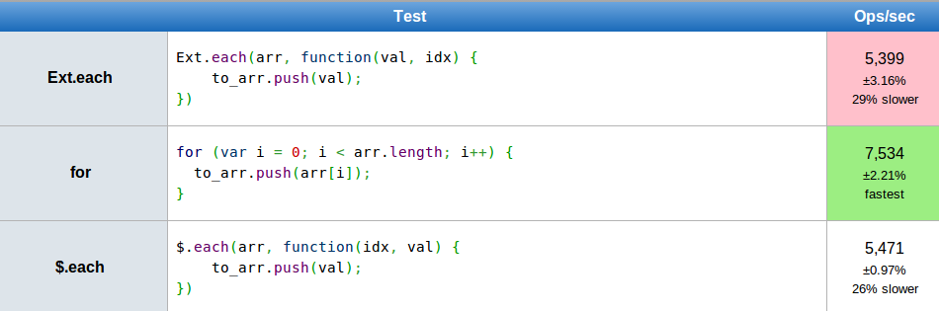
Optimizing JavaScript
Lets look at the numbers…
Ext.each() - for - $.each

Slide 61
Optimizing JavaScript
Lets look at the numbers…
Ext.each() - for - $.each
BAD

Slide 62
Optimizing JavaScript
So knowing that Ext.each is ridiculously slow, how can we improve the code below?
var myStore = Ext.getStore(‘Devices’);
myStore.each(function() {
console.log( this );
});

Slide 63
Optimizing JavaScript
So knowing that Ext.each is ridiculously slow, how can we improve the code below?
var myStore = Ext.getStore(‘Devices’),
data = myStore.data;
for( var i = 0; i < data.length; i++ ) {
console.log( data[ i ] );
}

Slide 64

Optimizing JavaScript

Slide 65
Optimizing JavaScript
So knowing that Ext.each is ridiculously slow, how can we improve the code below?
var myStore = Ext.getStore(‘Devices’),
data = myStore.data,
len = data.length;
for( var i = 0; i < len; i++ ) {
console.log( data[ i ] );
}

Slide 66
Optimizing JavaScript
Wait...is there a faster loop?

Slide 67

Optimizing JavaScript
Wait...is there a faster loop?
There might be.
Mind if I have a buddy of mine look at it?

Slide 68
Optimizing JavaScript
Every time browsers change their engines, the speed differences appear to change.

Slide 69
Optimizing JavaScript
For instance, decrementing while loops were a power player for a long time
var i = 10000;
while( i-- ) {
console.log( i );
}
However, this is no longer the case…

Slide 70
Optimizing JavaScript
Current benchmarks show that cached for loops are the most powerful.
var arr = [ … ]; // assume lots...
for (var i = 0, len = arr.length; i < len; i++) {
console.log( i );
}
I’ll always love you while loops...

Slide 71
Optimizing JavaScript
So to reiterate some rules for optimizing

Slide 72
Optimizing JavaScript
So to reiterate some rules for optimizing
Use the best loops possible

Slide 73
Optimizing JavaScript
So to reiterate some rules for optimizing
Use the best loops possible
Cache variables, components, etc. when possible

Slide 74
Optimizing JavaScript
So to reiterate some rules for optimizing
Use the best loops possible
Cache variables, components, etc. when possible
Optimize frequently repeated methods

Slide 75
Optimizing JavaScript
So to reiterate some rules for optimizing
Use the best loops possible
Cache variables, components, etc. when possible
Optimize frequently repeated methods
Avoid strenuous actions during render

Slide 76

Almost there...

Slide 77
Practices to Avoid
Unnecessary nesting of component structures

Slide 78
Practices to Avoid
Unnecessary nesting of component structures
Creating memory leaks created by improper component usage
Example: Not caching a window component

Slide 79
Practices to Avoid
Unnecessary nesting of component structures
Creating memory leaks created by improper component usage
Example: Not caching a window component
Huge controllers
Remember, each view should really have its own

Slide 80
Practices to Avoid
Unnecessary nesting of component structures
Creating memory leaks created by improper component usage
Example: Not caching a window component
Huge controllers
Remember, each view should really have its own
Bad folder structure

Slide 81
Practices to Avoid
Unnecessary nesting of component structures
Creating memory leaks created by improper component usage
Example: Not caching a window component
Huge controllers
Remember, each view should really have its own
Bad folder structure
Global variables

Slide 82
Practices to Avoid
Unnecessary nesting of component structures
Creating memory leaks created by improper component usage
Example: Not caching a window component
Huge controllers
Remember, each view should really have its own
Bad folder structure
Global variables
Using id

Slide 83
Practices to Avoid
Unnecessary nesting of component structures
Creating memory leaks created by improper component usage
Example: Not caching a window component
Huge controllers
Remember, each view should really have its own
Bad folder structure
Global variables
Using id
Not creating references
By creating refs you are essentially caching the component

Slide 84
Practices to Avoid
Unnecessary nesting of component structures
Creating memory leaks created by improper component usage
Example: Not caching a window component
Huge controllers
Remember, each view should really have its own
Bad folder structure
Global variables
Using id
Not creating references
By creating refs you are essentially caching the component
Not sticking with a standard naming convention

Slide 85
Practices to Avoid
Unnecessary nesting of component structures
Creating memory leaks created by improper component usage
Example: Not caching a window component
Huge controllers
Remember, each view should really have its own
Bad folder structure
Global variables
Using id
Not creating references
By creating refs you are essentially caching the component
Not sticking with a standard naming convention
Making your code overly complicated
D.R.Y and K.I.S.S

Slide 86
Practices to Avoid
Unnecessary nesting of component structures
Creating memory leaks created by improper component usage
Example: Not caching a window component
Huge controllers
Remember, each view should really have its own
Bad folder structure
Global variables
Using id
Not creating references
By creating refs you are essentially caching the component
Not sticking with a standard naming convention
Making your code overly complicated
D.R.Y and K.I.S.S
Forgetting to add the MVC files to Ext.require

Slide 87

That’s it
Questions?

