Slide 1
Analyzing fantasy football points Rhianna Ruggiero DSC 530

Slide 2
Statistical question:
Do wide receiver players in the NFL tend to overachieve on projected fantasy points compared to other positions

Slide 3
FantasyFootballWeekly.xlsx from Kaggle
The 5 variables that I will be using for my analysis include:
ROUNDPROJ
Represents the number of projected points for each player rounded to the nearest whole number
ROUNDTOTAL
The number of total points achieved by each player rounded to the nearest whole number
ROUNDOVER
The difference between the projected and total/final fantasy points rounded to a whole number
TOTALYARDS
The total number of yards that each player achieved. Combines receiving yards, rushing yards and passing yards
TOUCHDOWNS
The total number of touchdowns, including rushing, receiving and passing touch downs achieved by each player

Slide 4
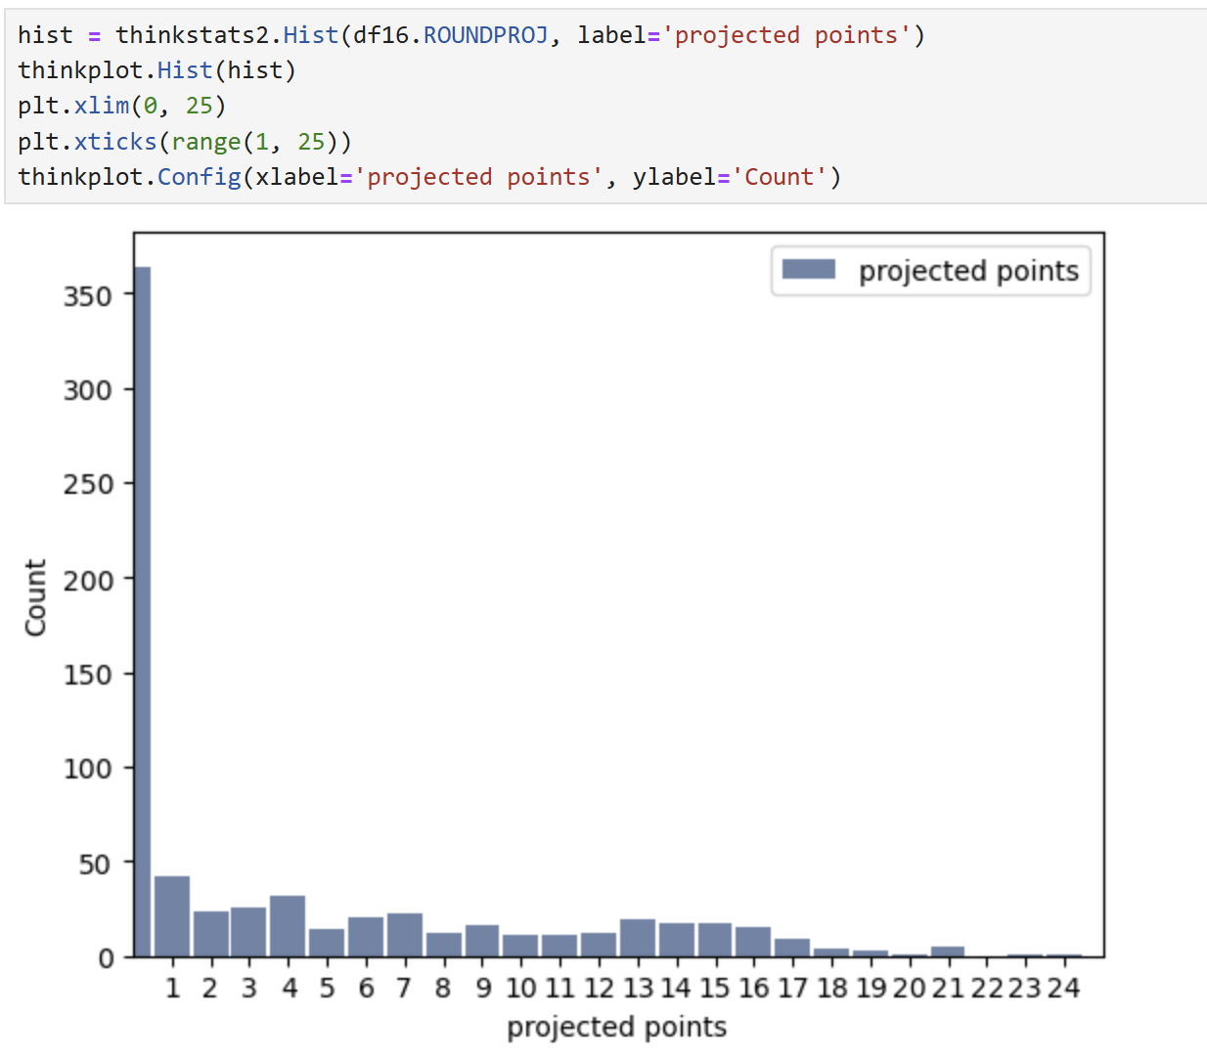
The histogram to the left shows most of the projected fantasy points being 0
Players who were projected 0 points most likely did not play that week, so the data is not important
Removing the players who were projected 0 points would help make the analysis cleaner

Slide 5
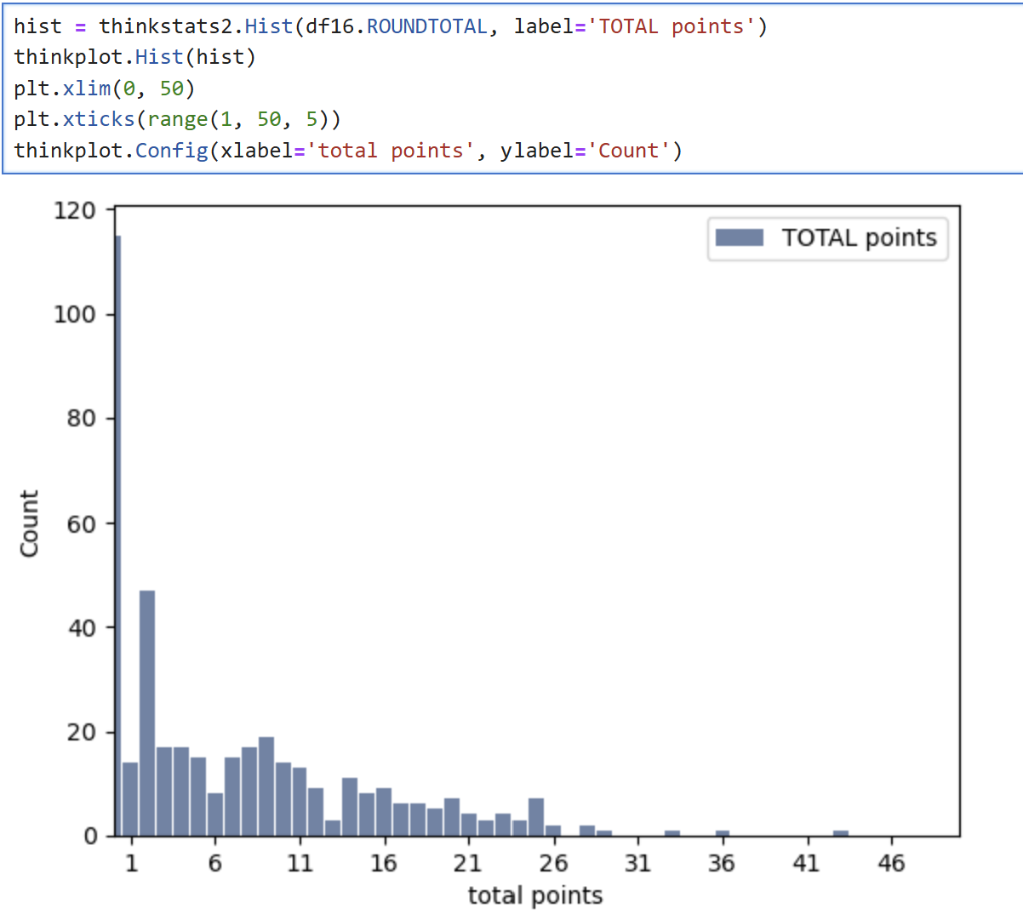
This histogram contains the data of total points achieved by fantasy players
Most players received 0 points, however a lot of these players were also projected 0 points
Ignoring the players who were projected and received 0 points would make the analysis cleaner

Slide 6
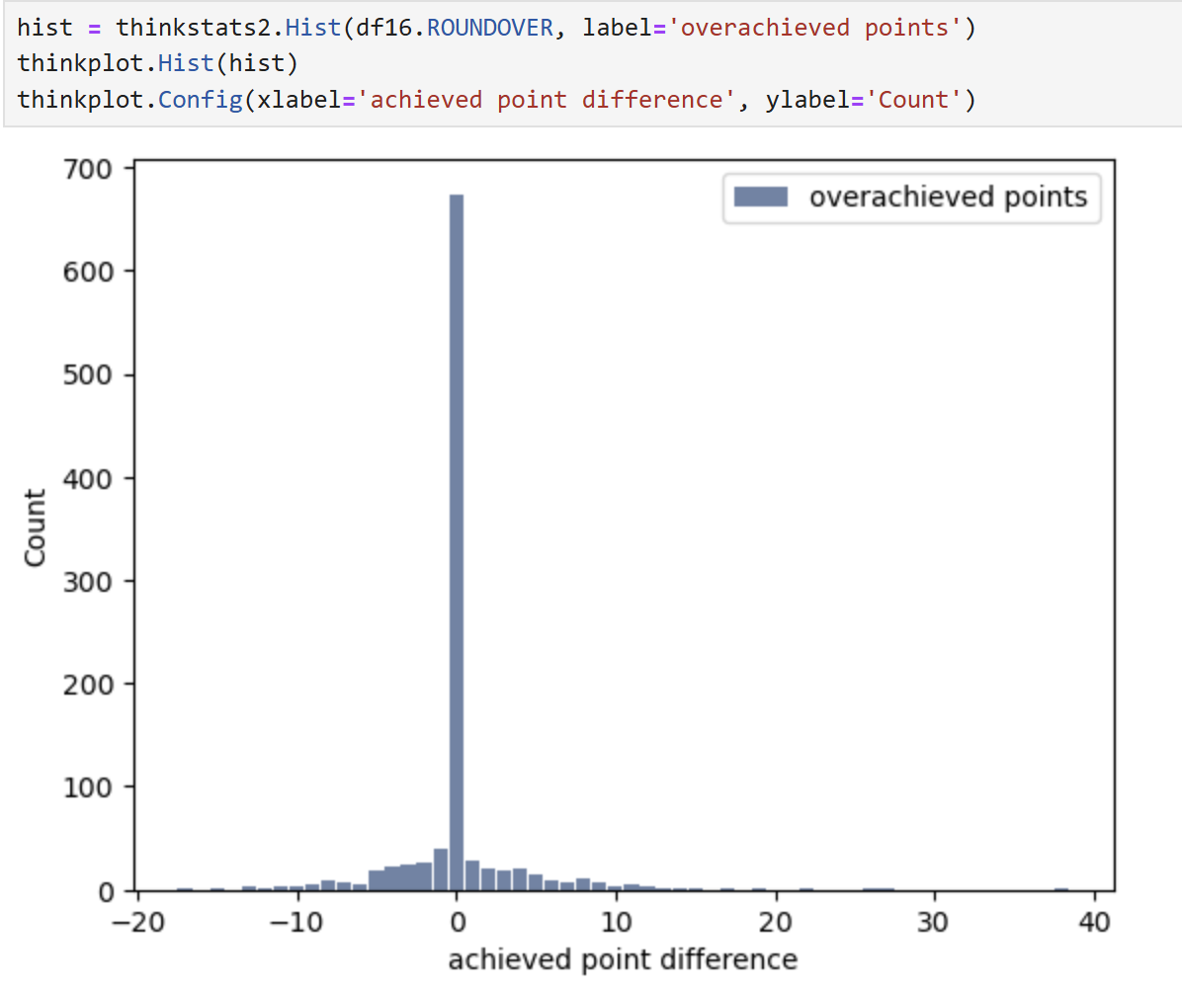
The histogram on the left shows how much players over or underachieved on their projected fantasy points
Most players are showing a 0 point difference, meaning that they achieved the same number of points that they were predicted
This is mostly due to players being projected 0 points and achieving 0 points
Again, these players should be ignored since they did not participate in the game

Slide 7
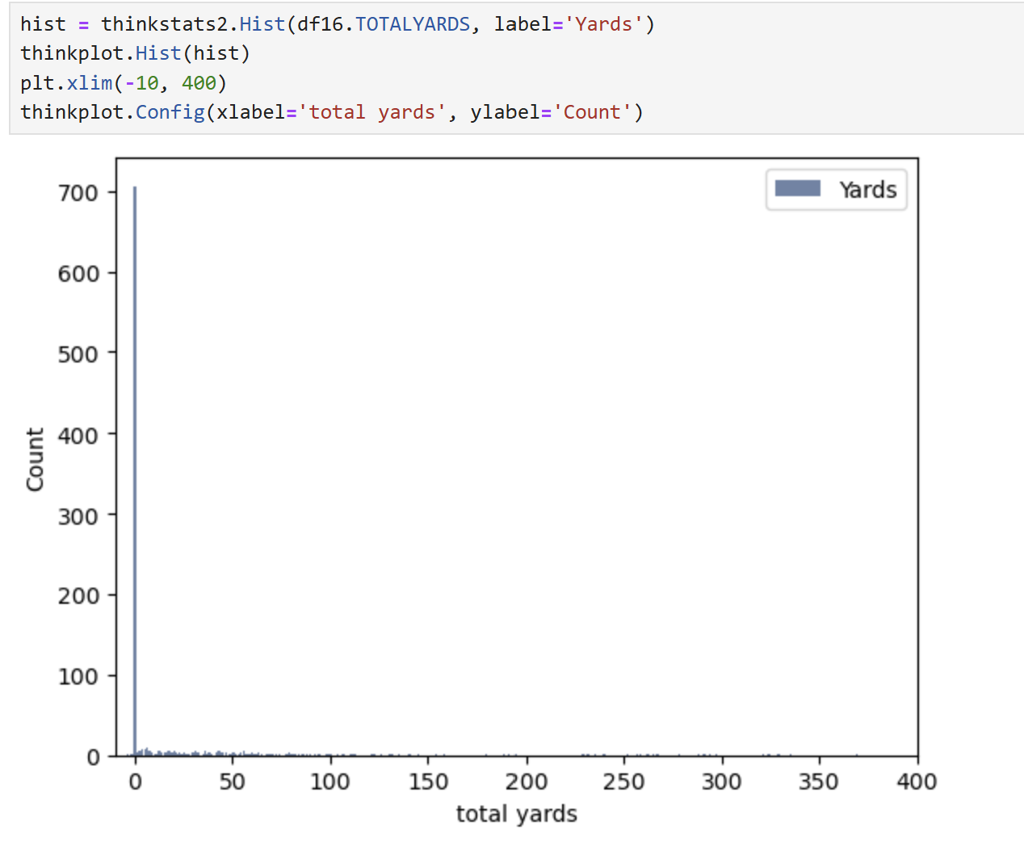
This histogram represents the distribution for the total number of yards each player achieved
Again, most players in the data did not end up playing, which causes the number of players to achieve 0 yards to be extremely high
Some players could have played and achieved 0 yards, so removing the players who did not play would help to see the data more clearly

Slide 8
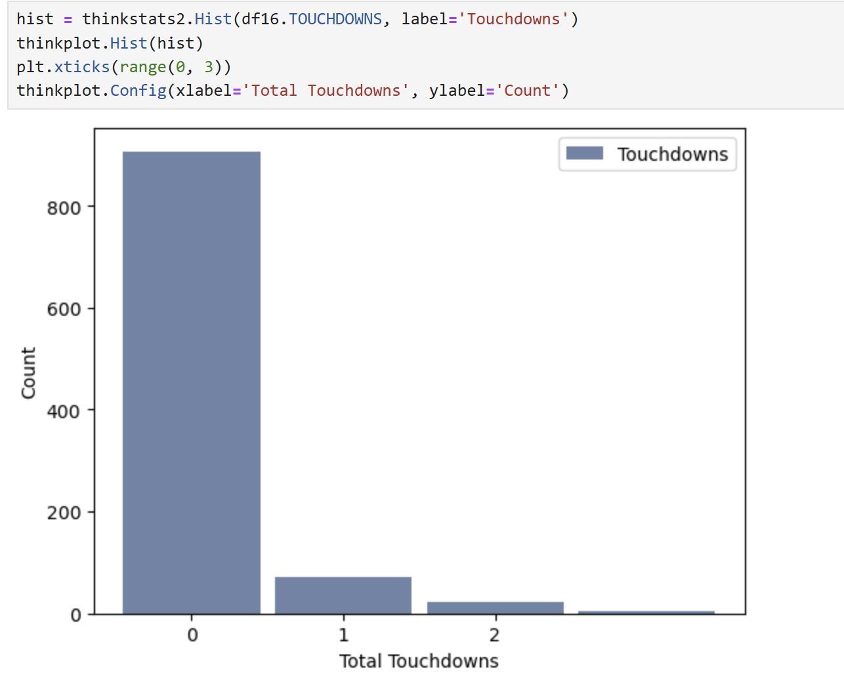
This histogram represents the number of touchdowns that players achieved
As expected, most players achieved 0 touchdowns, however this number is still skewed due to the number of players who did not play during the game
Removing the players who did not play would make each histogram and variable analysis more accurate

Slide 9
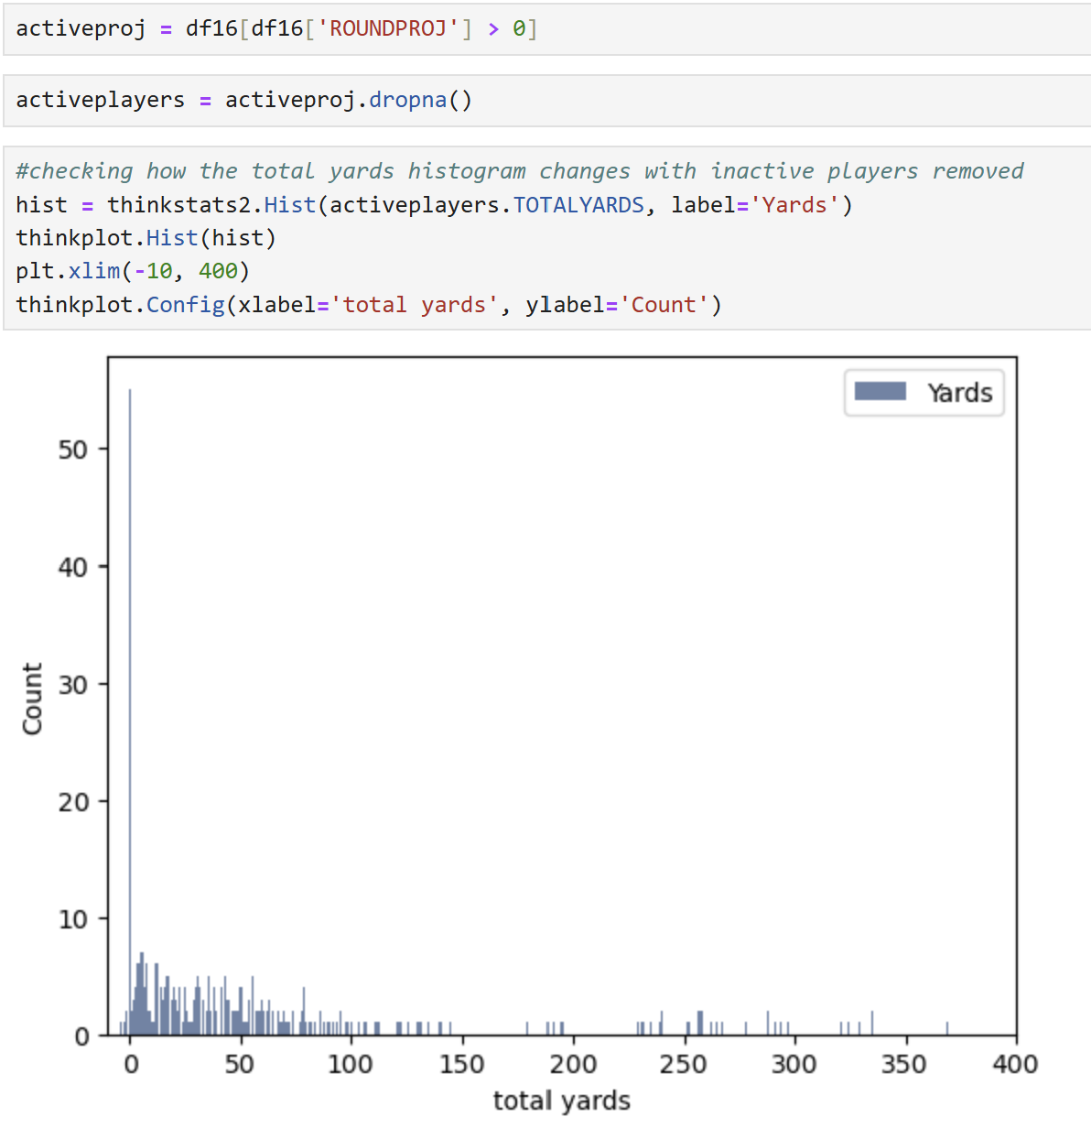
Extra histogram with only active players
This histogram shows how the TOTALYARDS histogram varies when inactive players are removed from the data
Many players still had 0 yards however this has gone significantly down (from around 700 to under 60)
By removing these outliers, it is easier to see that other than 0, most players received under 50 yards, with very few going above 300 yards
I believe that the outlier above 350 yards is important to keep in the data since it shows that there is a possibility that a player can get this many yards in a game

Slide 10
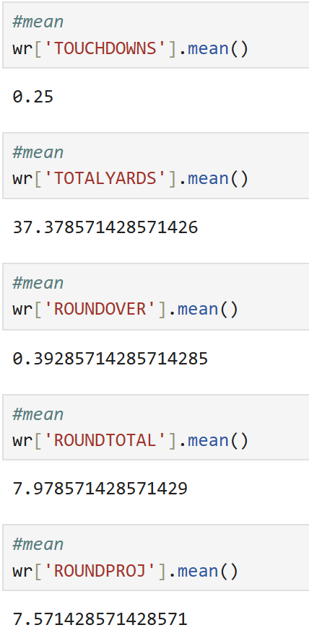
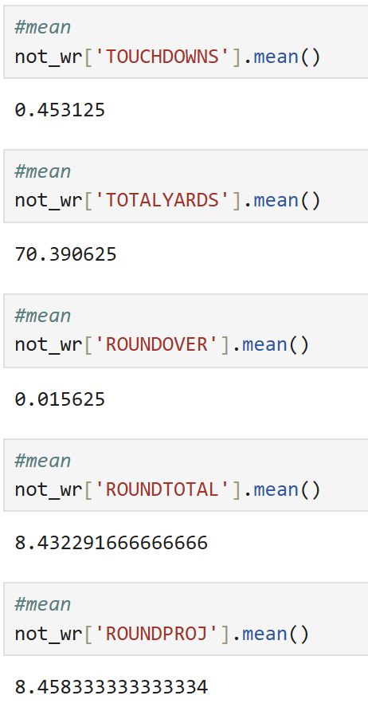
The Mean
The calculated mean for the 5 variables that I chose for wide receivers are:
TOUCHDOWNS: 0.25 touchdowns
TOTALYARDS: 37.38 total yards
ROUNDOVER: 0.39 points
ROUNDTOTAL: 7.98 points
ROUNDPROJ: 7.57 points
The calculated mean for the 5 variables that I chose for NOT wide receivers are:
TOUCHDOWNS: 0.45 touchdowns
TOTALYARDS: 70.39 total yards
ROUNDOVER: 0.016 points
ROUNDTOTAL: 8.43 points
ROUNDPROJ: 8.46 points
Surprisingly, wide receivers had on average slightly fewer total points than other players. They also had less projected points however non wide receivers had almost the same average number for total points and for projected points, with projected points being slightly higher. The average for projected points for wide receivers was less than the average for wide receivers total points, which could mean that wide receivers generally over-achieved on projected points.

Slide 11
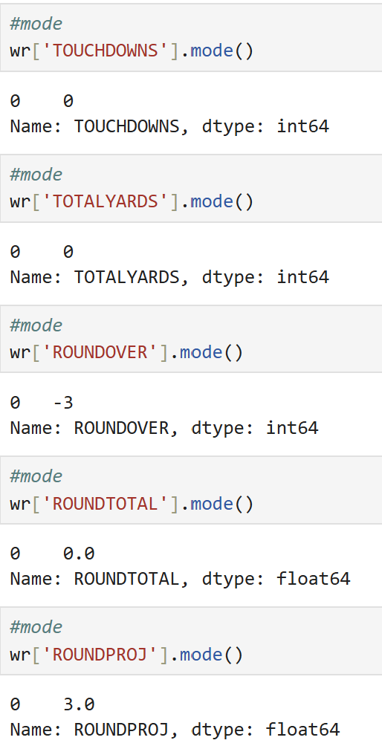
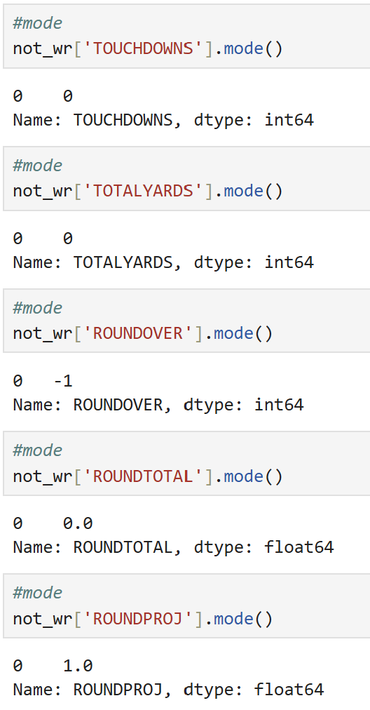
The Mode
The calculated mode for the 5 variables that I chose for wide receivers are:
TOUCHDOWNS: 0 touchdowns
TOTALYARDS: 0 total yards
ROUNDOVER: -3 points
ROUNDTOTAL: 0 points
ROUNDPROJ: 3 points
The calculated mode for the 5 variables that I chose for NOT wide receivers are:
TOUCHDOWNS: 0 touchdowns
TOTALYARDS: 0 total yards
ROUNDOVER: -1 points
ROUNDTOTAL: 0 points
ROUNDPROJ: 1 point
The mode is the same for touch downs, total yards and total points for wide receivers and other players. The mode for wide receivers for the difference between projected and total points is lower than other players at -3 vs -1 respectively. However, the mode for projected points is higher for wide receivers.

Slide 12
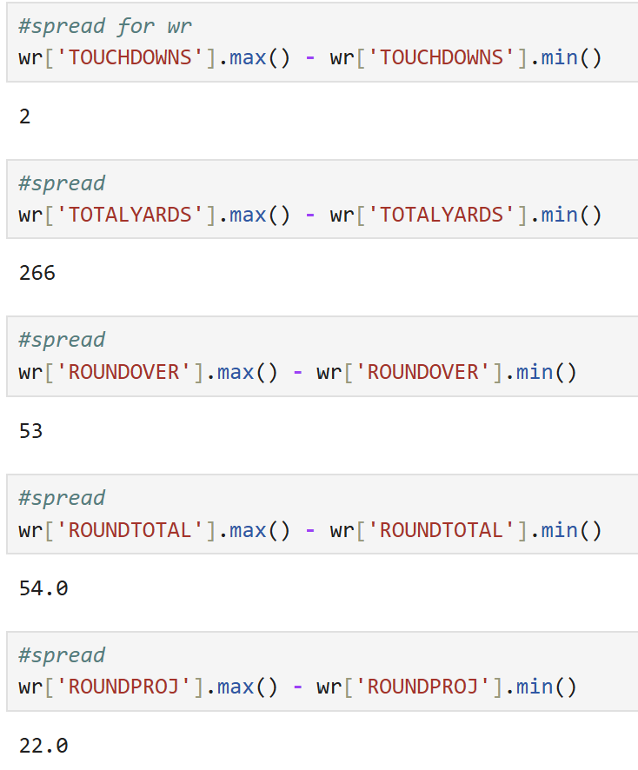
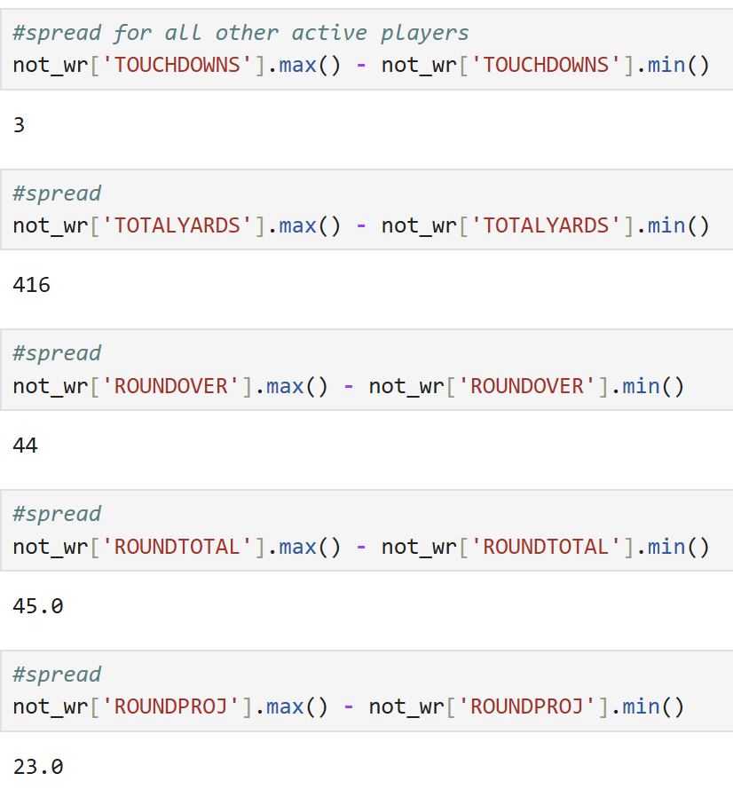
The Spread
The spread for the 5 variables that I chose for wide receivers are:
TOUCHDOWNS: 2
TOTALYARDS: 266
ROUNDOVER: 53
ROUNDTOTAL: 54
ROUNDPROJ: 22
The spread for the 5 variables that I chose for NOT wide receivers are:
TOUCHDOWNS: 3
TOTALYARDS: 416
ROUNDOVER: 44
ROUNDTOTAL: 45
ROUNDPROJ: 23
The spread for wide receivers is smaller for touchdowns, total yards and projected points. This means that there is less variation for wide receivers in these variables. The spread for not wide receivers for total yards came out to 416 yards which is fairly large. This could mean that some players did very poorly, but others did very well.

Slide 13
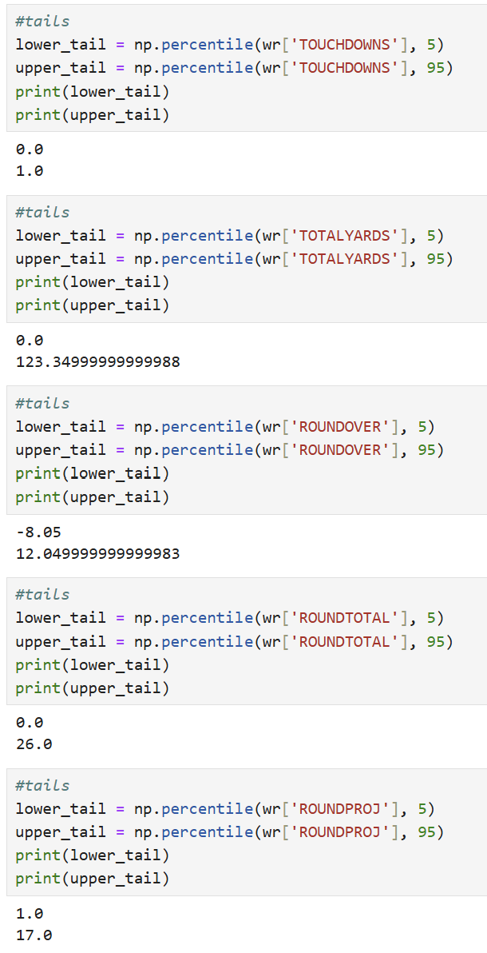
The Tails (90th percentile) for wide receivers
The tails for the 5 variables that I chose are:
TOUCHDOWNS:
Lower: 0
Upper: 1
TOTALYARDS:
Lower: 0
Upper 123.35
ROUNDOVER:
Lower: -8.05
Upper: 12.05
ROUNDTOTAL:
Lower: 0
Upper: 26
ROUNDPROJ:
Lower: 1
Upper: 17

Slide 14
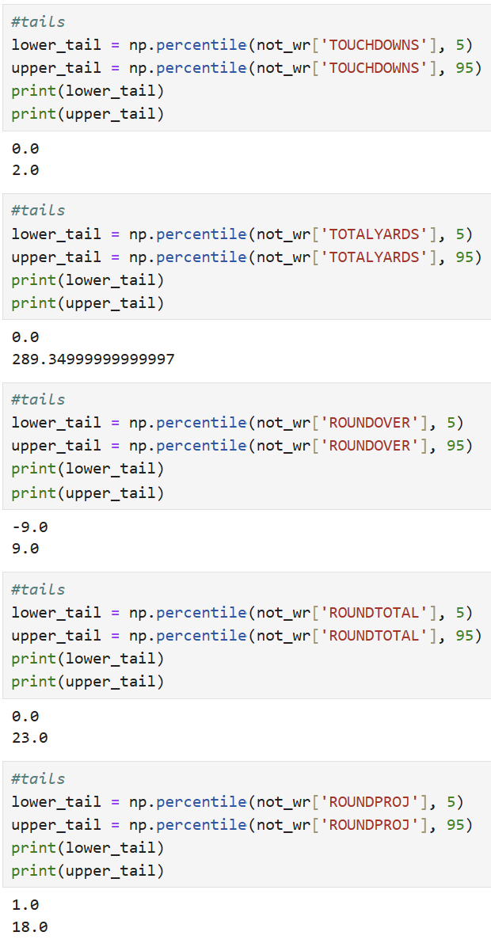
The Tails (90th percentile) for NOT wide receivers
The tails for the 5 variables that I chose are:
TOUCHDOWNS:
Lower: 0
Upper: 2
TOTALYARDS:
Lower: 0
Upper 289.35
ROUNDOVER:
Lower: -9
Upper: 9
ROUNDTOTAL:
Lower: 0
Upper: 23
ROUNDPROJ:
Lower: 1
Upper: 18

Slide 15
Comparing tails
The wide receivers have a smaller value for the upper tail for total yards as compared to not wide receivers by over 150.
Wide receivers had a lower value for the lower tail for the ROUNDOVER variable by 1 point however they had a higher value for the upper tail by over 3 points.
Wide receivers also had a higher value for the upper tail for total points by 3 points and had the same value as not wide receivers for the lower tail.
Wide receivers had a smaller value for the upper tails for both touch downs and projected points by 1.

Slide 16
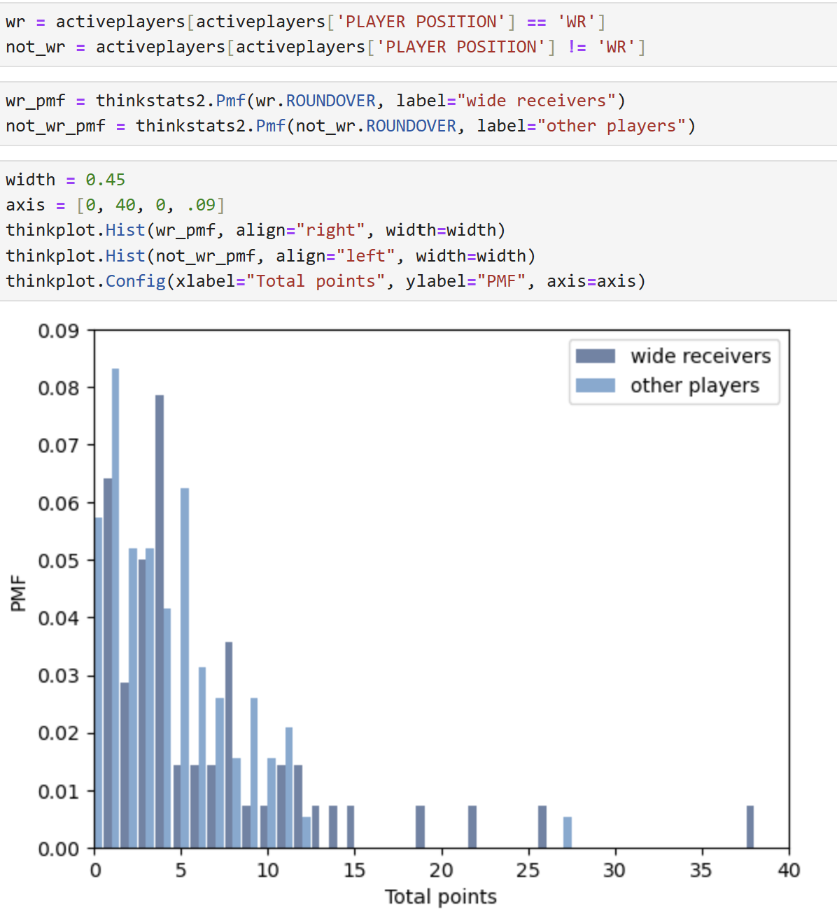
Comparing scenarios within the data
Do wide receivers tend to overachieve on projected points as compared to all other player positions?
According to the plot, it is hard to tell whether WRs tend to overachieve on points more than other players just by looking at it
There are more WRs that overachieve by a lot of points (more than 10) more than other players do
Typically, it looks like other players are more likely to overachieve on projected fantasy points than wide receivers, however wide receivers are more likely to overachieve by over 10 points

Slide 17
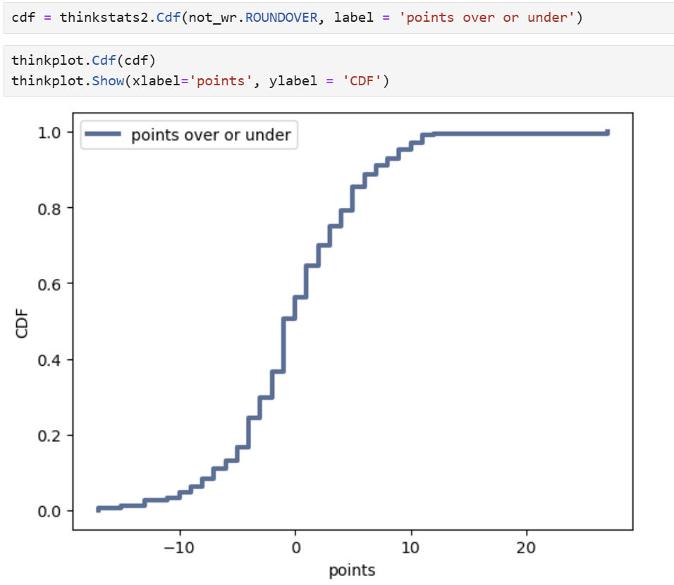
CDF of the ROUNDOVER variable for NOT Wide Receivers
This CDF of the ROUNDOVER variable (which represents how many points players went over or under what was expected, rounded) shows that most non-wide receiver players tended to achieve slightly less points or around the same amount that they were predicted to get
Around 50% of players under-achieved on fantasy points and 50% over-achieved
About 10% of players received 5 or more points under what they were expected to
Most players who received more points than they were projected to only received at most 10 points over with very few receiving 20 or more points over. This is shown by the horizontal line at the top of the curve.
Based on the S shape of the curve, we can determine that the data is close to being normal

Slide 18
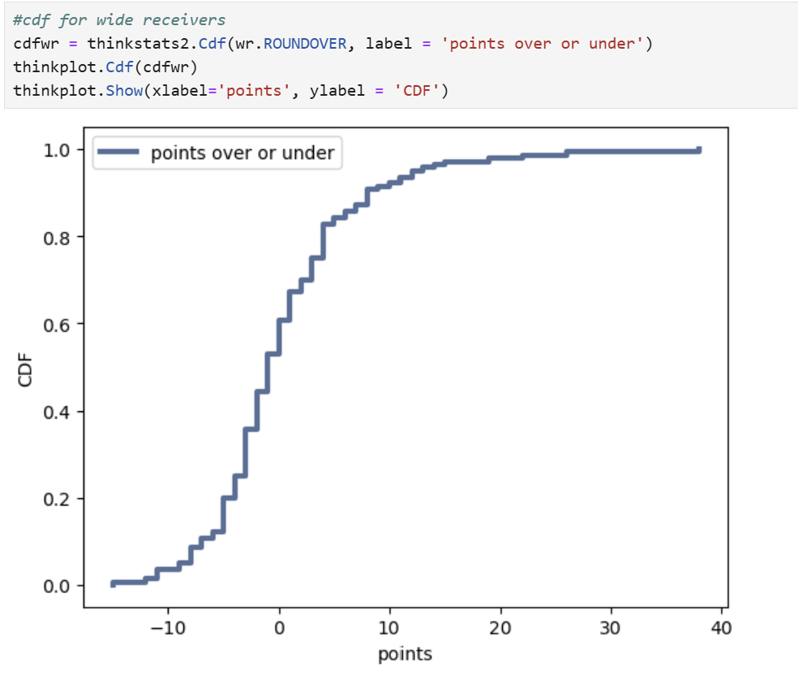
CDF Analysis for Wide Receivers
The CDF for wider receivers for the ROUNDOVER variable shows that slightly more than 50% of players got the same number of points that they were predicted to or overachieved on points
Most players who overachieved went over predictions by under 20 points, with few going well above that
This CDF is S-shaped, so the data is close to being normal
Very few players got more than 10 points less than they were projected

Slide 19

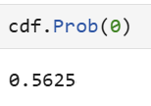
CDF Analysis & Comparison How does the CDF of the ROUNDOVER variable help address my statistical question?
In both CDFs, it looks as though they are split around 50%, where about half of players over-achieved and about half under-achieved on fantasy points
Specific calculations for CDF values are:
The specific CDF for wide receivers show that 61% of wide receivers either received the points that they were predicted to or over-achieved
The CDF for NOT wide receivers shows that around 56% of other players either received the points that they were projected to or over-achieved on points
This analysis shows that wide receivers may have a slightly higher chance to over-achieve on points than other players solely based on the CDF value
More analysis will need to be done to see if this hypothesis is statistically significant

Slide 20
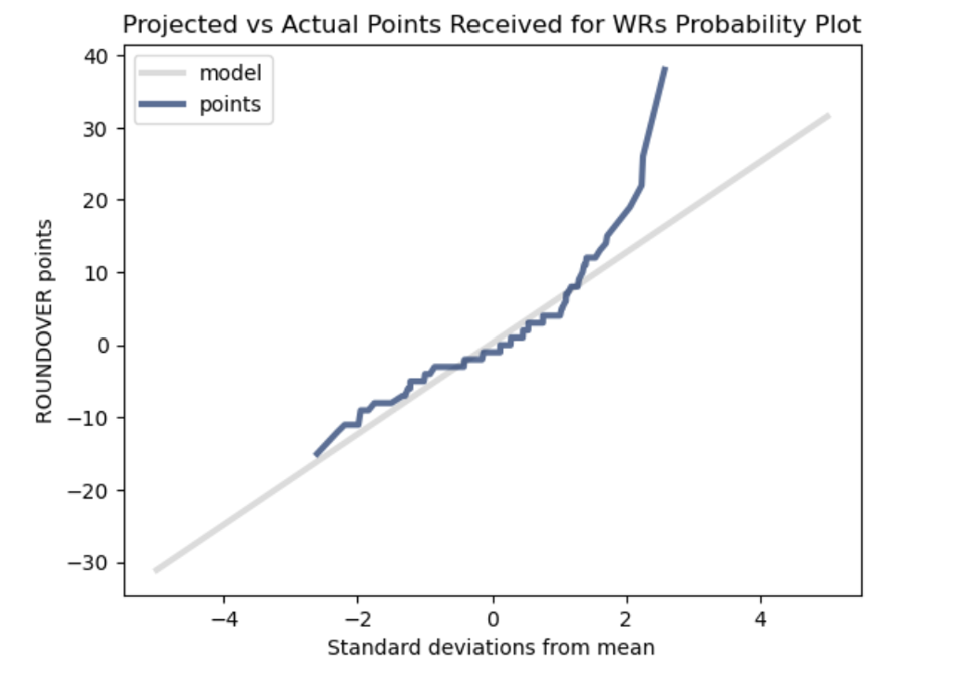
Analytical distribution – Normal Probability Plot for wide receivers
Using the MakeNormalPlot function from ThinkStats, I chose to create a normal probability plot for the ROUNDOVER variable based on the normal S-shaped CDF for wide receivers
The data mostly follows the normal model created to the right; however, it deviates mostly in the tails and especially at points above 10 or below -10
This shows that the wide receivers who overachieved in points the most greatly exceeded normal expectations
Wide receivers who underachieved in points only slightly differentiated from normal expectations
This plot shows that it may be hard to create a model due to the outliers when WRs exceed point expectations and obtain 40 or more points

Slide 21
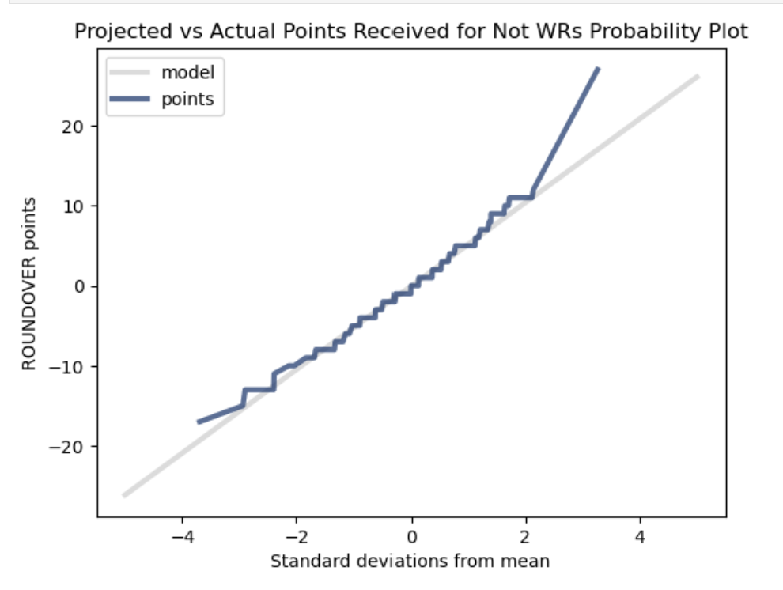
Analytical distribution – Normal Probability Plot for NOT wide receivers
Since the data for not wide receivers was also s-shaped I chose to compare the normal probability plot
The data mostly follows the normal model created to the right; However it deviates mostly in the tails especially above 10 points and below -10 points which is similar to the plot for WRs
This shows that the players who achieved more than 10 points over their projections exceeded normal expectations
This plot shows that it would be easier to create a model for the not wide receivers since the data mostly fits the normal line

Slide 22
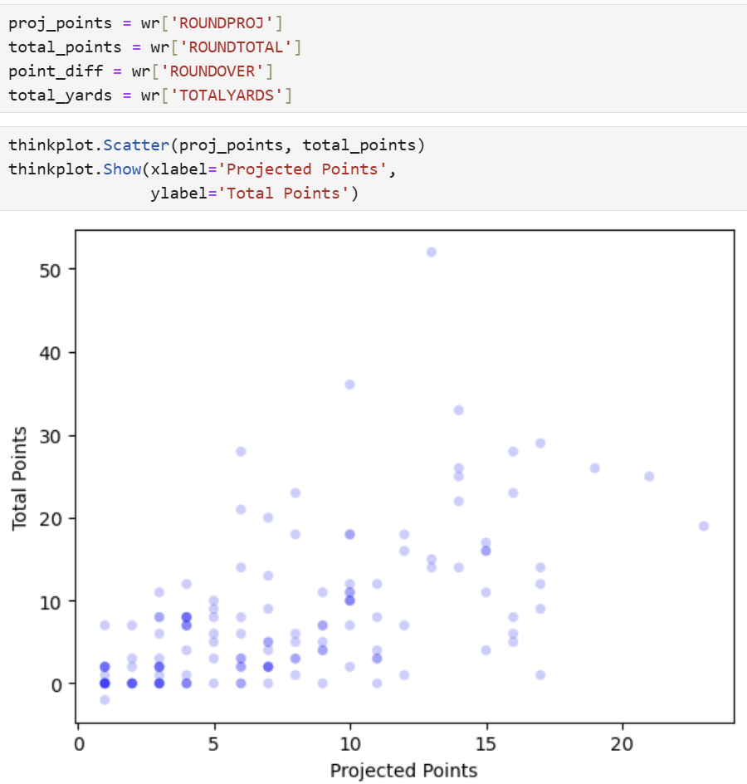
ROUNDPROJ vs ROUNDTOTAL for wide receivers Scatterplots and analysis of projected vs total points achieved
The covariance between these two variables is around 26.02, which is a middle-ranged number in this scenario. The positive number indicates that the two variables vary positively together, so if one variable increases, the other increases as well.
The Pearson’s correlation coefficient is 0.58. This number can represent that there is a moderate positive correlation between two variables, and that it is likely to be linear.
If Pearson’s correlation coefficient is 0, it does not necessarily mean that there is no relationship, it just means that there is no linear relationship since that parameter is only for linear relationships
According to the scatterplot, it looks like the two variables may have a positive linear relationship with each other
Based on this information, it seems that the two variables correlate with each other, however this does not mean that one variable causes another
Predicting the number of points that a player receives should not have an effect on the number of points that the players actually receive at the end of the game, but a higher prediction means they are likely to get a high number of total points

Slide 23
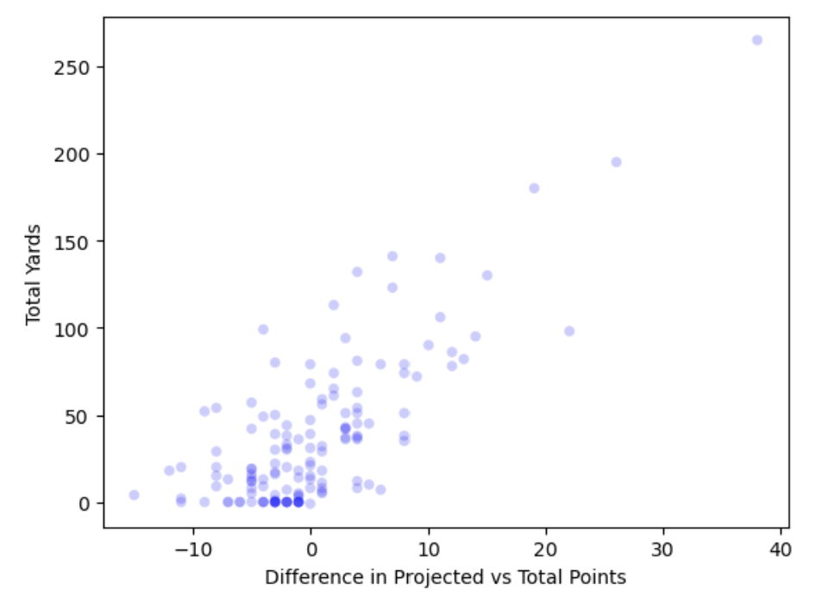
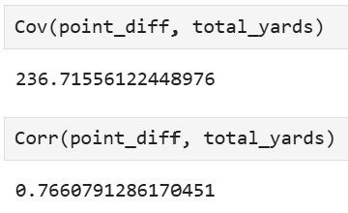
ROUNDOVER vs TOTALYARDS for not wide receivers Scatterplots and analysis of the point difference between projected and total points, and total number of yards achieved
The covariance between these two variables is around 236, which is a high number in this scenario. The positive number indicates that the two variables vary positively together, so if one variable increases, the other increases as well.
The Pearson’s correlation coefficient is 0.77. This number is on the higher side, meaning that the relationship between the variables is positive and strong.
The large Pearson’s correlation coefficient means that the relationship between the two variables is most likely linear
The scatterplot shows a clear relationship between the two variables as there are many players with a high number of yards and high points, and players with a lower number of yards have lower or even negative points
Based on this information, it seems that the two variables are likely to correlate with each other
However, we still cannot say that one variable causes another because correlation does not mean causation

Slide 24
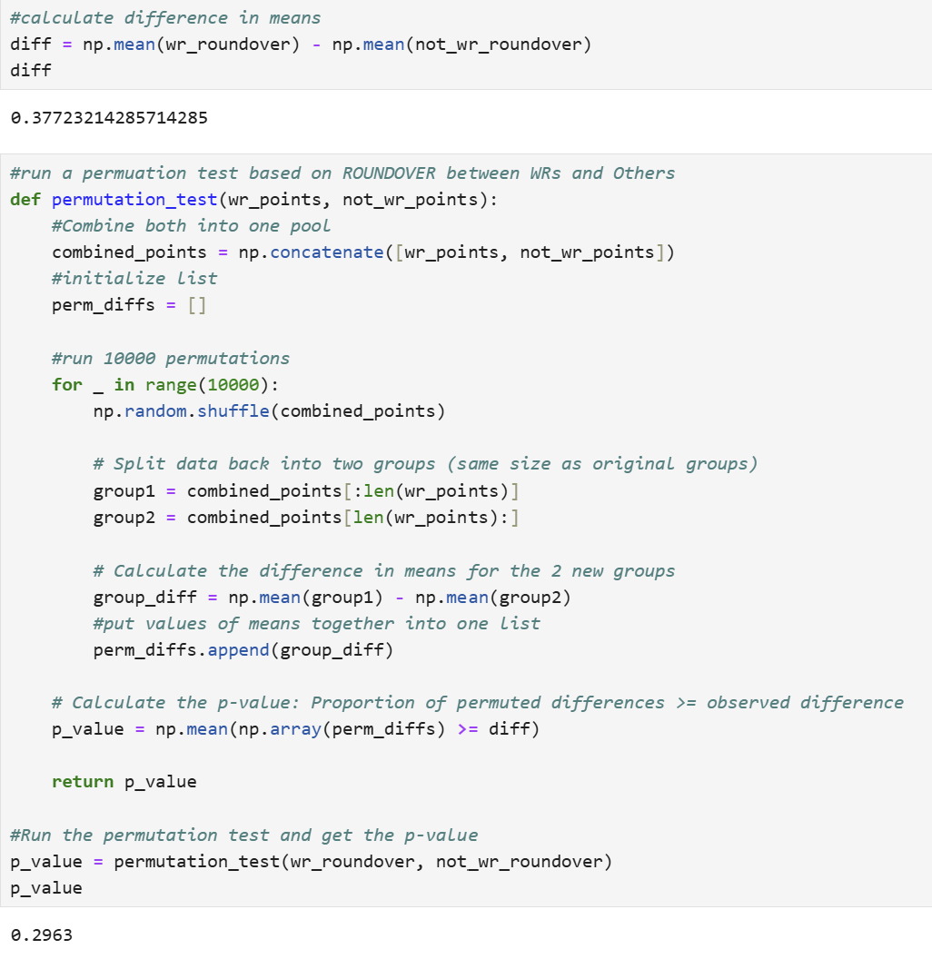
Hypothesis Test Null Hypothesis: There is no difference between Wide Receivers and other players and both groups have the same distribution for the ROUNDOVER variable
Using a permutation test, and difference in means I calculated the p value of the ROUNDOVER variable between wide receivers and other players
The p-value ends up being around 0.3 which means that we cannot reject the null hypothesis. There is no statistical significance between being a wide receiver and getting over the projected points versus other positions. If wide receivers over-achieve on points it could be due to random chance.

Slide 25
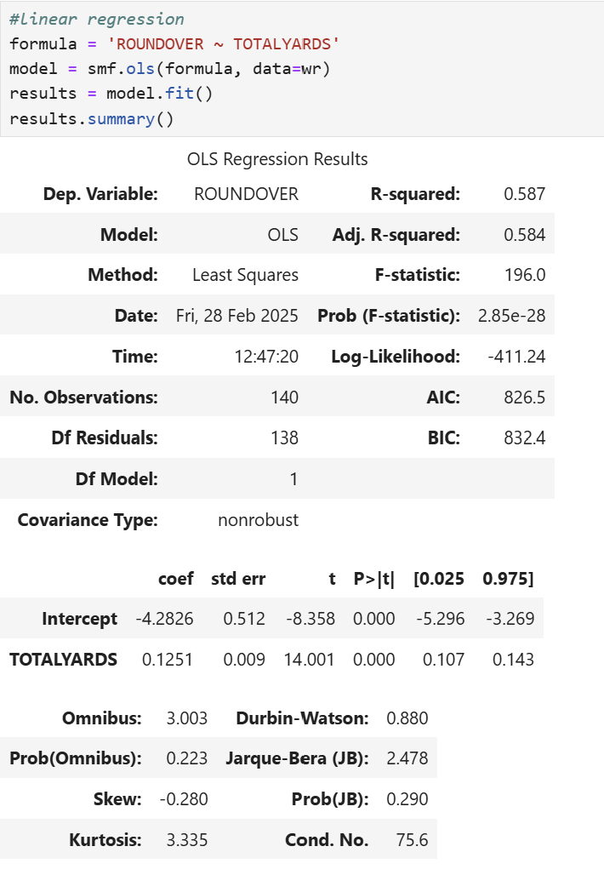
Regression Analysis
Dependent variable: ROUNDOVER
Explanatory variable: TOTALYARDS
The F-statistic came out to be 196 which is very high. This shows that this model does a good job explaining any variance in the ROUNDOVER variable.
The p value is most likely not exactly 0 as the results say but may be small enough to round to 0. This means that the result is highly significant and that TOTALYARDS significantly affects ROUNDSOVER as we would expect it to.

Slide 26
EDA Outcome
Based on all the analysis done on the data set it doesn’t seem like there is a clear difference between wide receivers and other players in that wide receivers are not likely to overachieve on projected points more
It does seem that although wide receivers are not more likely to overachieve than other players, they are more likely to overachieve by more points than other players

