Slide 1

Sinhgad College of Engineering, Pune-41 Accredited by NAAC with grade ‘A’
MINI PROJECT
ON
“YOU TUBE VIDEO VIRALITY
PREDICTION
AND
ANALYSIS”
Subject – Skill Development Laboratory
(T.E. Computer Engineering)
Project Members – Rhishabh Hattarki
Ghoshit Bhelawe

Slide 2
POINTS TO BE DISCUSSED
INTRODUCTION
PROBLEM DEFINITION
STATEMENT
SOFTWARE REQUIREMENTS
METHODOLOGY
GRAPHIC PRESENTATOIN

Slide 3
INTRODUCTION
YouTube , a video based communication medium , where people create , share and consume information.
On YouTube over 6 Billion hours of video are watched each month and 100 hours of video are uploaded to YouTube every month.
The purpose of this project is to analyze the data and predict the virality of the video on YouTube.

Slide 4
WHAT IS ML?
Machine learning is an application of artificial intelligence (AI) that provides systems the ability to automatically learn and improve from experience without being explicitly programmed.
It focuses on the development of computer programs that can access data and use it learn for themselves.
The primary aim is to allow the computers to learn automatically without human intervention or assistance and adjust actions accordingly.

Slide 5
PROBLEM DEFINITION
Analysis and prediction on basis of various countries dataset .
Analysis :
1. Graphs of most likes, views, comments and dislikes.
2. Word cloud.
3. Country wise analysis.
4. Video virality depending upon days.
5. Scattered Matrix.
Prediction :
Predicting the likes depending upon views, dislikes and comments of the video.

Slide 6
PROVINCE STATEMENT
The dataset for year 2016 -2017.
Restricted to analysis and prediction for virality of YouTube video.

Slide 7
SOFTWARE REQUIREMENTS
Details of software
Python , Version 3.7 (64 bit)
Spyder , Version 3
PyQt Designer , Version 5

Slide 8
METHODOLOGY
We used Random forest algorithm . Random forest is flexible to use machine learning algorithm that produces even without hyper parameter tuning .
Random forest can be used to rank the importance of variables in classification or regression problem in natural way .
Decision trees are a popular method for various machine learning tasks .
Its ensembled with n decision trees.

Slide 9
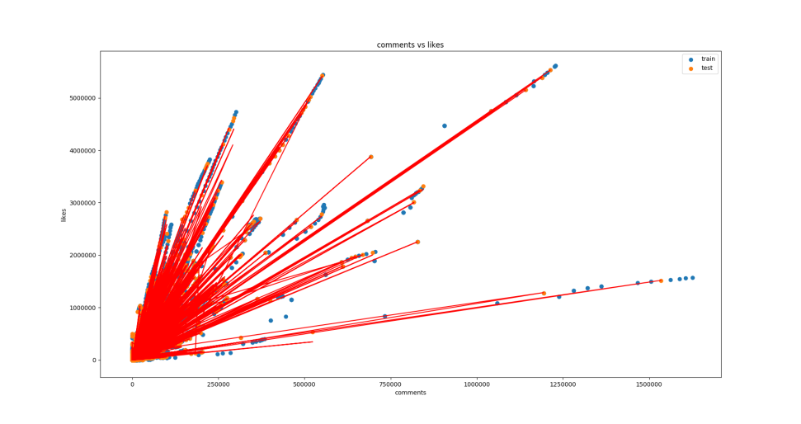
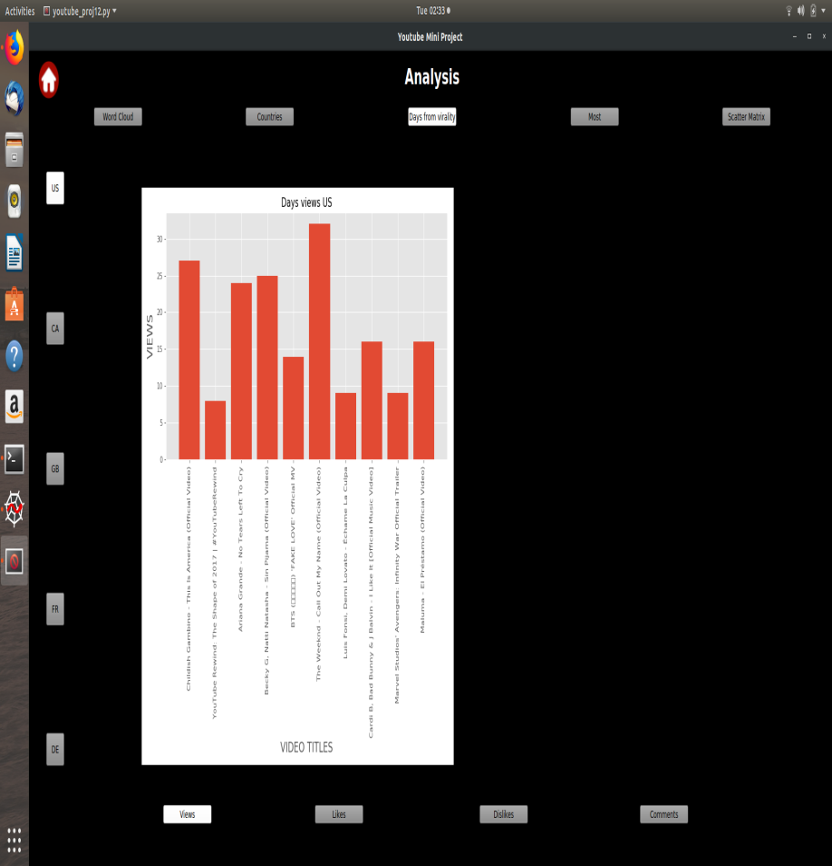
GRAPHIC PRESENTATION
Analysis graph
Prediction Graph

Slide 10
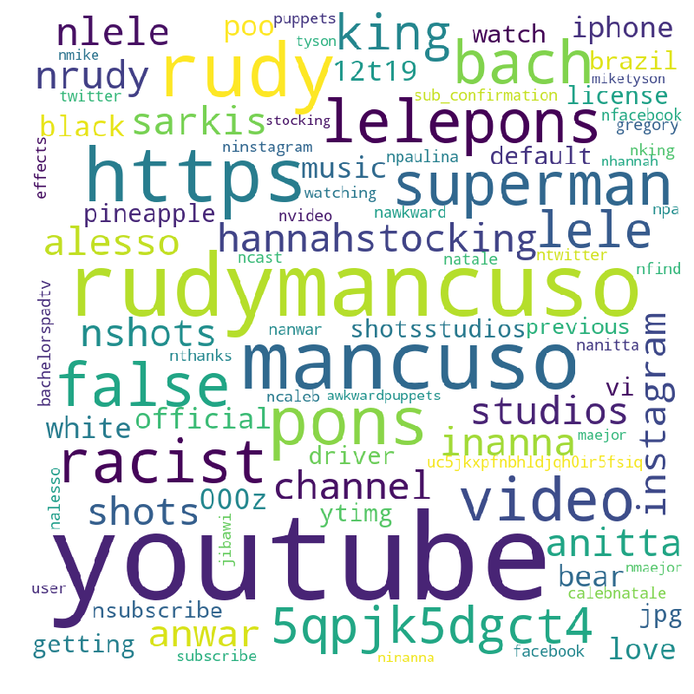
Word cloud

Slide 11
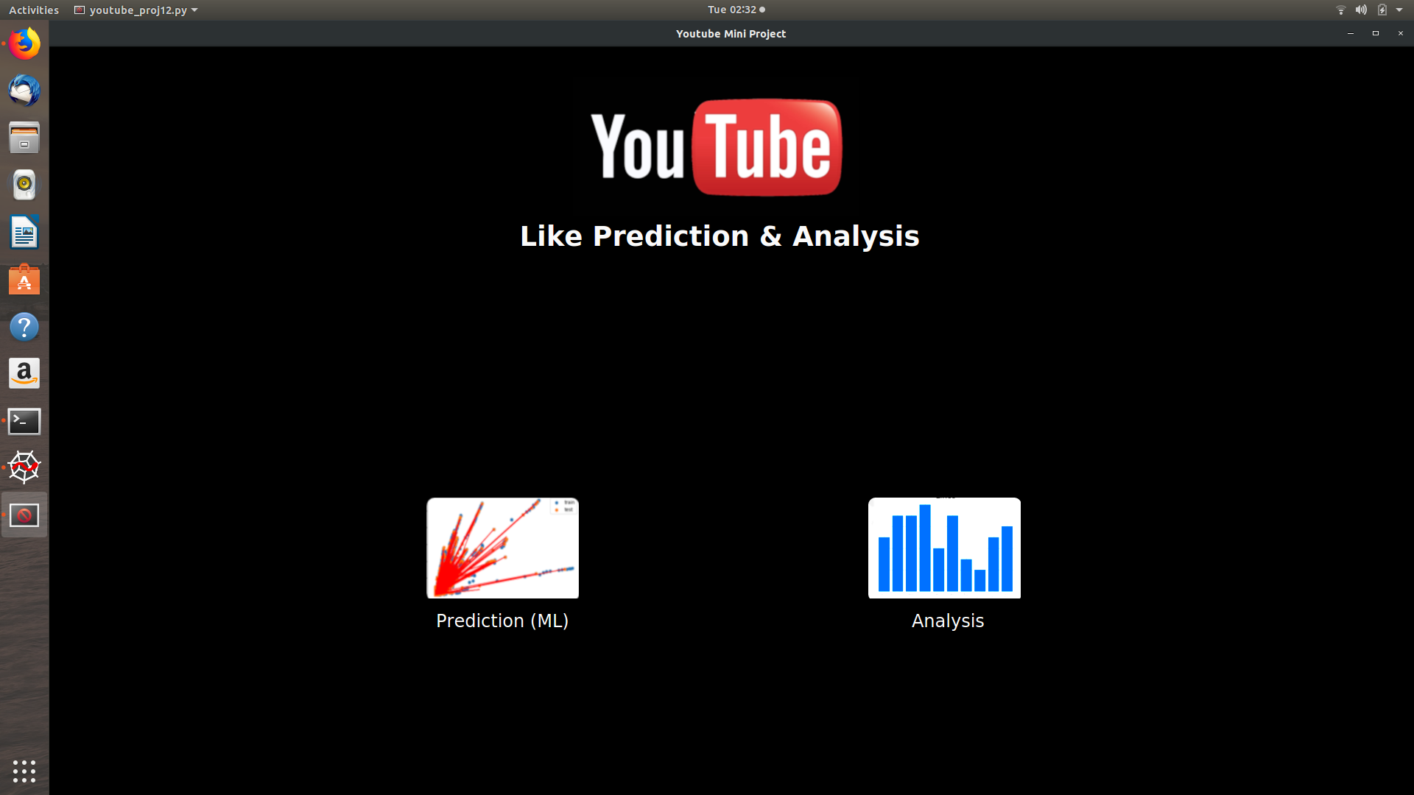
GUI Homepage

Slide 12
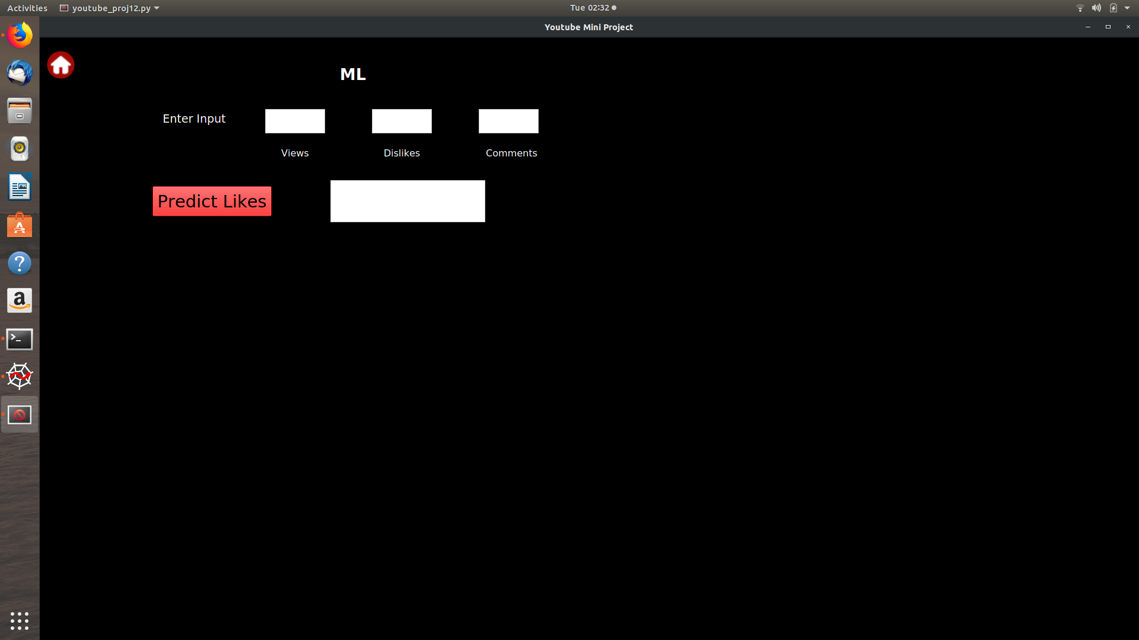
Prediction Page

Slide 13
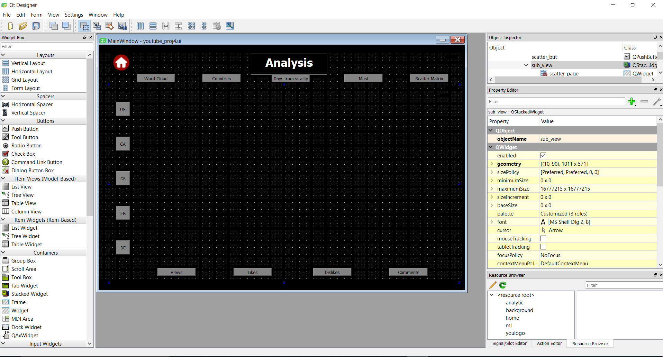
Using PyQt Designer

Slide 14
REFERENCES
Kaggle.com
http://sentdex.com
Machine learning mastery.com
Udemy ML course
https://towardsdatascience.com

Slide 15
THANK YOU

