Slide 1
Phenotyping Automation Project
Connor Bodie

Slide 2
Problem Statement and Context
Part of my role for the Ware Lab this summer was collecting sorghum seed phenotype data via manual imaging
The seed imaging process is time-consuming and monotonous:
For thousands of sorghum accessions, retrieve and dump a packet of ~100 seeds onto the imaging platform
Manually distribute the seeds such that none are touching
Take the image using an iPad with the Field Book App
Recollect the seeds into the packet
Repeat

Slide 3

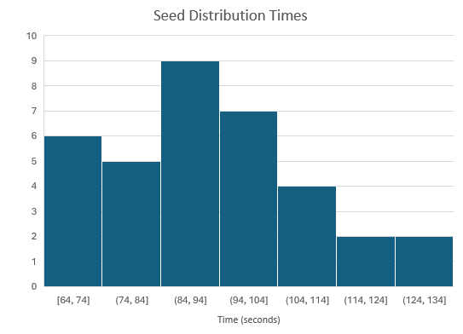
Bottleneck Data
Distributing the seeds takes the most time and attention:
$\overline{x}=1:32.6$
$SD=16.7 seconds$

Slide 4
Automation Approach
After discussing and experimenting with different approaches, we decided to pursue the following setup:
Poke holes into a surface (paper) at even intervals
Create a low-pressure vacuum on the underside of the surface
Somehow move the seeds around, until they find a hole and are suctioned to it and get stuck
Clear the remaining seeds off the surface

Slide 5
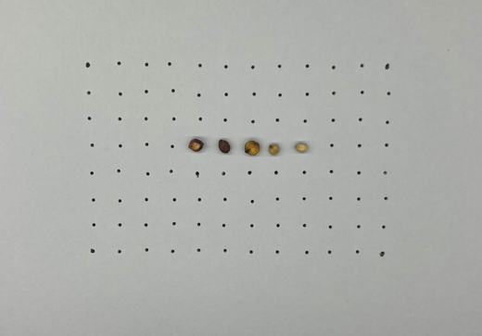
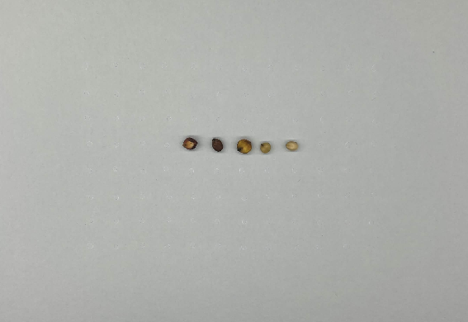
Image Processing Issues
The image processing layer of the existing phenotyping workflow will read the unoccupied surface punctures as seeds
To handle this, we made an additional image processing layer, which differentiates between puncture holes and seeds based on size, and covers the holes with pixels that match the background color

Slide 6
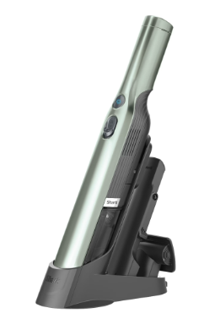
Vacuum
The vacuum we used was a Shark-WV201

Slide 7
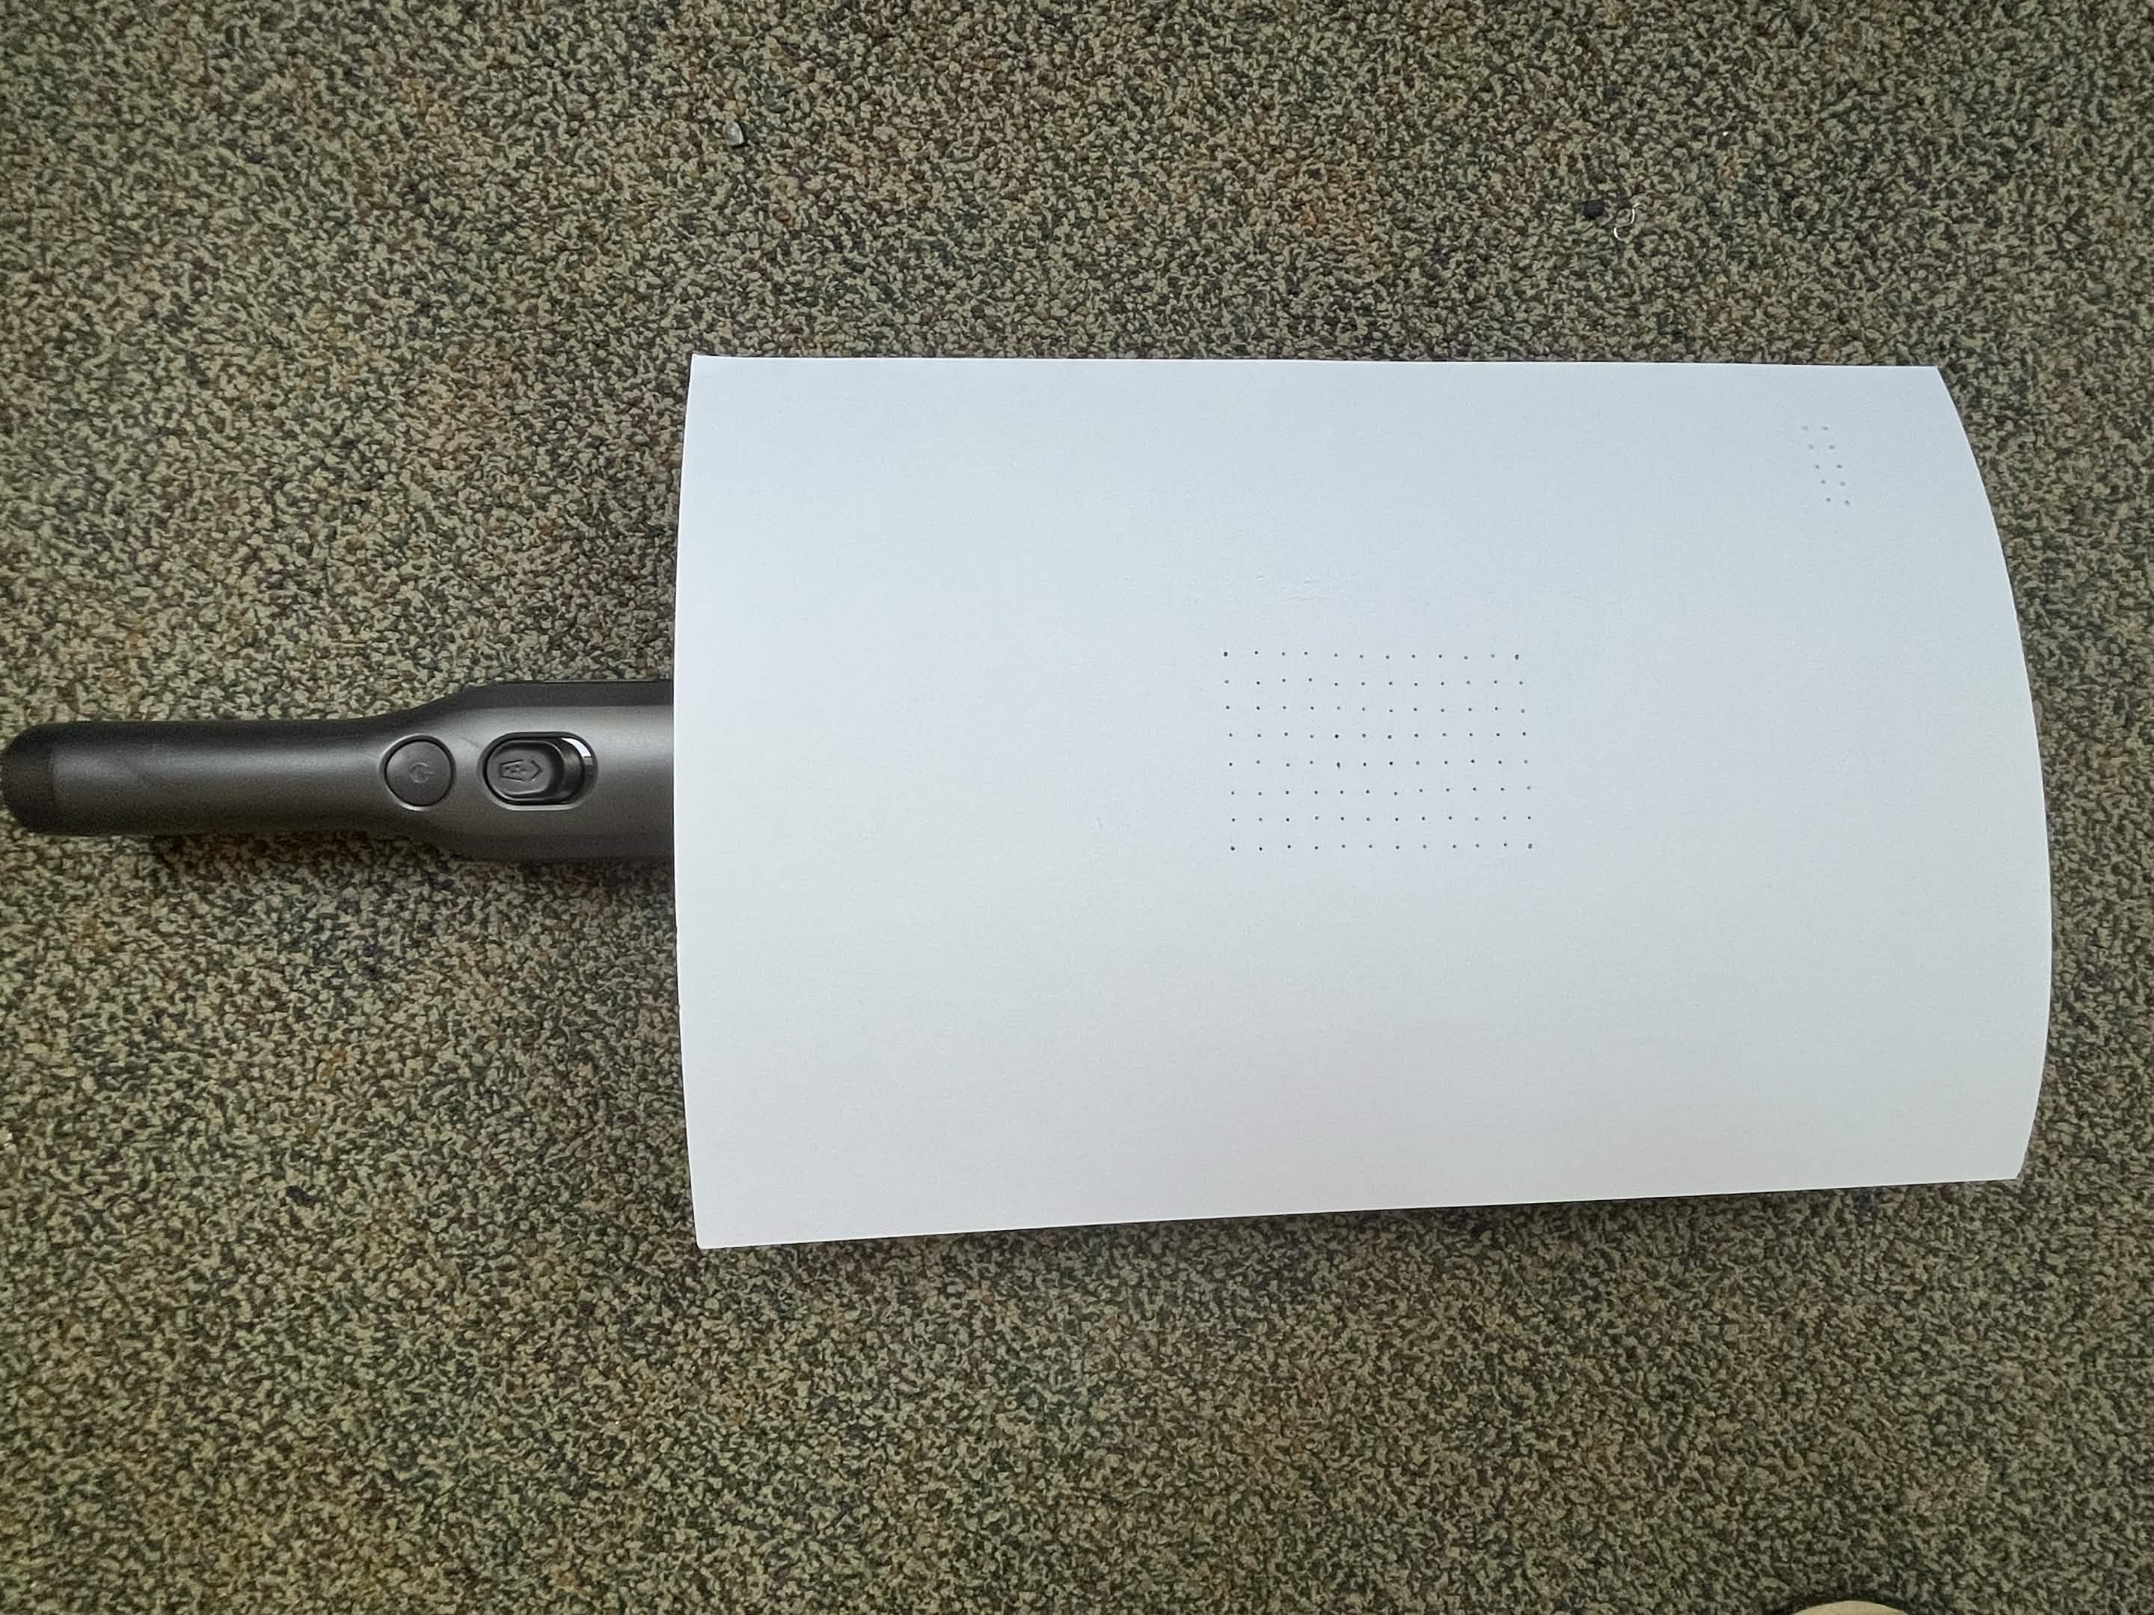
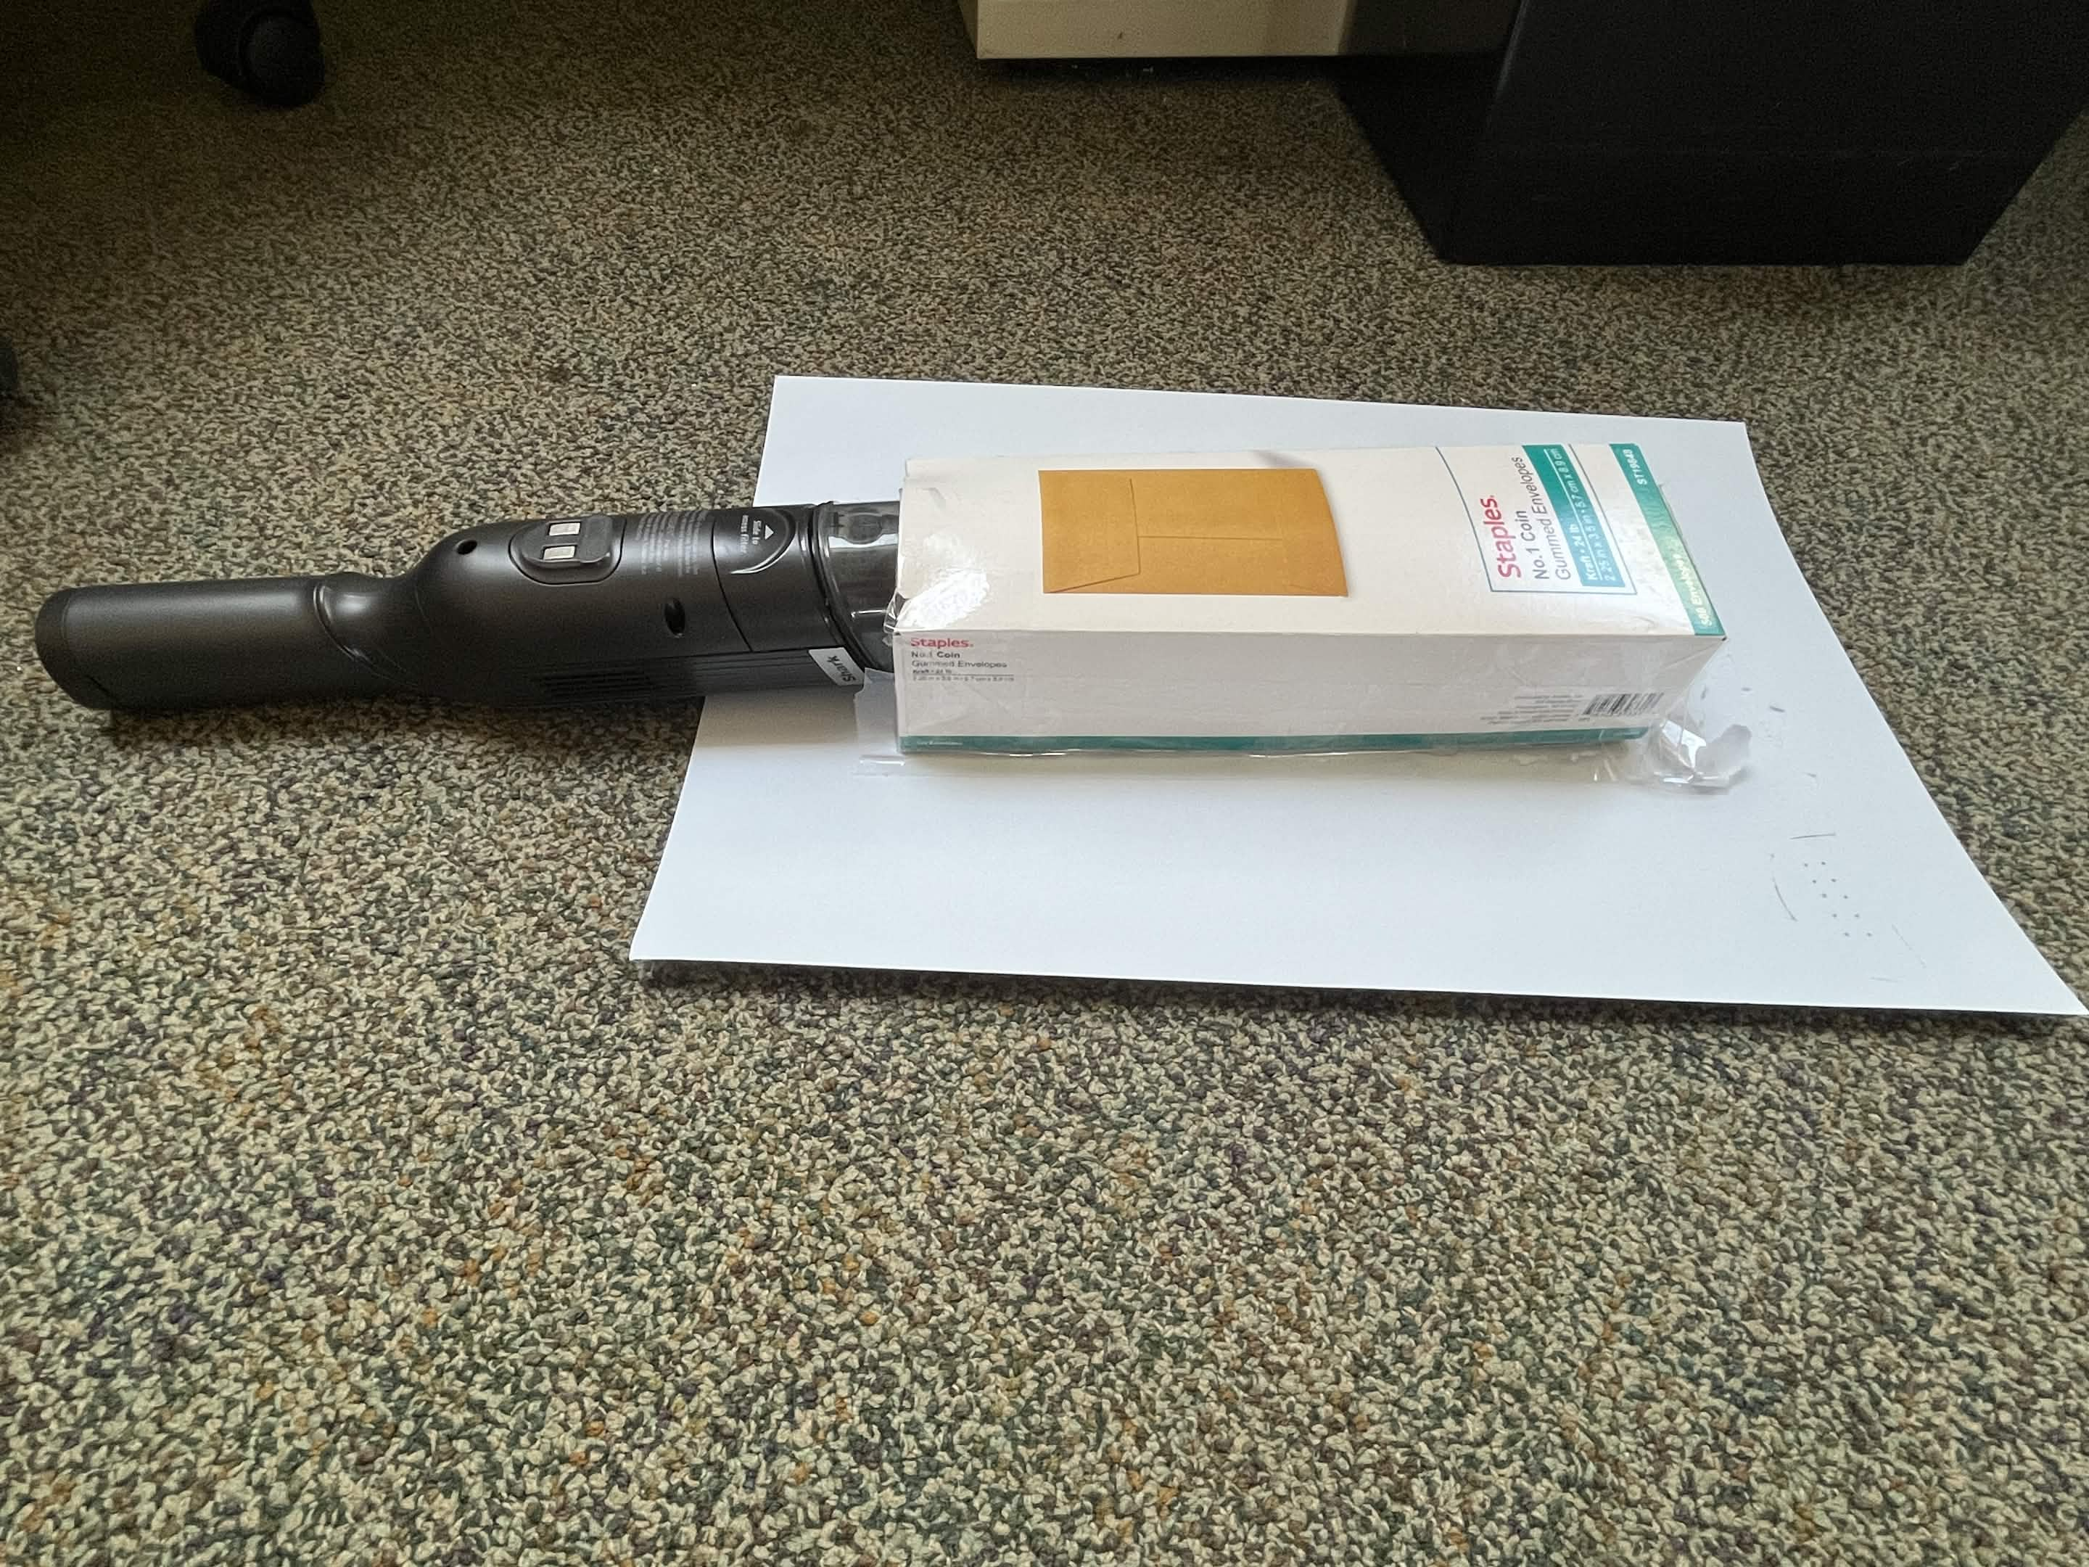
Tape and Cardboard (Version 0)

Slide 8
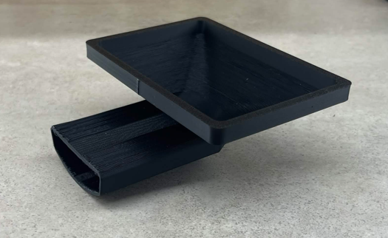
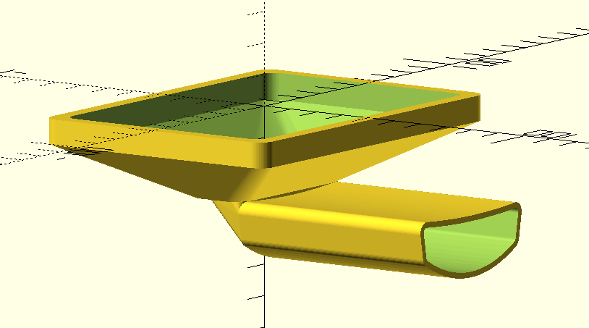
Version 1

Slide 9
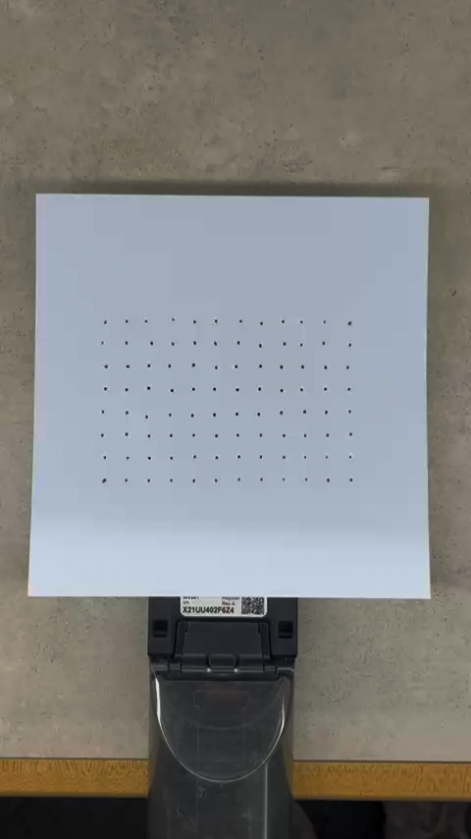
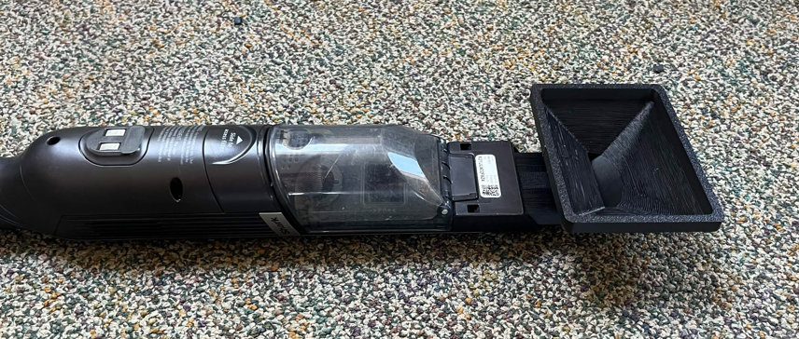
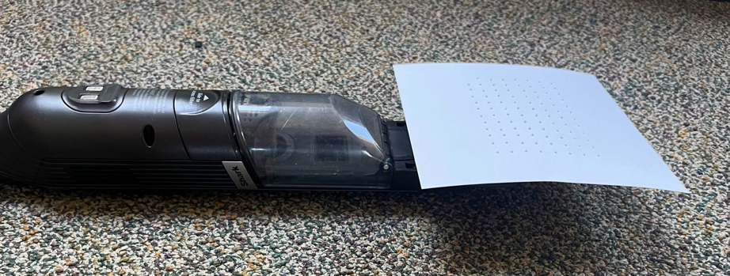
Version 1 Testing

Slide 10
Prototype Results Reflection
These initial tests showed that the concept could be successful
Next step was determining how we want to shuffle the seeds around
Vibration seemed promising but proved to be difficult to implement and tune
We decided to give the funnel an axis of rotation, which we can control using electronic components, and program to execute a “Jitter and dump” procedure.

Slide 11
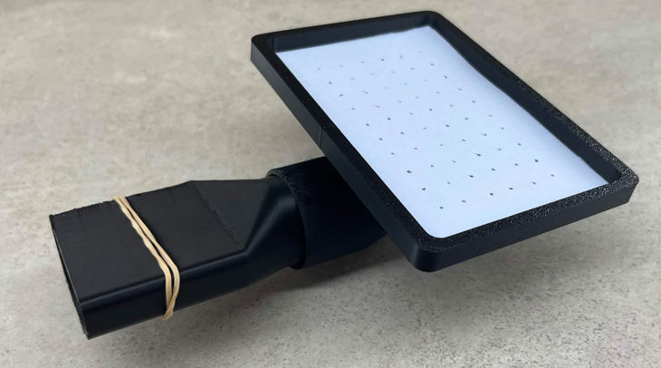
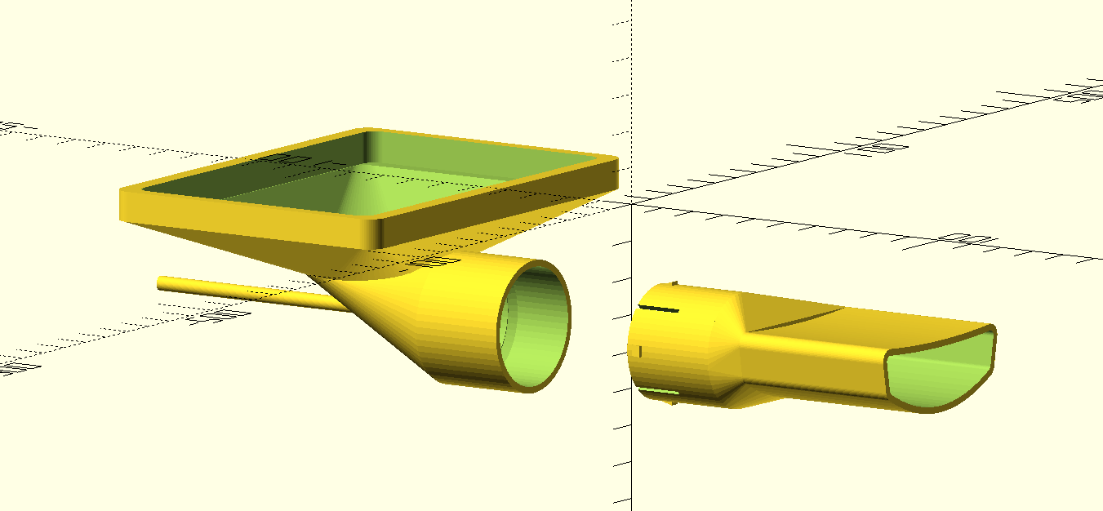
Version 2

Slide 12
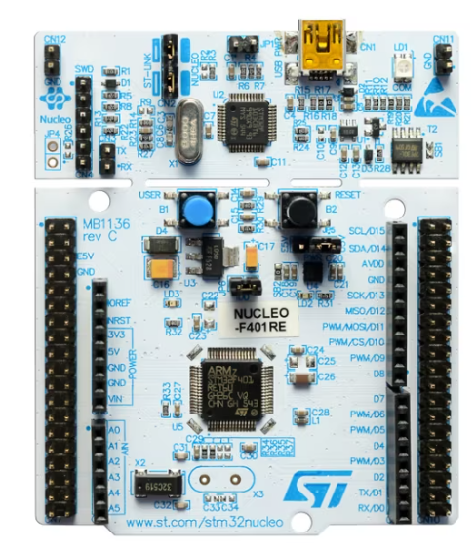
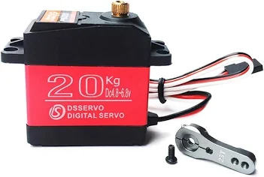
Electronics
Microcontroller: STM32 NUCLEO-F446RE
Servo: Miuzei 20Kg Digital Servo
Power Supply: COOLM 6V 3A Power Supply
Breadboard/Wires: ELGOO Electronics Kit

Slide 13
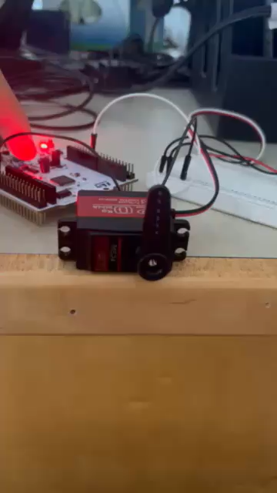
Jitter and Dump Procedure
The idea with the servo is that it will attach to the moving side of the funnel and control its angle
The procedure shown will shuffle the seeds back and forth, enabling many to claim a vacuum hole
Then, the funnel will dump the remaining seeds by flipping over, then come back to the original position for imaging

