Slide 1


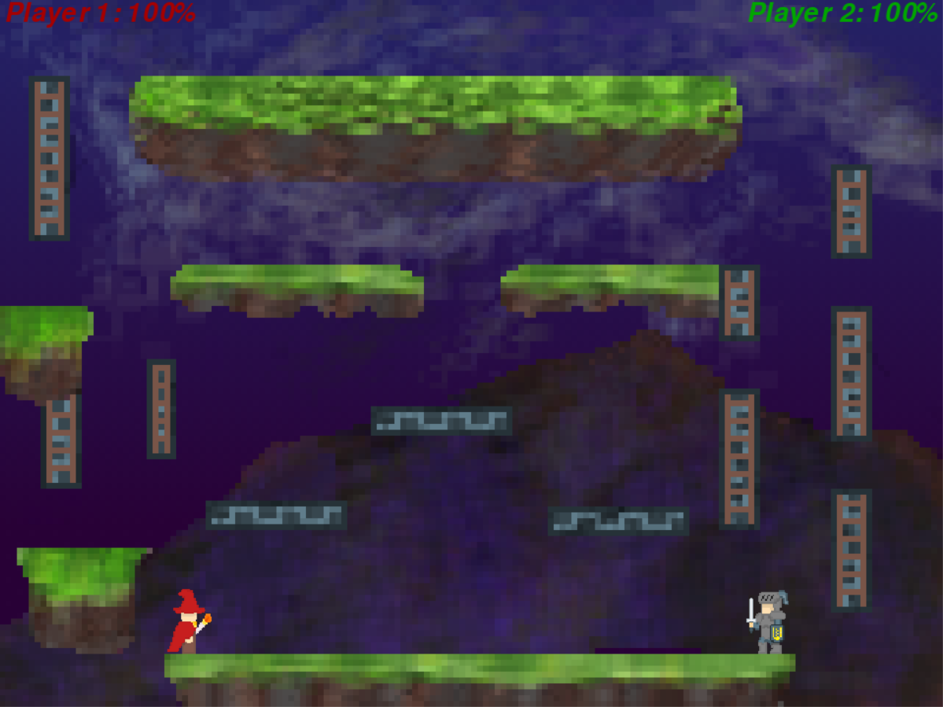
~ Team 13 ~
The Unprofessionals
Medieval Bashout
Operation Catapult 2021
Richard Caccamise, Nick Shircel, Alex Trick
Controls:
Player 1 (Wizard)
Player 2 (Knight)
Python Terms:
A class is like a code template for creating objects; often several objects.
We used classes for the wizard, knight, health counter, and more.
A method is a function that pertains to a specific object or class.
Hitboxes allow us to detect if points or shapes collide.
We used hitboxes to stop our characters from falling while on platforms and to detect when a character is hit by an attack
Medieval Bashout is a one-on-one fighting game featuring wizard and knight characters. Players are able to jump around the platforms and attack each other with fireballs, arrows, and slash attacks. The indicators at the top of the screen allow players to keep track of how much health their character has remaining.
Challenges we faced:
Creating functions to cycle through the frames and make an animated character
Connecting the slash attacks to their respective characters while also animating them
Creating methods that would stop the characters from falling while on platforms
Stopping different attacks and functions from interfering with each other when triggered at the same time
Necessary improvements:
Improved gravity code to make jumping and moving more realistic
Implement velocity
Implement friction
Improve hitbox detection so characters are unable to jump through the bottom of platforms
The ability to wall jump instead of climb up the walls
Selection between different characters
More characters to choose from
Q
Cast
Fireball
W
Jump
A
Move Left
S
Slash
Attack
D
Move Right
↑
Jump
0
Shoot
Arrow
←
Move Left
↓
Slash
Attack
→
Move Right
Example Classes:
Fireball
screen x, y
has_hit image
move_left move_right
draw_left draw_right
hitbox
Hitbox
screen x, y
scale width height
draw hit_by

