Slide 1


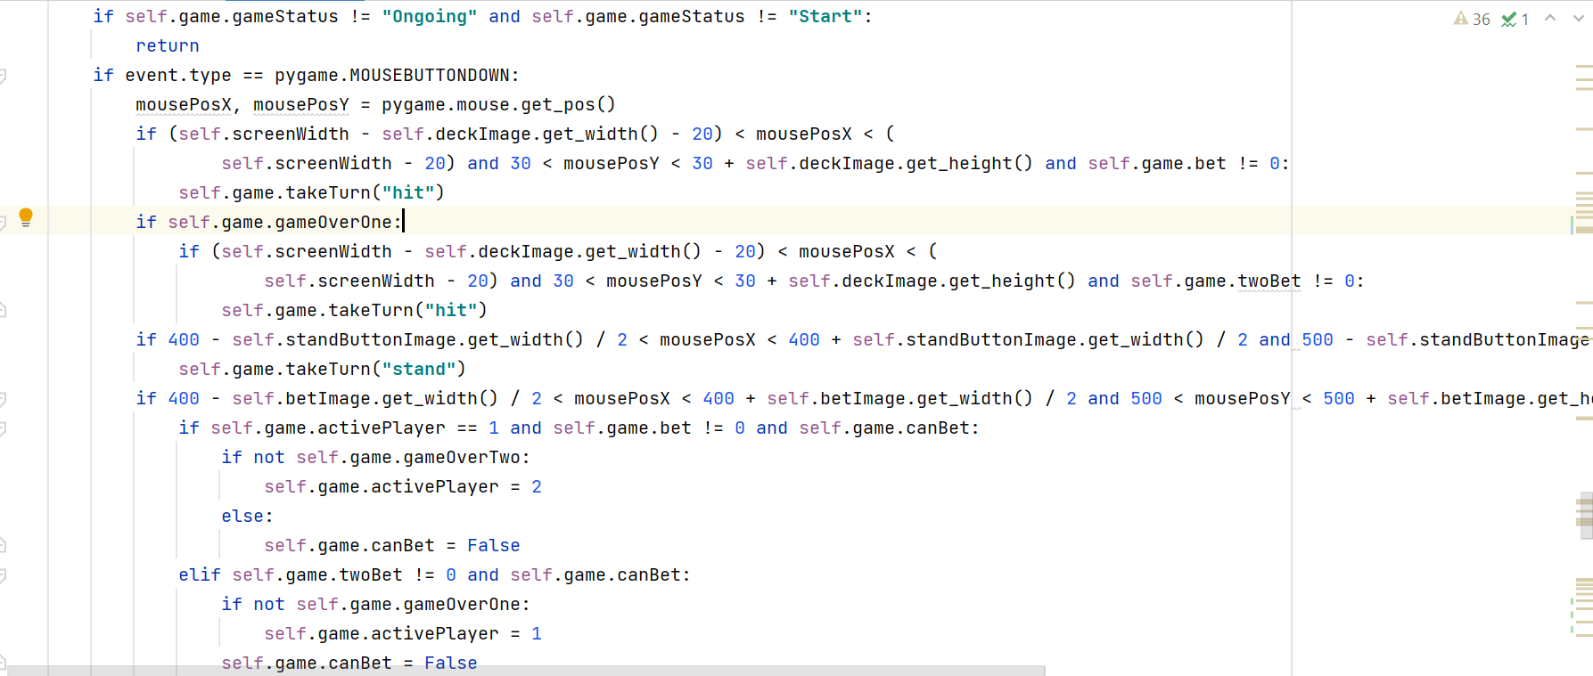
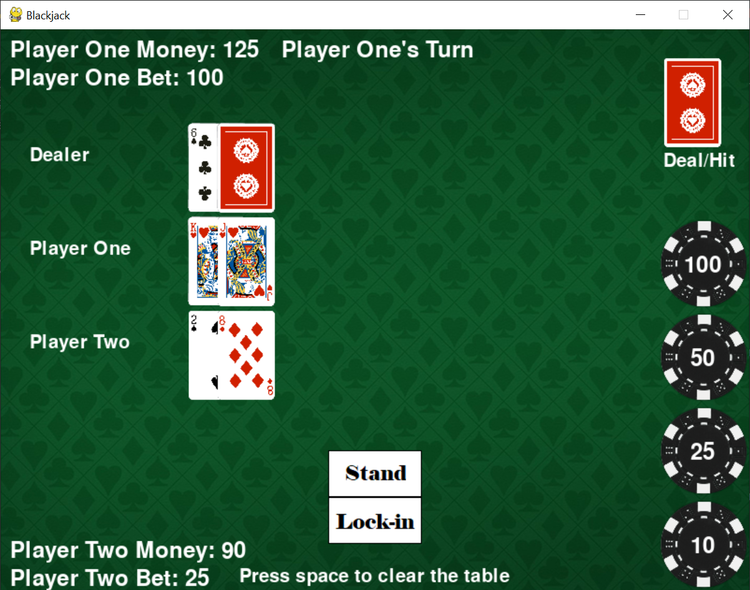
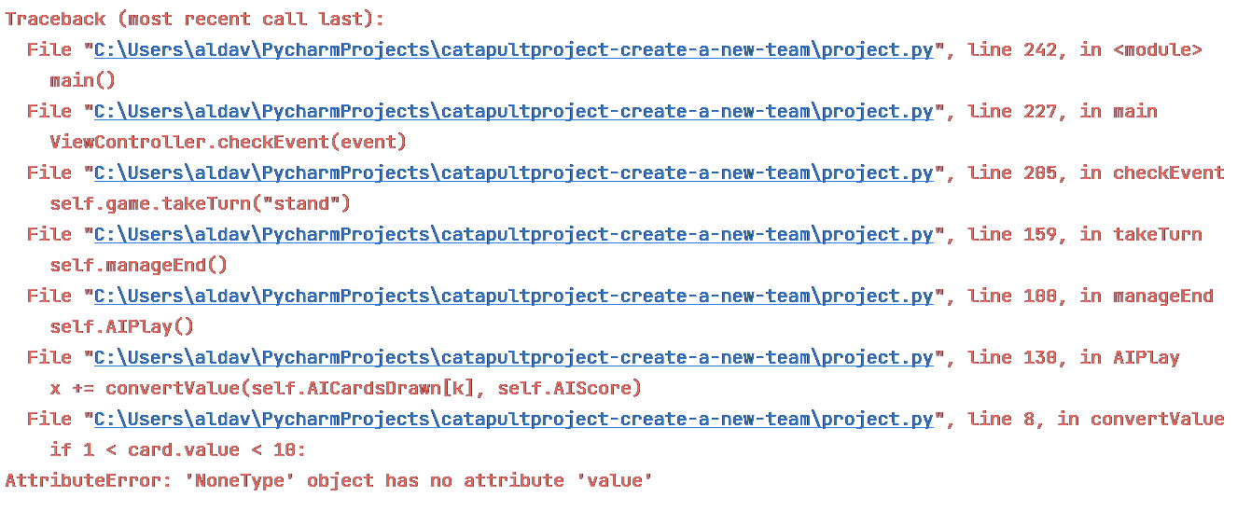
Team 11:
Create a New Team
Blackjack
Operation Catapult 2021
Alex Mohler and Chad Sweeney
The game that our team created is the casino game blackjack.
How to play:
Challenges we faced:
The goal of blackjack is to reach 21, or near it, without going over. If you go over 21, you lose.
If a player's hand is worth more than the dealer's hand at the end of the round, they win. If you are dealt 21 at the beginning of a round, that is called 'blackjack'. If you were dealt blackjack and the dealer wasn't also dealt blackjack, you automatically win.
Number cards are worth their number, face cards are worth 10, and aces are worth either 1 or 11, depending on if it will cause you to bust if it was worth 11.
The first problem that we faced was counting up how many points the player had in their hand based on what cards they were dealt.
Another problem that we experienced throughout the development process was with the function we wrote for drawing cards into the players' hands. The game would crash when the players used all 52 cards of the deck, and the game tried to draw another one after it reshuffled.
We also added another player after we had already programmed the functions of the game, which proved to be a painstaking process that added many extra lines of code to the project.
A screenshot of the event handler for our blackjack game
Blackjack terms:
Hit – Hitting means receiving another card from the dealer.
Stand – Standing means locking in your cards as-is, ending your turn.
Bust – Busting means going over 21, which is a loss.
Push – Pushing is when a player's hand is worth the same amount as the dealer's, resulting in a tie.
We had to get used to seeing this screen a lot.
A screenshot of our game after we implemented functioning multiplayer

