Slide 1

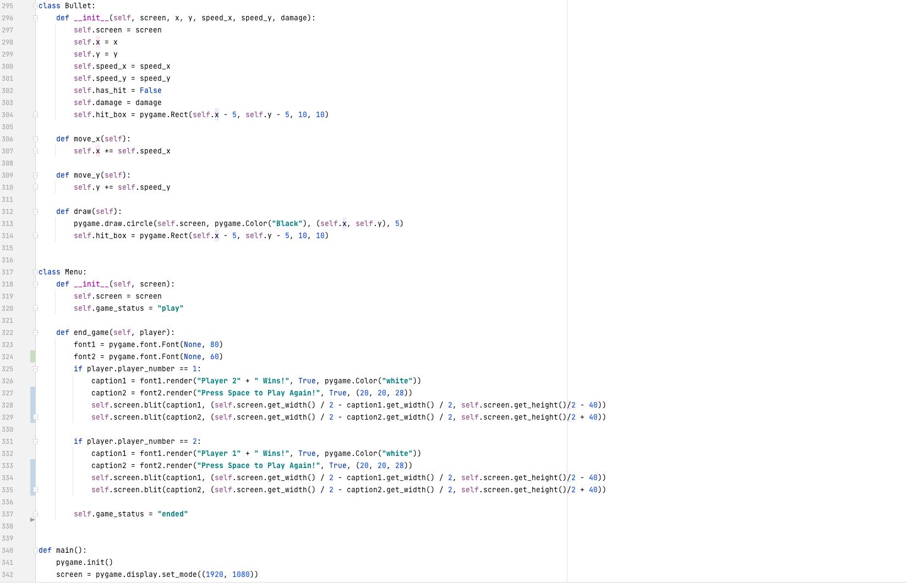
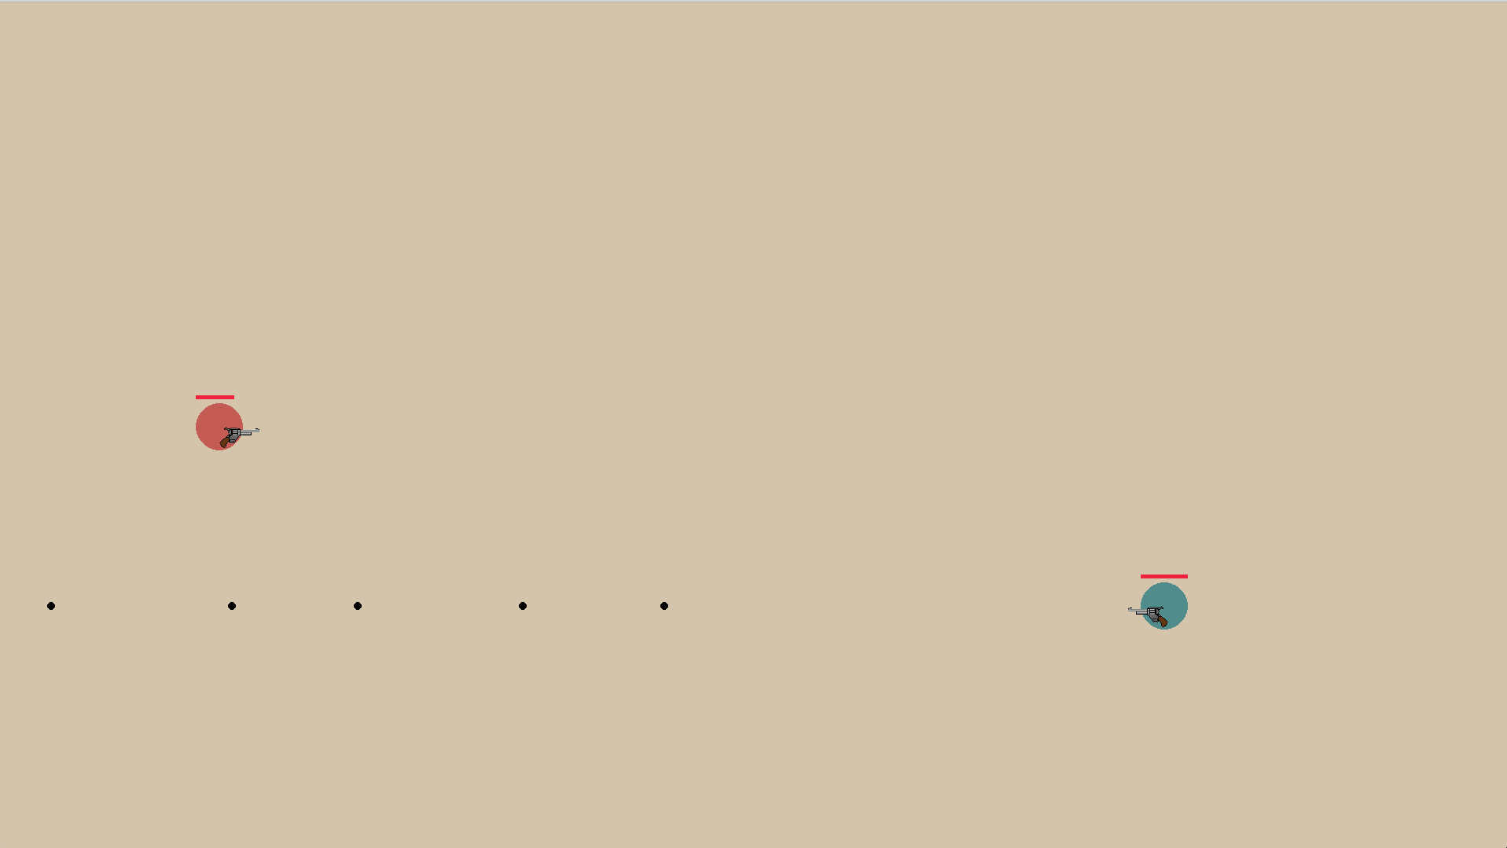
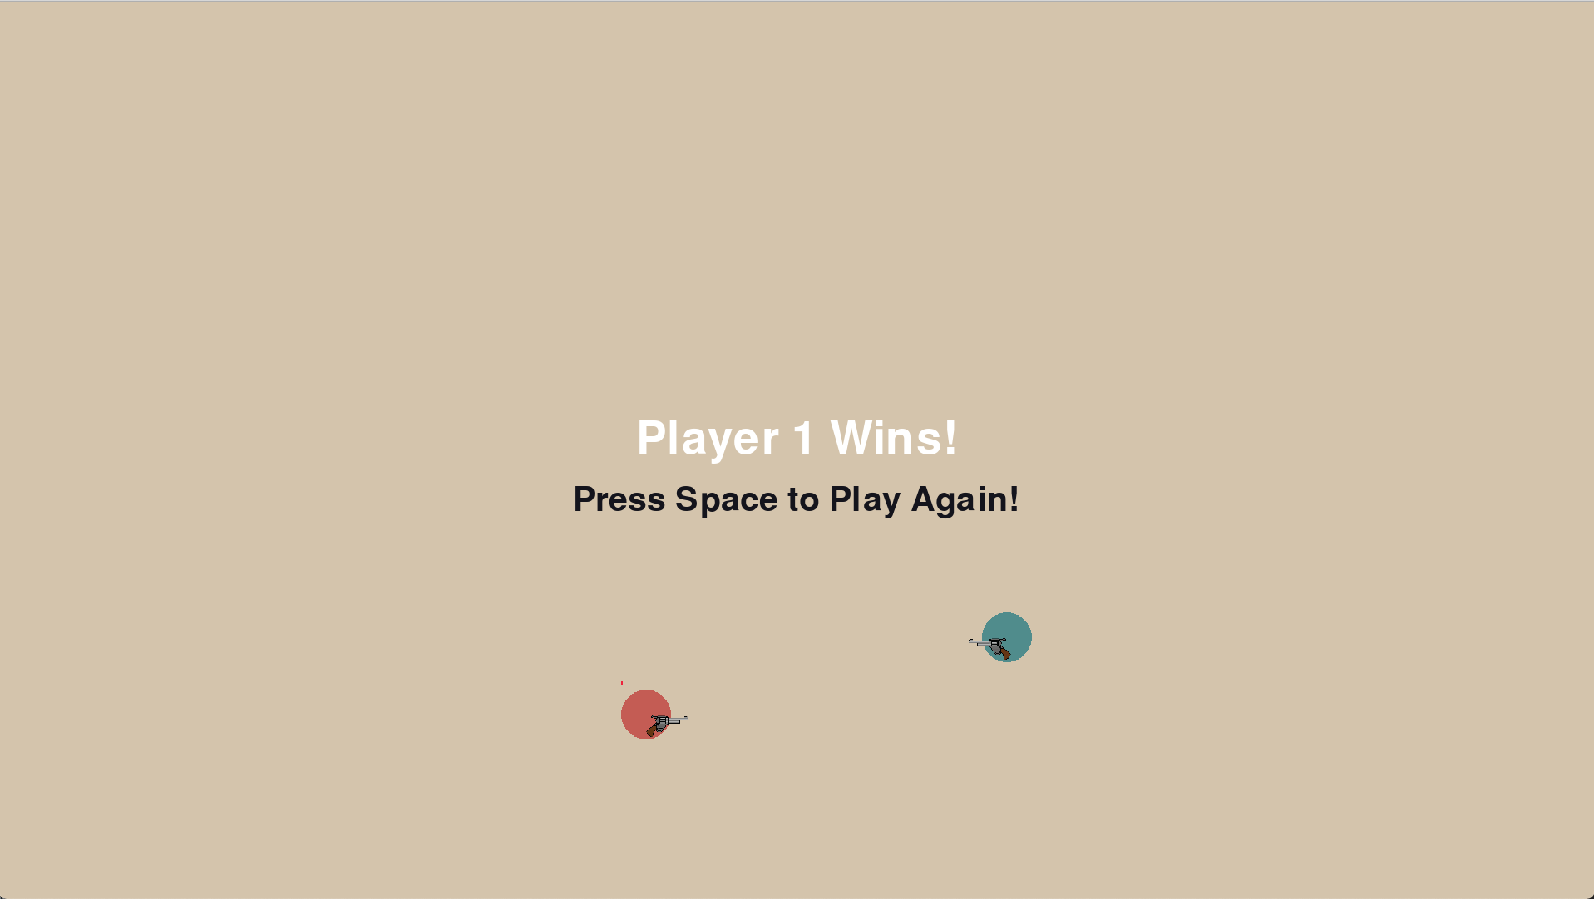
Team 07
Street Fighter: Circle Edition
Operation Catapult 2021
Charlie B, Ryan K, Ian T
Ideas:
Design Process:
1. Design moveable characters
2. Usable weapons (melee/gun)
3. Functional
health
4. Introduce
game logic
5. Finishing
touches
Result:
Fully functional 2 player game
Unable to implement wall hit detection
Battle royale styled game
Quick/Fun game to play
Online compatible
Background Information:
Knowledge of Python fundamentals
An understanding of game design
Reflection:
We underestimated the difficulty in adding custom wall hit detection. In the end, our game ended up being a fun, playable game

