Slide 1
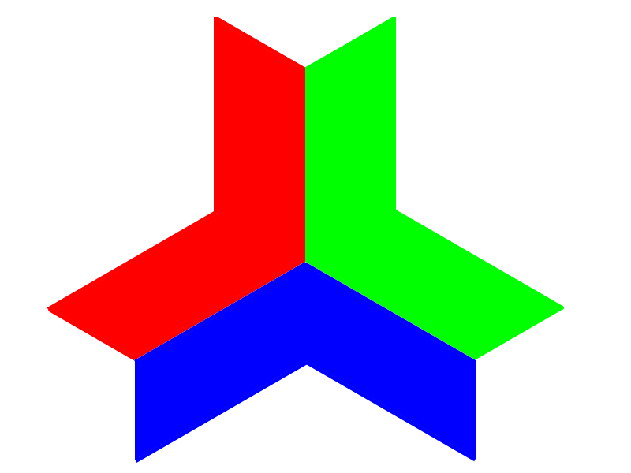

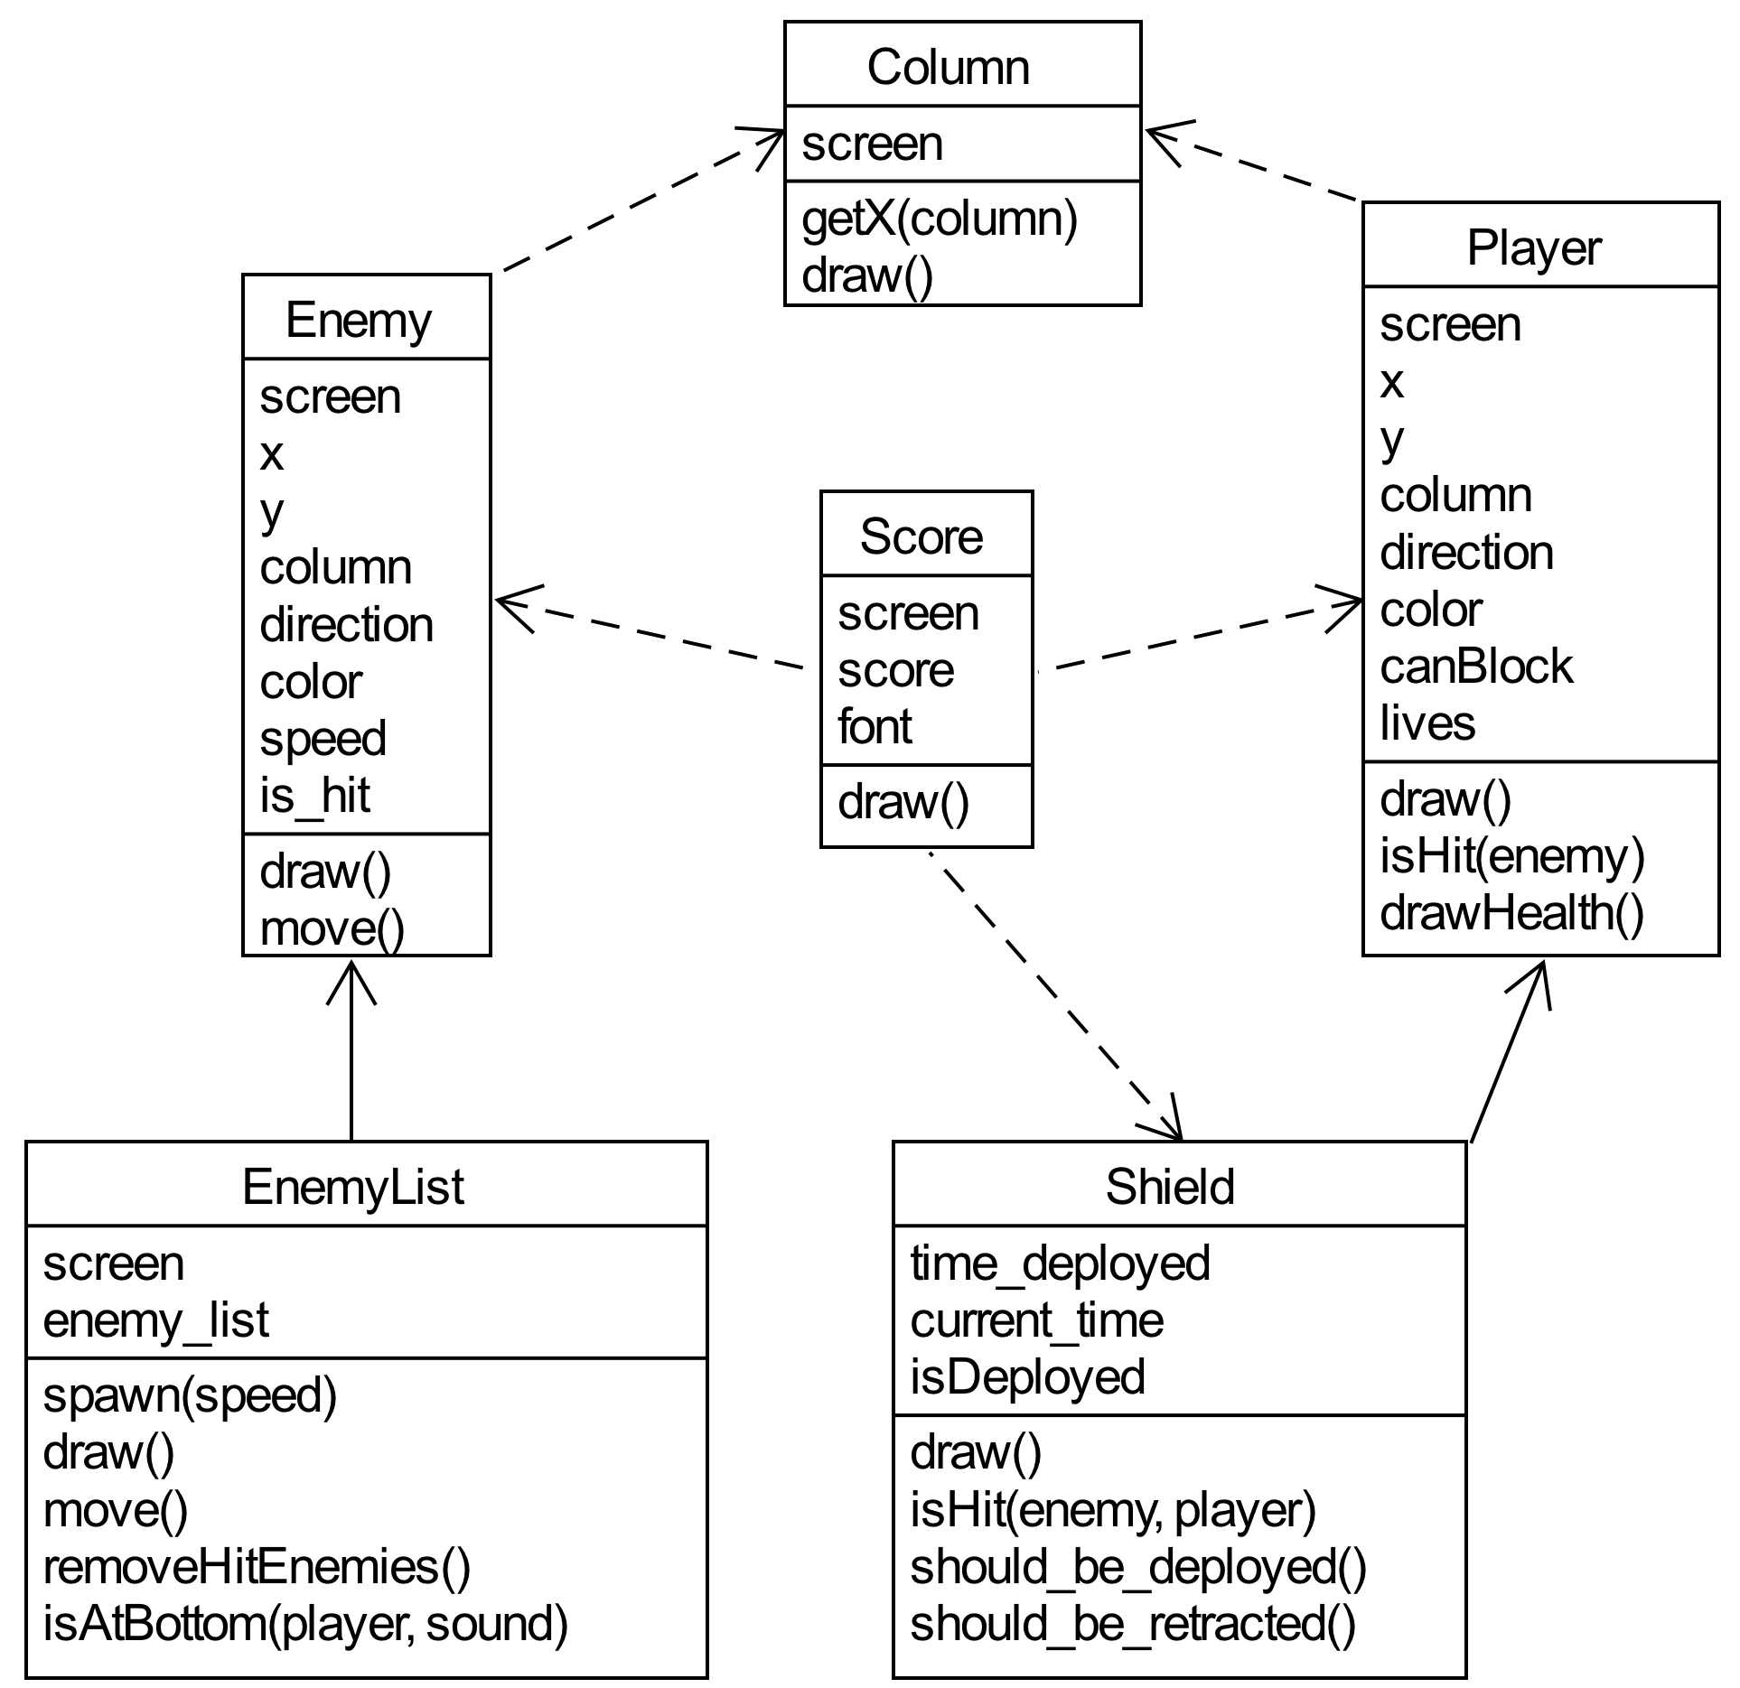
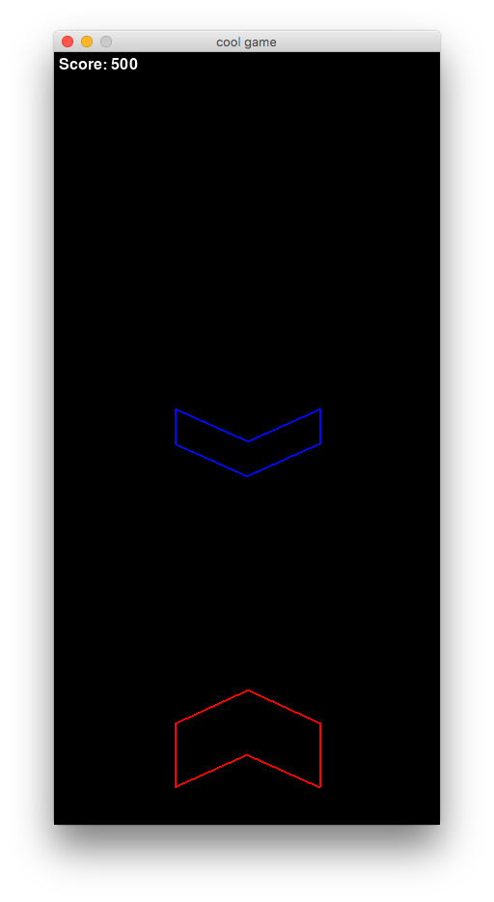
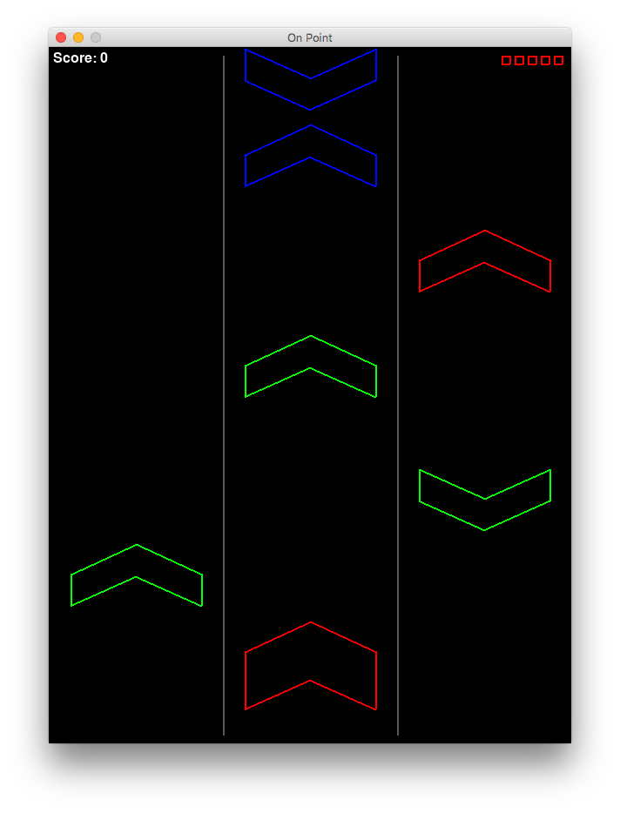
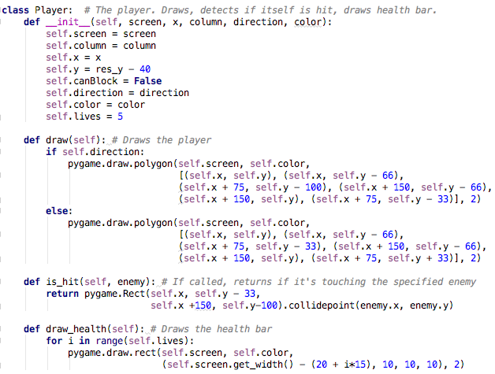
Team 12: Chevrons
On Point
Operation Catapult 2019
Tyler Kessis and Henry Verrill
UML Class Diagram:
This game is all about rhythm, timing, and matching in order to get the highest score!
How to Play:
The player starts with five lives displayed at the top right
The player has to match different combinations in order to get points. These variables are color, column, direction, and using the shield at the right time.
The chevrons that move down the screen get progressively faster as the player gets more points, which makes it harder to match them up.
Challenges:
Creating a polygon in the shape of a chevron
Implementing the shield and timings
List of high scores after game over
Implementing a balanced difficulty
Sorting high score list with multiple variables
Early Prototype:
New version:
Example Class:
Controls:
Red A | Color Green S | Blue D |  | Up Arrow
 | Shield Space |  | Left Arrow | Down Arrow | Right Arrow

