Slide 1
Using Computational Models to Examine the Evolution of Male Signals and Female Mate Choice
Including Developing New Testing Framework for SLiM
Andrea Chen, Dr. Robert J. Williamson (advisor)
Notes:
The question of the project, motivation and future plan

Slide 2
Computational models are used widely in biology
Modeling can be at various level of a biological system
Molecular
Individual
Population
Useful to show if a proposed mechanism is sufficient to produce the phenomenon of interest
Notes:
Cellular activity inside a cell that causes it to become a cancer cell
How airborne transmitted disease like covid spread between individuals
When two population interact; maybe through gene flow; how is it going to change the state for both population; like sex ratio, population size etc.
Many application in microbiology, systems biology, ecology and evolutionary biology
Save time and money by not going to experiment directly. Though computational models cannot replace experiments.

Slide 3

Individual-Based Modeling (IBM) is one of the modeling used
Explicitly simulate each individual in the system
Each individual has a set of properties and rules to follow
Useful to show if a proposed mechanism is sufficient to produce the phenomenon of interest
Notes:
For example, in an ecological IBM model, individuals will be the organisms in the population.
An example is Conway’s game of life. Each cell has two states, alive or dead. And they update their states based on the state of its neighbor cells
In ecology, a classical model is predator-prey.

Slide 4

Signals are essential to animal communication and mate choice
Signaler: I have a giant tail and thus a great mate. Pick me!
Receiver: You do have a big tail. How does it mean you are a high-quality mate?
Notes:
This is when the female needs to know if the signal is honest and does it convey reliable information of the signaler.
If the signal is honest, in this case, the female would show a preference for males with larger trains.
However, there’s a natural tendency for lying because signalers are usually asking for resources from the receiver. In this case it’s the number of eggs that female is willing to be fertilized by this male.
If a male wants to fertilize more eggs, he should be lying about how good he is through signaling so that he gets more eggs from the female. So there’s a conflict of interest between both parties.
but in nature, honest signals are very common. There are study found that the female peacock looks at the male’s trains from varies angles to assess the color of the eyespots (Loyau et al., 2007), and males with longer trains does have a higher chance of having successful mating (Loyau et al., 2005).
So male peacocks are indeed signaling honestly.
One
Mate choice
Honest Signal
Handicap Principle
A math model shows the signal doesn’t need to be costly at evolutionary equilibrium (what we’re basing off)

Slide 5

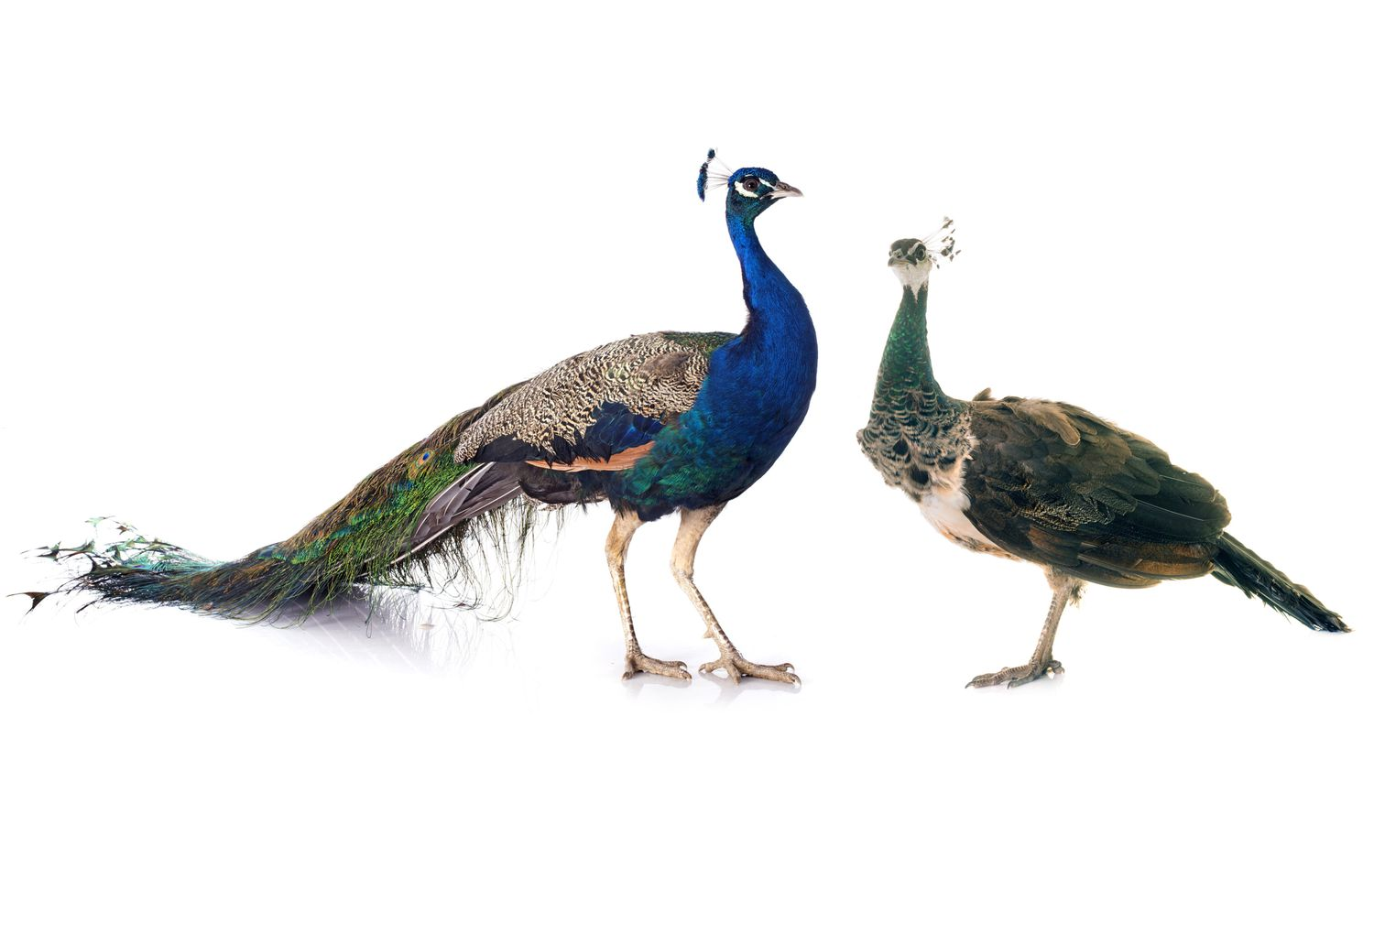
Handicap Principle (HP) is a widely spread explanation of honest signal evolution
It’s so hard to hide from the predator with such a big tail!
If he can survive with this long tail, he must have strong legs! My child with him will also be strong.
Notes:
One hypothesis that tries to explain why do honest signals evolved is HP.
There has been debates about whether HP is true and models have been developed to test the idea
HP: costly signals must be honest because the individual must be able to afford the cost, suggesting this individual has advantage on some trait that allows them to bear the cost.

Slide 6

There’s a conflict between two sexes
I want to be the only father of your children!
Nope you’re not. I won’t put all my eggs in one bucket.
Portion of this female’s egg that this male can fertilize

Slide 7
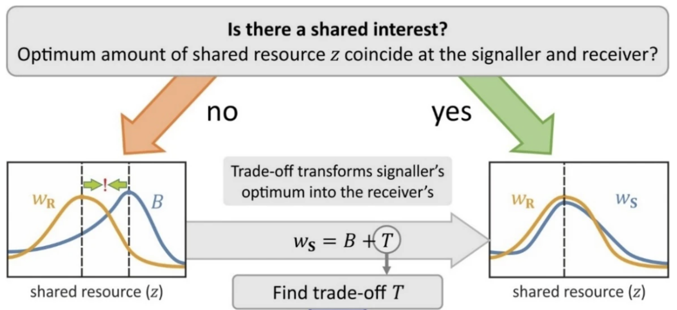
Mathematics has been used to model the signal game
Conflict of interest
Conflict resolved
(Számadó, 2023)

Slide 8
question
Prediction pics

Slide 9
Genome + model details
genome

Slide 10

Use IBM to test the dynamics in the signaling game
some result
SLiM
Notes:
Uses slim

Slide 11
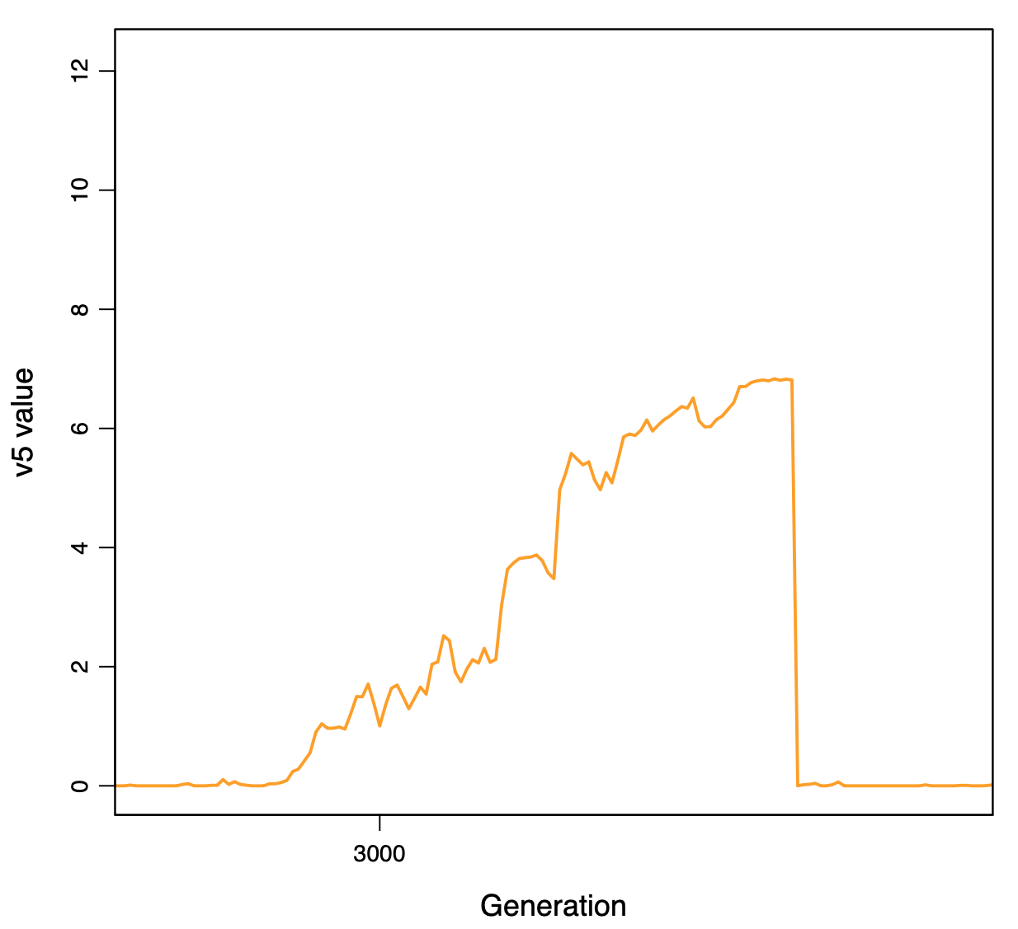
SLiM make optimization leads to unexpected difficulty
Underlining data structure
N vectors -> N individuals
M items each index -> M mutations
G generations -> G iteration
Runtime -> O(N*M*G) !!!
Optimization
Fitness is relative
Mutation can fix in a population
Fixed mutation is no longer simulated -> M
Notes:
Uses slim
Show the figure first
Added assert + tie to testing

Slide 12
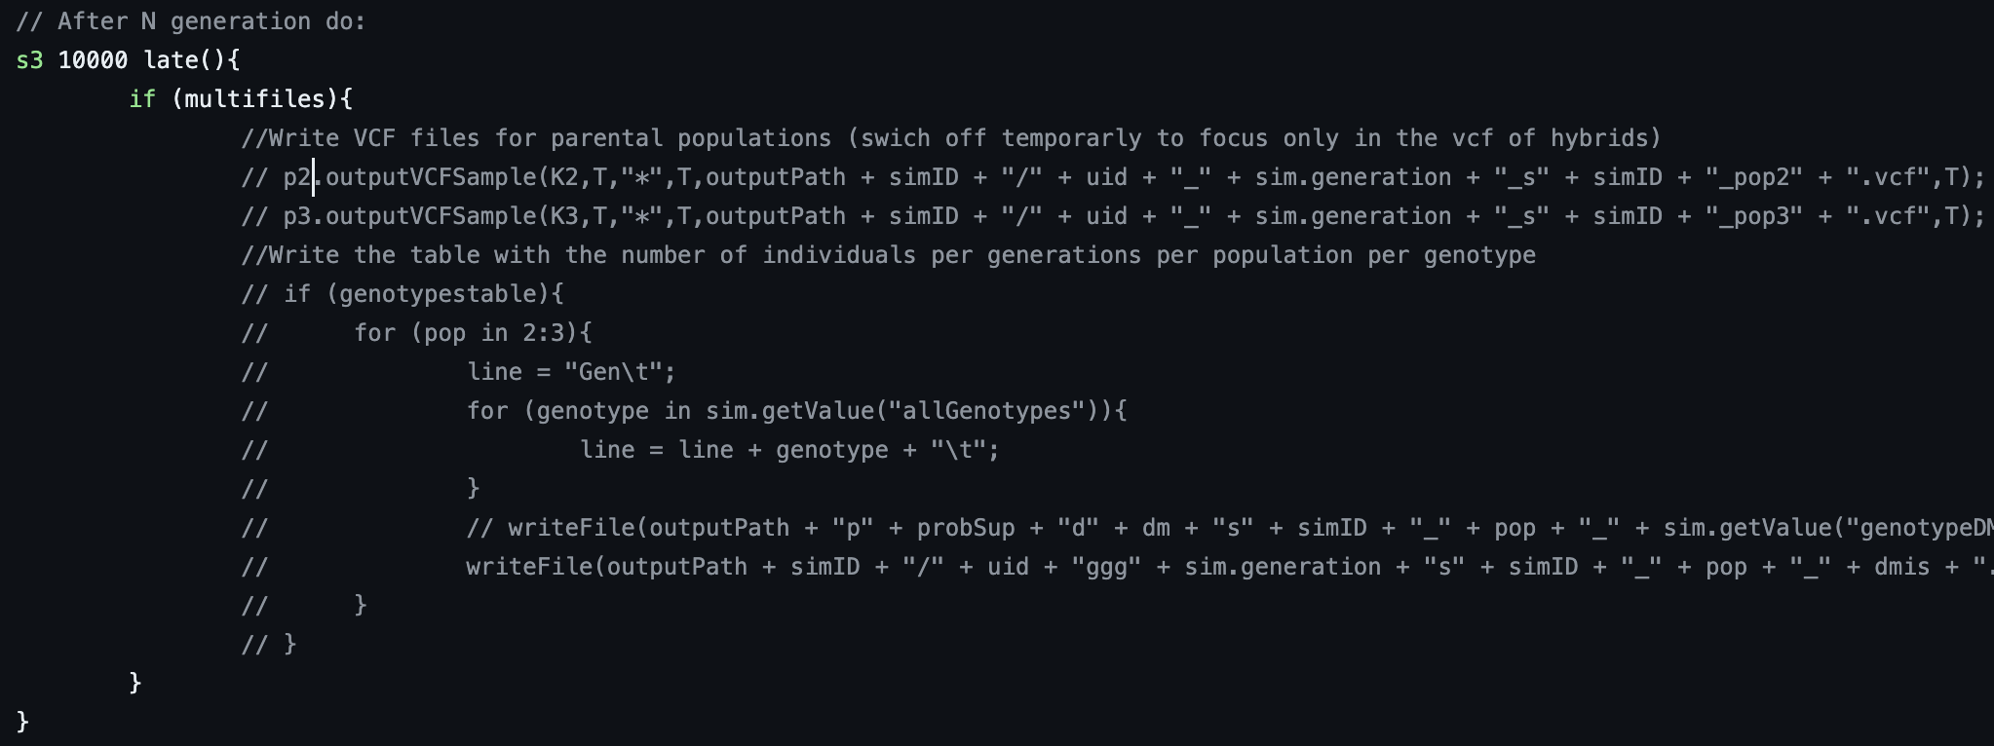
Published SLiM Code becomes a worry
(Maya-Lastra & Eaton, bioRxiv, 2021)
Notes:
Im going to show a snip of SLiM code from a publish paper. It doesn’t matter what the code does, I just want you to focus on the coding style
First figure: all code in this if statement is commented which means this block does nothing, but still exist in the final version of the code; what’s the point of this condition checking?
This is only about outputting data which might or might not be fine. But this snip that from the same file has a more serious question.
The author doesn’t have idea or complete control over its model and code. How can we be sure the result is reliable?

Slide 13
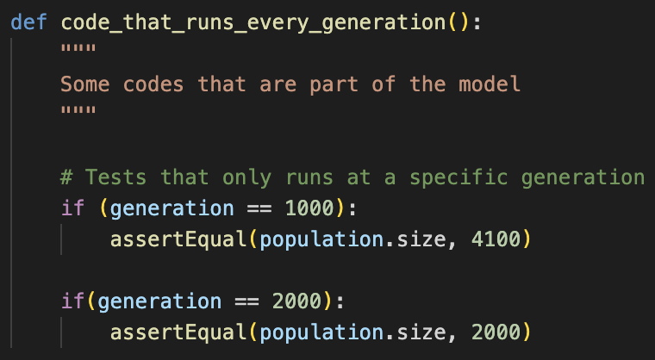
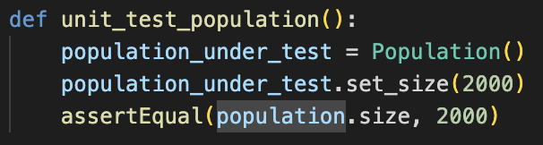
Runtime Assertion
Assertion will be embedded in the model’s code
Create an instance of the object under test
Manipulate the object using some functions
Test the state of the object through assertion
At a specific time in the simulation, an assertion function is called to test the state of any object
Usual approach with tests encapsulated
Notes:
Because of how slim is designed, the assertion test’s code will be embedded in the model’s code
I made a analogous python code

Slide 14
Future plan
Implement the assertion to more classes
Test different female and male signal strategies
Notes:
SLIM is much less flexible than self-wrote Python program and digging through the documentation is needed to construct the model correctly
We met with the developer of SLiM and Eidos and he has basically confirmed that assertion can be added no problem. We’re planning on designing a better way to do it so that the testing portion is encapsulated from the main classes

Slide 15
Q&A

