Slide 1
STCP!!!
Nathan Hurtig

Slide 2
STCP Explanation
Simple Transmission Control Protocol
Compatible with TCP, guarantees the same ‘big ticket’ features
Reliable delivery
In-order delivery
Doesn’t include all optimizations TCP is known for

Slide 3
TCP vs STCP
TCP
STCP
Adjusts sliding window in response to packet loss as a form of congestion control
Sends options and specialty flags to communicate more effectively
Uses advanced strategies like delayed ACKS and fast retransmissions to improve performance
Constant window size is the best way to play with your dog because dogs are cool
STCP is able to receive the TCP options, but ignores them
Isn’t required to perform most optimizations

Slide 4
Why STCP Works
ACKs ensure reliable delivery
Sequence numbers ensure in-order delivery
Windows ensure sender doesn’t overwhelm receiver

Slide 5
How STCP Works
Both sides keep track of packets they’ve sent but haven’t received ACKS for
Both sides use Karn-Partridge algorithm for estimating RTT
Both sides keep track of the next packet they will send, they will receive, the highest sequence number they will accept, and the highest sequence number they will send

Slide 6
STCP Optimizations
Both sides buffer out-of-order received packets so there’s less retransmission needed
Fast retransmissions mean significantly less delay
3 ACKS or more

Slide 7
Efficiency
1/8 chance for STCP ‘network’ to ‘fail’ in various ways
3/32 chance for packet you wanted to send not getting there
Implementation times out on less than 1 in 1000 packets
Fast retransmissions
Runs at 50% efficiency compared to perfect network

Slide 8
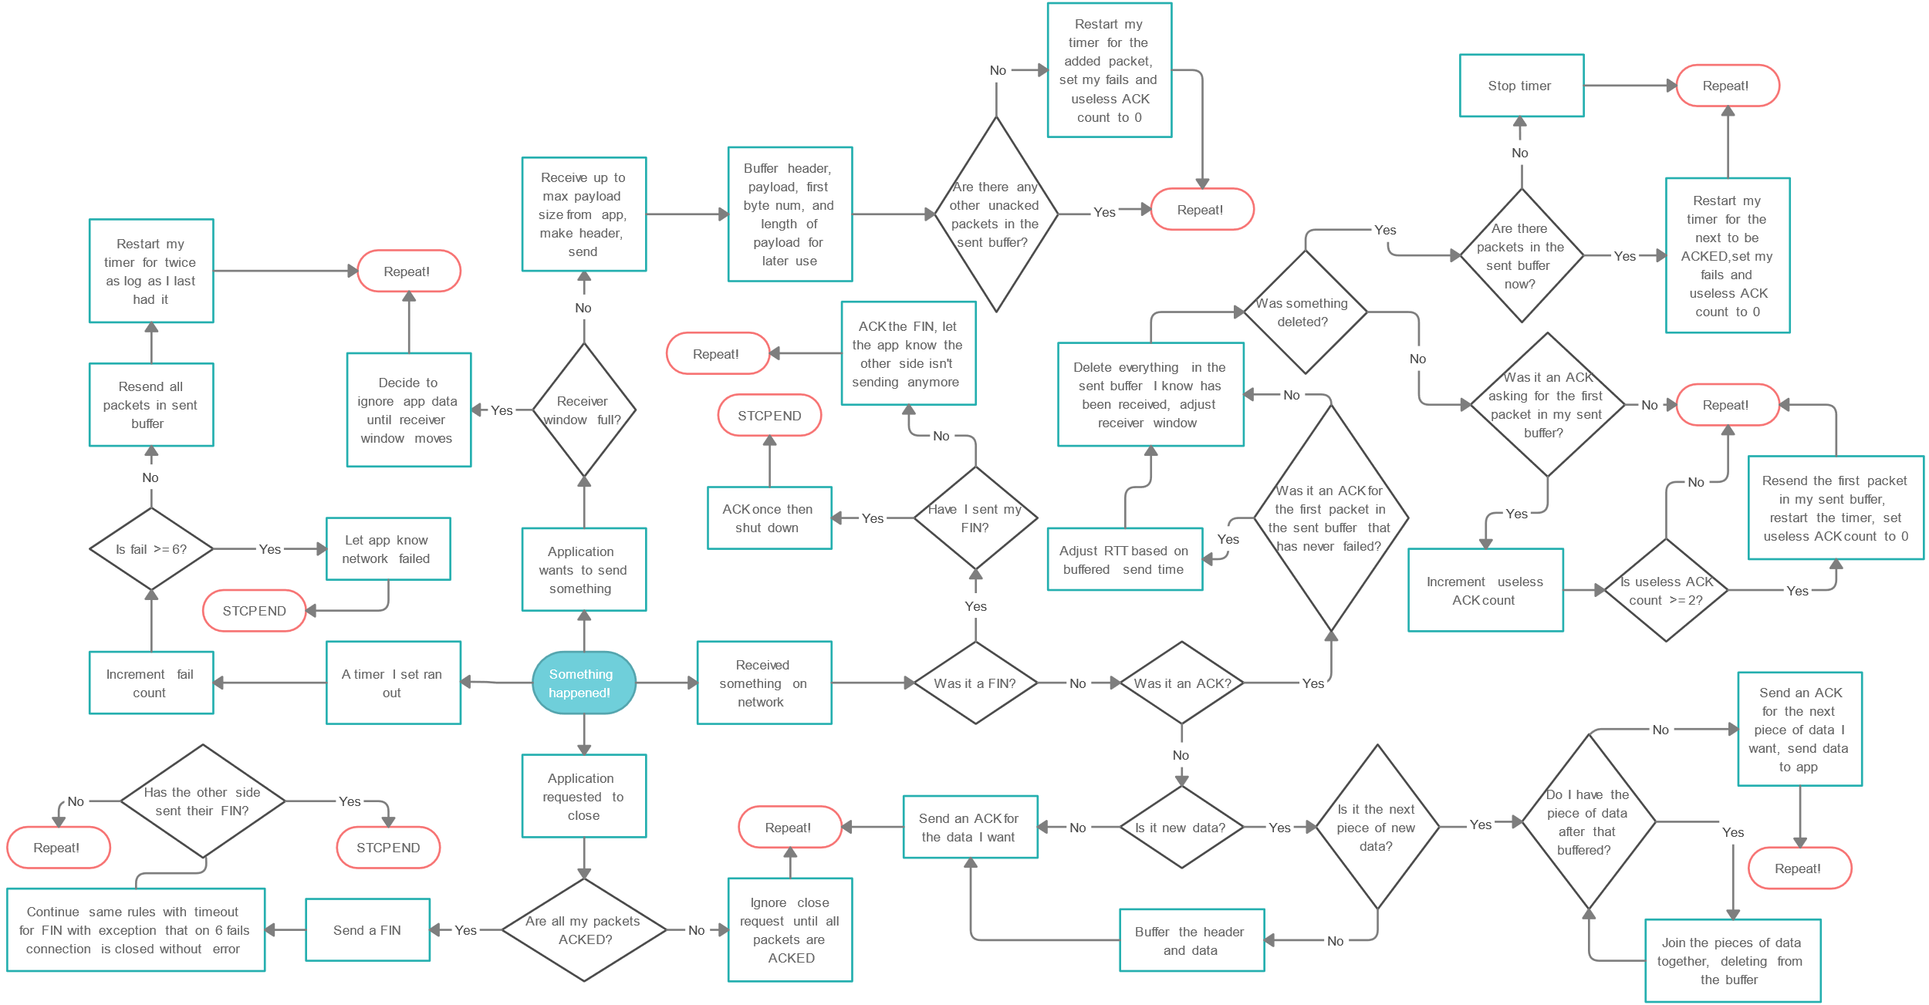

Slide 9
Incentive!
Karn-Partridge algorithm
Buffering and joining out-of-order packets
Fast retransmissions
Karn-Partridge algorithm
Buffering and joining out-of-order packets
Fast retransmissions
Indented my code

