Slide 1
Phishing Website Detection
Telling phishing sites from legitimate ones with machine learning
Erwin Perkowski · Mark Joseph Kenny · Sanil Maheshwari
CSSE 415 — Machine Learning · Final Project
Notes:
Title slide. Welcome the class with energy. The hook is on the next slide. Make sure all three of you are ready to own your sections.

Slide 2
Ever been scared to click a link?
Raise your hand if you've ever hesitated.
Notes:
HOOK — first 30 seconds, engage the room. Ask the question, wait for hands. Say: that hesitation is the instinct we tried to teach a machine. Eye contact, speak up.

Slide 3
Why Phishing?
• Fake sites built to steal logins, money, and data
• They appear and disappear within hours
• Many look identical to the real thing
• Block-lists and fixed rules can't keep up
• The #1 entry point for breaches — billions lost each year
Notes:
Cover the rubric out loud: WHAT (fake sites stealing credentials), WHY we care (huge losses — mention the FBI IC3 / BEC ~$2.9B figure and the ~$100M Google & Facebook invoice scam), WHY it's hard (fast-changing, look real, rules don't scale), and our angle: let ML learn the subtle signals instead of hard-coded rules. Erwin: tell your personal phishing-scandal story here.

Slide 4
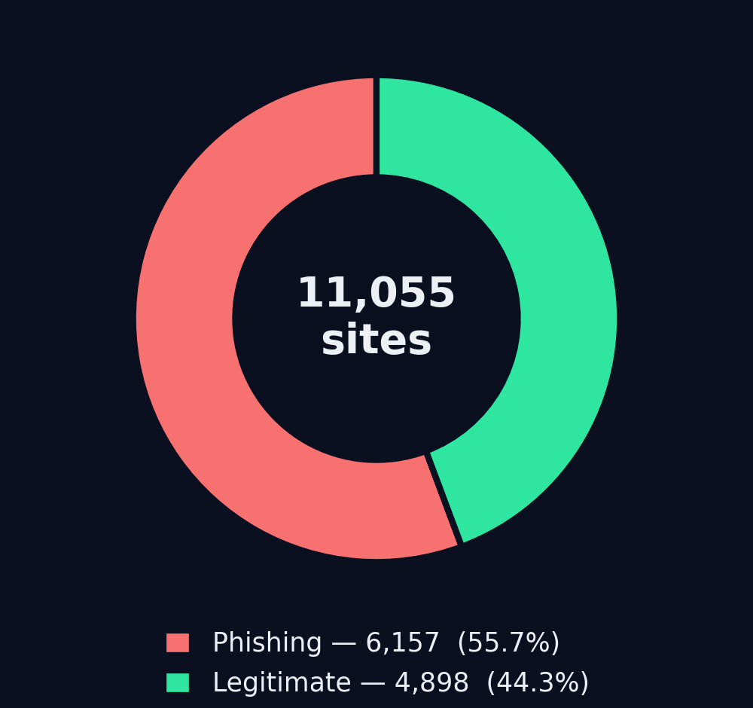
The Dataset
• UCI / UIUC phishing dataset
• 11,055 sites · 30 features · binary label
• Values encoded as −1 / 0 / +1
• Clean, research-grade — no missing values
• Also re-checked on 2 more datasets
Notes:
Describe the data: UCI/UIUC phishing set, 11,055 sites, 30 features, binary label, already clean. Classes reasonably balanced (donut) so accuracy is a fair starting metric. We ran the same pipeline on 2 more datasets to confirm it generalizes.

Slide 5
What Makes a URL Look Phishy?
🔗 URL length
🔒 HTTPS / SSL state
⚠️ Suspicious symbols ( @ // - IP )
⏳ Domain age
↪ Redirects
🪟 iframes & pop-ups
Notes:
Walk through the intuitive features so the audience builds a mental model: URL length, HTTPS/SSL, suspicious symbols (@, //, -, raw IP), domain age, redirects, iframes/pop-ups. Tie back to the hook — these are the cues a careful human looks for; we measure all 30 automatically.

Slide 6
Our Approach
1. Clean & verify the data
2. Encode features and label
3. 80 / 20 stratified train-test split
4. Scale where it matters (kNN, SVM, LogReg)
5. Feature engineering — pairwise interactions
6. Same protocol across all models & datasets
Notes:
Describe the pipeline so it's clear exactly what we did: clean/verify, encode, 80/20 stratified split (random_state 42), scale only for distance/margin models, feature engineering with pairwise interactions (up to 495 features, Lasso pruned to 320), consistent protocol across all 8 models and datasets.

Slide 7
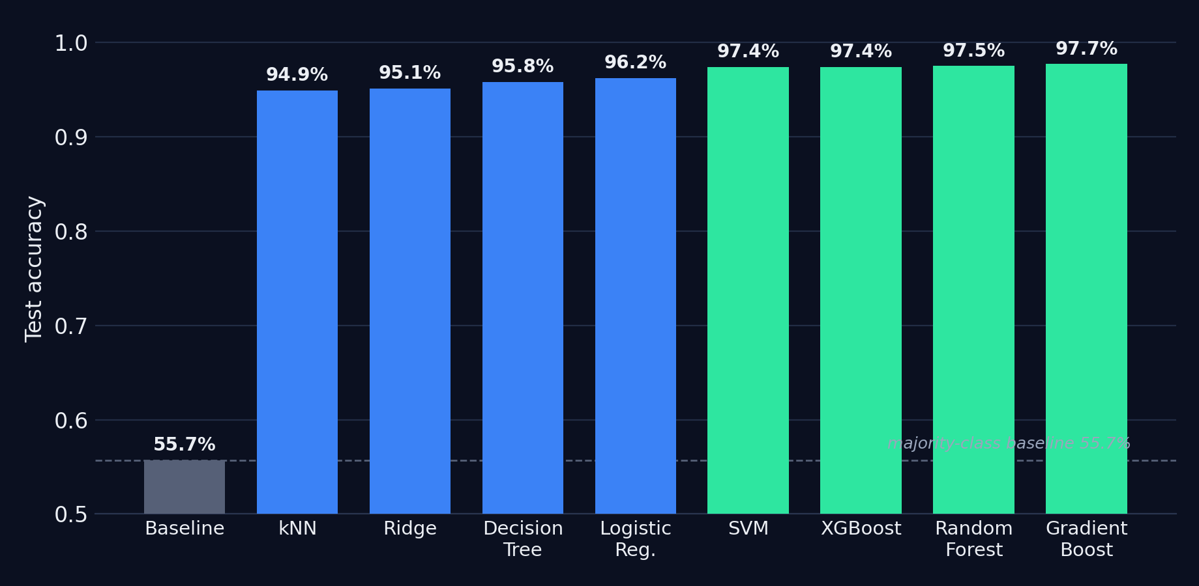
Models We Tested
8 classifiers — every one beats the 55.7% baseline
Notes:
We tested 8 classifiers from class: Logistic Regression, Decision Tree, kNN, Ridge, Random Forest, Gradient Boosting, SVM, XGBoost. The chart shows best accuracy per family vs the 55.7% majority baseline. Everything clears it easily; the green bars (SVM, XGBoost, RF, Gradient Boosting) are our strongest.

Slide 8
Strongest Models (1 / 2)
Gradient Boosting
• 97.7% accuracy — best overall
• 98.8% phishing recall
• Few phishing sites missed
Random Forest
• 97.5% accuracy
• Captures interactions natively
• Top tells: SSL state & anchor links
Notes:
Emphasize WHY these win. Gradient Boosting (97.7%) is best overall with ~98.8% phishing recall. Random Forest (97.5%) is essentially tied and very robust — it captures interactions natively, which is why hand-made interaction features barely helped it.

Slide 9
Strongest Models (2 / 2)
SVM (RBF)
• 97.4% accuracy
• Highest phishing recall — 99%
• Recall matters most to us
XGBoost
• 97.4% accuracy
• Regularized gradient boosting
• On par with RF and SVM
Notes:
SVM (97.4%) had the HIGHEST phishing recall (~99%) — call this out, because missing a phishing site is the costly error. XGBoost (97.4%) matches RF/SVM. The top four are within ~0.3% of each other; pick on recall + interpretability.

Slide 10
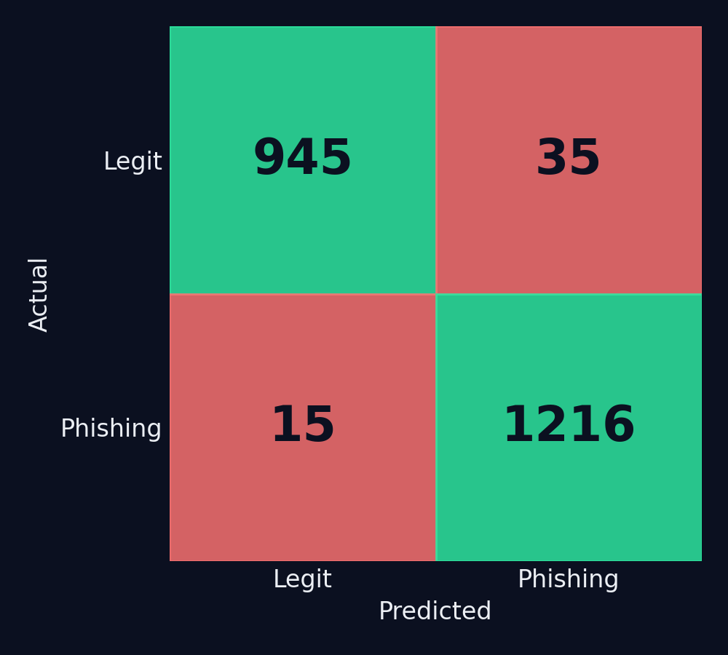
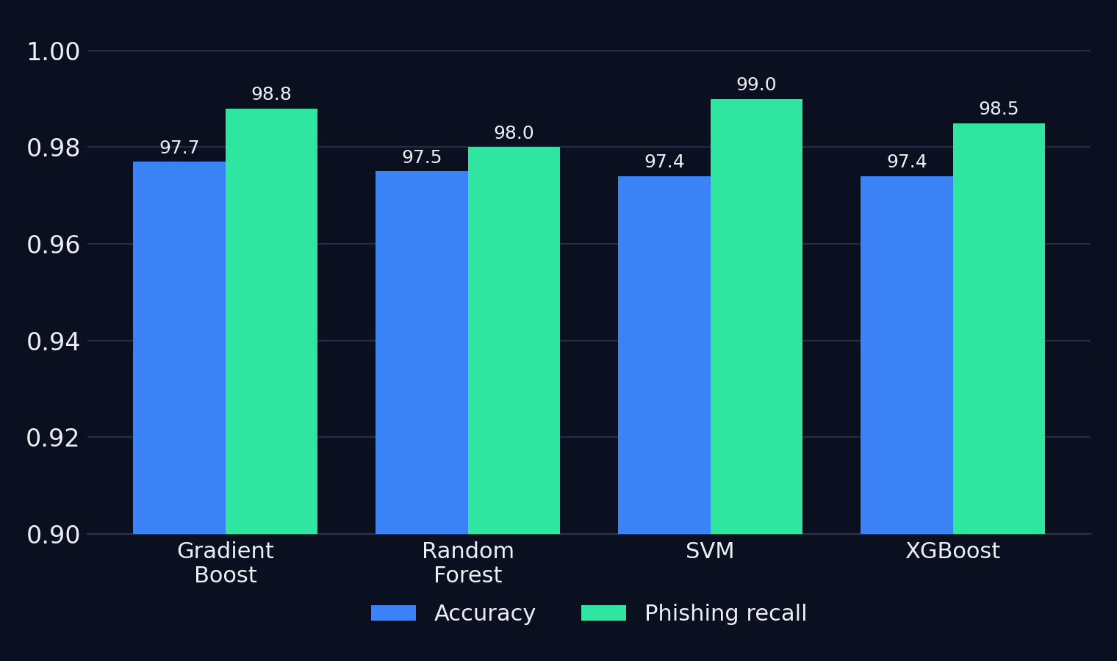
Results — Best Model
• 97.7% accuracy
• 98.8% phishing recall
• 15 of 1,231 phishing missed
• ~40 pts above baseline
Notes:
Results in detail (rubric wants tables/graphs). Left: confusion matrix of the best model (Gradient Boosting) — only 15 phishing sites missed out of 1,231. Middle: accuracy vs phishing recall for the top four. Right: the headline numbers. Stress recall again.

Slide 11
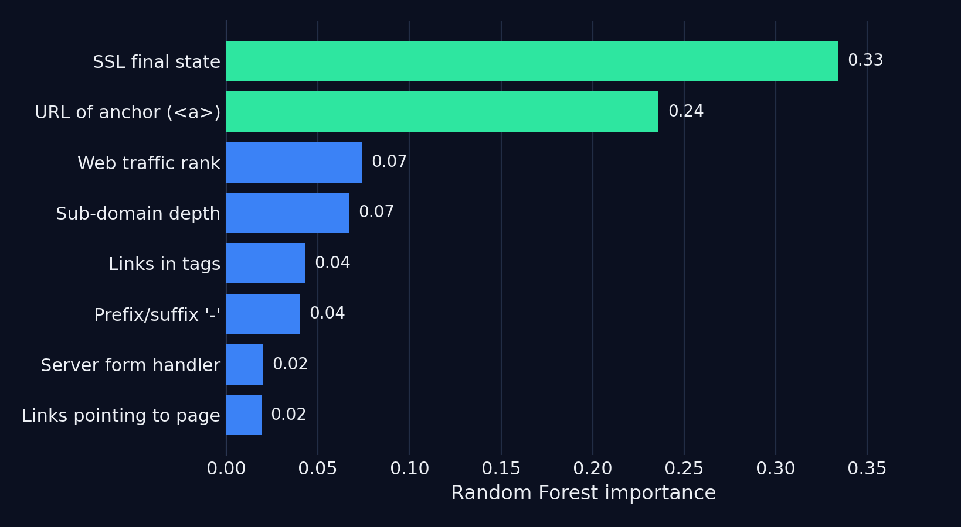
What Drives the Prediction?
• SSL state + anchor links ≈ 57% of importance
• Matches intuition: fake certs, deceptive links
• Interactions add extra signal
Notes:
Real Random Forest importances from our data. SSL final state (0.33) and URL-of-anchor (0.24) together are ~57% of importance — is the certificate legit, and where do the page's links actually point. Matches security intuition. The report also flagged useful interactions (SSL×RightClick, anchor×Iframe).

Slide 12

Live Demo
1. You pick a URL
2. We extract 30 features live (+ Safe Browsing)
3. The models vote: phishing or legitimate
4. We show the verdict and the signals behind it
QR — Firebase link pending
Notes:
DEMO — make it interactive. Put the printed QR on the board, give the class 2-3 links and let THEM guess before we run it. Suggested order (from DEMO.txt): wikipedia.org (legit), Google's Safe-Browsing test page (flagged), then http://192.168.1.1@bit.ly/freegift?login=admin (many URL red flags at once). >>> Send the Firebase URL to embed the real QR. <<<

Slide 13
What Worked & What Didn't
Worked
• Ensembles + SVM all hit ~97–98%
• Feature engineering lifted linear models
• High phishing recall
• Held up across datasets
Didn't help
• PCA — models already fast
• Lasso pruning — no accuracy gain
• Interactions barely moved trees
• Simple rules alone
Notes:
Honest evaluation. Worked: ensembles + SVM, feature engineering for linear models, high recall, reproducibility. Didn't: PCA wasn't needed (models already fast; it hurt interpretability), Lasso pruned features without raising accuracy, interaction features barely helped trees. PCA was an experiment, not a final model.

Slide 14
Obstacles & Lessons
• Feature explosion (495) → used Lasso to prune & stay interpretable
• Big datasets slow to tune → limited dimensions, budgeted compute
• Accuracy isn't enough → focused on recall + confusion matrices
Notes:
Three concrete obstacles + what we learned. 1) Interaction features blew up to 495 → Lasso/regularization to prune and keep it interpretable. 2) Dataset 2 too large for SVM/boosting to fully tune → dimensionality limits / PCA, deliberate compute budget. 3) Realizing accuracy isn't the target → we now evaluate with recall + confusion matrices. Each of us can take one.

Slide 15
Future Work
• Deeper hyperparameter search we had to skip on the big datasets
• More thorough feature-interaction engineering and selection
• Proper cross-dataset training and testing for generalization
• Stack / ensemble our strongest models together
• Add explainability (e.g. SHAP) to see why a site is flagged
• Error analysis on misclassified sites to find weak spots
Notes:
Future work, focused on doing MORE with the data and models given more time: fuller hyperparameter searches we skipped on the large datasets, deeper feature-interaction engineering/selection, proper cross-dataset train/test, stacking our best models, adding SHAP explainability, and error analysis on the misclassified sites to understand where the models break.

Slide 16
Conclusion
• Classic ML detects phishing well — 97.7% accuracy, 98.8% recall
• Ensembles (GB / RF / XGB) and SVM win
• SSL state and link behavior are the biggest tells
• PCA unnecessary; recall matters most
• Beats the majority baseline by ~40 points
Thank you — questions?
Notes:
Wrap up: classic ML solves this well (~97.7% accuracy, ~98.8% phishing recall). Winners: ensembles + SVM. SSL state & link behavior dominate. PCA wasn't needed; recall is the key metric. Thank the class and invite questions — handle them calmly and positively.

