Slide 1
CSSE 220
Inheritance: Abstract Classes
The git projects for today are:
PracticeAbstractClasses
PracticeSolutionAbstractClasses
Notes:
Bring hard copy of ChessPiece, King, Queen, etc.

Slide 2
Recall: Inheritance
Sometimes a new class is a special case of the concept represented by another already existing class
New class can “inherit” from an existing class, and new class can have new/different functionality
  How should this type of [general type] do this behavior?
The new class inherits from the existing one:
  all methods
  all instance fields
Q1

Slide 3
Examples
class SavingsAccount extends BankAccount
  SavingsAccount adds interest earning, keeps other traits
class Employee extends Person
  Employee adds pay information and methods, keeps other traits
class Manager extends Employee
  Manager adds information about employees managed, changes the pay mechanism, keeps other traits
Notes:
- animated bullets

Slide 4
What if we want to use inheritance, but the superclass is so general we don’t want to instantiate it?
Example: Shape superclass with Circle, Rectangle, Triangle subclasses
What would this code mean?
Shape shape = new Shape();
How can we make it impossible to instantiate the superclass, while still getting the code reuse benefits of inheritance?
Notes:
How should this generic “shape” be represented? There’s no reasonable default “shape”.

Slide 5
Solution: Abstract Classes
Hybrid of superclasses and interfaces
  Like regular superclasses:
    Provide shared fields
    Provide implementation of some methods
  Like interfaces
    Just provide signatures and docs of other methods
    Can’t be instantiated
Example:
  public abstract class BankAccount {
  /** documentation here */
  public abstract void deductFees();
  …
  }
Elided methods as before
Notes:
The main reason for using Abstract classes is to force programmers to create subclasses. Declaring certain methods abstract prevents you from coming up with useless default methods that others might inherit by accident.
This also allows code reuse when only a few methods of an interface differ in implementation.
Make the ChessPiece abstract, and pull the items that don’t change into the new abstract class, and leave the other methods abstract (see solution code). Walk students through this refactor for King/Queen, then have them implement the other pieces. Remind them that the Pawn is actually the hardest, and to do that LAST.

Slide 6
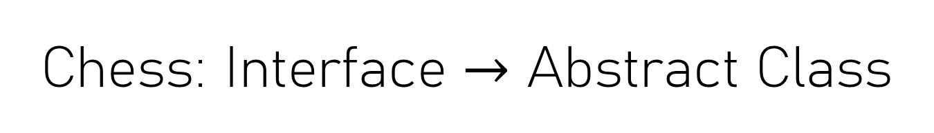
Chess: Interface $→$ Abstract Class
Let’s look at chessPieces/chessSupport
Sketch UML diagram (start with no fields/methods, just classes)
In StandardBoardProvider, uncomment King lines
Look at King and ChessPiece
Why should ChessPiece be an abstract class instead of an interface (or a concrete superclass)?
Notes:
Walk through the Chess example in Inheritance project. Start by showing the King and ChessPiece interface. Implement the queen, and note to the students how we end up copying a lot of code from the King into the Queen, there has to be a better way…
It works well to just make the ChessPiece a class first and put in a System.err.println(“Implement this method!”) then show them if we forget to implement a method (Queen’s checkMove) we see that message at runtime.
At this point, they should see the justification for an abstract class, show that on next slide

Slide 7
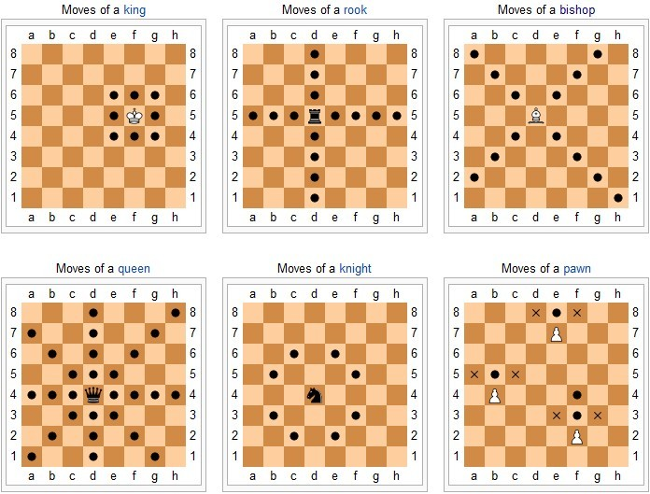
https://en.wikipedia.org/wiki/Chess#Movement
Notes:
Emphasize doing Pawn last it requires several things (hasMoved field) and needs to override the checkAttack method which is not obvious without looking at more code than they usually have to look at for the rest of the classes.
@Override
public boolean checkAttack(int dx, int dy, ChessPiece piece) {
if (this.isWhite() == piece.isWhite()) {
return false;
}
if (!movedCorrectDirection(dy)) {
return false;
}
dx = Math.abs(dx);
dy = Math.abs(dy);
return dx == 1 && dy == 1;
}

Slide 8
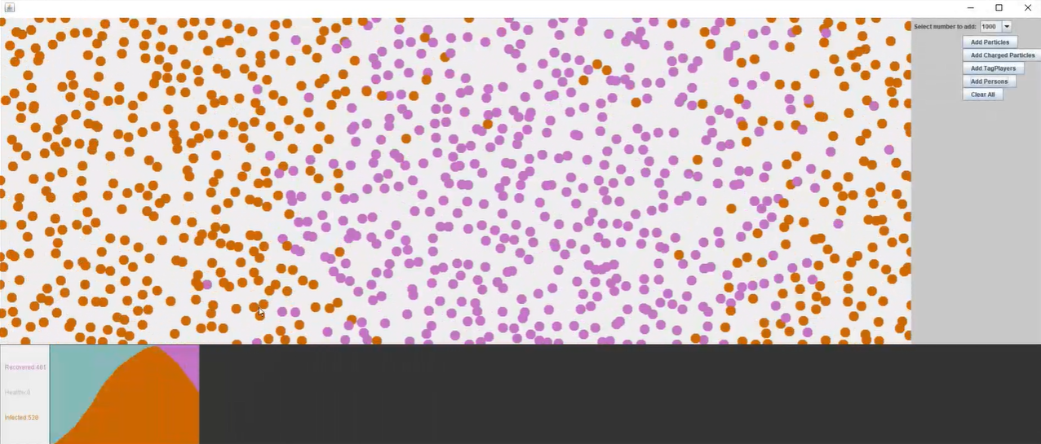
Upcoming Homework
RefactoringInheritance
  Requires you to use inheritance
  Avoid variable shadowing!
  Read instructions carefully
Notes:
Consider showing working version of the solution in the private repo or playing part of the final functionality video:
https://rose-hulman.hosted.panopto.com/Panopto/Pages/Viewer.aspx?id=c6958003-1803-436a-bc65-aba6002fdeb3

Slide 9
Work Time
Chess
Ask instructor/assistants for help!
Q8-Q9

Slide 10
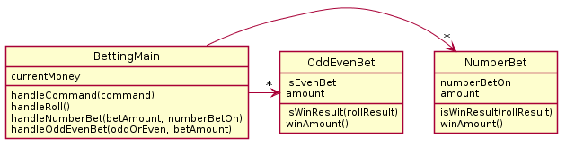
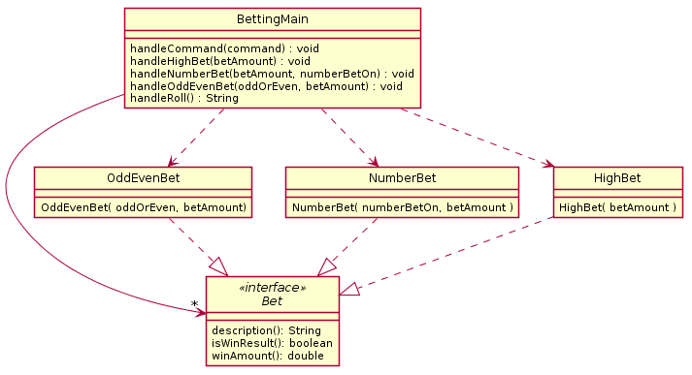
If time allows:
Review of BettingMain Interface

