Slide 1
CSSE 220
Interfaces
The git projects for today are:
PracticeReusableCode
PracticeSolutionReusableCode
Notes:
Bring print-outs of code from InterfacesSolution,
Current schedule:
Tomorrow – reactive GUI programming using interfaces (covered today)
Next week – extend to Inheritance
Two weeks to next test
Questions about current recursion assignment? Due tonight
You can use helper functions if you know how, but not needed for any of the problems

Slide 2
Interfaces – What, When, Why, How?
What:
  Is a Java construct that looks similar to a class, but has keyword interface
  Is used to express operations that multiple classes must have in common
Interfaces are different from classes:
  There No fields
  Operations have method headers but contain no code bodies
When to use:
  When abstracting an idea that has multiple, different implementations
Notes:
Talk about Vehicle interface as concept.
Do simple example now.

Slide 3
Interface Types: Key Idea
Interface types are like a contract
A class can promise to implement an interface
Any client code that uses the interface can automatically use new classes that implement the interface!
Notes:
QUIZ QUESTION 1
When thinking about interfaces, I like to give the example of a car:
I don’t care if it’s a truck, car, van, electric car, etc. When I get in a new car (or rental car, or friend’s car, etc.) … I know that the car will have the same “interface” for me to interact with. I’ll always have a brake and accelerator, a steering wheel, etc. I don’t need to know how the car works or how it’s different from another car, I just need to know how to use the interface.

Slide 4
Notation: In Code
public interface InterfaceName {
/**
* regular javadocs
*/
void methodName(int x, int y);
/**
* regular javadocs here
*/
int doSomething(Graphics2D g);
}
Automatically public, so we don’t specify it, but it is legal to specify public
No method body, just a semi-colon
public class SomeClass implements InterfaceName {
…
}
SomeClass promises to implement all the methods declared in the InterfaceName interface
Notes:
callouts animated
201710: have them study and do the numberSequence example. They don’t need to write all 3, just enough to get the feel for it.
Old:
Ask students to use this information to create a Function interface in the textCalculator project that fixes the errors in the code.
Once they’ve done that, they should implement the add and multiply classes that implement the Function interface.

Slide 5
Notation: In Code – Example 1
public interface Drivable {
void turn(double dir);
void accelerate(double force);
} // this describes the 'what it does'
public class Car implements Drivable {
@Override
public void turn(double direction) {
... // this captures the 'how it does it'
}
@Override
public void accelerate(double force) {
... // this captures the 'how it does it'
}
} // 'what' and 'how' are called separation of concerns
Notes:
callouts animated
201710: have them study and do the numberSequence example. They don’t need to write all 3, just enough to get the feel for it.
Old:
Ask students to use this information to create a Function interface in the textCalculator project that fixes the errors in the code.
Once they’ve done that, they should implement the add and multiply classes that implement the Function interface.

Slide 6
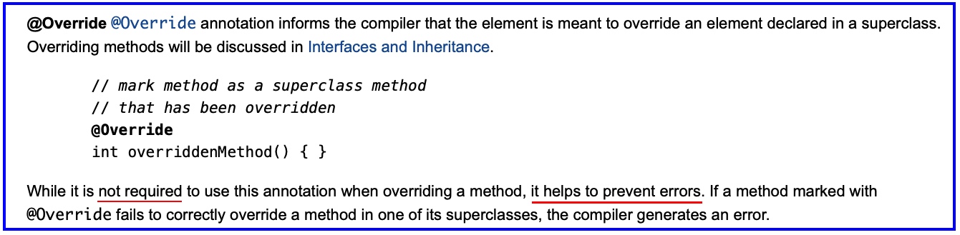
Notation: @Override Annotation
// The Java Tutorials on Annotations <-- Click here to learn more
public class Car implements Drivable {
@Override
public void turn(double direction) {
... // this captures the 'how it does it'
}
@Override
public void accelerate(double force) {
... // this captures the 'how it does it'
}
}
Notes:
callouts animated
201710: have them study and do the numberSequence example. They don’t need to write all 3, just enough to get the feel for it.
Old:
Ask students to use this information to create a Function interface in the textCalculator project that fixes the errors in the code.
Once they’ve done that, they should implement the add and multiply classes that implement the Function interface.

Slide 7
Notation: In Code – Example 2
public interface Drivable {
void turn(double dir);
void accelerate(double force);
} // this describes the 'what it does'
public class Truck implements Drivable {
@Override
public void turn(double direction) {
...
}
@Override
public void accelerate(double force) {
...
}
}
Notes:
callouts animated
201710: have them study and do the numberSequence example. They don’t need to write all 3, just enough to get the feel for it.
Old:
Ask students to use this information to create a Function interface in the textCalculator project that fixes the errors in the code.
Once they’ve done that, they should implement the add and multiply classes that implement the Function interface.

Slide 8
Notation: In Code – Example 3
public interface Drivable {
void turn(double dir);
void accelerate(double force);
} // this describes the 'what it does'
public class Hovercraft implements Drivable {
@Override
public void turn(double direction) {
...
}
@Override
public void accelerate(double force) {
...
}
}
Notes:
callouts animated
201710: have them study and do the numberSequence example. They don’t need to write all 3, just enough to get the feel for it.
Old:
Ask students to use this information to create a Function interface in the textCalculator project that fixes the errors in the code.
Once they’ve done that, they should implement the add and multiply classes that implement the Function interface.

Slide 9
Why?
Interfaces help to reduce coupling by having a client program coupled to the interface, not directly to a specific implementation
Similarity among classes that implement the interface is Java compiler enforced
Q1

Slide 10
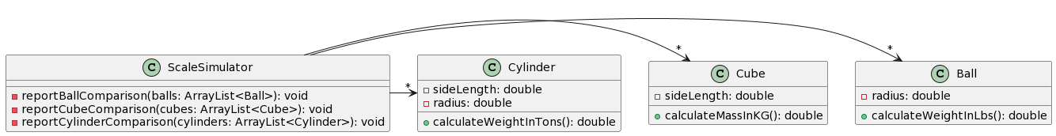
Open simpleExample
UML of current code
  Three classes with different weight measurements
Notes:
Imagine three different people developed these three classes. We have a scale simulator where we write code to compare/weigh things.
What if we wanted to compare all of them at the same time?

Slide 11
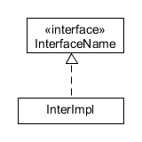
Notation: In UML
Closed triangle with a dashed line in UML is an “is-a” relationship
Read this as:
  InterImpl is-an InterfaceName
PlantUML Code:
Class ..|> Interface
Q3
Notes:
Might be good to draw the Pet, Cat, Dog UML diagram here.

Slide 12
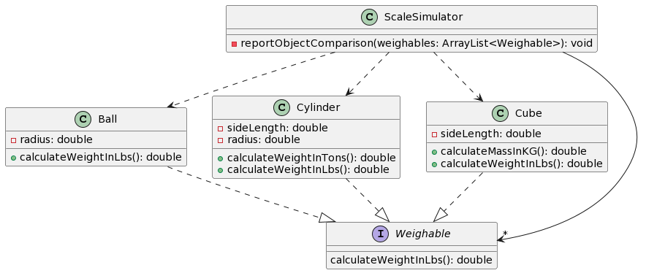
Code Refactoring
#1 Add and implement the interface
#2 Refactor Ball/Cube/Cylinder
#3 Refactor methods in ScaleSimulator
Before refactoring:
After refactoring:
Before refactoring:
After refactoring:
3
2
PlantUML:
Ball ..|> Weighable
Cube ..|> Weighable
Cylinder ..|> Weighable
1
Notes:
From the Interface Eclipse project, simpleExample package

Slide 13
Interface Types can replace class types
If Dog & Cat implement the Pet interface:
  Use the Interface in a Variable Declaration:
    Pet d = new Dog();
    Pet c = new Cat();
2 types are involved in these declarations:
Instantiation type is Dog or Cat
Declared type is Pet

Slide 14
Interface Types can replace class types
If Dog & Cat implement the Pet interface:
  Variable Declaration:
    Pet d = new Dog();
    Pet c = new Cat();
  Use the Interface as a Parameter's Type:
    public static void feedPet(Pet p) {…}
    Can call feedPet with any object of type Pet:
    { // client code calls feedPet with a Dog object and a Cat object
    Pet d1 = new Dog();
    feedPet(d1);
    feedPet(c); // 'c' declared in #1 (above)
    // ... More client code
    }

Slide 15
Interface Types can replace class types
If Dog & Cat implement the Pet interface:
  Variable Declaration:
    Pet d = new Dog();
    Pet c = new Cat();
  Parameters:
    public static void feedPet(Pet p) {…}
    Can call feedPet with any object of type Pet
  Declare fields in a class as type Pet:
    private Pet p1;

Slide 16
Interface Types can replace class types
If Dog & Cat implement the Pet interface:
  Variable Declaration:
    Pet d = new Dog();
    Pet c = new Cat();
  Parameters:
    public static void feedPet(Pet p) {…}
    Can call feedPet with any object of type Pet
  Declare fields in a class as type Pet:
    private Pet p1;
  Use Interfaces as Generic Type Parameters:
    ArrayList<Pet> pets = new ArrayList<Pet>();
    { // client code
    Pet myDoggy = new Dog();
    Pet myKitty = new Cat();
    pets.add(myDoggy);
    pets.add(myKitty);
    // ArrayList pets contains dog and cat object references
    }

Slide 17
Check your understanding…
public interface Pet{
private String name;
public Pet(String name){
this.name = name;
}
public void eatFood(){
System.out.println(this.name + " purrrs");
} //eatFood
}
Is this a valid interface?
Why or why not?
List all the reasons it is not valid

Slide 18
Valid interface
public interface Pet{
public void eatFood();
}
What happened to:
The fieldname?
The operation bodies?
The constructor?
Notes:
Name is an implementation detail.
It was needed to construct the Pet, not to use it.
Interfaces only describe how things are used, not how they are created.
Implementations, that is: classes that implement interfaces, describe how they are created.

Slide 19
A valid Class implementing Pet
public class Cat implements Pet {
private String name;
public Cat(String name){
this.name = name;
}
@Override
public void eatFood(){
System.out.println(this.name + " purrrs");
} //eatFood
// Java @ symbol introduces a Java Annotation

Slide 20
Why is this OK?
Pet p = new Dog();
p.eatFood(); // calls Dog’s eatFood method
p = new Cat();
p.eatFood(); // calls Cat’s eatFood method
Cat c1 = new Pet(); // Not OK
Why? Pet is parent type, Cat and Dog are child types
An object instance of a child type may be stored into a variable declared from a parent type, but not the other way around.
  A Dog is a Pet, and a Cat is a Pet,
  but a Pet is not required to be a Dog or a Cat.
  And how could you construct a Pet?
Q2
Notes:
Draw box-and-pointer diagram

Slide 21
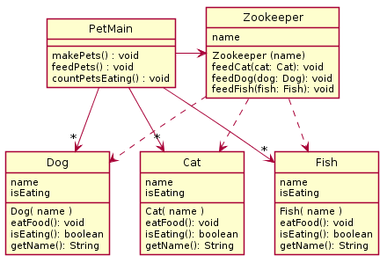
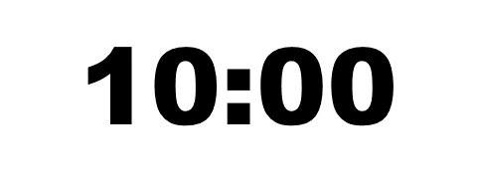
Zookeeper Problem: In the following scenario we have a Pet Zoo, with a Zookeeper who is in charge of feeding different types of animals. When the simulator runs, various pets are made and fed. Also, there is a way to count the number of pets that are eating. The animals include cats, dogs, and fish. All the animals have names, and can be told to eat food, as well as report that they are eating (once fed they always report eating). Show how an improved approach using interfaces can remove code duplication from the following design.
Try to make your own
improved design using a Java interface
Notes:
Leading questions to help:
What do they all have in common? So what goes in interface?
What can we do instead of the three feed methods?

Slide 22
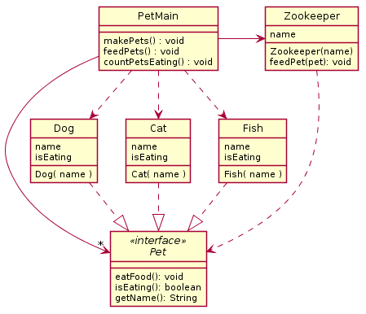
Pet Example
1 of List<Pet> in PetMain
Notes:
Now that we have developed an interface, let’s implement the changes in code.

Slide 23
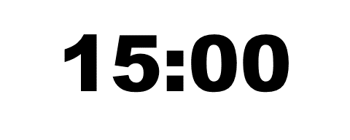
UML Solution… now code it!
3
2
Method makePets()
still must directly call
constructor for Dog,
Cat, and Fish
That’s why we have
the 3 dependency arrows
Method feedPet()
calls eatFood() from Pet
That’s why we have
this dependency arrow
1
#1 Add and implement the interface
1 of List<Pet> in PetMain
#2 Refactor Zookeeper to match UML
#3 Refactor PetMain to make a single List
Notes:
Now that we have developed an interface, let’s implement the changes in code.

Slide 24
How does all this help reuse?
Can pass an object instance of a class where an interface type is expected
  But only if the class implements the interface
We can use a new Pet object instance without changing the client method that uses the Pet instance. (When adding a Zebra class to PetMain, Zookeeper does not have to change!)
In a client program, use interface types for field, method parameter, and return types whenever possible. E.g., Pet instead of Dog, and List for ArrayList.
  List<Pet> pets = new ArrayList<Pet>();
Next week: because of interfaces, we can add classes that listen for Button presses and mouse clicks, without changing the Button or window.
Notes:
[Skipped downcasting from interface types to class types. Better to make interface type general enough. We’ll cover downcasts with inheritance.]

