Slide 1
CSSE 220
Inheritance
The git projects for today are:
PracticeReusableCode
PracticeSolutionReusableCode
Notes:
Bring hard copy of CheckingAccount. Start this not too long after the start of the 2nd hour.

Slide 2
Inheritance
Sometimes a new class is a special case of the concept represented by another already existing class
New class can “inherit” from an existing class, and new class can have new/different functionality
  How should this type of [general type] do this behavior?
The new class inherits from the existing one:
  all methods
  all instance fields
Q1

Slide 3
Examples
class SavingsAccount extends BankAccount
  SavingsAccount adds interest earning, keeps other traits
class Employee extends Person
  Employee adds pay information and methods, keeps other traits
class Manager extends Employee
  Manager adds information about employees managed, changes the pay mechanism, keeps other traits
Notes:
- animated bullets

Slide 4
Notation and Terminology
class SavingsAccount extends BankAccount {
// fields
// methods
}
Say “SavingsAccount is a BankAccount”
Superclass: BankAccount
Subclass: SavingsAccount
Notes:
Draw a Venn diagram here showing the set of all SavingsAccounts is a subset of the set of all BankAccounts. Subclass is like subset.
(Also inheritance flows down, so subclasses are below superclasses.)

Slide 5
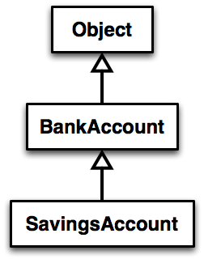
Inheritance in UML
Class Object is the “superest” class in Java
Solid line shows inheritance
Still means “is a”
Q2
Notes:
[Show code example here, just looking at code for BankAccount and SavingsAccount (not writing it live)]

Slide 6
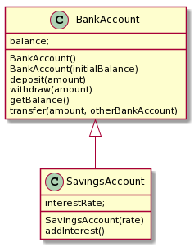
Look at Code
BankAccount (Superclass)
SavingsAccount (Subclass)
Plantuml source
  SavingsAccount -up-|> BankAccount
Notes:
Add a main method:
public static void main(String[] args) {
SavingsAccount sa = new SavingsAccount(5);
sa.deposit(100);
System.out.println(sa.getBalance() );
sa.addInterest();
System.out.println(sa.getBalance() );
}
Ask students, “How does sa know its starting balance?”
@startuml
skinparam style strictuml
class BankAccount {
balance;
BankAccount()
BankAccount(initialBalance)
deposit(amount)
withdraw(amount)
getBalance()
transfer(amount, otherBankAccount)
}
class SavingsAccount {
interestRate;
SavingsAccount(rate)
addInterest()
}
SavingsAccount -up-|> BankAccount
@enduml

Slide 7
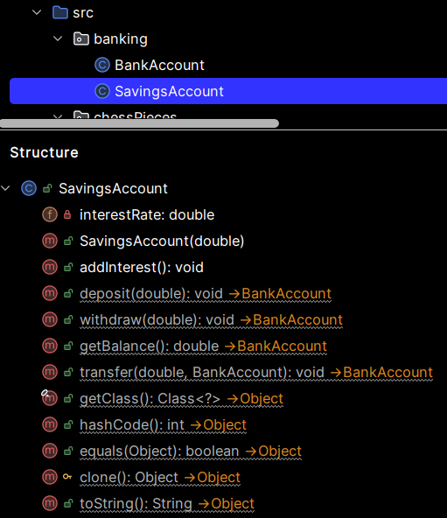
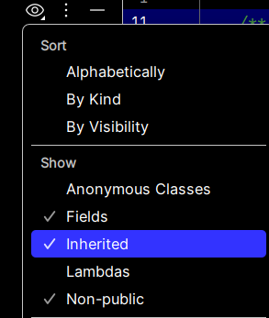
Structure
View in IntelliJ
Can optionally show
inherited fields/methods:
Notes:
Add a main method:
public static void main(String[] args) {
SavingsAccount sa = new SavingsAccount(5);
sa.deposit(100);
System.out.println(sa.getBalance() );
sa.addInterest();
System.out.println(sa.getBalance() );
}
Ask students, “How does sa know its starting balance?”

Slide 8
Interfaces vs. Inheritance
class ClickHandler implements MouseListener
  ClickHandler promises to implement all the methods of MouseListener
class CheckingAccount extends BankAccount
  CheckingAccount inherits (or overrides) all the methods of BankAccount
For client code reuse
i.e., what it does reuse
For implementation code reuse
i.e., how it does it code reuse
Notes:
We will implement CheckingAccount in a little while.

Slide 9
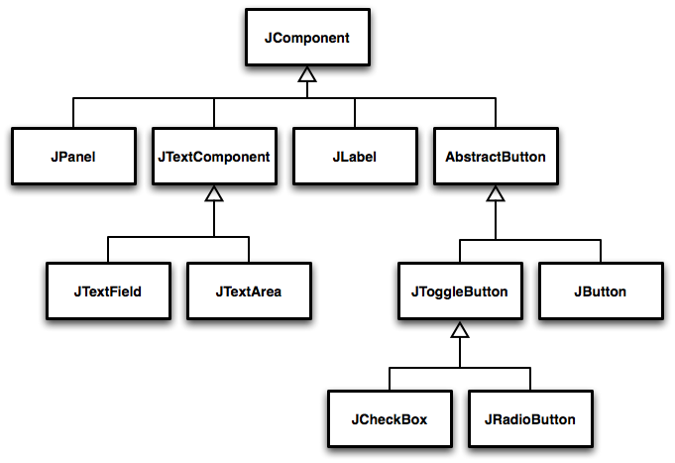
Inheritance Run Amok?
Notes:
Advanced code sometimes has deep inheritance hierarchies
Trace through a few paths asking students what might be inherited and what might be added at each level (See Figure 1 - 3, pages 422 - 3)
Every JComponent has a width and a height, so the JComponent class has a getWidth() and a getHeight() method.
Every JButton can have text or an icon on it, so the AbstractButton class has a setText() and a setIcon() method.

Slide 10
For methods, subclasses can:
Inherit methods unchanged
Override methods
  Declare a new method with same signature to use instead of superclass method
  i.e., change how it works
Add entirely new methods not in superclass
  i.e., add new what it does & how it does it
Q3

Slide 11
For fields, subclasses:
ALWAYS inherit all fields unchanged
  But cannot access superclass private fields
  Can access directly fields at access levels:
    public
    protected
    package
The subclass can add entirely new fields not in superclass
DANGER! Don’t use the same field name as a superclass field!
Q4
Notes:
Start to implement CheckingAccount, just create class, but do not add methods yet.
Draw UML diagram with details (See Figure on page 443) on board first [keep this, you’ll need it later]
Use no-arg constructor initially. We’ll add the argument later.

Slide 12
How Subclass calls Superclass Methods
Calling a superclass method from the subclass:
  super.methodName(args);
Calling superclass constructor:
  super(args);
Must appear as the first line of the subclass constructor
Q5
Notes:
Discuss super method calls.
Add CheckingAccount(double) constructor

Slide 13
Let’s Code CheckingAccount
A special type of BankAccount
Has 3 free transactions each month
Transactions that are counted:
  Withdraw
  Deposit
Every additional transaction (beyond) costs $1.50
  4 cost $1.50
  5 cost $3.00
At end of each month fees are deducted (all together)
  Transaction count is reset at this time
  Add new public method to CheckingAccount called deductFees()
Notes:
Override:
deposit( amount )
withdraw( amount )
deductFees()

Slide 14
Design then Implement
plantuml
Notes:
@startuml
skinparam style strictuml
class BankAccount {
balance
BankAccount()
BankAccount(initialBalance)
deposit(amount)
withdraw(amount)
getBalance()
transfer(amount, otherBankAccount)
}
class SavingsAccount {
interestRate
SavingsAccount(rate)
addInterest()
}
class CheckingAccount {
FREE_TRANSACTIONS
TRANSACTION_FEE
transactionCount
CheckingAccount(initialBalance)
deposit(amount)
withdraw(amount)
deductFees()
}
SavingsAccount -up-|> BankAccount
CheckingAccount -up-|> BankAccount
@enduml

Slide 15
Polymorphism and Subclasses
subclass instance is a superclass instance
  Polymorphism still works!
  BankAccount ba = new CheckingAccount();
  ba.deposit(100.0);
  BankAccount is declared type
  CheckingAccount is instantiated type
  The code above compiles and runs because
  CheckingAccount isA BankAccount
Q6
Notes:
Draw B&P diagrams. Show calls.
Why not? Because BankAccount doesn’t have an deductFees() method!

Slide 16
Polymorphism and Subclasses
This code (below) does not work
  CheckingAccount ca = new BankAccount();
  ca.deductFees();
  CheckingAccount is the declared type
  BankAccount is the instantiated type
  It doesn't compile because
  BackAccount is-not-a CheckingAccount
Q6
Notes:
Draw B&P diagrams. Show calls.
Why not? Because BankAccount doesn’t have an deductFees() method!

Slide 17
Another Example
Can use BankAccount's transfer method to transfer between different accounts:
  {
  SavingsAccount sa = …;
  CheckingAccount ca = …;
  sa.transfer(100, ca); //
  }
  public void transfer(double amount, BankAccount o){
  this.withdraw(amount);
  o.deposit(amount);
  }
Notes:
Suggest drawing B&P diagram and trace calls as practice for the exam.

Slide 18
Access Modifiers
  public any code can see it
  protected package and subclasses can see it
  default anything in the package can see it
  private only the class itself can see it
Notes:
  default (i.e., modifier missing) — only code
  in the same package can access it
    good choice for classes
  Protected — like default, but
  subclasses also have access
    sometimes useful for helper methods
Bad for fields!
Q7

