Slide 1
Python
3.x

Slide 2
Introduction
Python is a general-purpose interpreted, interactive, object-oriented and high-level programming language. Python was created by Guido van Rossum in the late eighties

Slide 3
Introduction
Python is Interpreted: no need to compile your program before executing it. This is similar to PERL and PHP.
Python is Object-Oriented: Python supports Object-Oriented style or technique of programming that encapsulates code within objects.
Python is Beginner's Language: Python is a great language for the beginner programmers and supports the development of a wide range of applications from simple text processing to WWW browsers to games.

Slide 4
FirstScript.py
print "Hello, Python!";

Slide 5
Identifiers
Identifier is a name used to identify a variable, function, class, module or other object. An identifier starts with a letter A to Z or a to z or an underscore (_) followed by zero or more letters, underscores and digits (0 to 9).
punctuation characters such as @, $ and % are not allowed. Python is case sensitive.

Slide 6
Conventions
Class names start with an uppercase letter and all other identifiers with a lowercase letter.
Starting an identifier with a single leading underscore indicates by convention that the identifier is meant to be private.
Starting an identifier with two leading underscores indicates a strongly private identifier.
If the identifier also ends with two trailing underscores, the identifier is a language-defined special name.

Slide 7
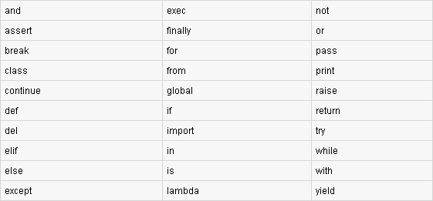
Reserved words

Slide 8
Variables & Data Types
Variables are reserved memory locations to store values.
Python has five standard data types:
Numbers
String
List
Tuple
Dictionary

Slide 9
Numbers
Python supports four different numerical types:
int (signed integers)
long (long integers [can also be represented in octal and hexadecimal])
float (floating point real values)
complex (complex numbers)

Slide 10
Strings
str = 'Hello World!'
print str # Prints complete string
print str[0] # Prints first character of the string
print str[2:5] # Prints characters starting from 3rd to 5th
print str[2:] # Prints string starting from 3rd character
print str * 2 # Prints string two times
print str + "TEST" # Prints concatenated string

Slide 11
Lists
A list contains items separated by commas and enclosed within square brackets ([]). lists are similar to arrays .
Items in a list can be of different data type.
list = [ 'abcd', 786 , 2.23, 'john', 70.2 ]
print list[2:]

Slide 12
Tuples
tuple consists of a number of values separated by commas ,enclosed within parentheses.
Tuples can be thought of as read-only lists .
tuple = ( 'abcd', 786 , 2.23, 'john', 70.2 )
print tinytuple * 2

Slide 13
Dictionary
Consist of key-value pairs
dict = {}
dict['one'] = "This is one"
dict[2] = "This is two"
Dict2={'name': 'john','code':6734, 'dept': 'sales'}
print(dict.keys())
print(dict.values())

Slide 14
Operators
Arithmetic,relational,logical,bitwise
a&b = 0000 1100
a|b = 0011 1101
a^b = 0011 0001
~a = 1100 0011
<<
>>

Slide 15
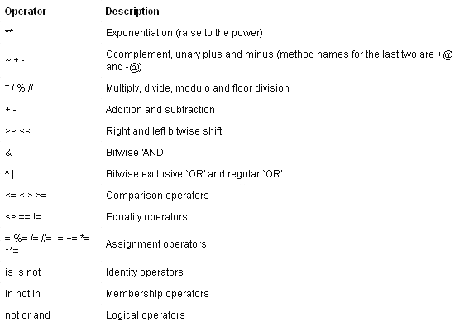

Slide 16
Control Structures(if , else , elif)
var1 = 100
if var1:
  print "1 - Got a true expression value" ;
  else:
  print "1 - Got a false expression value"

Slide 17
LOOPS
For
While
nested

Slide 18
FOR LOOP
for letter in 'Python':
print('Current Letter :', letter);
fruits = ['banana', 'apple', 'mango']
for fruit in fruits:
print('Current fruit :', fruit)

Slide 19
FOR LOOP
fruits = ['banana', 'apple', 'mango']
for index in range(len(fruits)):
print ('Current fruit :', fruits[index])

Slide 20
WHILE LOOP
count = 0
while (count < 9):
  print ('The count is:', count);
  count = count + 1 ;

Slide 21
Else with LOOPS
Python supports to have an else statement associated with a loop statement.
If the else statement is used with a for loop, the else statement is executed when the loop has exhausted iterating the list.
If the else statement is used with a while loop, the else statement is executed when the condition becomes false.

Slide 22
Functions
A block of organized, reusable code that is used to perform a single, related action.
P rovide better modularity for application and code reusability.
Function blocks begin with the keyword def followed by the function name and parentheses ( ( ) ).

Slide 23
Functions
Any input parameters or arguments should be placed within these parentheses.
The first statement of a function can be an optional statement - docstring.
The code block within every function starts with a colon (:) and is indented.
The statement return [expression] exits a function, optionally passing back an expression to the caller.

Slide 24
Functions
def printIt( str ):
"This prints a passed string into this function" printIt(str)
return
All parameters (arguments) in the Python language are passed by reference.

Slide 25
Pass By Reference

Slide 26
OOP CONCEPTS
Real World Programming

Slide 27
Object Oriented Programming
Class
Object , Instance
Class variable
Instance variable
Method

Slide 28
OOP Concepts
Encapsulation
Inheritence
Polymorphism

Slide 29
Class
class Employee:
‘Optional Docstring'
count = 0
def __init__(self, name, dept):
self.name = name
self.dept = dept
Employee.empCount += 1

Slide 30
class
def displayCount():
print("Total%d" %Employee.count)
def displayEmployee(self):
print "Name :%s,Dept:%s “%(self.name, self.dept)

Slide 31
Instances and id()
emp1 = Employee(“John”, “Accounts”)
emp2 = Employee("Smith", “Admin”)
emp1.displayEmployee()
emp2.displayEmployee()
print(id(emp1))
print(id(emp2))

Slide 32
Instances
hasattr(emp1, ‘dept')
getattr(emp1, ‘dept')
setattr(emp1, ‘dept', ‘sales’)
delattr(emp1, ‘dept')

Slide 33
Built In class attributes
print (Employee.__doc__)
print (Employee.__name__ )
print(Employee.__module__)
print(Employee.__bases__)
print (Employee.__dict__)

Slide 34
Destructors and Garbage Collection
__del__(self)
Destructor is called for an object when it is collected as garbage by Python.
Here file handlers , database connections related to the object can be closed.
Instance is eligible for GC when there is no variable referring to its location.

Slide 35
Data Hiding
class JustCounter:
__secretCount = 0
def count(self):
self.__secretCount += 1
print self.__secretCount

Slide 36
Data Hiding
counter = JustCounter()
counter.count()
counter.count()
print counter.__secretCount
print counter._JustCounter__secretCount
Singleton Class

Slide 37
Inheritence
One class can inherit properties from one or more other class.
Reusability of attributes.

Slide 38
Inheritence
class Animal
noOfLimbs=4
def __init__(self):
pass
def eat(self):
print(“Animal might eat anything”)
def speak(self):
print(“Diff animals make diff sounds”)

Slide 39
Inheritence
class Cat(Animal)
class Monkey(Animal)
class Lion(Animal)
class Snake(Animal)
Accounts –SavingsAccount, SalaryAccount
Automobile-TwoWheeler,FourWheeler,HLmv

Slide 40
Method Overriding & super()
Diamond Problem.
Resoving diamond problem using super().

Slide 41
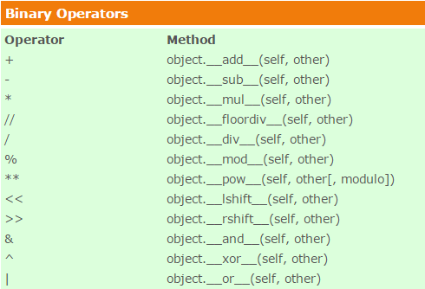
Magic Methods…

Slide 42
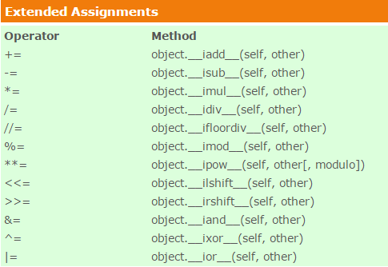
Magic Methods…

Slide 43
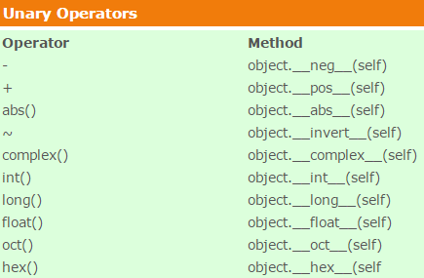
Magic Methods…

Slide 44
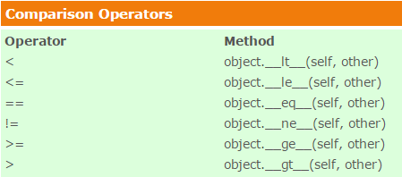
Magic Methods…

Slide 45
Iterators , Generators ,Decorators

Slide 46
Iterators
Any class which defines both following methods is called an Iterator class.
__iter__()
__next__()

Slide 47
Generators
Generators simplifies creation of iterators. A generator is a function that produces a sequence of results instead of a single value.
Generators make use of yield method.

Slide 48
Decorators
feature that lets you modify the language itself. A decorator is basically a wrap function. It takes a function as an argument and returns a replacement function.

Slide 49
Decorators
def addOne(f):
def inner():
return f() +1
return inner
@ addOne
def foo():
return 5

Slide 50
Deep and Shallow copy
import copy
a = Emp()
a1 = copy.copy(A)
A2= copy.deepcopy(A1)
Print (id(A) , id(a1) , id(a2))
__copy__ , __deepcopy__

Slide 51
Dynamic class or Metaclass
Foo = type('Foo', (), {‘attrib': ‘value’})
Or
Class Foo:
pass

Slide 52
File handling
Fh =open(filename ,mode,buffer)

Slide 53
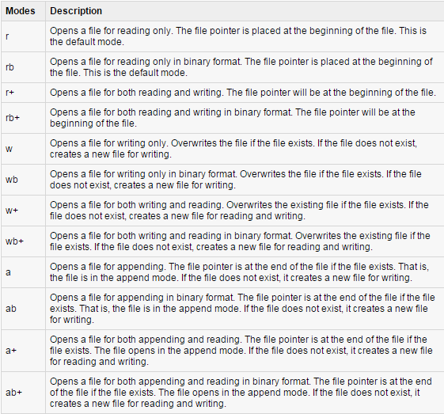
File handling

Slide 54
File Writing
fo = open("foo.txt", "wb")
fo.write( “This text will be written.\to the file\n");
fo.close()

Slide 55
File Reading(read , readline)
fo = open("foo.txt", "r+")
str = fo.read(10);
print "Read String is : ", str
fo.close()

Slide 56
File
position = fo.tell();
print "Current file position : ", position
position = fo.seek(0, 0); str = fo.read(10);

Slide 57
Exception Handling
Event that disrupts the normal flow of the program's instructions.

Slide 58
Exception Handling
try:
...........
except ExceptionI:
If there is ExceptionI, then execute this block.
except ExceptionII: If there is ExceptionII, then execute this block
else: If there is no exception execute this

Slide 59
Exception block for multiple exceptions
Try:
..
..
except(Exception1,Exceptn2,...ExceptionN):

Slide 60
Try finally
When using finally , exception clause should not be written, nor the else clause.
Try:
..
..
Finally:
..

Slide 61
User Defined Exceptions and raising exceptions
Raise Exception ,args

Slide 62
Modules
Sys, os, socket, copy,
Custom

Slide 63
OS
import os
Executing a command os.system()
Get the users environment os.environ()
Returns the current working directory. os.getcwd()
Return the real group id of the current process. os.getgid()

Slide 64
OS
Return the current process’s user id. os.getuid()
Returns the real process ID of the current process. os.getpid()
Set the current numeric umask and return the previous umask. os.umask(mask)
Return information identifying the current operating system. os.uname()

Slide 65
OS
Change the root directory of the current process to path. os.chroot(path)
Return a list of the entries in the directory given by path. os.listdir(path)
Create a directory named path with numeric mode mode. os.mkdir(path)
Recursive directory creation function. os.makedirs(path)

Slide 66
OS
Remove (delete) the file path. os.remove(path)
Remove directories recursively. os.removedirs(path)
Rename the file or directory src to dst. os.rename(src, dst)
Remove (delete) the directory path. os.rmdir(path)

Slide 67
OS
os.path.basename(path)
Os.path.abspath(relpath)
Os.path.isdir(path)
Os.path.split(path)
Os.path.exists(path)

Slide 68
sys
sys.version
sys.version_info
Sys.argv #list of command line args
sys.stdin, sys.stdout, sys.stderr
Sys.stdout.write ,sys.stdin.readline
Sys.platform
fh = open("test.txt","w") ; sys.stdout = fh print("This line goes to test.txt")

Slide 69
MySQLdb install on linux
$ gunzip MySQL-python-1.2.2.tar.gz
$ tar -xvf MySQL-python-1.2.2.tar
$ cd MySQL-python-1.2.2
$ python setup.py build
$ python setup.py install

