Slide 1
Lambda functions
g = lambda x: x**2
Print(g(2))
f = lambda x: x**2 + 2*x – 5
filter(lambda x: x % 3 == 0, [1, 2, 3, 4, 5, 6, 7])
def mw(n): return lambda x: x *n
double = mw(2)
Triple =mw(3)
Double(4)

Slide 2
Lambda functions
foo = [2, 18, 9, 22, 17, 24, 8, 12, 27]
print map(lambda x: x * 2 + 10, foo)

Slide 3
List Comprehensions
S = [x**2 for x in range(10)] V = [2**i for i in range(13)] M = [x for x in S if x % 2 == 0] print S; print V; print M

Slide 4
Regular expression Patterns
Match(),search(),findall(), raw string
Match.start()
Match.end()
^
$
.
[…]
[^…]
Re*
Re+
Re?

Slide 5
Regular expression Patterns
Re{n}
Re{n,m}
A|b
\d,\D
\s,\S
\w,\W

Slide 6
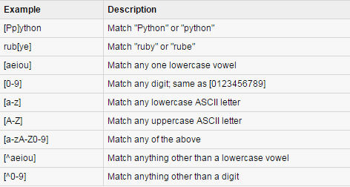
Regular expression Patterns

Slide 7
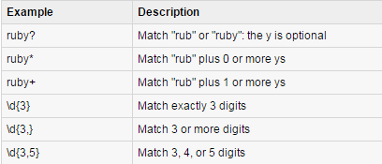
Regular expression Patterns

Slide 8
Socket module
Socket(family,type,protocol)
Family can be AF_INET, or AF_INET6 for IPv4 , IPv6
Type can be SOCK_STREAM for TCP sockets and SOCK_DGRAM for UDP sockets

Slide 9
Threading Module

Slide 10
Synchronising Threads
# Get lock to synchronize threads threadLock.acquire() print_time(self.name, self.counter, 3) # Free lock to release next thread threadLock.release()

