Slide 1
Project Visualizations

Slide 4
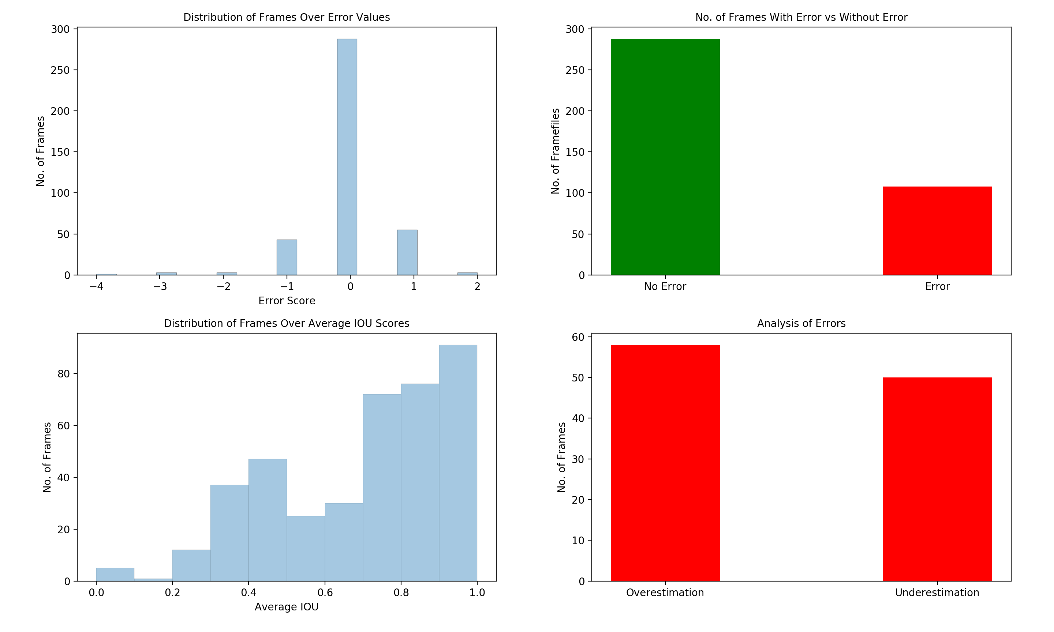

Slide 5
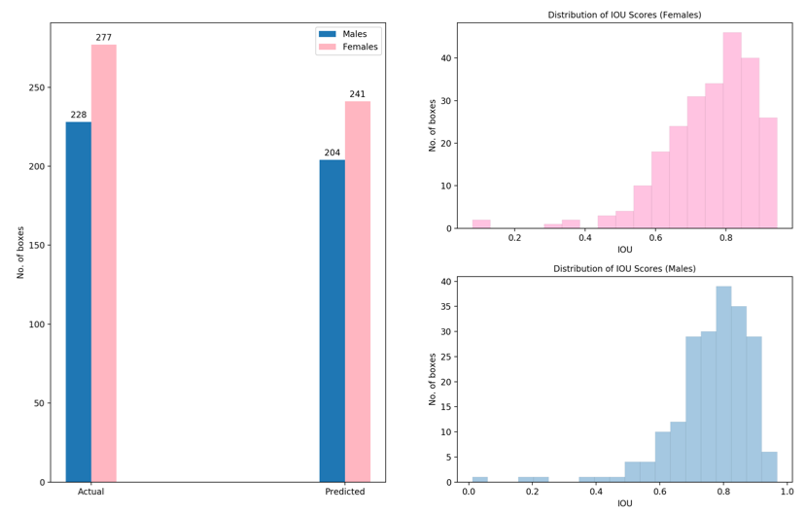
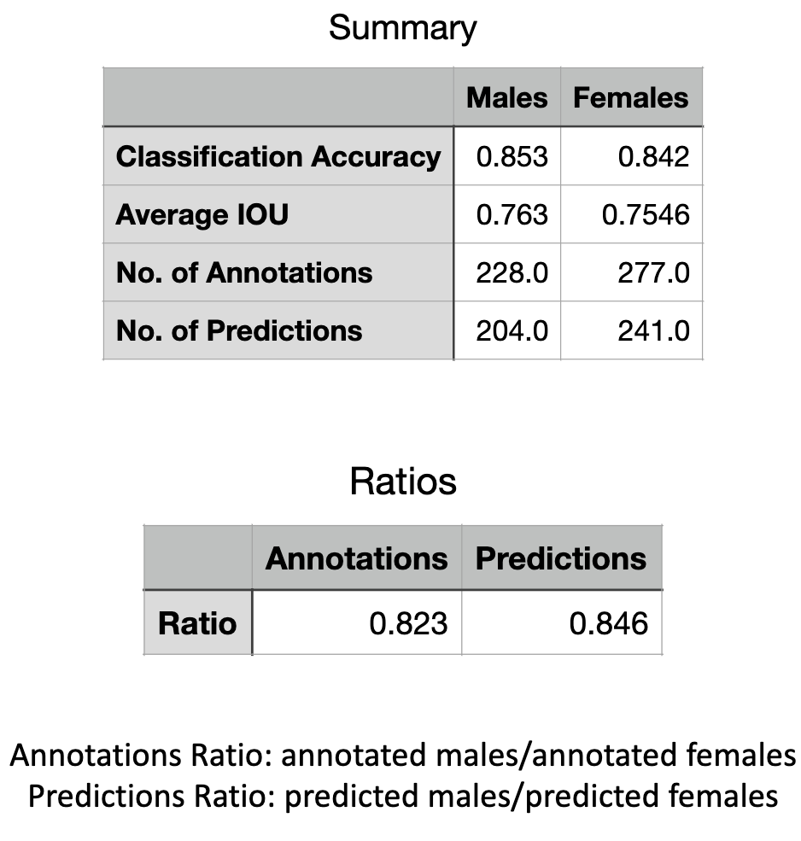

Slide 6
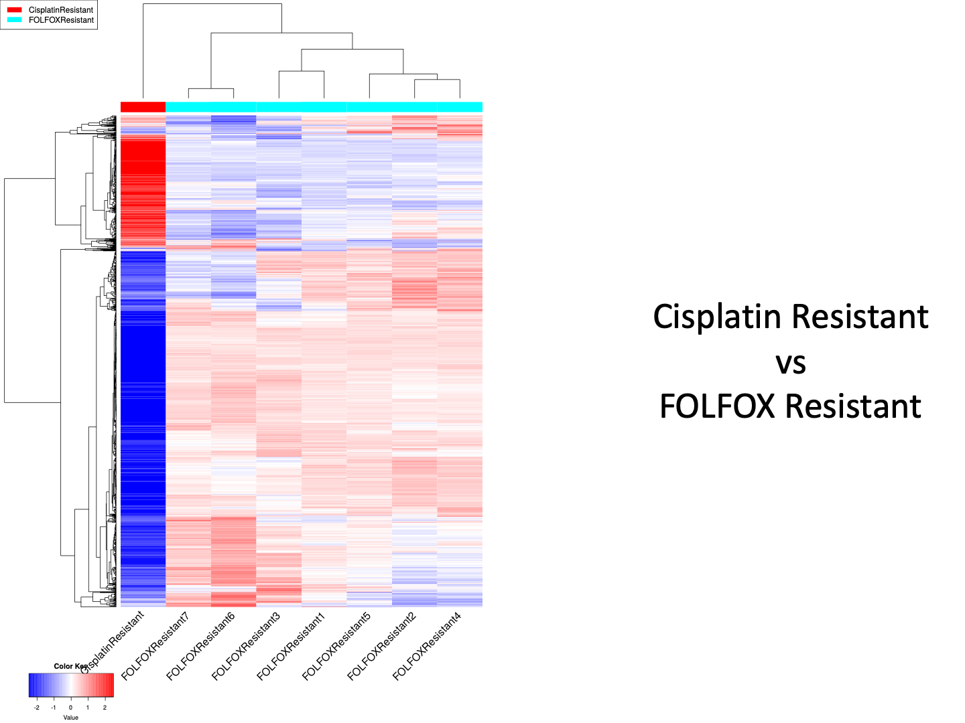

Slide 7
UNESCO Data Analysis
https://unesco-interface.herokuapp.com/home.html

