Slide 1
NYC Citywide Payroll Data Warehouse & ETL Pipeline
Dataset: NYC Citywide Payroll Dataset
Prepared By: Rhizu Joshi

Slide 2
PROBLEM STATEMENT
The NYC Citywide Payroll dataset contains large and inconsistent payroll records that make analysis difficult and inefficient.

Slide 3
OBJECTIVES
Build an automated ETL pipeline to clean, transform, and load NYC payroll data into a dimensional data warehouse.
Analyze key payroll metrics such as total payroll expenditure, overtime costs, average employee salary, and agency-wise compensation trends.
Develop interactive dashboards to identify payroll patterns, compare agency expenses, and monitor employee compensation across fiscal years.

Slide 4
2194488
16
Structured CSV Dataset
Source: NYC Open Data Payroll Dataset
Records
Columns
Data Type

Slide 5
DATASET OVERVIEW
Important Fields
Fiscal Year
Employee Name
Agency Name
Title Description
Base Salary
Overtime Hours
Overtime Pay
Work Location Borough

Slide 6
DATA PROFILING RESULTS
Issues Identified
Empty values in critical columns
Empty employee names
Leading/trailing spaces
Inconsistent text casing
Inconsistent data formats
Non-numeric salary values
Negative overtime/regular hours
Negative salaries
Validation Techniques
NULL checks
Regex format validation
Range checks
Duplicate detection
Consistency checks

Slide 7
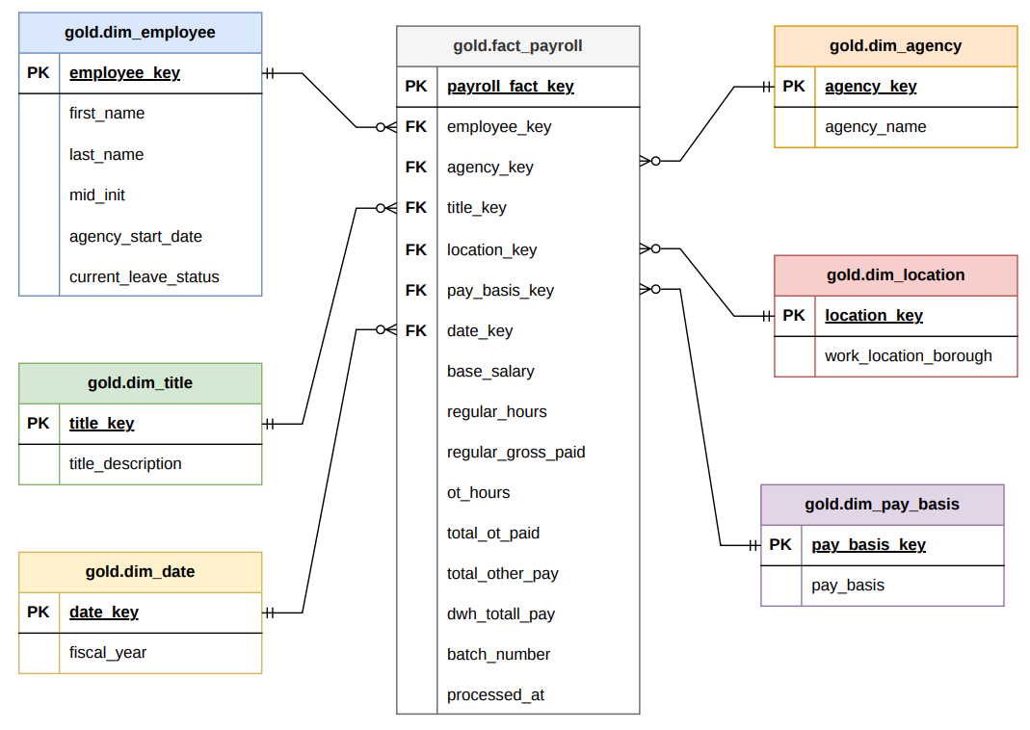
DATA WAREHOUSE DESIGN

Slide 8
Why Star Schema?
Better Analytics & Reporting
Simplified Querying
supports payroll analysis, KPI generation, and dashboard visualization
Simplifies analytical queries and reporting
Improved Performance
Scalable Warehouse Design
Improves query performance for payroll analysis
Provides a clear and scalable warehouse structure

Slide 9
FACT TABLE DETAILS
MEASURES
ADDITIONAL FEATURES
Base Salary
Regular Hours
Regular Gross Paid
Overtime Hours
Total Overtime Paid
Total Other Pay
Surrogate Keys
Foreign Keys
Batch Tracking
Derived Columns
Process Timestamp
One record represents:
A payroll payment entry for an employee in a specific fiscal year and agency

Slide 10
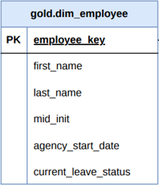
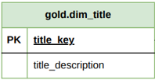
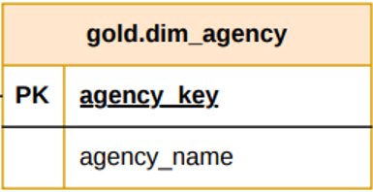
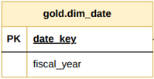
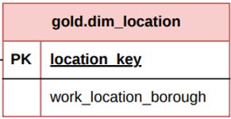
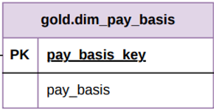
DIMENSION TABLE DETAILS

Slide 11
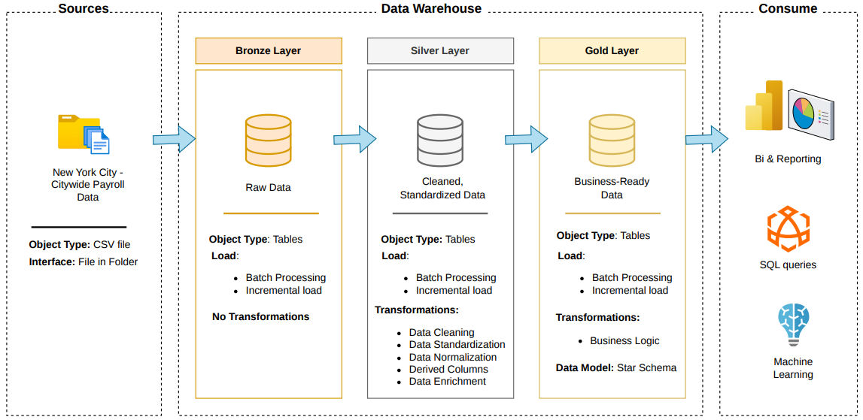

Slide 12





TOOLS & TECHNOLOGIES
This Photo by Unknown Author is licensed under CC BY-SA

Slide 13
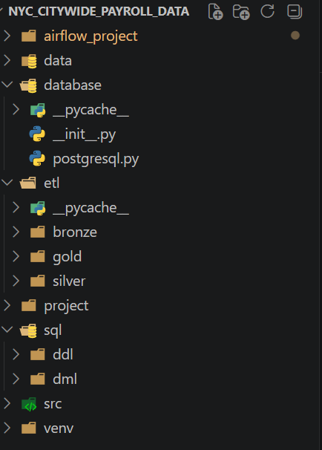
PROJECT STRUCTURE

Slide 14
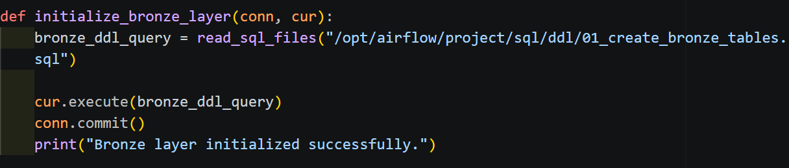
CODE HIGHLIGHTS
1. DDL Initialization

Slide 15
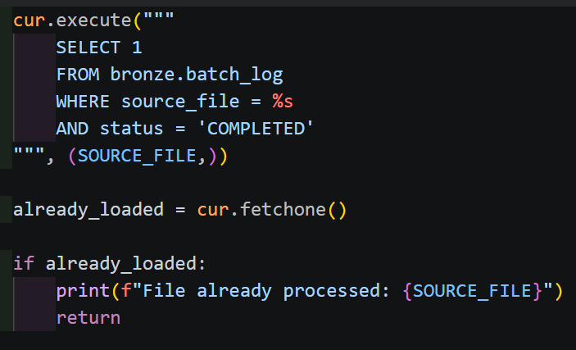
CODE HIGHLIGHTS
2. Incremental Load Check and Processing

Slide 16
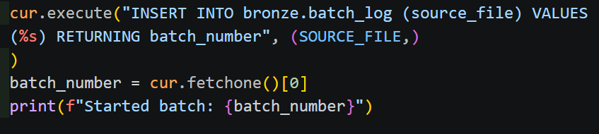
CODE HIGHLIGHTS
3. Batch Tracking System

Slide 17
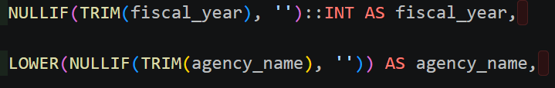
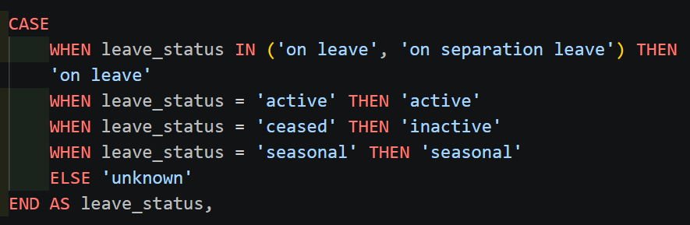
CODE HIGHLIGHTS
4. Data Transformations

Slide 18
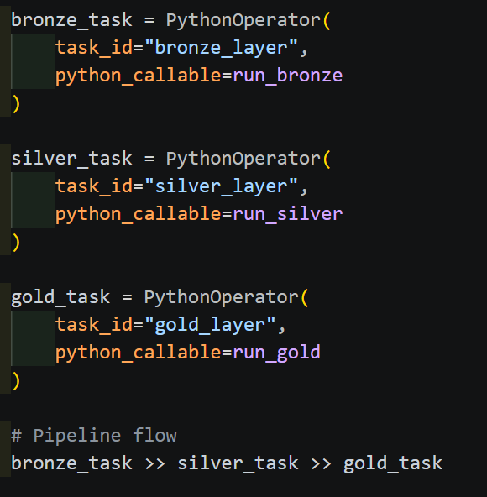
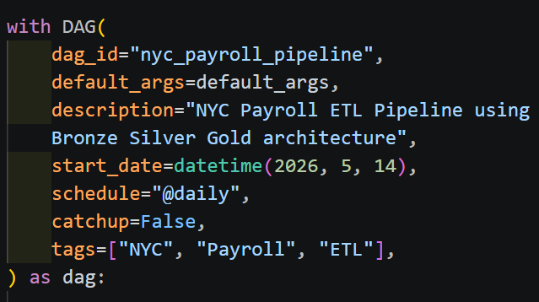
CODE HIGHLIGHTS
5. DAG workflow

Slide 19
PIPELINE EXECUTION GUIDE
Required Software
Docker Desktop
PostgreSQL
Python 3.x
Apache Airflow
Power BI Desktop
Required Libraries
psycopg2
airflow

Slide 20
PIPELINE EXECUTION GUIDE
Environment Setup
- Start Docker containers (PostgreSQL + Airflow)
- Verify database connection and services
Bronze Layer Execution (Data Ingestion + Initialization)
- Create schemas and tables (DDL execution inside Bronze script)
- Load raw NYC payroll CSV into bronze.nyc_payroll
- Maintain batch logging for tracking processed files
- Prevent duplicate ingestion using batch control logic

Slide 21
PIPELINE EXECUTION GUIDE
Silver Layer Transformation
-Clean and standardize raw data
-Prepare structured dataset for analytics
Gold Layer Loading
-Build dimension tables (employee, agency, title, location, etc.)
-Load fact table
-Establish foreign key relationships between fact and dimensions
-Handle NULLs, formatting issues, and inconsistencies

Slide 22
PIPELINE EXECUTION GUIDE
Airflow Orchestration
-Execute full pipeline using DAG: -Bronze → Silver → Gold
-Monitor task execution and dependencies
Dashboard Integration
-Connect Power BI to PostgreSQL
-Generate insights on payroll trends, overtime, and agency analysis

Slide 23
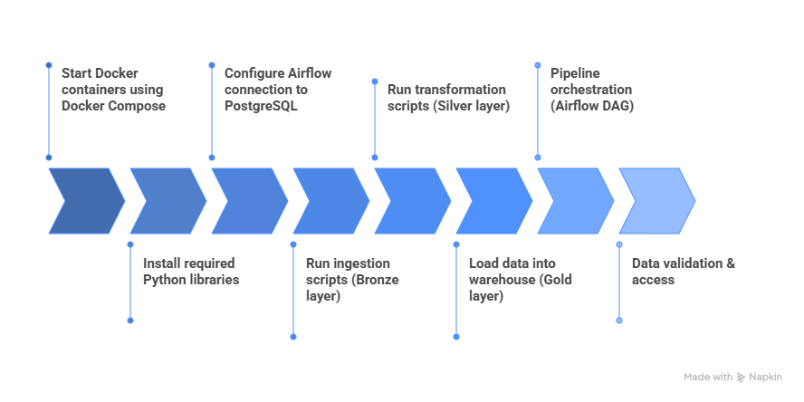
PIPELINE EXECUTION GUIDE

Slide 24
CHALLENGES FACED
Data Quality Issues
Technical Challenges
Missing and inconsistent values
Salary formatting inconsistencies
Duplicate records
Docker and Airflow Configurations
PostgreSQL constraint errors
Data type mismatches
Schema relationship debugging

Slide 25
SOLUTIONS & KEY LEARNINGS
Solutions Implemented
Regex-based validations
Data standardization rules
Dimensional modelling approach
Incremental ETL strategy
Key Learnings
ETL pipeline Development
Dimensional Modelling
ETL Orchestration Concepts
Data Warehouse Design

Slide 26
FUTURE ENHANCEMENTS
Fully automate pipelines using Airflow scheduling
Implement Slowly Changing Dimensions (SCD)
Add automated data quality testing
Optimize warehouse performance
Improve incremental loading logic
Deploy dashboards to cloud platforms

Slide 27
KEY INSIGHTS

Slide 28
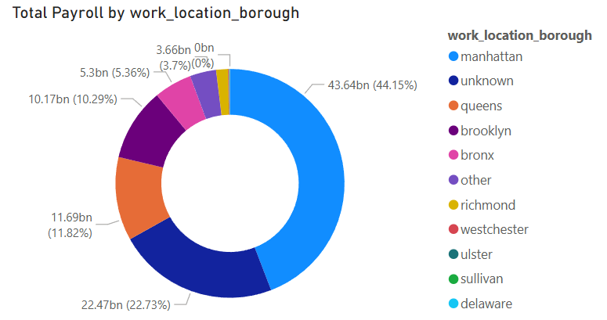
1. Total Payroll by Work Location

Slide 29
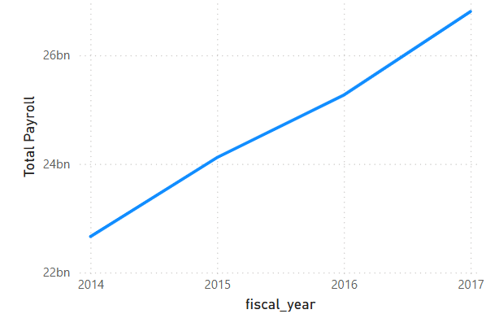
2. Payroll growth across fiscal years

Slide 30
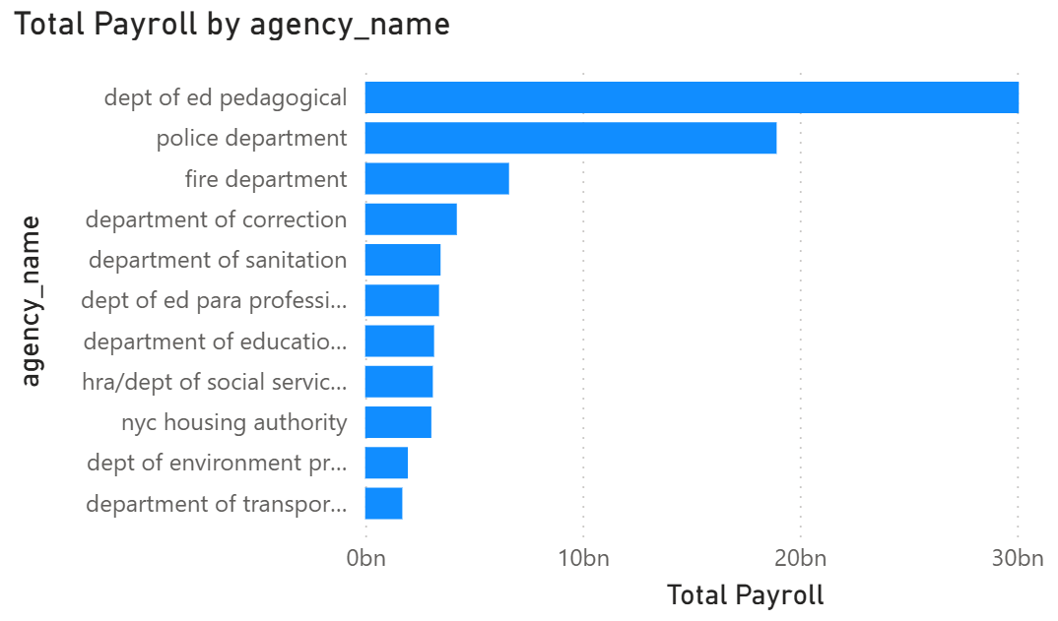
3. Highest payroll spending agency

Slide 31
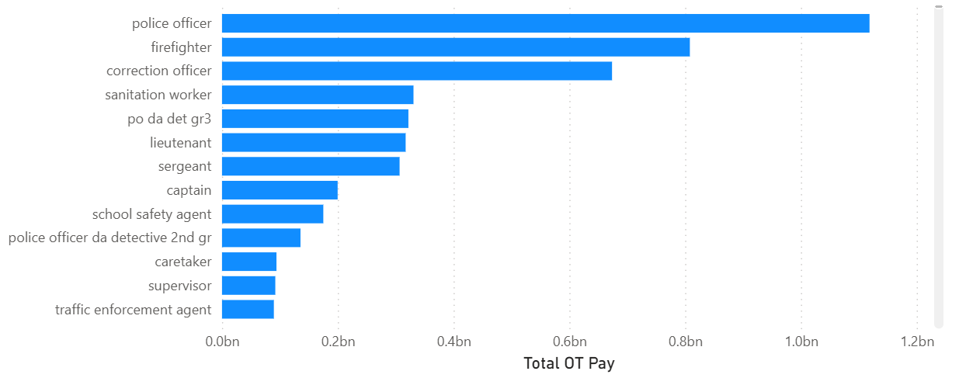
4. Total Overtime Pay by Titles

Slide 32
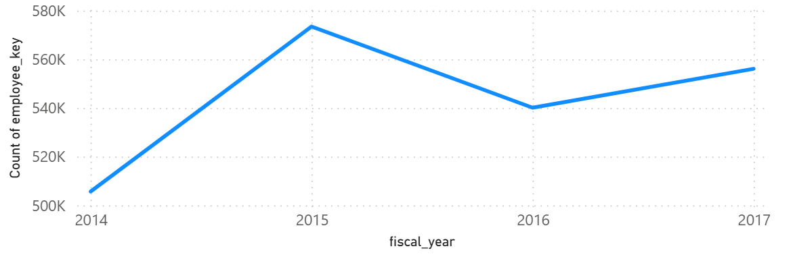
5. Workforce Growth over the Years

Slide 33
Thanks!
Do you have any questions?

