Slide 1
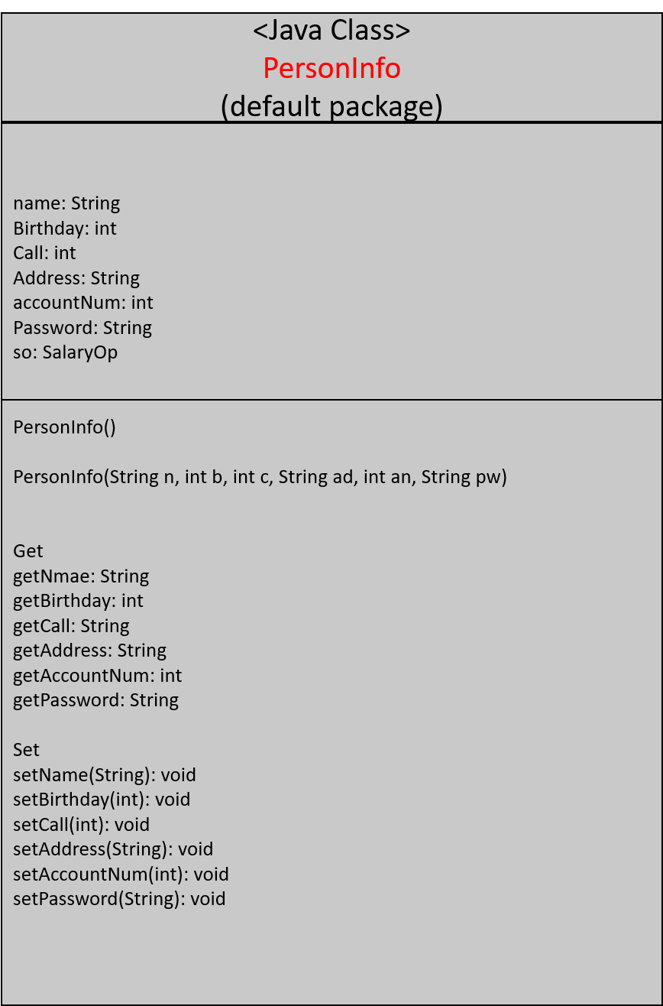
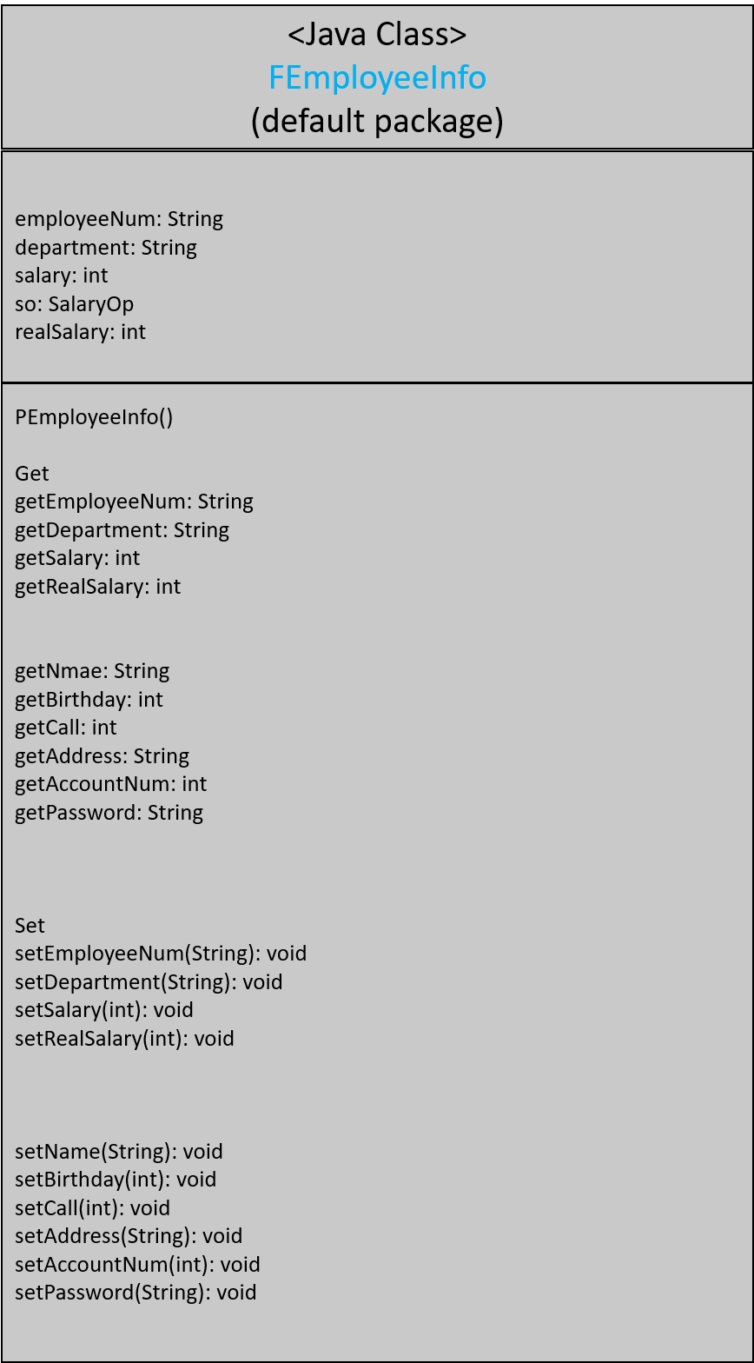
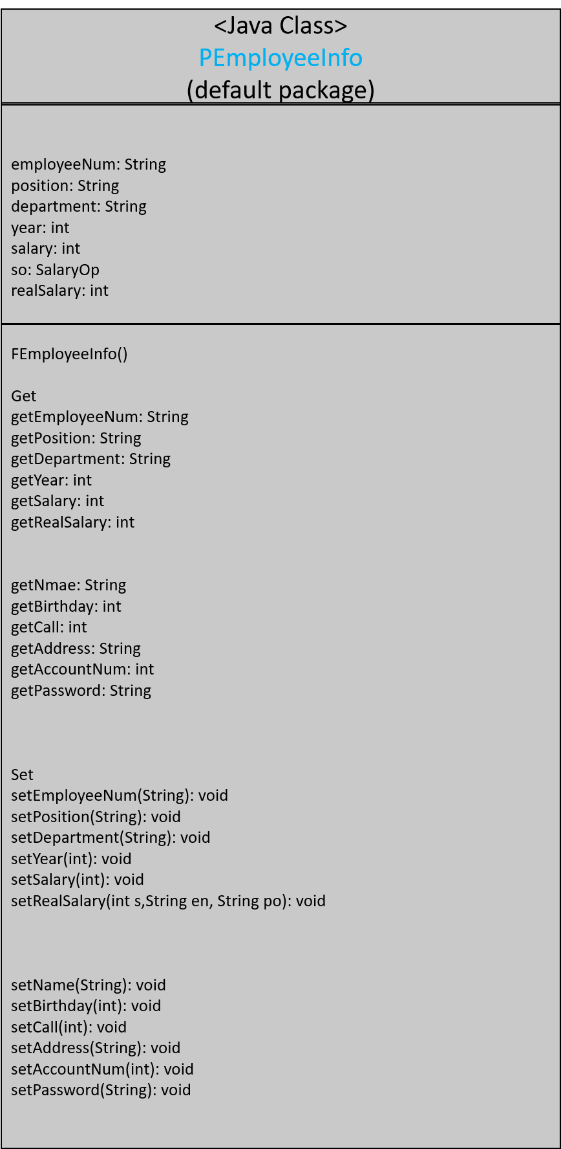
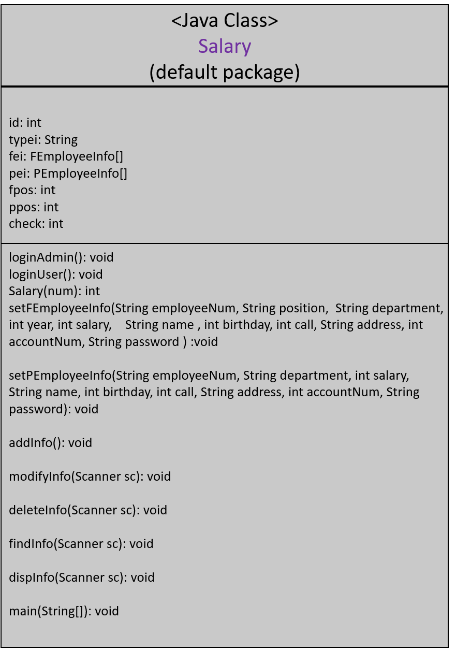
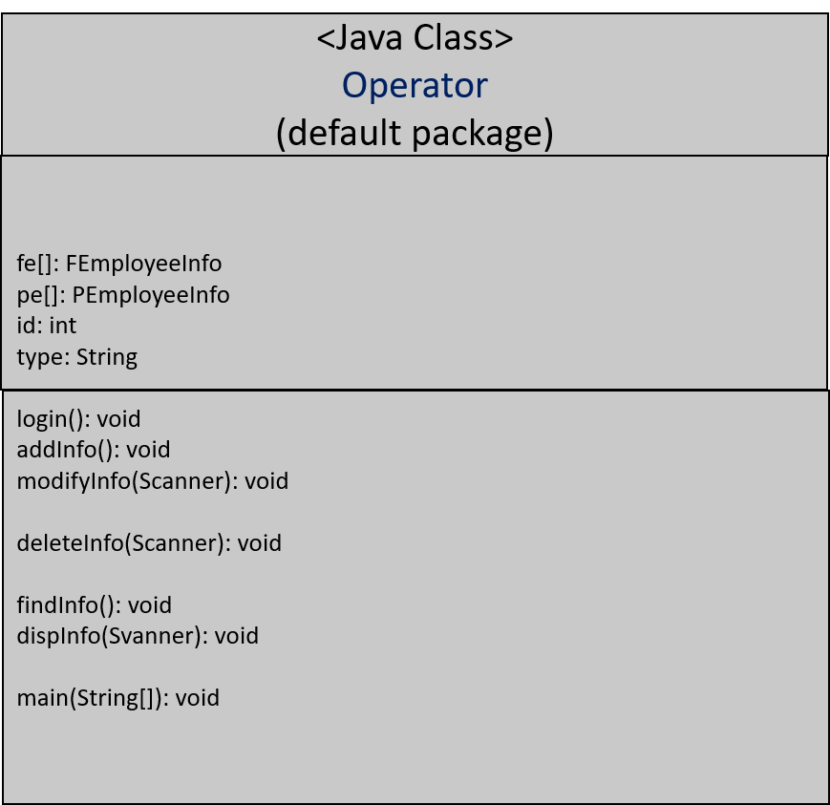
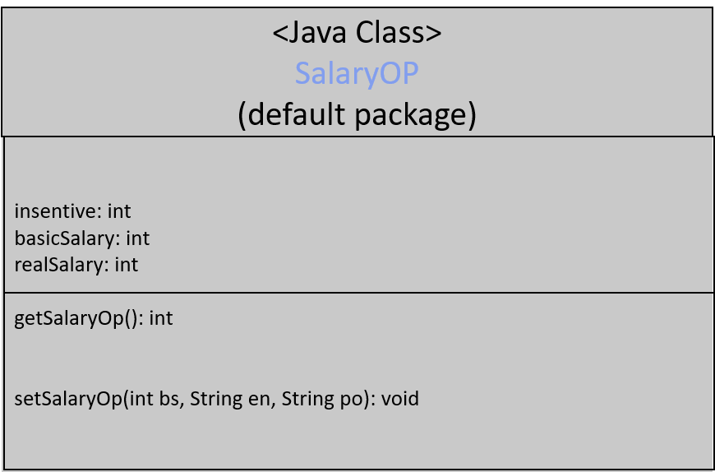

Slide 2
<Java Class>
PersonInfo
(default package)
name: String
Birthday: int
Call: int
Address: String
accountNum: int
Password: String
so: SalaryOp
PersonInfo()
PersonInfo(String n, int b, int c, String ad, int an, String pw)
Get
getNmae: String
getBirthday: int
getCall: String
getAddress: String
getAccountNum: int
getPassword: String
Set
setName(String): void
setBirthday(int): void
setCall(int): void
setAddress(String): void
setAccountNum(int): void
setPassword(String): void

Slide 3
<Java Class>
FEmployeeInfo
(default package)
employeeNum: String
department: String
salary: int
so: SalaryOp
realSalary: int
PEmployeeInfo()
Get
getEmployeeNum: String
getDepartment: String
getSalary: int
getRealSalary: int
getNmae: String
getBirthday: int
getCall: int
getAddress: String
getAccountNum: int
getPassword: String
Set
setEmployeeNum(String): void
setDepartment(String): void
setSalary(int): void
setRealSalary(int): void
setName(String): void
setBirthday(int): void
setCall(int): void
setAddress(String): void
setAccountNum(int): void
setPassword(String): void

Slide 4
<Java Class>
PEmployeeInfo
(default package)
employeeNum: String
position: String
department: String
year: int
salary: int
so: SalaryOp
realSalary: int
FEmployeeInfo()
Get
getEmployeeNum: String
getPosition: String
getDepartment: String
getYear: int
getSalary: int
getRealSalary: int
getNmae: String
getBirthday: int
getCall: int
getAddress: String
getAccountNum: int
getPassword: String
Set
setEmployeeNum(String): void
setPosition(String): void
setDepartment(String): void
setYear(int): void
setSalary(int): void
setRealSalary(int s,String en, String po): void
setName(String): void
setBirthday(int): void
setCall(int): void
setAddress(String): void
setAccountNum(int): void
setPassword(String): void

Slide 5
<Java Class>
Operator
(default package)
fe[]: FEmployeeInfo
pe[]: PEmployeeInfo
id: int
type: String
login(): void
addInfo(): void
modifyInfo(Scanner): void
deleteInfo(Scanner): void
findInfo(): void
dispInfo(Svanner): void
main(String[]): void

Slide 6
<Java Class>
Salary
(default package)
id: int
typei: String
fei: FEmployeeInfo[]
pei: PEmployeeInfo[]
fpos: int
ppos: int
check: int
loginAdmin(): void
loginUser(): void
Salary(num): int
setFEmployeeInfo(String employeeNum, String position, String department, int year, int salary, String name , int birthday, int call, String address, int accountNum, String password ) :void
setPEmployeeInfo(String employeeNum, String department, int salary, String name, int birthday, int call, String address, int accountNum, String password): void
addInfo(): void
modifyInfo(Scanner sc): void
deleteInfo(Scanner sc): void
findInfo(Scanner sc): void
dispInfo(Scanner sc): void
main(String[]): void

Slide 7
<Java Class>
SalaryOP
(default package)
insentive: int
basicSalary: int
realSalary: int
getSalaryOp(): int
setSalaryOp(int bs, String en, String po): void

