Slide 1
Convolutional Neural Network (CNN) to detect flooding snowpack at Phenocam sites:
Data from 9 phenocam sites
NEON-DELA
NEON-LENO
NEON-LIRO
NEON-NIWO
Arsltarmdcrresw
Arsltarmdcrprcw
Huyckpreserveny
Arsgreatbasinltar098
Laclaflamme
Automated R script takes lat/lon of a site and enters information into to the following website:
https://www.esrl.noaa.gov/gmd/grad/solcalc/table.php?
Local sunrise, sunset, and solar noon are determined for the given site for each day throughout the year
Next, images from within +/- 30 minutes of Solar Noon are downloaded for an given period of time, e.g., 3-6 months
Images are visually inspected to determine whether the site is dry:
Dry (no water or snow)
Flooded (visible flood waters > 50% coverage on ground)
Snowpack (visible snowpack >50% coverage on ground)
The above information is entered into a spreadsheet along with the site name and date

Slide 2
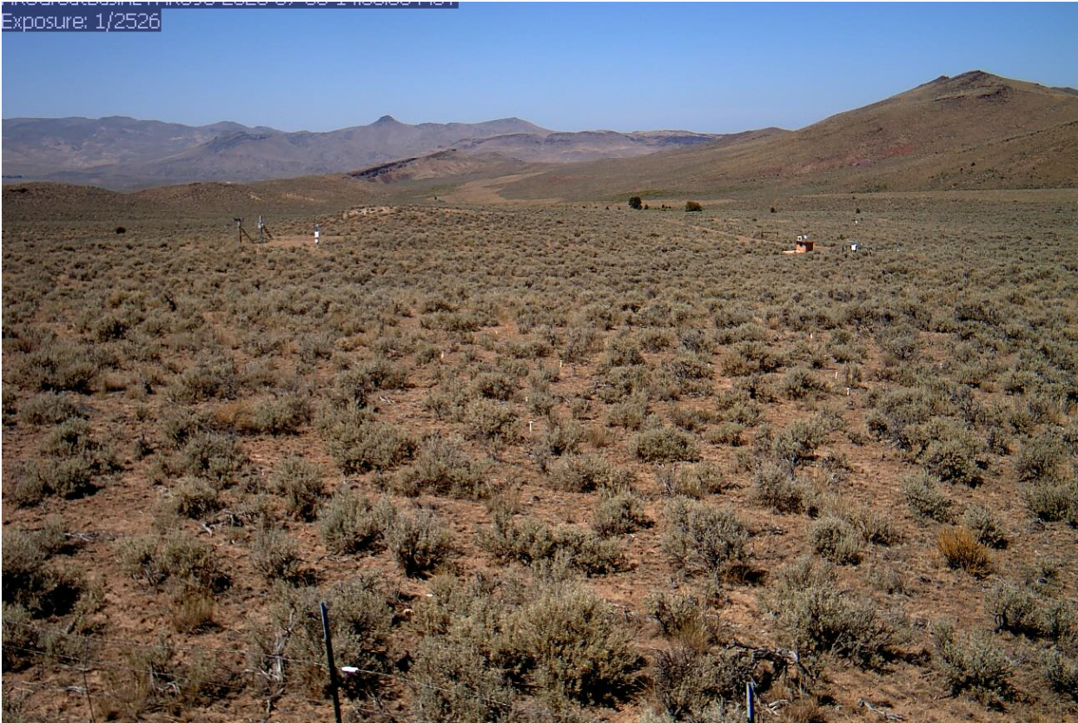
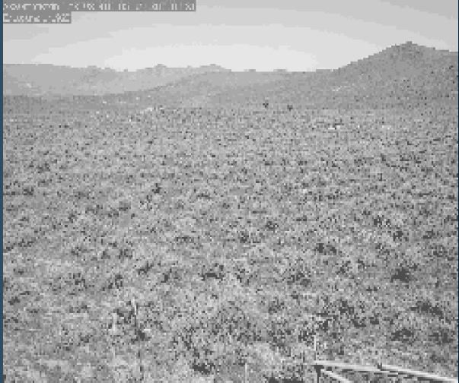
Images are converted from nominally sized colored images to grayscale image at 20% of nominal width and height

Slide 3
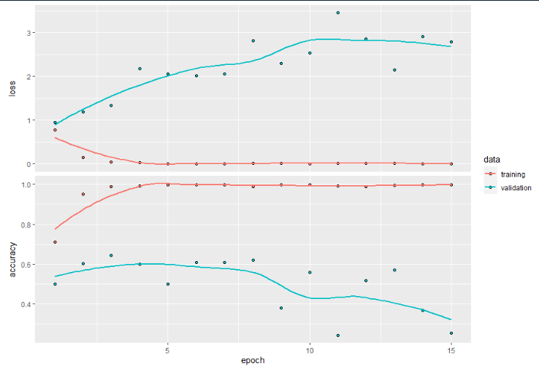
Images and metadata are fed into another R script that fits the CNN
Training and testing datasets are created, with 80% and 20% of the data, respectively.
A validation dataset is created from the training dataset to validate the model through each iteration
The CNN Model is run using 15 epochs

Slide 4
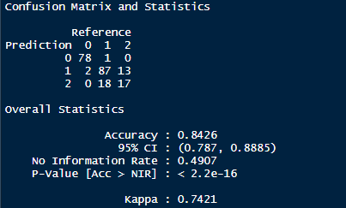
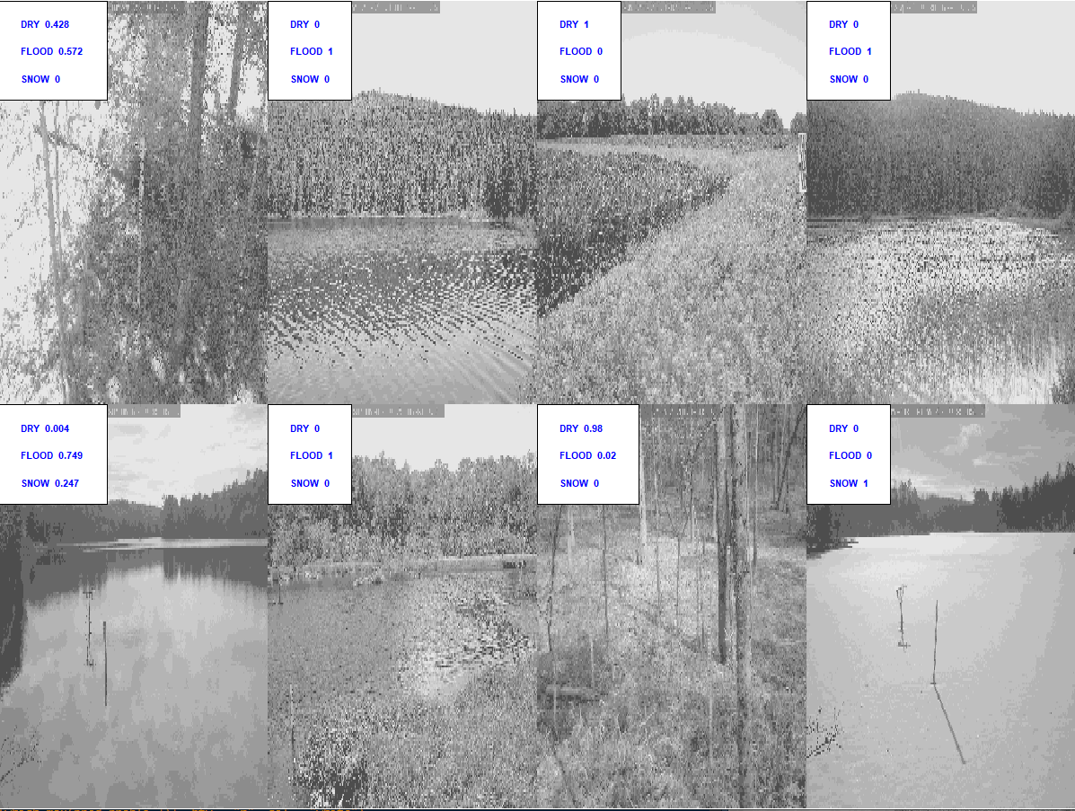
Results:
84% accuracy
The model does well determining dry vs wet, but has a tough time deciphering between flood and snowpack.
A snippet of the prediction output is shown on the right. Two things are evident:
The lack of confidence between snowpack and flooding as determined by the model
The model inherently provides estimates of partial flooding/snowpack at a site

Slide 5
Summary:
The model does well determining dry vs wet, but has a tough time deciphering between flood and snowpack.
Potential cause:
Images were fed in as grayscale to save space and memory. Floodwater and snowpack usually appear as smooth gray surfaces.
Path Forward: Create new models
Model 1:
Rerun the same model with RGB images. This will require some reworking of the code because the matrices will be different dimensions
Model 2:
if model 1 falls short, create a model that incorporates a temporal component, e.g., changes of an image from day 1 to day n. Can we sill snowpack or floods start to take shape at a site?

