Slide 1
Introduction to SDN
Li, Runhui
ANSR LAB, DePT. of Computer SCI & Tech The Chinese University of Hong Kong

Slide 2
Roadmap
SDN
Design principles
SDN infrastructure
OpenFlow: manage packet flow in SDN
Mininet: SDN simulator
Lessons learned

Slide 3
Traditional Network
Control plane
Control
Control
Control
Control
data
data
Data plane
data
data
Msg

Slide 4
Example: VM Migration
VM
VM
VM
VM
VM
VM
VM
Physical machine
Physical machine
Physical machine
Re-configuration!

Slide 5
Example
Load balancing
Lack of global view
Lack of centralized control
Security path
Lack of flexible forwarding

Slide 6
Management is Disaster!
Compute configuration for distributed devices
Forwarding tables
Configure without communication guarantee
Given network-level protocols

Slide 7
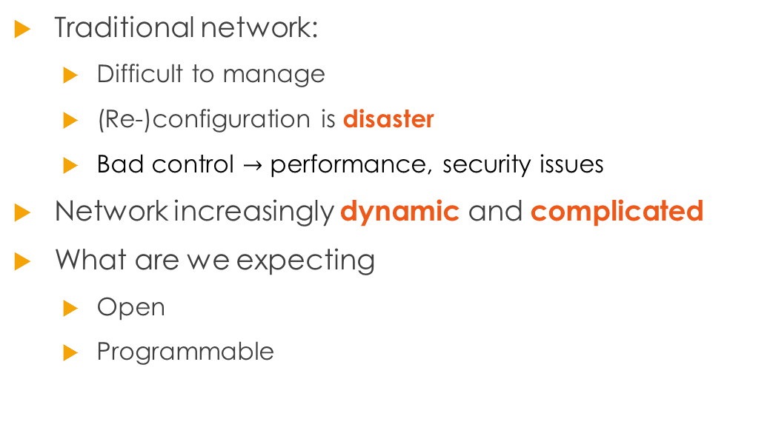
Motivation
Traditional network:
Difficult to manage
(Re-)configuration is disaster
Bad control $→$ performance, security issues
Network increasingly dynamic and complicated
What are we expecting
Open
Programmable

Slide 8
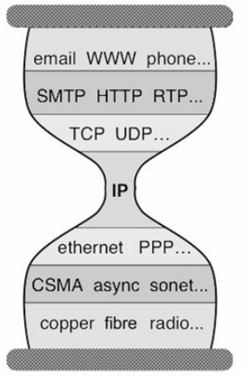
Lessons from Data Plane
Applications
Data transmission is NEAT
Layering in data plane
Layering excellent abstraction
Decomposition
Independent
Compatible
Control plane: lack of abstraction
(Un)reliable transport
(transport layer)
Global packet delivery
(network layer)
Local packet delivery
(data link layer)
Physical transition of bits
(physical layer)
Notes:
Delivery is decomposed into fundamental components

Slide 9
Network Control Problem
Distribution to physical devices
Abstraction for distributed state
Configuration of each physical device
E.g., forwarding tables, ACLs
Abstraction for simplified configuration
Forwarding with given network-level protocol
Abstraction general forwarding model
What is desired abstraction?

Slide 10
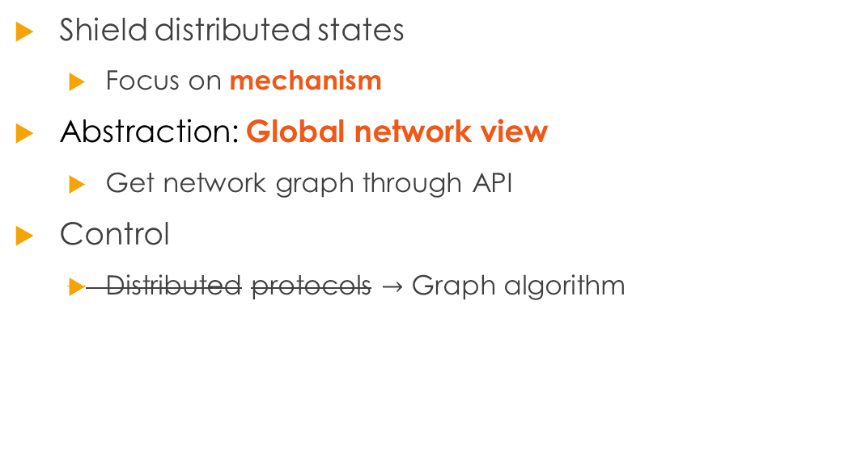
Distribution
Shield distributed states
Focus on mechanism
Abstraction: Global network view
Get network graph through API
Control
Distributed protocols $→$ Graph algorithm

Slide 11
Configuration
Control program: desired behavior
Do NOT need to concern the implementation
What abstraction to control program

Slide 12
Example: Access Control
Network virtualization

Slide 13
Configuration
Control program: desired behavior
Do NOT need to concern the implementation
What abstraction to control program
Simplified view
Enough and only enough to specify desire
Behavior = function (view)

Slide 14
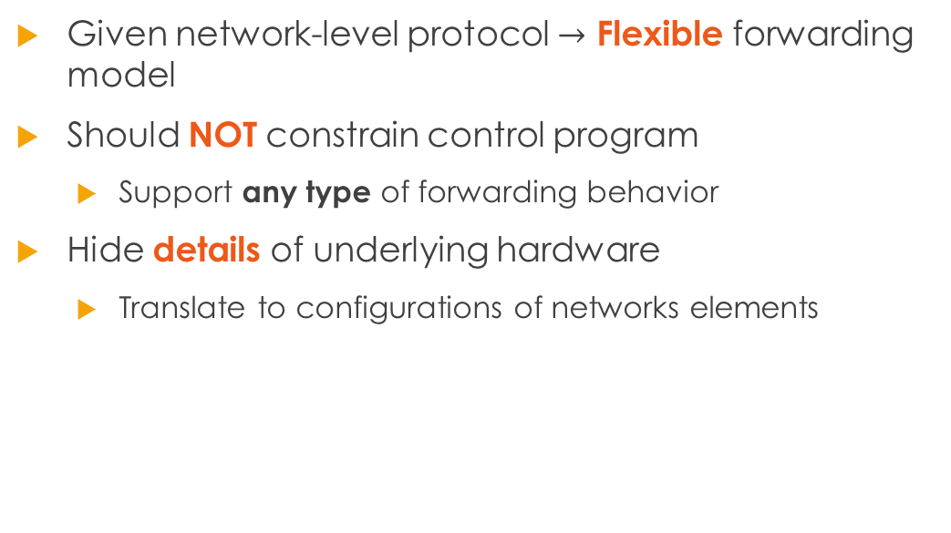
Forwarding
Given network-level protocol $→$ Flexible forwarding model
Should NOT constrain control program
Support any type of forwarding behavior
Hide details of underlying hardware
Translate to configurations of networks elements

Slide 15
The Core of SDN
Distribution
Global network view
Configuration
Simplified model
Forwarding
Generalized forwarding

Slide 16
Roadmap
SDN
Design principles
SDN infrastructure

Slide 17
Analogy to Operating System
App 1
App 2
…
App N
Operating System
Abstraction for applications
Manage resources
CPU
Memory
Hard disk
Network

Slide 18
Core Challenge
Distributed control into logically centralized control
Global network view
Module/Layer
Gathers information from data plane
Sends commands to network devices
Network Operating System

Slide 19
Distribution Layer
Control program
Global Network View
Networking OS

Slide 20
Network Virtualization
Network Virtualization
Control program
Global Network View
Networking OS

Slide 21
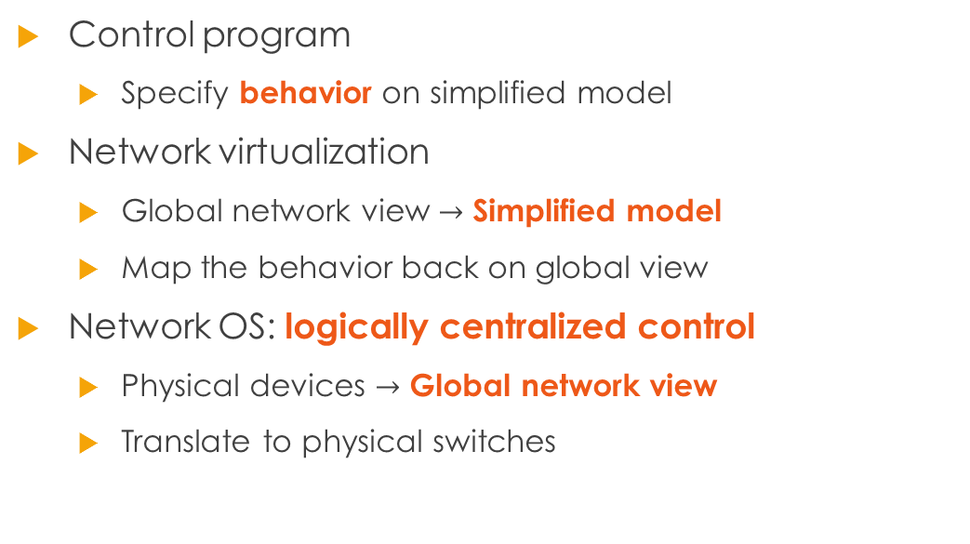
Control Plane Abstraction
Control program
Specify behavior on simplified model
Network virtualization
Global network view $→$ Simplified model
Map the behavior back on global view
Network OS: logically centralized control
Physical devices $→$ Global network view
Translate to physical switches

Slide 22
To Be More Specific
Applications
(Cntrl prog)
Network applications
Routing algorithm
Intrusion detection, etc.
Northbound interface
Network OS
Topology/inventory
Statistic
Southbound interface
OpenFlow, etc.
Forwarding devices/ data plane
SDN Controller
Network OS
Forwarding devices

Slide 23
Roadmap
SDN
Design principles
SDN infrastructure
OpenFlow

Slide 24
OpenFlow
Standard communication interface between control and data planes of SDN

Slide 25
Data Flow in SDN
App 1
App 2
…
App N
Networking OS
Drop, modify or forward
Packet missing
Cache action
Data forwarding device
Data forwarding device
Data forwarding device
MSG
Fast Path

Slide 26
Fault-tolerance & Scalability
Logically centralized control $≠$ Single physical controller
App
App
…
App
App
App
…
App
Networking OS
Networking OS
East/West protocol
Data forwarding device

Slide 27
Fault-tolerance & Scalability
App 1
App 2
…
App N
Network OS
Network OS
Networking OS
Data forwarding device
Data forwarding device
…
Data forwarding device

Slide 28
Roadmap
SDN
Design principles
SDN infrastructure
OpenFlow
Mininet

Slide 29
Quick Overview
What is mininet
Network emulator
Running real kernel, switches and application code on a single machine
Why mininet
Accurate and convincing emulation
Building a customized network is simple and fast
Command-line interface (CLI) and a handy Python API

Slide 30
Motivation
Imagine you are deploying a cluster of tens of thousands of hosts
How to make sure network settings work?
Imagine you are a poor PhD student (as I am …)
You want to validate your networked system in large scale setting
However, you only own a workstation or a laptop

Slide 31
Mininet Basics build a network
Switch s1
Controller c1
Host h1
Host h2
Example: building a two-host network
sudo mn

Slide 32
Mininet Basics Hosts
Thread 1 private variables
Thread n private variables
…
Multi-threading model
Shared memory, public variable, etc.

Slide 33
Mininet Basics Hosts
Thread 1 private variables
Thread n private variables
Host 1
network settings
Host n
network settings
…
…
Shared memory, public variable, etc.
Your physical machine
operating system, libraries, applications, etc.
Light-weighted copy of your machine
Shares all resources of your machine
Except for network settings (e.g., IP, Ethernet)
Connected via open virtual switch (i.e., OVS)

Slide 34
Mininet Basics Data Flow
Host 1
Host 2
OVS
Exactly as you send through physical network
Execute the kernel code
Split the packet, encapsulate, resemble, …

Slide 35
Mininet Basics Capabilities of Hosts
FTP server
FTP client
Host 1
Host 2
Libraries, applications shared among all virtual hosts
Run your own program on virtual hosts!!
[hostname] [cmd]

Slide 36
Demo: nc Command

Slide 37
Features
Various topologies
Trees, linear, etc.
Run customized control program
Even run a third-party controller

Slide 38
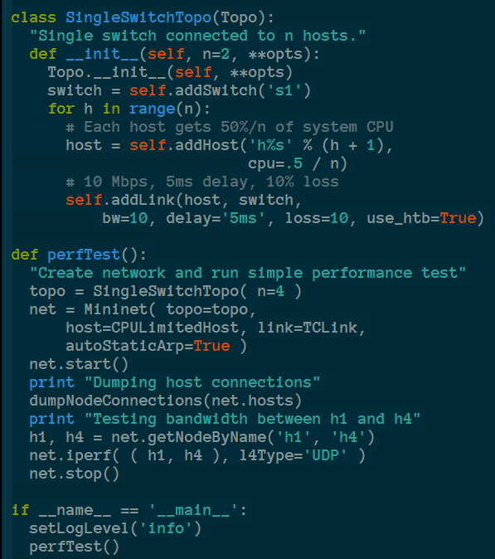
Python API
Switch
Host
Link

Slide 39
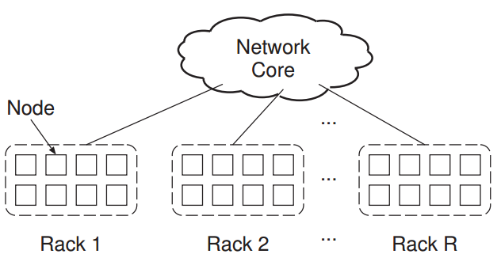
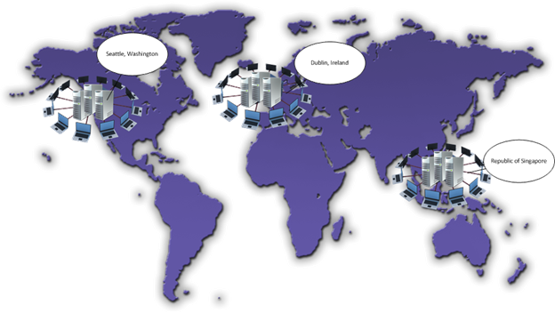
Case Study Distributed File System Emulator
Seatle
Dublin
Network is the major bottleneck!
SG

Slide 40
Conclusion
Control problem in traditional network
Lack of abstraction
Distribution, configuration and forwarding
NOS, network virtualization and general forwarding
SDN infrastructure
Mininet: handy but powerful network emulator

Slide 41
Roadmap
SDN
Design principles
SDN infrastructure
OpenFlow
Mininet
Lessons learned

Slide 42

“The Power of Abstration”
“Modularity based on abstraction is the way things get done”
-Barbara Liskov
Abstraction $→$ Interfaces $→$ Modularity

Slide 43
Extracting Simplicity
The ability to master complexity is not the same as the ability to extract simplicity
When first getting systems to work
Mastering complexity
When making systems easy to use and understand
Extracting simplicity
You will never succeed in extracting simplicity
Unless realize it is different from mastering complexity

Slide 44
References
Kreutz, et al. “Software-Defined Networking: A Comprehensive Survey”, IEEE Trans. on Computers
Scott Shenker, “The Future of Networking and the Past of Protocols”
Mininet [http://mininet.org/] tutorials:
https://www.youtube.com/channel/UCEoaojfEY_6L5TWWjIn9t9Q

