Slide 1
Distributed File System Evolution
From Google File System to Tachyon
LI, Runhui
ANSR Lab, CUHK

Slide 2
How does A File System Serve Us?
File system
as a black box

Slide 3
File System Basics
File 2
Chunks
1
2
3
4
5
6
File 1
Information stored in file systems:
Data chunks/blocks
Metadata: file and chunk space, file-to-chunk mapping

Slide 4
File Read
I want to read bytes 1000~2000 file 1
Get block 5
FS Client
File system
as a black box
Data flowing out …

Slide 5
File Write/Append
I want to write bytes 1000~2000 file 1
Write at location XXX!!
FS Client
File system
as a black box
Data flowing in …

Slide 6
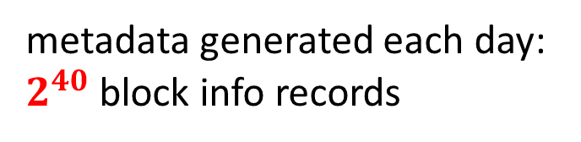
Seems Not Complicated… But!
Tough metadata management!!
metadata generated each day:
$2^{40}$ block info records
File system
as a black box
How can I access blk XXX?
Go get some coffee and WAIT
for me to check the records!
Things become rather different when we talk about BIG data systems
How big?
Hundreds of TB per day in cluster of Microsoft
Traditional file system (e.g., FAT32) has 512 bytes/4KB block size
Leveraging Endpoint Flexibility in Data-Intensive Clusters, SIGCOMM’13

Slide 7
Of Course, Distributed
Nodes
Clients
Data → multiple storage servers (nodes)
How does a client tell where to put/get a file?
Thousands clients accessing file system simultaneously
High parallelization
High throughput

Slide 8
Reliability & Availability
Don’t worry, we get backup in other nodes
Nodes
Multiple hosts → higher chance of component failures
In large data cluster, failure is normal rather than exceptional
Disk error, OS upgrade, operational failure
Must guarantee
Reliability (data is not lost)
Availability (data can be accessed RIGHT NOW)

Slide 9
Consistency Control
Write “def” at offset 100
Node 1
Node 2
Blk 1
What’s the data in offset 100?
Blk 1
WASTED
offset 100 “def”;
offset 100 “abc”;
offset 100 “abc”;
offset 100 “def”;
abc
def
Write “abc” at offset 100
A file modified simultaneously by different clients
Different nodes may see different sequence of write requests

Slide 10
Probably not so Simple …
Vast amount of data
Metadata management
Manage distributed nodes, serve thousands of clients
High parallelization
High throughput
Fault tolerance
Consistency control

Slide 11
De-centralized Design
Id =0
Id =1
Id =2
Id =3
Id =4
File1
Hash(File1)%5=3
Hash(File2)%5=2
File2
Distributed hash table
A naive approach
Drawback: difficult to handle dynamic cluster

Slide 12
De-centralized Design
File1
Id = 100
File2
Hash(file1) = 79
Hash(file2) = 123
Id = 150
File2
Id = 200
Id = 300
Distributed hash table
Improved version
Hash value space: 0~300
Node join/leave is less painful

Slide 13
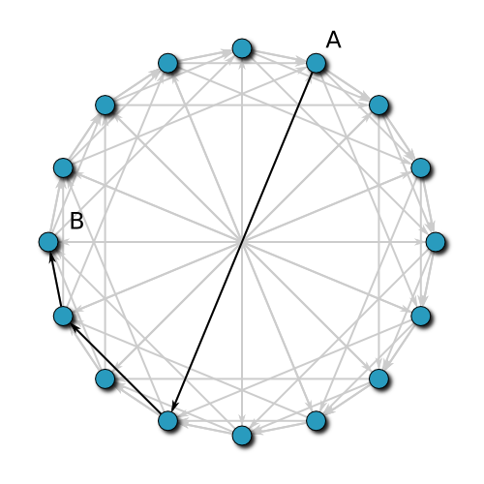

De-centralized Design
Each node communicates with only a subset of nodes in the system
Query can be accomplished within $Log(node \#)$ relays
Chord: A Scalable Peer-to-peer Lookup Service for Internet Applications, SIGCOMM’01

Slide 14
Problem of De-centralized Design
Difficult control
Hard to get an global view of the system
Difficult to achieve load balancing or manipulate the data placement
Query is expensive

Slide 15
File System Abstraction
Metadata management → controlling the file system (control plane)
Allocate space for data chunks
Reclaim space of deleted files
Direct read/write request
Data read/write (data plane)
Remember the group study of SDN?

Slide 16
Traditional Network
Control plane
Control
Control
Control
Control
data
data
Data plane
data
data
Msg

Slide 17
Distribution Layer
Control program
Global Network View
Networking OS

Slide 18
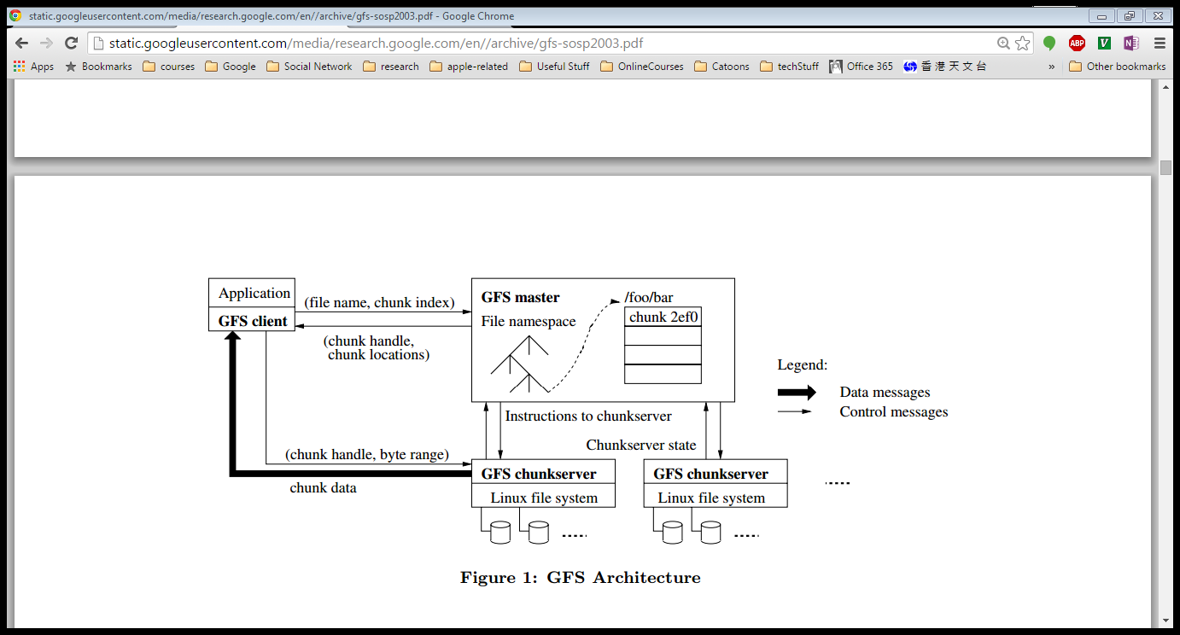
Google File System
data
What is the target?
High performance (Concurrent read/write)
Simple design and management (global view of the system)

Slide 19
Google File System
metadata
data
What is the target?
High performance (Concurrent read/write)
Simple design and management (global view of the system)

Slide 20
Google File System
Interface
metadata
data
What is the target?
High performance (Concurrent read/write)
Simple design and management (global view of the system)

Slide 21
Single Master
Global view → single master to manage metadata
Single master enables us to
Apply sophisticated chunk placement schemes
Avoid the complicated consistency control of metadata operations
But master may
Become bottleneck since it need to handle all metadata operations and queries
Fail!! This could be a disaster

Slide 22
Avoid Master from Being a Bottleneck
Performance guarantee
64MB big chunks
Minimize involvement in read/write request
Improve concurrency with advanced locking scheme

Slide 23
Why Big Chunks?
Metadata in GFS:
file and chunk namespaces,
mapping from file to chunks,
locations of each chunk’s replicas
Large chunk size (64MB by default)
Small metadata size
Metadata in memory
Large file in practice
Client
Master
4KB/query vs.
64MB/query
ChunkServer
Read latency = query metadata + get data
Caching small amount of metadata → can access large range of data

Slide 24
Offloading Involvement in Read/Write Operation
To handle concurrent write operations, we need consistency control
Typically, one agent determine the sequence of write requests
In GFS there could be
Thousands of clients appending thousands of file
If we use master as the agent for consistency control…
Master will become bottleneck

Slide 25
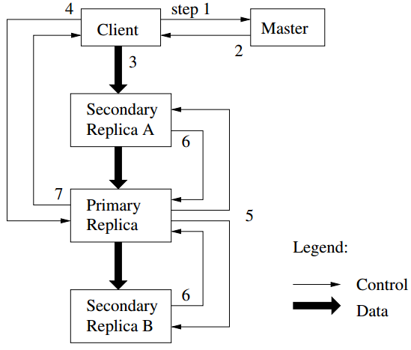
Minimizing Involvement in Read/Write Operation
Cache in
different replicas
A
B
C
B
A
C
Let do in order “BAC”
C
A
B
Lease
Offload the consistency control to chunk servers

Slide 26
Lease
switch
switch
switch
switch
switch
R
C
R
R
C
Separate data flow from control flow
Always pick path with optimal transmission
Leveraging topology to improve write performance

Slide 27
Lazy Garbage Collection
There are several situations a chunk will exist in the system as “garbage”
File deletion
A failed chunk construction, but some node may successfully create the chunk
Eager deletion is expensive
Master must have most updated information about the whole system
Must make sure the chunk delete message is sent and the chunk is safely deleted
Lazy deletion, however, can be merged into a regular heartbeat with chunk servers

Slide 28
Lazy, Lazy and Lazy…
Reduce burden of master SIGNIFICANTLY
Simplify master design
Single master mode makes this design feasible
All metadata query goes through master
Monitor operations can be finished by periodically heartbeat
Other lazy features in GFS:
Stale replication deletion
Replica locations in master
Etc..

Slide 29
Locking for Metadata Operation
Ensuring high concurrency
Remove directory concept (/a/b/c and /a/b are just two names in the file namespace)
To create a new file /foo/bar
Read lock on /foo, write lock on /foo/bar
In traditional file system: write lock on /foo, write lock on /foo/bar
Traditional lock scheme prevents reading other files in dir /foo/ while creating /foo/bar
Locking in GFS improves concurrency

Slide 30
Master Fault Tolerance
Operation log and metadata checkpoint
Operation log is crucial: write locally and replicate to remote hosts
Backup master load the nearest checkpoint and replay the operations in the operation logs
Restore the master status before failure
Shadow master replay replicated operation log
With failure, shadow master makes GFS keep functional in “read-only” mode

Slide 31
Problem of GFS
Round 1
Round 2
Round 3
File System
Original data
Intermediate data
Intermediate data
Final result
Fault tolerance is important
GFS achieves fault tolerance by replicating data to different nodes
The overhead of replicating data is huge
While GFS is targeting at SINGLE-application, a lot of applications (e.g., machine learning applications) contains iterative jobs
GFS does not cache data, neither on chunkserver nor client

Slide 32
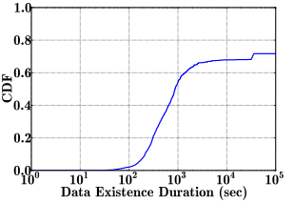
Problem
Replicate even the intermediate result
Replicating may consume much more time than computing itself
Writing into local memory is much more efficient
Replication is so expensive.. Re-computing the result is even faster!
We cannot compromise fault tolerance
But can we use re-computing as fault tolerance instead?

Slide 33
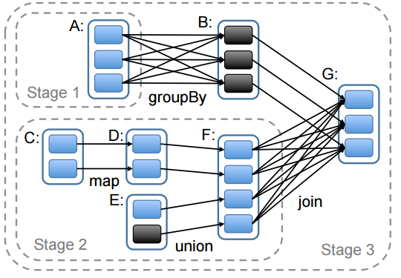
Re-Computing is Not New
MapReduce, Spark, etc..

Slide 34
Leveraging Memory is Not New Either
Both re-computing and in-memory operations are adopted by computing frameworks
We missed a storage component
and these features should be carried out by storage layer
WHY storage layer?

Slide 35
Inter-framework Data Sharing
Spark job1
MapReduce job1
File 1
HDFS
File 1
Inter-framework data sharing does not benefit from leveraging memory

Slide 36
Inefficient Memory Usage
Spark job1
Spark job2
Spark mem
Spark mem
File 1
File 1
HDFS
File 1

Slide 37
Losing Cached Data with Execution Exceptions
Spark job1
Data storage & execution in one thread
Spark mem
File 1
output
HDFS
How to handle?

Slide 38
Split Memory Data Management from Execution
Spark job1
MapReduce job1
MemFS
HDFS
File 1
Dedicated distributed in-memory storage layer
Efficient sharing and memory usage
Intermediate data survives with execution exceptions

Slide 39
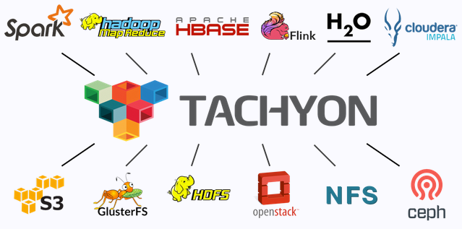
Tachyon
Memory-centric distributed storage system
Sit on top of persistent storage
Tachyon: Reliable, Memory Speed Storage for Cluster Computing Frameworks, SoCC’14

Slide 40
Performance and Fault Tolerance
Lineage layer
Store ONE copy of data in local memory for fast access
Eliminate the replication overhead
Provide fault tolerance with lineage (re-computing)
Persistent layer
Existing file systems which provides reliable storage (e.g., HDFS, Amazon S3)
Used for checkpointing (ultimate fault-tolerance)

Slide 41
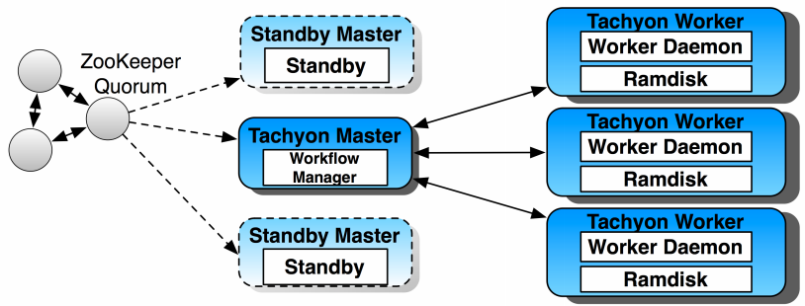
Architecture

Slide 42
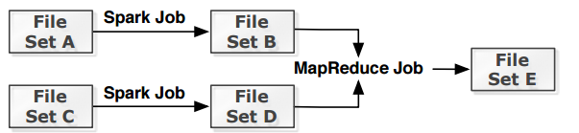
Lineage
DAG: relationship of data
Tracks how data is generated
Provides guidance for re-computation in data loss event

Slide 43
Challenge
Unbounded computation
Data loss event may trigger a lot of re-computation job
Checkpoint crucial data to bound re-computation cost
Resource allocation
Re-computation consumes resources
Make sure normal job is not affected

Slide 44

Bound Re-computation Cost
Edge algorithm
First priority checkpointing leaves
Checkpoint popular files

Slide 45
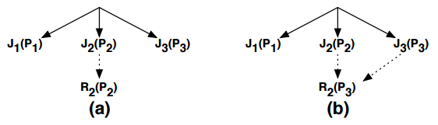
Resource Allocation (Priority Based)
Re-computing job has lowest priority (P1)
If the output data is requested by a job with higher priority P2 > P1
The priority of re-computation grows to P2

Slide 46
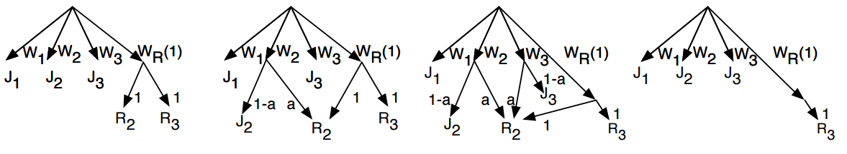
Fair Sharing Based

Slide 47
What are the Opportunities?
As a memory buffer, Tachyon absorbs large portion of read/write operations to the underlying file system
The access pattern to the underlying persistent storage is changed
Should we revisited it?
Can we use SSD more aggressively? Since the # of write requests to the underlying file system is significantly reduced.
Write operation to underlying storage is batched and issued by Tachyon as chechpoint operations, is this an opportunity for erasure coding?

Slide 48
Thank you

