Slide 1
RNA sequencing-based Machine Learning for Detection of
Triple Negative Breast Cancer
Ruben Holthuijsen (1064459) • Sander van Swieten (1063788) • Vince van Doorn (1061669)
Victor de Sousa Gama (0929470) • Kevin Hartman (1044032)

Slide 2





Outline
Introduction and objective
Project set up
Machine learning approach
Results and evaluation
Discussion

Slide 3

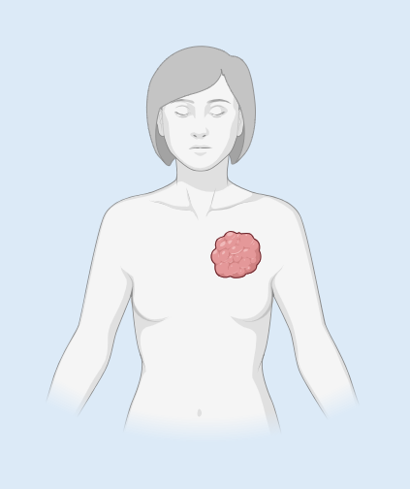



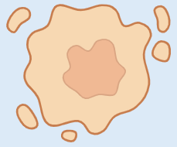

Introduction and objective
2.3 million cases of breast cancer worldwide in 2022
TNBC overview
Women younger than 40 years of age are highest risk
Triple-Negative Breast Cancer
~10-20% of breast cancer
Triple-Negative Breast Cancer (TNBC)
Breast Cancer
(BC)
ER (ESR1)
/
PR (PGR)
/
HER2 (ERBB2)
/
Images created in https://BioRender.com

Slide 4
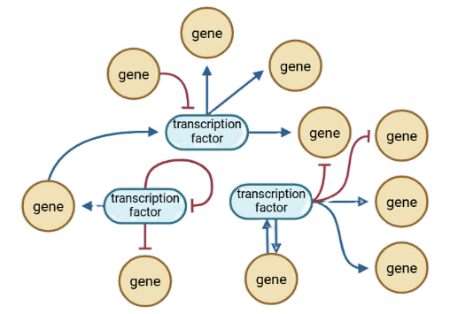
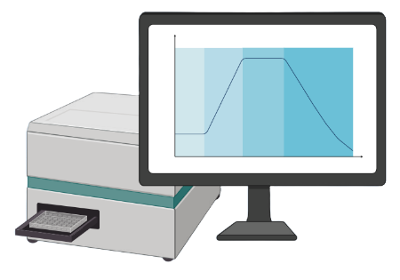

Introduction and objective
Research questions
How accurately can TNBC status be predicted?
TNBC
nTNBC
Which gene features are most useful?
What algorithm gives highly accurate results?
Can we meet important ethical principles?
Images created in https://BioRender.com

Slide 5
Project set up
Workflow
TCGA-BRCA
Outlier removal
Mean removal
Standardization
Deduplication
Literature
Two methods:
Result 1 article
Assessment of 65 articles
Machine learning
Five methods:
PCA
BORUTA
LASSO
RFE
Statistical
Three models:
Logistical regression Support Vector Machine
Random Forest
Also applied:
SMOTE
Class weights
Classification
TNBC / nTNBC
Data loading
Preprocessing
Feature
selection
Model
Output

Slide 6
Project set up
Data loading
RNA expression data of TNBC patients
TCGA-BRCA n = 1097
Label based on clinical data
Drop indeterminable cases
Drop cases without RNA data
Tumor samples:
Breast cancer (BC)
Triple-Negative Breast Cancer (TNBC)

Slide 7
Project set up
Preprocessing
Dimensionality
Harmonization
Selection
Quantified in all datasets
Deletion
With near-zero variance
Recursive feature elimination
Principal Component Analysis
Outlier removal
Applying logarithm transformation
Scaling
Standardization
Deduplication
Rows (cases), no duplicates
Columns (genes)

Slide 8
Machine learning approach
Feature selection
Literature
Machine learning
Result 1 article
Feature extraction: PCA
60660 features (all)
65 research papers
oncogenes and biomarkers
Feature selection: BORUTA (Random Forest)
297 features
(research papers)
Feature selection: LASSO (Regression)
SMOTE
Feature selection: RFE (Support Vector Machine)
Statistical methods
19962 features (protein)

Slide 9



Machine learning approach
Feature selection
Assessment
Criteria
Result
Read 65 papers
‘Overexpressed in TNBC’
Explainable
‘Critical role in TNBC’
Assumption:
‘biomarker results in near perfect model’
‘Distinct biomarker for TNBC’
Assumption proven false

Slide 10
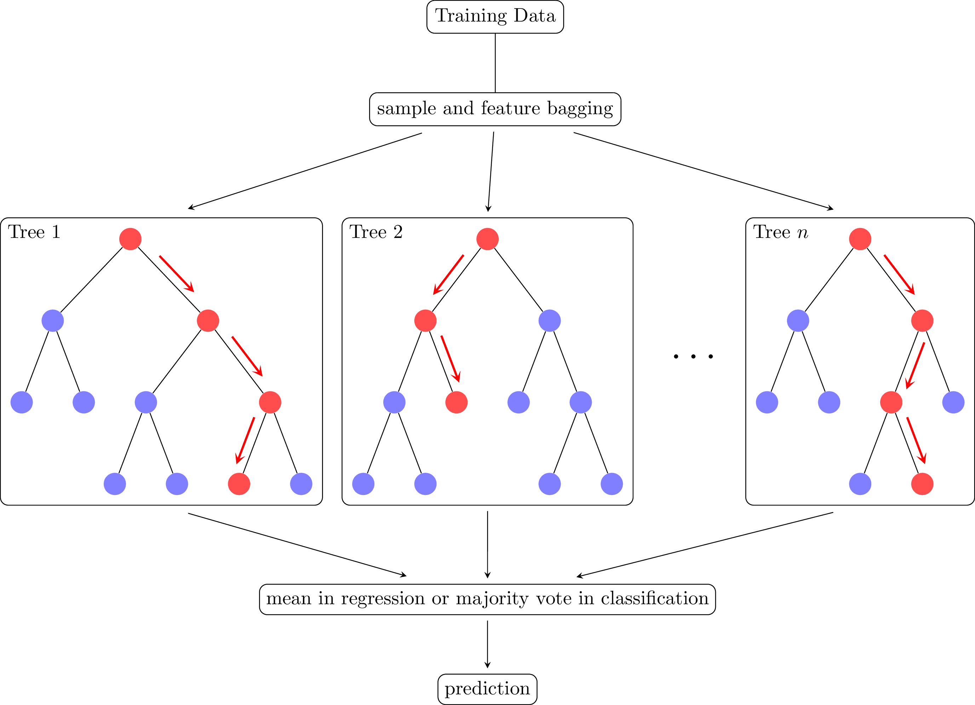
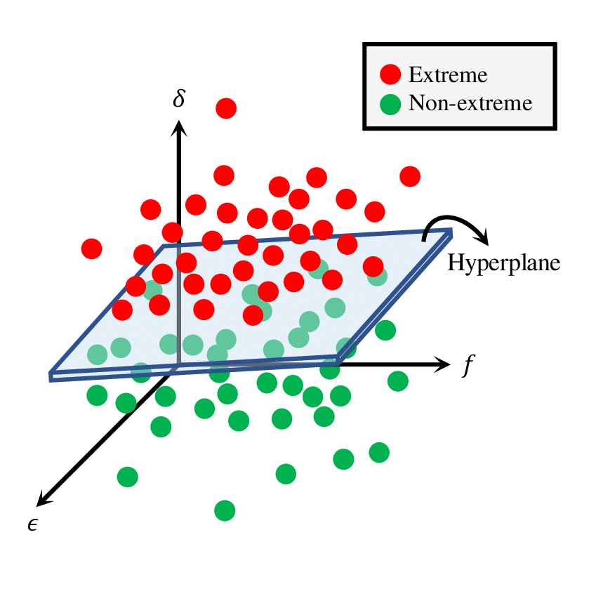
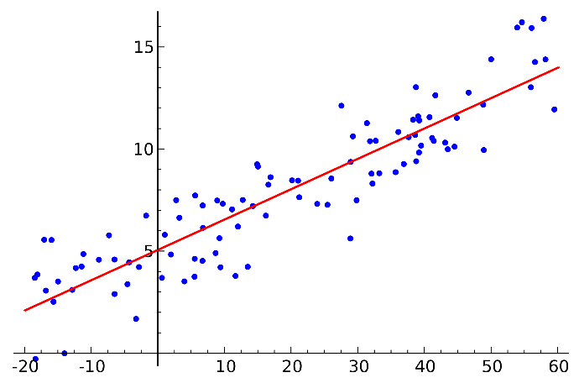
Machine learning approach
Models
Logistic regression
Random Forest
Support Vector Machine
SMOTE

Slide 11
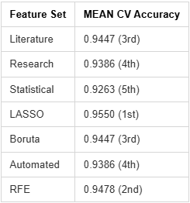
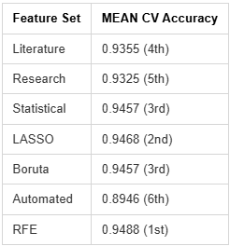
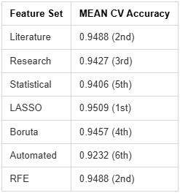
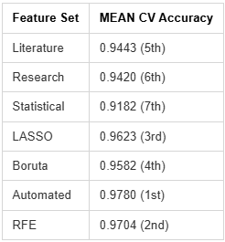
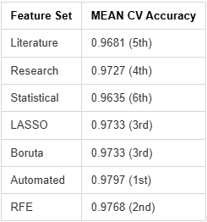
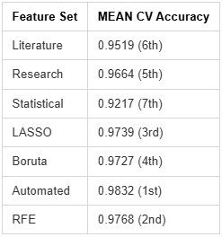
Logistic regression
Random Forest
Support Vector Machine
Results and
evaluation
Model accuracy
SMOTE
Logistic Regression
Random Forest
Support Vector Machine
Notes:
TODO: Part of approach or results?

Slide 12
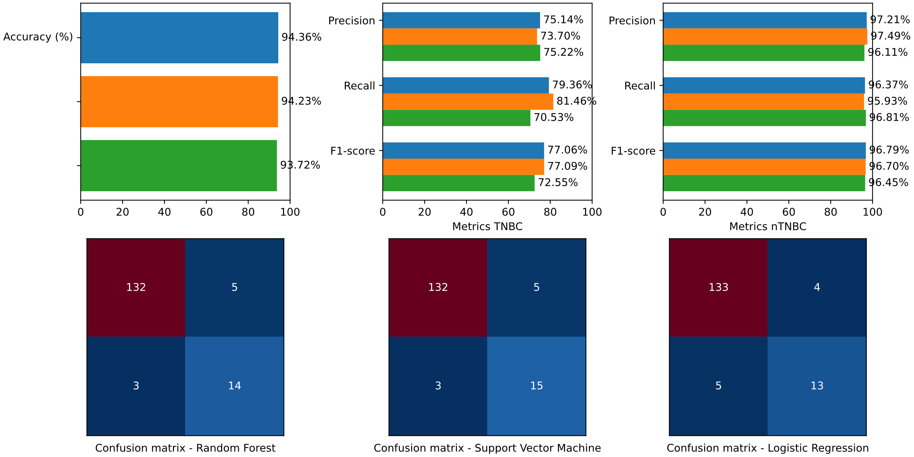

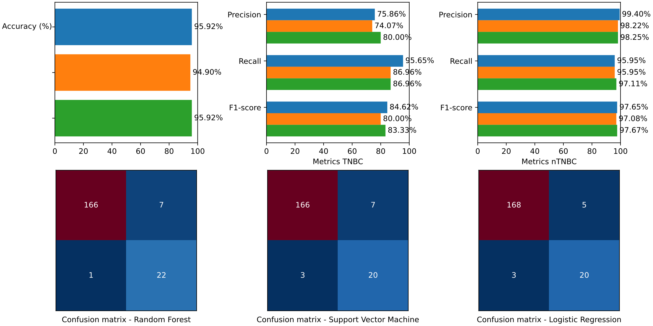
Cross Validation Five Fold
Results and evaluation
Selected feature set
LASSO
Validation
LASSO

Slide 13
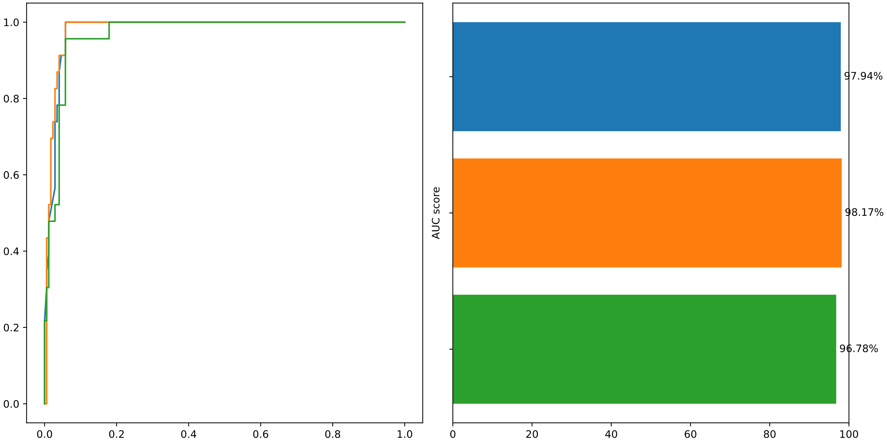
Results and evaluation
Selected feature set
AUROC
LASSO

Slide 14
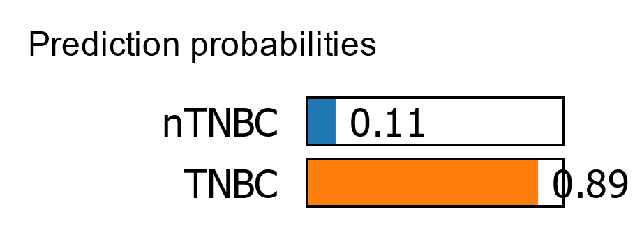
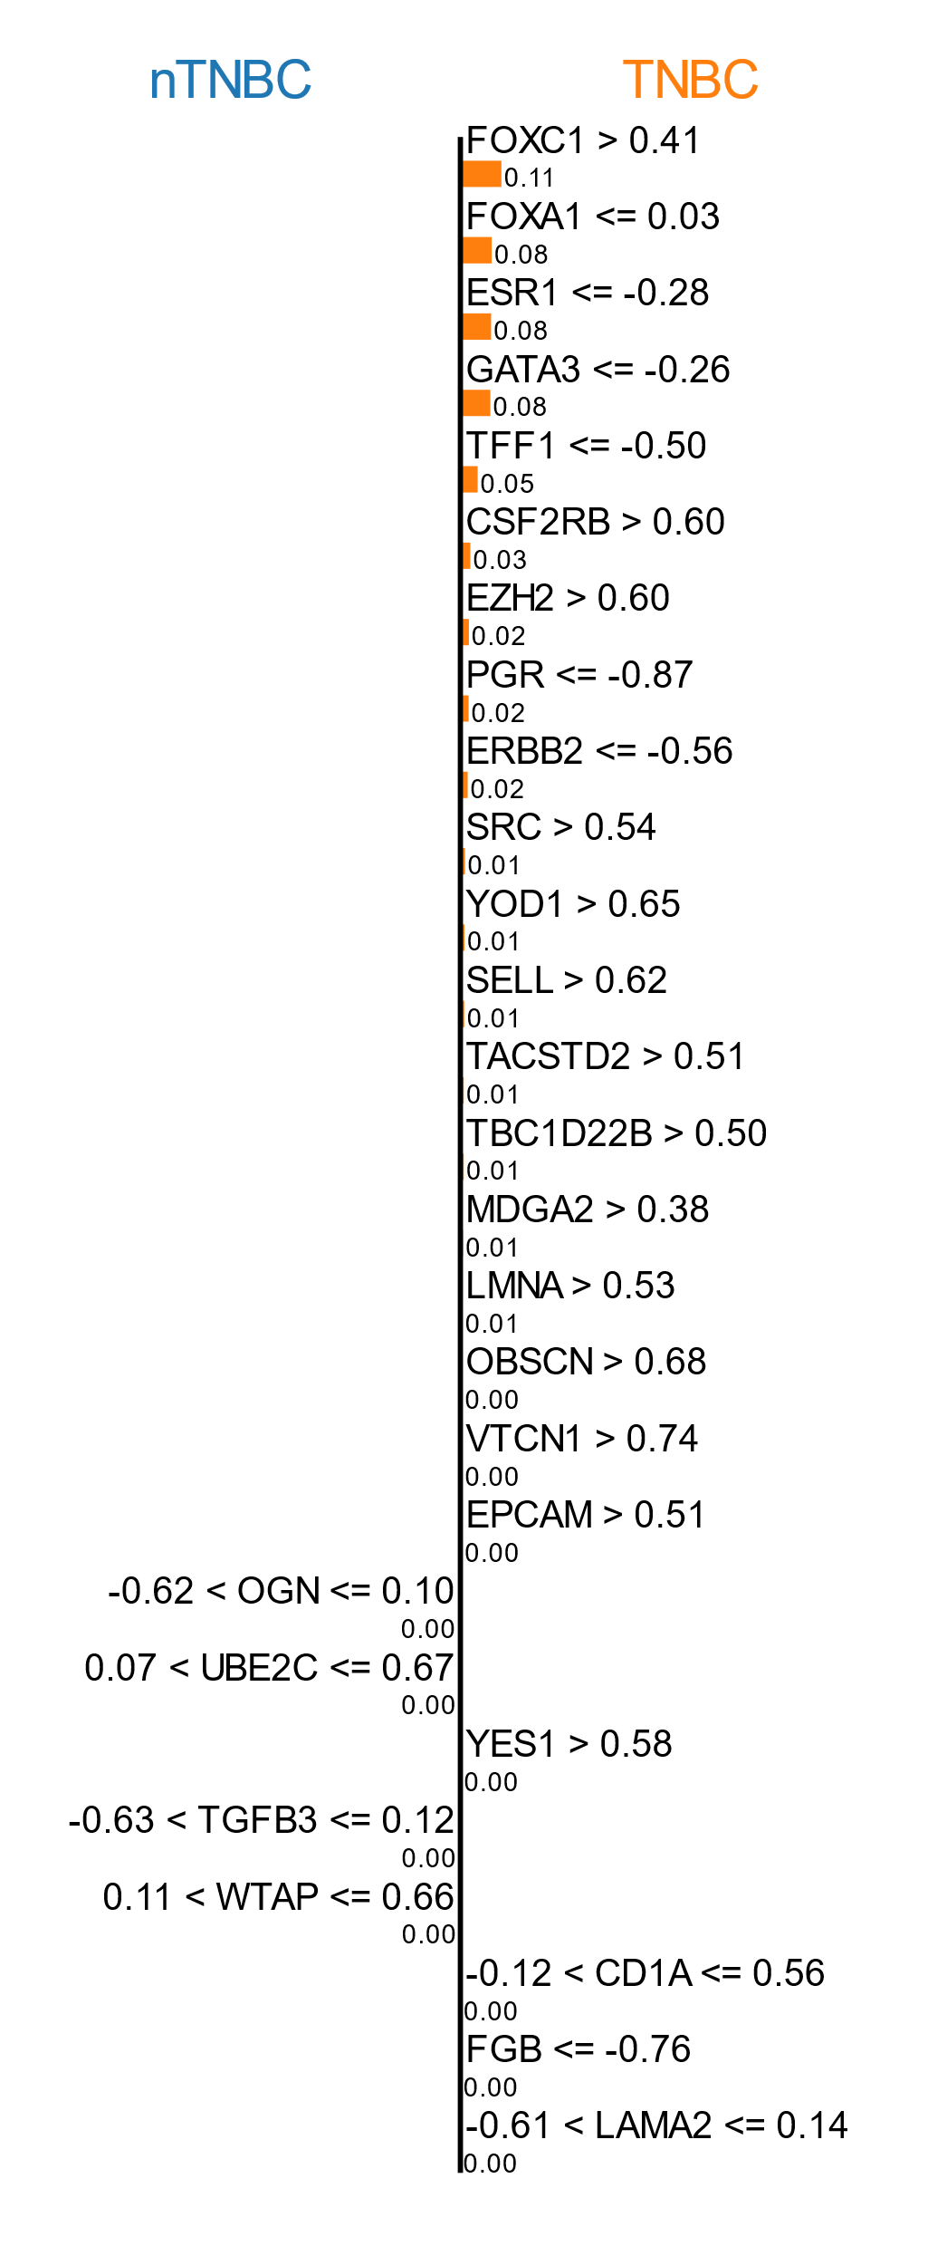
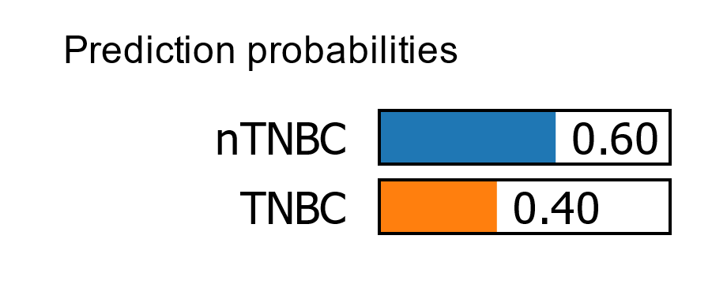
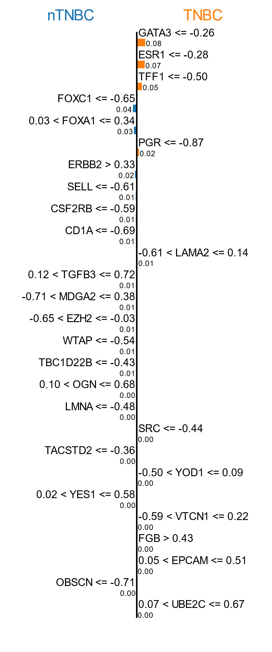
Results and evaluation
Interpretability
LIME
True Positive
True Negative

Slide 15
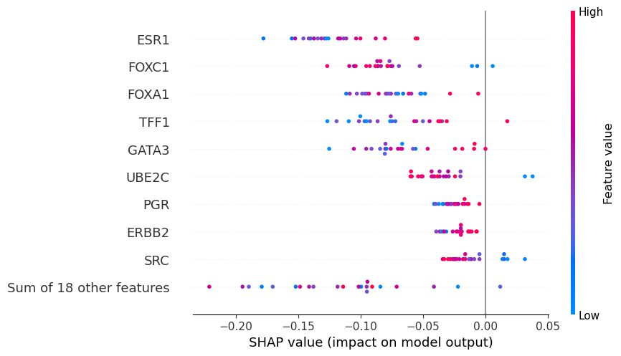
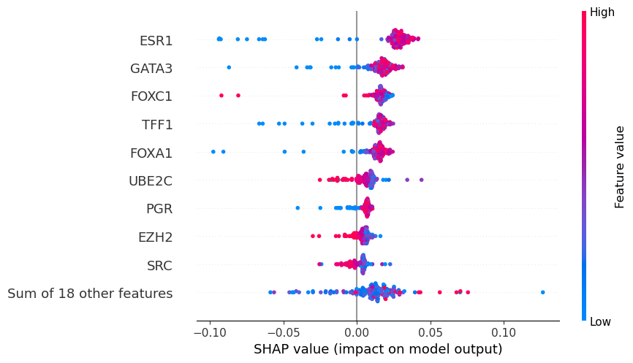
Results and evaluation
Interpretability
SHAP
True Positive
True Negative

Slide 16
Discussion
How accurately can TNBC status be predicted?
Accuracy is high, around 0.95 for most combinations
Accuracy is misleading due to unbalanced data:
- assume “everything is nTNBC” = accuracy of 0.8843
Important to consider other metrics
TNBC
nTNBC
Promising results

Slide 17
Discussion
Which gene features are most useful?
Literature based gives better accuracy than manual analysis
Automated features (PCA) are a wildcard and inexplicable: worst accuracy
with raw data, then suddenly best accuracy with SMOTE applied
Use of 297 genes referenced in literature, reduced by LASSO, gives best results, though RFE is similar
Genes selected by LASSO match those identified as high importance in literature
Images created in https://BioRender.com

Slide 18
Discussion
What algorithm gives highly accurate results?
Algorithms give similar results, Random Forest slightly better
SMOTE improves accuracy
Random Forest with LASSO-selected features:
Precision 75.86%
Recall 95.65%
F1-score of 84.62%.
Images created in https://BioRender.com

Slide 19
Discussion
Can we meet important ethical principles?
Privacy: patient data not saved in repository, instead provided instructions to acquire
Fairness/Bias: clinical data such as race, age, etc. was never part of training data, only RNA-seq was used. Use clinical data to verify fairness and lack of bias
Interpretability: Automated (PCA) features, problematic, discarded.
LASSO-selected features backed up by literature and interpretable through SHAP/LIME
Images created in https://BioRender.com

Slide 20
Thank you for your attention
Ruben Holthuijsen (1064459) • Sander van Swieten (1063788) • Vince van Doorn (1061669)
Victor de Sousa Gama (0929470) • Kevin Hartman (1044032)

