Slide 1
Quantum Software Engineering
Quantum computing project

Slide 2
Content
Paper: Quantum-Based Software Engineering
Code Implementation
Latest news in the market
Company and its quantum-related service

Slide 3
Main points discussed in the paper
Paper name: Quantum-Based Software Engineering (Zhao et al., 2025)
Techniques:
Quantum Search Algorithms (Section 5.1):
Includes Grover’s algorithm and amplitude amplification. These are about searching an unstructured space by preparing a quantum superposition and amplifying the “good” solutions.
Annealing-Based Optimization (Section 5.3):
Using quantum annealers or adiabatic quantum computing to gradually evolve a system toward a low-energy state that corresponds to a good solution.

Slide 4
Following techniques:
Quantum Machine Learning (Section 5.4):
Models like quantum neural networks (QNNs), quantum support vector machines (QSVMs), quantum embedding methods etc. These use parameterized quantum circuits or quantum feature spaces’

Slide 5
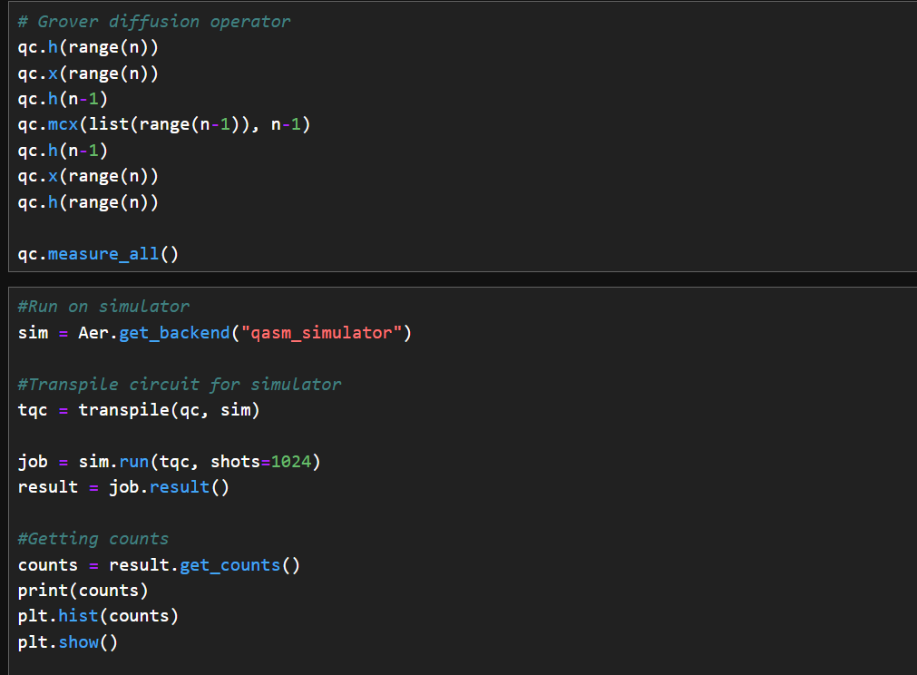
Code Implementation focused mainly on Search algorithm

Slide 6

The Company and its quantum-related service Aqacia Home - Aqacia
The company offers consultation in quantum machine learning services like optimization and Control
Floquet: a Joint Venture between Aqacia and 2pi Software. It is a Quantum enabler company, creating services that will allow users to access current quantum technologies as well as developing its own cloud-based Quantum products.

Slide 7
Latest news:
Google Quantum AI Joins DARPA to Benchmark Path to Utility-Scale Fault-Tolerant Computing - Quantum Computing Report
Google Quantum AI has been selected to participate in the DARPA Quantum Benchmarking Initiative (QBI). The QBI aims to assess quantum computing approaches to determine if a utility-scale, fault-tolerant computer can be built by 2033. The program provides rigorous, third-party benchmarking, a specialized capability for the quantum industry.
Google Quantum AI will partner with DARPA and its technical experts, who will act as a validator for its approach. This collaboration aligns with Google’s mission to build quantum computing systems for complex problems in fields such as medicine, energy, and machine learning.

