Slide 1

PORYGON (Team 11) SER 502 Instructor: Dr. Ajay Bansal

Slide 2




Team Members
Anmol Mallikarjun Nemagouda
Git Username: AnmolNemagouda
Chandrakanth Dhanunjai Chintala Git Username: Cchinta2
Kaumudi Degekar Gulbarga Git Username: KaumudiDG
Rakshilkumar Modi Git Usernames: rakshil14 rakshil14-2

Slide 3
Overview
About the Language.
Design.
Design Components.
Feature list.
General Rules of the program
Grammar
Snapshots of the Programming Language

Slide 4
ABOUT THE LANGUAGE
1

Slide 5
About the Language
Name: Porygon
Extension: .pgon
Paradigm: Imperative
Programming languages used: Python and Prolog.

Slide 6

2

Slide 7
Source Code (Porygon file)
Character Stream
Lexer
(Python SLY)
Tokens
Parser (Prolog)
Syntax tree
Evaluator (Prolog)

Slide 8
DESIGN COMPONENTS
3

Slide 9
Design Components
Script: A script that helps to run the Porygon program file.
Source Code: This is the source code for the newly developed language that needs to be executed.
Lexer: We will be using Python (Lark- subject to change) as a Lexer for this project. It accepts the source code as an input and breaks down the given code into tokens. The tokens will be generated as a list which will then be passed on to Prolog for parsing.

Slide 10
Design Components
Parser: We be using Prolog as a parser for this project. It will take the token list from the lexer and generate a parse tree as per the defined grammar.
Evaluator: This is used to evaluate the parse tree generated by the parser and execute the instructions.

Slide 11
FEATURE LIST
4

Slide 12
Features list
Declarations:
Constant declaration.
Plain declaration.
Variable declaration.
Commands:
If
If else
If else ladder
For value in range
Traditional for loop..
While loop
Assignment..
Print Statement.
Print in newline

Slide 13
Features list
Assignment:
Initial assignment.
Declarative assignment.
Shorthand Assignment.
Operations:
Arithmetic (addition, subtraction, multiplication, division.).
Modulus.
Operations(cont.):..
Increment.
Decrement.
Square of a number.
Square root.
Cube of a number.
Cube root.
Exponent.
String length.
Sting Concatenation.

Slide 14
Features list
Operations(Cont.):
Ternary.
Boolean operations.
Additional features:
Error Handling.
Type Checking.

Slide 15
GENERAL RULES OF THE PROGRAM
5

Slide 16
General Rules of the Program
Data Types:
Integers.
Strings.
Floating point numbers
Boolean expressions.
Keywords:
Const
If
else
Keywords(cont.):
Elseif
For
While
And
Or
Not
Printnl
Print
In

Slide 17
General Rules of the Program
Keywords (cont.):
True.
False.
Sq
Sqrt
Cb
Cbrt
Mod
.range
Int
Keywords(cont.):
Float
Bool
String
Strlen

Slide 18
General Rules of the Program
Basic rules:
Each program begins and ends with curly braces ‘{}’.
Each declaration and command line must end with a semi colon ‘;’.
String Values must be enclosed within double-quotes (“ “).
Comments should start with ‘#’.

Slide 19
General Rules of the Program
Variable rules:
Variable names should always begin with a lowercase letter.
Variable names can be alphanumeric and can contain ‘_’ , however they cannot end with ‘_’.
Variable names can also contain uppercase letters.
Initial declaration should always be done before commands.
Data types(cont.):
Initial values for integer and float are ‘0’ and ‘0.0’ respectively.
Only integer operations will be performed with ‘int’ keyword and float operations with ‘float’ keyword.
Float values will always be returned for square root and cube root operations.

Slide 20
GRAMMAR
6

Slide 21
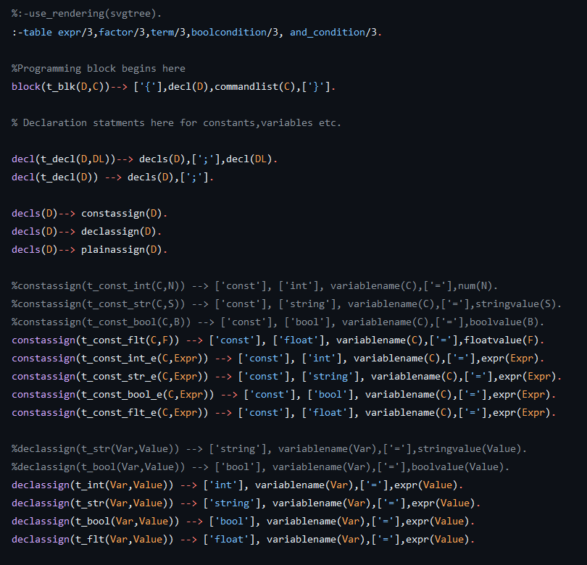

Slide 22
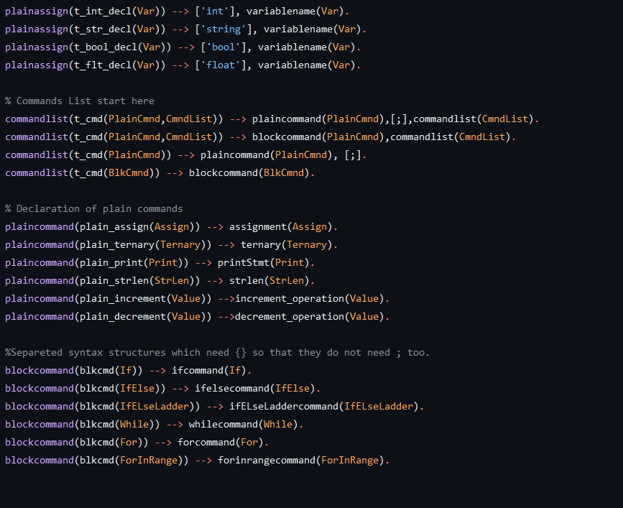

Slide 23
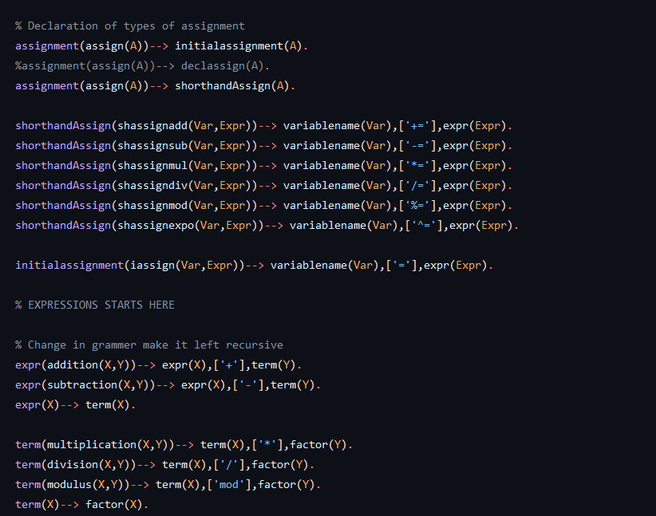

Slide 24
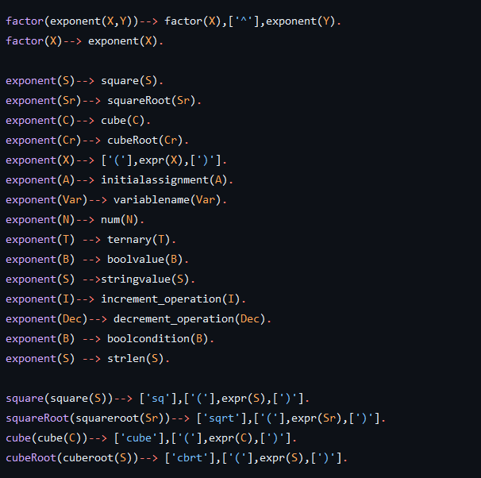

Slide 25
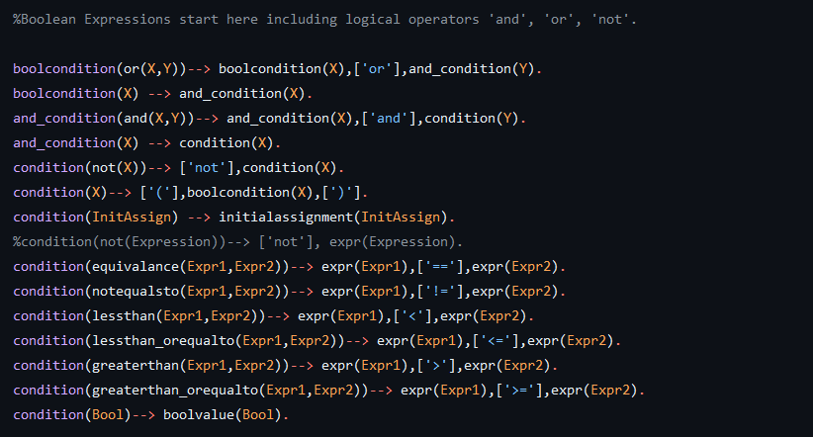

Slide 26
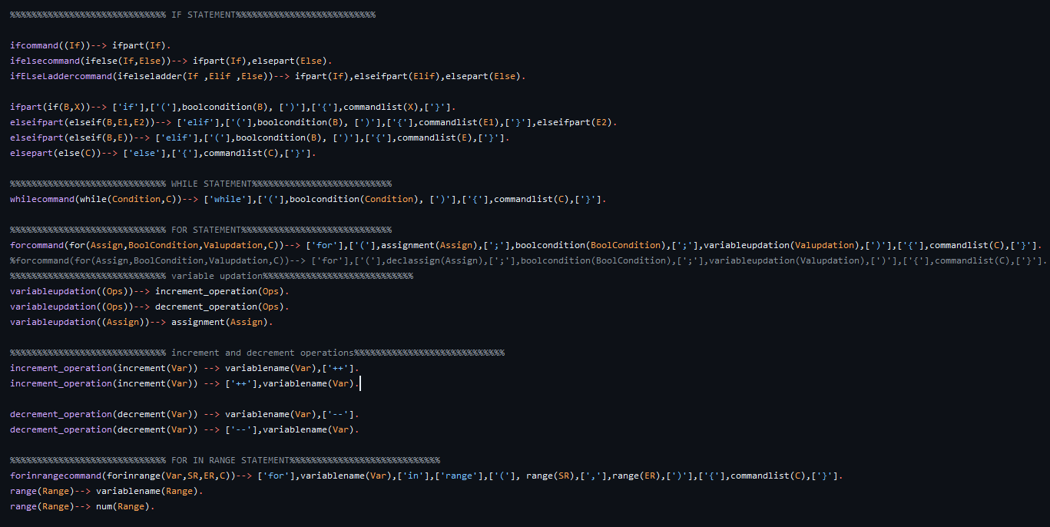

Slide 27
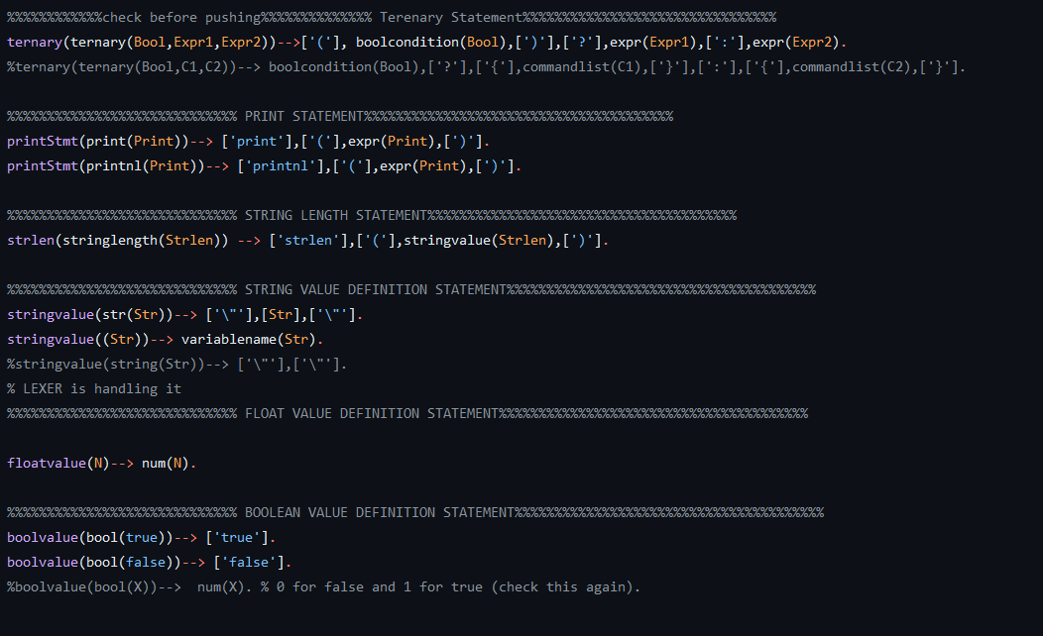

Slide 28
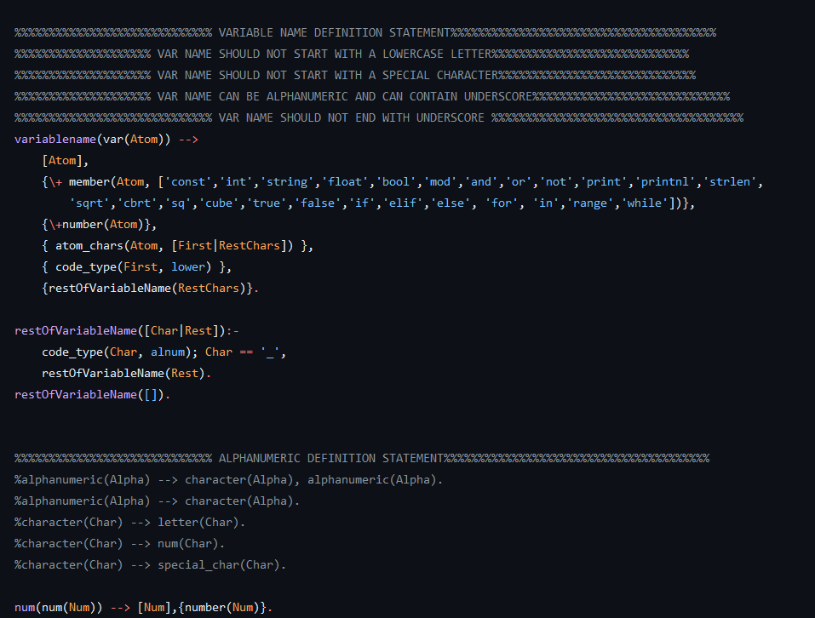

Slide 29
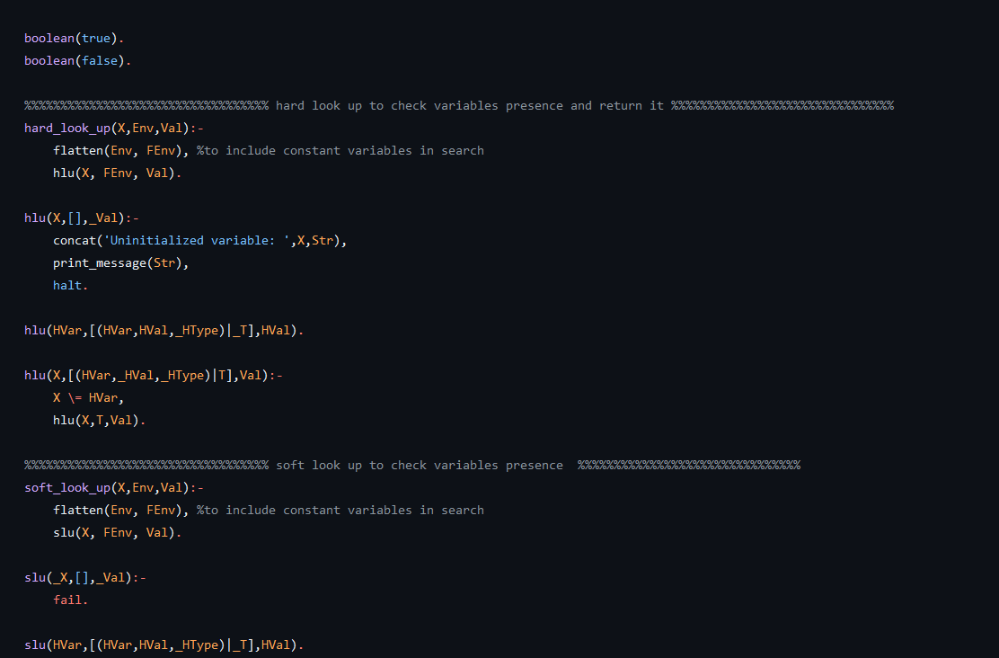
EVALUATOR

Slide 30
SNAPSHOTS OF THE PROGRAMMING LANGUAGE
7

Slide 31
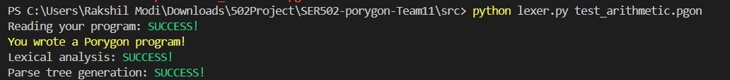
PROGRAM RUNNING

Slide 32
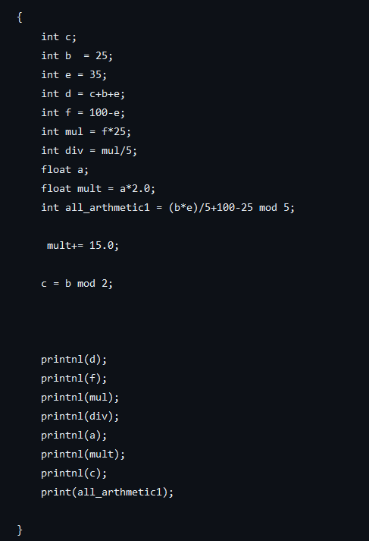
PROGRAM EXAMPLE

Slide 33
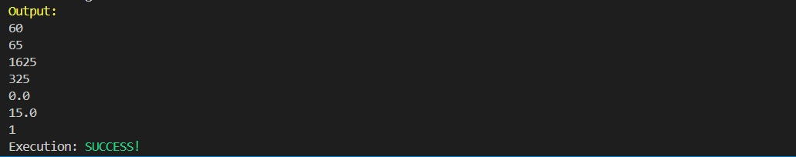
OUTPUT

Slide 34
THANKS!

