Slide 1

Predicting Software Developers
From
New Coder Survey

Slide 2
“We're building a massive open dataset about new coders” -freeCodeCamp.org
> 16,000 new coder respondents
> 50 questions
Coding related Questions
Time and money spent learning
Websites, Bootcamps, Podcasts, YouTube Channels used to learn
Events attended
Demographic Questions
Employment
Personal
Family
Financial
Educational
Location
Prediction Variable: Is the respondent a Software Developer?

Slide 3
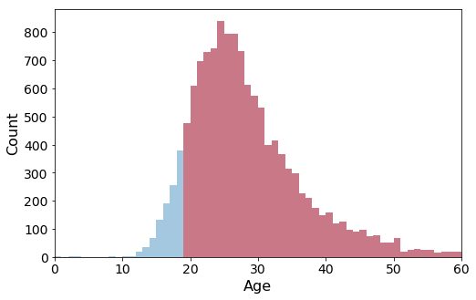
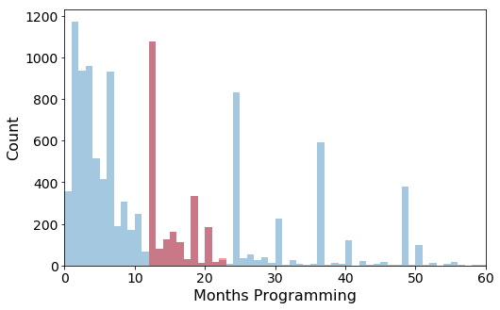
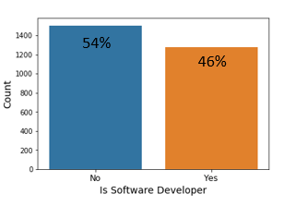
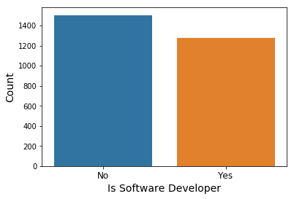
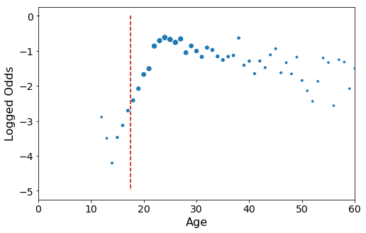
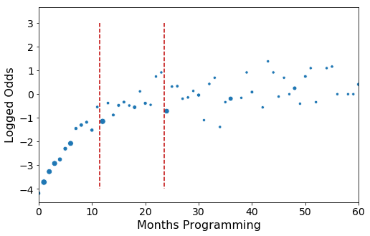
Visualizing The Subset
Filter 1
Older than 18
Filter 2
1-2 years programming experience*
Respondents in subset: 2,778
54%
46%
*Developers with less than 1 year programming were included

Slide 4
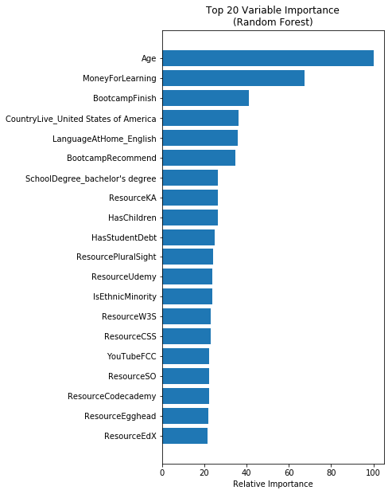
Out of Box Models with Original Features

Slide 5
Going For Maximum Accuracy
Feature Engineering
PCA Subspace
Polynomial Features
Combined Dummies
Capped Outliers
Binned Numerical Data
Division Interaction
Random Forest
Grid Search CV
criterion: entropy
max depth: 50
max features: 0.1
max leaf nodes: None
min samples leaf: 1
n estimators: 300
Recursive Feature Elimination CV
161 Features
Logistic Regression
Ridge Logistic Regression CV
C = .35 (lambda=2.86)
Recursive Feature Elimination CV
197 Features

Slide 6
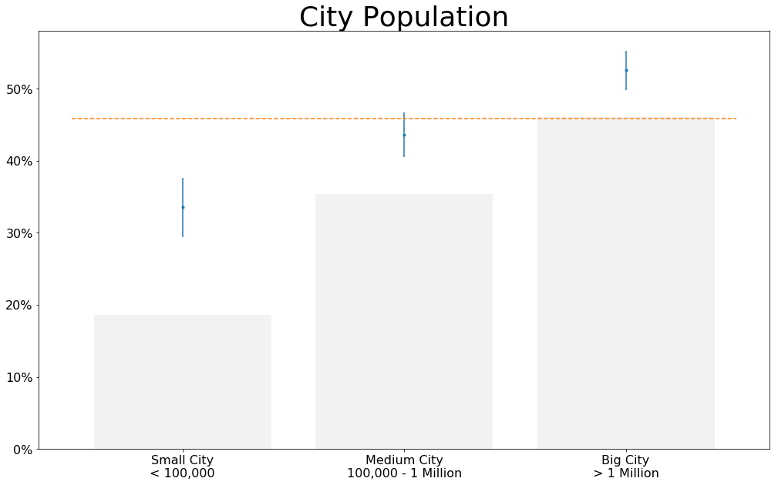
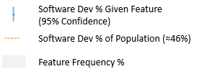
% of software devs in survey population (≈46%)
% of small city respondents that are software devs (≈34%)
% of survey population living in a small city (≈19%)

Slide 7
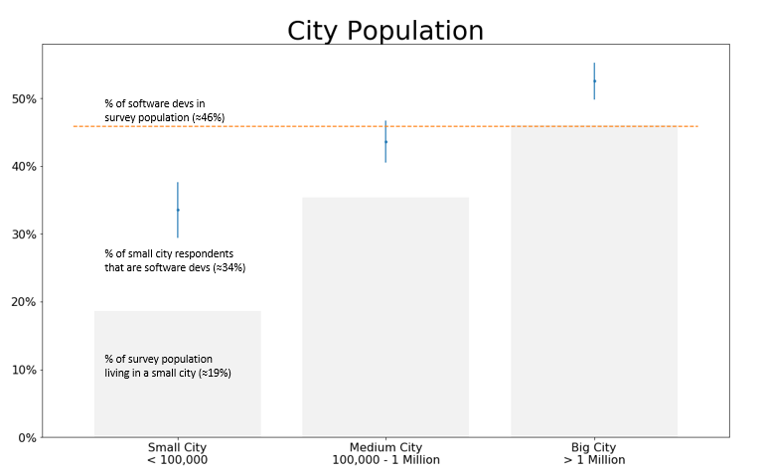

Slide 8
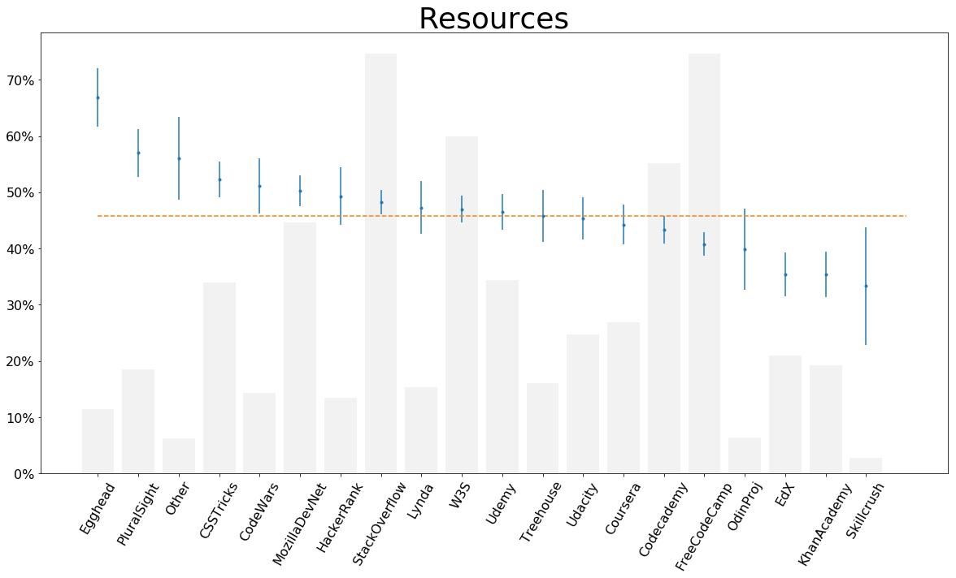

Slide 9
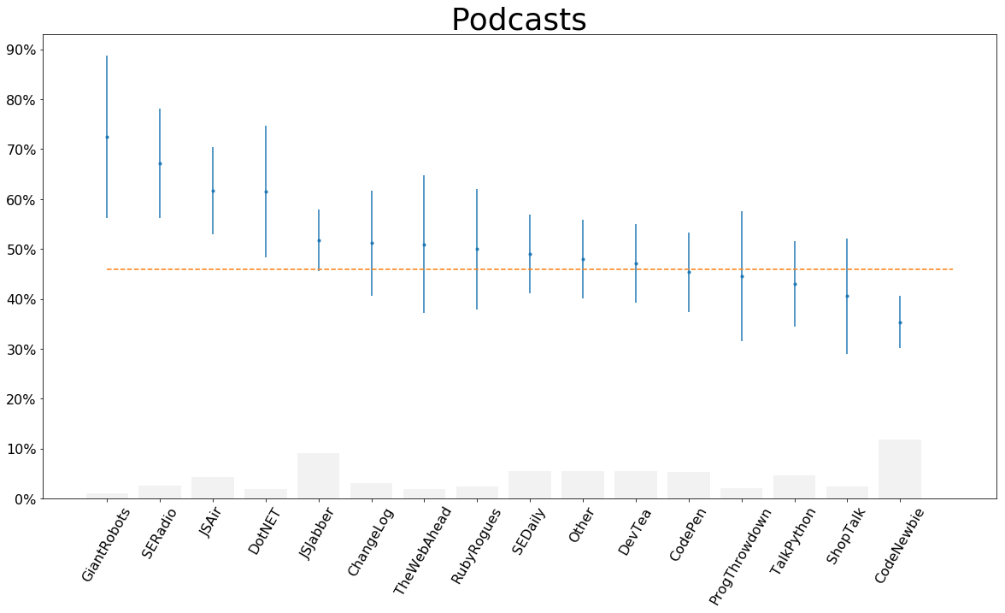

Slide 10
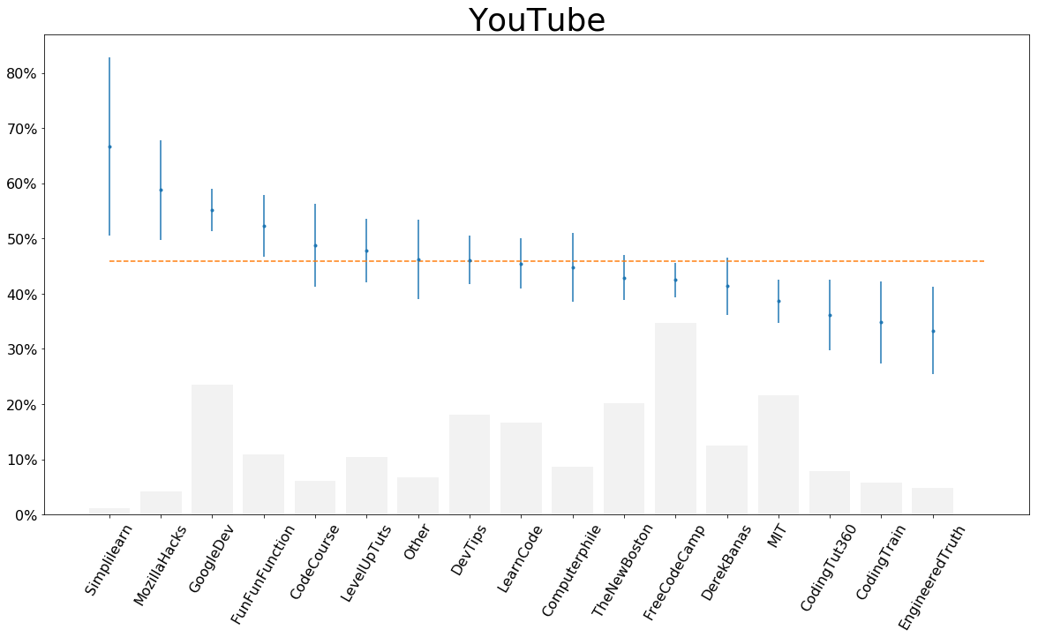

Slide 11
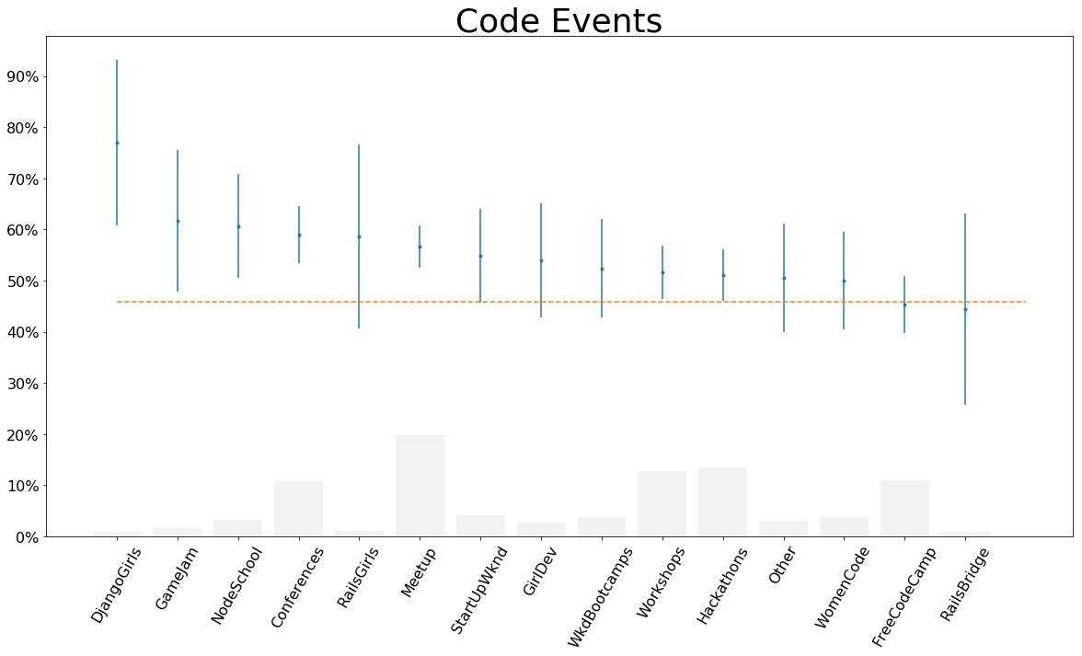

Slide 12
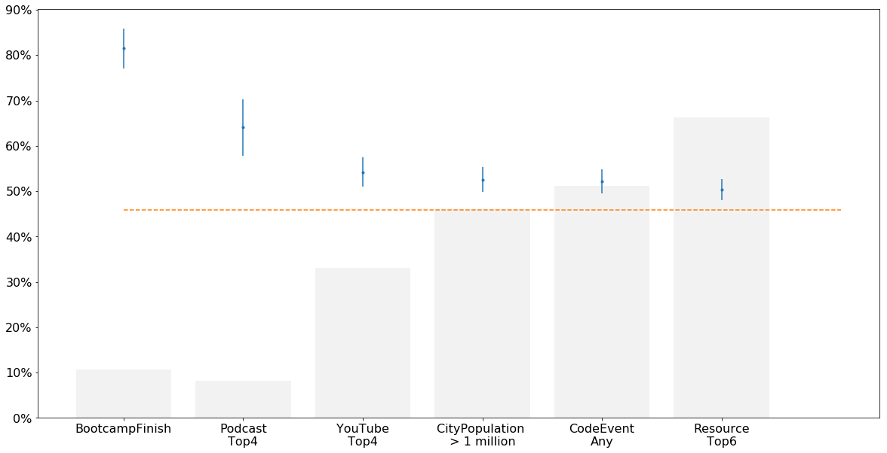
Final Features
Top 4 Podcasts:
Giant Robots
SE Radio
JS Air
Dot Net
Top 4 YouTube:
Simplilearn
MozillaHacks
GoogleDev
FunFunFunction
Top 6 Resources:
Egghead
PluralSight
Other
CSS Tricks
CodeWars
Feature Frequency
Software Dev Proportion, Population (≈ 46%)
Notes:
Egghead – JavaScript tools and frameworks
PluralSight -

Slide 13
Accuracy: 63.5%

Slide 14
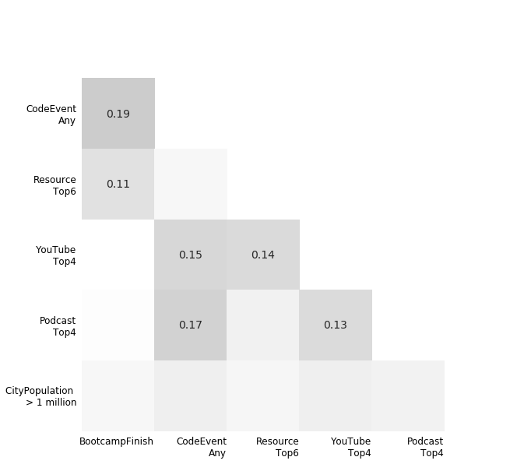
Cross Validated Accuracy: 63.5%

