Slide 1
DECICE Workshop
Vittorio Cozzolino
E-mail: vittorio.cozzolino@huawei.com
Senior Software Engineer
Munich/Dublin Research Center
2023.11.06

Slide 2
DECICE Workshop Agenda
Part 1
HAICGU cluster overview
Login HAICGU cluster
MQTT application
Build containers
Push the containers to internal registry
Deploy containers on Kubernetes using YAML files
Check containers logs and status
Part 2
Intro about KubeEdge
Deploy MQTT application on KubeEdge
Build and push aggregator container
Modify YAML
Deploy on edge node

Slide 3


DECICE Workshop – Part 1 HAICGU Cluster
ssh
dev
haproxy
kubectl (kube-api-server)
HAICGU Kubernetes Cluster
Master
cn01
cn02
Worker
cn03
cn04
cn05
cn06
Worker
cn07
Edge

Slide 4
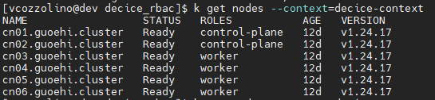
DECICE Workshop – Part 1 Login HAICGU Cluster
SSH to dev node with pub/private key
Run this command to copy the k8s cluster config into your home folder
cd && mkdir .kube && cp ../kubernetes/config ~/.kube
Run the command → kubectl get nodes –A and check the output. You should see what’s shown below.
Not all users have the same access rights to the kubernetes cluster:
DECICE users have limited access to the cluster (limited to `decice` namespace).
Admins have no visibility restrictions of cluster resources.
In this tutorial, we will deploy everything in the decice namespace.

Slide 5
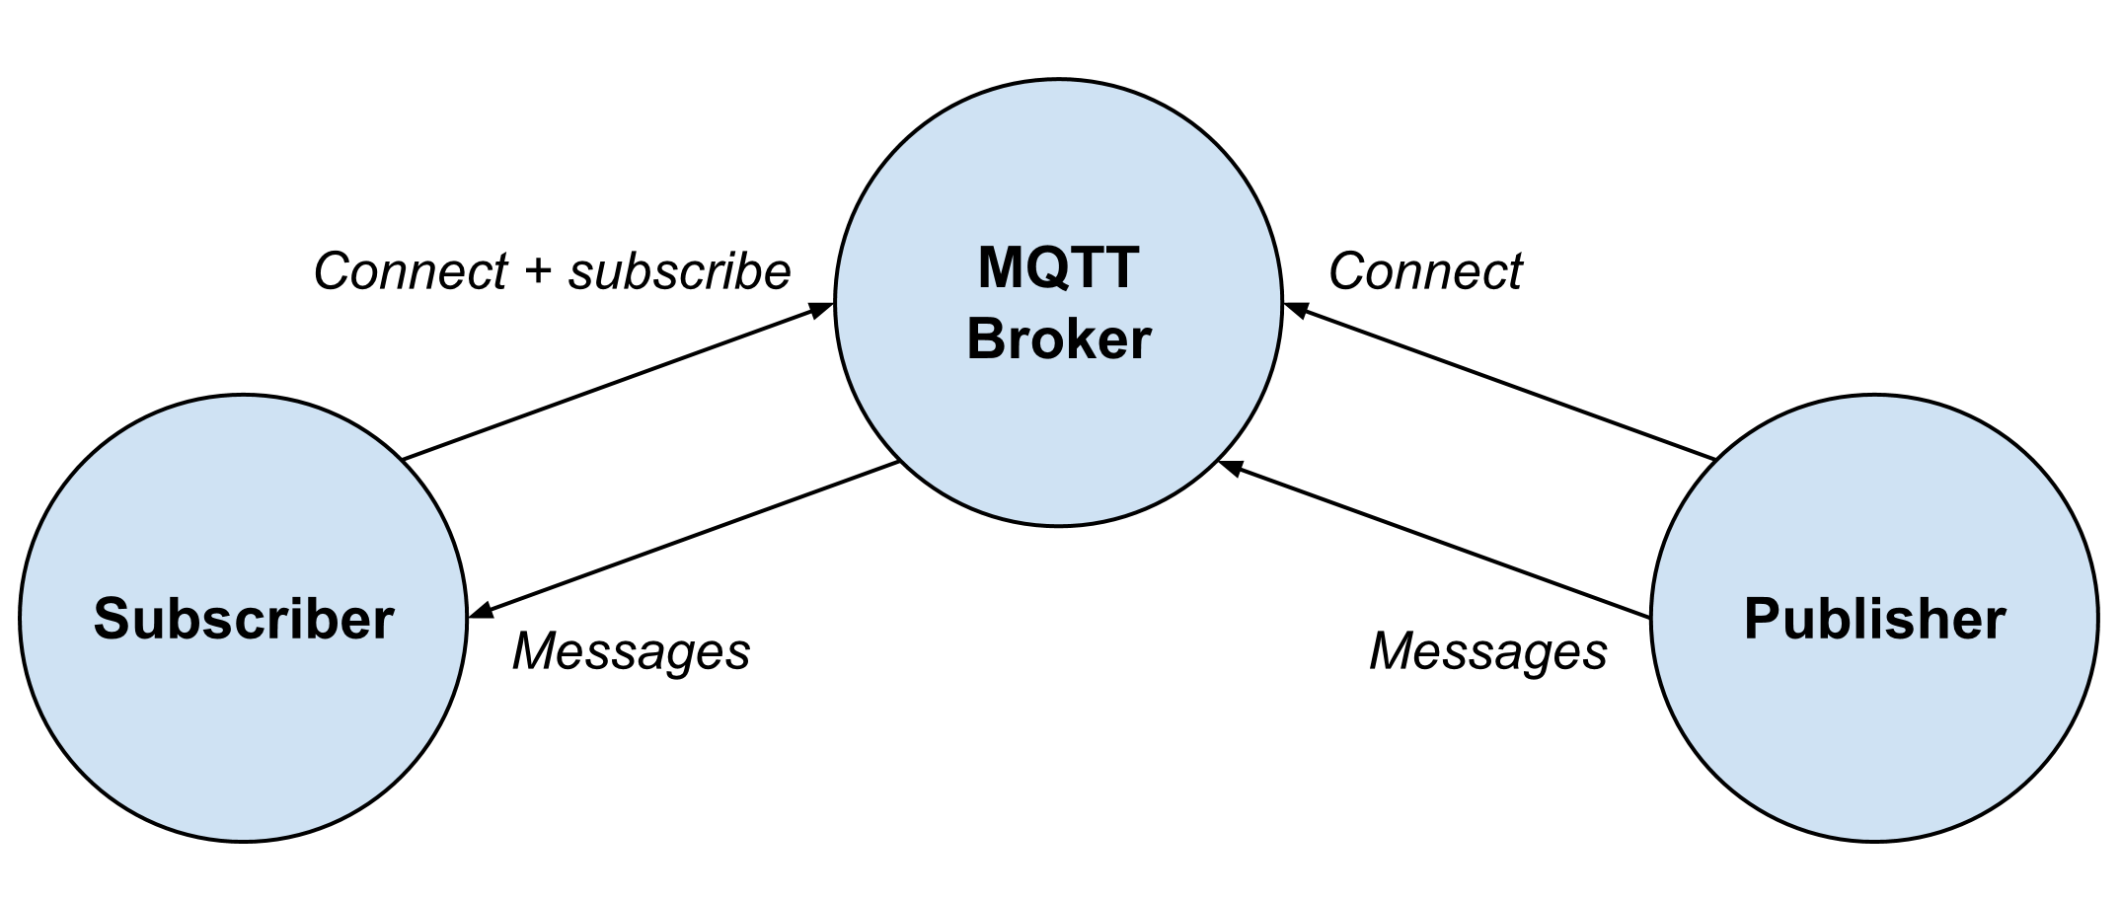
DECICE Workshop – Part 1 Build and Push MQTT Application
Goal: Deploy on the cluster a MQTT publisher and subscriber and check that they can write/read on a predefined topic. On the k8s cluster, a MQTT broker (mosquito) is already installed and running.
In the GitHub repository (https://github.com/rho770/oehi-cc-training.git) you will find:
Python scripts for the publisher and subscriber.
Dockerfiles to build the images for publisher and subscriber.
YAML files to deploy the containers on the k8s cluster.
Note: You can run the Python scripts from shell rather than deploying the containers, however this procedure will not be described in the following slides. To do so, remember to run this command from shell first:
module load GCC Python paho-mqtt

Slide 6
DECICE Workshop – Part 1 Build and Push MQTT Application
Make sure that you are in your home folder → cd
Pull the repository with → git clone https://github.com/rho770/oehi-cc-training.git ~/demo/
Move to the demo folder → cd ~/demo/ workflow1.
In the folder, there are both deploy and undeploy scripts that can be used to automated the steps illustrated below.
Check/Edit the Python code (optional).
Build the publisher image with → podman build -f publisher.dockerfile . -t cn04:30500/"$USER"-publisher:latest
you might need sudo rights to run the podman command!
Build the subscriber image with → podman build -f subscriber.dockerfile . -t cn04:30500/"$USER"-subscriber:latest
Push the images:
Inside the Kubernetes cluster, we have deployed a private Docker image registry for DECICE.
To push an image to the private registry, run the commands below:
Push the subscriber image with → podman push cn04:30500/"$USER"-subscriber:latest
Push the publisher image with → podman push cn04:30500/"$USER"-publisher:latest
Deploy your containers on Kubernetes using the provided YAML file (*):
Deploy the MQTT publisher → envsubst < yaml/publisher.yaml | kubectl create -f -
Deploy the MQTT subscriber → envsubst < yaml/subscriber.yaml | kubectl create -f -
Check the logs from the pods:
Find out the name of the pods by running first kubectl get pods –n decice
kubectl logs –n decice –f publisher_pod_name
kubectl logs –n decice –f subscriber_pod_name
To delete the resources created, run the following:
Undeploy the MQTT publisher → envsubst < yaml/publisher.yaml | kubectl delete -f -
Undeploy the MQTT subscriber → envsubst < yaml/subscriber.yaml | kubectl delete -f -
Extra: Have a look at the YAML files to understand how pods are assigned to k8s nodes and where the connection details for the broker are located.
(*): We use the shell command envsubst to replace environment variables in the YAML file with their actual value. In this case, the current shell user username.

Slide 7
DECICE Workshop Agenda
Part 2

Slide 8
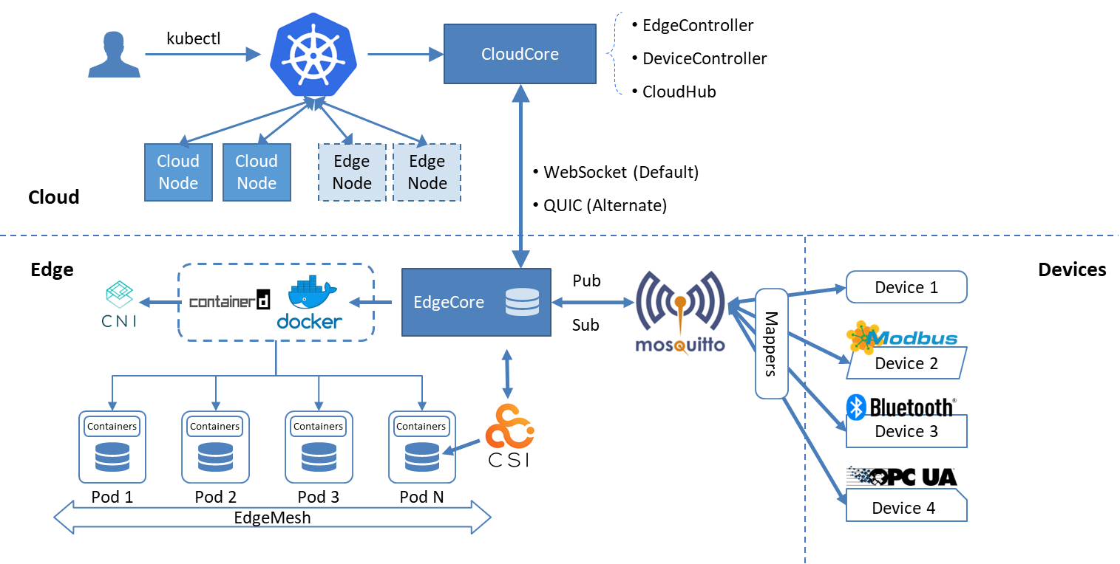
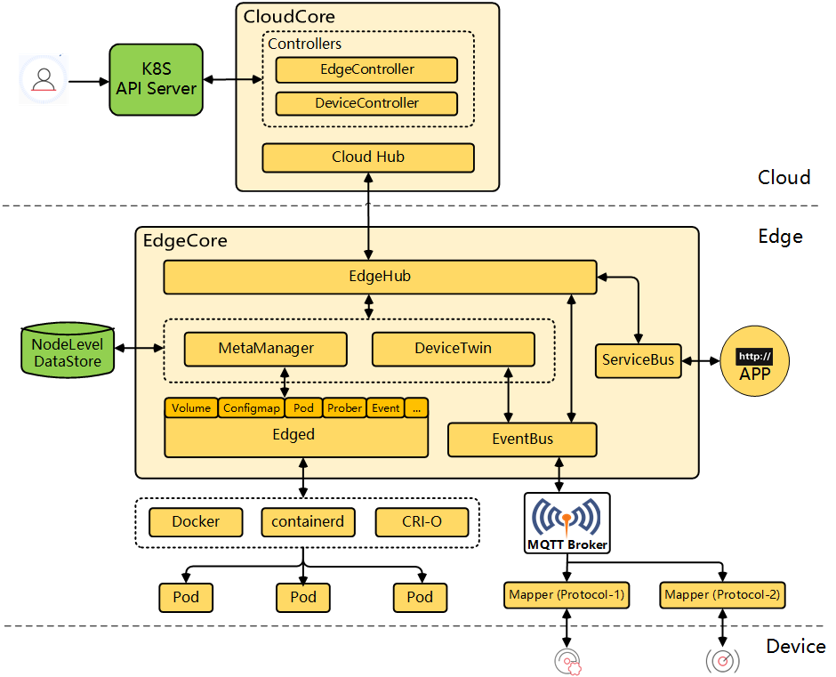
DECICE Workshop – Part 2 KubeEdge
KubeEdge is built upon Kubernetes and extends native containerized application orchestration and device management to hosts at the Edge. It consists of cloud part and edge part, provides core infrastructure support for networking, application deployment and metadata synchronization between cloud and edge. It also supports MQTT which enables edge devices to access through edge nodes.
Advantages
Kubernetes-native support: Managing edge applications and edge devices in the cloud with fully compatible Kubernetes APIs.
Cloud-Edge Reliable Collaboration: Ensure reliable messages delivery without loss over unstable cloud-edge network.
Edge Autonomy: Ensure edge nodes run autonomously and the applications in edge run normally, when the cloud-edge network is unstable or edge is offline and restarted.
Edge Devices Management: Managing edge devices through Kubernetes native APIs implemented by CRD.
Extremely Lightweight Edge Agent: Extremely lightweight Edge Agent(EdgeCore) to run on resource constrained edge.

Slide 9
DECICE Workshop – Part 2 KubeEdge
In the Cloud
CloudHub: a web socket server responsible for watching changes at the cloud side, caching and sending messages to EdgeHub.
EdgeController: an extended kubernetes controller which manages edge nodes and pods metadata so that the data can be targeted to a specific edge node.
DeviceController: an extended kubernetes controller which manages devices so that the device metadata/status data can be synced between edge and cloud.
On the Edge
EdgeHub: a web socket client responsible for interacting with Cloud Service for the edge computing (like Edge Controller as in the KubeEdge Architecture). This includes syncing cloud-side resource updates to the edge, and reporting edge-side host and device status changes to the cloud.
Edged: an agent that runs on edge nodes and manages containerized applications.
EventBus: a MQTT client to interact with MQTT servers (mosquitto), offering publish and subscribe capabilities to other components.
ServiceBus: an HTTP client to interact with HTTP servers (REST), offering HTTP client capabilities to components of cloud to reach HTTP servers running at edge.
DeviceTwin: responsible for storing device status and syncing device status to the cloud. It also provides query interfaces for applications.
MetaManager: the message processor between edged and edgehub. It is also responsible for storing/retrieving metadata to/from a lightweight database (SQLite).

Slide 10
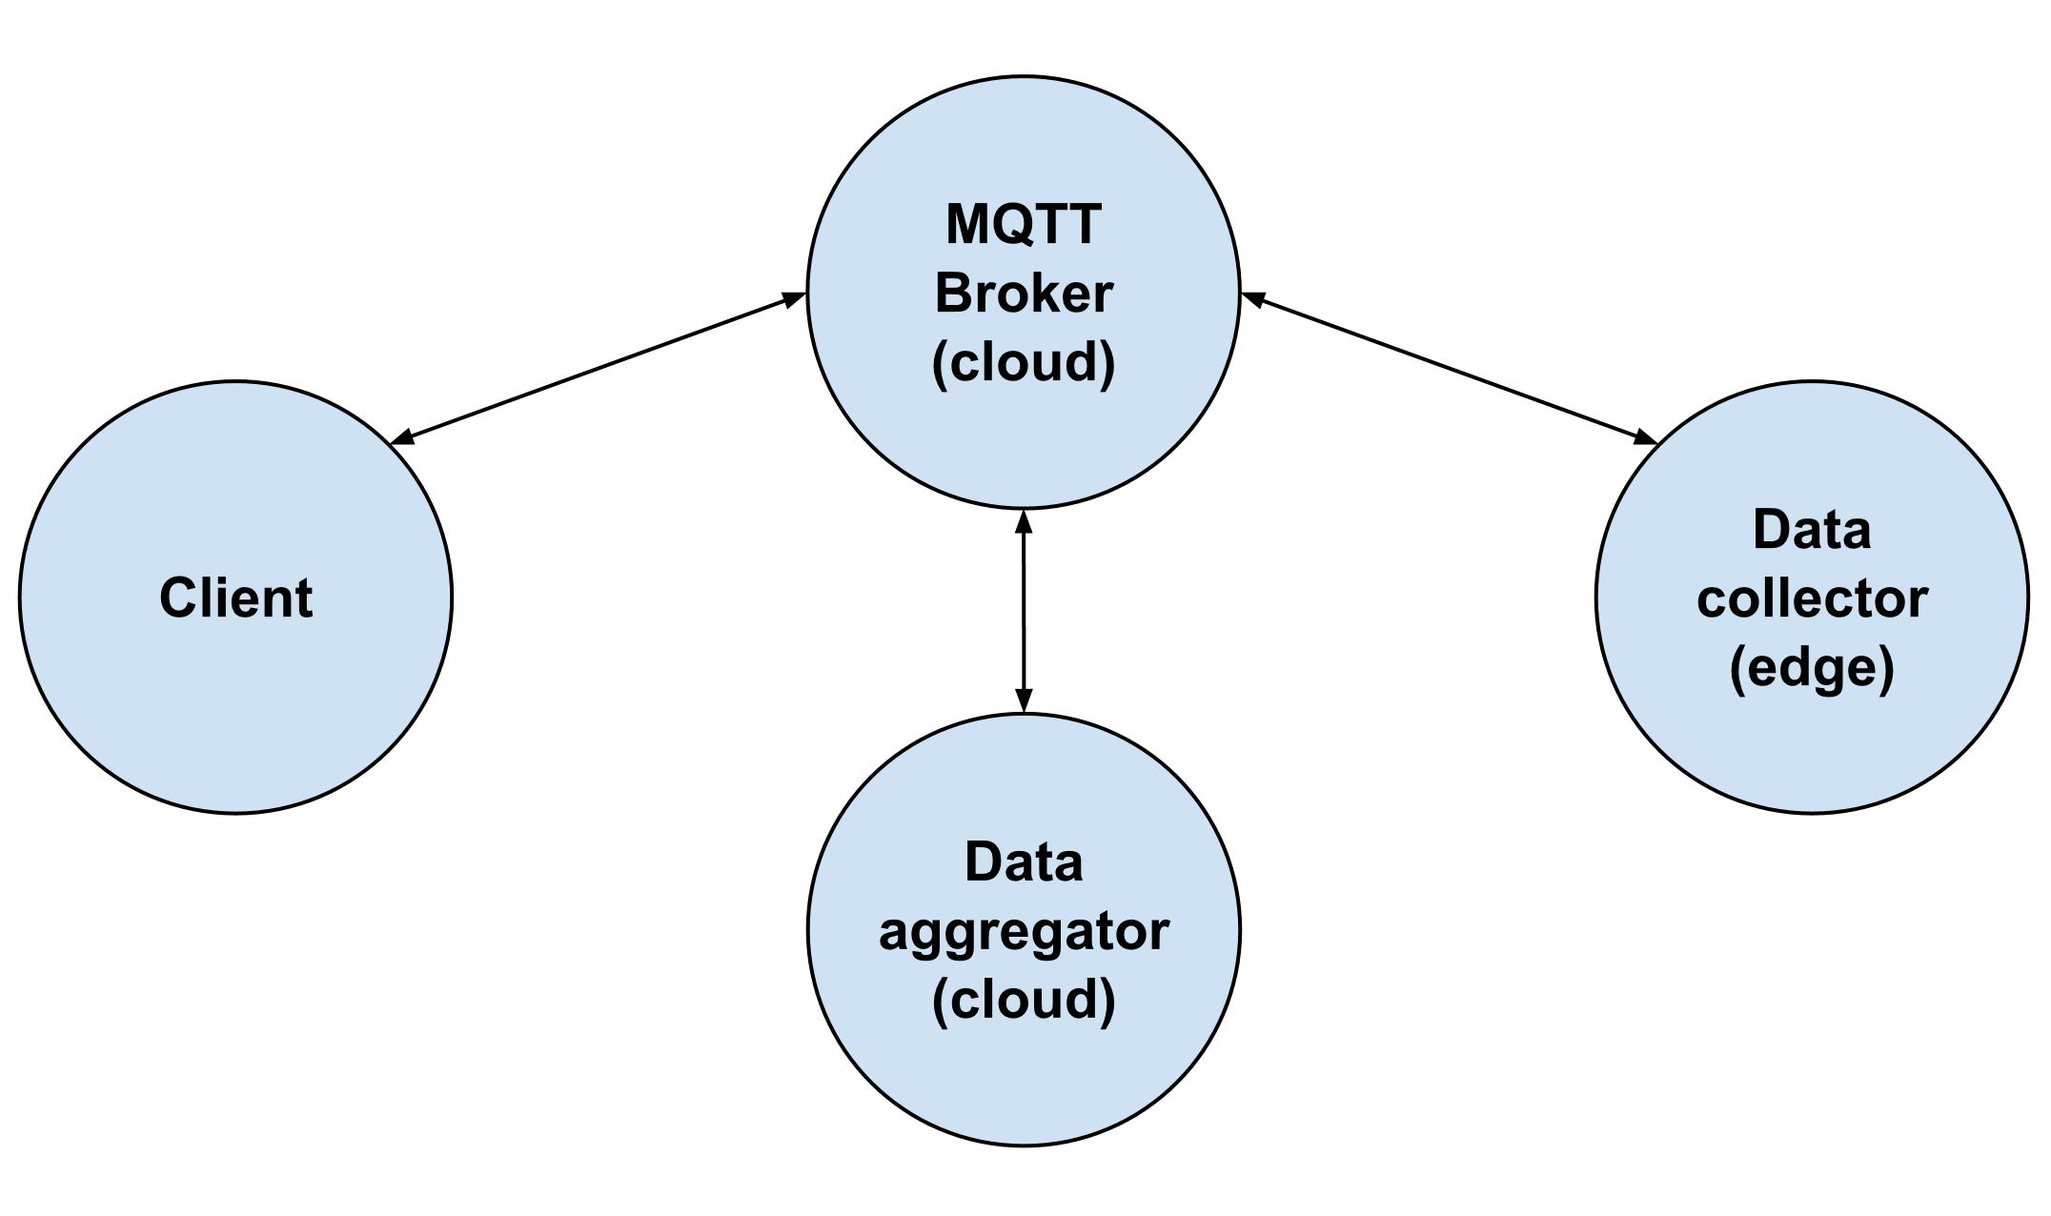
DECICE Workshop – Part 2 MQTT Data Aggregation and Collection at the Edge
Goal: Deploy on the cluster a MQTT data aggregator (cloud), a data collector (edge) and client (check figure).
In the GitHub repository (https://github.com/rho770/oehi-cc-training.git) you will find:
Python scripts for the aggregator, collector, and client.
Dockerfiles to build the images for aggregator, collector, and client.
YAML files to deploy the containers on the k8s cluster.
You can run the Python scripts from shell rather than deploying the containers, however this procedure will not be described in the following slides.

Slide 11
DECICE Workshop – Part 2 MQTT Data Aggregation and Collection at the Edge
Make sure that you are in your home folder → cd
Pull the repository with → git clone https://github.com/rho770/oehi-cc-training.git ~/demo/
Move to the demo folder → cd ~/demo/ workflow2.
In the folder, there are both deploy and undeploy scripts that can be used to automated the steps illustrated below.
Check/Edit the Python code (optional).
Build the aggregator image with → podman build -f aggregator_cloud.dockerfile . -t cn04:30500/"$USER"-aggregator:latest
Build the collector image with → podman build -f collector_edge.dockerfile . -t cn04:30500/"$USER"-collector:latest
Build the client image with → podman build -f client.dockerfile . -t cn04:30500/"$USER"-client-wf:latest
Push the images:
To push an image to the private registry, run the commands below:
Push the aggregator image with → podman push cn04:30500/"$USER"-aggregator:latest
Push the collector image with → podman push cn04:30500/"$USER"-collector:latest
Push the client image with → podman push cn04:30500/"$USER"-client-wf:latest
Deploy your containers on Kubernetes using the provided YAML file:
Deploy the MQTT cloud aggregator → envsubst < yaml/aggregator_cloud.yaml | kubectl create -f –
Deploy the MQTT edge collector → envsubst < yaml/collector_edge.yaml | kubectl create -f -
Deploy the MQTT client → envsubst < yaml/client.yaml | kubectl create -f -
Check the logs from the pods:
Find out the name of the pods by running first kubectl get pods –n decice
kubectl logs –n decice –f client_pod_name
To delete the resources created, run the following:
Undeploy the MQTT aggregator → envsubst < yaml/aggregator_cloud.yaml | kubectl delete -f -
Undeploy the MQTT collector → envsubst < yaml/collector_edge.yaml | kubectl delete -f -
Undeploy the MQTT client → envsubst < yaml/client.yaml | kubectl delete -f -
Extra: Have a look at the YAML files to understand how we scheduled the collector on the KubeEdge edge node.

Slide 12
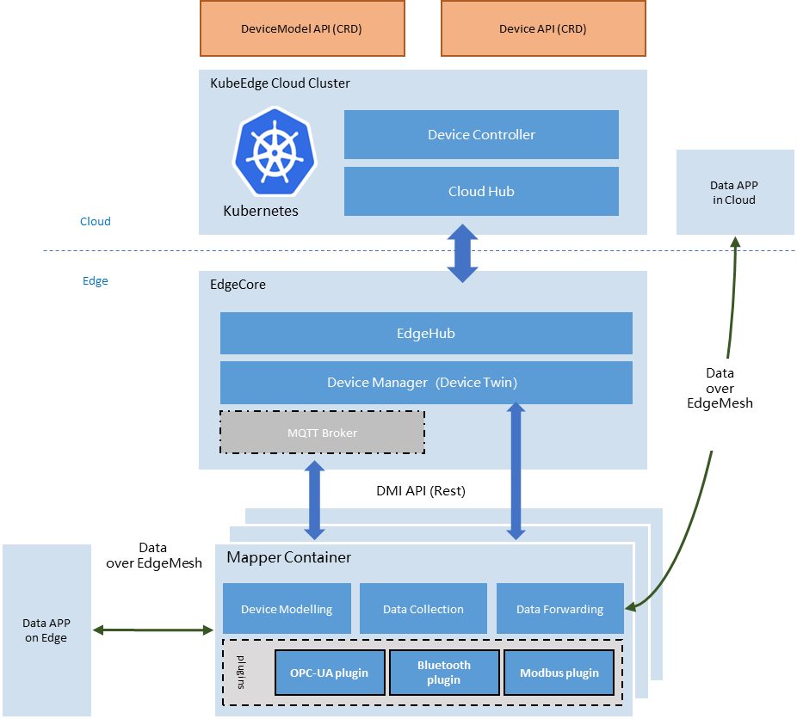
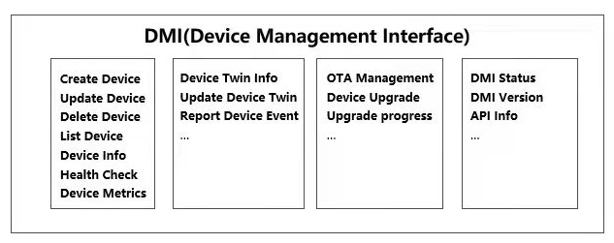
DECICE Workshop – Part 2 – Extra KubeEdge – Device Management Interface (DMI)
Decoupled control plane and data plane for IoT devices
Device (data) as a Service
Help developers to focus on their own application development
Reduced channel congestion between cloud and edge
A more flexible and unified way to manage IoT Devices

Slide 13
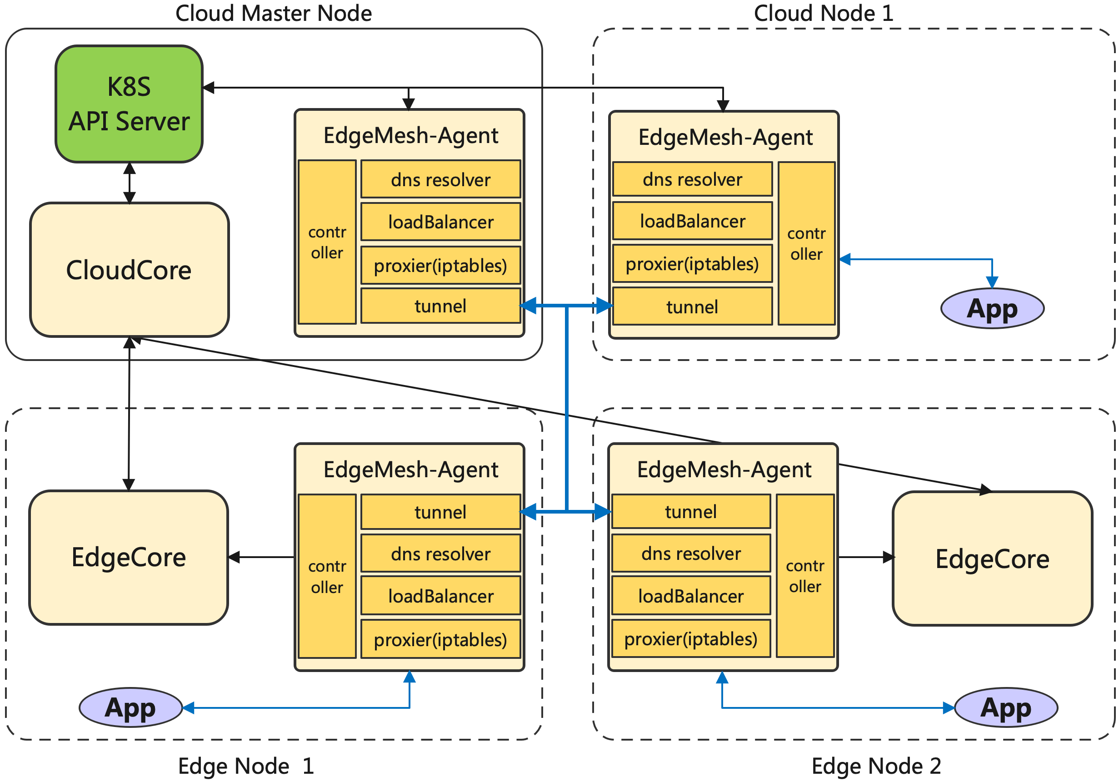
DECICE Workshop – Part 2 – Extra KubeEdge – EdgeMesh
EdgeMesh satisfies the new requirements in edge scenarios (e.g., limited edge resources, unstable edge cloud network, complex network structure, etc.), that is, high availability, high reliability, and extreme lightweight:
High availability
Use the capabilities provided by LibP2P to connect the network between edge nodes
Divide the communication between edge nodes into intra-LAN and cross-LAN
High reliability (offline scenario)
Metadata is distributed through the KubeEdge edgehub/cloudhub tunnel, no need to access the cloud apiserver
EdgeMesh integrates a lightweight node-level DNS server, service discovery no longer accesses the cloud CoreDNS
Extreme lightweight
Each node has one and only one Agent, which saves edge resources
Core Components
Proxier: Responsible for configuring the kernel's iptables rules, and intercepting requests to the EdgeMesh process.
DNS: Built-in DNS resolver, which resolves the DNS request in the node into a service cluster IP.
LoadBalancer: Load balancer, which forwards requests to corresponding backend instances through rich load balancing strategies.
Controller: Obtains metadata (e.g., Service, Endpoints, Pod, etc.) by accessing the apiserver of Kubernetes or KubeEdge.
Tunnel: Based on LibP2P implementation, using automatic relay, MDNS and hole punching to provide the ability to communicate across subnets.
User value
Enable users to have the ability to access edge-to-edge/edge-to-cloud/cloud-to-edge applications across different LANs
Compared to the mechanism of CoreDNS + Kube-Proxy + CNI service discovery, users only need to simply deploy an Agent to finish their goals

