Slide 1


MSIS 615 Project
Hugo Santos
Lanelle Sneed
Rhoda Nankabirwa
Amanda Delany

Slide 2
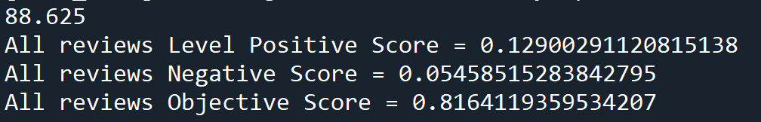
Sentiment Analysis
In reviewing sentiment analysis we are determining the individual sentiment of each word. To start, we took an overall sentiment review of all the reviews we scraped consolidated into a single string.
You can see here that most words were considered to be objective in nature and did not indicate a particular positive or negative sentiment. However, of those that had a positive vs negative sentiment we can see that the positive sentiment was about 12.9% where as negative was about 5.46%, so there were over twice the amount of positively trended words vs negative. Overall we can take this to mean that in general, Boston restaurants have more positive vs negative reviews based on the initial search page of Yelp.

Slide 3
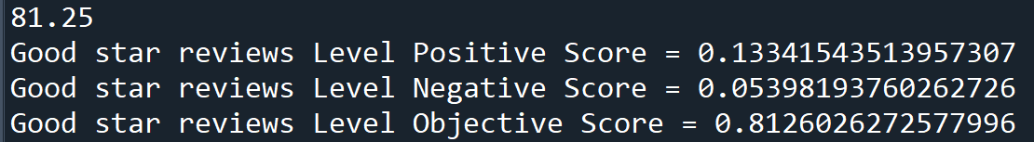
Sentiment Analysis – Good star ratings only
For this selection, we just isolated the reviews determined to have a “good” rating- over a 4.0
You can see here, that our numbers are similar to the overall reviews, but have changed marginally for both positive and negative word score. With positive now at 13.34% and negative at 5.4%. This is even a greater ratio of positive vs negative than the initial review.

Slide 4
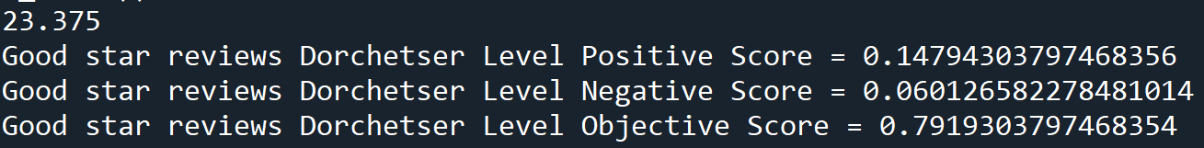
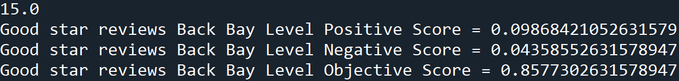
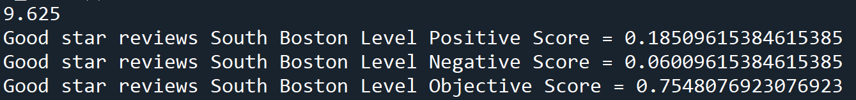
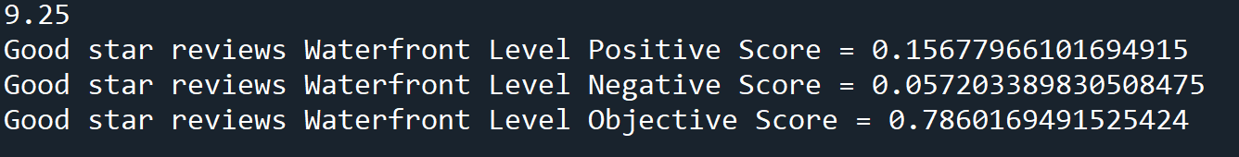
Sentiment Analysis – Neighborhoods
Now let us take a look at some neighborhoods (neighborhoods analyzed in this section were taken from our top neighborhoods prior in our analysis).
Dorchester
BackBay
South Boston
Waterfront

Slide 5
Sentiment Analysis – Neighborhoods
To break this down a little further:
Negative % by neighborhood:
Dorchester – 6.01%
Back Bay – 4.36%
South Boston – 6.01%
Waterfront – 5.72%
We can see here that overall the highest % of negative sentiment existed within Dorchester and South Boston, however this is still minor when compared to the positive sentiment %.
Positive % by neighborhood:
Dorchester – 14.79%
Back Bay – 9.87%
South Boston – 18.51%
Waterfront – 15.68%
So here we can conclude that in general, the reviews of restaurants in South Boston had the greatest positive sentiment.

Slide 6
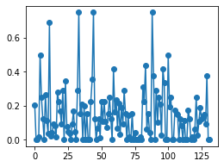
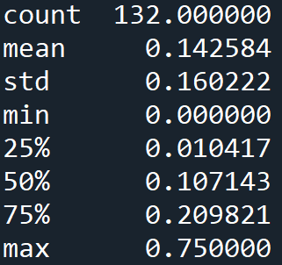
Graph of Positive Sentiment of Individual Reviews
Here we can see an overall summary of the statistics of the positive sentiment of each review pulled in the dataset. Our mean positive sentiment score here is 14.26% positive.

Slide 7
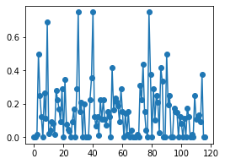
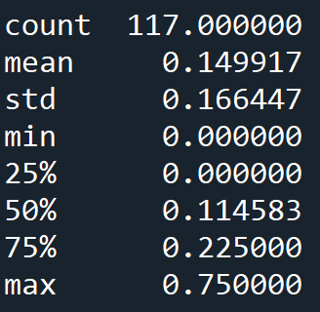
Graph of Positive Sentiment of Individual Reviews – Good Star Rating Only
Here we can see an overall summary of the statistics of the positive sentiment of each review pulled in the dataset for those that had over 4 stars. Our mean positive sentiment score here is 14.99% positive. It is also interesting to note here that the majority of the reviews in our dataset are identified as being over 4 stars (117 vs 132)

Slide 8
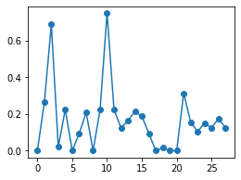
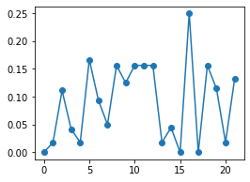
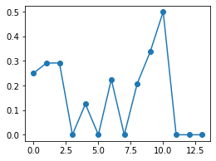
Graph of Positive Sentiment of Individual Reviews – Neighborhoods with Good star ratings
Dorchester
BackBay
South Boston
Waterfront

Slide 9
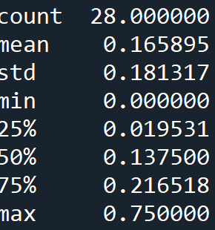
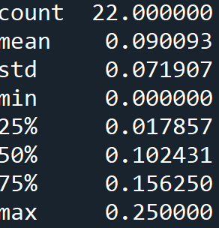
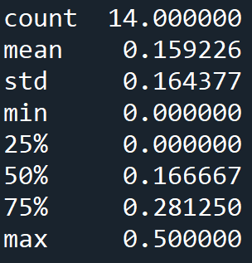
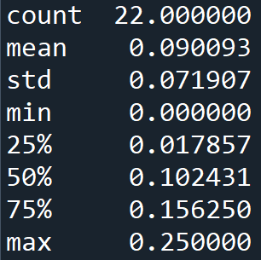
Summary Data of Positive Sentiment of Individual Reviews – Neighborhoods with Good star ratings
Dorchester
Back Bay
South Boston
Waterfront
Here we can see that although Dorchester has the highest mean, it has some outlying reviews that may be throwing that data off. In general, it looks like Back Bay and Waterfront have the most consistently positive reviews (indicated by the lower standard deviation).

