Slide 1
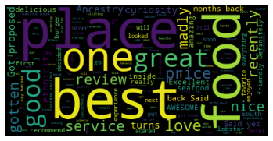
What do people say about minority owned restaurants in Boston?
😊 😊
👌 😒
🙌 😁

Slide 2
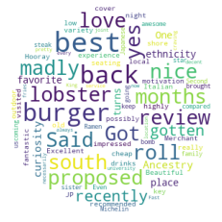
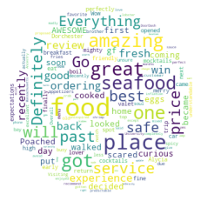
Restaurant type review
Steakhouse
Seafood

Slide 3
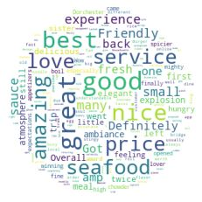

Location review
Dorchester
Backbay

Slide 4
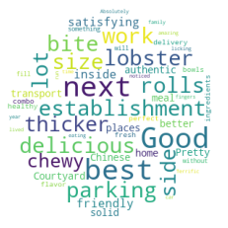
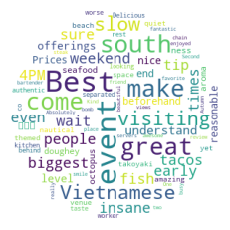
Location review
South Boston
Waterfront

Slide 5
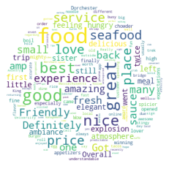
Good Star Rating (>=4)

Slide 6
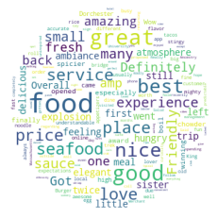

Good Star Rating (>=4), Location
Dorchester
Backbay

Slide 7
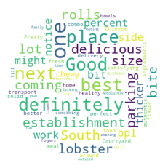
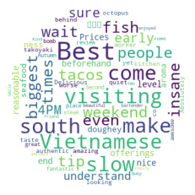
Good Star Rating (>=4), Location
South Bay
Waterfront

