Slide 1

SQL Functions
Notes:
Prompt: Data Scientists joining together to build the ultimate AI system

Slide 2
SQL REVIEW
SELECT
WHERE
CREATE TABLE
PRIMARY KEY
FOREIGN KEY
REFERENCES
UPDATE
SET
INSERT INTO
VALUES
DROP TABLE
TRUNCATE TABLE
IN
BETWEEN
AS
COUNT(*)
SUM()
AVG(),
MAX(),
MIN()
GROUP BY
HAVING
ORDER BY
DISTINCT
LIKE
INNER JOIN
LEFT JOIN
RIGHT JOIN
FULL OUTER JOIN
ABS()
LOG()
RAND()
ROUND()
POW()
SQRT()
CONCAT()
LOWER()
UPPER()
TRIM()
SUBSTRING()
CURDATE()
NOW()
TIME()
DATEDIFF()
TIMEDIFF()
REPLACE()
Notes:
Look up the syntax and usage of REPLACE

Slide 3
DISTINCT
The SQL DISTINCT clause is used to remove duplicate values from a result set.
When DISTINCT is applied to a column in a SELECT statement, it ensures that only unique values for that column are returned, eliminating any duplicates.
Syntax:
Retrieve unique invoice dates:
This query fetches all the unique dates on which invoices were issued from the Invoice table. If multiple invoices were issued on the same day, the date will appear only once in the result set.
SELECT DISTINCT InvoiceDate
FROM Invoice;
SELECT DISTINCT column1, column2, ...
FROM table_name;
When to Use DISTINCT:
• To eliminate duplicates from your result set when you’re only interested in unique values.
• On columns with repeating values, where you want to count or list only unique occurrences.
Get a list of unique customer first names:
SELECT DISTINCT FirstName
FROM Customer;

Slide 4
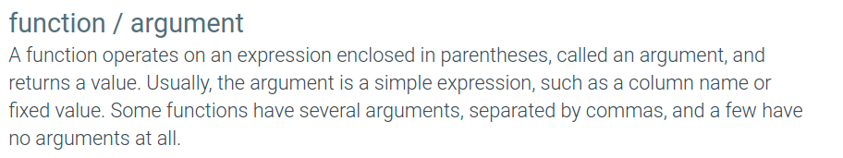
FUNCTIONS IN SQL
Function / Argument
operates on an expression enclosed in parentheses(argument) returning a value
Numeric
String
Date/Time

Slide 5
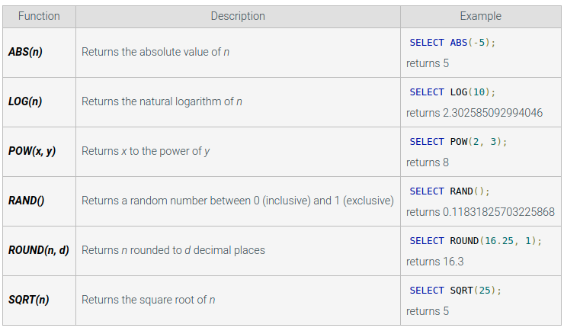
NUMERIC FUNCTIONS

Slide 6
COMBINING FUNCTIONS:
You can combine these functions for more complex calculations. For example, you could round the result of a logarithm calculation:
Example: Rounding the logarithm of invoice totals
SELECT InvoiceID, ROUND(LOG(Total), 2) AS RoundedLogTotal
FROM Invoice
WHERE Total > 0;
Explanation: This query calculates the logarithm of the invoice total and rounds the result to 2 decimal places.

Slide 7
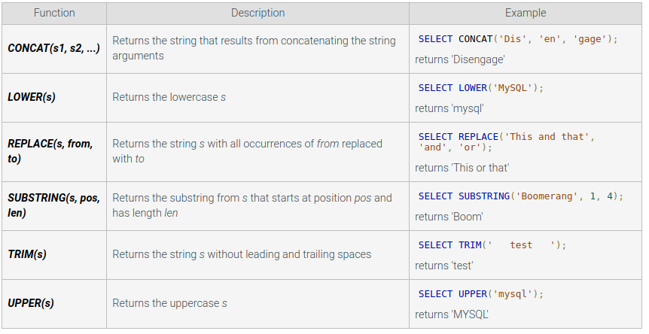
STRING FUNCTIONS

Slide 8
STRING FUNCTION EXAMPLES: CONCAT(), LOWER()
CONCAT(): Concatenating Strings
The CONCAT() function combines two or more strings into one. It’s useful for creating full names from separate FirstName and LastName columns, for example.
Example: Combining first and last names into a full name
LOWER(): Converting Text to Lowercase
The LOWER() function converts all characters in a string to lowercase. This can be useful when comparing text data case-insensitively.
Example: Converting email addresses to lowercase
SELECT CustomerID, CONCAT(FirstName, ' ', LastName) AS FullName
FROM VIPCustomer;
SELECT CustomerID, LOWER(Email) AS LowercaseEmail
FROM VIPCustomer;

Slide 9
STRING FUNCTION EXAMPLES: TRIM() AND SUBSTRING()
TRIM(): Removing Leading and Trailing Spaces
The TRIM() function removes any leading and trailing spaces from a string. It’s useful for cleaning up user input or inconsistent data.
Example: Removing extra spaces from customer names
SUBSTRING(): Extracting Part of a String
The SUBSTRING() function extracts a portion of a string, starting from a given position and extracting a specified number of characters.
Example: Extracting the first 3 characters of the first name
SELECT CustomerID, TRIM(FirstName) AS CleanedFirstName,
TRIM(LastName) AS CleanedLastName
FROM VIPCustomer;
SELECT CustomerID, SUBSTRING(FirstName, 1, 3) AS NamePrefix
FROM VIPCustomer;
Explanation: This query removes any extra spaces at the beginning or end of the FirstName and LastName fields.
Explanation: This query extracts the first 3 characters from the FirstName of each customer, which can be useful for generating a prefix or performing partial matches.

Slide 10
COMBINING STRING FUNCTIONS
You can also combine these functions for more complex string manipulations.
Example: Concatenating a cleaned full name and lowercased email address
SELECT CustomerID, CONCAT(TRIM(FirstName), ' ', TRIM(LastName)) AS FullName,
LOWER(Email) AS LowercaseEmail
FROM VIPCustomer;
Explanation: This query trims any extra spaces from FirstName and LastName, concatenates them into a full name, and converts the Email to lowercase.

Slide 11
LIKE
Let’s say we have a Customer table with the following columns: CustomerID, FirstName, LastName, and Email. We can use the LIKE clause to perform different types of pattern matching on this data.
Find customers with first names that start with ‘A’:
The SQL LIKE clause is used in a WHERE statement to search for a specified pattern in a column. It’s commonly used with string data types to find rows where a column matches a particular pattern. Wildcards are often used with LIKE to specify patterns:
%: Represents zero or more characters.
_: Represents a single character.
Syntax:
SELECT CustomerID, FirstName, LastName
FROM Customer
WHERE FirstName LIKE 'A%';
Find customers with a last name that starts with ‘S’ and has 5 letters:
SELECT CustomerID, FirstName, LastName
FROM Customer
WHERE LastName LIKE 'S____';
SELECT column1, column2, ...
FROM table_name
WHERE column LIKE pattern;
Find customers whose email starts with ‘a’ and ends with ‘.com’:
SELECT CustomerID, FirstName, LastName, Email
FROM Customer
WHERE Email LIKE 'a%@%.com';

Slide 12
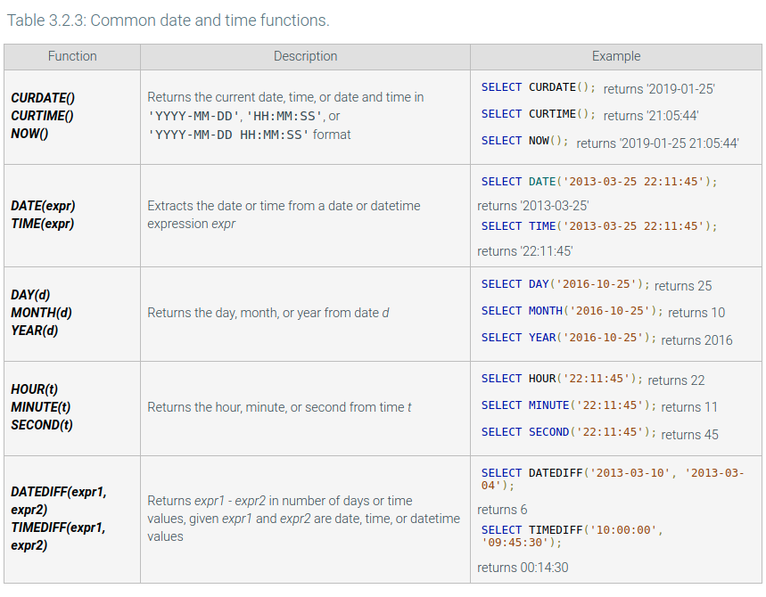
DATE/TIME FUNCTIONS

Slide 13
CURTIME(): RETRIEVES THE CURRENT TIME
The CURTIME() function returns the current time (without the date) in the format HH:MM:SS or HHMMSS depending on the query context.
Example: Retrieve the current time and check which invoices were created today at that time
SELECT InvoiceID, Total, CURTIME() AS CurrentTime
FROM Invoice
WHERE CURDATE() = InvoiceDate;
Explanation: This query shows the InvoiceID and Total of invoices created today, along with the current time. It uses CURTIME() to retrieve the current time and CURDATE() to compare only the date part of the InvoiceDate.

Slide 14
NOW(): RETRIEVES THE CURRENT DATE AND TIME
The NOW() function returns the current date and time in the format YYYY-MM-DD HH:MM:SS. It’s useful when you need to log timestamps or compare data based on both date and time.
Example: Retrieve all invoices created in the last hour
SELECT InvoiceID, Total, InvoiceDate
FROM Invoice
WHERE InvoiceDate >= NOW() - INTERVAL 1 HOUR;
Explanation: This query retrieves all invoices created in the last hour. It uses the NOW() function to get the current date and time and compares it with the InvoiceDate column to filter invoices created within the last hour.

Slide 15
DATEDIFF(): CALCULATES THE DIFFERENCE BETWEEN TWO DATES
The DATEDIFF() function returns the difference in days between two dates. It’s commonly used to calculate time intervals, such as how long a customer has been a VIP or the number of days since an invoice was issued.
Example: Calculate how many days have passed since each customer joined
Example 2: Find overdue invoices (overdue by more than 30 days)
SELECT InvoiceID, CustomerID, Total, DATEDIFF(NOW(), InvoiceDate) AS DaysOverdue
FROM Invoice
WHERE DATEDIFF(NOW(), InvoiceDate) > 30;
SELECT CustomerID, FirstName, LastName, DATEDIFF(NOW(), JoinDate) AS DaysSinceJoined
FROM VIPCustomer;
Explanation: This query calculates the number of days since each customer joined the VIP program by subtracting the JoinDate from the current date and time (NOW()).
Explanation: This query identifies invoices that are overdue by more than 30 days by calculating the difference between the current date (NOW()) and the InvoiceDate.

