Slide 1

SQL JOINS
Notes:
Prompt: Data Scientists joining together to build the ultimate AI system

Slide 2
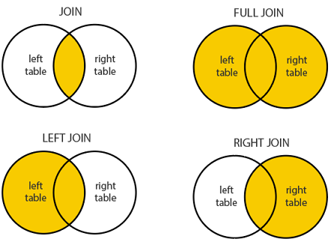
JOINING TABLES
JOIN is used to combine rows from two or more tables based on a related column between them.
There 4 major types of joins.
INNER JOIN returns rows when there is a match in both tables.
LEFT JOIN returns all rows from the left table and the matched rows from the right table
RIGHT JOIN returns all rows from the right table and the matched rows from the left table
FULL (OUTER) JOIN returns all rows when there is a match in either table. If there is no match
INNER JOIN
Notes:
INNER and LEFT JOINs are the most common. You will likely use these in 98.3% of all cases. ☺

Slide 3
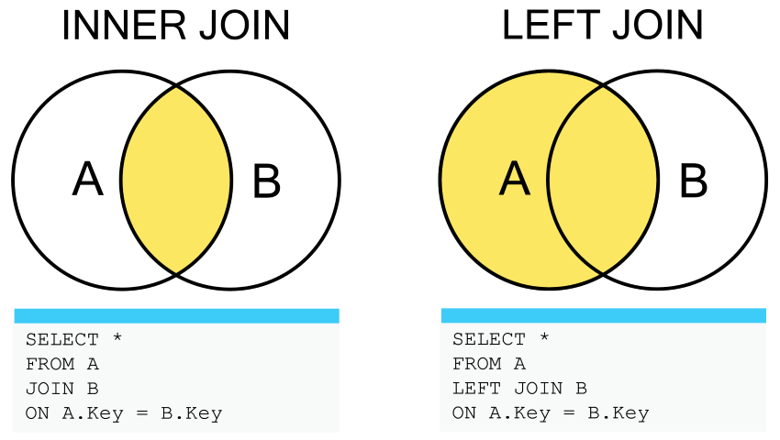
INNER JOIN
An INNER JOIN returns rows when there is a match in both tables. It excludes rows where the condition is not met.
Retrieve customer names and their invoice totals by joining Customer and Invoice
SELECT c.FirstName, c.LastName, i.Total
FROM Customer c
INNER JOIN Invoice i ON c.CustomerId = i.CustomerId;
Customer
CustID
Invoice
CustID

Slide 4
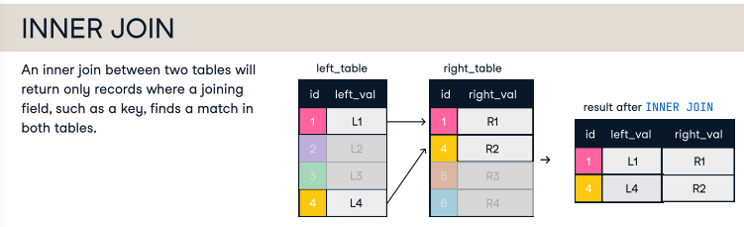

Slide 5
LEFT JOIN
A LEFT JOIN returns all rows from the left table and the matched rows from the right table. If there is no match, the result will include NULL values for the columns from the right table.
List all tracks and their corresponding album titles, including tracks without an album assigned:
SELECT t.Name, a.Title
FROM Track t
LEFT JOIN Album a ON t.AlbumId = a.AlbumId;
Track
AlbumID
Album
AlbumID

Slide 6
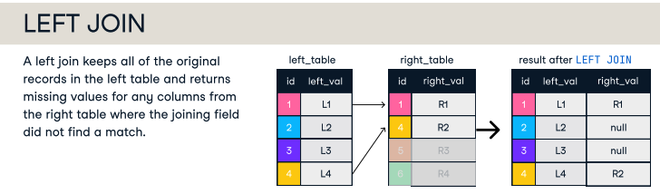

Slide 7
RIGHT JOIN
A RIGHT JOIN returns all rows from the right table and the matched rows from the left table. If there’s no match, the result will include NULL values for the left table.
List all albums and the tracks they contain, including albums without tracks
SELECT a.Title, t.Name
FROM Track t
RIGHT JOIN Album a ON t.AlbumId = a.AlbumId;
Track
AlbumID
Album
AlbumID
Can be converted into a LEFT JOIN by reversing the tables

Slide 8
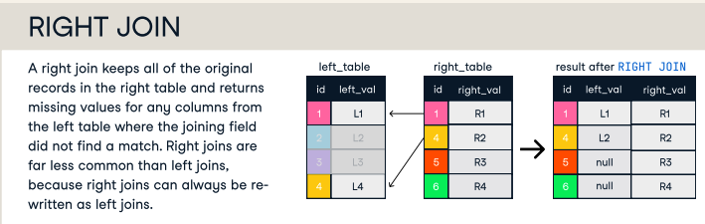

Slide 9
FULL JOIN (AKA FULL OUTER JOIN)
A FULL OUTER JOIN returns all rows when there is a match in either table. If there is no match, the result will include NULL values for the missing data from both tables.
Retrieve all artists and albums, showing nulls where there’s no match:
SELECT ar.Name AS ArtistName, al.Title AS AlbumTitle
FROM Artist ar
FULL OUTER JOIN Album al ON ar.ArtistId = al.ArtistId;
Track
AlbumID
Album
AlbumID

Slide 10
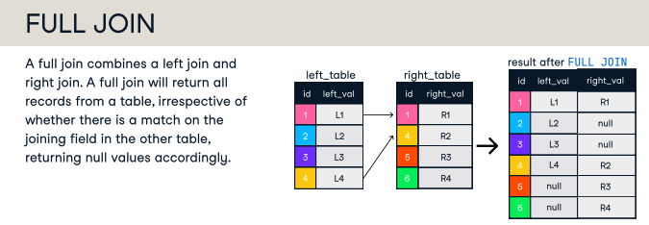

Slide 11
UNION
Syntax:
SELECT column1, column2, ...
FROM table1
UNION
SELECT column1, column2, ...
FROM table2;
The UNION operator is used to combine results of two or more SELECT queries into a single result set.
It removes duplicate rows by default, so the result set contains only unique rows.
If you want to include all duplicate rows, you can use UNION ALL.
Let’s say we have two tables: VIPCustomer (for VIP customers) and RegularCustomer (for regular customers). We want to retrieve a list of all customers, combining both tables.
Key Points:
Queries must have the same number of columns.
The columns must have compatible data types in corresponding positions.
The column names in the result will be based on the first SELECT statement.
By default, UNION removes duplicates, but UNION ALL keeps all rows.
SELECT CustomerID, FirstName, LastName
FROM VIPCustomer
UNION
SELECT CustomerID, FirstName, LastName
FROM RegularCustomer;

Slide 12
