Slide 1

SQLite3
Notes:
Prompt: Spaceport docks where starships are fueled by the colorful gases of a nebula

Slide 2


Slide 3

Connecting to an SQLite Database with Python
1. Import sqlite3:
This module provides a lightweight, built-in database engine that is part of Python’s standard library.
It allows you to create, connect to, and interact with SQLite databases.
2. Connect to the Database:
3. Create a Cursor:
cursor(): The cursor object allows us to execute SQL queries and retrieve data from the database.
It acts as a control structure to interact with the database.
Notes:
Steps to Get SQLite Connection Information in DBeaver:
1. Open DBeaver and ensure your SQLite database is connected.
2. Locate Your Database File:
• If you’ve already created a database in DBeaver, you can find the file path by:
• Right-clicking on your SQLite connection in the Database Navigator (left sidebar).
• Select Edit Connection.
• In the General tab, you’ll see the file path to your SQLite database file (it typically ends with .db).
3. Use the Database File Path in Your Python Code:
• The only connection information you need for SQLite is the path to the .db file.
Copying an SQLite database is straightforward since it’s a file-based database. You can simply copy the .db file to another location.
1. Locate the SQLite Database File:
• In DBeaver, right-click on your SQLite connection and choose Edit Connection.
• In the General tab, find the Database File path (it will be something like /path/to/your/database.db).
2. Copy the File:
• Navigate to that file location using your file explorer (Windows Explorer, Finder on Mac, etc.).
• Copy the .db file by right-clicking on it and selecting Copy.
3. Paste the File to a New Location:
• Navigate to the desired new location on your system.
• Paste the .db file there (right-click and choose Paste).

Slide 4
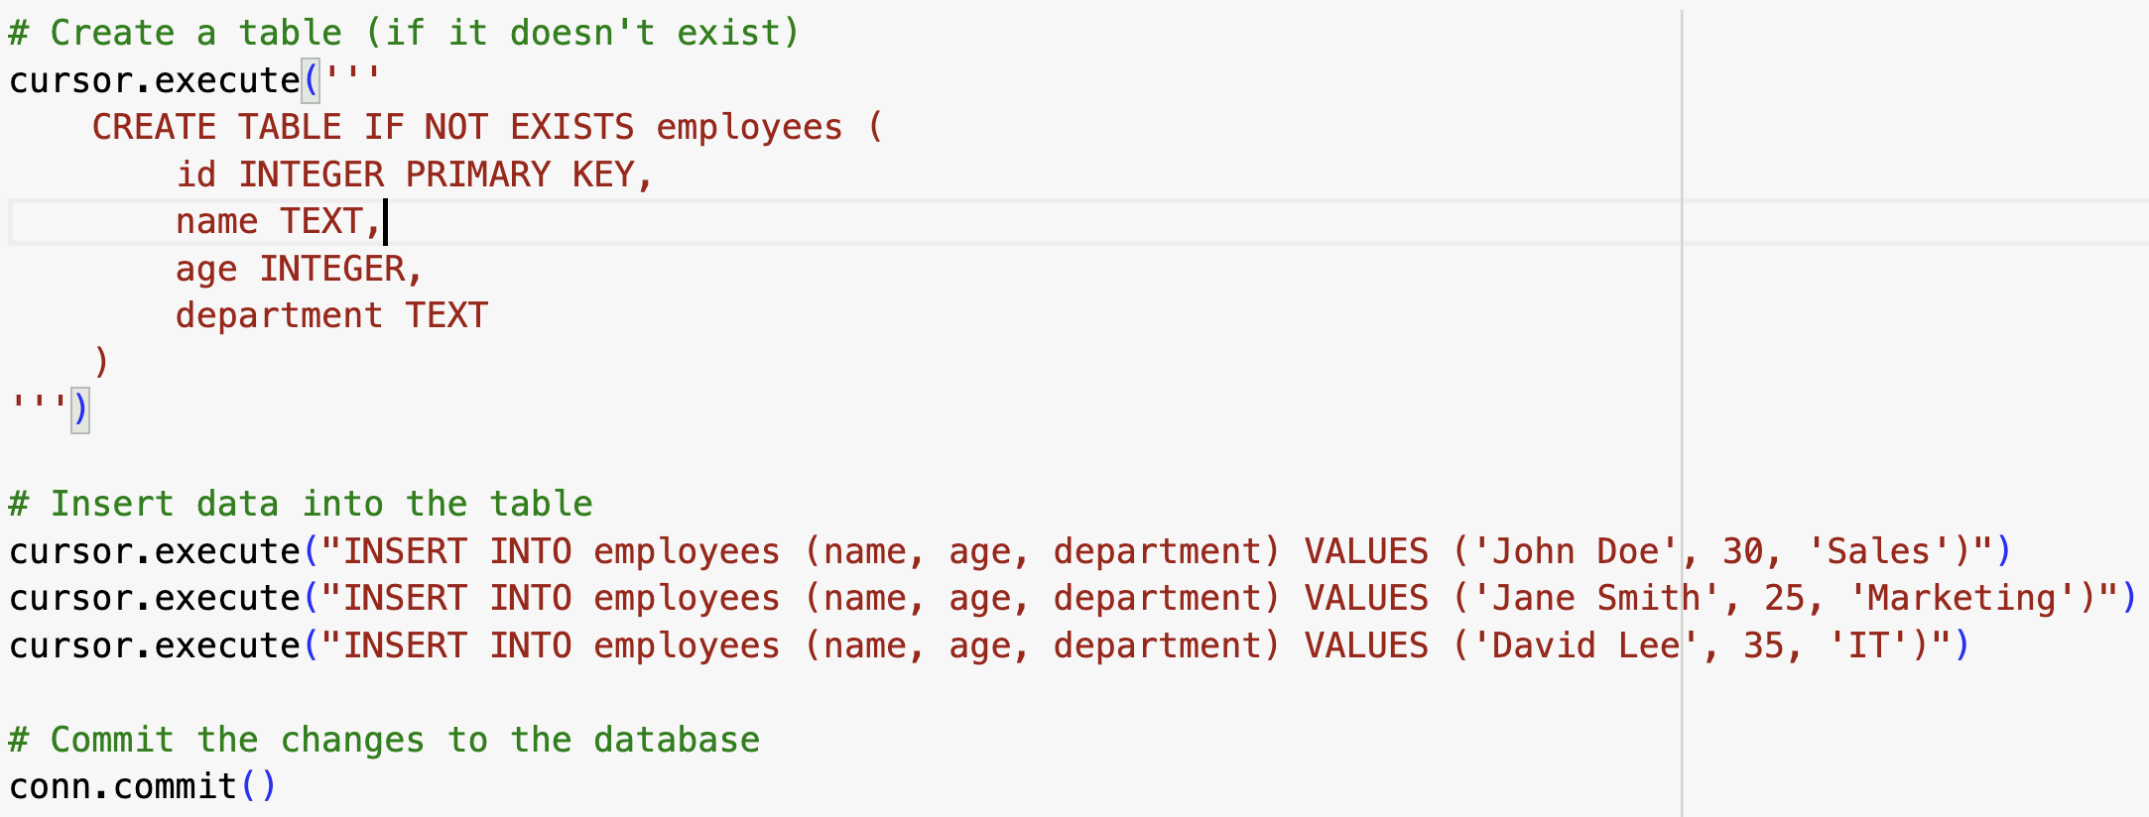
Creating and Inserting into a Table
This SQL statement creates a table named employees if it doesn’t already exist. The table has four columns:
id: An integer that serves as the primary key, which means it uniquely identifies each row.
name: A text field to store the employee’s name.
age: An integer to store the employee’s age.
department: A text field to store the employee’s department.
The IF NOT EXISTS clause ensures that the table is only created if it doesn’t already exist, avoiding errors if it already does.
SQL INSERT Statement: These queries insert three employee records into the employees table. Each record contains the name, age, and department values.
commit(): This command saves any changes made during the session (like the data inserted above) to the database. Without committing, the changes would not be permanent.

Slide 5
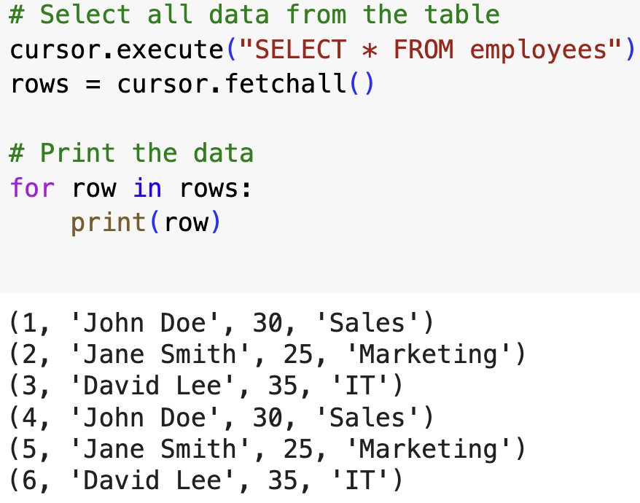
Selecting Data from a Table
SELECT * FROM employees: This SQL query retrieves all the rows and columns from the employees table.
fetchall(): This fetches all the results of the query as a list of tuples. Each tuple represents a row in the table.
This loop iterates over the rows list and prints each row (a tuple) representing an employee’s data.

Slide 6
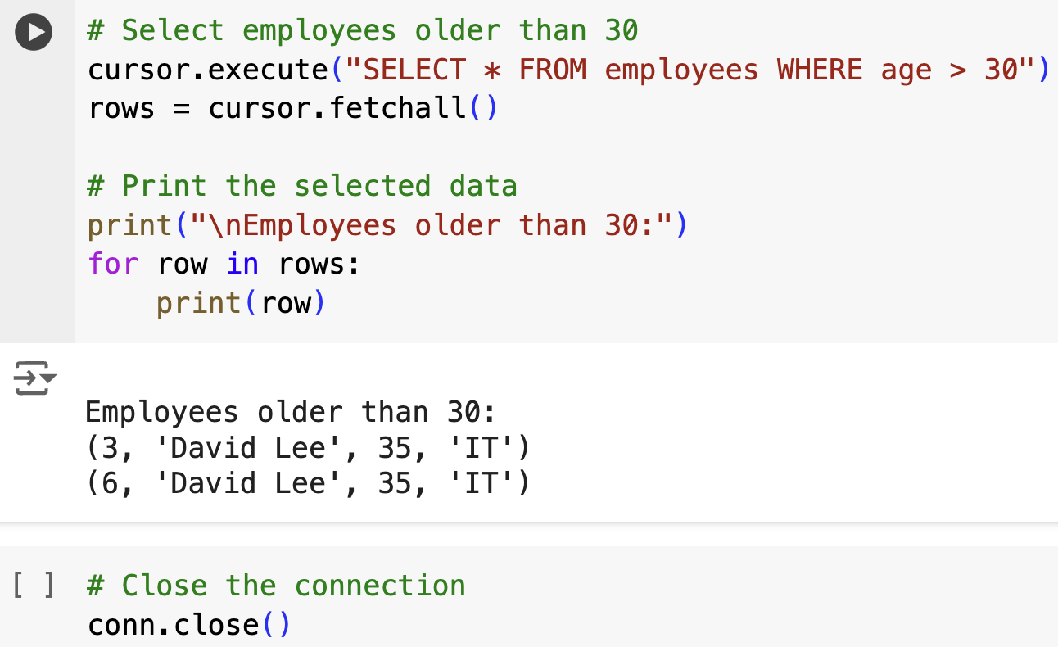
Filtering Data from a Table & Closing the Connection
SQL Query with WHERE Clause: This query retrieves only the rows where the age is greater than 30, filtering the results based on this condition.
This loop prints out only the employees whose age is greater than 30. It provides filtered data based on the condition.
close(): Closes the connection to the database. It’s a good practice to close the connection after all queries are completed to release resources.

