Slide 1
Explainable AI with SHAP

Slide 2
Explainable AI
Explainable AI/ML aims to create models and methods that are transparent, interpretable, and explainable
One goal is to help ensure that AI and ML are ethical and accountable
There are several techniques that aim to make ML models explainable
Interpretable models
Model agnostic methods (local and global)
A common model agnostic local method:
SHAP (SHapley Additive exPlanations)

Slide 3
Shapley Values

Slide 4
Shapley Values
Shapley values are a concept in cooperative game theory
Introduced by Lloyd Shapley in 1951
Shapley won the Nobel Prize in Economics for this contribution in 2012
Shapley values try to solve this problem:
Setup: A coalition of players cooperate to produce a value
How much did each player contribution to the value?
What payoff can each player reasonably expect?

Slide 5
Shapley Values
Coalition
1
Value
2
3
Example: Kaggle or Hackathon Competition
4
Example: Team
Example: Prize is $10,000

Slide 6
Shapley Values
Coalition
1
How should each player be rewarded?
Value
2
$3000
What if there are interactions between team members?
(Certain combinations of members work better or worse than the sum of the parts)
$2000
3
$1000
Example: Kaggle or Hackathon Competition
$4000
4
Example: Team
Example: Prize is $10,000

Slide 7
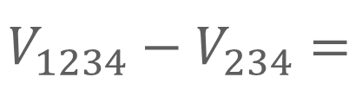
Shapley Values
For each individual, compute the marginal contribution by comparing the value for a coalition with the member and without the member
1
2
2
3
3
4
4

Slide 8

Shapley Values
For each individual, compute the marginal contribution by comparing the value for a coalition with the member and without the member
Marginal contribution of Member 1 to Coalition(234)
1
2
2
3
3
4
4

Slide 9








Shapley Values
Compute the marginal contribution of each member to all combinations of coalitions with and without that member
VS
VS
VS
VS
VS
VS
VS
VS

Slide 10

Shapley Values
Compute the marginal contribution of each member to all combinations of coalitions with and without that member
The Shapley value is the average marginal contribution for each member averaged across the coalition comparisons
=
8

Slide 11
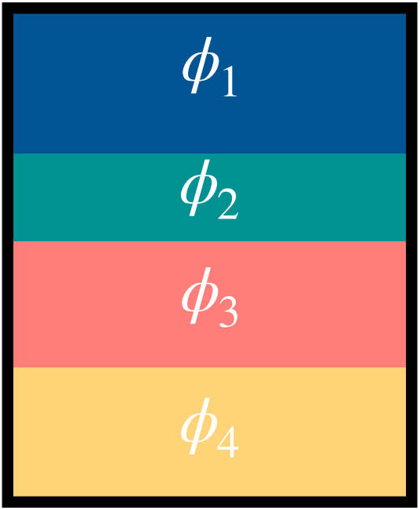
Shapley Values
Repeat for all coalition members to get the Shapley values for each member
1
2
3
4

Slide 12
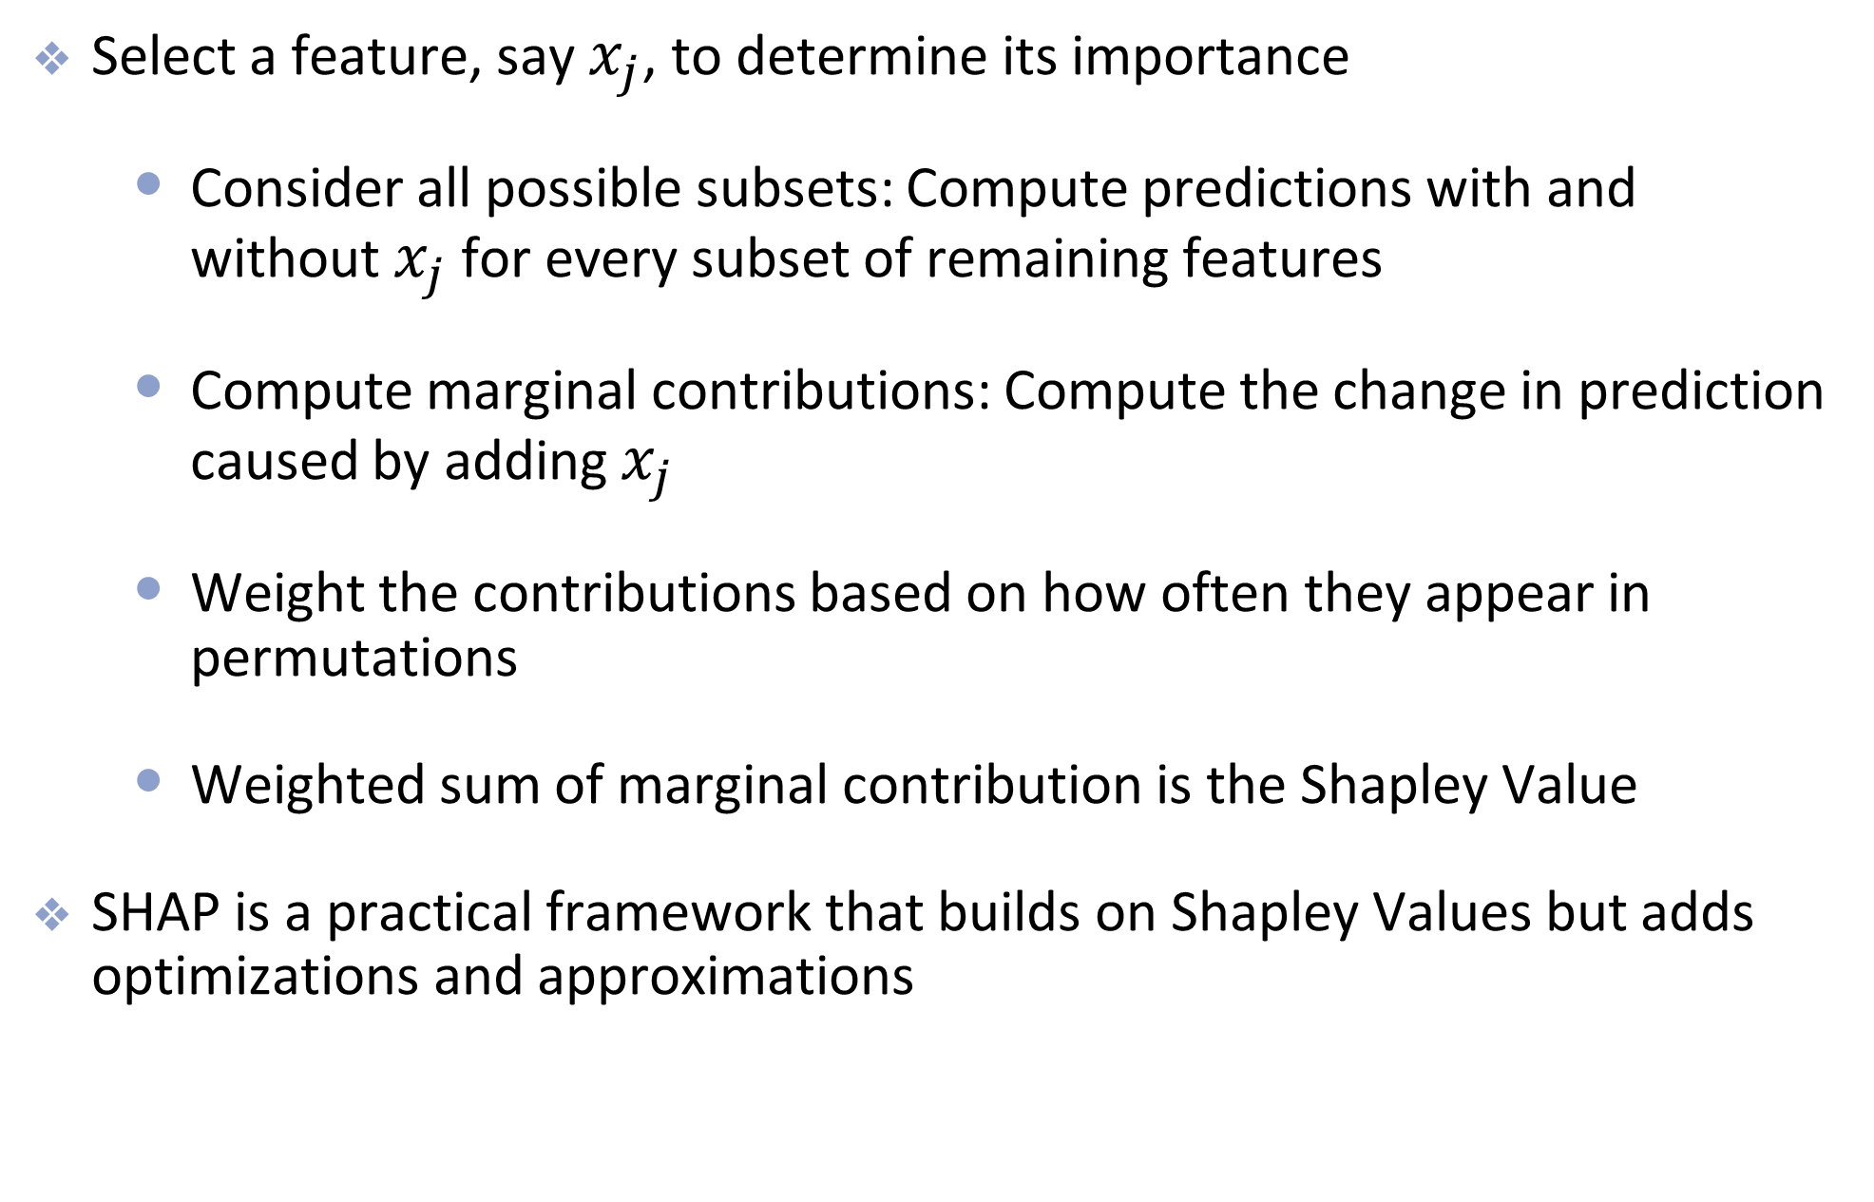
In Machine Learning

Slide 13
SHapley Additive exPlanations

Slide 14
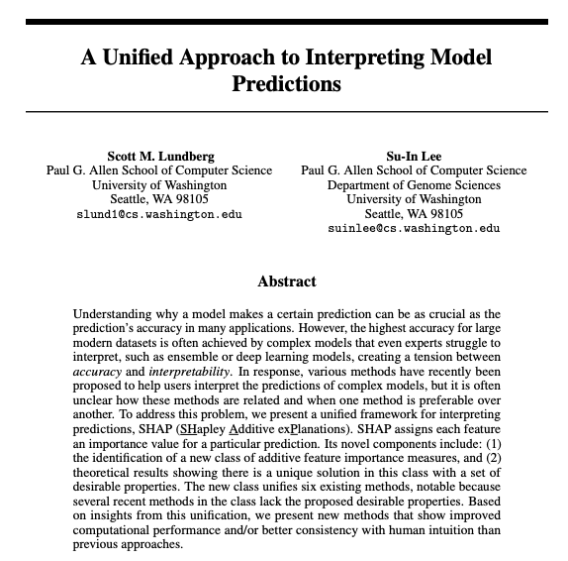
Shapley applied to explainable AI
In 2017, Lundberg and Lee extended the idea of Shapley values to explainable machine learning

Slide 15
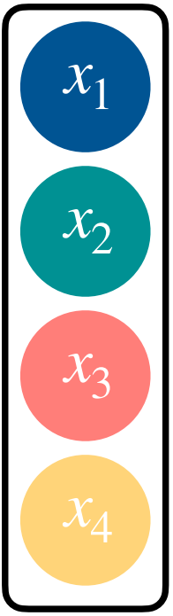
SHAP
Example: ML Blackbox model
Example: Prediction
Example: Features

Slide 16
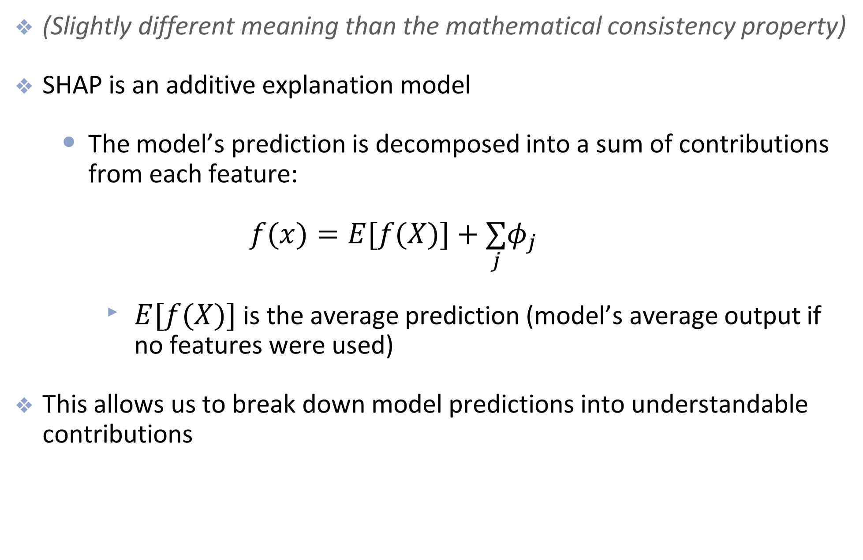
SHapley Additive exPlanations

Slide 17
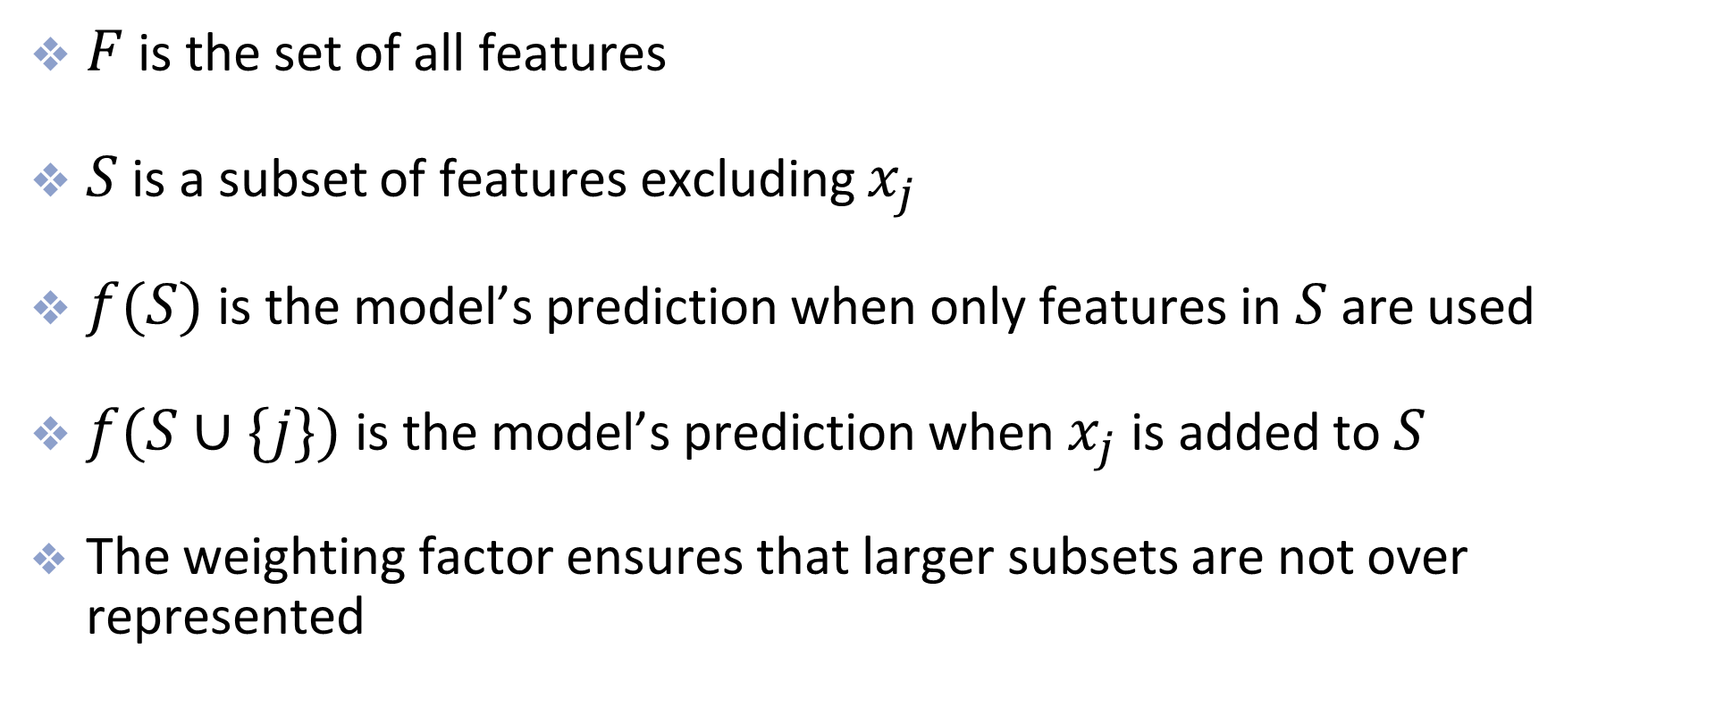
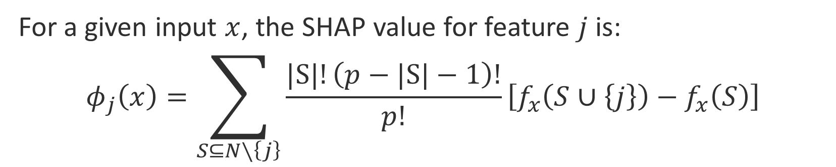
SHAP values
For a given input $x$, the SHAP value for feature $j$ is:
$$φ_{j}\left(x\right)=\sum_{S⊆N∖\left\{j\right\}}{\frac{|S|!\left(p−|S|−1\right)!}{p!}}\left[f_{x}\left(S∪\left\{j\right\}\right)−f_{x}\left(S\right)\right]$$
Notes:
SHAP computes the average marginal contribution of j.

Slide 18
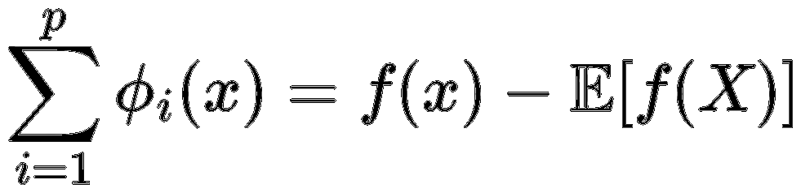
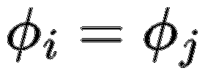
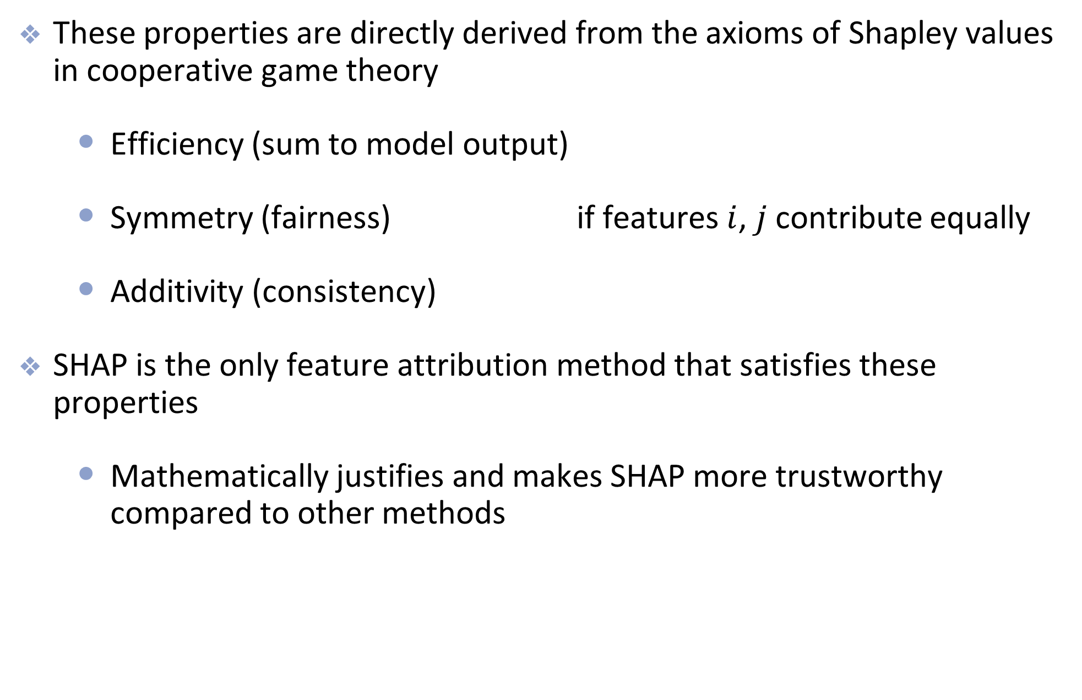
Properties of SHAP
These properties are directly derived from the axioms of Shapley values in cooperative game theory
Efficiency (sum to model output)
Symmetry (fairness) if features $i$, $j$ contribute equally
Additivity (consistency)
SHAP is the only feature attribution method that satisfies these properties
Mathematically justifies and makes SHAP more trustworthy compared to other methods

Slide 19
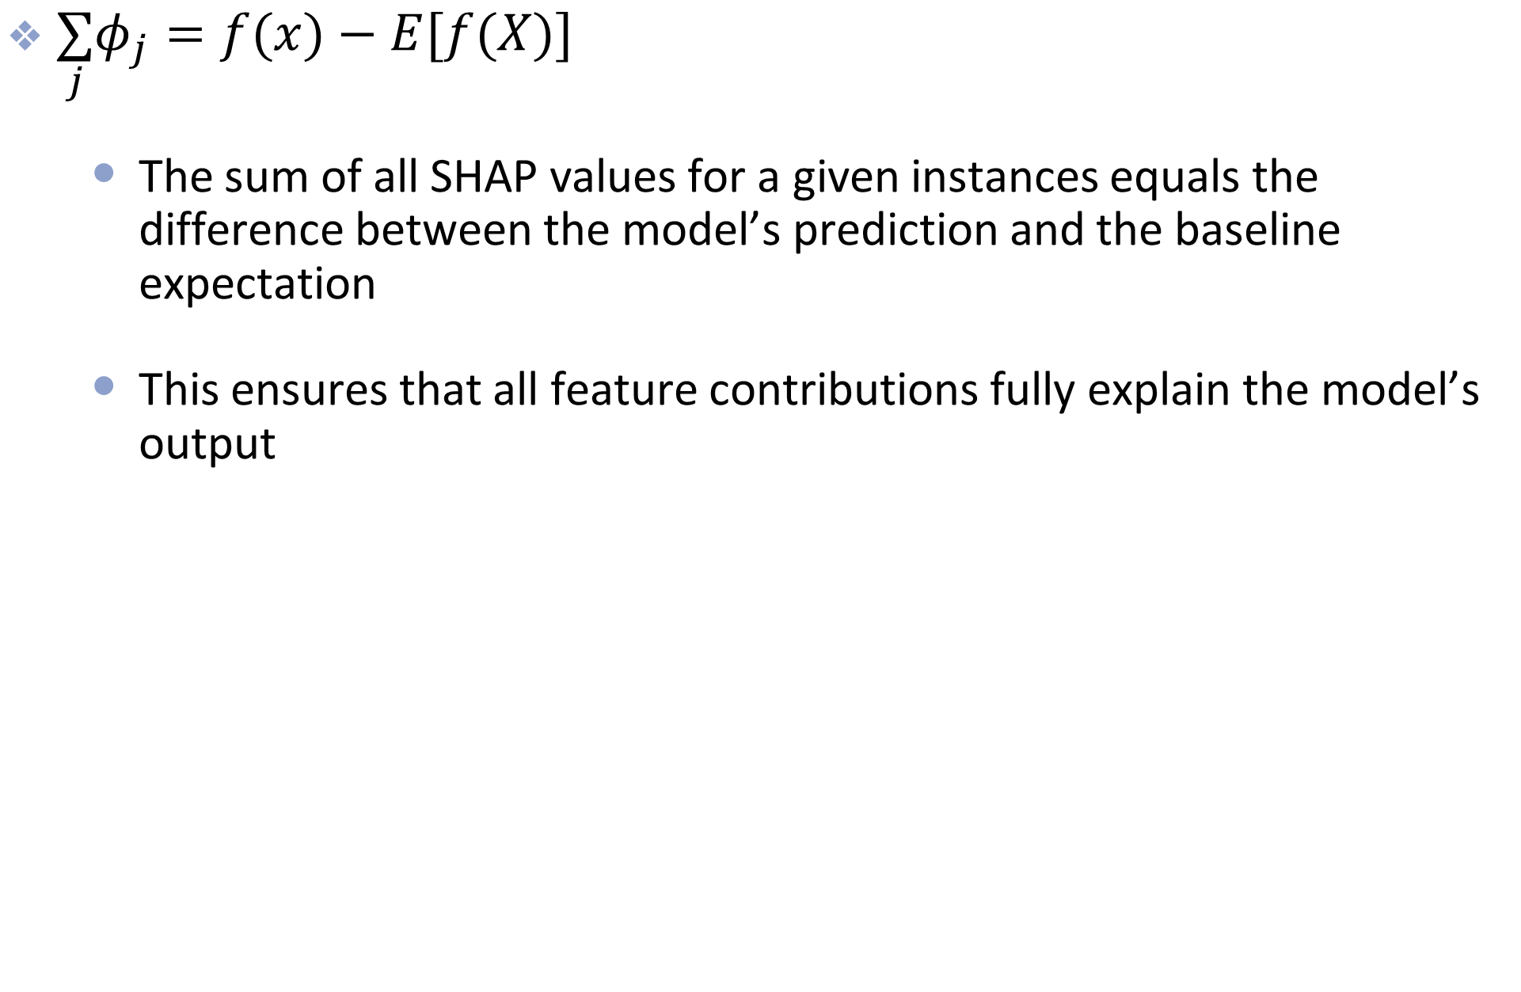
Properties of SHAP: Efficiency

Slide 20
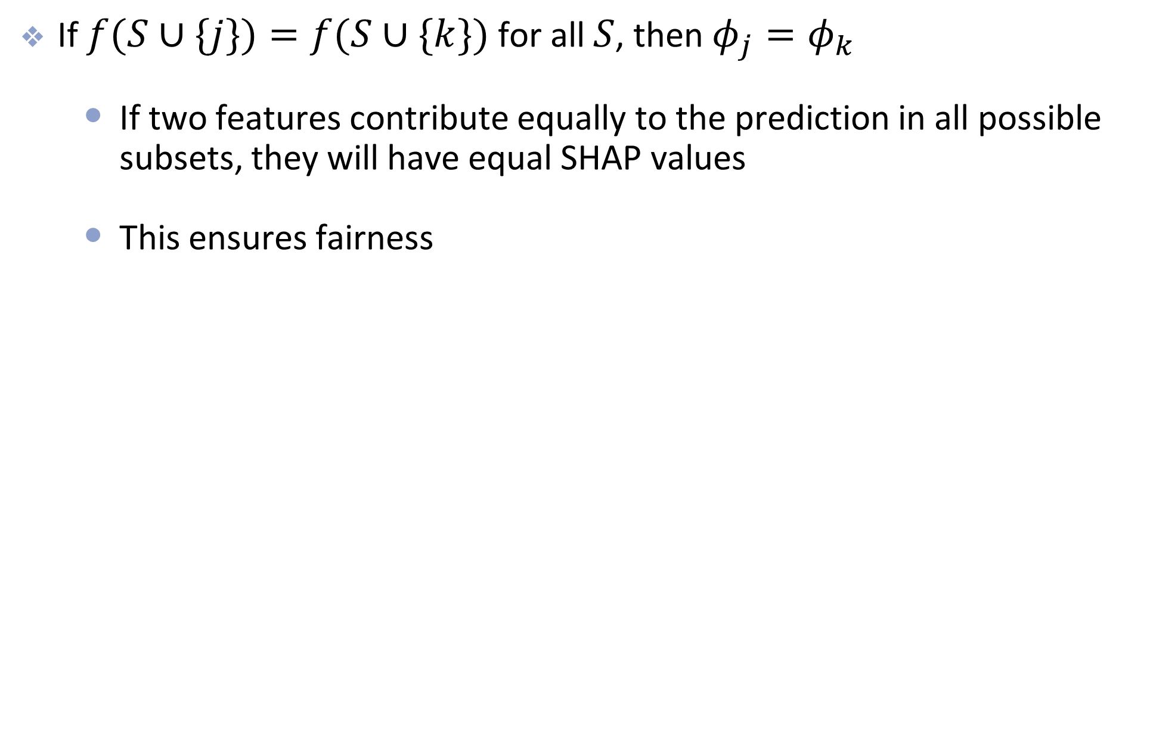
Properties of SHAP: Symmetry

Slide 21
Properties of SHAP: Additivity
Mathematical Consistency
If a model changes to depend more on a feature, the SHAP value for that feature should not decrease
This ensure that SHAP values are consistent across different models

Slide 22
Types of SHAP
Kernel SHAP (slow but model agnostic)
Works for any model
Uses random sampling and wtd regression to estimate values
Tree SHAP (fast but only works for tree based models)
Optimized for tree models (RF, Boosting)
Uses dynamic programming to compute SHAP value exactly
Deep SHAP (faster than kernel SHAP)
Optimized for neural networks
Uses back propagation and DeepLIFT to estimate SHAP values

Slide 23
Local Explainability
SHAP is a local explanation technique
Designed to explain how each feature contributes to the final prediction of an individual prediction
Global explanations can be computed by aggregation

Slide 24
Example: Human- vs Natural-Started Fire

Slide 25
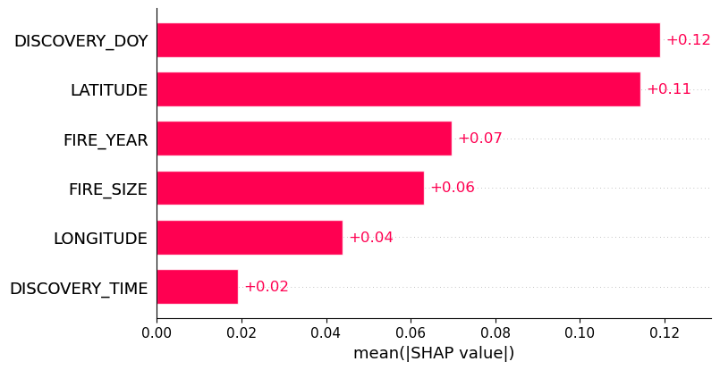
Global Importances:
Mean absolute SHAP value over all the samples
Notes:
This plot shows global feature importance using the mean absolute SHAP value across all samples.
Each bar answers the question: On average, how much does this feature change the model’s predictions?
The direction of the effect is ignored here — we only care about magnitude. A larger bar means the model relies on that feature more often or more strongly.
It’s important to emphasize that this is not causal importance. It tells us how much the model uses a feature, not whether the feature causes the outcome.

Slide 26
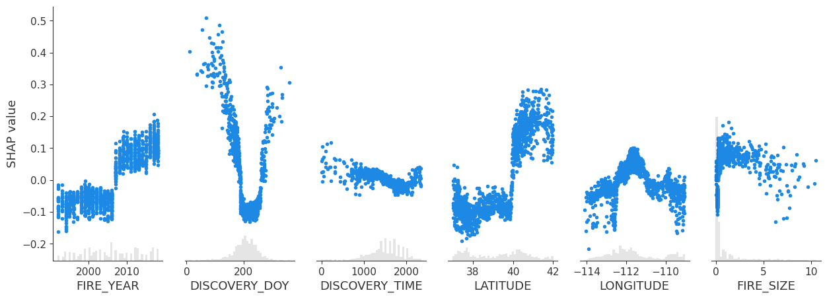
Global Importances:
Scatterplots of feature value vs SHAP value
Notes:
This plot shows how a feature affects predictions, not just how important it is.
The x‑axis is the actual feature value, and the y‑axis is the SHAP value — how much that feature pushes the prediction up or down.
Positive SHAP values increase the prediction; negative values decrease it.
Vertical spread indicates nonlinear or context‑dependent effects, meaning the same feature value can have different impacts depending on other features.

Slide 27
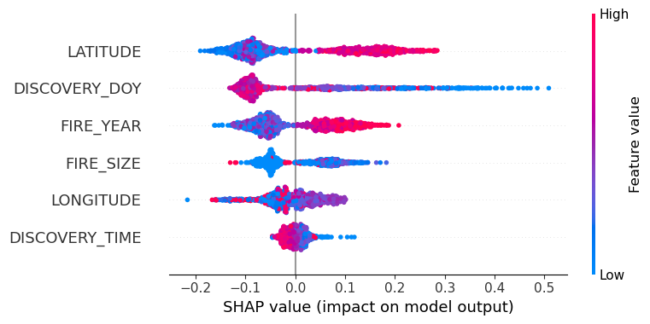
Global Importances:
Beeswarm Plot
Notes:
The beeswarm plot combines global importance with direction of influence.
Features are sorted by overall importance from top to bottom. Each dot represents one data point.
The x‑axis shows the SHAP value, and color represents the feature value.
Wide horizontal spread indicates a highly influential feature.
If high and low feature values appear on both sides, that suggests interactions or nonlinear behavior.

Slide 28
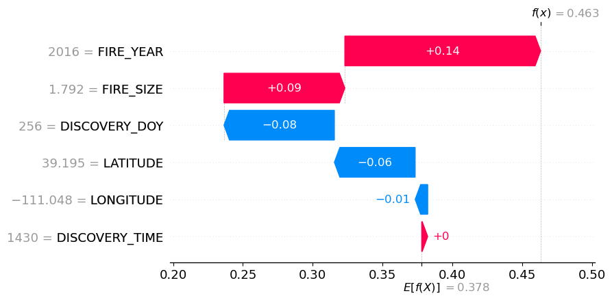
Local Importance: Waterfall plot
(Single prediction)
Notes:
This plot explains one specific prediction.
We start from the baseline prediction, which is the model’s average output.
Each bar shows how a feature pushes the prediction up or down for this instance.
Red bars increase the prediction; blue bars decrease it.
All contributions sum exactly to the final prediction, illustrating the efficiency property of SHAP.

Slide 29
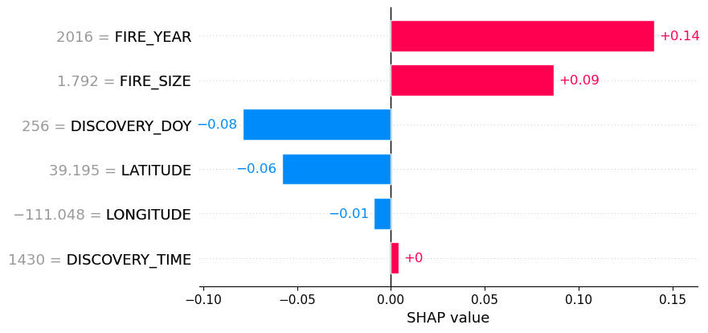
Local Importance: Bar plot
(Single prediction)

Slide 30
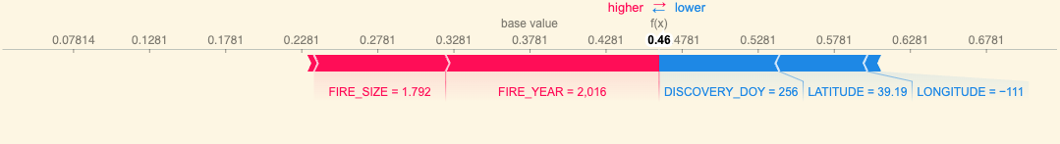
Local Importance: Force plot
(Single prediction)

Slide 31
SHAP Value Overview
SHAP gives us two views of a model:
Global: which features matter overall
Bar plots tell us how much a feature matters.
Scatter and beeswarm plots tell us how it affects predictions
Local: why a specific prediction happened
Waterfall plots show the model’s reasoning step by step.”

Slide 32
Disadvantages
But it still has a few limitations:
Slow (especially kernel SHAP)
Can be hard to interpret
Misleading when features are correlated
SHAP assumes that features are independent
If features are correlated, SHAP can arbitrarily split their importance or attribute too much importance to one and downplaying the other

Slide 33
Summary
SHAP is one way to help explain model predictions
It is a powerful and theoretically sound method for interpreting machine learning models
The shap library in python provides (fairly) fast implementation and lots of examples
Be cautious of assigning causation

