Slide 1
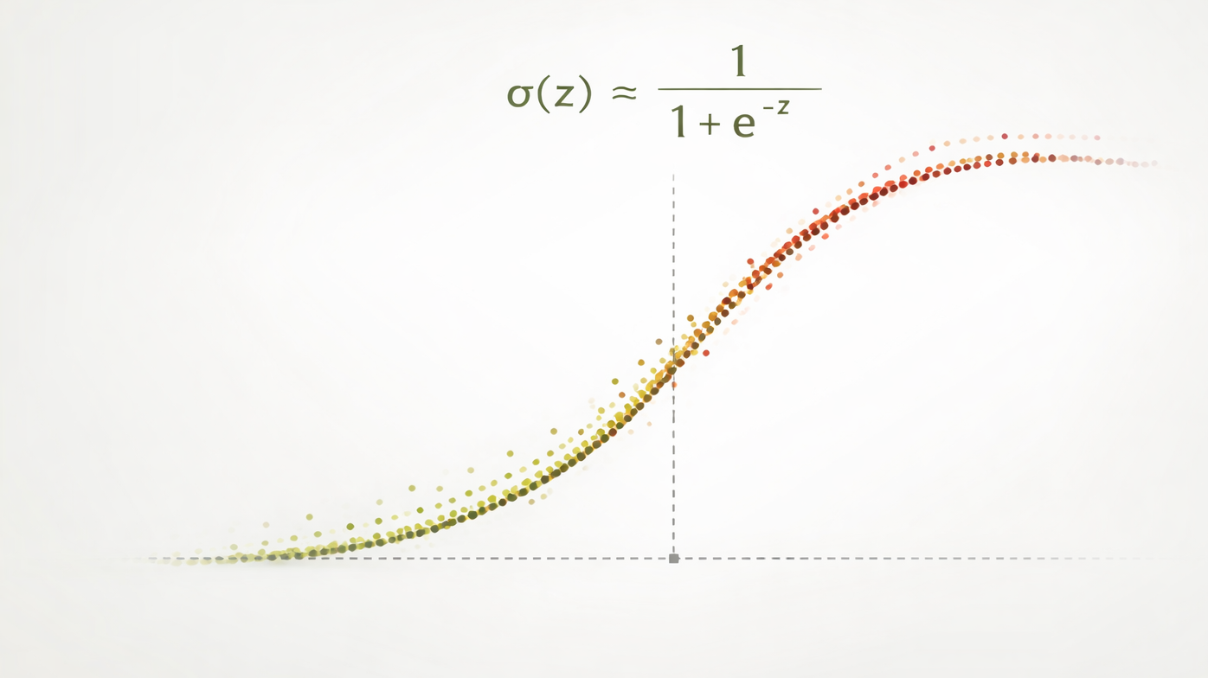
Intro to Machine Learning

Slide 2
Motivation: Binary Outcomes
• Problem: Predict binary outcome y ∈ {0,1} from features x ∈ ℝᵖ
Why not linear regression?
✗ Unbounded predictions: ŷ ∈ (-∞, ∞), not [0,1]
✗ Inappropriate error model: assumes Gaussian noise, not Bernoulli
Provides a useful starting point with a linear combination of features

Slide 3
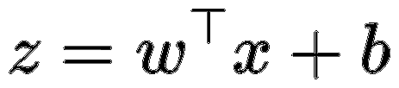
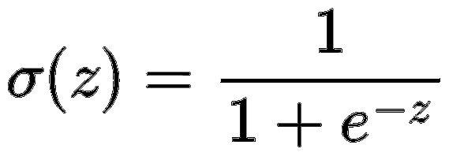
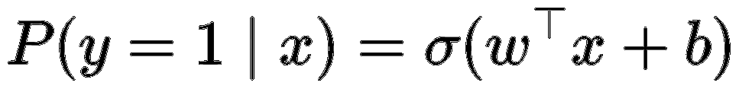
From Linear Scores to Probabilities
Linear predictor (score):
Treat z as latent score or log-odds, not direct prediction
Need a function that:
• Maps ℝ → (0,1)
• Is smooth and monotonic
Solution: Logistic (sigmoid) function:
Model:
Question: What does P(y = 0 | x) look like?

Slide 4
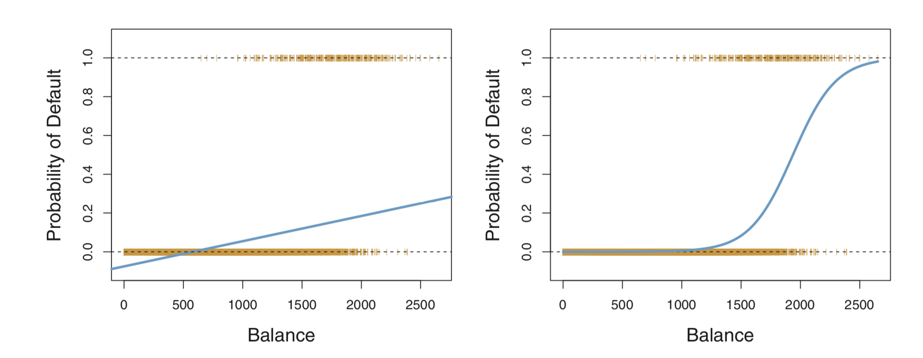
Linear v. Logistic
Picture from Introduction to Statistic Learning by James et. al

Slide 5
Statistical Interpretation: Bernoulli Model
Explicitly model the data-generating process:
This choice:
✓ Matches the binary nature of the data
✓ Provides a principled likelihood-based objective

Slide 6
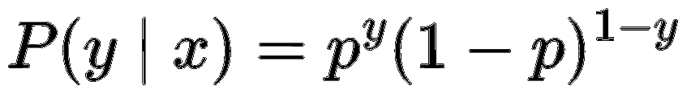
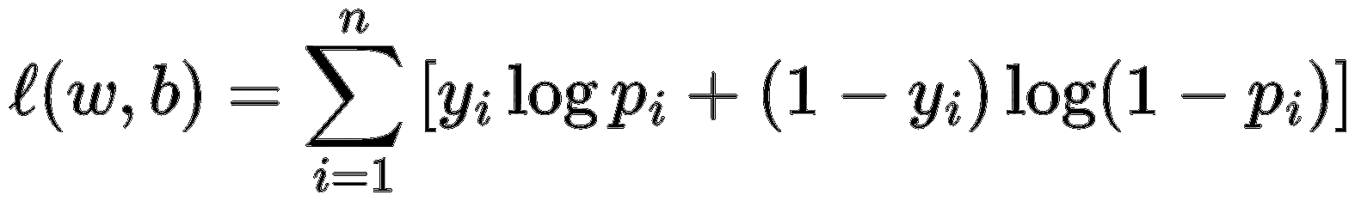
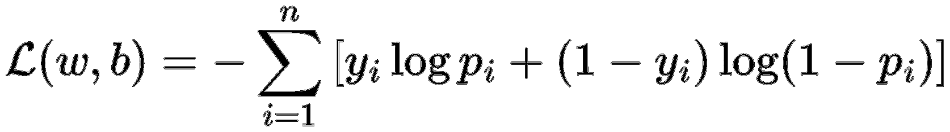
Likelihood and Loss Functions
Likelihood for one observation:
Log-likelihood for n samples:
Loss function (negative log-likelihood):

Slide 7
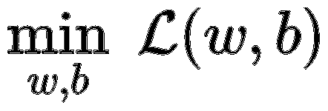
Optimization Problem
Objective:
Key properties:
✓ Convex objective → unique global minimum
✗ No closed-form solution
Common methods: Gradient Descent, SGD, Newton's Method

Slide 8
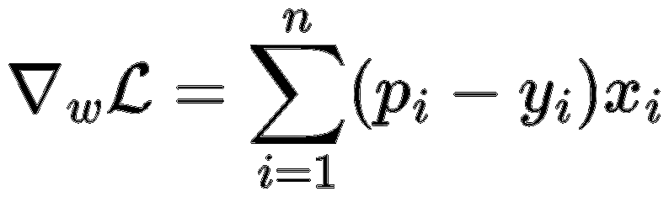
Optimization: Gradient Descent
Gradient:
Parallels linear regression:
• Linear regression: uses residuals (ŷ - y)
• Logistic regression: uses probabilistic errors (p - y)
Interpretation:
• When p > y: feature gradient pushes toward 1
• When p < y: feature gradient pulls toward 0
• When p ≈ y: minimal gradient signal

Slide 9
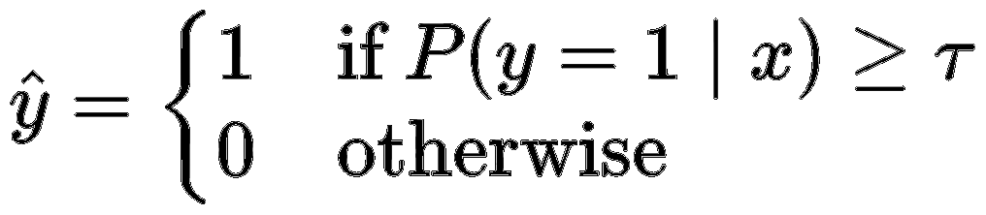
Classification: Decision Rule
Although logistic regression models probabilities,
classification requires a decision threshold τ:
• Standard choice: τ = 0.5
• Can be adjusted based on cost considerations

Slide 10
Conceptual Summary
1. Start with linear regression structure
2. Interpret as log-odds (latent score)
3. Apply sigmoid to get probabilities
4. Model with Bernoulli likelihood
5. Optimize cross-entropy loss (convex)
6. Solve via gradient-based optimization

