Slide 1
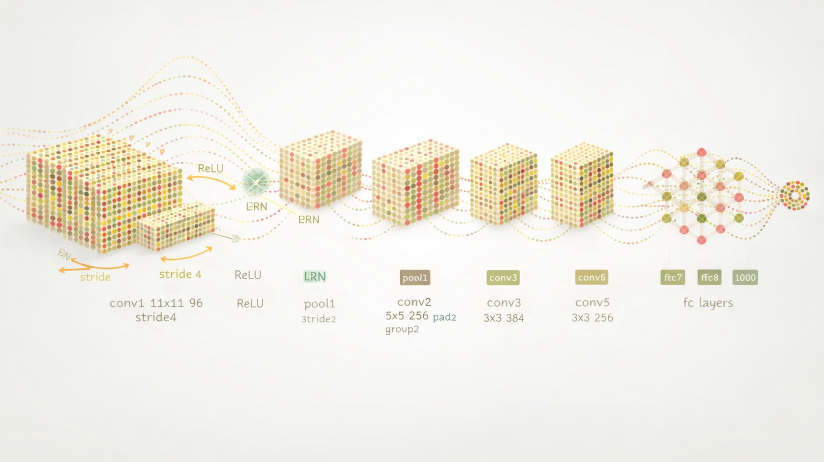
Convolutional Neural Networks

Slide 2
Terms
ANN = Artificial neural network
DNN = Deep neural network
CNN = Convolutional neural network
RNN = Recurrent neural network

Slide 3
Biological motivation of CNNs
CNNs are inspired by the structure and function of the visual cortex
Simple cells
Respond to patterns of light of a certain orientation (such as edges or bars)
Complex cells
Respond to patterns of light in a location but are less sensitive to the exact position
When looking at images, our brain perceives features (both simple and abstract) rather than every detail

Slide 4
Convolutional Neural Networks
CNNs mimic the structure and function of the visual system
They use layers of “convolutions” (or filters) to learn and extract features of the input data
Specifically designed to process and analyze data with a grid-like structure
Images
Videos

Slide 5
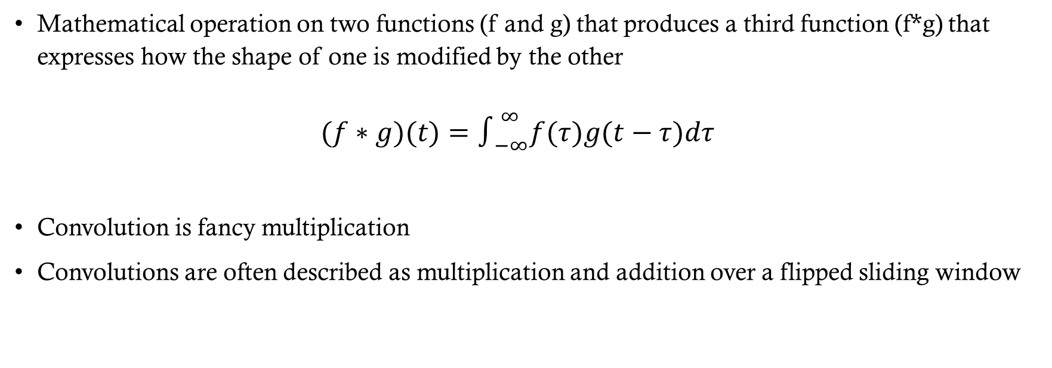
What is a convolution?
Mathematical operation on two functions (f and g) that produces a third function (f*g) that expresses how the shape of one is modified by the other $(f∗g)(t)=∫_{−∞}^{∞}f(τ)g(t−τ)dτ$
Convolution is fancy multiplication
Convolutions are often described as multiplication and addition over a flipped sliding window

Slide 6
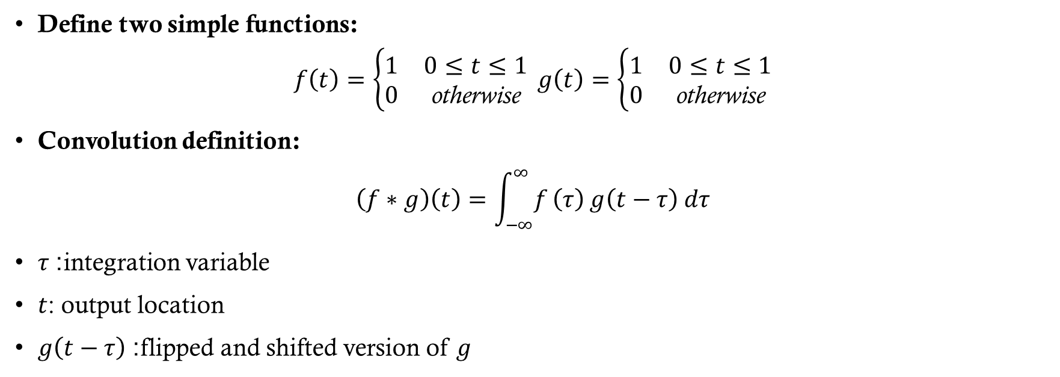
Continuous example
Define two simple functions:
$$f\left(t\right)=\left\{\begin{matrix}1 & 0≤t≤1 \\ 0 & \text{otherwise}\end{matrix}\right. g\left(t\right)=\left\{\begin{matrix}1 & 0≤t≤1 \\ 0 & \text{otherwise}\end{matrix}\right.$$
Convolution definition:
$$\left(f∗g\right)\left(t\right)=\int_{−∞}^{∞}{f}\left(τ\right) g\left(t−τ\right) dτ$$
$τ$: integration variable
$t$: output location
$g\left(t−τ\right)$: flipped and shifted version of $g$

Slide 7

Continuous example
$f\left(τ\right)$is nonzero on [0, 1]
$g\left(t−τ\right)$is nonzero when$t−1≤τ≤t$
Therefore:
$\left(f∗g\right)\left(t\right)=$ Length of Overlap between the intervals$\text{[}\text{0}\text{, }\text{1}\text{] }\text{and} [t−1, t]$
Notes:
For Desmos:
y\ =1\ \left\{x\ >\ 0\right\}\ \left\{x\ <\ 1\right\}
y\ =\ 1\ \left\{x\ >\ a-1\right\}\ \left\{x\ <\ a\right\}

Slide 8
Discrete Example
Suppose patients come to our hospital this week with a certain disease and a different number of patients come each day
M: 1 patients T: 2 patients W: 3 patients Th: 4 patients F: 5 patient
In vector format: [1, 2, 3, 4, 5]
Suppose that we treat each patient with 3 doses of medication
How many doses of medication will we need each day?
[3, 6, 9, 12, 15]

Slide 9
Discrete Example
Suppose patients come to our hospital this week with a certain disease and a different number of patients come each day
In vector format: [1, 2, 3, 4, 5]
Now suppose that patients need a multi-day regimen with 3 doses the first day, 2 the second day, and 3 doses the third day
[3, 2, 1]
How many doses of medication will we need each day?

Slide 10
Discrete Example
Suppose patients come to our hospital this week with a certain disease and a different number of patients come each day
In vector format: [1, 2, 3, 4, 5]
Now suppose that patients actually need a multi-day regimen with 3 doses the first day, 2 the second day, and 1 doses the third day
[3, 2, 1]
How many doses of medication will we need each day?
Monday: 1*3
Tuesday: 2*3 + 1*2
Wednesday: 3*3 + 2*2 + 1*1
Thursday: 4*3 + 3*2 + 2*1
Friday: 5*3 + 4*2 + 3*1
Saturday: 5*2 + 4*1
Sunday: 5*1

Slide 11

Discrete Example
1 | 2 | 3 | 4 | 5
$$⊛$$
3 | 2 | 1
Flip this vector
3
5 | 4 | 3 | 2 | 1
Slide across
Multiply and Add at each “slide”

Slide 12

Discrete Example
3 | 2 | 1
5 | 4 | 3 | 2 | 1
3
3
$$=$$

Slide 13
Discrete Example
3 | 2 | 1
5 | 4 | 3 | 2 | 1
6 | 2
8
$$=$$

Slide 14
Discrete Example
3 | 2 | 1
5 | 4 | 3 | 2 | 1
9 | 4 | 1
14
$$=$$

Slide 15
Discrete Example
3 | 2 | 1
5 | 4 | 3 | 2 | 1
12 | 6 | 2
20
$$=$$

Slide 16
Discrete Example
3 | 2 | 1
5 | 4 | 3 | 2 | 1
15 | 8 | 3
26
$$=$$

Slide 17
Discrete Example
3 | 2 | 1
5 | 4 | 3 | 2 | 1
 | 10 | 4
14
$$=$$

Slide 18
Discrete Example
3 | 2 | 1
5 | 4 | 3 | 2 | 1
 |  | 5
5
$$=$$

Slide 19
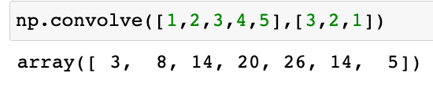


Discrete Example
1 | 2 | 3 | 4 | 5
$$⊛$$
3 | 2 | 1
$$=$$
3 | 8 | 14 | 20 | 26 | 14 | 5

Slide 20
Uses of convolutions
Convolutions have application is a vast array disciplines
Probability
Statistics
Image processing
Signal processing
Acoustics
Computer vision
Etc.

Slide 21
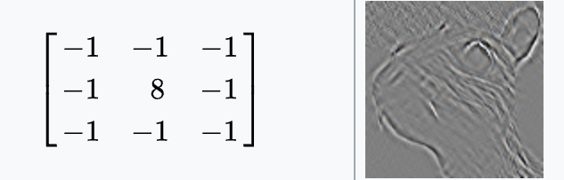
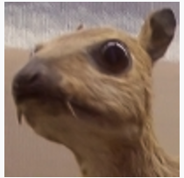
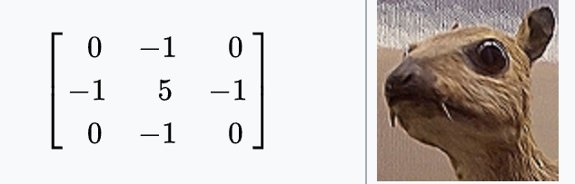
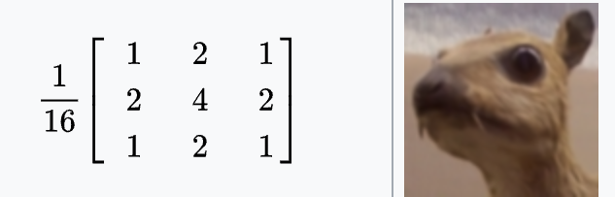
Convolutions in Image Processing
In image processing, convolving a filter with the original image results in a range of effects, depending on the filter
Edge detection
Sharpen
Blur

Slide 22
CNN Architecture
Basic structure of a CNN:
Convolutional layers
part of fitting process involves the network finding the filters that help identify the image
Pooling layers
Flattening and Fully connected layers

Slide 23
CNN Architecture

Slide 24
Convolutional Layer

Slide 25


Convolution with one filter
This is learned by the model
0 | 0 | 0 | 0 | 0 | 0 | 0
0 | 0 | 1 | 0 | 1 | 0 | 0
0 | 0 | 0 | 0 | 0 | 0 | 0
0 | 0 | 0 | 1 | 0 | 0 | 0
0 | 1 | 0 | 0 | 0 | 1 | 0
0 | 0 | 1 | 1 | 1 | 0 | 0
0 | 0 | 0 | 0 | 0 | 0 | 0
0 | 0 | 1
1 | 0 | 0
0 | 1 | 1
$$⊛$$
$$=$$
Input Image
Feature Detector/ Filter
Feature Map

Slide 26
Convolution with one filter
0 | 0 | 0 | 0 | 0 | 0 | 0
0 | 0 | 1 | 0 | 1 | 0 | 0
0 | 0 | 0 | 0 | 0 | 0 | 0
0 | 0 | 0 | 1 | 0 | 0 | 0
0 | 1 | 0 | 0 | 0 | 1 | 0
0 | 0 | 1 | 1 | 1 | 0 | 0
0 | 0 | 0 | 0 | 0 | 0 | 0
0
0 | 0 | 1
1 | 0 | 0
0 | 1 | 1
$$⊛$$
$$=$$
Input Image
Feature Detector/ Filter
Feature Map

Slide 27
Convolution with one filter
0 | 0 | 0 | 0 | 0 | 0 | 0
0 | 0 | 1 | 0 | 1 | 0 | 0
0 | 0 | 0 | 0 | 0 | 0 | 0
0 | 0 | 0 | 1 | 0 | 0 | 0
0 | 1 | 0 | 0 | 0 | 1 | 0
0 | 0 | 1 | 1 | 1 | 0 | 0
0 | 0 | 0 | 0 | 0 | 0 | 0
0 | 0
0 | 0 | 1
1 | 0 | 0
0 | 1 | 1
$$⊛$$
$$=$$
Input Image
Feature Detector/ Filter
Feature Map

Slide 28
Convolution with one filter
0 | 0 | 0 | 0 | 0 | 0 | 0
0 | 0 | 1 | 0 | 1 | 0 | 0
0 | 0 | 0 | 0 | 0 | 0 | 0
0 | 0 | 0 | 1 | 0 | 0 | 0
0 | 1 | 0 | 0 | 0 | 1 | 0
0 | 0 | 1 | 1 | 1 | 0 | 0
0 | 0 | 0 | 0 | 0 | 0 | 0
0 | 0 | 1
0 | 0 | 1
1 | 0 | 0
0 | 1 | 1
$$⊛$$
$$=$$
Input Image
Feature Detector/ Filter
Feature Map

Slide 29
Convolution with one filter
0 | 0 | 0 | 0 | 0 | 0 | 0
0 | 0 | 1 | 0 | 1 | 0 | 0
0 | 0 | 0 | 0 | 0 | 0 | 0
0 | 0 | 0 | 1 | 0 | 0 | 0
0 | 1 | 0 | 0 | 0 | 1 | 0
0 | 0 | 1 | 1 | 1 | 0 | 0
0 | 0 | 0 | 0 | 0 | 0 | 0
0 | 0 | 1 | 0
0 | 0 | 1
1 | 0 | 0
0 | 1 | 1
$$⊛$$
$$=$$
Input Image
Feature Detector/ Filter
Feature Map

Slide 30
Convolution with one filter
0 | 0 | 0 | 0 | 0 | 0 | 0
0 | 0 | 1 | 0 | 1 | 0 | 0
0 | 0 | 0 | 0 | 0 | 0 | 0
0 | 0 | 0 | 1 | 0 | 0 | 0
0 | 1 | 0 | 0 | 0 | 1 | 0
0 | 0 | 1 | 1 | 1 | 0 | 0
0 | 0 | 0 | 0 | 0 | 0 | 0
0 | 0 | 1 | 0 | 1
0 | 0 | 1
1 | 0 | 0
0 | 1 | 1
$$⊛$$
$$=$$
Input Image
Feature Detector/ Filter
Feature Map

Slide 31
Convolution with one filter
0 | 0 | 0 | 0 | 0 | 0 | 0
0 | 0 | 1 | 0 | 1 | 0 | 0
0 | 0 | 0 | 0 | 0 | 0 | 0
0 | 0 | 0 | 1 | 0 | 0 | 0
0 | 1 | 0 | 0 | 0 | 1 | 0
0 | 0 | 1 | 1 | 1 | 0 | 0
0 | 0 | 0 | 0 | 0 | 0 | 0
0 | 0 | 1 | 0 | 1
1
0 | 0 | 1
1 | 0 | 0
0 | 1 | 1
$$⊛$$
$$=$$
Input Image
Feature Detector/ Filter
Feature Map

Slide 32
Convolution with one filter
0 | 0 | 0 | 0 | 0 | 0 | 0
0 | 0 | 1 | 0 | 1 | 0 | 0
0 | 0 | 0 | 0 | 0 | 0 | 0
0 | 0 | 0 | 1 | 0 | 0 | 0
0 | 1 | 0 | 0 | 0 | 1 | 0
0 | 0 | 1 | 1 | 1 | 0 | 0
0 | 0 | 0 | 0 | 0 | 0 | 0
0 | 0 | 1 | 0 | 1
1 | 1
0 | 0 | 1
1 | 0 | 0
0 | 1 | 1
$$⊛$$
$$=$$
Input Image
Feature Detector/ Filter
Feature Map

Slide 33
Convolution with one filter
0 | 0 | 0 | 0 | 0 | 0 | 0
0 | 0 | 1 | 0 | 1 | 0 | 0
0 | 0 | 0 | 0 | 0 | 0 | 0
0 | 0 | 0 | 1 | 0 | 0 | 0
0 | 1 | 0 | 0 | 0 | 1 | 0
0 | 0 | 1 | 1 | 1 | 0 | 0
0 | 0 | 0 | 0 | 0 | 0 | 0
0 | 0 | 1 | 0 | 1
1 | 1 | 2
0 | 0 | 1
1 | 0 | 0
0 | 1 | 1
$$⊛$$
$$=$$
Input Image
Feature Detector/ Filter
Feature Map

Slide 34
Convolution with one filter
0 | 0 | 0 | 0 | 0 | 0 | 0
0 | 0 | 1 | 0 | 1 | 0 | 0
0 | 0 | 0 | 0 | 0 | 0 | 0
0 | 0 | 0 | 1 | 0 | 0 | 0
0 | 1 | 0 | 0 | 0 | 1 | 0
0 | 0 | 1 | 1 | 1 | 0 | 0
0 | 0 | 0 | 0 | 0 | 0 | 0
0 | 0 | 1 | 0 | 1
1 | 1 | 2 | 0
0 | 0 | 1
1 | 0 | 0
0 | 1 | 1
$$⊛$$
$$=$$
Input Image
Feature Detector/ Filter
Feature Map

Slide 35
Convolution with one filter
0 | 0 | 0 | 0 | 0 | 0 | 0
0 | 0 | 1 | 0 | 1 | 0 | 0
0 | 0 | 0 | 0 | 0 | 0 | 0
0 | 0 | 0 | 1 | 0 | 0 | 0
0 | 1 | 0 | 0 | 0 | 1 | 0
0 | 0 | 1 | 1 | 1 | 0 | 0
0 | 0 | 0 | 0 | 0 | 0 | 0
0 | 0 | 1 | 0 | 1
1 | 1 | 2 | 0 | 0
0 | 0 | 1
1 | 0 | 0
0 | 1 | 1
$$⊛$$
$$=$$
Input Image
Feature Detector/ Filter
Feature Map

Slide 36
Convolution with one filter
0 | 0 | 0 | 0 | 0 | 0 | 0
0 | 0 | 1 | 0 | 1 | 0 | 0
0 | 0 | 0 | 0 | 0 | 0 | 0
0 | 0 | 0 | 1 | 0 | 0 | 0
0 | 1 | 0 | 0 | 0 | 1 | 0
0 | 0 | 1 | 1 | 1 | 0 | 0
0 | 0 | 0 | 0 | 0 | 0 | 0
0 | 0 | 1 | 0 | 1
1 | 1 | 2 | 0 | 0
1
0 | 0 | 1
1 | 0 | 0
0 | 1 | 1
$$⊛$$
$$=$$
Input Image
Feature Detector/ Filter
Feature Map

Slide 37
Convolution with one filter
0 | 0 | 0 | 0 | 0 | 0 | 0
0 | 0 | 1 | 0 | 1 | 0 | 0
0 | 0 | 0 | 0 | 0 | 0 | 0
0 | 0 | 0 | 1 | 0 | 0 | 0
0 | 1 | 0 | 0 | 0 | 1 | 0
0 | 0 | 1 | 1 | 1 | 0 | 0
0 | 0 | 0 | 0 | 0 | 0 | 0
0 | 0 | 1 | 0 | 1
1 | 1 | 2 | 0 | 0
1 | 0
0 | 0 | 1
1 | 0 | 0
0 | 1 | 1
$$⊛$$
$$=$$
Input Image
Feature Detector/ Filter
Feature Map

Slide 38
Convolution with one filter
0 | 0 | 0 | 0 | 0 | 0 | 0
0 | 0 | 1 | 0 | 1 | 0 | 0
0 | 0 | 0 | 0 | 0 | 0 | 0
0 | 0 | 0 | 1 | 0 | 0 | 0
0 | 1 | 0 | 0 | 0 | 1 | 0
0 | 0 | 1 | 1 | 1 | 0 | 0
0 | 0 | 0 | 0 | 0 | 0 | 0
0 | 0 | 1 | 0 | 1
1 | 1 | 2 | 0 | 0
1 | 0 | 0
0 | 0 | 1
1 | 0 | 0
0 | 1 | 1
$$⊛$$
$$=$$
Input Image
Feature Detector/ Filter
Feature Map

Slide 39
Convolution with one filter
0 | 0 | 0 | 0 | 0 | 0 | 0
0 | 0 | 1 | 0 | 1 | 0 | 0
0 | 0 | 0 | 0 | 0 | 0 | 0
0 | 0 | 0 | 1 | 0 | 0 | 0
0 | 1 | 0 | 0 | 0 | 1 | 0
0 | 0 | 1 | 1 | 1 | 0 | 0
0 | 0 | 0 | 0 | 0 | 0 | 0
0 | 0 | 1 | 0 | 1
1 | 1 | 2 | 0 | 0
1 | 0 | 0 | 2
0 | 0 | 1
1 | 0 | 0
0 | 1 | 1
$$⊛$$
$$=$$
Input Image
Feature Detector/ Filter
Feature Map

Slide 40
Convolution with one filter
0 | 0 | 0 | 0 | 0 | 0 | 0
0 | 0 | 1 | 0 | 1 | 0 | 0
0 | 0 | 0 | 0 | 0 | 0 | 0
0 | 0 | 0 | 1 | 0 | 0 | 0
0 | 1 | 0 | 0 | 0 | 1 | 0
0 | 0 | 1 | 1 | 1 | 0 | 0
0 | 0 | 0 | 0 | 0 | 0 | 0
0 | 0 | 1 | 0 | 1
1 | 1 | 2 | 0 | 0
1 | 0 | 0 | 2 | 1
0 | 0 | 1
1 | 0 | 0
0 | 1 | 1
$$⊛$$
$$=$$
Input Image
Feature Detector/ Filter
Feature Map

Slide 41
Convolution with one filter
0 | 0 | 0 | 0 | 0 | 0 | 0
0 | 0 | 1 | 0 | 1 | 0 | 0
0 | 0 | 0 | 0 | 0 | 0 | 0
0 | 0 | 0 | 1 | 0 | 0 | 0
0 | 1 | 0 | 0 | 0 | 1 | 0
0 | 0 | 1 | 1 | 1 | 0 | 0
0 | 0 | 0 | 0 | 0 | 0 | 0
0 | 0 | 1 | 0 | 1
1 | 1 | 2 | 0 | 0
1 | 0 | 0 | 2 | 1
1
0 | 0 | 1
1 | 0 | 0
0 | 1 | 1
$$⊛$$
$$=$$
Input Image
Feature Detector/ Filter
Feature Map

Slide 42
Convolution with one filter
0 | 0 | 0 | 0 | 0 | 0 | 0
0 | 0 | 1 | 0 | 1 | 0 | 0
0 | 0 | 0 | 0 | 0 | 0 | 0
0 | 0 | 0 | 1 | 0 | 0 | 0
0 | 1 | 0 | 0 | 0 | 1 | 0
0 | 0 | 1 | 1 | 1 | 0 | 0
0 | 0 | 0 | 0 | 0 | 0 | 0
0 | 0 | 1 | 0 | 1
1 | 1 | 2 | 0 | 0
1 | 0 | 0 | 2 | 1
1 | 4
0 | 0 | 1
1 | 0 | 0
0 | 1 | 1
$$⊛$$
$$=$$
Input Image
Feature Detector/ Filter
Feature Map

Slide 43
Convolution with one filter
0 | 0 | 0 | 0 | 0 | 0 | 0
0 | 0 | 1 | 0 | 1 | 0 | 0
0 | 0 | 0 | 0 | 0 | 0 | 0
0 | 0 | 0 | 1 | 0 | 0 | 0
0 | 1 | 0 | 0 | 0 | 1 | 0
0 | 0 | 1 | 1 | 1 | 0 | 0
0 | 0 | 0 | 0 | 0 | 0 | 0
0 | 0 | 1 | 0 | 1
1 | 1 | 2 | 0 | 0
1 | 0 | 0 | 2 | 1
1 | 4 | 2
0 | 0 | 1
1 | 0 | 0
0 | 1 | 1
$$⊛$$
$$=$$
Input Image
Feature Detector/ Filter
Feature Map

Slide 44
Convolution with one filter
0 | 0 | 0 | 0 | 0 | 0 | 0
0 | 0 | 1 | 0 | 1 | 0 | 0
0 | 0 | 0 | 0 | 0 | 0 | 0
0 | 0 | 0 | 1 | 0 | 0 | 0
0 | 1 | 0 | 0 | 0 | 1 | 0
0 | 0 | 1 | 1 | 1 | 0 | 0
0 | 0 | 0 | 0 | 0 | 0 | 0
0 | 0 | 1 | 0 | 1
1 | 1 | 2 | 0 | 0
1 | 0 | 0 | 2 | 1
1 | 4 | 2 | 1
0 | 0 | 1
1 | 0 | 0
0 | 1 | 1
$$⊛$$
$$=$$
Input Image
Feature Detector/ Filter
Feature Map

Slide 45
Convolution with one filter
0 | 0 | 0 | 0 | 0 | 0 | 0
0 | 0 | 1 | 0 | 1 | 0 | 0
0 | 0 | 0 | 0 | 0 | 0 | 0
0 | 0 | 0 | 1 | 0 | 0 | 0
0 | 1 | 0 | 0 | 0 | 1 | 0
0 | 0 | 1 | 1 | 1 | 0 | 0
0 | 0 | 0 | 0 | 0 | 0 | 0
0 | 0 | 1 | 0 | 1
1 | 1 | 2 | 0 | 0
1 | 0 | 0 | 2 | 1
1 | 4 | 2 | 1 | 0
0 | 0 | 1
1 | 0 | 0
0 | 1 | 1
$$⊛$$
$$=$$
Input Image
Feature Detector/ Filter
Feature Map

Slide 46
Convolution with one filter
0 | 0 | 0 | 0 | 0 | 0 | 0
0 | 0 | 1 | 0 | 1 | 0 | 0
0 | 0 | 0 | 0 | 0 | 0 | 0
0 | 0 | 0 | 1 | 0 | 0 | 0
0 | 1 | 0 | 0 | 0 | 1 | 0
0 | 0 | 1 | 1 | 1 | 0 | 0
0 | 0 | 0 | 0 | 0 | 0 | 0
0 | 0 | 1 | 0 | 1
1 | 1 | 2 | 0 | 0
1 | 0 | 0 | 2 | 1
1 | 4 | 2 | 1 | 0
0
0 | 0 | 1
1 | 0 | 0
0 | 1 | 1
$$⊛$$
$$=$$
Input Image
Feature Detector/ Filter
Feature Map

Slide 47
Convolution with one filter
0 | 0 | 0 | 0 | 0 | 0 | 0
0 | 0 | 1 | 0 | 1 | 0 | 0
0 | 0 | 0 | 0 | 0 | 0 | 0
0 | 0 | 0 | 1 | 0 | 0 | 0
0 | 1 | 0 | 0 | 0 | 1 | 0
0 | 0 | 1 | 1 | 1 | 0 | 0
0 | 0 | 0 | 0 | 0 | 0 | 0
0 | 0 | 1 | 0 | 1
1 | 1 | 2 | 0 | 0
1 | 0 | 0 | 2 | 1
1 | 4 | 2 | 1 | 0
0 | 0
0 | 0 | 1
1 | 0 | 0
0 | 1 | 1
$$⊛$$
$$=$$
Input Image
Feature Detector/ Filter
Feature Map

Slide 48
Convolution with one filter
0 | 0 | 0 | 0 | 0 | 0 | 0
0 | 0 | 1 | 0 | 1 | 0 | 0
0 | 0 | 0 | 0 | 0 | 0 | 0
0 | 0 | 0 | 1 | 0 | 0 | 0
0 | 1 | 0 | 0 | 0 | 1 | 0
0 | 0 | 1 | 1 | 1 | 0 | 0
0 | 0 | 0 | 0 | 0 | 0 | 0
0 | 0 | 1 | 0 | 1
1 | 1 | 2 | 0 | 0
1 | 0 | 0 | 2 | 1
1 | 4 | 2 | 1 | 0
0 | 0 | 1
0 | 0 | 1
1 | 0 | 0
0 | 1 | 1
$$⊛$$
$$=$$
Input Image
Feature Detector/ Filter
Feature Map

Slide 49
Convolution with one filter
0 | 0 | 0 | 0 | 0 | 0 | 0
0 | 0 | 1 | 0 | 1 | 0 | 0
0 | 0 | 0 | 0 | 0 | 0 | 0
0 | 0 | 0 | 1 | 0 | 0 | 0
0 | 1 | 0 | 0 | 0 | 1 | 0
0 | 0 | 1 | 1 | 1 | 0 | 0
0 | 0 | 0 | 0 | 0 | 0 | 0
0 | 0 | 1 | 0 | 1
1 | 1 | 2 | 0 | 0
1 | 0 | 0 | 2 | 1
1 | 4 | 2 | 1 | 0
0 | 0 | 1 | 2
0 | 0 | 1
1 | 0 | 0
0 | 1 | 1
$$⊛$$
$$=$$
Input Image
Feature Detector/ Filter
Feature Map

Slide 50
Convolution with one filter
0 | 0 | 0 | 0 | 0 | 0 | 0
0 | 0 | 1 | 0 | 1 | 0 | 0
0 | 0 | 0 | 0 | 0 | 0 | 0
0 | 0 | 0 | 1 | 0 | 0 | 0
0 | 1 | 0 | 0 | 0 | 1 | 0
0 | 0 | 1 | 1 | 1 | 0 | 0
0 | 0 | 0 | 0 | 0 | 0 | 0
0 | 0 | 1 | 0 | 1
1 | 1 | 2 | 0 | 0
1 | 0 | 0 | 2 | 1
1 | 4 | 2 | 1 | 0
0 | 0 | 1 | 2 | 1
0 | 0 | 1
1 | 0 | 0
0 | 1 | 1
$$⊛$$
$$=$$
Input Image
Feature Detector/ Filter
Feature Map

Slide 51
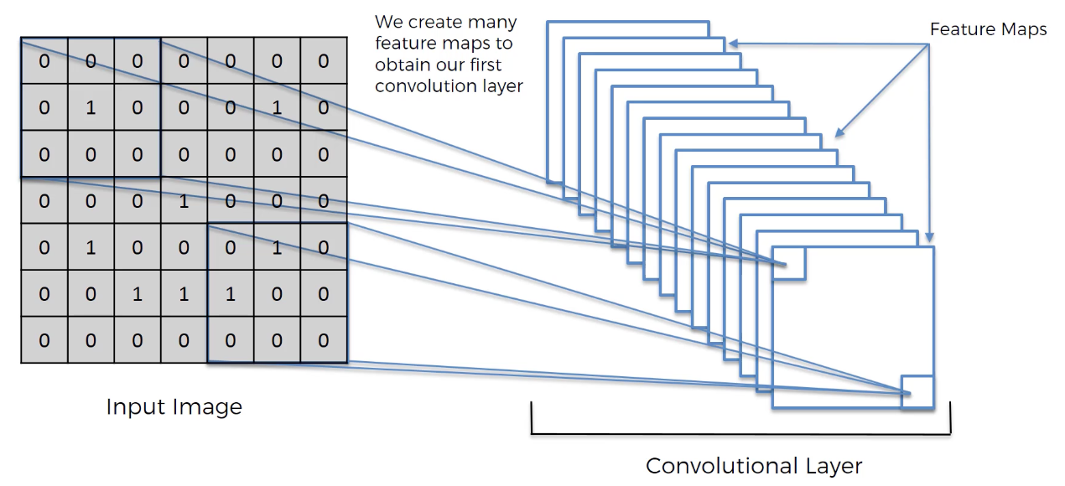
Convolutional Layer

Slide 52
Pooling Layer

Slide 53
Max Pooling
Pooling layers operate on the feature maps to summarize the pixels in a rectangular neighborhood
Max pooling is the most common, though other pooling operations are occasionally used
The purpose of the pooling layer is to:
Reduce the the spatial size of the feature map
Help make the network robust to small translations and distortions of the input data

Slide 54
Max Pooling
0 | 0 | 1 | 0 | 1
1 | 1 | 2 | 0 | 0
1 | 0 | 0 | 2 | 1
1 | 4 | 2 | 1 | 0
0 | 0 | 1 | 2 | 1
1
Max Pooling
Box size: 2x2 Stride = 2
Feature Map
Pooled Feature Map

Slide 55
Max Pooling
0 | 0 | 1 | 0 | 1
1 | 1 | 2 | 0 | 0
1 | 0 | 0 | 2 | 1
1 | 4 | 2 | 1 | 0
0 | 0 | 1 | 2 | 1
1 | 2
Max Pooling
Box size: 2x2 Stride = 2
Feature Map
Pooled Feature Map

Slide 56
Max Pooling
0 | 0 | 1 | 0 | 1
1 | 1 | 2 | 0 | 0
1 | 0 | 0 | 2 | 1
1 | 4 | 2 | 1 | 0
0 | 0 | 1 | 2 | 1
1 | 2 | 1
Max Pooling
Box size: 2x2 Stride = 2
Feature Map
Pooled Feature Map

Slide 57
Max Pooling
0 | 0 | 1 | 0 | 1
1 | 1 | 2 | 0 | 0
1 | 0 | 0 | 2 | 1
1 | 4 | 2 | 1 | 0
0 | 0 | 1 | 2 | 1
1 | 2 | 1
4
Max Pooling
Box size: 2x2 Stride = 2
Feature Map
Pooled Feature Map

Slide 58
Max Pooling
0 | 0 | 1 | 0 | 1
1 | 1 | 2 | 0 | 0
1 | 0 | 0 | 2 | 1
1 | 4 | 2 | 1 | 0
0 | 0 | 1 | 2 | 1
1 | 2 | 1
4 | 2
Max Pooling
Box size: 2x2 Stride = 2
Feature Map
Pooled Feature Map

Slide 59
Max Pooling
0 | 0 | 1 | 0 | 1
1 | 1 | 2 | 0 | 0
1 | 0 | 0 | 2 | 1
1 | 4 | 2 | 1 | 0
0 | 0 | 1 | 2 | 1
1 | 2 | 1
4 | 2 | 1
Max Pooling
Box size: 2x2 Stride = 2
Feature Map
Pooled Feature Map

Slide 60
Max Pooling
0 | 0 | 1 | 0 | 1
1 | 1 | 2 | 0 | 0
1 | 0 | 0 | 2 | 1
1 | 4 | 2 | 1 | 0
0 | 0 | 1 | 2 | 1
1 | 2 | 1
4 | 2 | 1
0
Max Pooling
Box size: 2x2 Stride = 2
Feature Map
Pooled Feature Map

Slide 61
Max Pooling
0 | 0 | 1 | 0 | 1
1 | 1 | 2 | 0 | 0
1 | 0 | 0 | 2 | 1
1 | 4 | 2 | 1 | 0
0 | 0 | 1 | 2 | 1
1 | 2 | 1
4 | 2 | 1
0 | 2
Max Pooling
Box size: 2x2 Stride = 2
Feature Map
Pooled Feature Map

Slide 62
Max Pooling
0 | 0 | 1 | 0 | 1
1 | 1 | 2 | 0 | 0
1 | 0 | 0 | 2 | 1
1 | 4 | 2 | 1 | 0
0 | 0 | 1 | 2 | 1
1 | 2 | 1
4 | 2 | 1
0 | 2 | 1
Max Pooling
Box size: 2x2 Stride = 2
Feature Map
Pooled Feature Map

Slide 63
Flattening & Fully connected layers

Slide 64
Image to Classification
After one or more convolution and pooling layers
Send the result into a regular ANN
Combine features into a wider variety of attributes
Perform the classification step

Slide 65
Flattening
Flattening simply means to turn the input grid into a vector that can be input into a regular ANN

Slide 66
Fully connected layer
The output layer will have a neuron for every possible class

Slide 67
Summary

Slide 68
ImageNet
Large visual database designed for object recognition research
~14 million images
Hand-annotated (Mechanical Turk) into 20,000+ categories
Subset of the data is used in the ImageNet Large Scale Visualization Recognition Challenge (ILSVRC)
Help end AI winter
In 2012 AlexNet achieved a top-5 error rate more than 10.8 percentage points lower than the runner up
“Suddenly people started to pay attention, not just within the AI community but across the industry as a whole” (from The Economist)

Slide 69
ImageNet Large-Scale Visual Recognition Challenge
Subset of ImageNet Data
1.2 million training images
1000 classes
AlexNet
8 layers
ResNet
Graph from ImageNet Wikipedia page
152 layers

Slide 70
Modern CNN Architectures

Slide 71
Various CNN Architectures
We should think of the word “architecture” fairly literally
It takes time, education, and practice to become an “architect”
True for architects that design buildings
True for architects that design CNNs
We can learn from what others have done and other architectures that have been successful

Slide 72
Innovations that made depth possible
ReLU (and its relatives)
Skip connections
Better weight initializations
Batch normalization
Normalize the inputs of each layer (helps with internal covariate shift, vanishing gradients, overfitting)
Dropout
Randomly dropout or “turn off” some of the neurons during training
Forces the network to have redundant representation of features
(Not an exhaustive list)

Slide 73
AlexNet (2012)
Innovations
Deep convolutions
ReLu
Also:
Dropout
Data augmentation
GPU

Slide 74
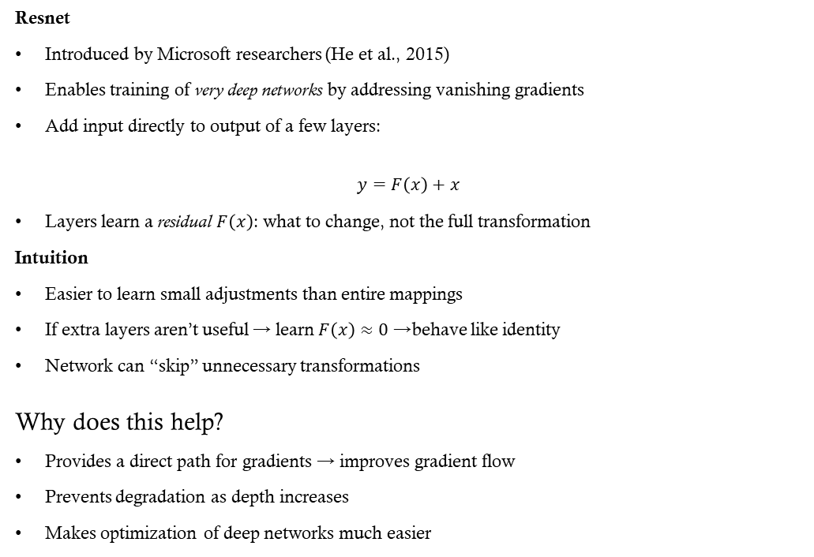
ResNet (Residual Network)
Resnet
Introduced by Microsoft researchers (He et al., 2015)
Enables training of very deep networks by addressing vanishing gradients
Add input directly to output of a few layers:
$$y=F\left(x\right)+x$$
Layers learn a residual $F\left(x\right)$: what to change, not the full transformation
Intuition
Easier to learn small adjustments than entire mappings
If extra layers aren’t useful → learn $F\left(x\right)≈0$→ behave like identity
Network can “skip” unnecessary transformations
Why does this help?
Provides a direct path for gradients → improves gradient flow
Prevents degradation as depth increases
Makes optimization of deep networks much easier

Slide 75
CNN Training

Slide 76
Training components
Initialization
Forward pass
Compute loss
Backpropagation
Update weights
Repeat over mini-batches
Architectural hyperparameters:
Kernel (filter) size
Stride
Padding
Number of filters

Slide 77
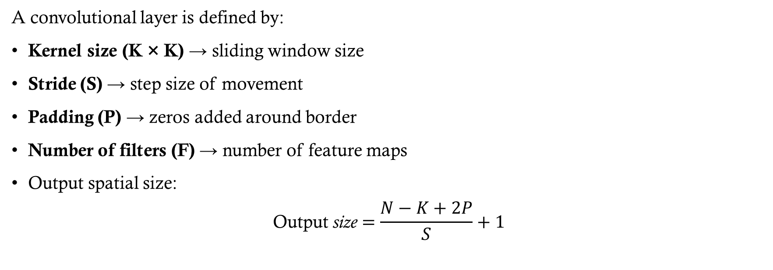
CNN Layer Components
A convolutional layer is defined by:
Kernel size (K × K) → sliding window size
Stride (S) → step size of movement
Padding (P) → zeros added around border
Number of filters (F) → number of feature maps
Output spatial size:
$$\text{Output} \text{size}=\frac{N−K+2P}{S}+1$$

Slide 78

Kernel (Sliding Window)
What does kernel size control?
Spatial pattern scale detected
Parameter count
Parameters per filter:
$$K×K×C$$
Where $C$ is the number of input channels (typically 1 or 3).

Slide 79
Kernel Size
Larger kernels:
More parameters
Higher variance
More compute
Larger receptive field per layer
Smaller kernels (e.g., 3×3):
Fewer parameters
Deeper networks needed
Better regularization
More nonlinearities
This is why modern CNNs prefer stacked 3×3 convolutions.

Slide 80
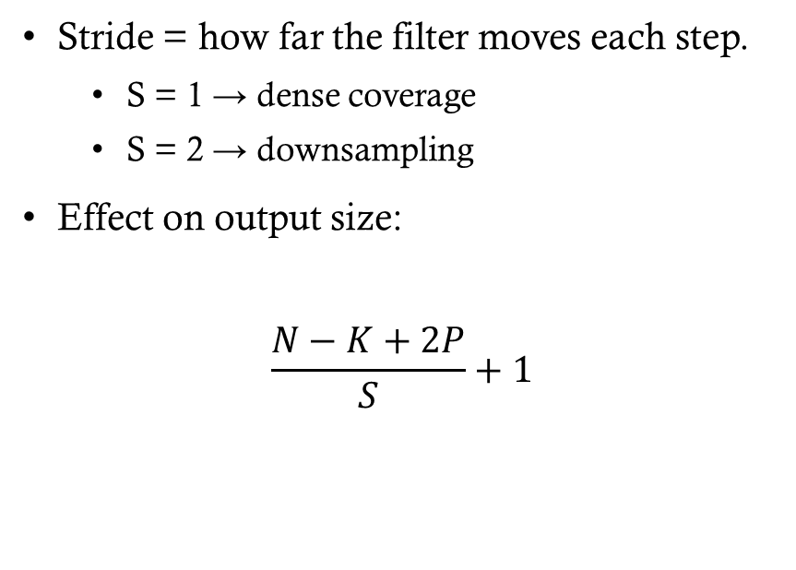
Stride
Stride = how far the filter moves each step.
S = 1 → dense coverage
S = 2 → downsampling
Effect on output size:
$$\frac{N−K+2P}{S}+1$$
Larger stride:
Smaller output feature maps
Fewer activations
Fewer gradient paths
Faster training
More aggressive information compression
Smaller stride:
More overlap
More gradient signal
Better fine-detail learning
Higher computation cost

Slide 81
Padding
Padding adds zeros around input borders.
Types:
No padding
Same padding (preserve size)
Without padding:
Spatial size shrinks each layer
With padding:
Spatial resolution preserved
Without padding:
Border pixels used fewer times
Gradients weaker at edges
Spatial size shrinks quickly
With padding:
More uniform gradient flow
Deeper networks possible
Preserves spatial alignment
Padding helps stabilize training in deep CNNs.

Slide 82
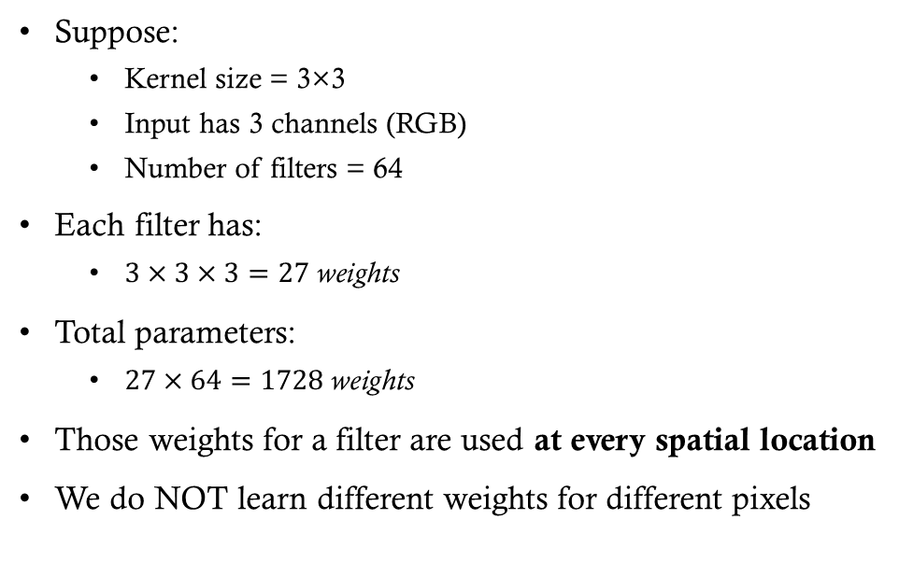
Weight Sharing
Fully connected (no sharing)
If you flatten a 224×224 image:
Input size ≈ 50,000 pixels
If next layer has 100 neurons
You need 50,000 × 100 = 5,000,000 weights
Each neuron has its own independent weights.
Suppose:
Kernel size = 3×3
Input has 3 channels (RGB)
Number of filters = 64
Each filter has:
$3×3×3=27 \text{weights}$
Total parameters:
$27×64=1728 \text{weights}$
Those weights for a filter are used at every spatial location
We do NOT learn different weights for different pixels

Slide 83
Using Pre-trained Models

Slide 84
Pre-trained models
Large models trained on massive datasets (ImageNet, web text, etc.)
Learn general-purpose representations
Why Use Them?
Avoid training from scratch (expensive + data-hungry)
Work well even with small datasets
Faster convergence, better performance
Which Layers?
Initial layers → general features
Later layers → task-specific features

Slide 85
Transfer Learning
Transfer Learning
Keep lower layers (feature extraction)
Replace/train top layers for new task
Optionally fine-tune entire network
Direct Use
Apply the model as-is if the task is very similar
Some Considerations
Freeze layers when data is small
Fine-tune when data is larger
More similarity → less retraining needed

