Slide 1
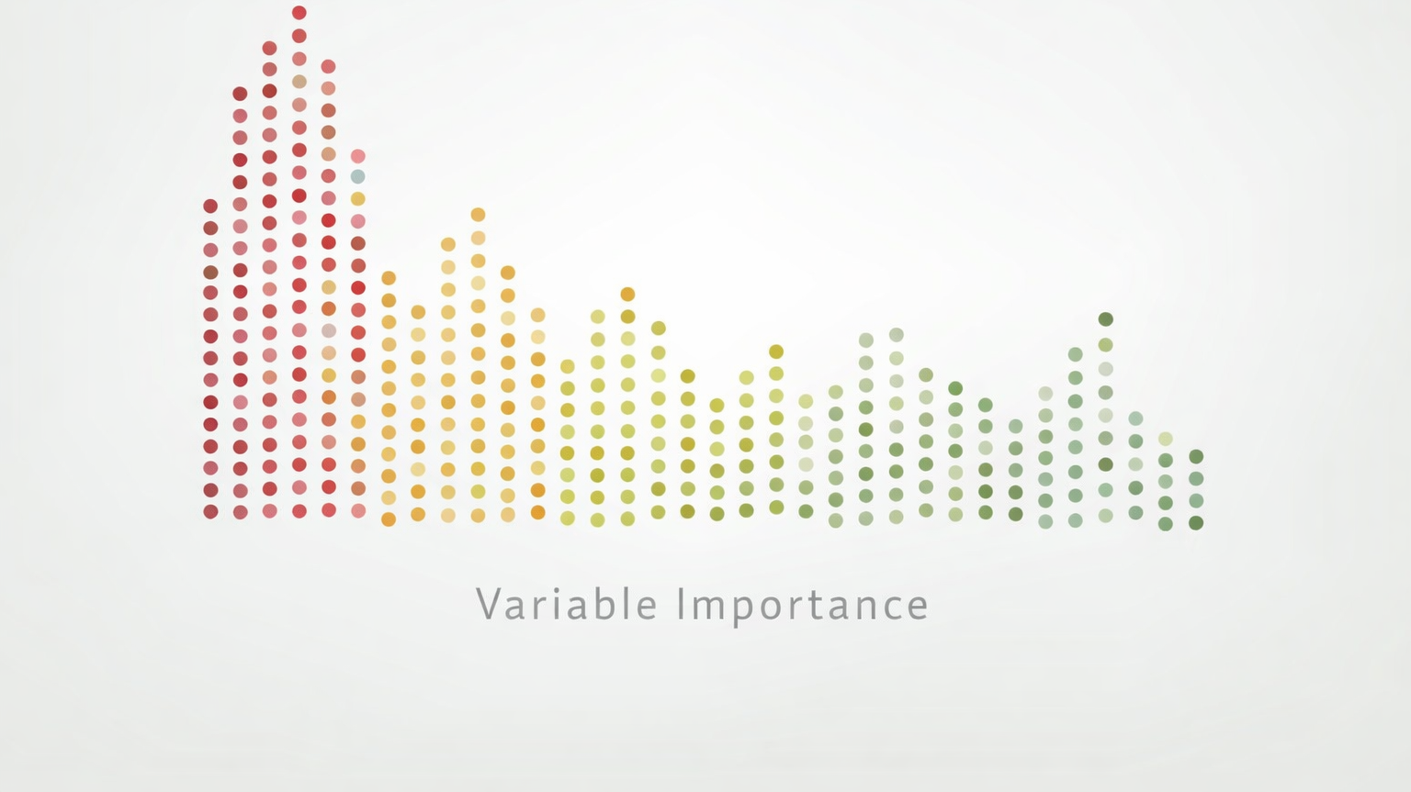
Variable Importance

Slide 2
Why do we need Variable Importance?
Which variables drive predictions?
Can we simplify the model?
What insights can we extract?
Applications:
Healthcare → risk factors
Finance → default drivers
Policy → key interventions

Slide 3
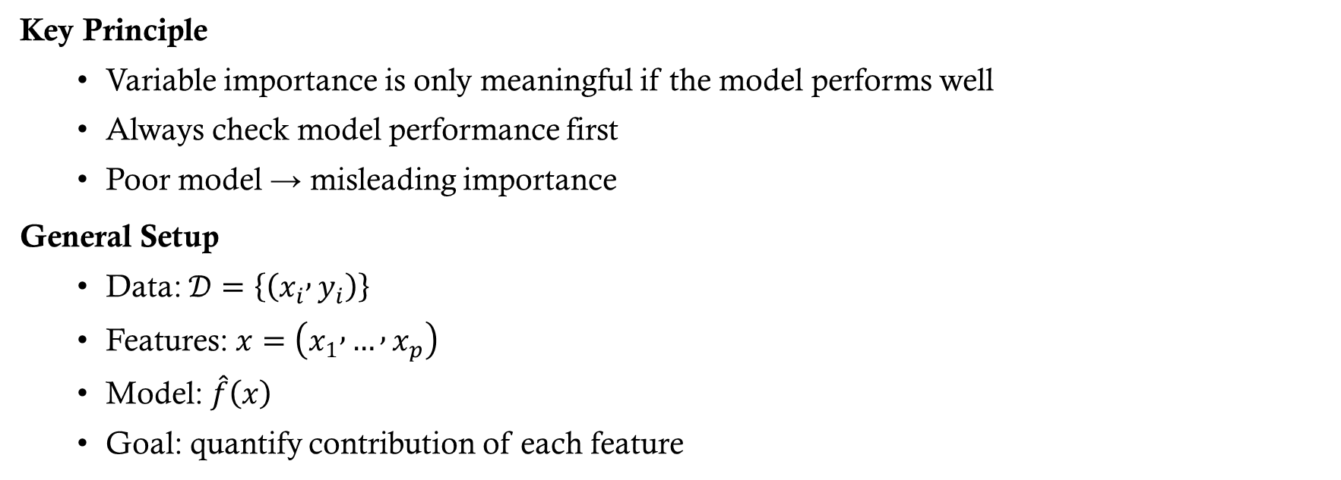
Variable Importance Principles
Key Principle
Variable importance is only meaningful if the model performs well
Always check model performance first
Poor model → misleading importance
General Setup
Data: $𝒟=\left\{\left(x_{i} , y_{i}\right)\right\}$
Features: $x=\left(x_{1} , … , x_{p}\right)$
Model: $\hat{f}\left(x\right)$
Goal: quantify contribution of each feature

Slide 4
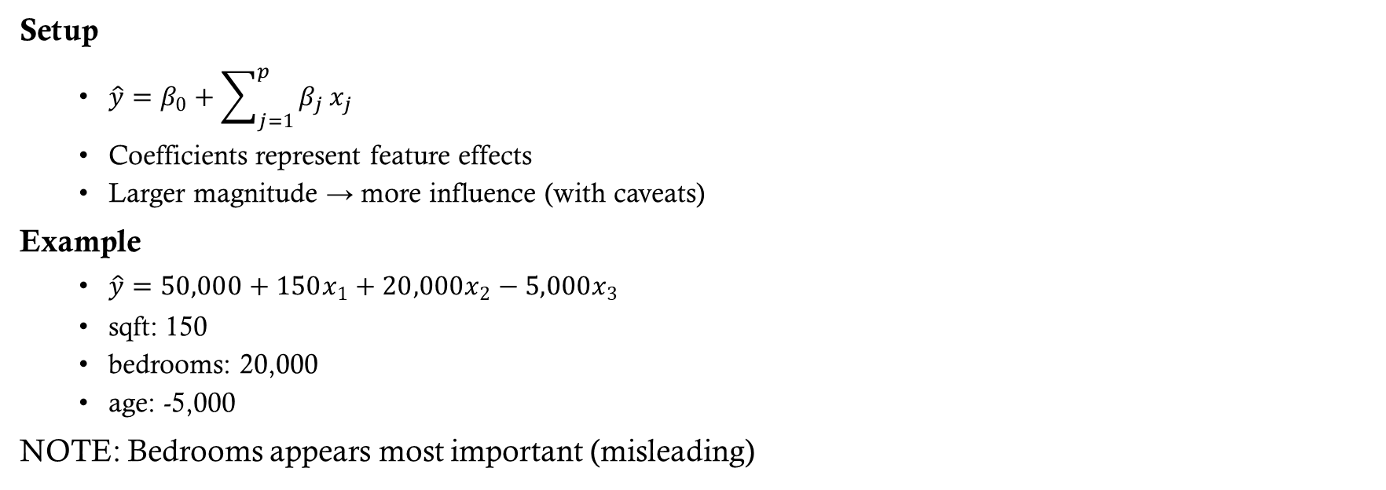
Linear Regression Example
Setup
$\hat{y}=β_{0}+\sum_{j=1}^{p}{β_{j}}x_{j}$
Coefficients represent feature effects
Larger magnitude → more influence (with caveats)
Example
$\hat{y}=50,000+150x_{1}+20,000x_{2}−5,000x_{3}$
sqft: 150
bedrooms: 20,000
age: -5,000
NOTE: Bedrooms appears most important (misleading)

Slide 5
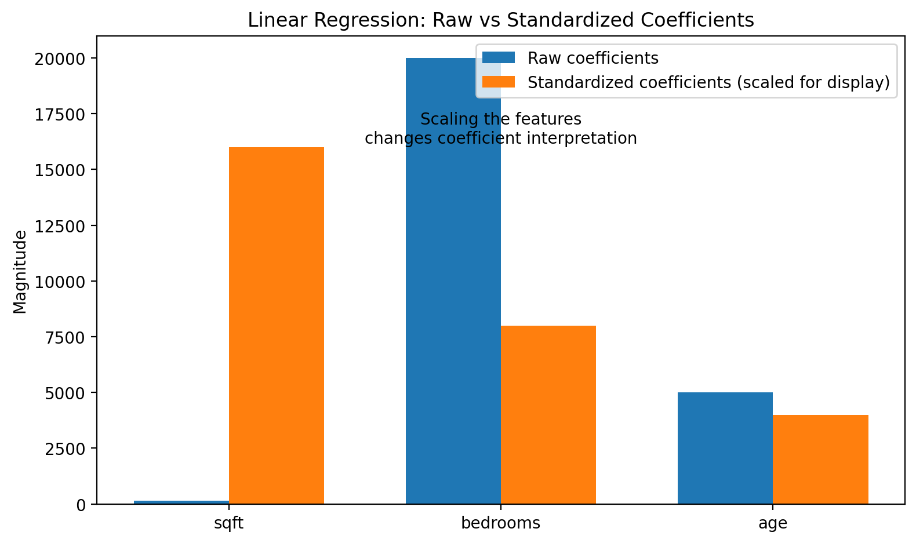

Feature Scaling
We scale features:
$x_{j}^{\left(std\right)}=\frac{x_{j}−μ_{j}}{σ_{j}}$
Then fit:
$\hat{y}=β_{0}+\sum{β_{j}^{\left(std\right)}}x_{j}^{\left(std\right)}$
Example (After Scaling)
sqft: 0.80
bedrooms: 0.40
age: 0.20
This figure shows why raw coefficients can mislead us. Bedrooms looks largest in raw units, but once we account for feature scale, square footage becomes the strongest signal. The core lesson is that we should compare standardized effects, not raw coefficients, when ranking feature importance in linear models.

Slide 6
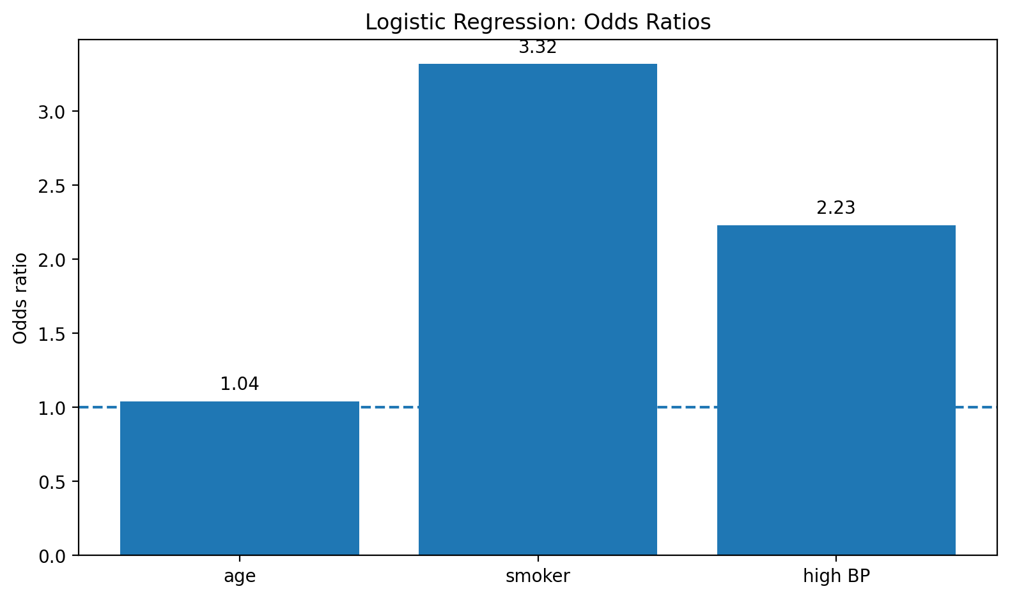
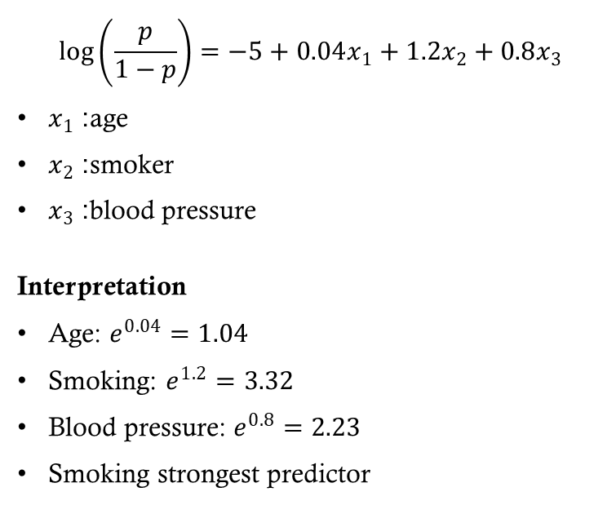
Logistic Regression
$$\log\left(\frac{p}{1−p}\right)=−5+0.04x_{1}+1.2x_{2}+0.8x_{3}$$
$x_{1}$: age
$x_{2}$: smoker
$x_{3}$: blood pressure
Interpretation
Age: $e^{0.04}=1.04$
Smoking: $e^{1.2}=3.32$
Blood pressure: $e^{0.8}=2.23$
Smoking strongest predictor
"Here, odds ratios make logistic regression interpretable. A value near 1 means little change in odds, while larger values indicate stronger effects. Smoking has the largest odds ratio in this example, so it is the strongest predictor among these features."

Slide 7
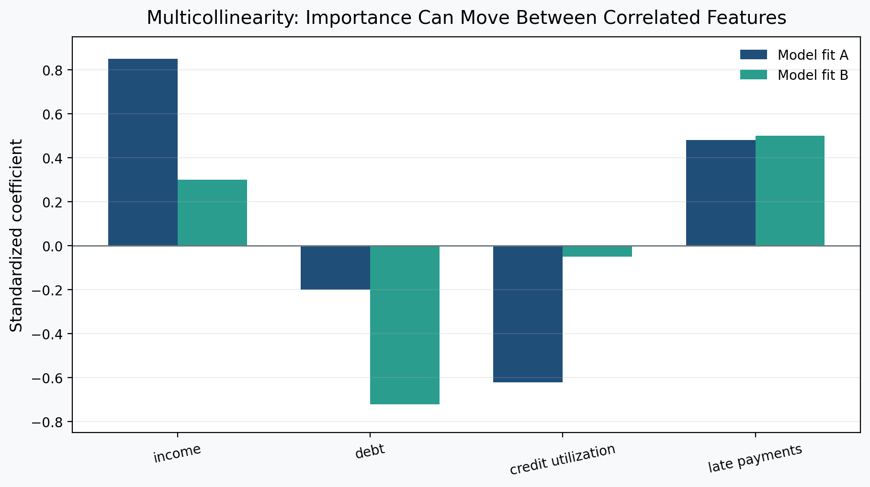
Correlated Features
With correlated predictors, coefficients can shift between model fits even when overall performance is similar. The predictive signal is shared, so individual coefficient-based importance becomes unstable. Interpret these values cautiously under multicollinearity.

Slide 8
Logistic Regression Pitfalls
Pitfalls:
Log-odds interpretation
Scale issues
Class imbalance
Correlated predictors
Poor model performance

Slide 9
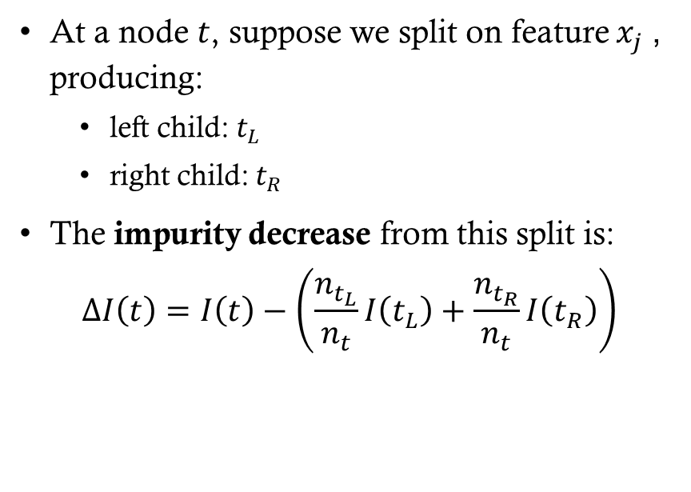
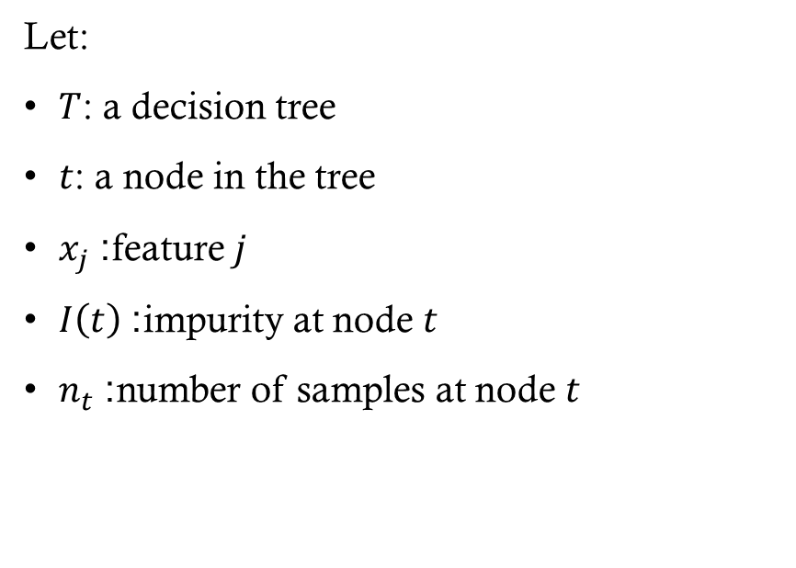
Decision Tree Importance
Let:
$T$: a decision tree
$t$: a node in the tree
$x_{j}$: feature $j$
$I\left(t\right)$: impurity at node $t$
$n_{t}$: number of samples at node $t$
At a node $t$, suppose we split on feature $x_{j}$, producing:
left child: $t_{L}$
right child: $t_{R}$
The impurity decrease from this split is:
$$ΔI\left(t\right)=I\left(t\right)−\left(\frac{n_{t_{L}}}{n_{t}}I\left(t_{L}\right)+\frac{n_{t_{R}}}{n_{t}}I\left(t_{R}\right)\right)$$

Slide 10
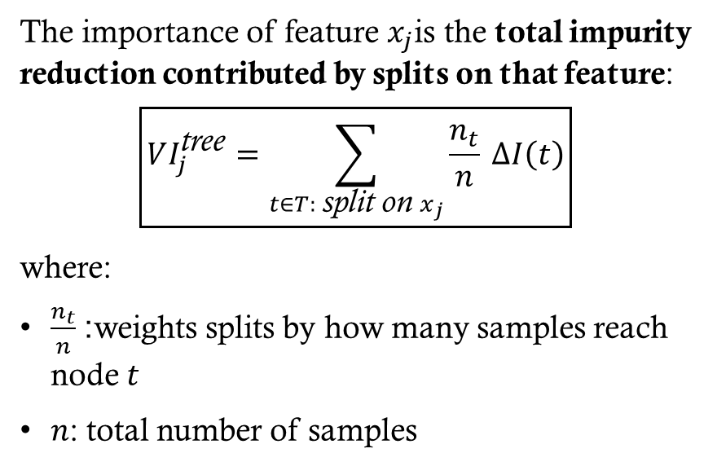
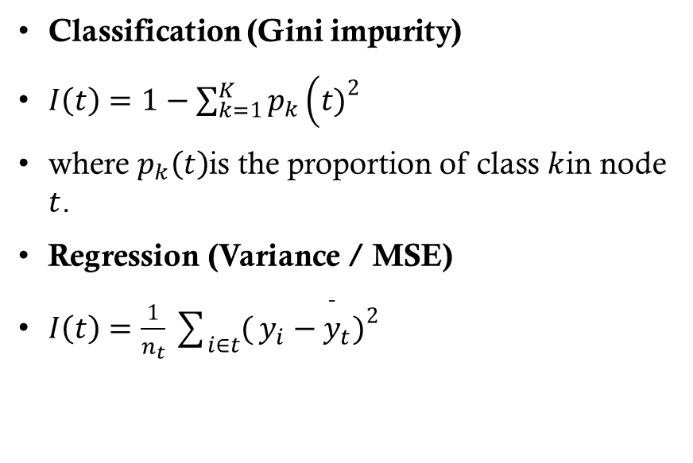
Impurity Functions
Classification (Gini impurity)
$I\left(t\right)=1−\sum_{k=1}^{K}{p_{k}}\left(t{\left.)\right.}^{2}\right.$
where $p_{k}\left(t\right)$is the proportion of class $k$in node $t$.
Regression (Variance / MSE)
$I\left(t\right)=\frac{1}{n_{t}}\sum_{i∈t}{(}\left.y_{i}−{\overset{ˉ}{y}}_{t}{\left.)\right.}^{2}\right.$
The importance of feature $x_{j}$is the total impurity reduction contributed by splits on that feature:
$$\boxed{VI_{j}^{\text{tree}}=\sum_{t∈T: \text{split} \text{on} x_{j}}{\frac{n_{t}}{n}} ΔI\left(t\right)}$$
where:
$\frac{n_{t}}{n}$: weights splits by how many samples reach node $t$
$n$: total number of samples

Slide 11

Random Forests
Mean Decrease in Impurity (MDI)
The standard random forest importance (used in CART-based forests) is:
$$\boxed{VI_{j}^{\text{RF}}=\frac{1}{B}\sum_{b=1}^{B}{V}I_{j}^{\left(b\right)}}$$

Slide 12
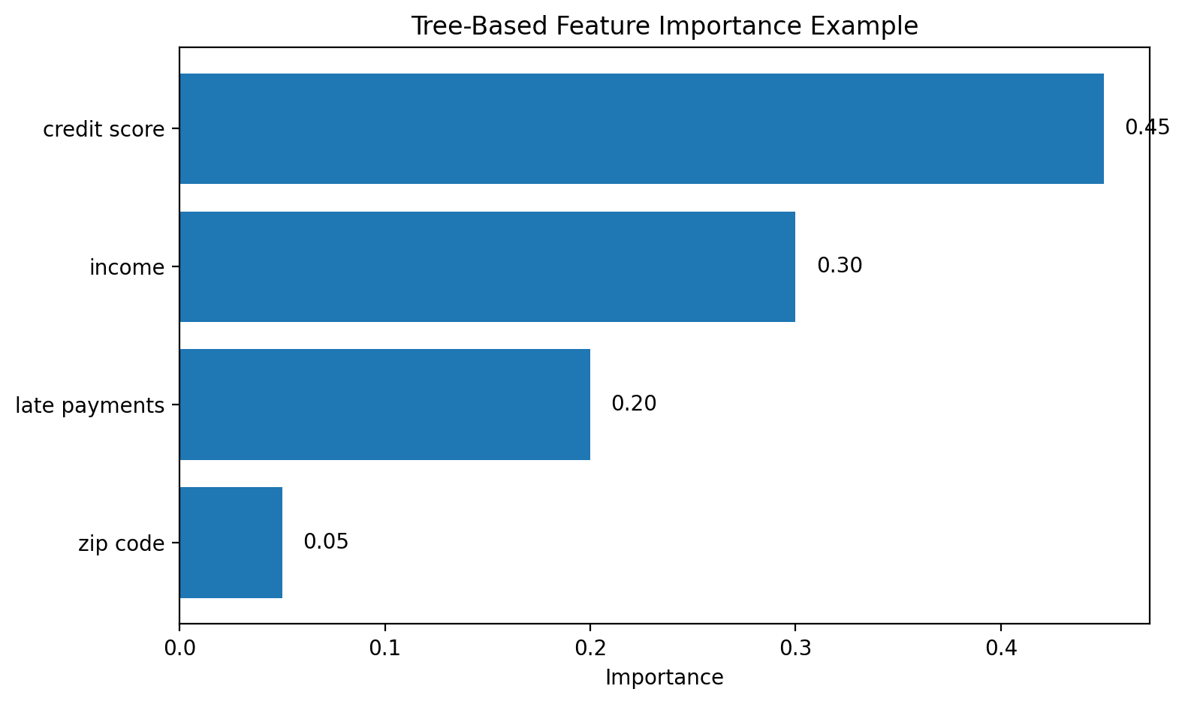
RF Importance Example
This tree-based importance chart summarizes total impurity reduction by feature. Credit score contributes the most, followed by income and late payments. Remember that this ranking is model-specific and can be affected by feature correlation or split bias.

Slide 13
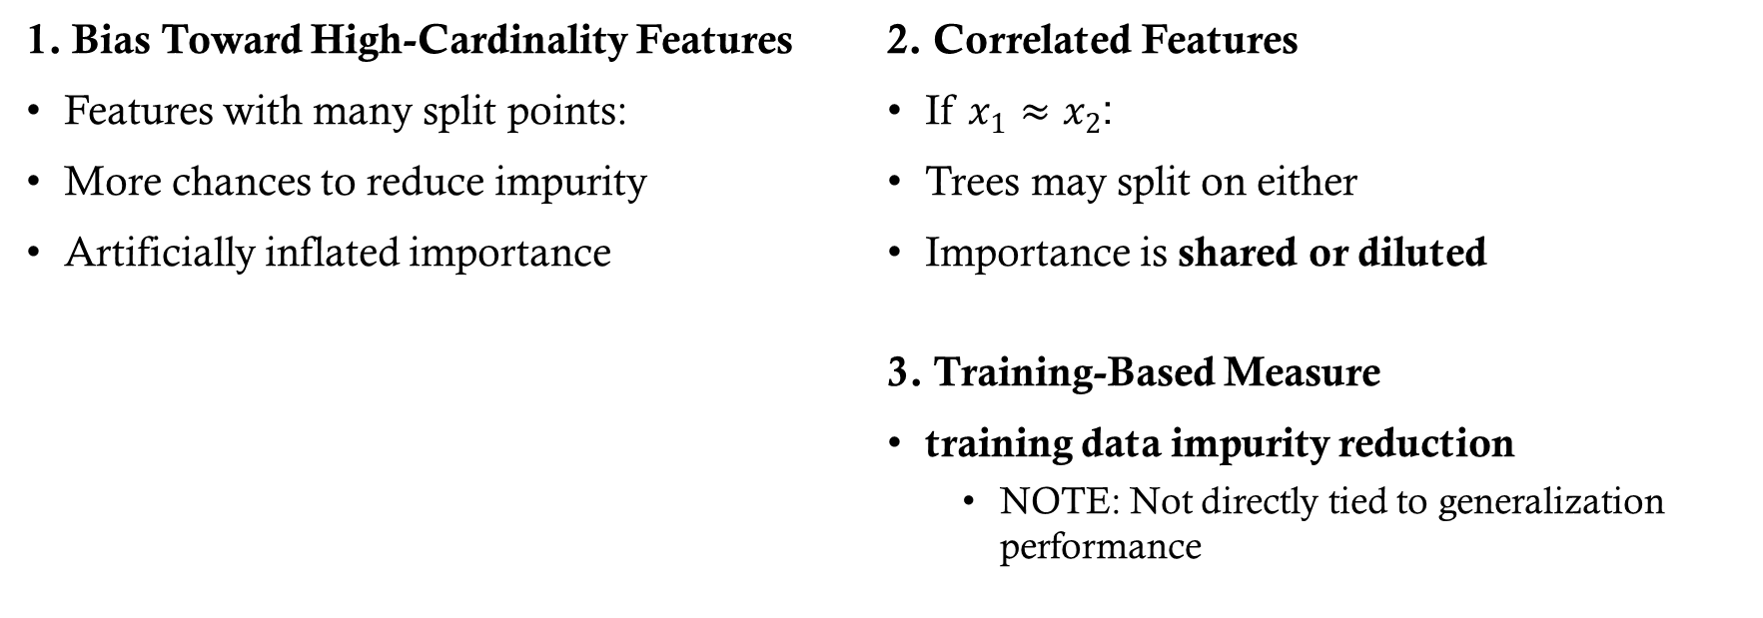
DT and RF MDI Limitations
1. Bias Toward High-Cardinality Features
Features with many split points:
More chances to reduce impurity
Artificially inflated importance
2. Correlated Features
If $x_{1}≈x_{2}$:
Trees may split on either
Importance is shared or diluted
3. Training-Based Measure
training data impurity reduction
NOTE: Not directly tied to generalization performance

Slide 14
Model Agnostic
The above-described mechanisms are model specific.
What about other models, such as ANNs?

Slide 15
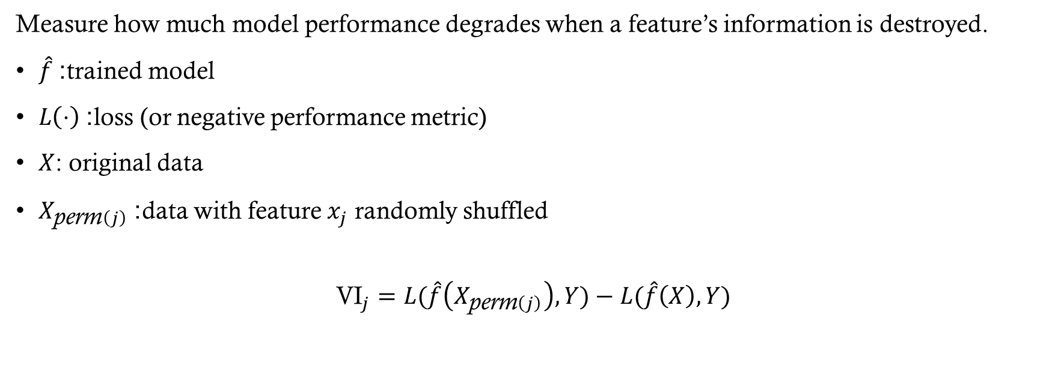
Permutation Importance
Measure how much model performance degrades when a feature’s information is destroyed.
$\hat{f}$: trained model
$L\left(⋅\right)$: loss (or negative performance metric)
$X$: original data
$X_{\text{perm}\left(j\right)}$: data with feature $x_{j}$ randomly shuffled
$${\text{VI}}_{j}=L(\hat{f}\left(X_{\text{perm}\left(j\right)}\right),Y)−L(\hat{f}\left(X\right),Y)$$

Slide 16
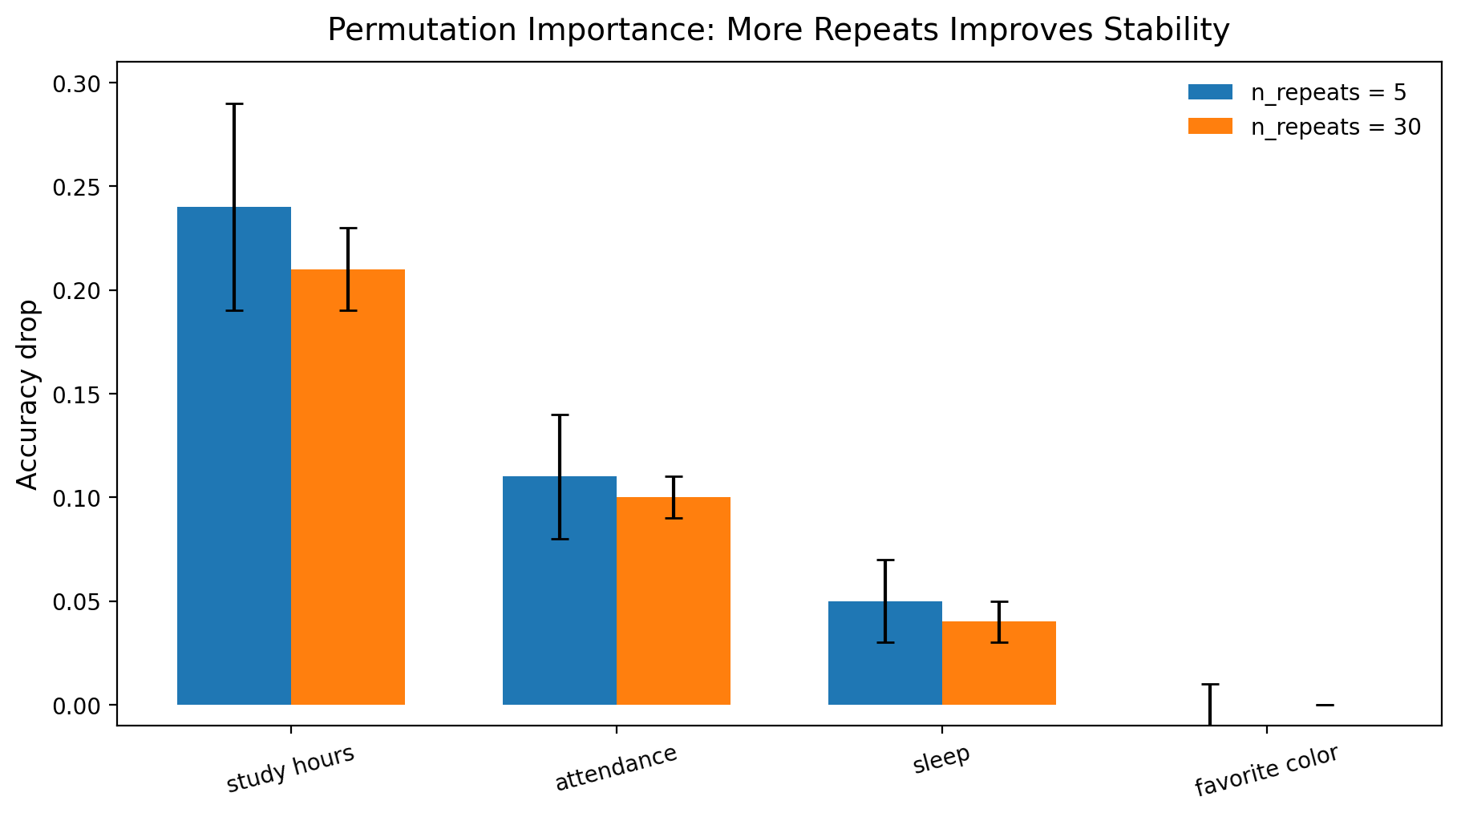
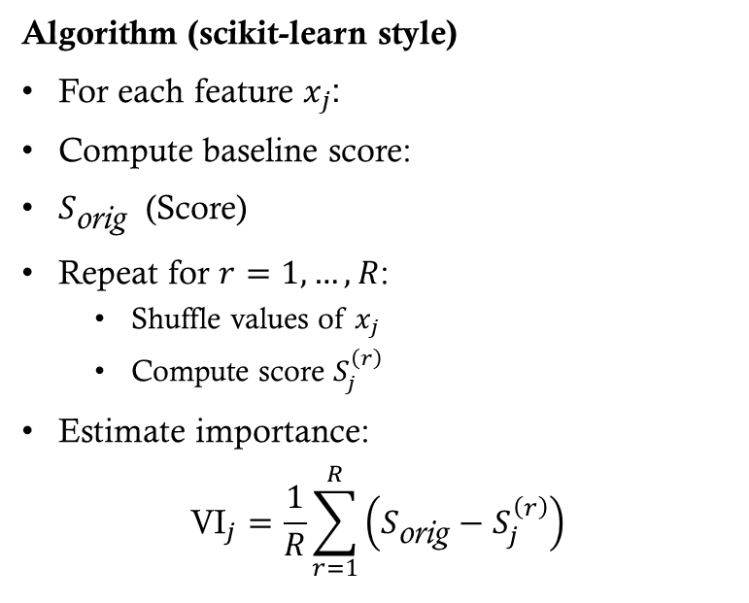
Permutation Importance
Algorithm (scikit-learn style)
For each feature $x_{j}$:
Compute baseline score:
$S_{\text{orig}}$ (Score)
Repeat for $r=1,…,R$:
Shuffle values of $x_{j}$
Compute score $S_{j}^{\left(r\right)}$
Estimate importance:
$${\text{VI}}_{j}=\frac{1}{R}\sum_{r=1}^{R}{\left(S_{\text{orig}}−S_{j}^{\left(r\right)}\right)}$$
Permutation importance asks: How much does model accuracy drop when one feature is shuffled? Study hours causes the largest drop, so it is most important. The error bars show variation across repeats, which helps us separate stable signals from noise.

