Slide 1

Gradient Descent

Slide 2
Optimization in machine learning
Many (all?) machine learning problems can be posed as a minimization or maximization problem
In some cases, a closed-form solution exists
  E.g, linear regression
Most of the time, a closed-form solution doesn’t exist
We can solve these problems using optimization theory

Slide 3


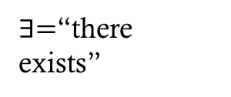
Unconstrained Optimization
An unconstrained optimization problem has the form
$$\min_{x∈ℝ^{d}}{f(x)}$$
  where $f:ℝ^{d}→ℝ$ is called the objective function.
  What about maximization?
A point $x^{∗}∈ℝ^{d}$ is called a
local minimizer if $∃r>0$
such that $f\left(x^{∗}\right)≤f\left(x\right)∀x$
satisfying $\left\|x−x^{∗}\right\|<r$
$x^{∗}$ is called a global
minimizer if
$f\left(x^{∗}\right)≤f\left(x\right) ∀x∈ℝ^{d}$
Is a global minimizer also a
local minimizer?
$∃=$“there exists”
$∀=$“for all”
Local
Global

Slide 4
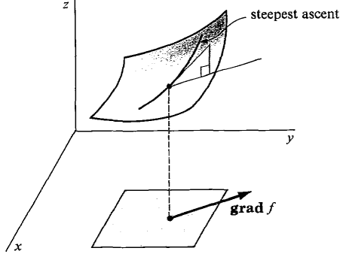




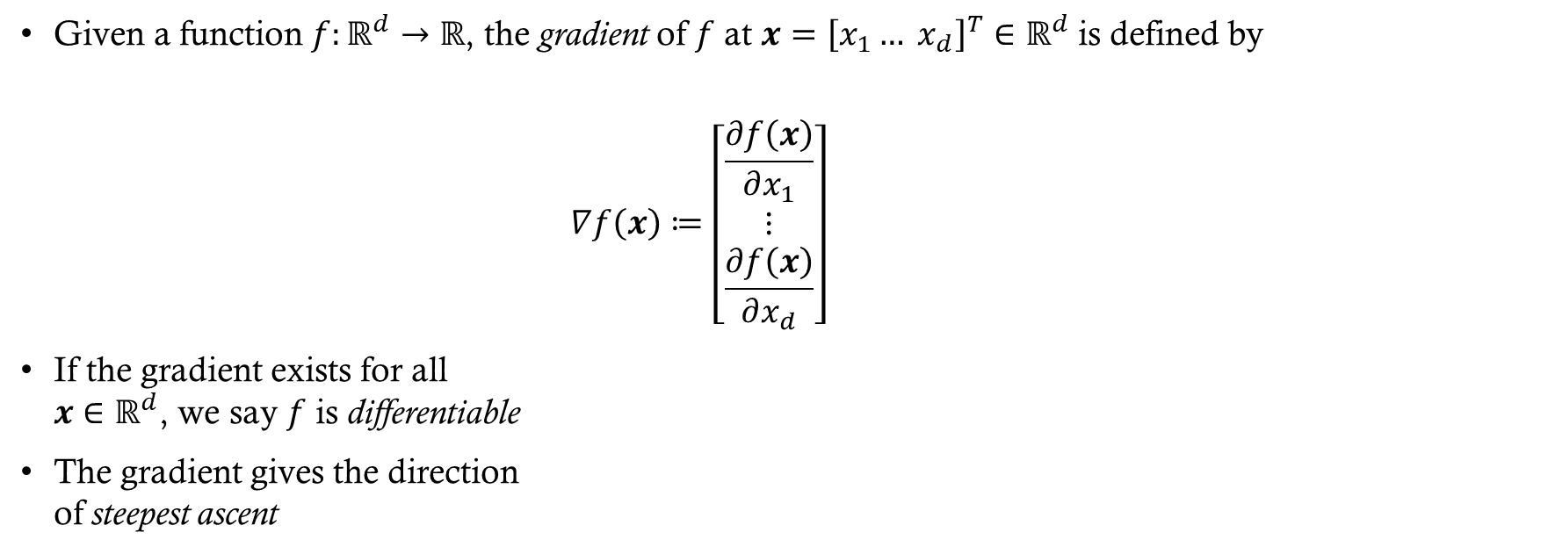
Gradient
Given a function $f:ℝ^{d}→ℝ$, the gradient of $f$ at $x={\left[x_{1}… x_{d}\right]}^{T}∈ℝ^{d}$ is defined by
$$∇f\left(x\right)≔\left[\begin{matrix}\frac{∂f\left(x\right)}{∂x_{1}} \\ ⋮ \\ \frac{∂f\left(x\right)}{∂x_{d}}\end{matrix}\right]$$
If the gradient exists for all
$x∈ℝ^{d}$, we say $f$ is differentiable
The gradient gives the direction
of steepest ascent

Slide 5

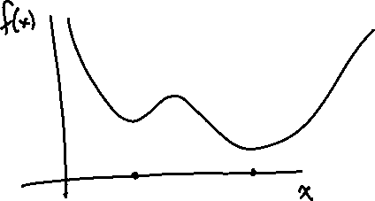
First Order Necessary Condition
If $f$ is differentiable and $x^{∗}$ is a local minimizer of $f$, then
$∇f\left(x^{∗}\right)=0.$
Note that this condition is necessary but not sufficient for $x^{∗}$ to be a local minimizer
  Why?
If $∇f\left(x\right)=0$ for some $x$, then $x$ is said to be a critical point or a stationary point of $f$

Slide 6
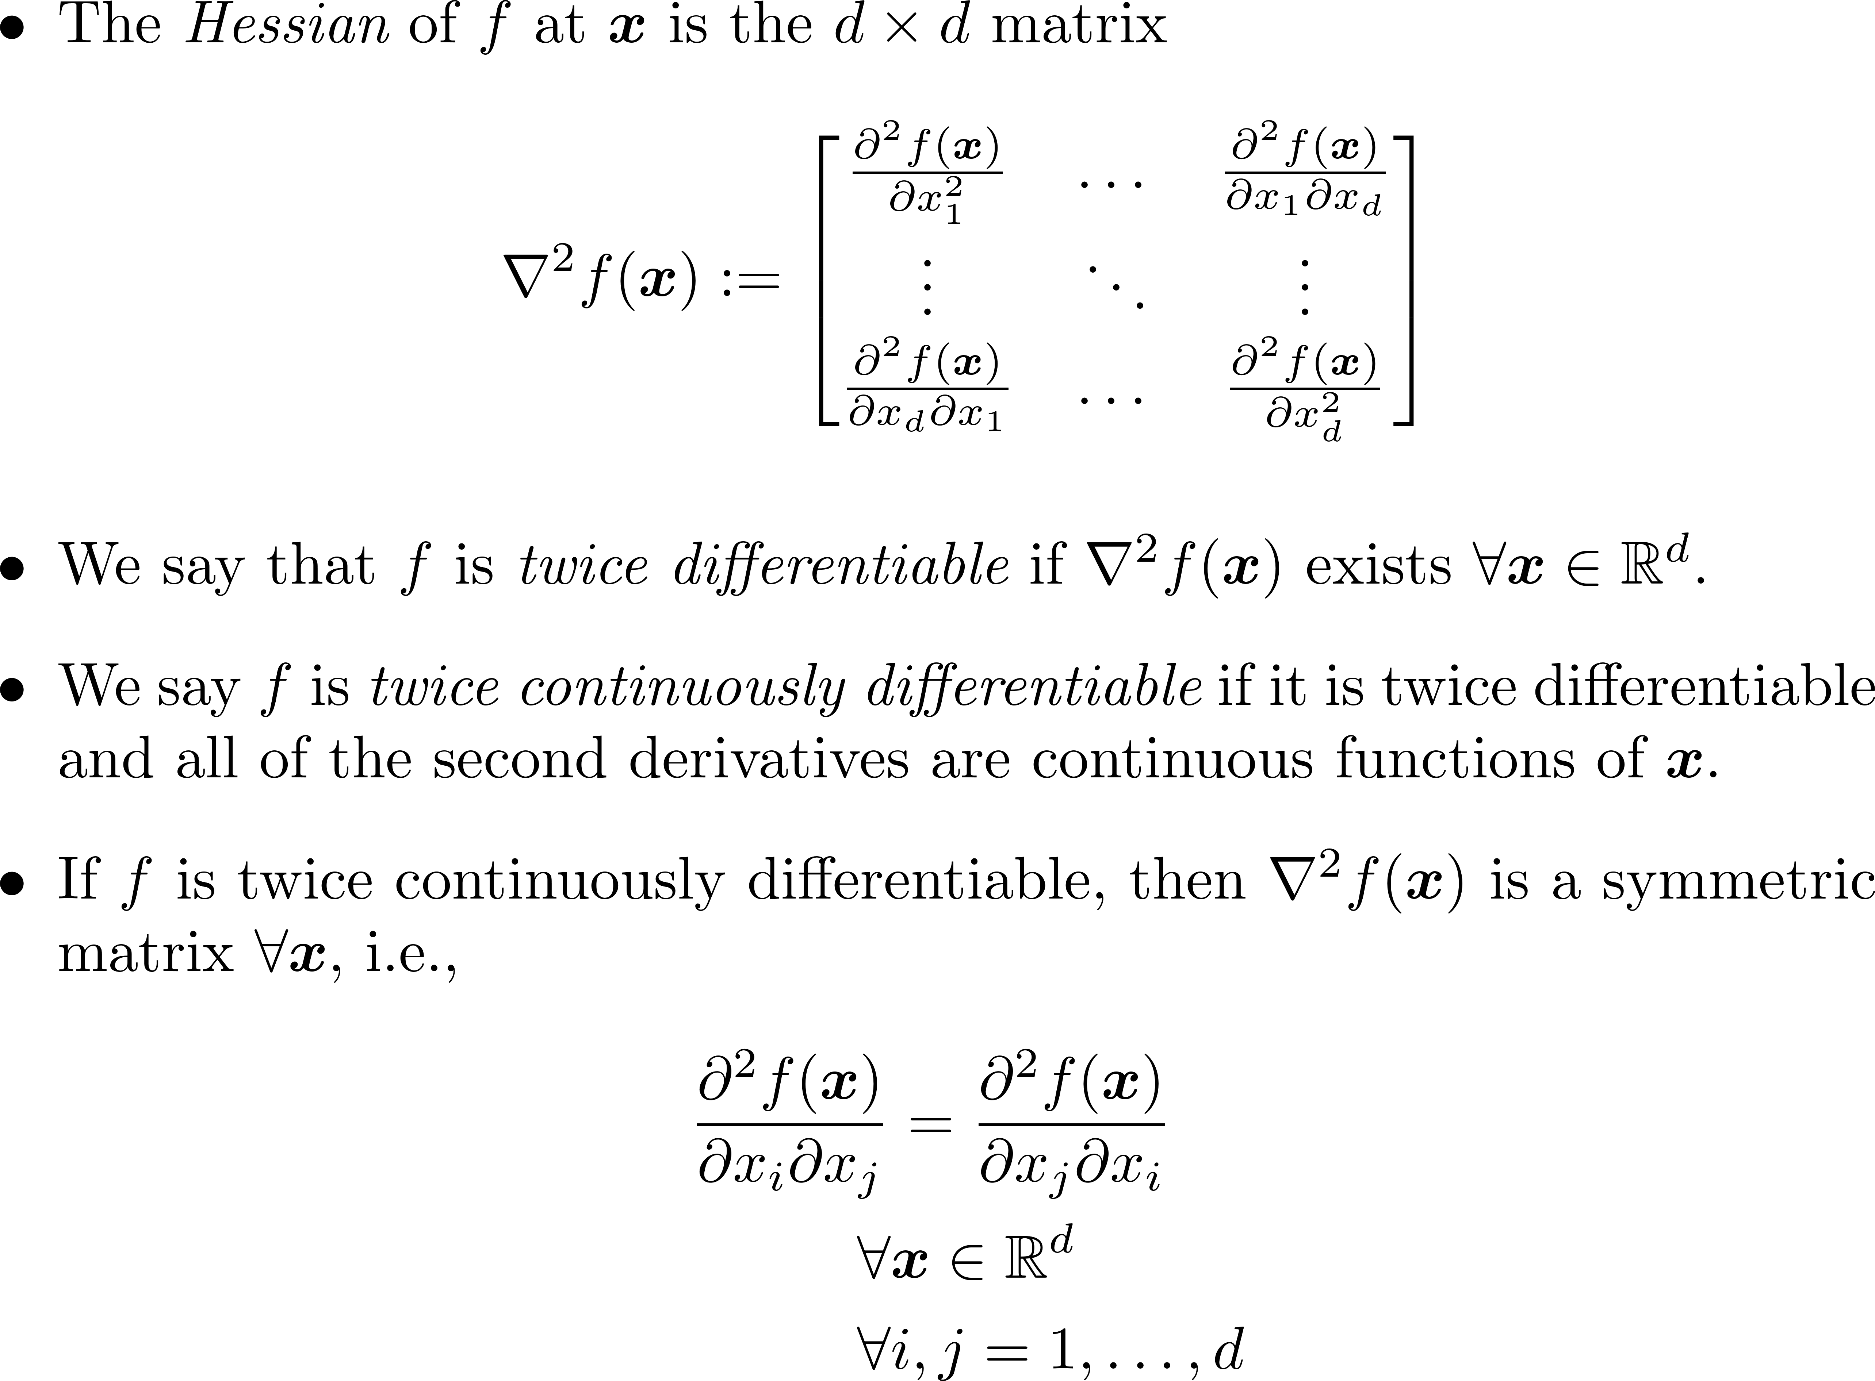
Hessian

Slide 7
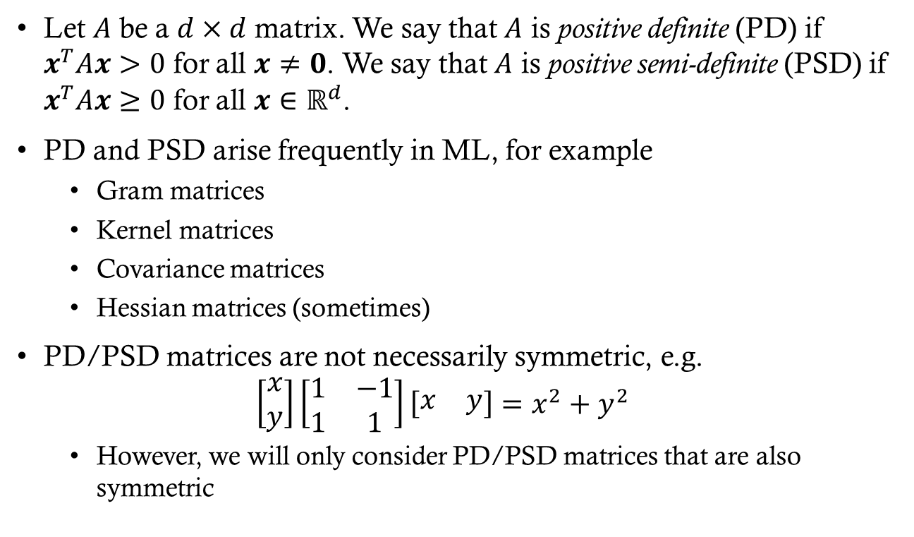
Positive (Semi-)Definite Matrices
Let $A$ be a $d×d$ matrix. We say that $A$ is positive definite (PD) if $x^{T}Ax>0$ for all $x≠0$. We say that $A$ is positive semi-definite (PSD) if $x^{T}Ax≥0$ for all $x∈ℝ^{d}$.
PD and PSD arise frequently in ML, for example
  Gram matrices
  Kernel matrices
  Covariance matrices
  Hessian matrices (sometimes)
PD/PSD matrices are not necessarily symmetric, e.g.
$\left[\begin{matrix}x \\ y\end{matrix}\right]\left[\begin{matrix}1 & −1 \\ 1 & 1\end{matrix}\right]\left[\begin{matrix}x & y\end{matrix}\right]=x^{2}+y^{2}$
  However, we will only consider PD/PSD matrices that are also symmetric

Slide 8
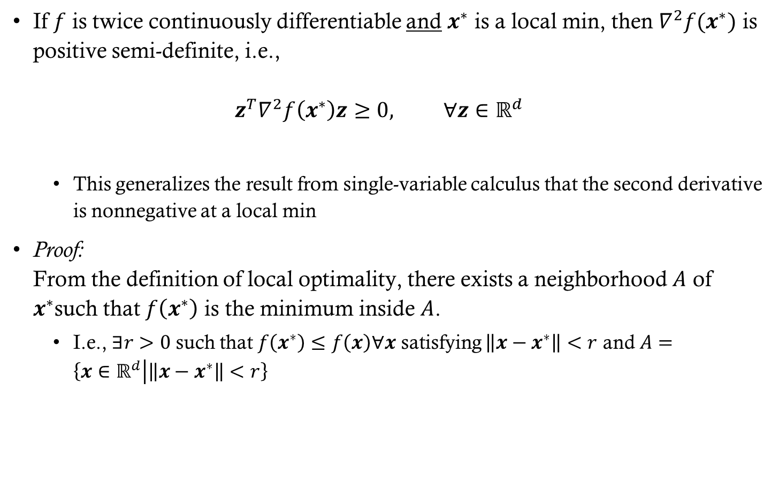
Second Order Necessary Condition
If $f$ is twice continuously differentiable and $x^{∗}$ is a local min, then $∇^{2}f(x^{∗})$ is positive semi-definite, i.e.,
$z^{T}∇^{2}f\left(x^{∗}\right)z≥0, ∀z∈ℝ^{d}$
  This generalizes the result from single-variable calculus that the second derivative is nonnegative at a local min
Proof:
From the definition of local optimality, there exists a neighborhood $A$ of $x^{∗}$such that $f\left(x^{∗}\right)$ is the minimum inside $A$.
  I.e., $∃r>0$ such that $f\left(x^{∗}\right)≤f\left(x\right)∀x$ satisfying $\left\|x−x^{∗}\right\|<r$ and $A=\left\{x∈ℝ^{d} | \left\|x−x^{∗}\right\|<r\right\}$

Slide 9
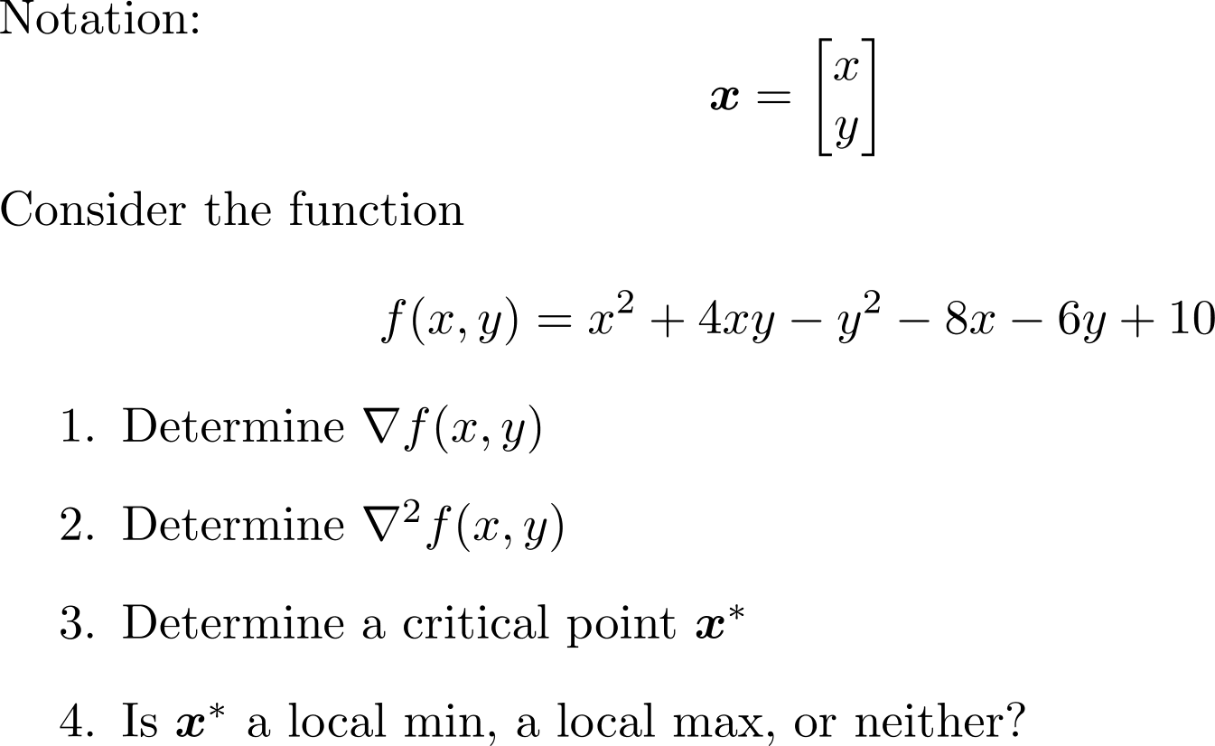
Group Exercise

Slide 10
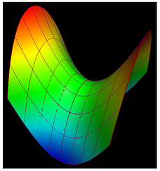

Group Exercise Solutions
$∇f\left(x,y\right)=\left[\begin{matrix}2x+4y−8 \\ 4x−2y−6\end{matrix}\right]$
$∇^{2}f\left(x,y\right)=\left[\begin{matrix}2 & 4 \\ 4 & −2\end{matrix}\right]$
$∇f\left(x,y\right)=\left[\begin{matrix}0 \\ 0\end{matrix}\right]$
$⇒\left[\begin{matrix}2 & 4 \\ 4 & −2\end{matrix}\right]\left[\begin{matrix}x \\ y\end{matrix}\right]=\left[\begin{matrix}8 \\ 6\end{matrix}\right]$
$⇒\left[\begin{matrix}x \\ y\end{matrix}\right]$=$\left[\begin{matrix}2 \\ 1\end{matrix}\right]$
$\left[\begin{matrix}0 & 1\end{matrix}\right]\left[\begin{matrix}2 & 4 \\ 4 & −2\end{matrix}\right]\left[\begin{matrix}0 \\ 1\end{matrix}\right]=−2$
  Similarly $\left[\begin{matrix}1 & 0\end{matrix}\right]\left[\begin{matrix}2 & 4 \\ 4 & −2\end{matrix}\right]\left[\begin{matrix}1 \\ 0\end{matrix}\right]=2$ so $∇^{2}f$ is neither PD nor negative definite so neither

Slide 11

Convexity
We say that $f$ is convex if
$f\left(tx+\left(1−t\right)y\right)≤tf\left(x\right)+\left(1−t\right)f\left(y\right)$
for all $x,y∈ℝ^{d}$ and $t∈\left[0,1\right]$.
We say $f$ is strictly convex if
$f\left(tx+\left(1−t\right)y\right)<tf\left(x\right)+\left(1−t\right)f\left(y\right)$
$∀x≠y$ and $t∈\left(0,1\right)$.

Slide 12

Convexity

Slide 13

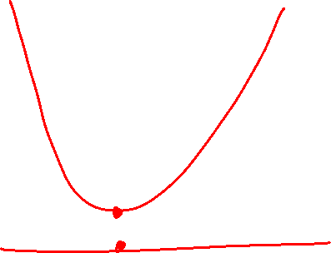
Convex functions are nice
Properties of convex functions
If $f$ is convex, then every local min is a global min
If $f$ is strictly convex, then $f$ has at most one global min

Slide 14
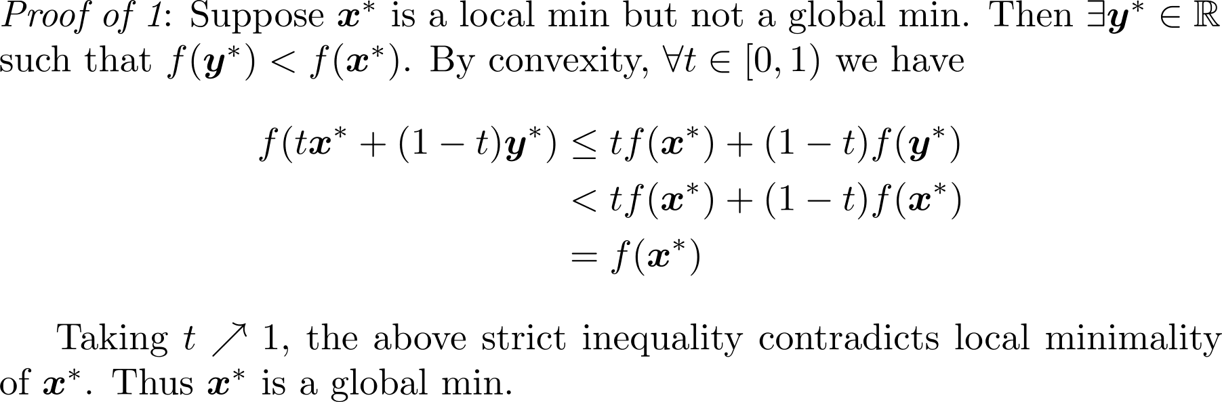
Convex functions are nice
Notes:
Do proof on board

Slide 15
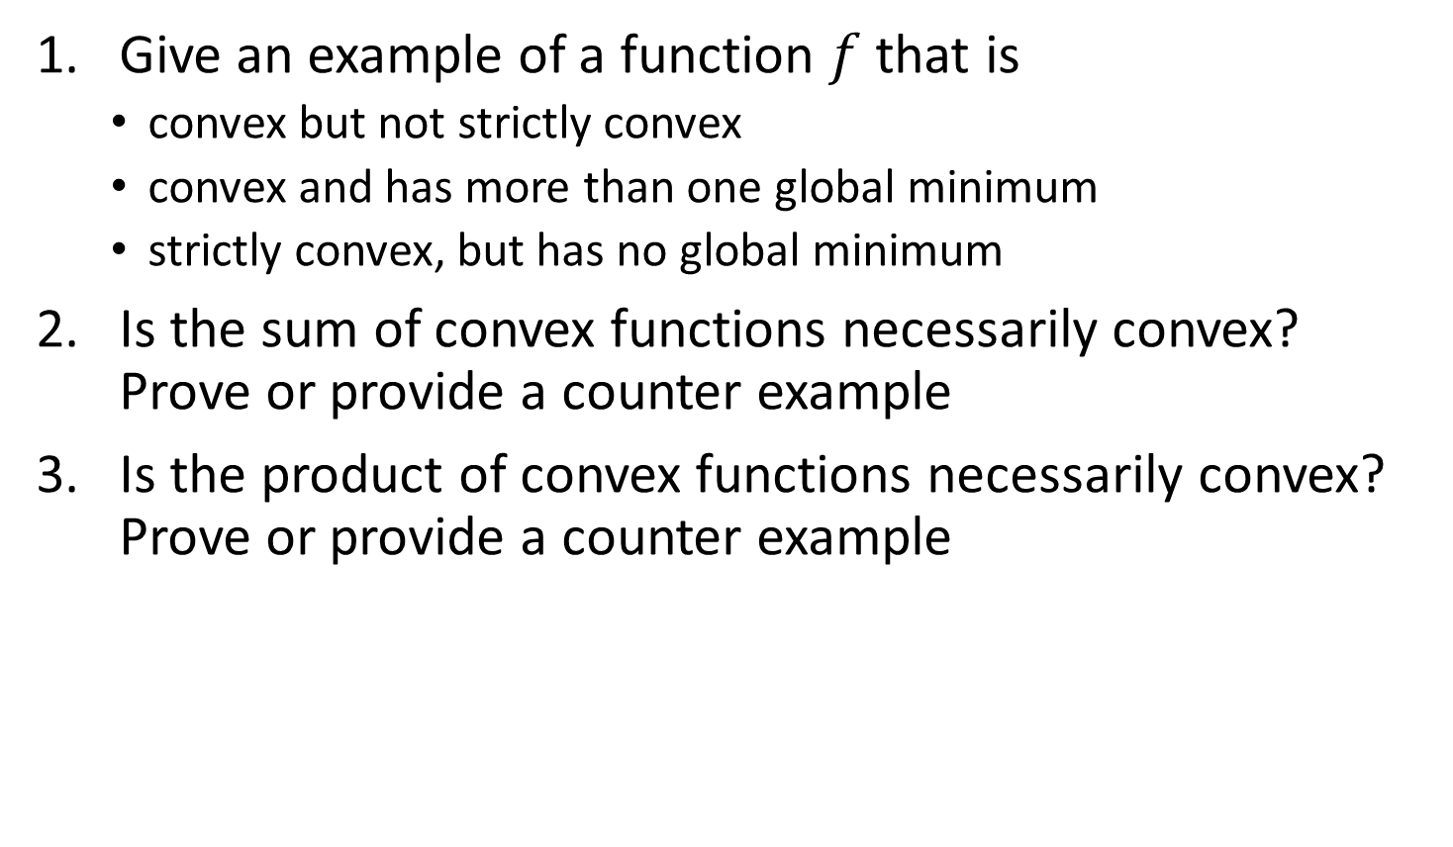
Group Exercise
Give an example of a function $f$ that is
  convex but not strictly convex
  convex and has more than one global minimum
  strictly convex, but has no global minimum
Is the sum of convex functions necessarily convex? Prove or provide a counter example
Is the product of convex functions necessarily convex? Prove or provide a counter example

Slide 16
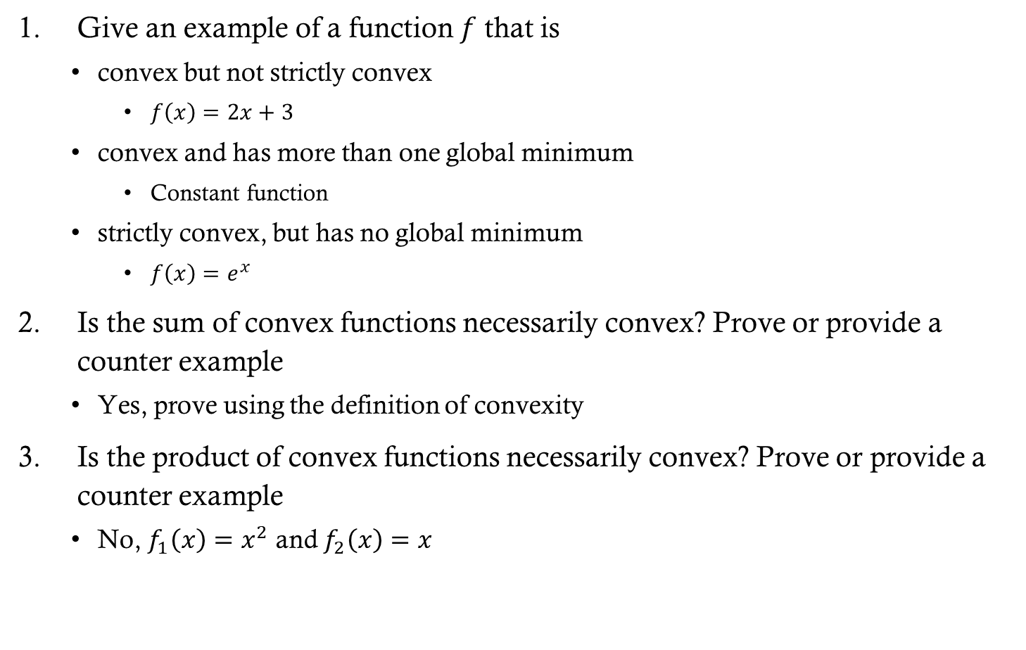
Group Exercise Solutions
Give an example of a function $f$ that is
  convex but not strictly convex
    $f\left(x\right)=2x+3$
  convex and has more than one global minimum
    Constant function
  strictly convex, but has no global minimum
    $f\left(x\right)=e^{x}$
Is the sum of convex functions necessarily convex? Prove or provide a counter example
  Yes, prove using the definition of convexity
Is the product of convex functions necessarily convex? Prove or provide a counter example
  No, $f_{1}\left(x\right)=x^{2}$ and $f_{2}\left(x\right)=x$

Slide 17
Iterative methods
In many problems, an analytical solution to the minimization problem does not exist
  Including (regularized) logistic regression
However, we can use an iterative method to solve it
  Convexity guarantees that the iterative solution is the global minimum
Notes:
All of these methods are iterative

Slide 18
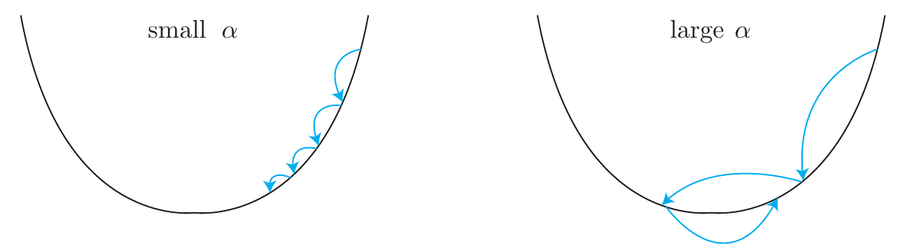
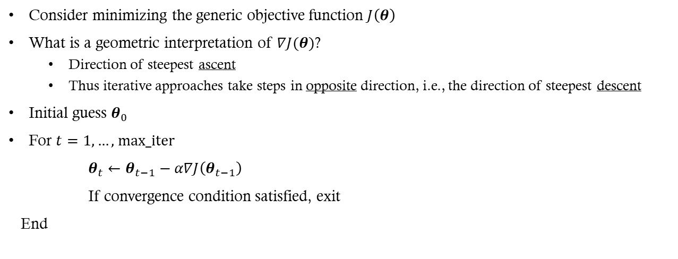
Gradient Descent (GD)
Consider minimizing the generic objective function $J\left(θ\right)$
What is a geometric interpretation of $∇J(θ)$?
  Direction of steepest ascent
  Thus iterative approaches take steps in opposite direction, i.e., the direction of steepest descent
Initial guess $θ_{0}$
For $t=1,…\text{, }\text{max}\text{_}\text{iter}$
$θ_{t}←θ_{t−1}−α∇J\left(θ_{t−1}\right)$
If convergence condition satisfied, exit
End

Slide 19

Step Size
In practice, typically need $α$ to decrease as a function of $t$
  Example: $α_{t}=\frac{1}{t}$

Slide 20

Group Exercise
What would be a good convergence condition (also known as a stopping criterion) for terminating GD?
What are some potential problems with setting $α_{t}=\frac{1}{t}$?
How could you choose $α_{t}$ to counter these problems?
Does the initialization $θ_{0}$ affect the result?

Slide 21
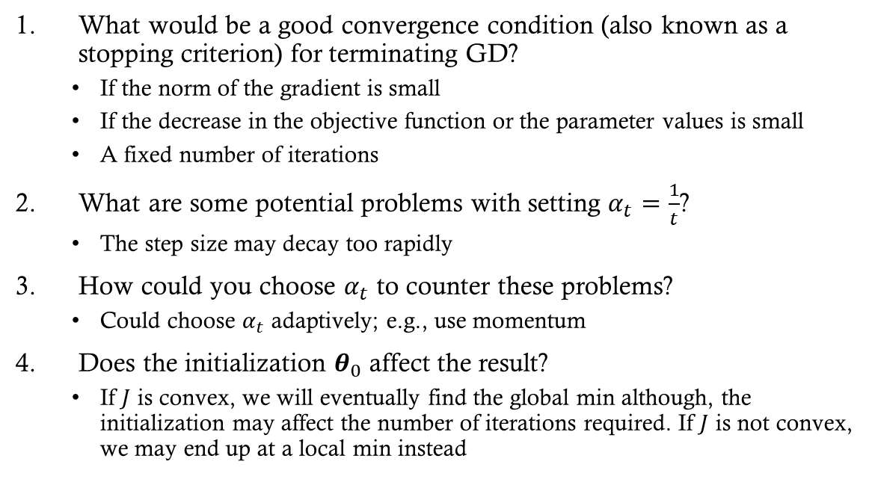
Group Exercise Solutions
What would be a good convergence condition (also known as a stopping criterion) for terminating GD?
  If the norm of the gradient is small
  If the decrease in the objective function or the parameter values is small
  A fixed number of iterations
What are some potential problems with setting $α_{t}=\frac{1}{t}$?
  The step size may decay too rapidly
How could you choose $α_{t}$ to counter these problems?
  Could choose $α_{t}$ adaptively; e.g., use momentum
Does the initialization $θ_{0}$ affect the result?
  If $J$ is convex, we will eventually find the global min although, the initialization may affect the number of iterations required. If $J$ is not convex, we may end up at a local min instead
Notes:
I’ll cover some of these optimization methods in more detail in my deep learning class next semester as they become really important in that context
For the initialization question, draw an example on the board

Slide 22

Stochastic Gradient Descent (SGD)
In many ML problems, we can write
$J\left(θ\right)=\sum_{i=1}^{n}{J_{i}(θ)}$
Thus
$∇J\left(θ\right)=\sum_{i=1}^{n}{∇J_{i}(θ)}$
Notes:
Recall that $L$ is the loss function and $f_{θ}$ is either our classification or regression function that depends on the parameters $θ$

Slide 23

Stochastic Gradient Descent (SGD)
In GD, we calculate the gradient using all of the data
  For large $n$, each step in the parameter space $θ$ takes a lot of computations
  Thus learning can occur slowly
For SGD, we estimate the gradient using a small random sample of training inputs
  Speeds up gradient descent and learning

Slide 24

Stochastic Gradient Descent
Pick a random set of $m<n$ training inputs
  Referred to as a mini-batch
Estimate the gradient using the samples from the mini-batch and take a step in the direction of the negative gradient
If $m$ is large enough, then the estimated gradient will be roughly equal to the gradient using the full data

Slide 25
Stochastic Gradient Descent Summary
A training epoch:
Pick a random subset of the training data
  Referred to as a mini-batch
Update the parameters using the gradient estimates from the mini-batch
Pick another random mini-batch from the remaining training points and repeat step 2
  Repeat until all training inputs have been used
Repeat multiple epochs until stopping conditions are met

Slide 26
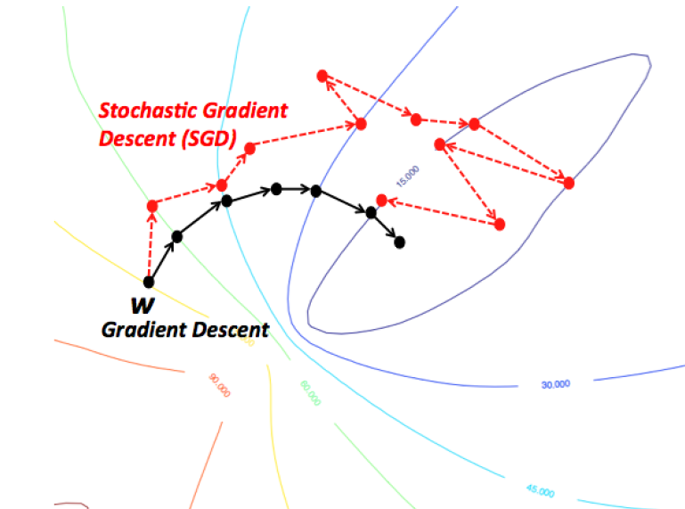
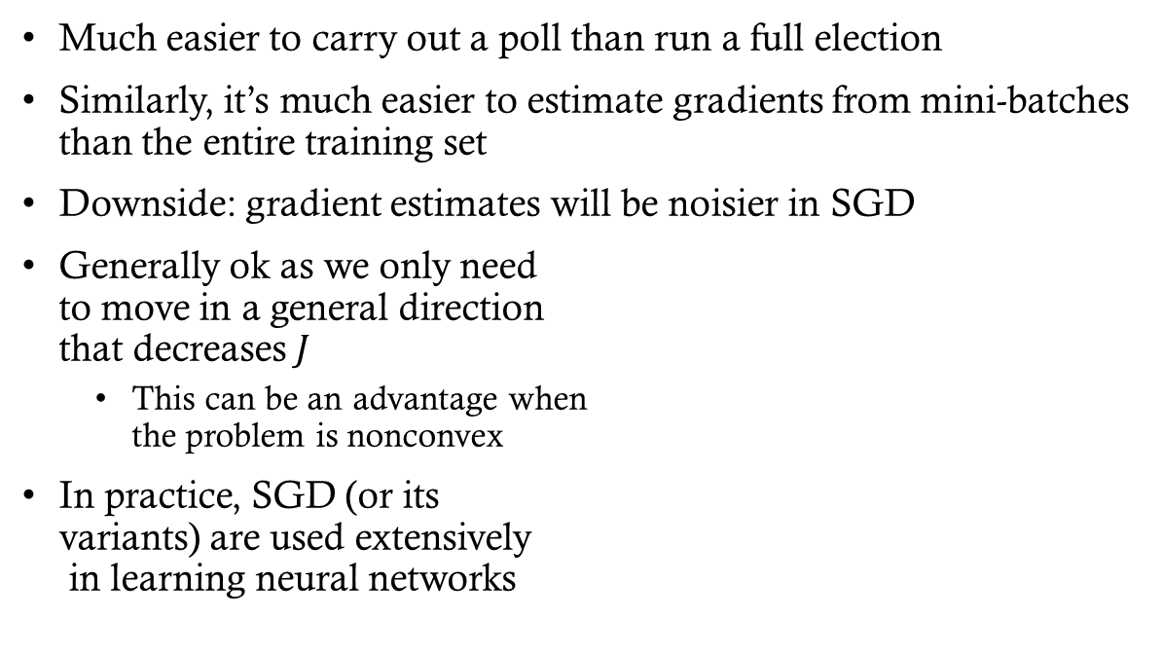
Analogy to political polling
Much easier to carry out a poll than run a full election
Similarly, it’s much easier to estimate gradients from mini-batches than the entire training set
Downside: gradient estimates will be noisier in SGD
Generally ok as we only need
to move in a general direction
that decreases $J$
  This can be an advantage when
  the problem is nonconvex
In practice, SGD (or its
variants) are used extensively
in learning neural networks

Slide 27
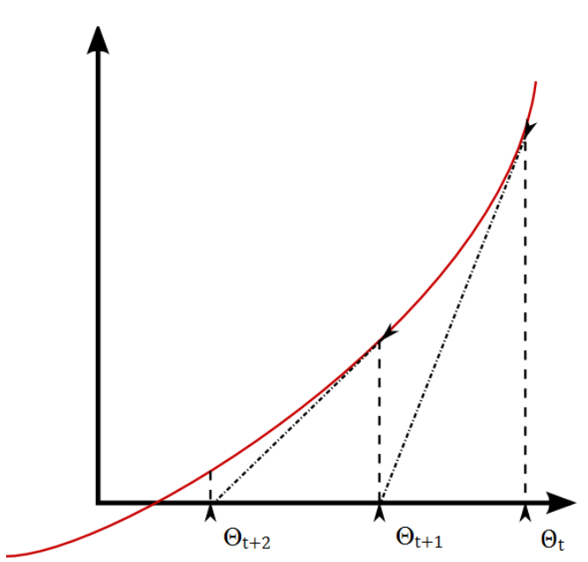
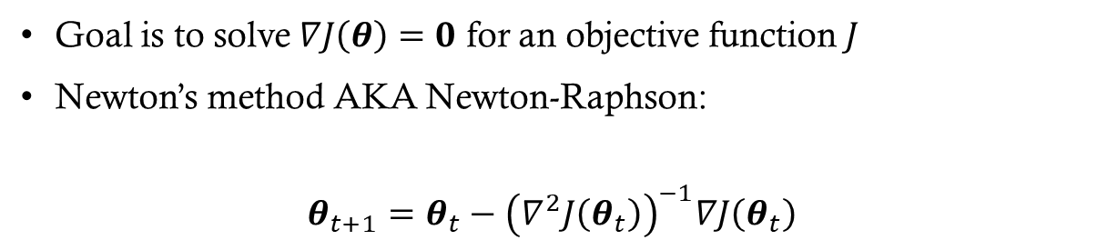

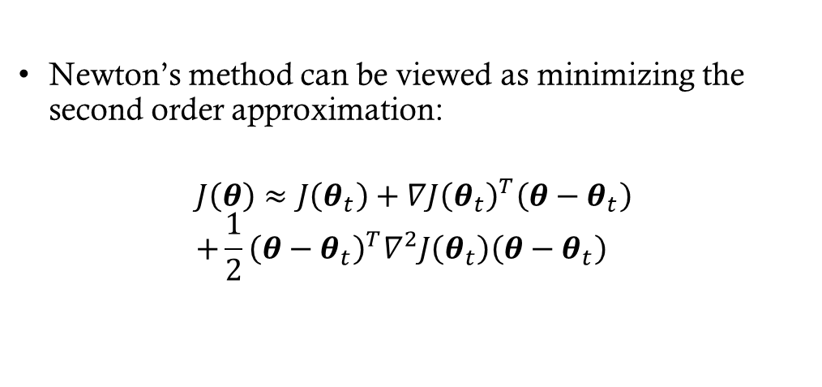
Newton’s method
Goal is to solve $∇J\left(θ\right)=0$ for an objective function $J$
Newton’s method AKA Newton-Raphson:
$$θ_{t+1}=θ_{t}−{\left(∇^{2}J\left(θ_{t}\right)\right)}^{−1}∇J\left(θ_{t}\right)$$
Newton’s method can be viewed as minimizing the second order approximation:
$$J\left(θ\right)≈J\left(θ_{t}\right)+∇J{\left(θ_{t}\right)}^{T}\left(θ−θ_{t}\right) \\ +\frac{1}{2}{\left(θ−θ_{t}\right)}^{T}∇^{2}J\left(θ_{t}\right)\left(θ−θ_{t}\right)$$
Notes:
Newton’s method approximates the objective function with a quadratic function and then jumps to the minimum of that quadratic function. Repeat until convergence.

Slide 28
Group exercise
One advantage of Newton’s method is that it converges to a minimum in relatively few steps. What is a disadvantage of Newton’s method?
Answer: You have to invert a matrix (the Hessian) at each step
  This can be very slow for high-dimensional data
Thus in practice, Newton’s method is rarely used
However, Newton’s method has provided inspiration for other optimization techniques that are faster to compute

Slide 29
Takeaways
The combination of convexity and differentiability enables us to determine if a global minimum exists
Differentiability also provides us with methods for finding a minimum when a closed-form solution may not exist
Thus, when considering loss functions for an ML problem, convexity and differentiability are important properties to consider

