Slide 1
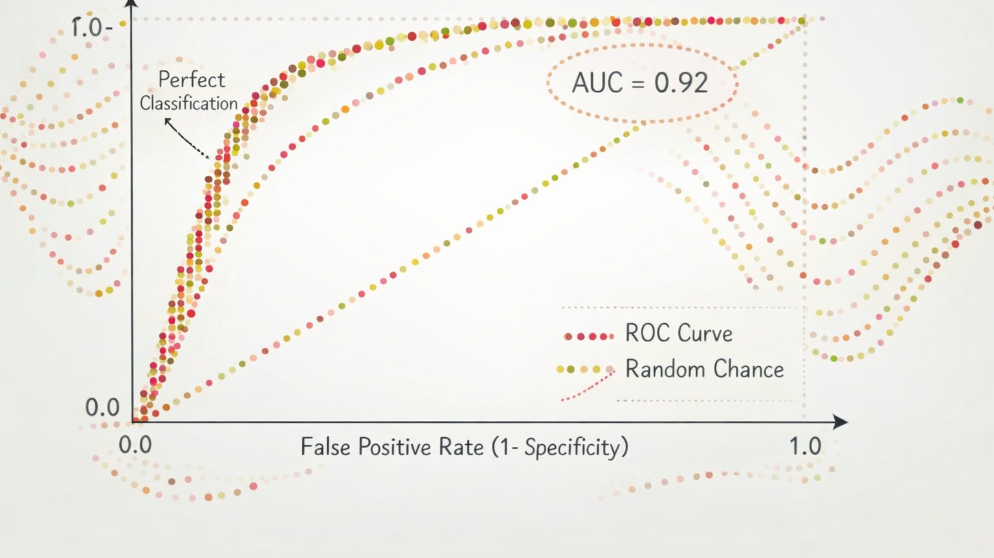
Classification Metrics

Slide 2
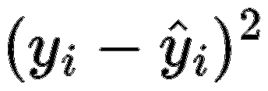
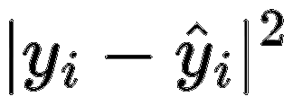
Regression vs Classification (Review)
Regression and Classification are both supervised learning methods
Regression
  The target or response variable (y) is numeric
  Model predicts the value of y
  Prediction accuracy is measured by how close the predicted value is to the truth, such as
              or

Slide 3
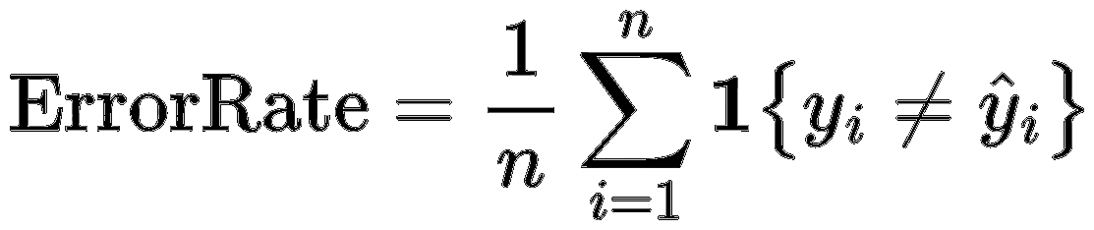
Regression vs Classification (Review)
Regression and Classification are both supervised learning methods
Classification
  The target or response variable (y) is categorical
  Model predicts category of y (or in some cases the probability of being in a particular class, given the features)
  Prediction accuracy can be measured by the error rate,

Slide 4
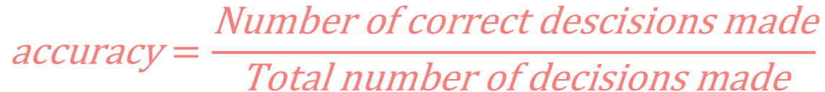
Accuracy
$$\text{accuracy}=\frac{\text{Number} \text{of} \text{correct} \text{descisions} \text{made}}{\text{Total} \text{number} \text{of} \text{decisions} \text{made}}$$
Accuracy assumes equal costs for all types of errors
When is accuracy not a good fitness metric?
  When there is class skew (e.g., imbalance)
  In these cases good accuracy could mean always predicting the majority class!

Slide 5

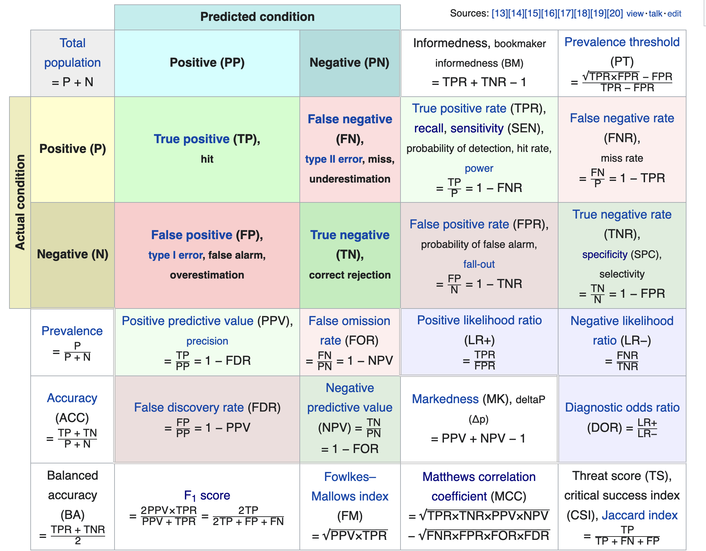

Slide 6
Confusion Matrix
Predicted Output
Positive (PP)
Negative (PN)
True Positives
TP
False Negatives
FN
Positive (P)
True Values
False Positives
FP
True Negatives
TN
Negative (N)

Slide 7
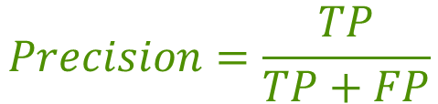
Precision
Predicted Output
Positive (PP)
Negative (PN)
True Positives
TP
False Negatives
FN
Positive (P)
Of those that are predicted to be positive, the percent that are actually positive
Describes how good the model is at predicting the positive class
Also call positive predictive value
True Values
False Positives
FP
True Negatives
TN
Negative (N)
$$Precision=\frac{TP}{TP+FP}$$
Under what conditions is high precision the most appropriate performance objective for a classification model?
Notes:
High precision is most important when false positives are costly, harmful, or difficult to reverse, even if some true cases are missed.

Slide 8
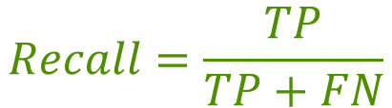
Recall
Predicted Output
Positive (PP)
Negative (PN)
True Positives
TP
False Negatives
FN
Positive (P)
Of those that are actually positive, the percent that are predicted to be positive
The proportion of positives that are correctly identified
Also called sensitivity or
true positive rate
True Values
False Positives
FP
True Negatives
TN
Negative (N)
$$Recall=\frac{TP}{TP+FN}$$
Under what conditions is high recall the most appropriate performance objective for a classification model?
Notes:
High recall is most important when missing true positives is costly or dangerous, and false positives can be tolerated or corrected later.

Slide 9
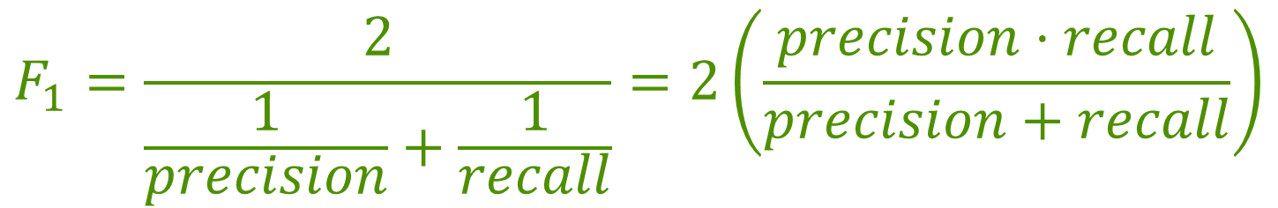
F1 Score
The precision & recall are often combined into one metric called F1
F1 is the harmonic mean of the precision and recall
$$F_{1}=\frac{2}{\frac{1}{precision}+\frac{1}{recall}}=2\left(\frac{precision⋅recall}{precision+recall}\right)$$
The F1 score favors classifiers with similar precision and recall scores

Slide 10
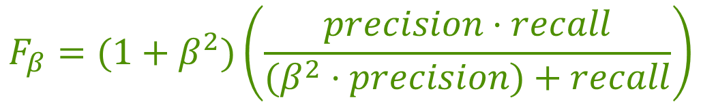
F𝛽 Score
The F1 score can be generalized to give more weight to either the precision or recall
$$F_{β}=(1+β^{2})\left(\frac{precision⋅recall}{(β^{2}⋅precision)+recall}\right)$$
0 < 𝛽 < 1 ⟹ More weight given to the precision
𝛽 > 1 ⟹ More weight given to the recall
𝛽 = 1 ⟹ Equal weight given to precision and recall (F1)

Slide 11





Other Measures
Recall / Sensitivity / True Positive Rate
Precision /
Positive Predictive Rate
Predicted Output
Predicted Output
Positive (PP)
Negative (PN)
F1
Positive (PP)
Negative (PN)
TP
FN
TP
FN
$$\frac{TP}{TP+FP}$$
Positive (P)
$$\frac{TP}{TP+FN}$$
Positive (P)
True Values
True Values
FP
TN
FP
TN
Negative (N)
Negative (N)
ROC Curve &
AUC
Specificity /
True Negative Rate
Negative Predictive Value
Predicted Output
Predicted Output
Positive (PP)
Negative (PN)
Positive (PP)
Negative (PN)
TP
FN
$$\frac{TN}{TN+FN}$$
TP
FN
$$\frac{TN}{TN+FP}$$
Positive (P)
Positive (P)
True Values
True Values
FP
TN
FP
TN
Negative (N)
Negative (N)

Slide 12
ROC Curve and AUC
ROC stands for Receiver Operating Curve
  Developed in WWII to model false positive and false negative detections of radar operators
  It plots the True Positive Rate (sensitivity) versus the False Positive Rate (1 - specificity) for different classification thresholds
AUC stands for Area Under the (ROC) Curve
  It is a single measure for summarizing the ROC curve
    AUC =1 ⟹ perfect model
    AUC = 0.5 ⟹ random model

Slide 13
Building the ROC Curve
Many classifier actually predict a probability or score rather than a classification
Then the classification is made by setting a threshold
  For example: if P(yi = positive) > p then classify yi as positive (for 0 < p < 1)
The ROC curve looks at the true positive rate versus the false positive rate for a range of thresholds

Slide 14
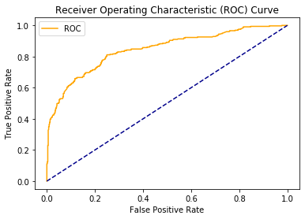
Example ROC Curve

Slide 15
Metrics in Scikit-Learn

Slide 16
Function names
https://scikit-learn.org/stable/api/sklearn.metrics.html#
accuracy_score(y_true, y_pred)
(default for many functions)
classification_report(y_true, y_pred)
confusion_matrix(y_true, y_pred)
f1_score(y_true, y_pred)
precision_score(y_true, y_pred)
recall_score(y_true, y_pred)
roc_auc_score(y_true, y_score) Note:(The second argument must be a score (e.g. probability) and not a class prediction

Slide 17
.predict() vs .predict_proba()
For classification estimators, there are two ways to product predictions
.predict() will produce an 1D array with n rows with the class prediction
      Class with the highest probability
.predict_proba() will produce a 2D array with n rows and n-class columns
      Each column is the probability of the row observation being in class 0 to n-class

Slide 18
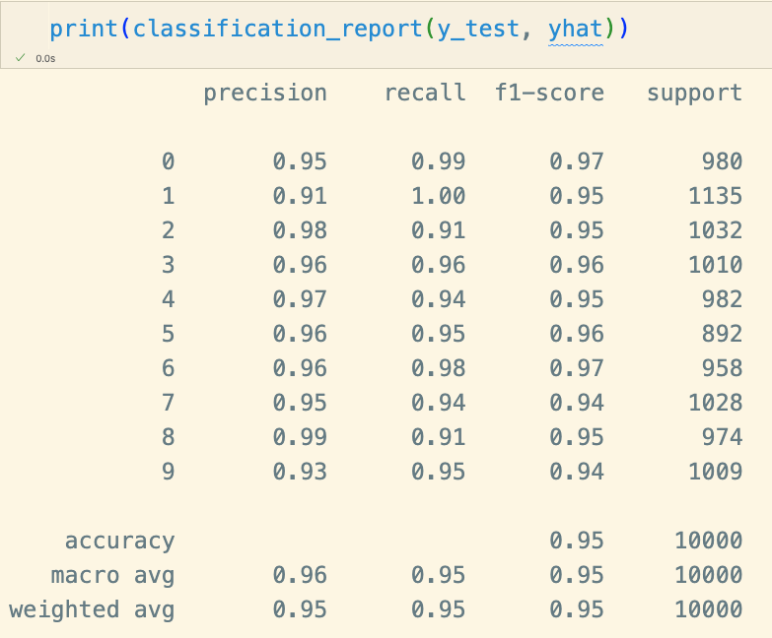
Classification Report
This special function will show precision, recall, f1, and accuracy for all class (treat each class as positive class)

Slide 19
Multi-class Classification

Slide 20
Multi-class Strategies
Some classifiers (e.g., Naive Bayes, KNN) are capable of handling multiple classes directly
Other classifiers (e.g., binary logistic regression) are binary classifiers
For binary classifiers, there are two strategies for extending to multiple classes:
    One-versus-all (OvA) (sometimes called One-versus-rest (OvR))
    One-versus-one (OvO)

Slide 21
One Versus All (OvA)
For each class, train a model that classify that class versus all the rest:
    Classify 1 versus not 1
    Classify 2 versus not 2
    etc.
Classify a value into the classier whose classifier outputs the highest score (e.g., predictive probabilities)

Slide 22
One Versus One (OvO)
Train a binary classifier for every pair of classes
    1 vs 2
    1 vs 3
    2 vs 3
    4 vs 5
    etc
Classify value into the class that wins the most duels

Slide 23
OvA Versus OvO
Suppose there are q classes
OvO requires training q(q-1)/2 classifiers
    For the MNIST example this means 10(10-1)/2 = 45 classifiers
    However, each classifier needs only use a small subset of the data
In general OvA is the preferred strategy (only trains q classifiers)
But for classifiers that scale poorly with the size of the training set (e.g., SVM) OvO is preferred

Slide 24

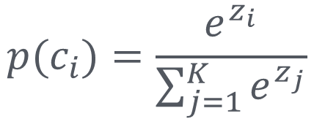
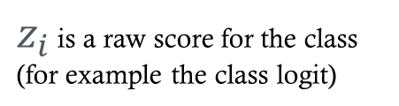
Softmax function
A mathematical function that converts a vector of real-valued scores into a probability distribution
Used to convert real-valued outputs to “probabilities”
Can be used as a way to extend logistic regression
Often used in multi-class NN
$z_{i}$ is a raw score for the class (for example the class logit)
$$p(c_{i})=\frac{e^{z_{i}}}{\sum_{j=1}^{K}{e^{z_{j}}}}$$
Probability of class $c_{i}$
Sum over all classes

