Slide 1
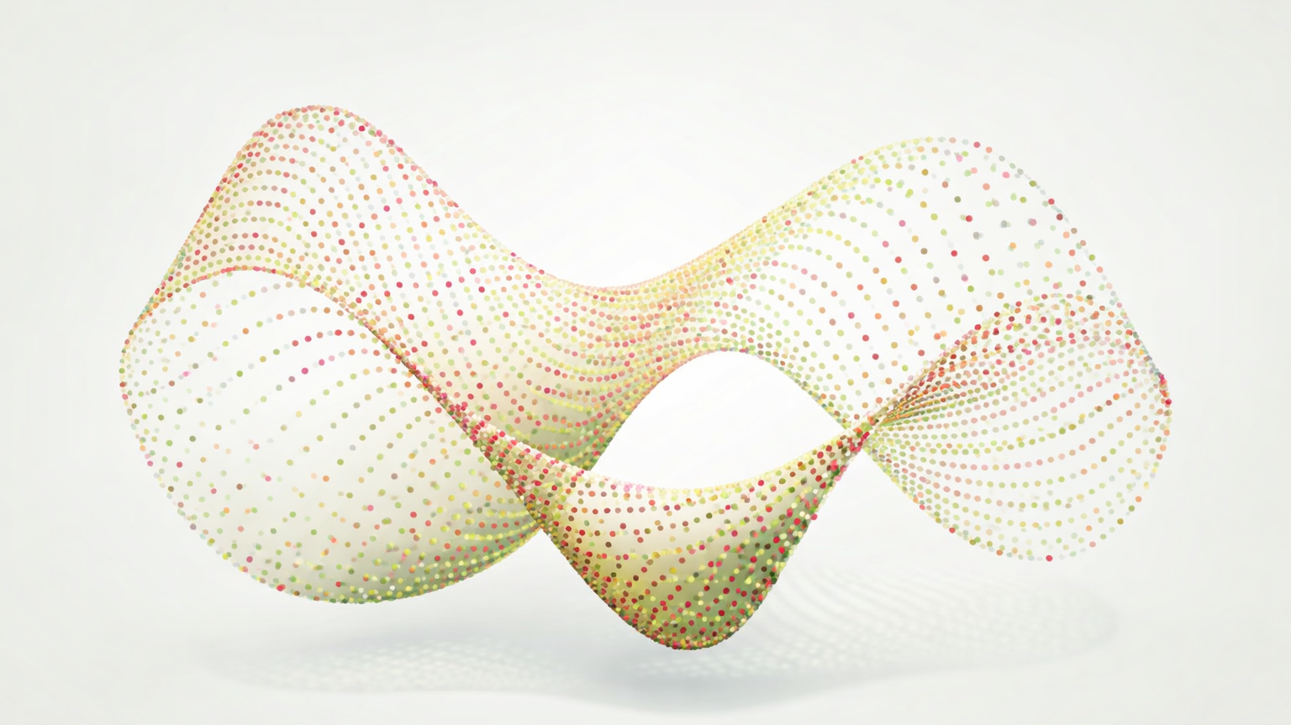
Manifold Learning

Slide 2
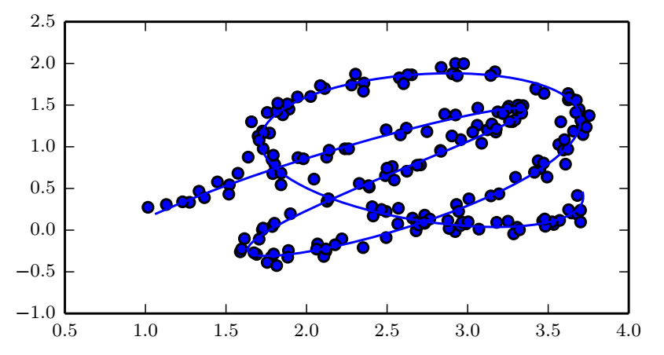
Manifold learning
Informally, a manifold in machine learning loosely means a connected set of points in high dimensions that can be approximated well by a small number of dimensions
Sometimes referred to as the manifold assumption
Simplifies the learning problem greatly and helps with the curse of dimensionality
Is this a good assumption in machine learning?
Goodfellow et al., 2016
Notes:
Fewer dimensions means we have less space we need to characterize

Slide 3
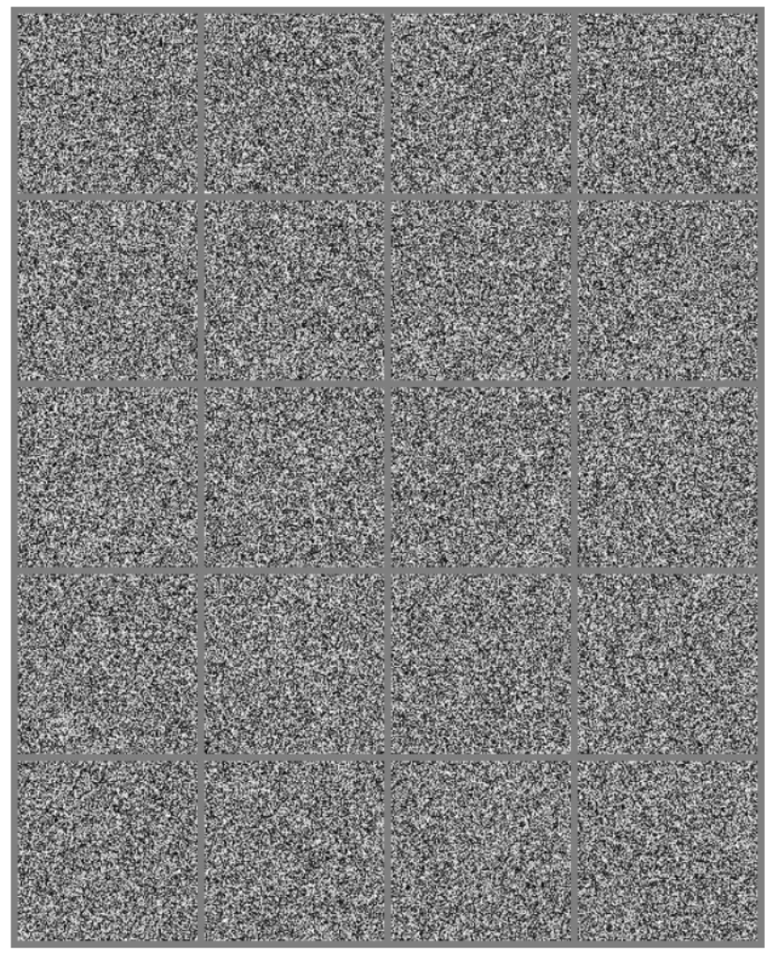
The manifold assumption in practice
The probability distribution over images, text strings, and sounds that occur in real life is highly concentrated
Example: randomly generated images (right) rarely (never?) look like real objects
Example: picking random letters unlikely to give real text
Is this sufficient for the manifold assumption?
No, also need to establish that the examples we encounter are connected to each other by other examples

Slide 4
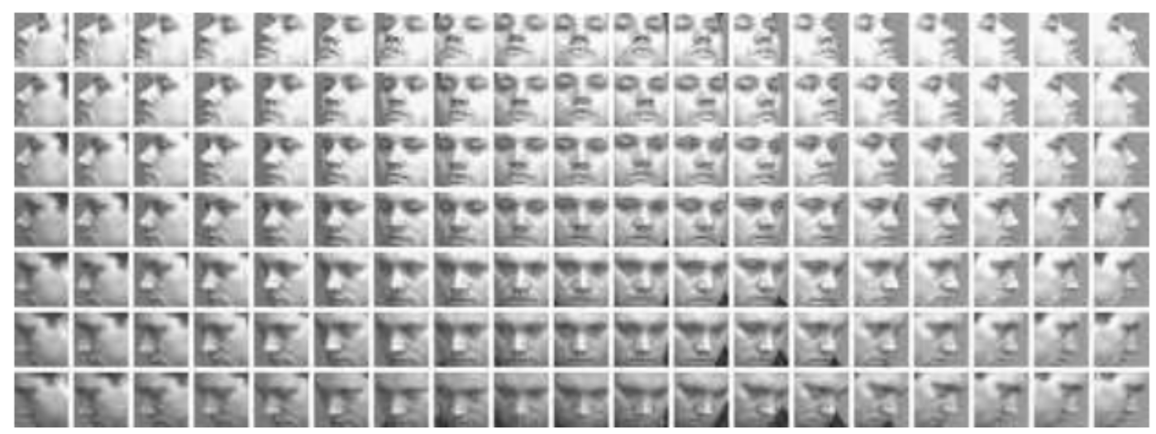
The manifold assumption in practice
In images, we can think of many possible transformations that trace out a manifold
Dim or brighten the lights, gradually move or rotate objects, etc.
Multiple manifolds may be involved (e.g. human manifolds and cat manifolds)
Notes:
Can make similar arguments for language and sound.

Slide 5
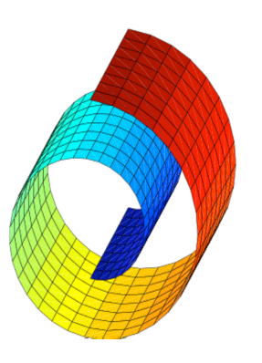
Manifold learning

Slide 6
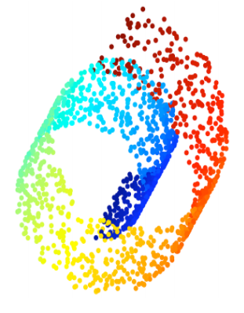
Manifold learning

Slide 7
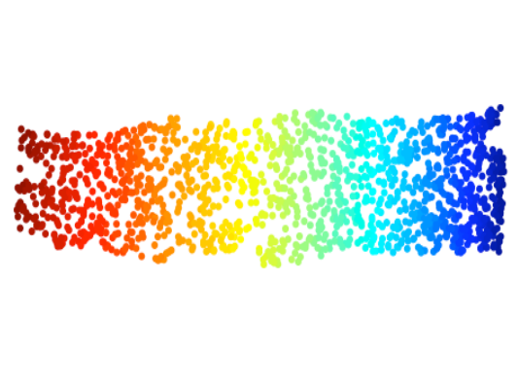
Manifold learning

Slide 8
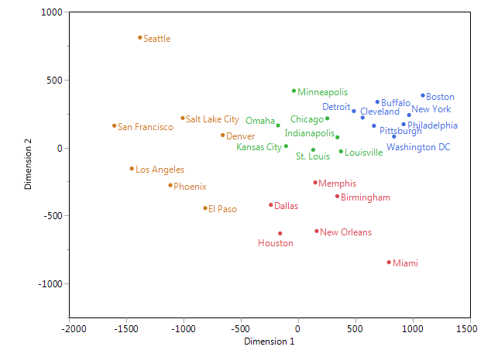
Multidimensional Scaling (MDS)
MDS is a class of dimensionality reduction methods
Goal: minimize the “difference” between corresponding distances in the high and low dimensional spaces
Example: projecting cities on a 3D Earth to a 2D map

Slide 9
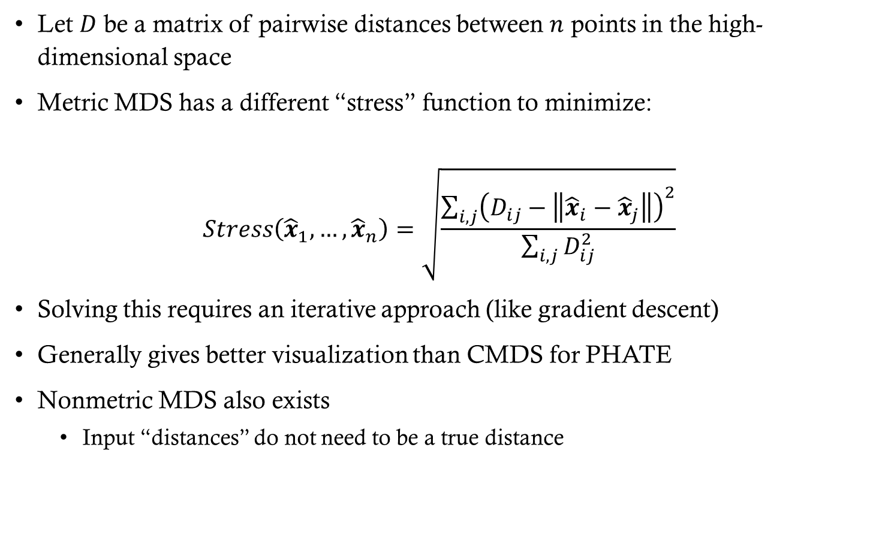
Metric MDS
Let $D$ be a matrix of pairwise distances between $n$ points in the high-dimensional space
Metric MDS has a different “stress” function to minimize:
$$Stress\left({\hat{x}}_{1},…,{\hat{x}}_{n}\right)=\sqrt{\frac{\sum_{i,j}{{\left(D_{ij}−\left\|{\hat{x}}_{i}−{\hat{x}}_{j}\right\|\right)}^{2}}}{\sum_{i,j}{D_{ij}^{2}}}}$$
Solving this requires an iterative approach (like gradient descent)
Generally gives better visualization than CMDS for PHATE
Nonmetric MDS also exists
Input “distances” do not need to be a true distance

Slide 10
Manifold Learning
Large Euclidean distances often uninformative
Exit the manifold
Also likely to suffer from the curse of dimensionality
Thus MDS on Euclidean distances often isn’t great
Solution: input “better” distances
We’ll construct distances from a graph

Slide 11
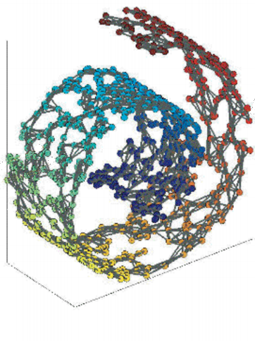
Manifold learning

Slide 12
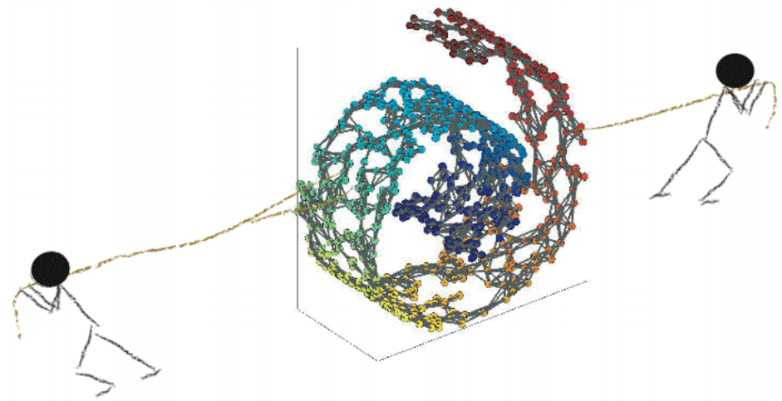
Manifold learning

Slide 13
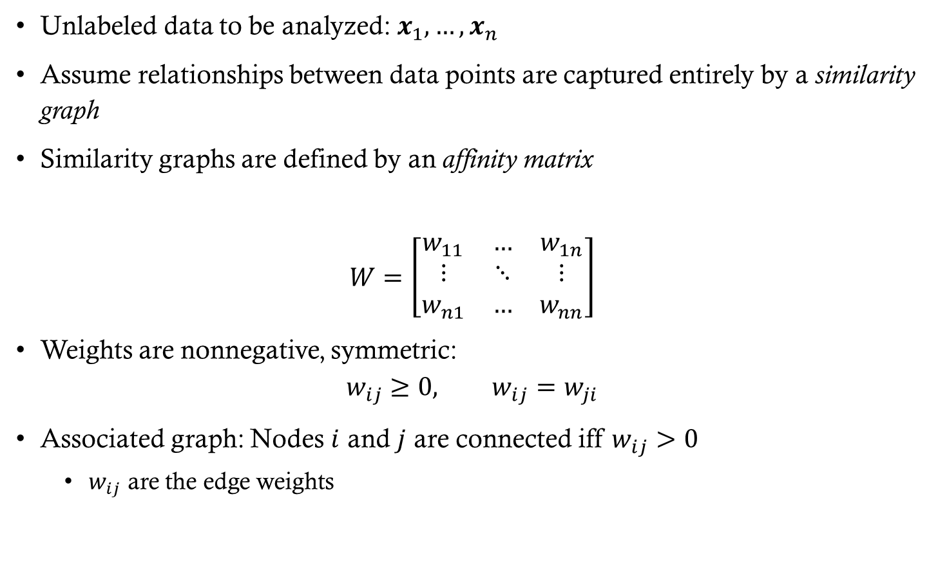
Similarity Graphs
Unlabeled data to be analyzed: $x_{1},…,x_{n}$
Assume relationships between data points are captured entirely by a similarity graph
Similarity graphs are defined by an affinity matrix
$$W=\left[\begin{matrix}w_{11} & … & w_{1n} \\ ⋮ & ⋱ & ⋮ \\ w_{n1} & … & w_{nn}\end{matrix}\right]$$
Weights are nonnegative, symmetric:
$$w_{ij}≥0, w_{ij}=w_{ji}$$
Associated graph: Nodes $i$ and $j$ are connected iff $w_{ij}>0$
$w_{ij}$ are the edge weights

Slide 14
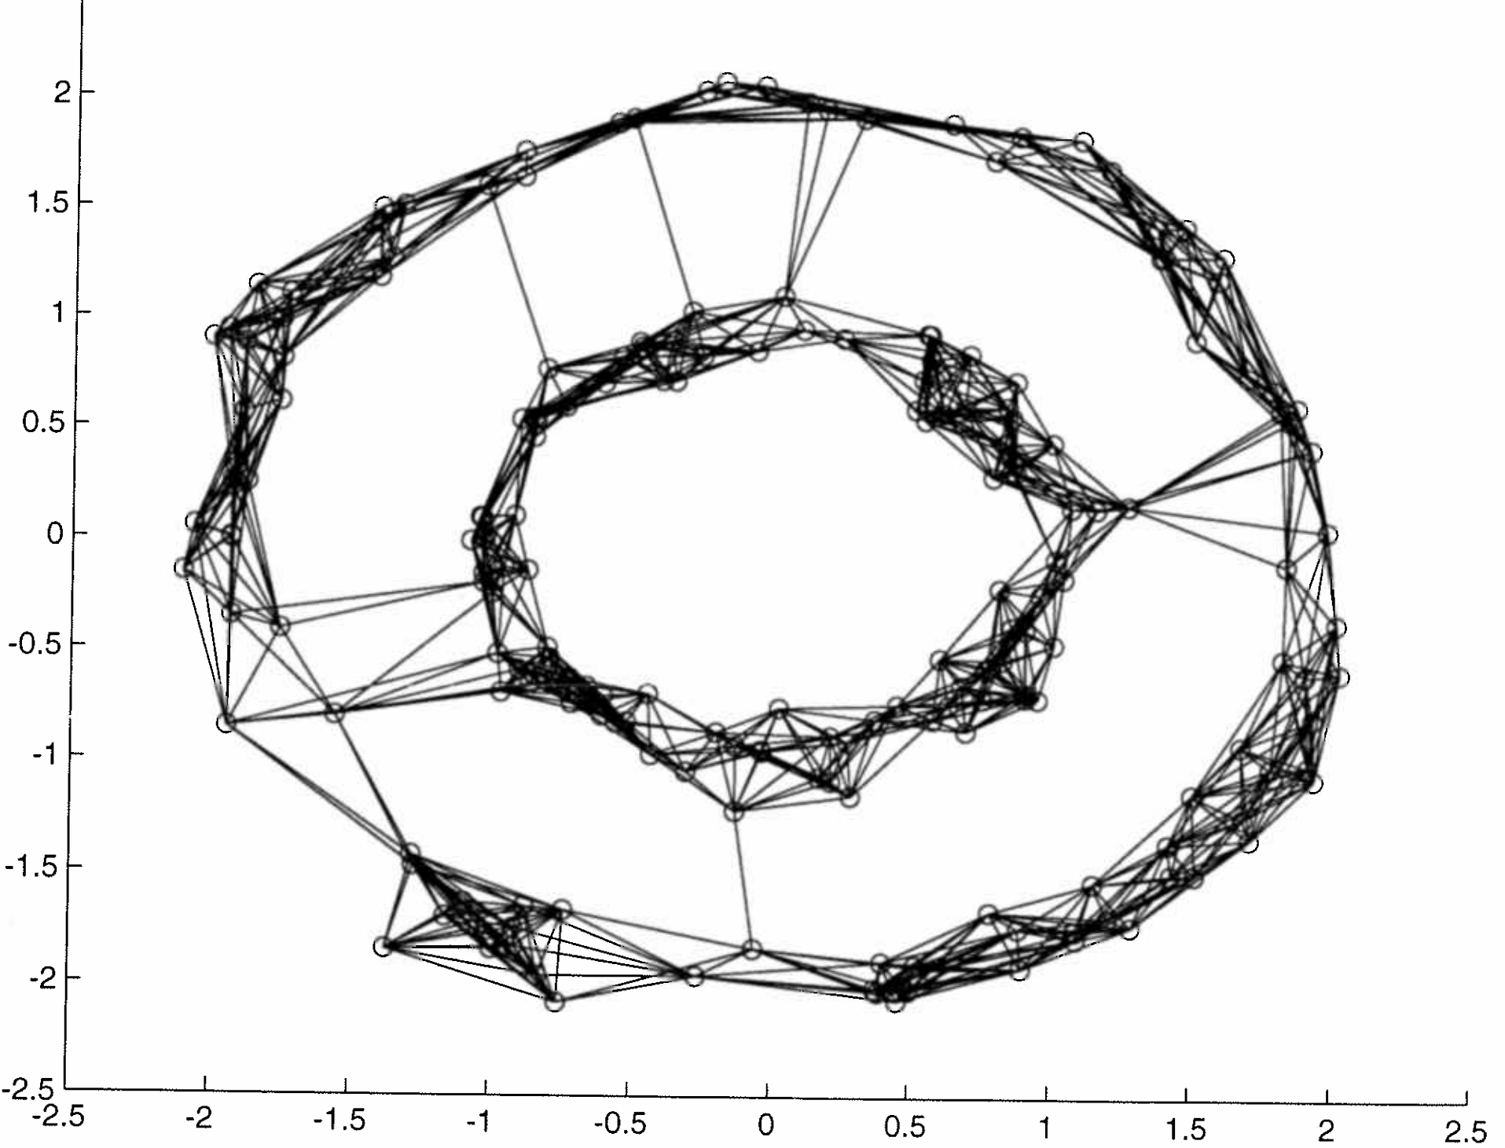

Similarity Graphs
Similarity graphs are defined by two things
Graph structure (which edges are connected)
Examples
$k$-nn graph
$ε−$ball graph
Complete graph
Weights
Examples
$w_{ij}=\exp\left(−\frac{1}{2σ^{2}}{\left\|x_{i}−x_{j}\right\|}^{2}\right)$
$w_{ij}=\left\{\begin{matrix}1 & \text{if} ∃ \text{an} \text{edge} \text{between} \text{nodes} i \text{and} j \\ 0 & \text{otherwise}\end{matrix}\right.$
11-nn graph

Slide 15
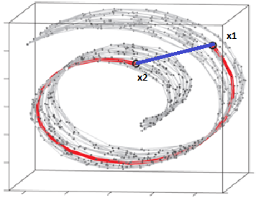
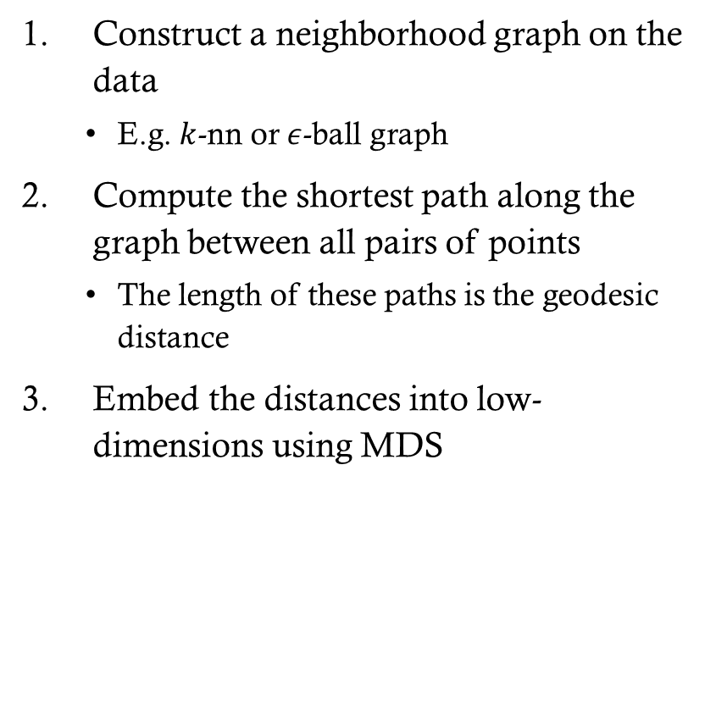
ISOMAP
Construct a neighborhood graph on the data
E.g. $k$-nn or $ε$-ball graph
Compute the shortest path along the graph between all pairs of points
The length of these paths is the geodesic distance
Embed the distances into low-dimensions using MDS

Slide 16
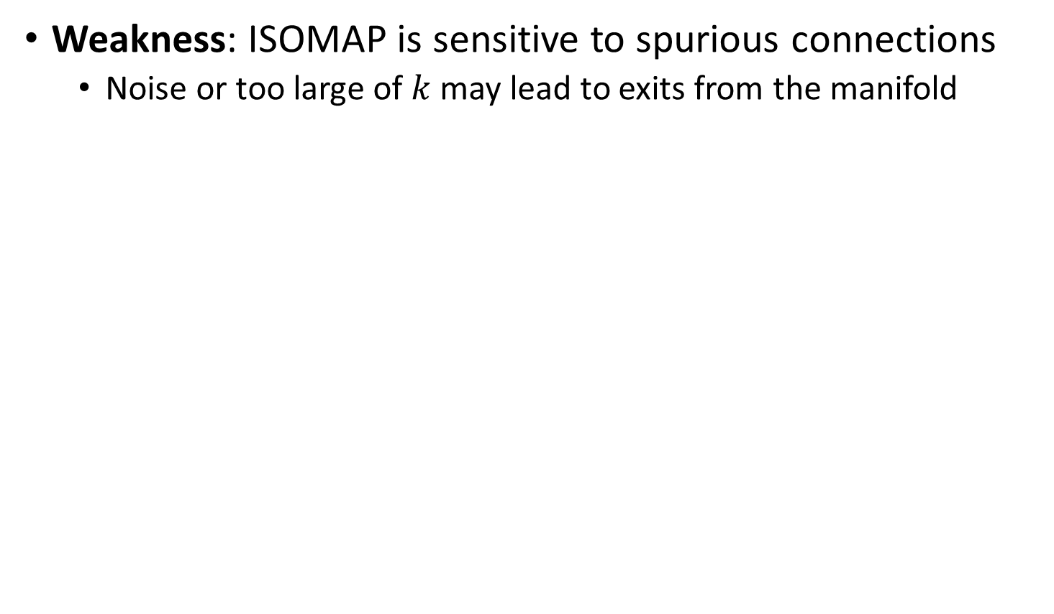
ISOMAP
Weakness: ISOMAP is sensitive to spurious connections
Noise or too large of $k$ may lead to exits from the manifold

Slide 17
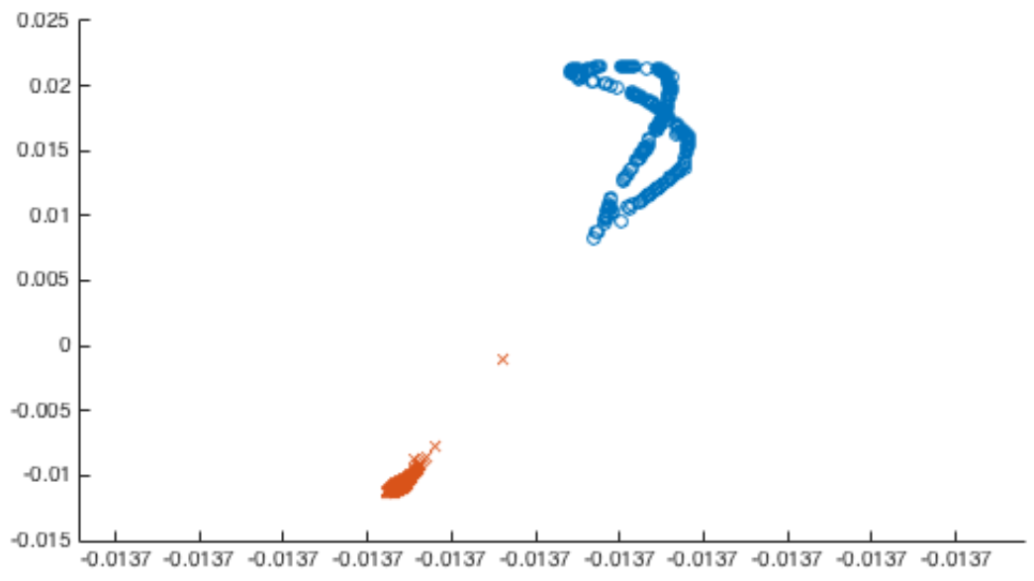
Laplacian Eigenmaps
Direct embedding of the graph structure
Based on an eigendecomposition of the (normalized) graph Laplacian
Works for clustering, but may not preserve local structure well

Slide 18
Diffusion Maps
More robust than ISOMAP

Slide 19
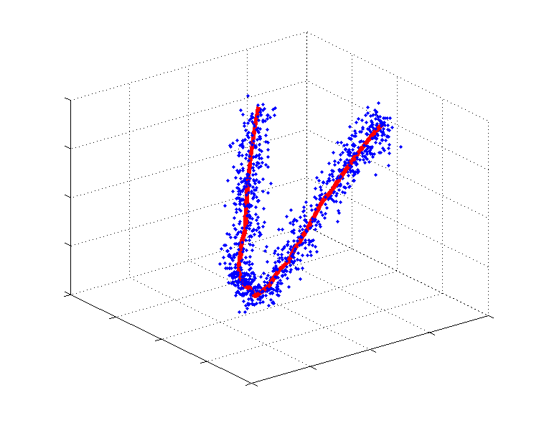
Capturing local neighborhoods
x
Large Euclidean distance gives wrong global structure for visualizing
Small Euclidean distances ok
Encodes local structure
Notes:
Remember, we’re trying to learn the actual underlying structure.

Slide 20
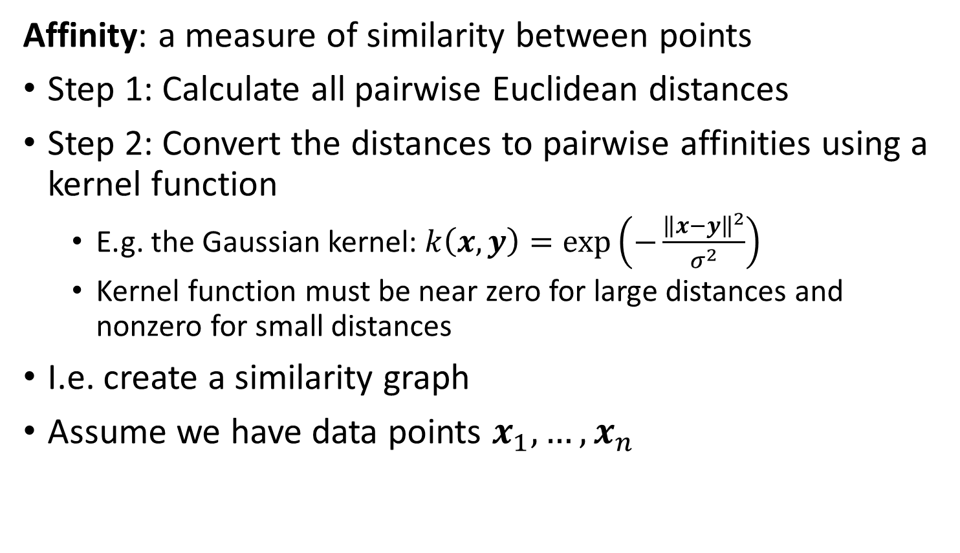
From distances to affinities
Affinity: a measure of similarity between points
Step 1: Calculate all pairwise Euclidean distances
Step 2: Convert the distances to pairwise affinities using a kernel function
E.g. the Gaussian kernel: $k\left(x,y\right)=\exp\left(−\frac{{\left\|x−y\right\|}^{2}}{σ^{2}}\right)$
Kernel function must be near zero for large distances and nonzero for small distances
I.e. create a similarity graph
Assume we have data points $x_{1},…,x_{n}$

Slide 21
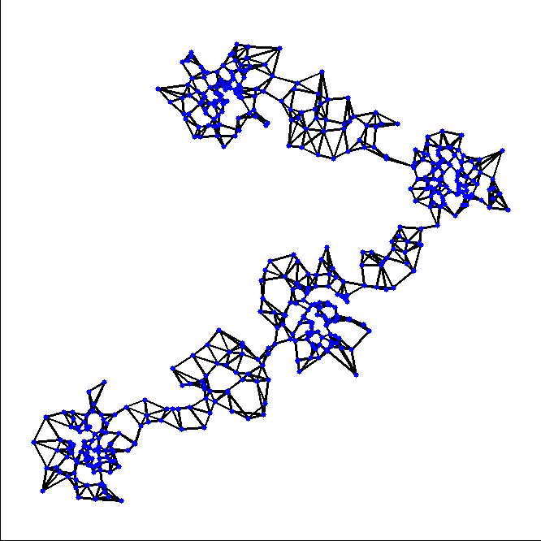

Diffusion Operator
Big Euclidean steps bad, likely to exit structure
Small steps good, likely to stay within structure
Shortest path (ISOMAP) is sensitive to outliers and spurious connections
Solution: consider all possible paths via random walks
Can do this computationally cheaply using diffusion
Notes:
In diffusion, we are looking at all possible random walks. This like an ensemble approach where any given random walk may not encode the information well, but taking multiple random walks gives you more robust results, and denoises the data

Slide 22
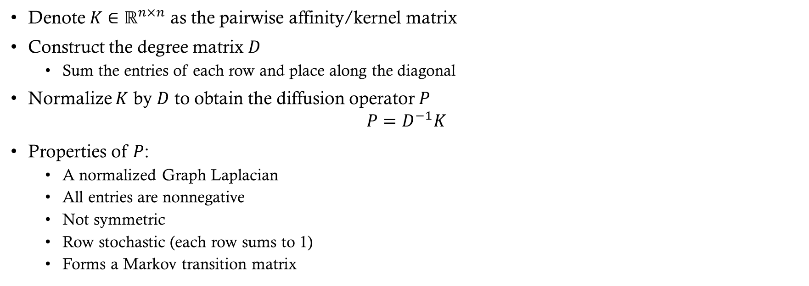
Diffusion Operator
Denote $K∈ℝ^{n×n}$ as the pairwise affinity/kernel matrix
Construct the degree matrix $D$
Sum the entries of each row and place along the diagonal
Normalize $K$ by $D$ to obtain the diffusion operator $P$
$$P=D^{−1}K$$
Properties of $P$:
A normalized Graph Laplacian
All entries are nonnegative
Not symmetric
Row stochastic (each row sums to 1)
Forms a Markov transition matrix

Slide 23
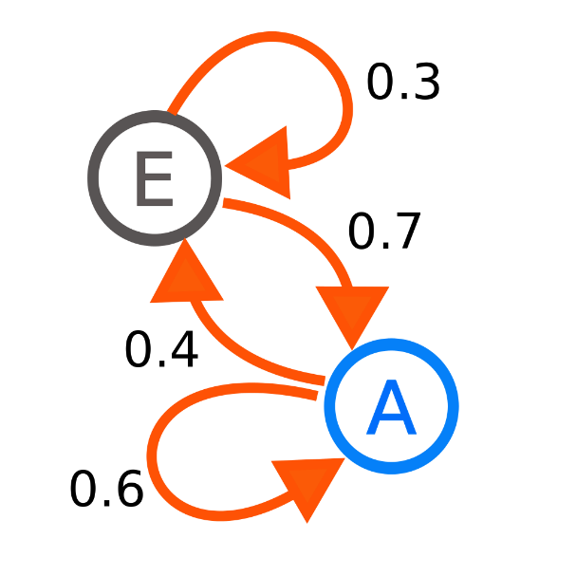
Markov Processes
R
Used to model a system’s state over time
Consists of a set of possible states and transition probabilities
Example: suppose the weather is either sunny or rainy
Two states: sunny (S) and rainy (R)
If states are independent, then we flip a coin each day
Weather is usually NOT independent
Suppose we live in an area where it’s uncommon for it to rain for multiple days
Model this with a Markov chain
Transition probabilities indicate how “sticky” each state is
S

Slide 24
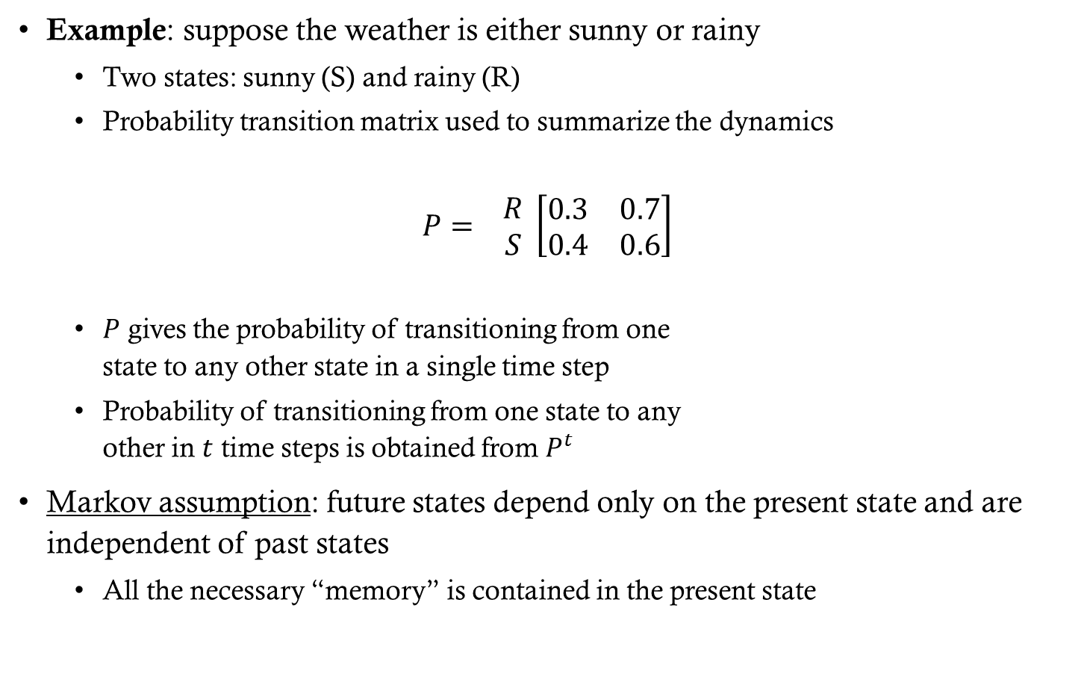

Markov Processes
Example: suppose the weather is either sunny or rainy
Two states: sunny (S) and rainy (R)
Probability transition matrix used to summarize the dynamics
$$P= \begin{matrix}R \\ S\end{matrix} \left[\begin{matrix}0.3 & 0.7 \\ 0.4 & 0.6\end{matrix}\right]$$
$P$ gives the probability of transitioning from one state to any other state in a single time step
Probability of transitioning from one state to any other in $t$ time steps is obtained from $P^{t}$
Markov assumption: future states depend only on the present state and are independent of past states
All the necessary “memory” is contained in the present state
$$\begin{matrix}R & S\end{matrix}$$
R
S

Slide 25
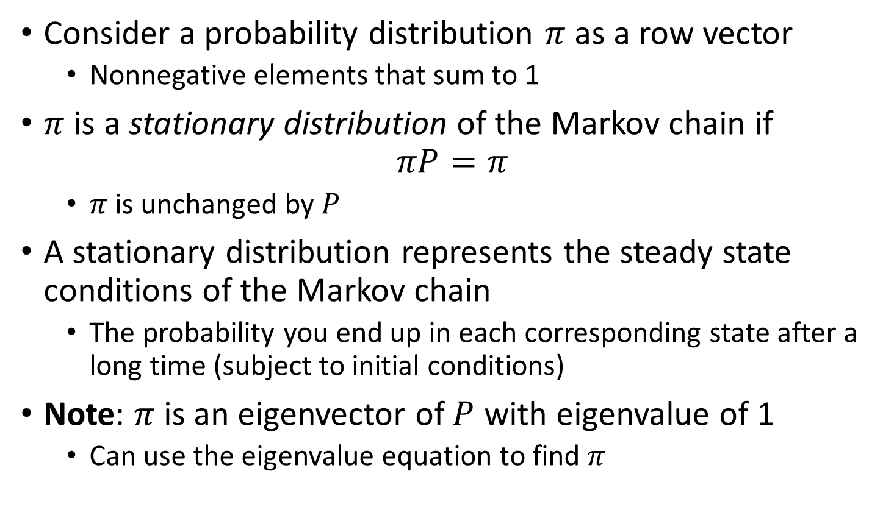
Stationary Distribution
Consider a probability distribution $π$ as a row vector
Nonnegative elements that sum to 1
$π$ is a stationary distribution of the Markov chain if
$$πP=π$$
$π$ is unchanged by $P$
A stationary distribution represents the steady state conditions of the Markov chain
The probability you end up in each corresponding state after a long time (subject to initial conditions)
Note: $π$ is an eigenvector of $P$ with eigenvalue of 1
Can use the eigenvalue equation to find $π$

Slide 26
Diffusion Denoises and Recovers Global Structure

Slide 27

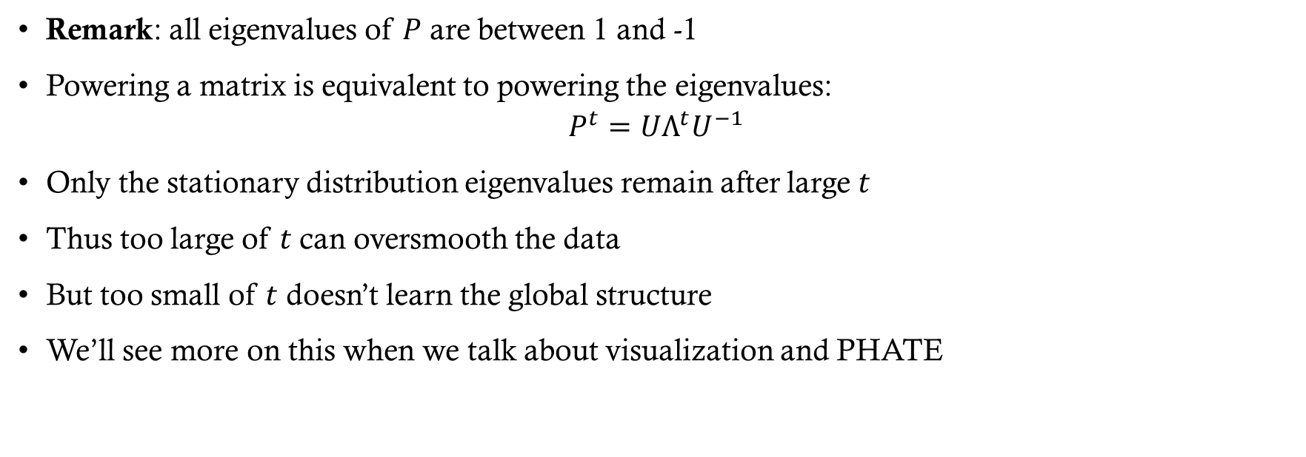
The time scale $t$
Remark: all eigenvalues of $P$ are between 1 and -1
Powering a matrix is equivalent to powering the eigenvalues:
$$P^{t}=UΛ^{t}U^{−1}$$
Only the stationary distribution eigenvalues remain after large $t$
Thus too large of $t$ can oversmooth the data
But too small of $t$ doesn’t learn the global structure
We’ll see more on this when we talk about visualization and PHATE

Slide 28
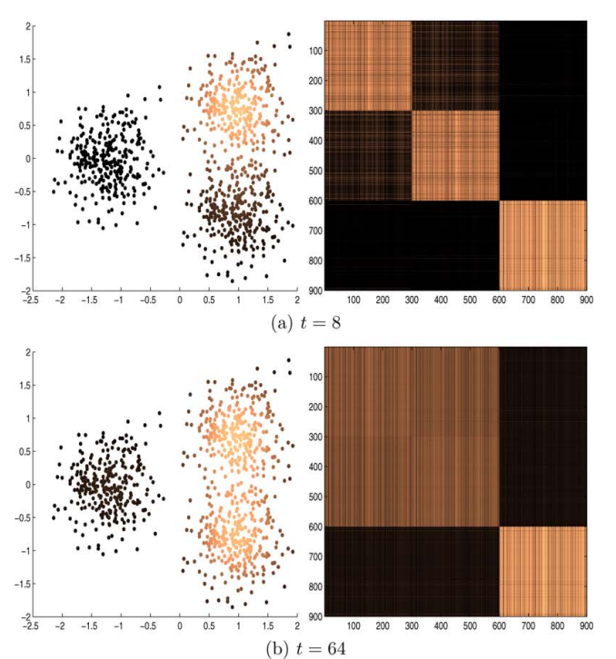
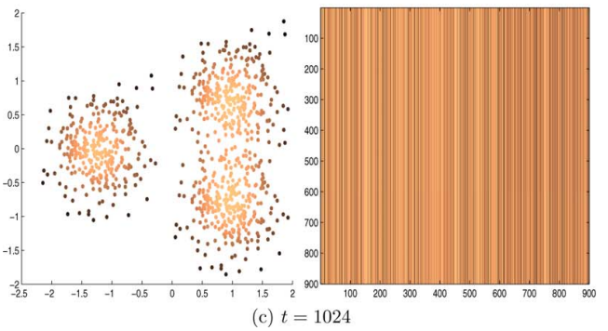

The time scale $t$

Slide 29
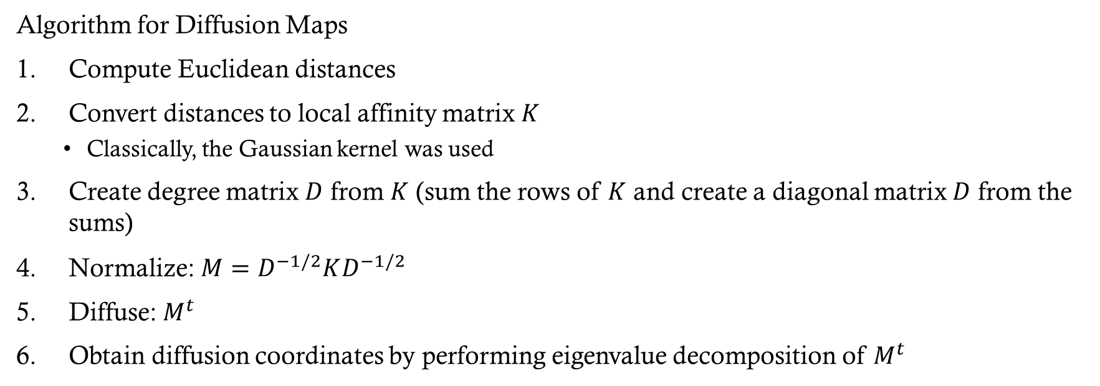
Diffusion Maps
Algorithm for Diffusion Maps
Compute Euclidean distances
Convert distances to local affinity matrix $K$
Classically, the Gaussian kernel was used
Create degree matrix $D$ from $K$ (sum the rows of $K$ and create a diagonal matrix $D$ from the sums)
Normalize: $M=D^{−1/2}KD^{−1/2}$
Diffuse: $M^{t}$
Obtain diffusion coordinates by performing eigenvalue decomposition of $M^{t}$

Slide 30
Visualizing Stucture with Manifolds

Slide 31
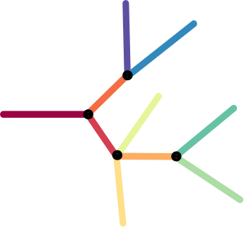
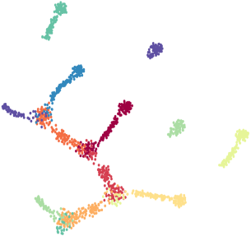
Visualization with t-SNE
Artificial Tree Data
t-SNE
1400 points, 60 dimensions
Notes:
Doesn’t work so well when you don’t have clusters

Slide 32
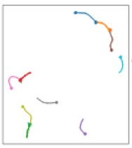
UMAP still fails at global structure
Artificial Tree Data
UMAP
1400 points, 60 dimensions
Notes:
Note that the colors have changed in this figure, but the structure is generally the same. UMAP still breaks things apart like t-SNE.

Slide 33
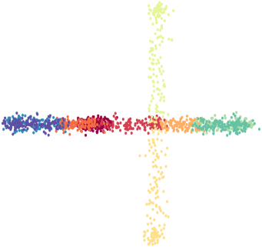
Balancing local and global information
T-SNE and UMAP are good for local structure
PCA is good for global structure
Diffusion maps (DM) does well at capturing both
Idea: use DM to visualize data
t-SNE
UMAP
PCA

Slide 34
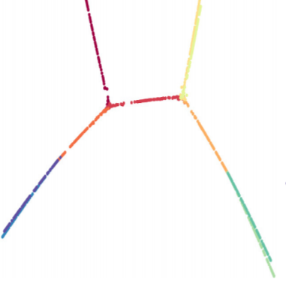
Visualization with Diffusion Maps
DM captures the information accurately and robustly, but not for visualization
DM tends to place the structure in higher dimensions
DM can also be unstable with boundaries and intersections
Diffusion Maps
Artificial Tree Data
1400 points, 60 dimensions

Slide 35
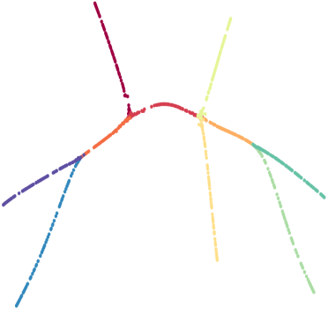
PHATE (Potential of Heat-diffusion for Affinity-based Transition Embedding)
Visualizing Structure and Transitions in High-Dimensional Biological Data (Nature Biotechnology, 2019)
A method for visualizing data built off of the diffusion framework
PHATE
Artificial Tree Data
1400 points, 60 dimensions

Slide 36
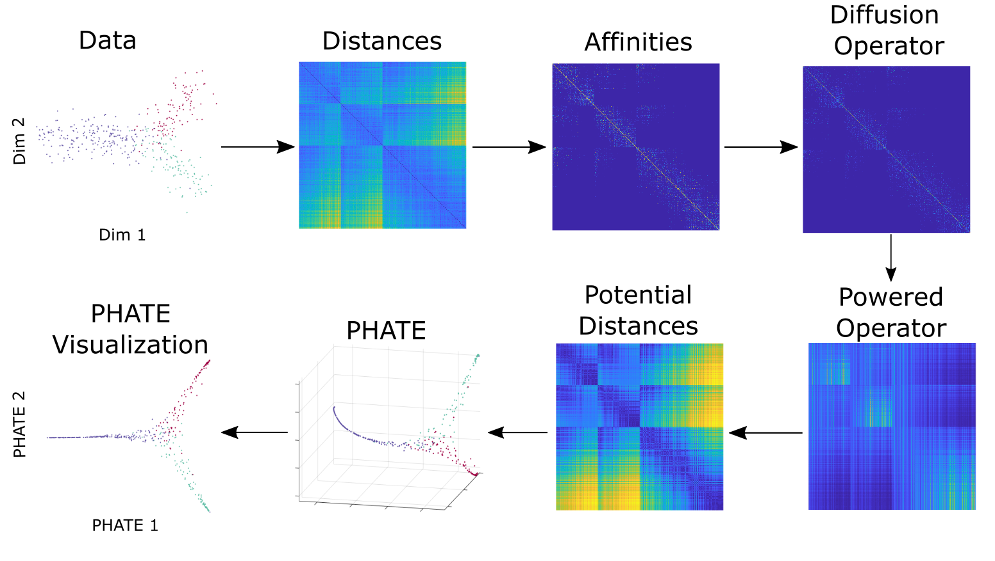
The PHATE Algorithm
Encode local information
Learn global information and denoise
Transform to low dimensions

Slide 37
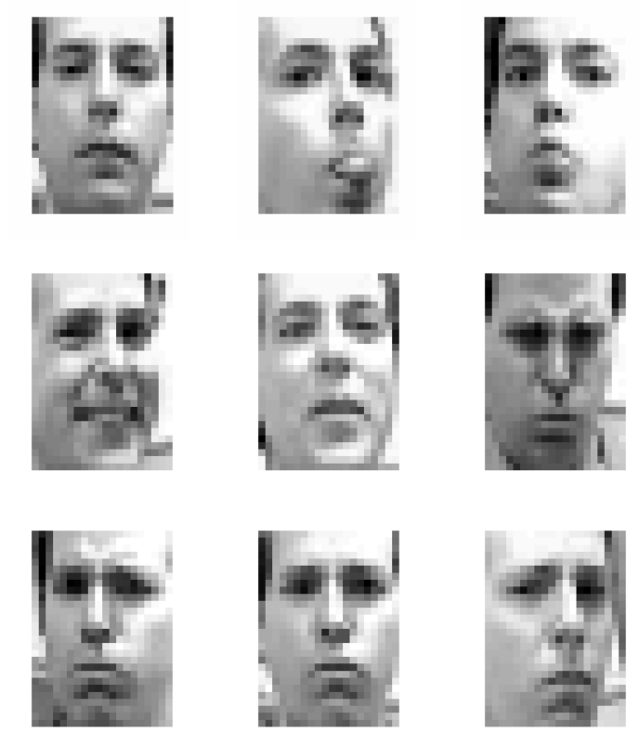
PHATE on Frey Faces
Frey Faces dataset
1965 frames taken from a video of Brendan Frey making various faces in front of a camera
Resolution: 20x28
Frames are given out of order to PHATE w/o information about sequential ordering

Slide 38
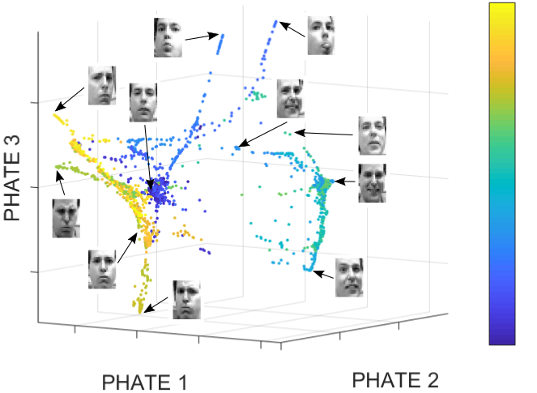
PHATE on Frey Faces
Notes:
PHATE captures the sequential ordering without including time as a direct input. Each branch corresponds to different poses

Slide 39
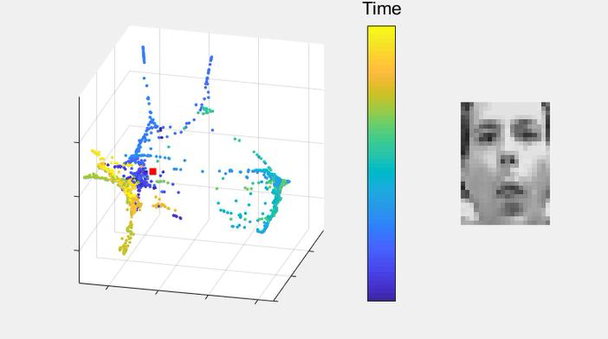
PHATE on Frey Faces
Notes:
In this video, you can see how PHATE captures the transition to several different poses

Slide 40
The PHATE Algorithm
Capturing Local Neighborhoods

Slide 41
Capturing local neighborhoods
x
Large Euclidean distance gives wrong global structure for visualizing
Small Euclidean distances ok
Encodes local structure
Notes:
Remember, we’re trying to learn the actual underlying structure.

Slide 42
From distances to affinities
Step 1: Calculate all pairwise Euclidean distances
Step 2: Convert the distances to pairwise affinities using a kernel function
E.g. the Gaussian kernel
Kernel function must be near zero for large distances and nonzero for small distances
Affinity: a measure of similarity between points
Problem: many data have both dense and sparse regions
A kernel bandwidth fixed for dense regions doesn’t work well for sparse regions and vice versa
Idea: use locally adaptive bandwidth

Slide 43
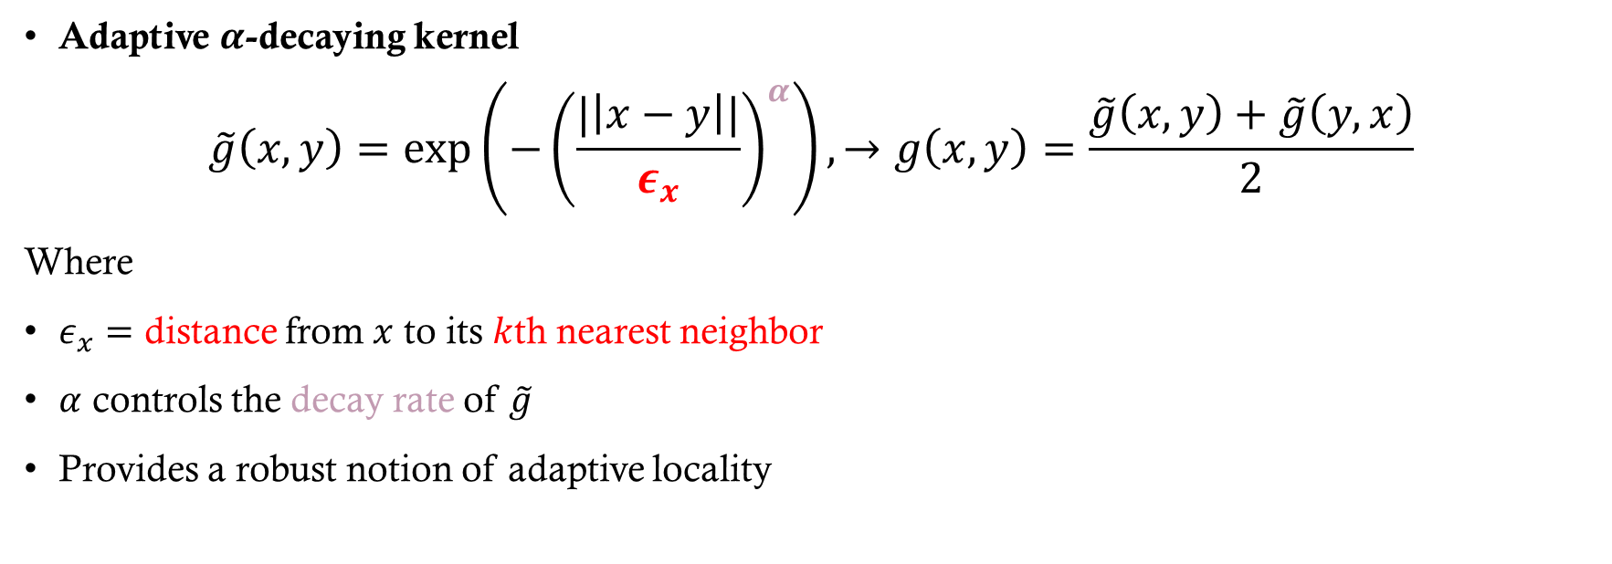
Capturing Local Neighborhoods
Adaptive $α$-decaying kernel
$$\tilde{g}\left(x,y\right)=\exp\left(−{\left(\frac{|\left|x−y\right||}{ε_{x}}\right)}^{α}\right), →g\left(x,y\right)=\frac{\tilde{g}\left(x,y\right)+\tilde{g}\left(y,x\right)}{2}$$
Where
$ε_{x}=$ distance from $x$ to its $k$th nearest neighbor
$α$ controls the decay rate of $\tilde{g}$
Provides a robust notion of adaptive locality
Notes:
And so I do this by converting the distances to a local affinity (e.g. a kernel function)
Instead of truncated Gaussians

Slide 44
The PHATE Algorithm
Learn global information and denoise

Slide 45
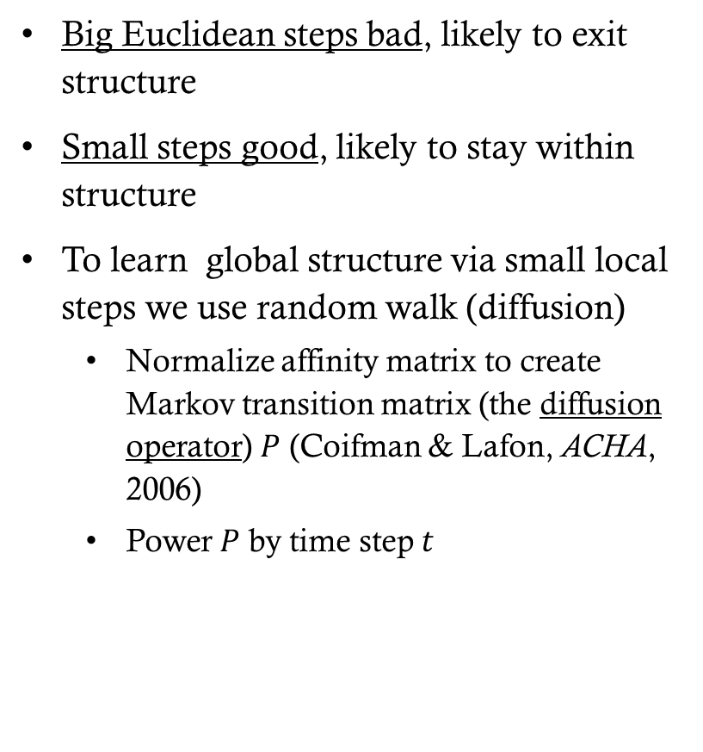
Diffusion Denoises and Recovers Global Structure
Big Euclidean steps bad, likely to exit structure
Small steps good, likely to stay within structure
To learn global structure via small local steps we use random walk (diffusion)
Normalize affinity matrix to create Markov transition matrix (the diffusion operator) $P$ (Coifman & Lafon, ACHA, 2006)
Power $P$ by time step $t$
Notes:
In diffusion, we are looking at all possible random walks. This like an ensemble approach where any given random walk may not encode the information well, but taking multiple random walks gives you more robust results, and denoises the data

Slide 46
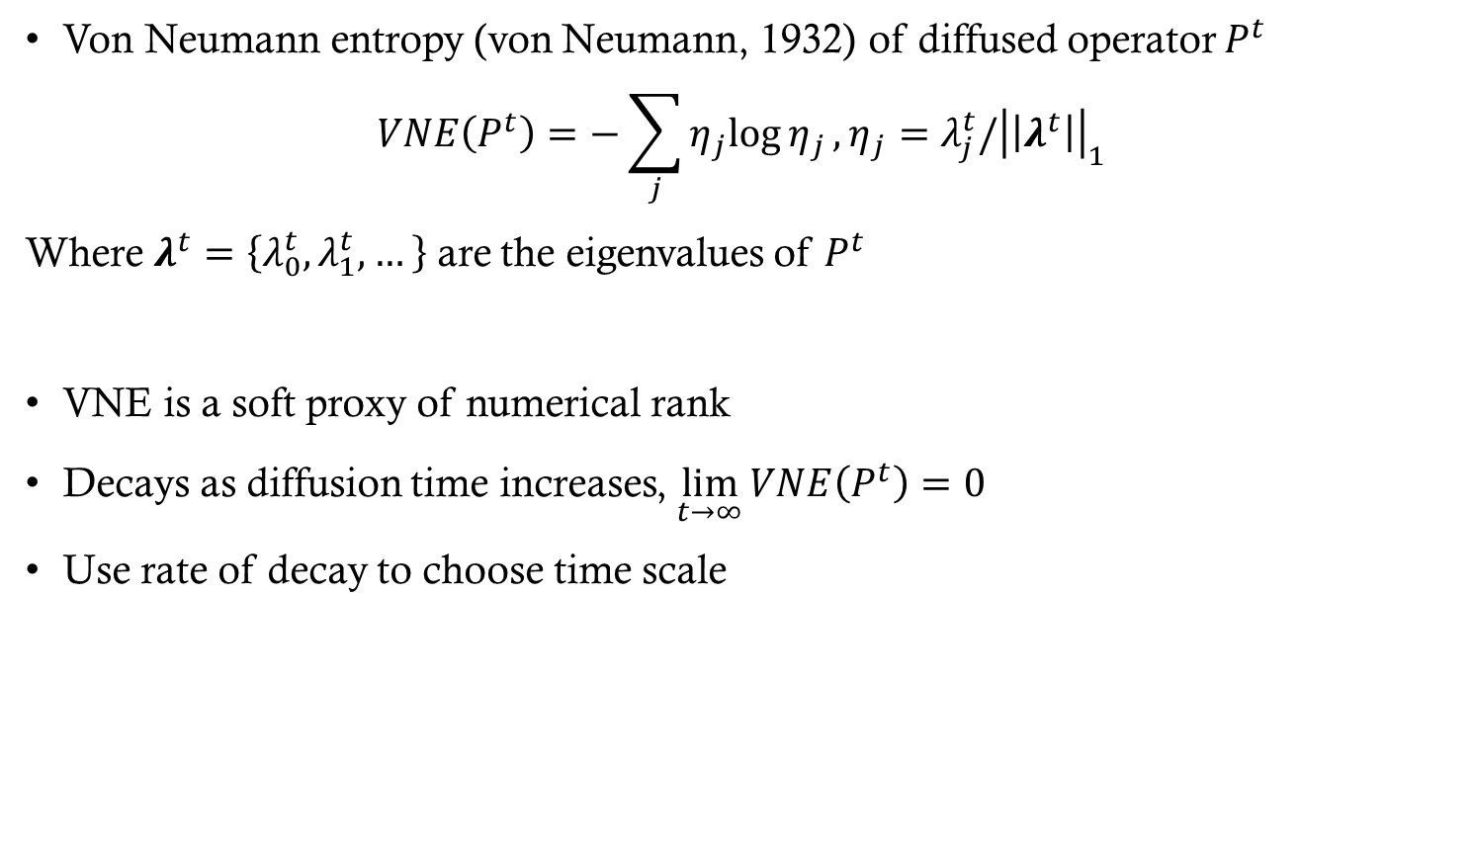
How much diffusion?
Von Neumann entropy (von Neumann, 1932) of diffused operator $P^{t}$
$$VNE\left(P^{t}\right)=−\sum_{j}{η_{j}log{η_{j}}}, η_{j}=λ_{j}^{t}/{\left|\left|λ^{t}\right|\right|}_{1}$$
Where $λ^{t}=\left\{λ_{0}^{t},λ_{1}^{t},…\right\}$ are the eigenvalues of $P^{t}$
VNE is a soft proxy of numerical rank
Decays as diffusion time increases, $\lim_{t→∞}{VNE\left(P^{t}\right)=0}$
Use rate of decay to choose time scale

Slide 47
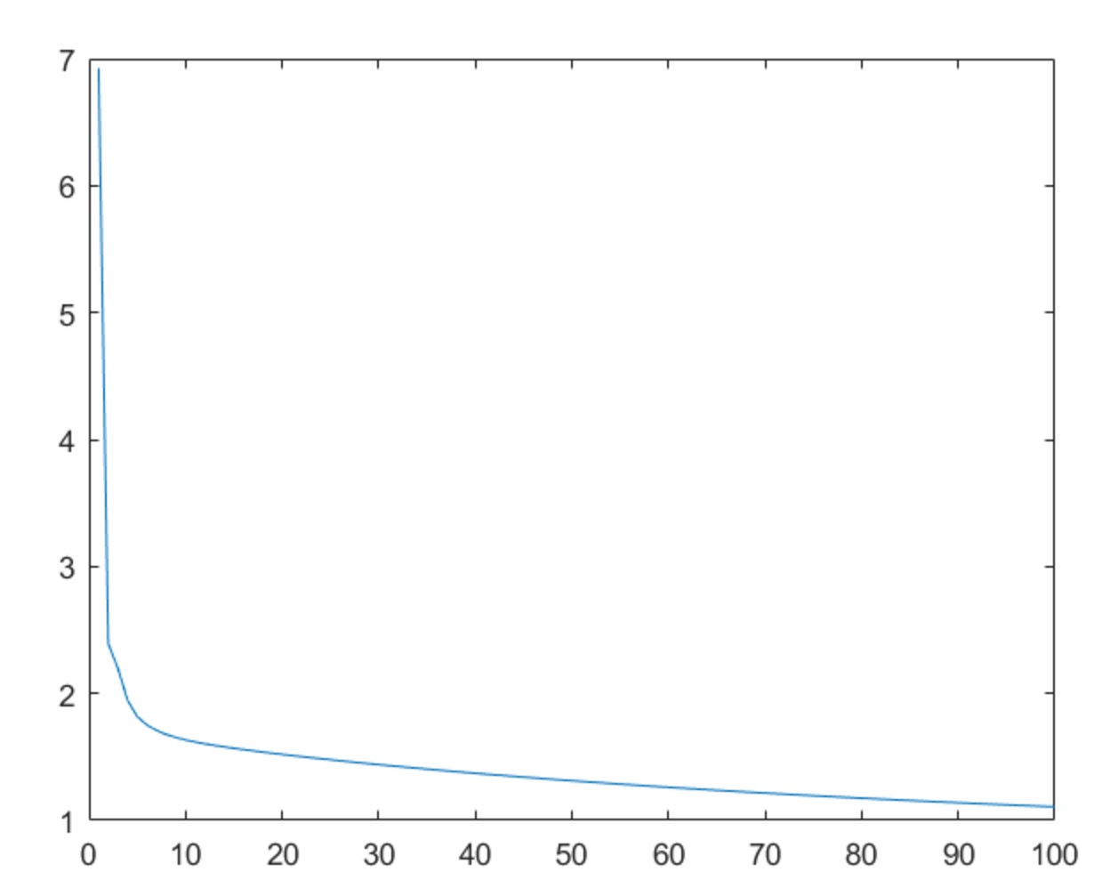
How much diffusion?
Embedding is visually robust in the flatter region
Rapid decline corresponds to denoising
Von Neumann Entropy
Flatter region corresponds to losing real signal
Time of diffusion

Slide 48
The PHATE Algorithm
Transform to low dimensions

Slide 49
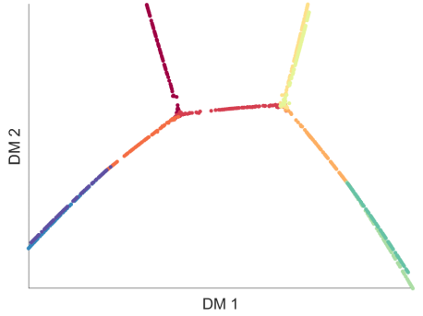
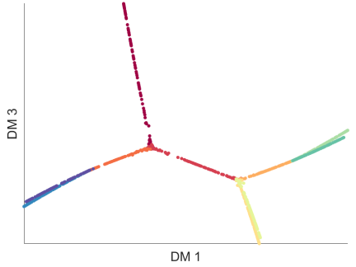
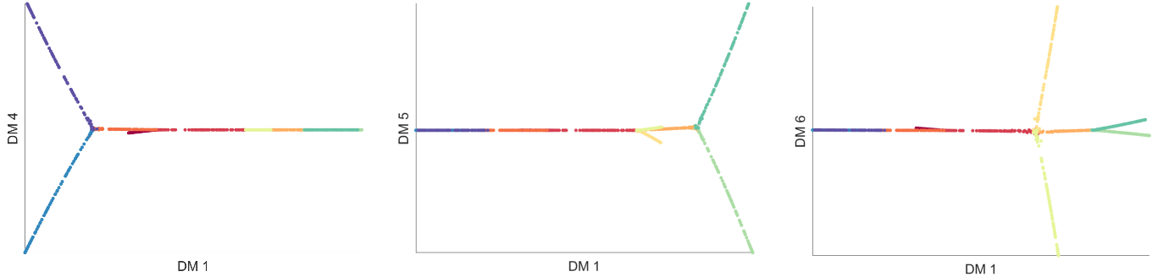
Potential Distances
Diffusion operator contains global and local structure
Encoded in multiple dimensions

Slide 50
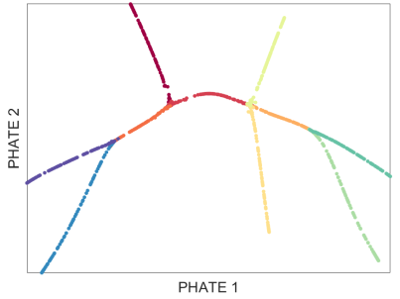
Potential Distances
Diffusion operator contains global and local structure
Encoded in multiple dimensions
To extract this information, we transform diffused probabilities using a potential transformation
Forms an information distance between diffused probabilities
Connected to heat potential
Embed for visualization using multidimensional scaling (MDS)

