Slide 1
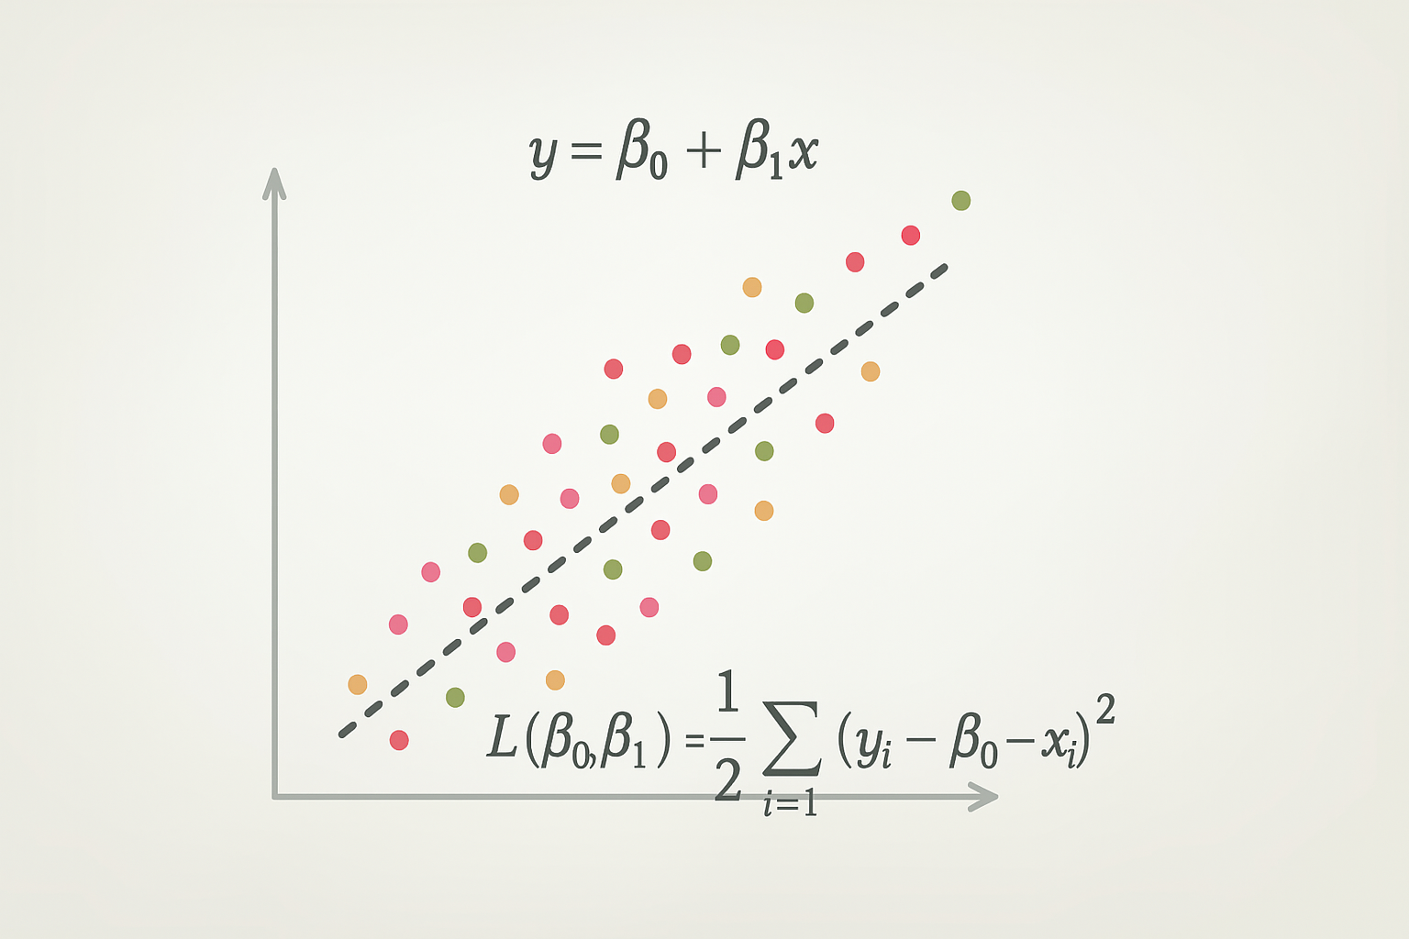
Intro to regression

Slide 2
Linear Regression

Slide 3
Linear Regression
Linear regression is a supervised learning approach for predicting a quantitative response
Linear regression has been around for a long time
    Still very widely used
    Best method for truly linear relationships
    Many "fancier" methods are based on linear regression

Slide 4
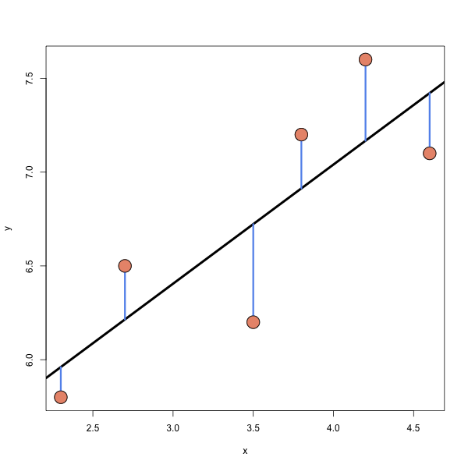
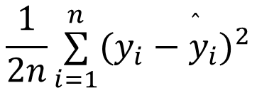
Least Squares
Least squares line is the line that minimizes
$$\frac{1}{2n}\overset{n}{\underset{i=1}{∑}}(y_{i}−{\overset{̂}{y}}_{i})^{2}$$

Slide 5
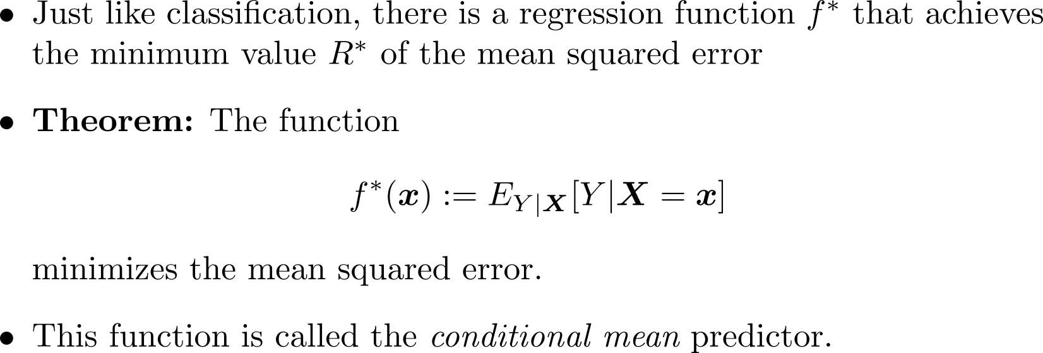
Conditional Mean

Slide 6
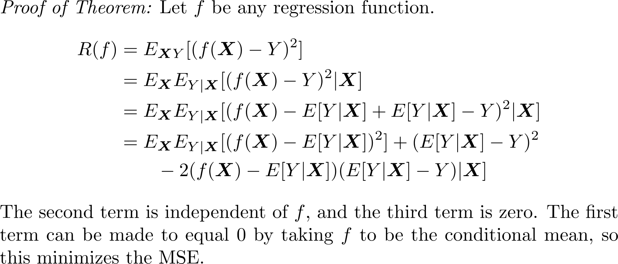
Conditional Mean

Slide 7
Training a Linear Regression Model

Slide 8
General model-based training
Define an appropriate objective function
  Cost/Loss functions are minimized (machine learning)
  Utility/Fitness functions are maximized (statistics)
    For example, the likelihood in MLE is a utility function
“Train” the model by solving the optimization problem using an appropriate optimization method
  a “closed-form” solution (rare)
  a numerical method (usually)
    Gradient descent or variants (Adam, Newton’s method)

Slide 9
Optimizing the objective function
Minimum vs. Minimizer
Given a function, f, how do we minimize the function?
What if there is no analytic solution? (I.e., no closed form?)
A minimizer is the value x that produces the smallest output f(x).
Differential calculus!
Numerical approaches.

Slide 10


Ordinary least squares objective
What does it mean to “fit” a line to data?
How do we measure goodness?
Why use ${\left(y−\hat{y}\right)}^{2}$and not $\left|y−\hat{y}\right|$ ?
The objective function:
We want $\hat{y}=Xβ$ to be a good approximation.
We want $y−\hat{y}$ to be small.
Differentiability/punishing larger errors.
$$J\left(β\right)=\frac{1}{2n}​{\left(y−Xβ\right)}^{T}\left(y−Xβ\right)$$

Slide 11

Method 1: Normal Equations
Matrix notation cost function:
$J(β)=\frac{1}{2n}(y−Xβ)^{T}(y−Xβ)$
Derivative of Cost Function:
$∇J(β)=\frac{1}{n}X^{T}(Xβ−y)$
Set equal to 0 an rearrange (normal equations):
$(X^{T}X)\overset{̂}{β}=X^{T}y$
Solution for $\overset{̂}{β}$:
$\overset{̂}{β}=(X^{T}X)^{−1}X^{T}y$

Slide 12
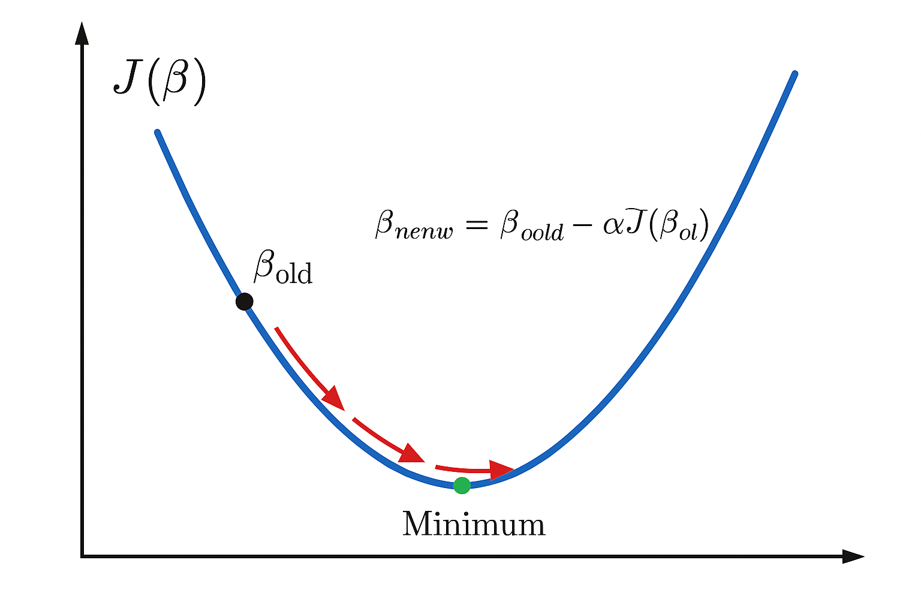
Method 2: Gradient Descent (High level)
Numerical optimization algorithm that tweaks parameters iteratively until the minimum is found
  “Descend” the gradient of the cost function in the steepest direction until the minimum is reached
What is the gradient?
  The vector that points in the direction of the greatest rate of increase for a function
  It is the vector of partial derivatives

Slide 13
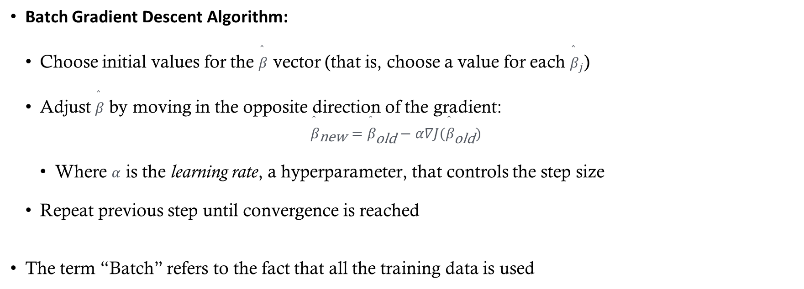
Method 2: Gradient Descent
Batch Gradient Descent Algorithm:
  Choose initial values for the $\overset{̂}{β}$ vector (that is, choose a value for each ${\overset{̂}{β}}_{j}$)
  Adjust $\overset{̂}{β}$ by moving in the opposite direction of the gradient:
  ${\overset{̂}{β}}_{\text{new}}={\overset{̂}{β}}_{\text{old}}−α∇J({\overset{̂}{β}}_{\text{old}})$
    Where $α$ is the learning rate, a hyperparameter, that controls the step size
  Repeat previous step until convergence is reached
The term “Batch” refers to the fact that all the training data is used

Slide 14
Learning Rate
If the learning rate is too high, the gradient descent algorithm will bounce around the minimum and never converge
  (See Figure 4-5 in HOML)
If the learning rate is too low, it could take a very long time to find the minimum
  (See Figure 4-4 in HOML)
It is common to start with a small learning rate (~0.01) and adjust based on the performance of the model

Slide 15
Gradient Descent Variations
Stochastic Gradient Descent (SGD)
  How it works:
    Chooses one random instance at each step.
    Computes the gradient based on that single instance.
  Pros:
    Faster per update (small computation).
    Randomness helps escape local minima on complex cost surfaces.
  Cons:
    Updates are noisy; the algorithm never fully “settles.”
    True minimum is rarely reached—oscillates around it.

Slide 16
Gradient Descent Variations
Mini-Batch Gradient Descent
  How it works:
    Chooses a small random subset (mini-batch) of training data at each step.
    Computes the gradient based on that subset.
  Pros:
    More stable than SGD (less noisy updates).
    Faster than full batch gradient descent for large datasets.
    Leverages vectorized operations for efficiency.
  Cons:
    Still introduces some randomness, so convergence is not perfectly smooth.
    Requires tuning batch size (too small = noisy, too large = slow).

Slide 17
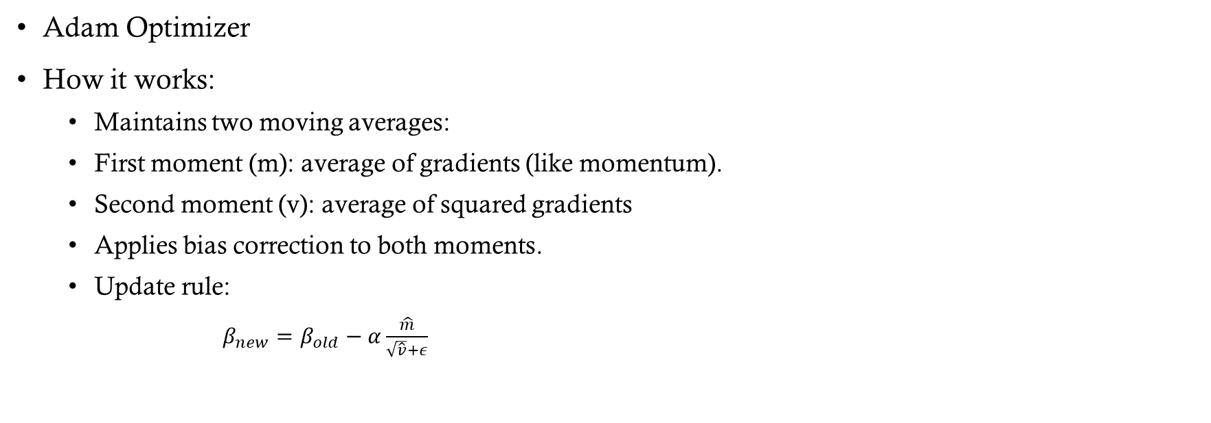
Gradient Descent Variations
Adam Optimizer
How it works:
  Maintains two moving averages:
  First moment (m): average of gradients (like momentum).
  Second moment (v): average of squared gradients
  Applies bias correction to both moments.
  Update rule:
    $β_{new}=β_{old}−α\frac{\hat{m}}{\sqrt{\hat{v}}+ε}$

Slide 18
Learning Schedule
A way to help “settle” stochastic gradient descent
Gradually reduce the learning rate according to a function called the “learning schedule”
Additional Points:
  Common schedules include:
  Step decay: Reduce learning rate by a factor after a fixed number of epochs.
  Exponential decay: Multiply learning rate by a constant factor each epoch.
  Polynomial decay: Decrease learning rate following a polynomial function.
Modern techniques:
  Cosine Annealing: Learning rate follows a cosine curve, often combined with restarts.
  One-cycle policy: Increase learning rate initially, then decrease sharply for better convergence.
  Adaptive methods (Adam, RMSProp): Adjust learning rate per parameter automatically based on gradient history.

Slide 19
Regularization

Slide 20
Regularization
Adding constraints to model to "simplify" the model to help prevent overfitting
Regularization: Techniques that constrain a model to reduce overfitting and improve generalization.
  Explicit Regularization
  Implicit Regularization

Slide 21
Explicit Regularization
Intentionally and directly add a regularization term to the loss function
Explicitly modify the optimization objective
Examples (not exhaustive, but these are the most common):
      L1 Regularization (Lasso)
      L2 Regularization (Ridge)
      Elastic Net (combine L1 and L2 regularization)

Slide 22
Implicit Regularization
Any regularization method that does not explicitly modify the cost or objective function
Can be a byproduct of an algorithm, the learning process, or other choices made in training
Examples (not exhaustive):
    Early stopping (in gradient-based optimization, stop training before convergence is reached)
    Dropout (randomly ignoring some parts of a neural network)
    Pruning (simplifying a grown decision tree)
    Data augmentation (adding synthetic data to increase the sample size)

Slide 23
Example of Explicit Regularization in Linear Regression

Slide 24

Regularized Cost Functions
Least squares cost function: finds the 𝛽's that minimize
$J(β)=\frac{1}{n}\overset{n}{\underset{i=1}{∑}}{\left(y_{i}−β_{0}−\overset{p}{\underset{j=1}{∑}}β_{j}x_{ij}\right)}^{2}$

Slide 25
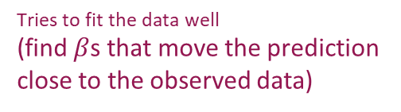
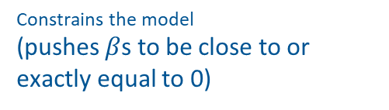
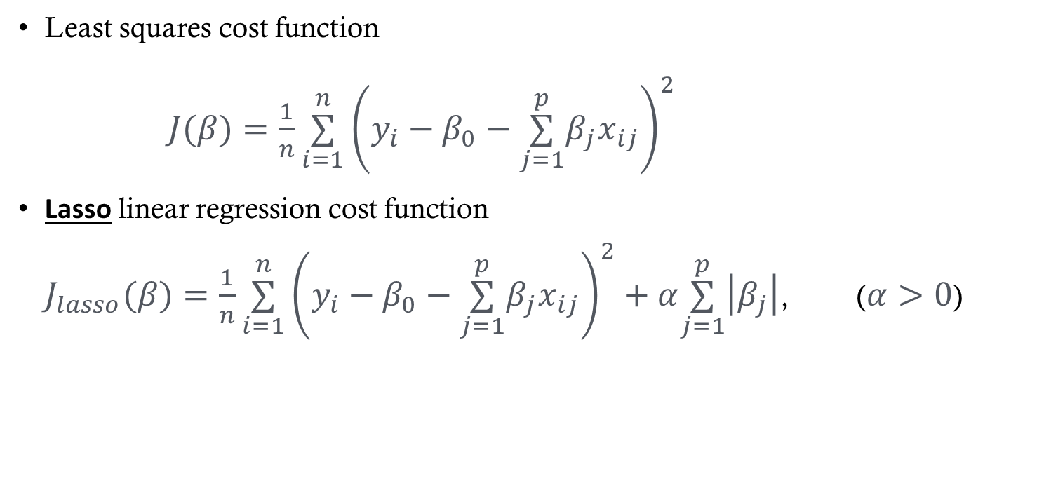
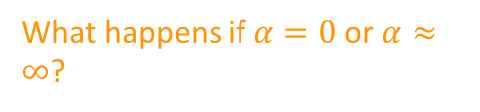
L1 Penalty: LASSO
Least squares cost function
$J(β)=\frac{1}{n}\overset{n}{\underset{i=1}{∑}}{\left(y_{i}−β_{0}−\overset{p}{\underset{j=1}{∑}}β_{j}x_{ij}\right)}^{2}$
Lasso linear regression cost function
$J_{lasso}(β)=\frac{1}{n}\overset{n}{\underset{i=1}{∑}}{\left(y_{i}−β_{0}−\overset{p}{\underset{j=1}{∑}}β_{j}x_{ij}\right)}^{2}+α\overset{p}{\underset{j=1}{∑}}\left|β_{j}\right|$, ($α>0$)
Tuning parameter that controls relative impact of two criteria
What happens if $α=0$ or $α≈∞$?
Tries to fit the data well
(find $β$s that move the prediction close to the observed data)
Constrains the model
(pushes $β$s to be close to or exactly equal to 0)

Slide 26
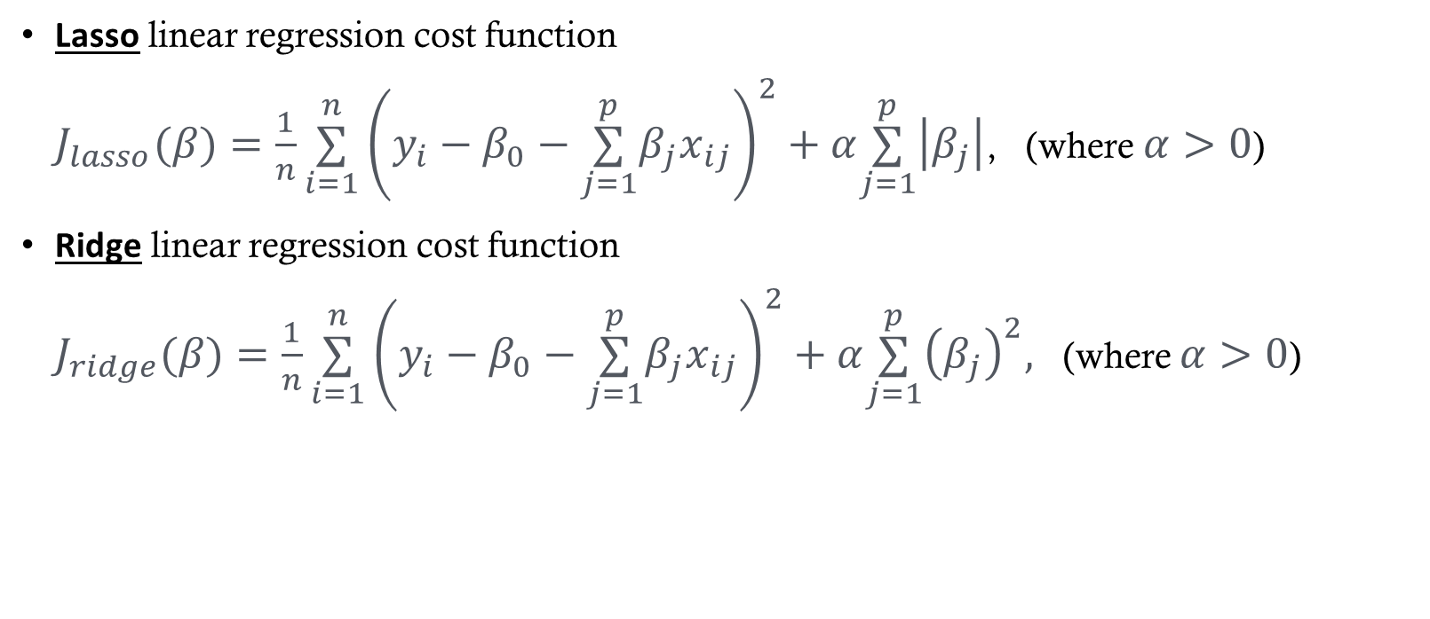
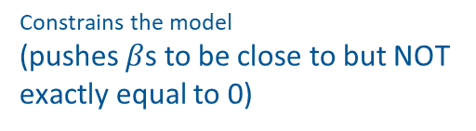
Regularized Cost Functions
ℓ1 penalty
Lasso linear regression cost function
$J_{lasso}(β)=\frac{1}{n}\overset{n}{\underset{i=1}{∑}}{\left(y_{i}−β_{0}−\overset{p}{\underset{j=1}{∑}}β_{j}x_{ij}\right)}^{2}+α\overset{p}{\underset{j=1}{∑}}\left|β_{j}\right|$, (where $α>0$)
Ridge linear regression cost function
$J_{ridge}(β)=\frac{1}{n}\overset{n}{\underset{i=1}{∑}}{\left(y_{i}−β_{0}−\overset{p}{\underset{j=1}{∑}}β_{j}x_{ij}\right)}^{2}+α\overset{p}{\underset{j=1}{∑}}{\left(β_{j}\right)}^{2},$ (where $α>0$)
ℓ2 penalty
Constrains the model
(pushes $β$s to be close to but NOT exactly equal to 0)

Slide 27
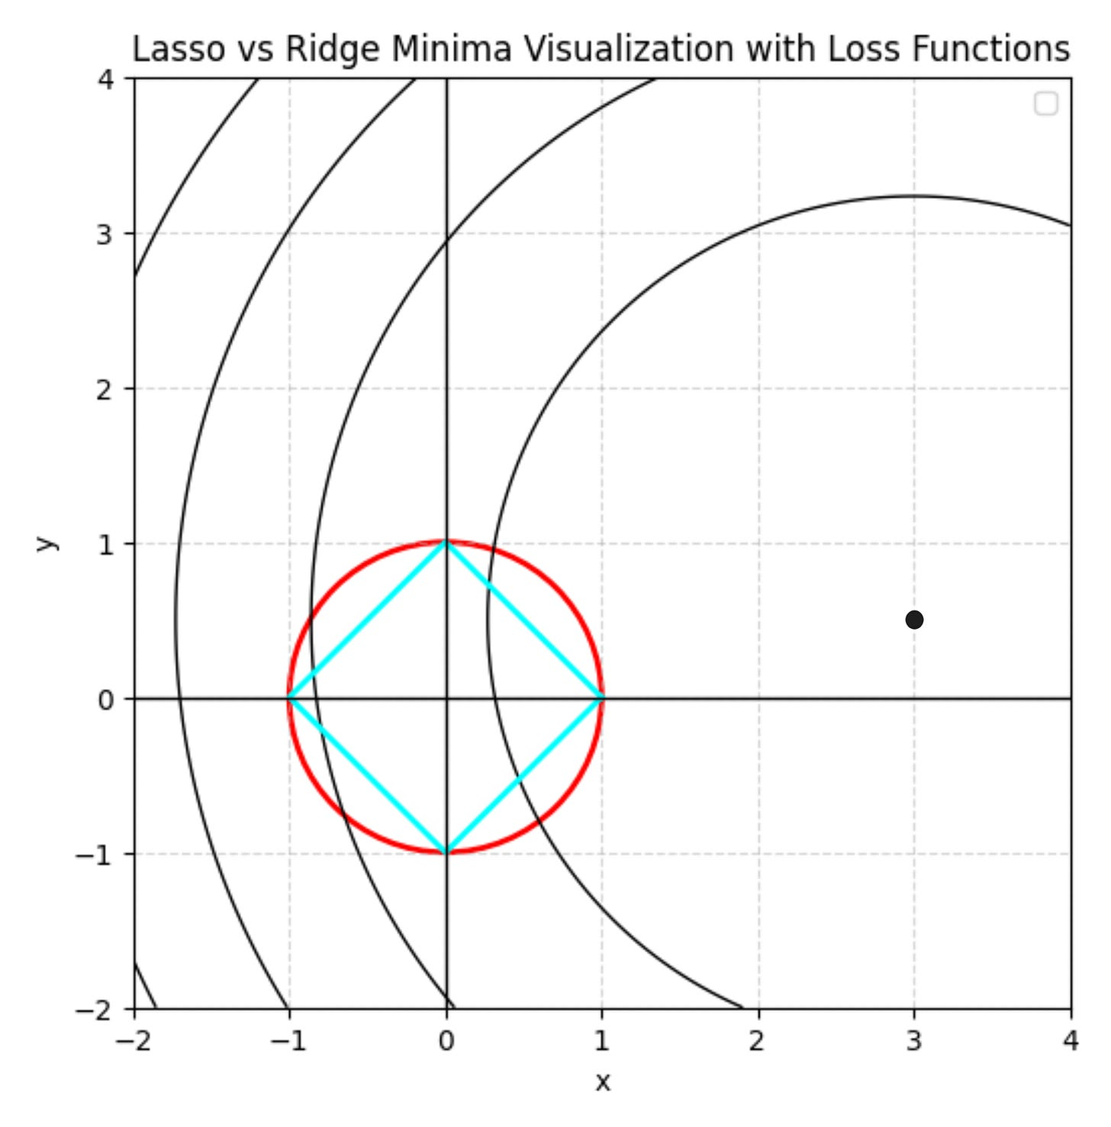
Lasso v. Ridge Visualization
Let’s explore this further in Desmos: https://www.desmos.com/3d
https://www.vizuaranewsletter.com/p/if-regularization-is-easy-can-you: This is a great source for an intuitive description!

Slide 28
Ridge vs Lasso
Lasso
  Forces some coefficients to be exactly 0 (advantage)
  Built in variable selection
  Coefficients can be very different for correlated features (disadvantage)
Ridge
  Coefficients will never be exactly 0 (fact)
  Tends to estimate similar coefficient for correlated features (advantage)
Neither method will universally dominate
Lasso generally performs better when many of the features don’t contribute to predictability
Ridge generally performs better when many of the features contribute to the prediction and when features are correlated

Slide 29
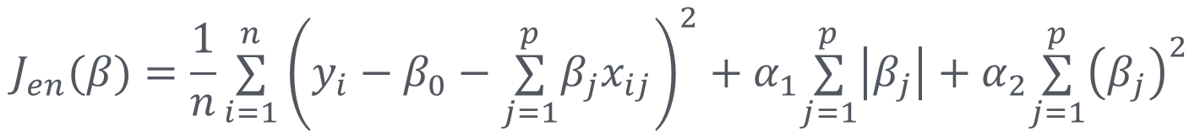
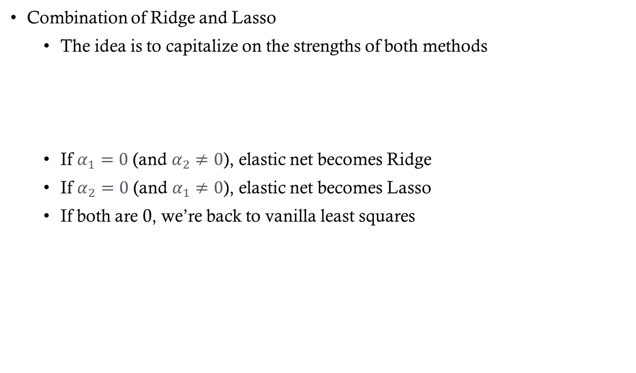
Elastic-Net Regularization
Combination of Ridge and Lasso
    The idea is to capitalize on the strengths of both methods
    If $α_{1}=0$ (and $α_{2}≠0$), elastic net becomes Ridge
    If $α_{2}=0$ (and $α_{1}≠0$), elastic net becomes Lasso
    If both are 0, we’re back to vanilla least squares
$$J_{en}(β)=\frac{1}{n}\overset{n}{\underset{i=1}{∑}}{\left(y_{i}−β_{0}−\overset{p}{\underset{j=1}{∑}}β_{j}x_{ij}\right)}^{2}+α_{1}\overset{p}{\underset{j=1}{∑}}\left|β_{j}\right|+α_{2}\overset{p}{\underset{j=1}{∑}}{\left(β_{j}\right)}^{2}$$

Slide 30
Regularization Generally
We’ve just looked at Lasso, Ridge, and Elastic net (explicit regularization) in the context of linear regression
Regularization is a general set of methodologies, not limited to linear regression
  Used in many models: logistic regression, neural networks, decision trees, etc.
  Goal: improve generalization by reducing overfitting
  Can be applied to weights, complexity, or even the training process

Slide 31
“Nonlinear” linear regression

Slide 32
Polynomial Regression
Sometimes the relationship between X and y is non-linear
We can use linear regression to model non-linear relationships (between X and y)
  Add quadratic, cubic, etc. terms to the model
  This is sometimes called polynomial regression
  (Now we are moving into the realm of multiple regression, where we have more than one predictor)
$$y_{i}=β_{0}+β_{1}x_{i}+β_{2}x_{i}^{2}+β_{3}x_{i}^{3}+ε_{i}$$

Slide 33
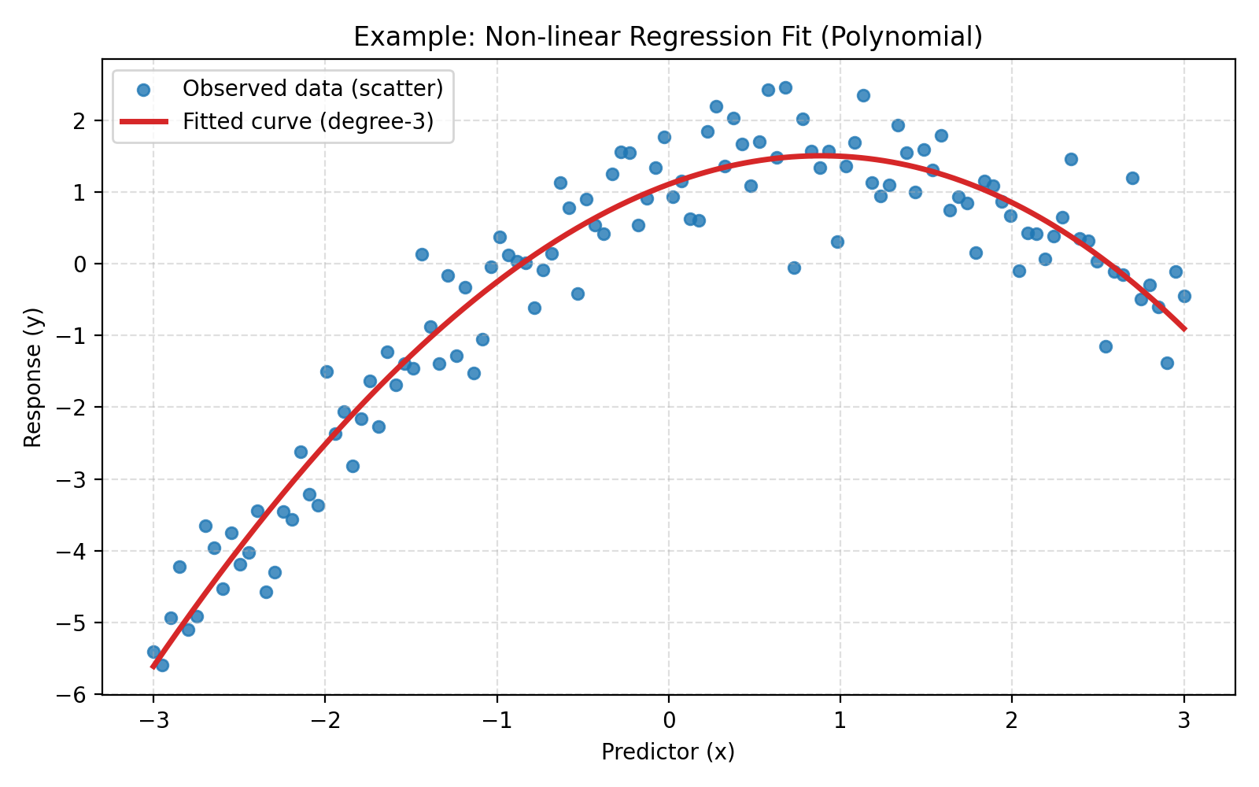
Polynomial Regression
$$y_{i}=β_{0}+β_{1}x_{i}+β_{2}x_{i}^{2}+ε_{i}$$

Slide 34
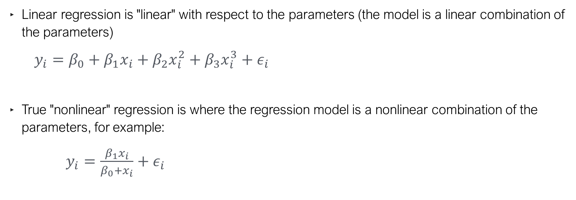
Terminology
Linear regression is "linear" with respect to the parameters (the model is a linear combination of the parameters)
$y_{i}=β_{0}+β_{1}x_{i}+β_{2}x_{i}^{2}+β_{3}x_{i}^{3}+ε_{i}$
True "nonlinear" regression is where the regression model is a nonlinear combination of the parameters, for example:
$y_{i}=\frac{β_{1}x_{i}}{β_{0}+x_{i}}+ε_{i}$

Slide 35
More Terminology
Just FYI:
  Multiple regression is a regression model with more than one predictor (or feature)
  Multivariate regression is a regression model with more than one response (or target)

Slide 36
Interaction & polynomial features
from sklearn.linear_model import LinearRegression
from sklearn.preprocessing import PolynomialFeatures
# Add squared and cubed features for every predictor plus interactions
poly = PolynomialFeatures(degree=3)
X = poly.fit_transform(X)
# Only include up to 3rd-order interactions
inter = PolynomialFeatures(degree=3, interaction_only=True)
X = inter.fit_transform(X)

Slide 37
Regression Metrics

Slide 38

Evaluating a regression model
In regression (we are predicting a numeric variable),
what does a “good” prediction look like?
Ideally, $\hat{y}$, (the prediction) is close to $y$ (the observed value)

Slide 39
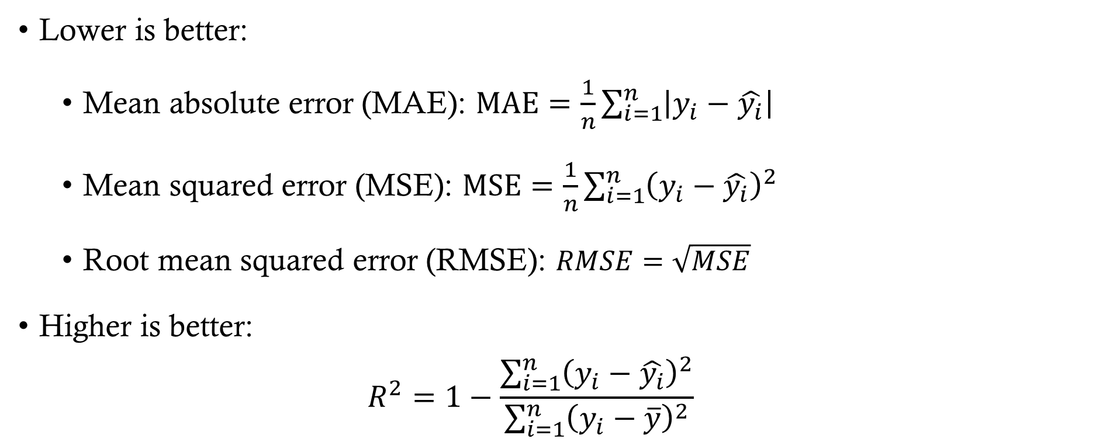
Common Regression Metrics
Lower is better:
  Mean absolute error (MAE): $\text{MAE}=\frac{1}{n}\sum_{i=1}^{n}{\left|y_{i}−\hat{y_{i}}\right|}$
  Mean squared error (MSE): $\text{MSE}=\frac{1}{n}\sum_{i=1}^{n}{{\left(y_{i}−\hat{y_{i}}\right)}^{2}}$
  Root mean squared error (RMSE): $RMSE=\sqrt{MSE}$
Higher is better:
  $$R^{2}=1−\frac{\sum_{i=1}^{n}{{\left(y_{i}−\hat{y_{i}}\right)}^{2}}}{\sum_{i=1}^{n}{{\left(y_{i}−\overline{y}\right)}^{2}}}$$

Slide 40
Regression Metric Comparisons
MAE (Mean Absolute Error) ✅ Easy to interpret (average absolute difference) ✅ Less sensitive to outliers than MSE ❌ Does not penalize large errors as strongly
R² (Coefficient of Determination) ✅ Measures proportion of variance explained ✅ Easy to compare across models ❌ Can be misleading for non-linear
MSE (Mean Squared Error) ✅ Penalizes large errors more (squared term) ✅ Commonly used in optimization (differentiable) ❌ Sensitive to outliers
RMSE (Root Mean Squared Error) ✅ Same units as target variable ✅ Highlights large errors clearly ❌ Still sensitive to outliers

Slide 41
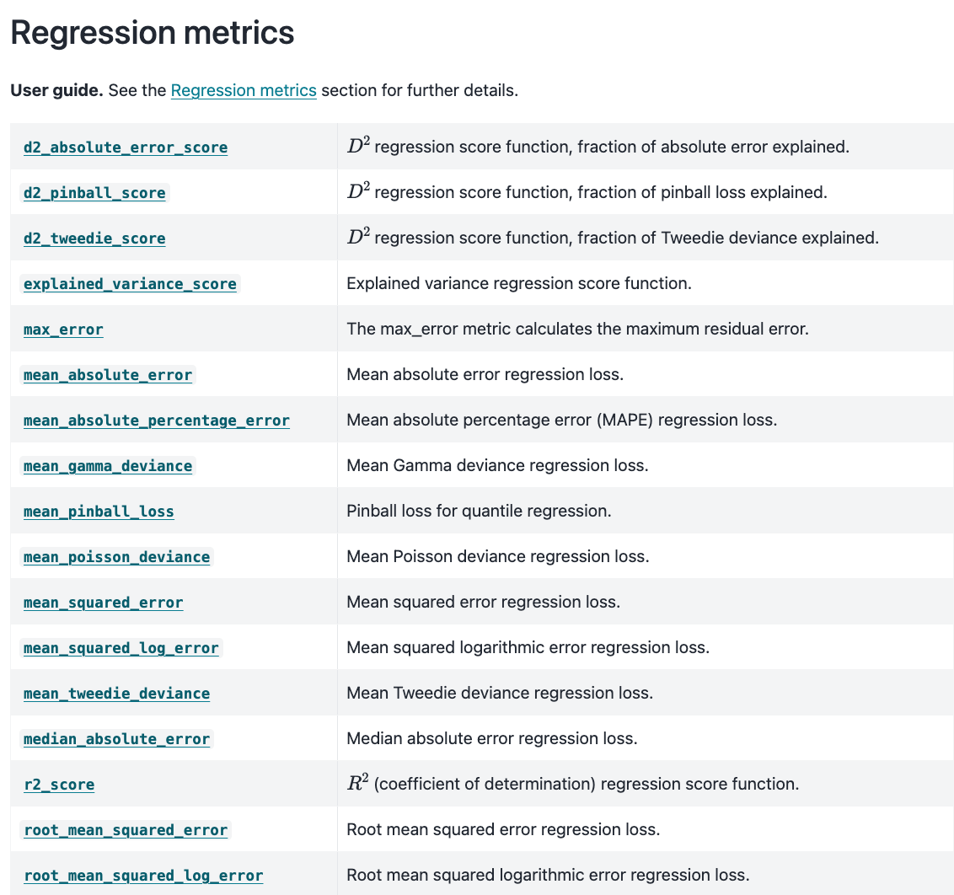
Regression Metrics in Scikit-Learn
In v1.4 or greater (previous versions have a “squared” argument in the MSE function)

Slide 42
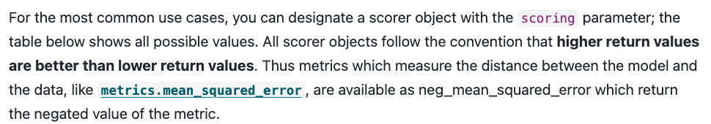
Model Selection Metrics
Models selection tools, such as “GridSearchCV” and “cross_val_score” use a scoring parameter

