Slide 1
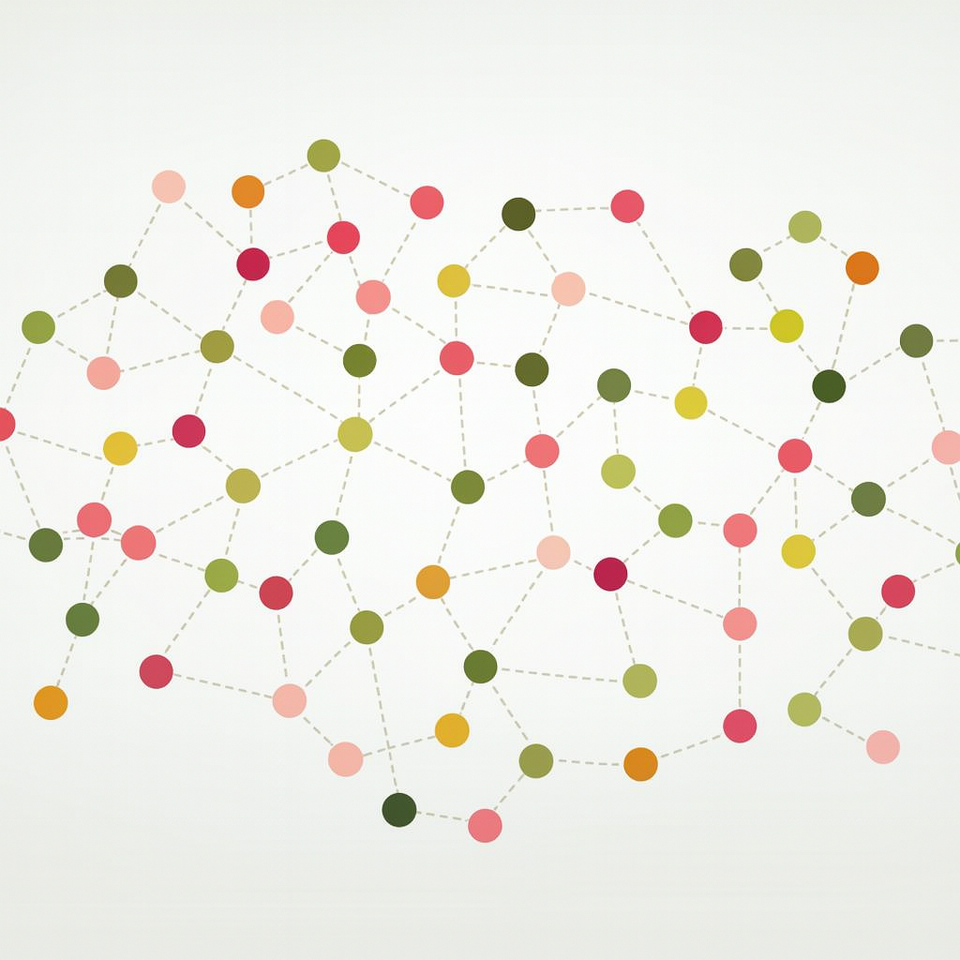
K-Nearest Neighbors

Slide 2
Instance-based vs Model-based
Instance-Based
Model-Based

Slide 3
K-Nearest Neighbors

Slide 4
KNN or k-NN or kNN
K Nearest Neighbors is a supervised instance-based ML model
It is general fairly quick fit and predict
It often does a surprisingly good job
Can be used for both regression and classification tasks

Slide 5
K-NN Method
TRAINING ALGORITHM
Standardize and Store the data
      KNN is called a lazy learner because it doesn’t actually do anything until the prediction phase
      Why is standardizing (or scaling) important?

Slide 6
K-NN Method
PREDICTION ALGORITHM
Calculate the distance from the value to be predicted to all the points in the training data
      How should we calculate distance?
Find the k-nearest training data points
Predict the target value for the new point:
      Regression:
      Classification:

Slide 7
k-nn regression

Slide 8



Visualization of KNN
Values of $y$
Training data
8
4
9
7
$$x_{1}$$
6
5
6
2
4
3
4
4
$$x_{2}$$

Slide 9
Visualization of KNN
Values of $y$
Training data
8
4
9
7
$$x_{1}$$
6
?
5
6
4
4
3
4
2
$$x_{2}$$

Slide 10
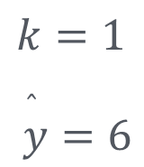
Visualization of KNN
Values of $y$
Training data
8
4
9
7
$$k=1$$
$$\overset{̂}{y}=6$$
$$x_{1}$$
6
?
5
6
4
4
3
4
2
$$x_{2}$$

Slide 11
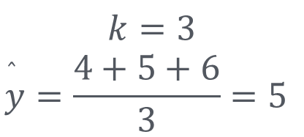
Visualization of KNN
Values of $y$
Training data
8
4
9
7
$$k=3$$
$$\overset{̂}{y}=\frac{4+5+6}{3}=5$$
$$x_{1}$$
6
?
5
6
4
4
3
4
2
$$x_{2}$$

Slide 12
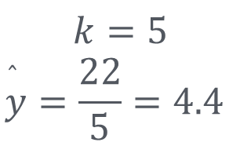
Visualization of KNN
Values of $y$
Training data
8
4
9
7
$$k=5$$
$$\overset{̂}{y}=\frac{22}{5}=4.4$$
$$x_{1}$$
6
?
5
6
4
4
3
4
2
$$x_{2}$$

Slide 13
k-nn classification

Slide 14
Visualization of KNN
Values of $y$
Training data
$$x_{1}$$
$$x_{2}$$

Slide 15
Visualization of KNN
Values of $y$
Training data
$$x_{1}$$
?
$$x_{2}$$

Slide 16
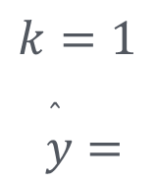
Visualization of KNN
Values of $y$
Training data
$$k=1$$
$$\overset{̂}{y}=$$
$$x_{1}$$
?
$$x_{2}$$

Slide 17
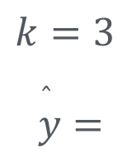
Visualization of KNN
\
Values of $y$
Training data
$$k=3$$
$$\overset{̂}{y}=$$
$$x_{1}$$
?
$$x_{2}$$

Slide 18
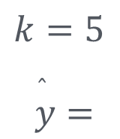
Visualization of KNN
Values of $y$
Training data
$$k=5$$
$$\overset{̂}{y}=$$
$$x_{1}$$
?
$$x_{2}$$

Slide 19
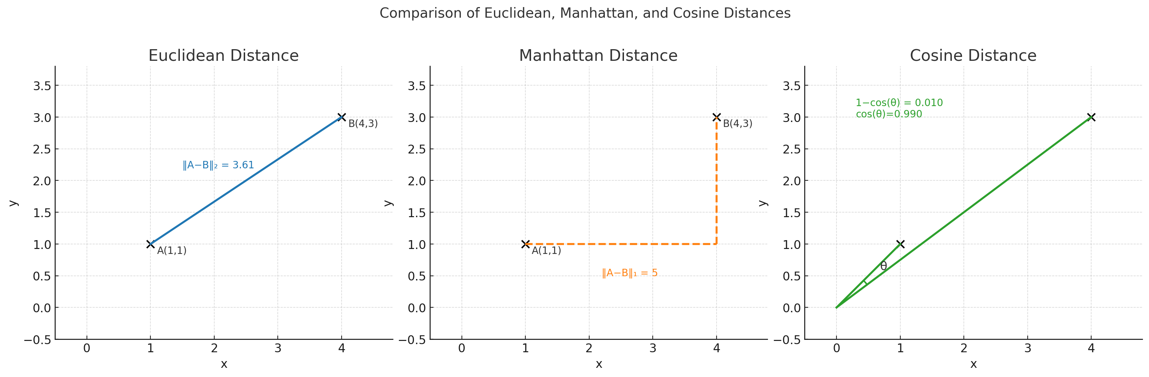
Choice of Distance
Euclidean most common
Cosine is often used for high-dimensional data

Slide 20
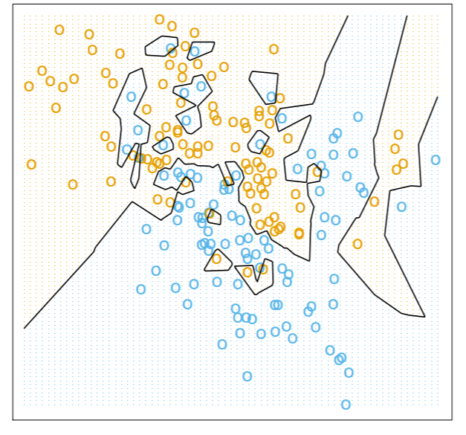
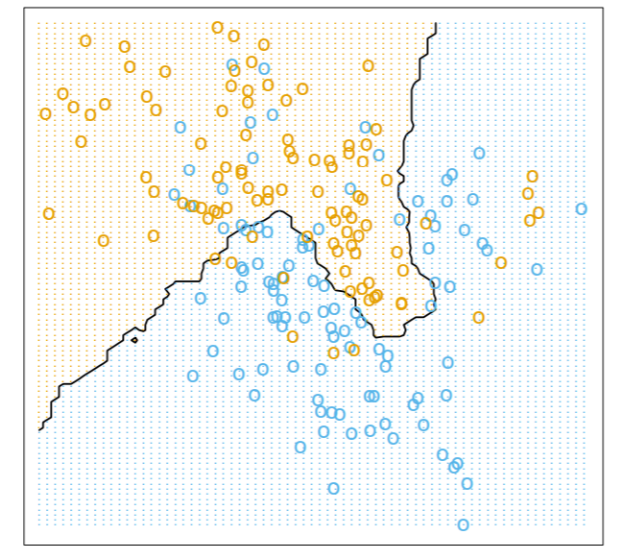
Effect of k on Decision Boundary
1 - NN
15 - NN
https://fderyckel.github.io/machinelearningwithr/knnchapter.html

Slide 21
KNN Considerations
For what types of data is kNN most suitable?
- Continuous, well-scaled numerical data with moderate dimensionality.
Why does kNN struggle in high-dimensional spaces?
- Distances lose meaning (“curse of dimensionality”), making neighbors unreliable.
What happens when the dataset is very large?
- kNN must compute distances to all points → slow predictions.
How does noise or irrelevant features affect kNN?
- They distort distance calculations and harm neighbor selection.
Why do we standardize or normalize features before using kNN?
- To ensure features contribute fairly; prevents scale dominance.
How does class imbalance impact kNN?
- Majority-class neighbors dominate, biasing predictions.
How does the choice of k affect outcomes?
- Low k: overfit, high k: underfit
Is kNN discriminative or generative?
- Discriminative
Is kNN parametric or non-parametric?
- Non-parametric

Slide 22
K-NN SUMMARY
Choosing k :
  • Small k : Sensitive to noise, can overfit.
  • Large k : Smooths boundaries, but may underfit.
Distance Metrics: Common ones are:
  • Euclidean Distance (default in Scikit-learn)
  • Manhattan Distance
  • Minkowski Distance (generalization)
  • Cosine Distance (based on angles)
IMPORTANT Scaling Features: Since KNN is distance-based, ensure features are on a similar scale (e.g., use Min-Max Scaling or Standardization).
Advantages:
• Simple to understand and implement.
• No explicit training phase; training data is directly used.
Disadvantages:
• Computationally expensive for large datasets.
• Sensitive to irrelevant features and feature scaling.

