Slide 1
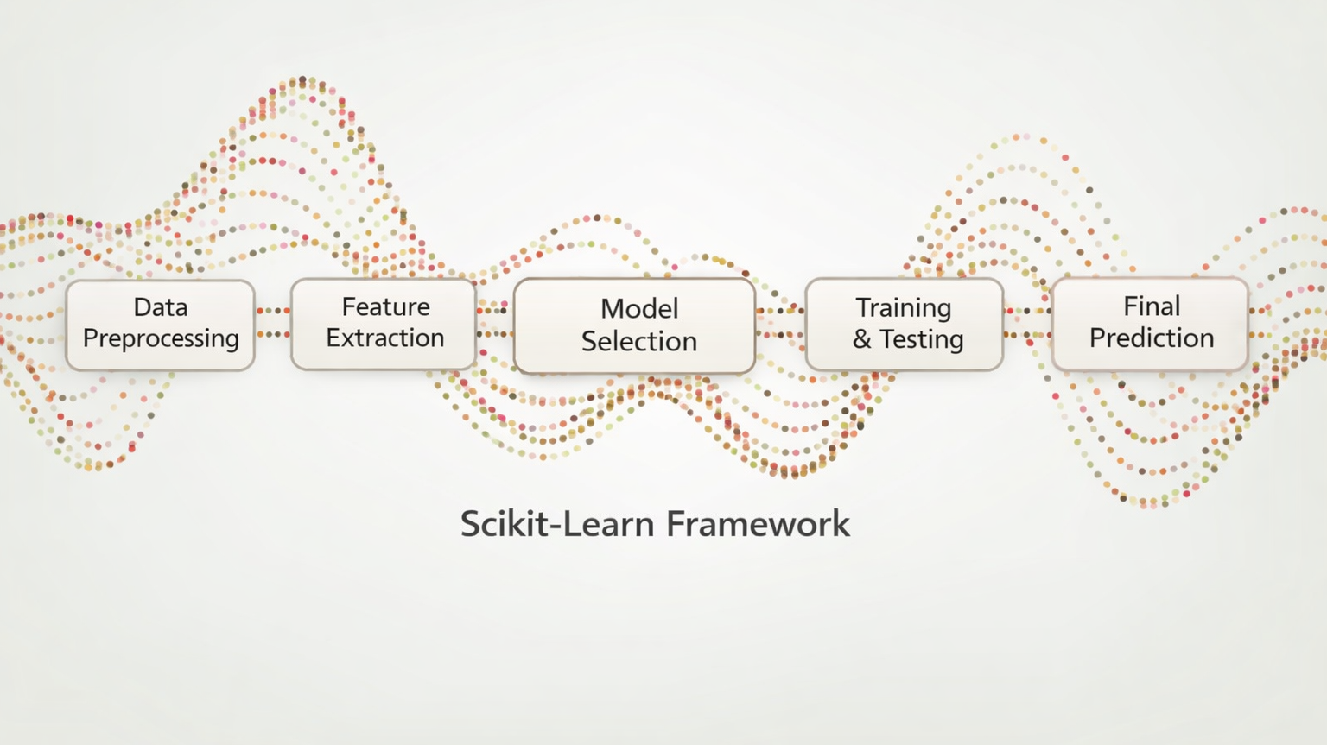
Introduction to
Scikit-Learn

Slide 2
What is Scikit-Learn
Scikit-Learn is one of the best-known Python packages for machine learning
scikit-learn.org
It provides efficient versions of many common ML algorithms
It has a clean, uniform, and streamlined API
    Once you understand the syntax of Scikit-Learn, it is straightforward to use any model inside the library
In Python, Scikit-Learn is called with sklearn
    import sklearn

Slide 3
Scikit-Learn Design
Consistency:
* All objects share a consistent and sensible interface
Inspection:
* All hyperparameter and learned parameters are directly accessible (as attributes of the object)
* Learn parameters have an underscore suffix
Nonproliferation of classes:
* Datasets and hyperparameters are Pandas, Numpy, or base Python objects
Composition:
* Existing building blocks are reused as much as possible
Sensible defaults:
* Most parameters have reasonable default values

Slide 4
Scikit-Learn Design: Consistency
Estimators:
  Any object that can estimate some parameter based on a dataset
  The .fit() method performs the estimation
Transformers:
  Estimators that can also transform a dataset
  Transformation is performed with the .transform() method
  The .fit_transform() method fits and transforms in one step
  Example: StandardScaler
Predictors:
  Estimators that are capable of making predictions
  Has a .predict() method
  Usually have a built-in .score() method
  Example: KNeighborsClassifier

Slide 5
Object-oriented modeling
A model is an object:
  It has state (learned parameters)
  It has methods (fit, predict)
This allows:
  Reuse
  Inspection
  Composition (pipelines)
from sklearn.linear_model import LinearRegression
# Model instantiation
model = LinearRegression()
#Model fit
model.fit(X, y)
model.predict(X_new)
#Model learned parameters:
coefficients = model.coef_

Slide 6
Simple Scikit-Learn Usage
Prepare the data into a feature matrix and a target vector
Choose a model and import the estimator class from Scikit-Learn
Instantiate the model class and choose hyperparamters
(not all models classes have hyperparameters)
Fit the model by calling the .fit() method
Apply the model with the .predict() or the .transform() method
Class: Scikit-Learn makes extensive use of Python classes and object oriented programming principles
Hyperparameters: Also called tuning parameters are parameters of the learning algorithm and not the model. That is, its value is used to control the learning process and is chosen by the modeler rather than learned from the data.

Slide 7
Preparing your data
The data should be in tabular form
    Generally, Numpy or Pandas objects
    The rows should be the observations or samples
The feature matrix (X) should be a 2D Numpy array or a Pandas DataFrame
    This applies even when there is only 1 feature
    Note: if only one feature, it often must be reshaped using .reshape(-1, 1)
The target (Y) should be a 1D Numpy array or a Pandas Series

Slide 8
Example
import numpy as np
from sklearn.linear_model import LinearRegression
# Create simple data
X = np.array([1, 2, 3, 4, 5]).reshape(-1, 1) # feature matrix (n_samples, n_features)
y = np.array([2, 4, 6, 8, 10]) # target vector
# Instantiate and fit the model
model = LinearRegression()
model.fit(X, y)
# Make predictions
y_pred = model.predict(X)
# Inspect learned parameters
print("Slope:", model.coef_[0])
print("Intercept:", model.intercept_)

Slide 9
Become friends with the documentation
A large part of learning Scikit-Learn is getting comfortable with the documentation
The documentation is vast and sometimes intimidating but learning how to read it will help you know how to implement the right model for your situation
https://scikit-learn.org/stable/

