Slide 1
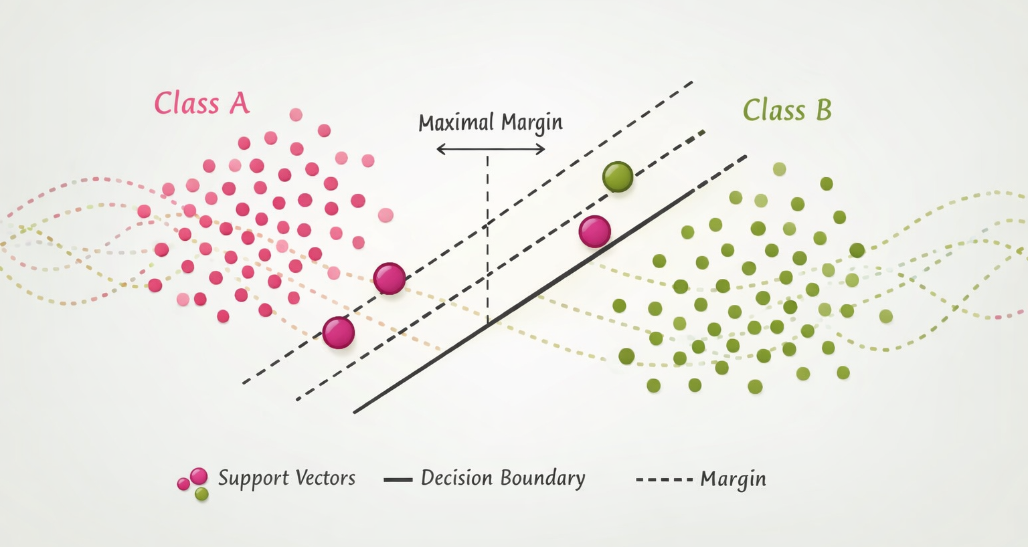
Support Vector Machines

Slide 2
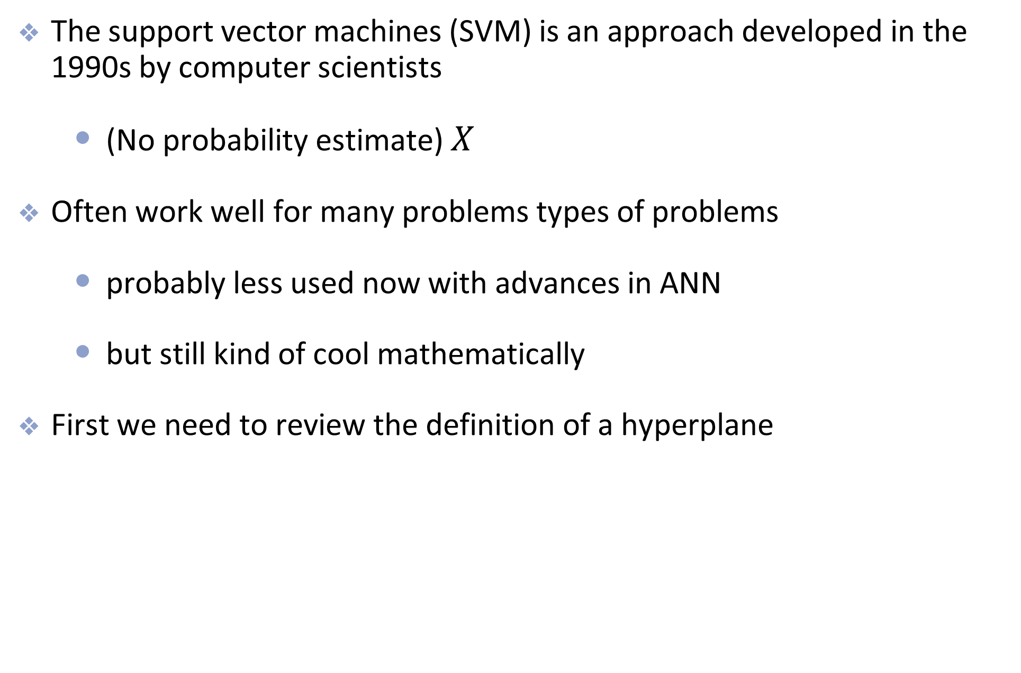
Introduction to SVM
The support vector machines (SVM) is an approach developed in the 1990s by computer scientists
(No probability estimate) $X$
Often work well for many problems types of problems
probably less used now with advances in ANN
but still kind of cool mathematically
First we need to review the definition of a hyperplane

Slide 3
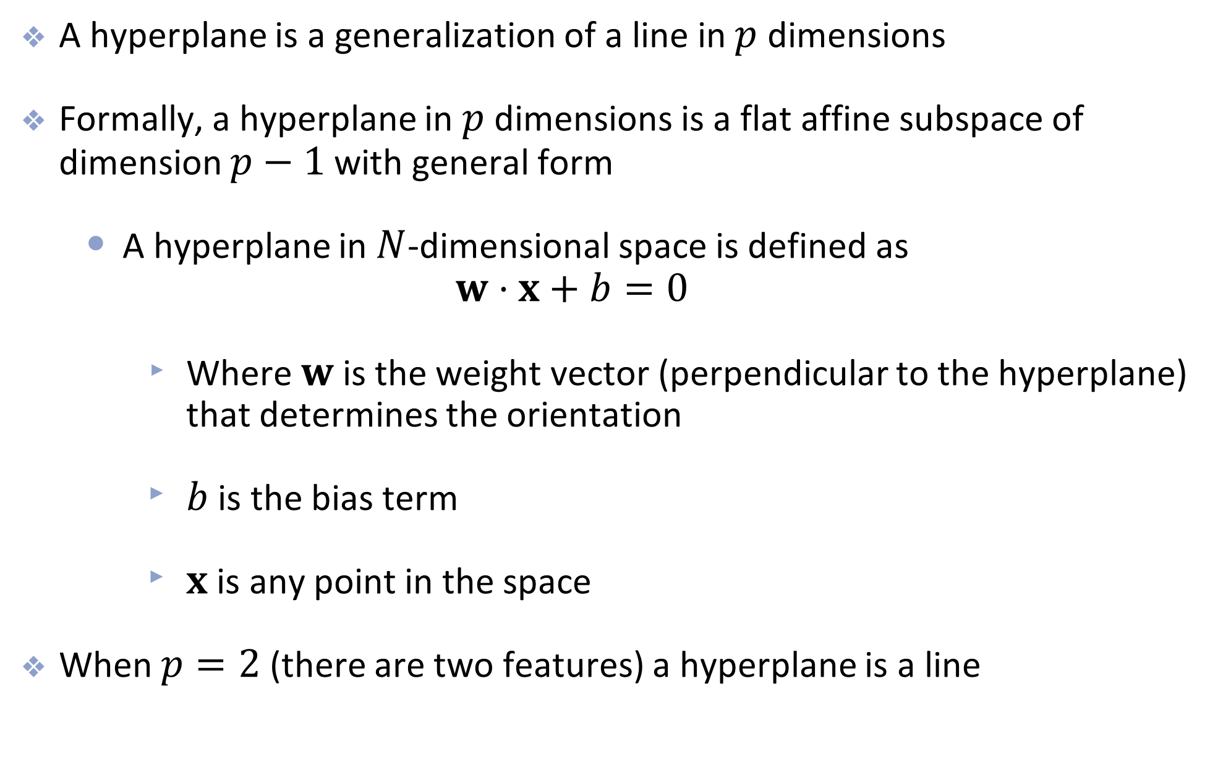
Hyperplanes
A hyperplane is a generalization of a line in $p$ dimensions
Formally, a hyperplane in $p$ dimensions is a flat affine subspace of dimension $p−1$ with general form
A hyperplane in $N$-dimensional space is defined as $w⋅x+b=0$
Where $w$ is the weight vector (perpendicular to the hyperplane) that determines the orientation
$b$ is the bias term
$x$ is any point in the space
When $p=2$ (there are two features) a hyperplane is a line

Slide 4
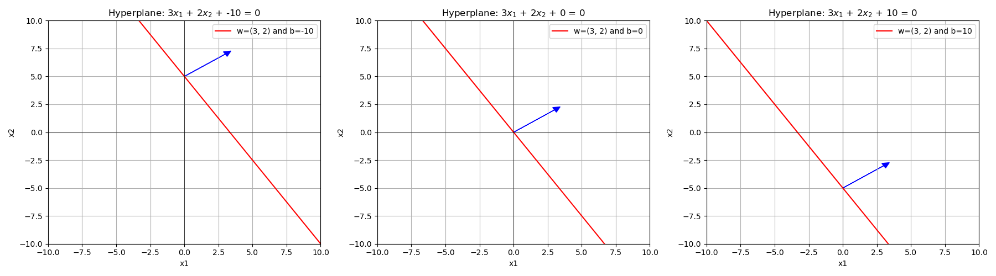
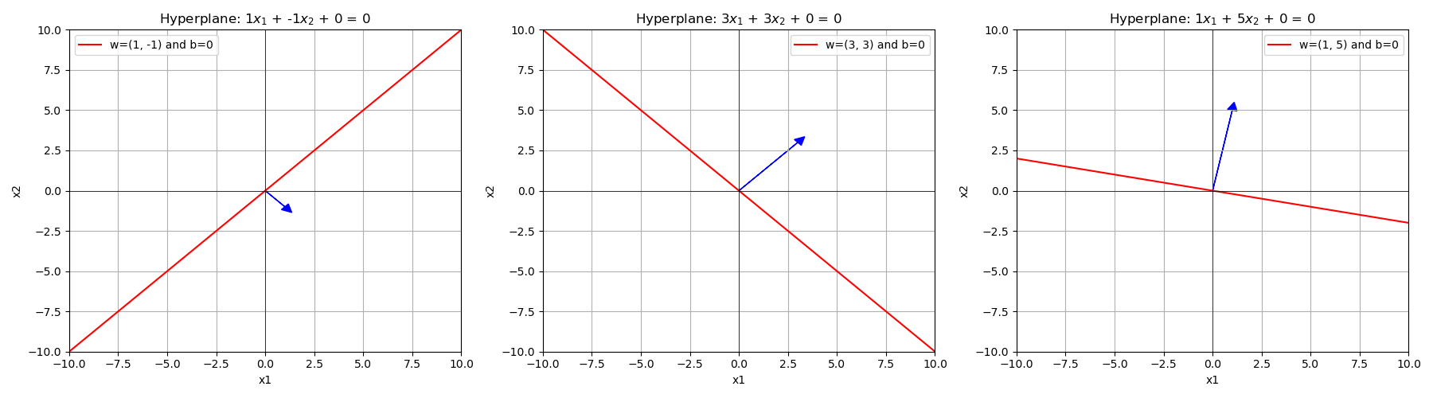
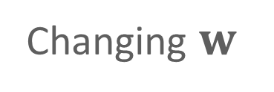
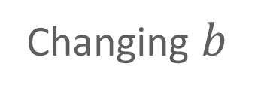
Changing $b$
Changing $w$

Slide 5
High-level view of SVM

Slide 6
Introduction to SVM
The main idea:
Find the hyperplane that completely and optimally separates two classes in a feature space

Slide 7
Separate the group
Consider two linearly separable groups
groups can be separated with a hyperplane
Which line (hyperplane) is the “best” separator?

Slide 8
Introduction to SVM
The main idea:
Find the hyperplane that completely and optimally separates two classes in a feature space

Slide 9
Introduction to SVM
The main idea:
Find the hyperplane that completely and optimally separates two classes in a feature space
If there is no such hyperplane (because classes aren’t linearly separably)
Soften the definition of “completely separates”
Expand the feature space so that separation is possible

Slide 10
Maximal margin (or hard margin) classifier

Slide 11
Maximal Margin Classifier
Decision boundary is the hyperplane that is farthest from the training observations
Fits the “widest possible street”

Slide 12
Maximal Margin Classifier
Notice that only the points on the edge of the street matter
These are called support vectors (decision boundary is supported by these instances)
The support vectors are just points in this two dimensional feature space, but in higher dimensions, they will be actual vectors.

Slide 13
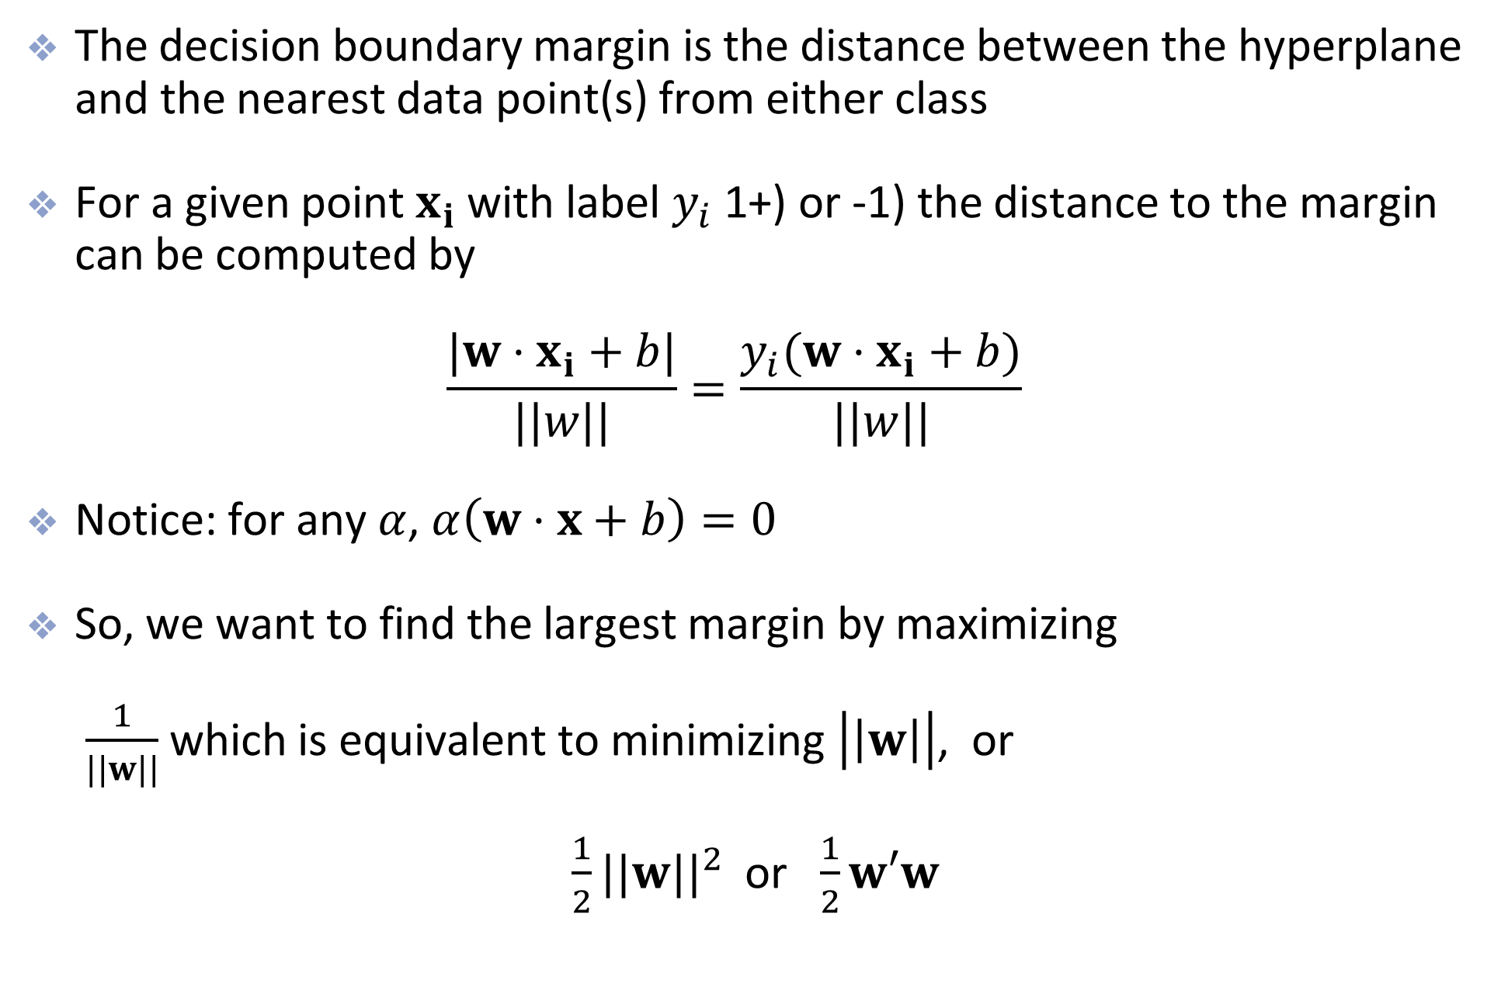
Margins
The decision boundary margin is the distance between the hyperplane and the nearest data point(s) from either class
For a given point $x_{i}$ with label $y_{i}$ (+1 or -1) the distance to the margin can be computed by $\frac{|w⋅x_{i}+b|}{||w||}=\frac{y_{i}(w⋅x_{i}+b)}{||w||}$
Notice: for any $α$, $α\left(w⋅x+b\right)=0$
So, we want to find the largest margin by maximizing $\frac{1}{||w||}$ which is equivalent to minimizing $\left|\left|w\right|\right|$, or
$\frac{1}{2}||w||^{2}$ or $\frac{1}{2}w′w$
Notes:
Add a slide before reviewing the distance between a point and a line.
ADD SOME SCAFFOLDING, REVISIT MATH ROOTS! REVISIT PROJECTION, DOT PRODUCT, DISTANCE TO PLANE
Here’s the crucial fact:
If $\left(w , b\right)$defines a separating hyperplane, then so does
$$\left(α , wαb\right)$$
for any positive $α$.
Why?
Because:
$$α\left(w⋅x+b\right)=0$$
defines the exact same decision boundary.
So we are free to scale $w$and $b$however we like.
Step 3: Use That Freedom to Fix the Numerator
Since we can scale arbitrarily, we choose a convenient normalization:
$$\underset{i}{\min{}}y_{i}\left(w⋅x_{i}+b\right)=1$$
This means:
The closest correctly classified point satisfies
$$y_{i}\left(w⋅x_{i}+b\right)=1$$
This is not a restriction. It’s just choosing a scale.
Step 5: Why This Works
Originally:
$$\text{margin}=\underset{i}{\min{}}\frac{y_{i}\left(w⋅x_{i}+b\right)}{∥w∥}$$
After normalization:
$$\text{margin}=\frac{1}{∥w∥}$$
The numerator disappears because we fixed it.

Slide 14
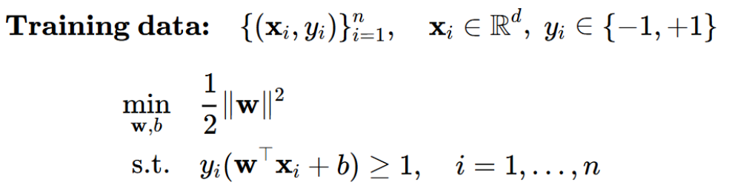
SVM Optimization Problem

Slide 15

Hinge Loss
Sometimes you’ll see the term “hinge loss” in connection with SVM
For and individual data point $x_{i}$ with label $y_{i}$, the hinge loss is $\text{loss}(x_{i},y_{i},w,b)=max(0,1−y_{i}(w⋅x_{i}+b))$
When summed across all data points we get the hard margin cost function

Slide 16
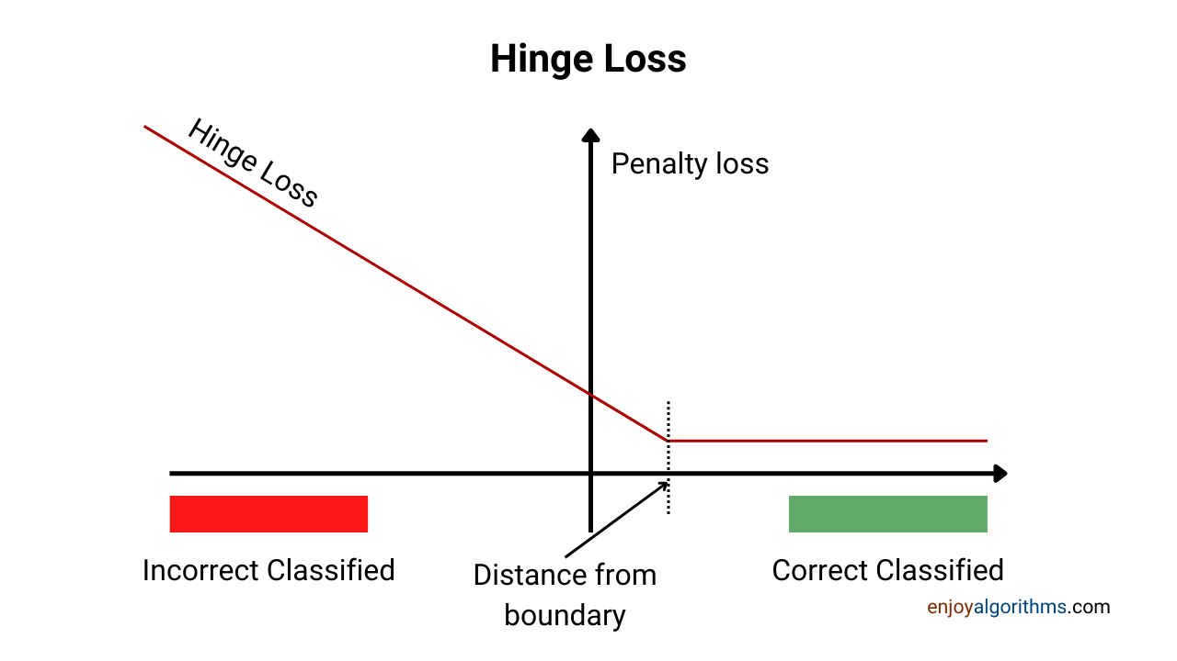
Hinge Loss

Slide 17
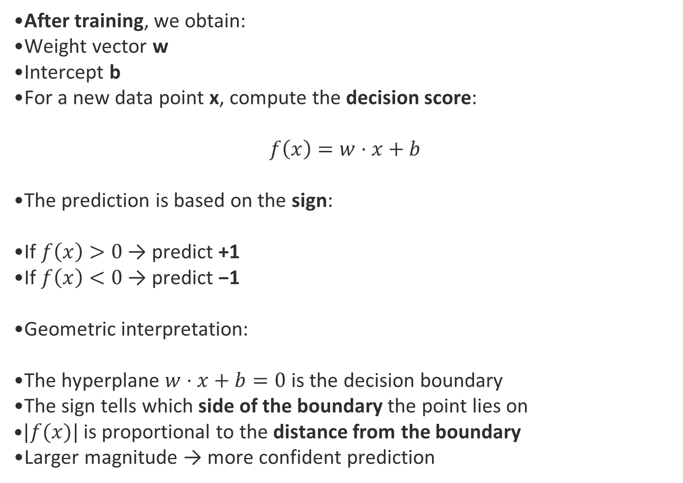
SVM Decision Process
After training, we obtain:
Weight vector w
Intercept b
For a new data point x, compute the decision score:
$$f\left(x\right)=w⋅x+b$$
The prediction is based on the sign:
If $f\left(x\right)>0$ → predict +1
If $f\left(x\right)<0$ → predict −1
Geometric interpretation:
The hyperplane $w⋅x+b=0$ is the decision boundary
The sign tells which side of the boundary the point lies on
$|f(x)|$ is proportional to the distance from the boundary
Larger magnitude → more confident prediction

Slide 18
Potential problems
What if a separating hyperplane does not exist?
Then there is no maximum marginal classifier

Slide 19
Soft Margin SVM

Slide 20
Potential problems
In this case, a natural generalization would be to allow some points to spill into the “street” or margin

Slide 21
Support Vector Classifier (Soft margin)
Hyper-parameter C controls the width of the road and the amount of over-spill that is allowed
When C is small, the margin is wider and more points are involved in determining the direction of the boundary
C=0.1
C=1
C=10

Slide 22
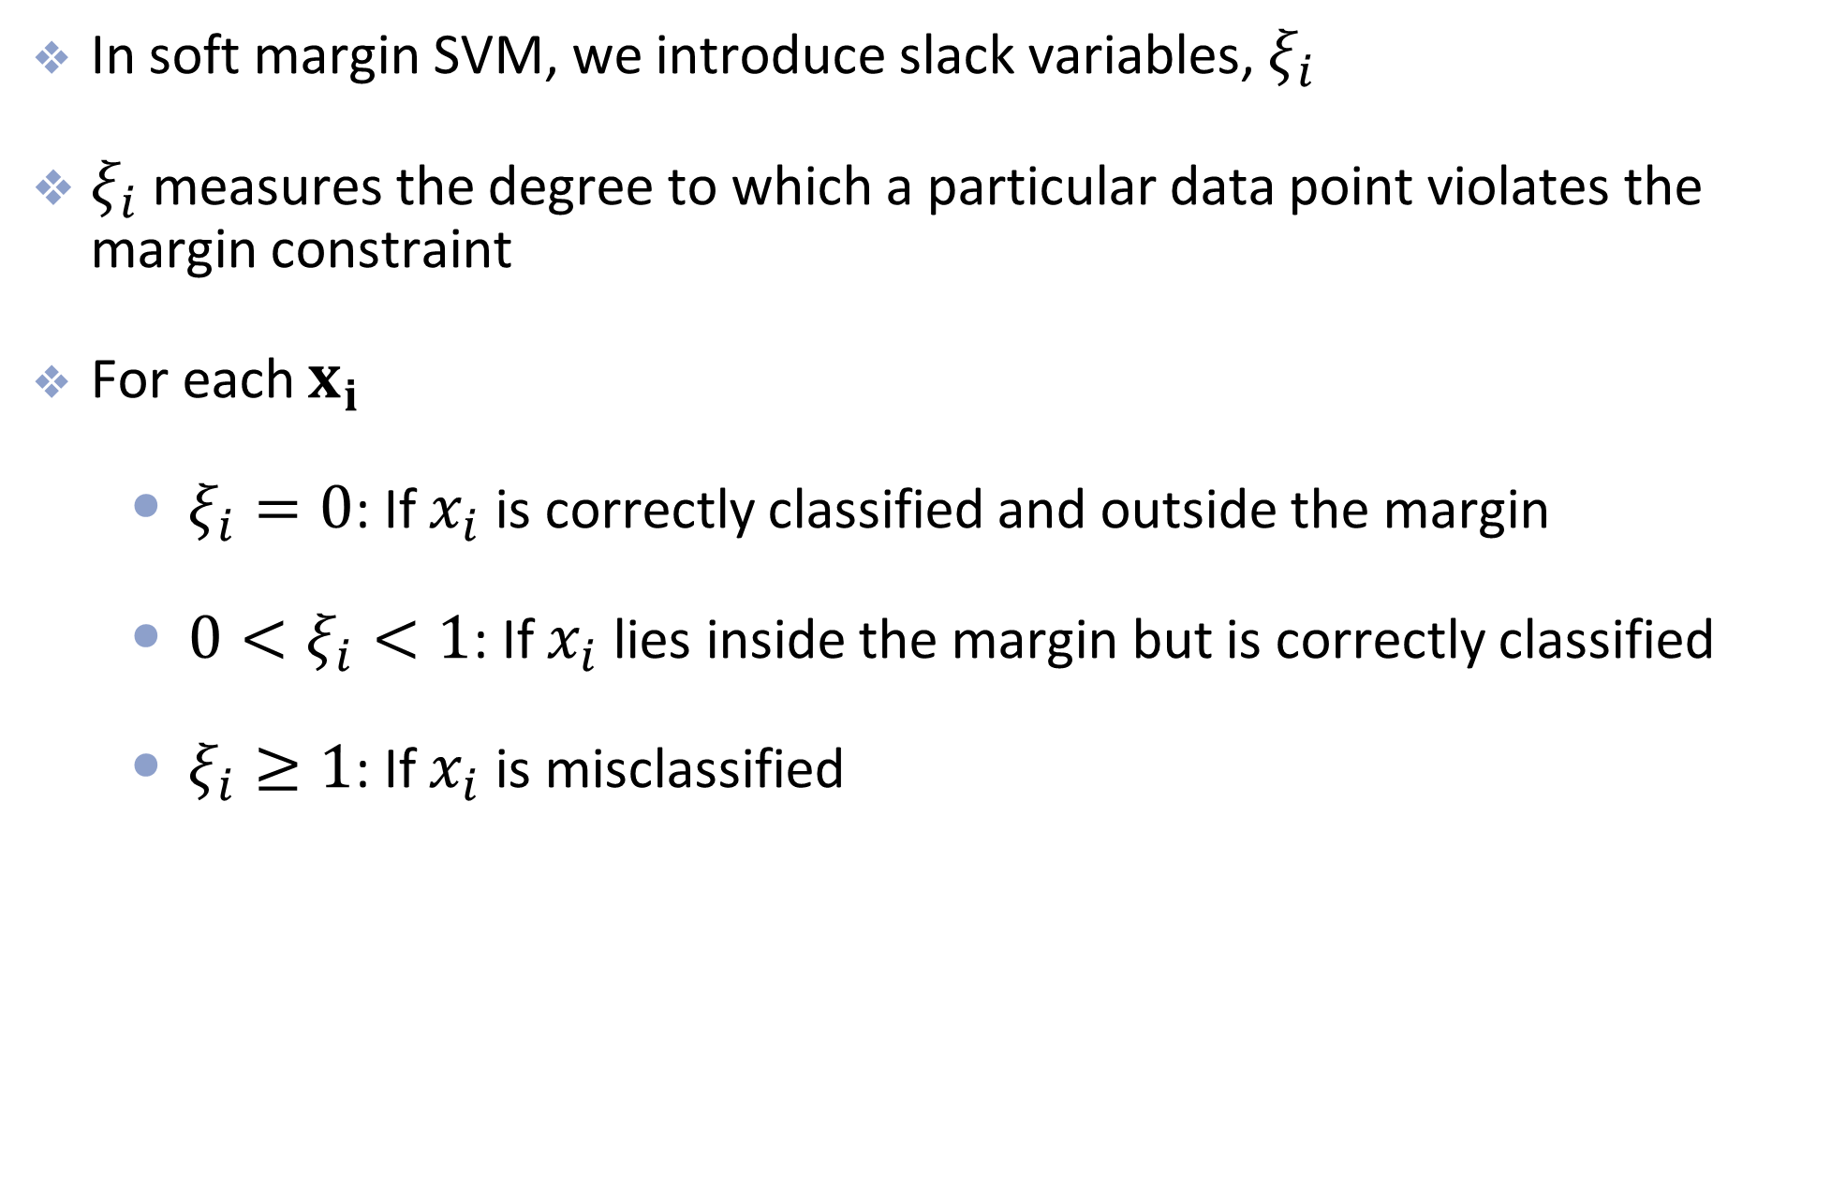
Slack Variables
In soft margin SVM, we introduce slack variables, $ξ_{i}$
$ξ_{i}$ measures the degree to which a particular data point violates the margin constraint
For each $x_{i}$
$ξ_{i}=0$: If $x_{i}$ is correctly classified and outside the margin
$0<ξ_{i}<1$: If $x_{i}$ lies inside the margin but is correctly classified
$ξ_{i}≥1$: If $x_{i}$ is misclassified

Slide 23
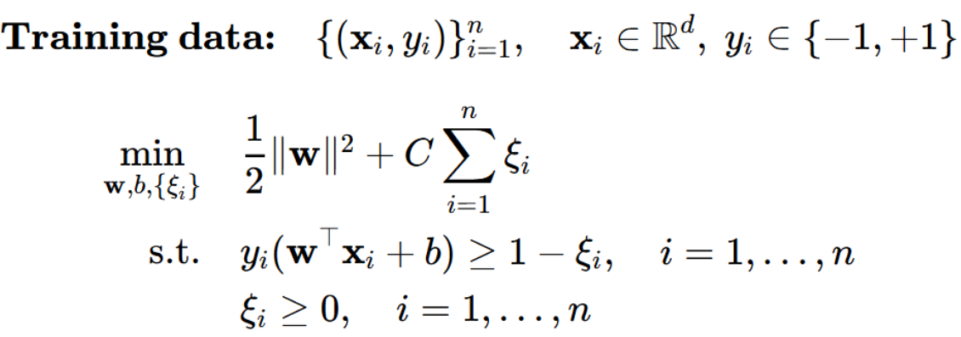
Optimization w/ Slack Variables

Slide 24
Support Vectors
The points inside the margin (or points wrongly misclassified, if any) are the support vectors
Only these points effect the decision boundary (the support vectors influence the position and orientation of the hyperplane)
When C is small, the street is wider so more points are involved in making the decision boundary
Can lead to underfitting
When C is large, the street more narrow so fewer points are involved in making the decision boundary
Can lead to overfitting

Slide 25
Non-linearly separable data

Slide 26
Non-linearly Separable
Now what happens if the classes aren’t linearly separable

Slide 27
Non-linearly Separable
One possibility is to add polynomials terms to a linear model (e.g. logistic regression)

Slide 28
Non-linearly Separable
This is the decision boundary of a logistic regression model after adding 4th order polynomials to the feature matrix

Slide 29

Examples
Here we can visualize how adding higher dimensions can create linear separability
In 1-dimension the data is not linearly separable
After applying the transformation $φ(x)=x^{2}$ we have linear separation

Slide 30
Another Example
Another Example

Slide 31
A solution and a problem
While mapping to higher-dimensional space can create linearly separable data…
…It can be computationally expensive to directly compute the transformation
E.g., polynomial space gets really big really fast, especially with lots of features
…It is also hard to determine how many higher-dimensions to include
This is where SVMs and the Kernel Trick come to the rescue

Slide 32
Support Vector Machines

Slide 33
Support Vector Machines
The main idea behind SVMachines is to
create linear separation by expanding the feature space
but in a specific way using kernels - a computationally efficient trick for expanding the feature space
this is called the kernel trick

Slide 34

Dot Products
Given two vectors in n-dimensional space: $a=(a_{1},a_{2},…,a_{n})$ and $b=(b_{1},b_{2},…,b_{n})$
The dot product between $a$ and $b$ is $⟨a,b⟩=\overset{n}{\underset{i=1}{∑}}a_{i}b_{i}=a′b$

Slide 35
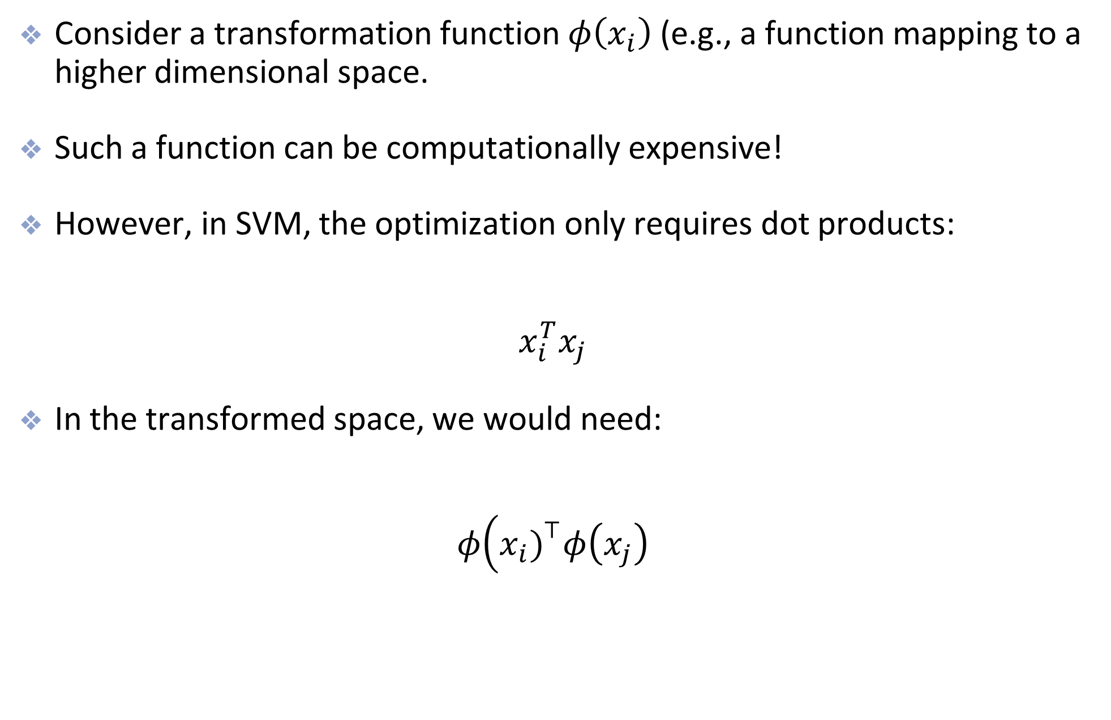
Results from previous slide
Consider a transformation function $φ\left(x_{i}\right)$ (e.g., a function mapping to a higher dimensional space.
Such a function can be computationally expensive!
However, in SVM, the optimization only requires dot products:
$$x_{i}^{T}x_{j}$$
In the transformed space, we would need:
$$φ\left(x_{i}{\left.)\right.}^{⊤}φ\left(x_{j}\right)\right.$$

Slide 36
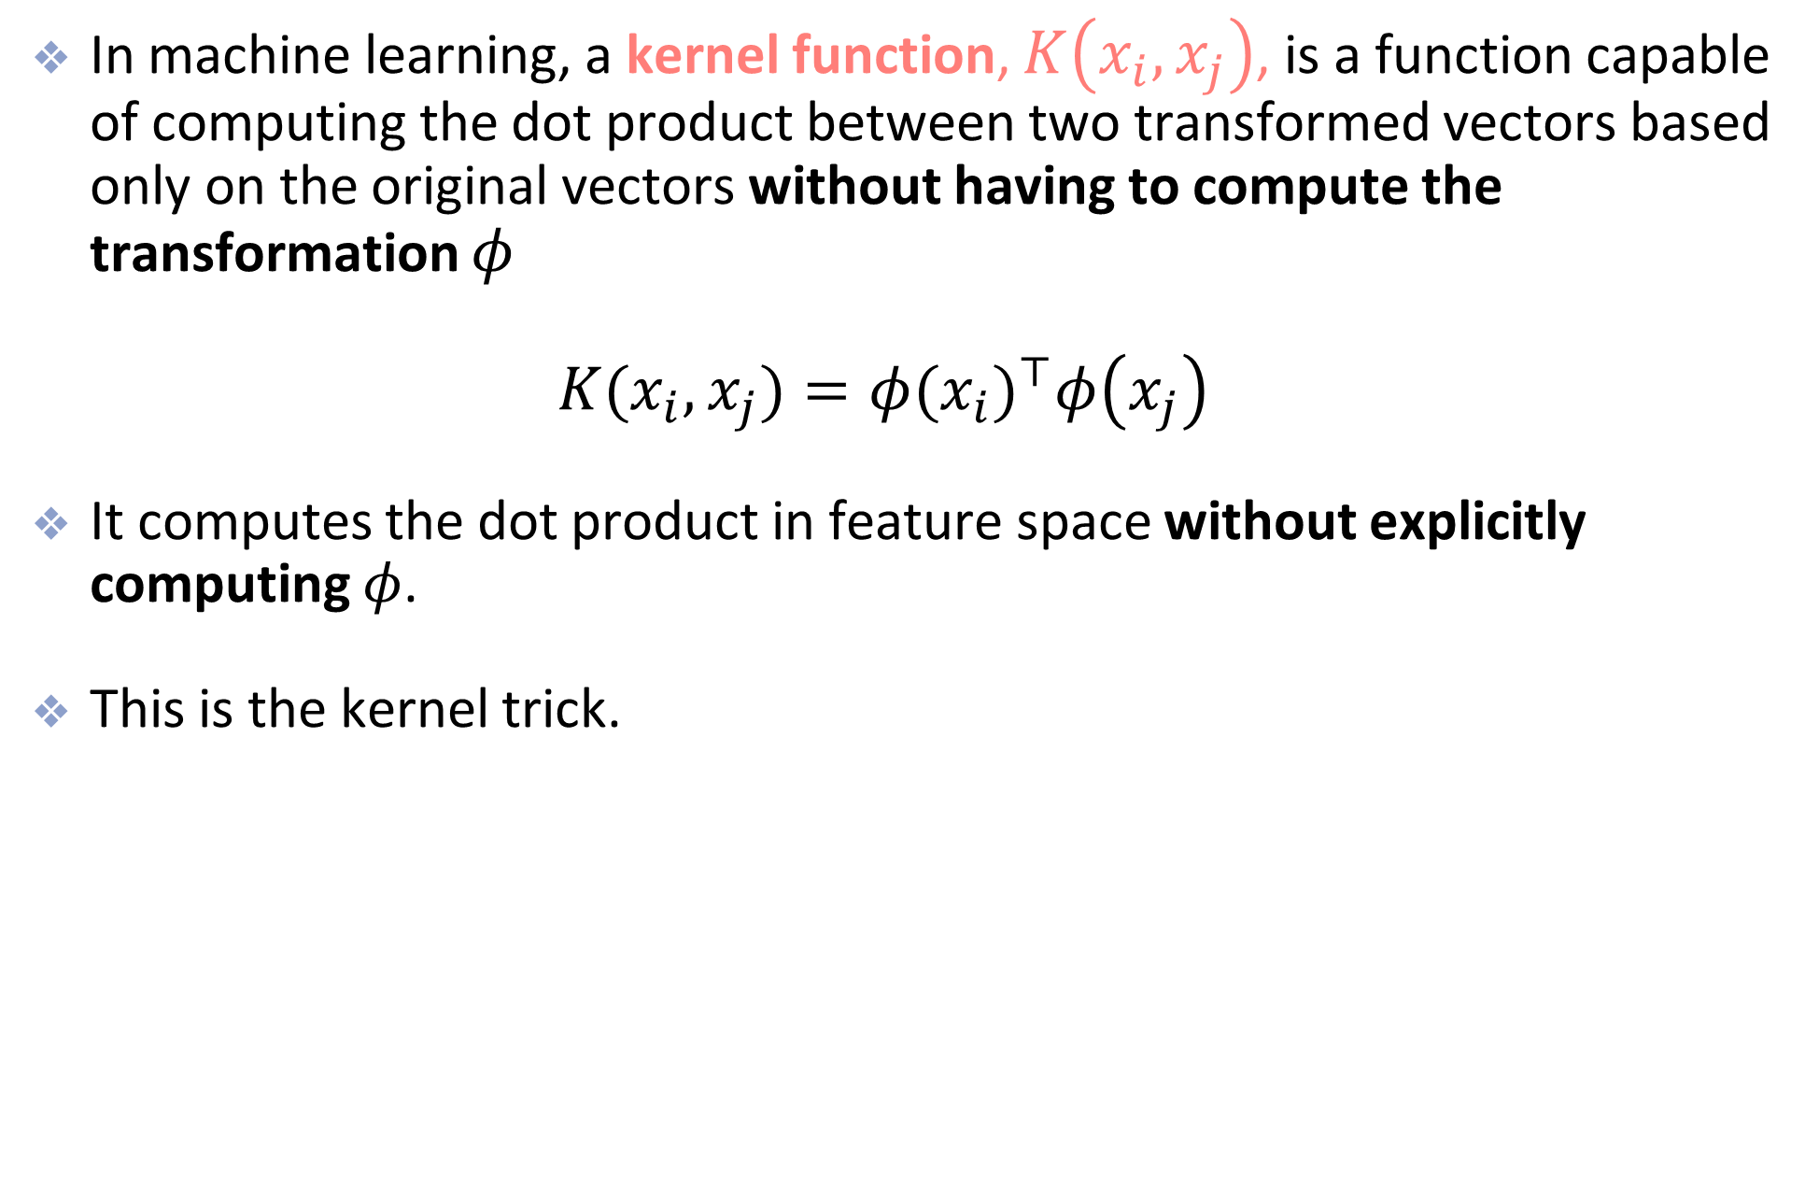
The Kernel Trick
In machine learning, a kernel function, $K\left(x_{i},x_{j}\right)$, is a function capable of computing the dot product between two transformed vectors based only on the original vectors without having to compute the transformation $φ$ $K(x_{i},x_{j})=φ(x_{i})^{⊤}φ\left(x_{j}\right)$
It computes the dot product in feature space without explicitly computing $φ$.
This is the kernel trick.

Slide 37

Common Kernels
The previous example uses the 2nd order polynomial kernel
Common kernels:
Linear: $K(a,b)=a^{′}b$
Polynomial: $K(a,b)=(γa^{′}b+r)^{d}$
Gaussian RBF: $K(a,b)=exp(−γ(||a−b||^{2})$

Slide 38
So how does this all fit in to SVM?
Primal vs Dual Problem
Given a constrained optimization problem (the primal problem) …
…It is possible to express a different but related problem, called the dual problem
The dual problem is usually faster to solve
But the dual problem typically gives a lower bound to the solution of the primal problem
Under some conditions, the primal and dual problems have the same solution and SVM meets these conditions
Notes:
Introduce concepts in 586

Slide 39
Math is cool
If you’ve never taken an optimization class, the concept of primal vs dual can be a little confusing
The dual formulation is basically the expression of the optimization problem in terms of Lagrange multipliers
HOML give some of the formulas for going back and forth between the primal and dual problems
Quote from Book: If you are starting to get a headache, that’s perfectly normal: it’s an unfortunate side effect of the kernel trick

Slide 40
Summary of the Kernel Trick in SVM
A kernel function replaces the dot product in the SVM objective function
By using the kernelized version
we implicitly map the input data into higher-dimensions…
…where it might be linearly separable
…without needing to perform the transformation explicitly

Slide 41
Gaussian RBF Kernel

Slide 42

More about the RBF Kernel
The Gaussian RBF kernel is very popular and is the default for the SVC and SVR functions in sklearn
$K(a,b)=exp(−γ(||a−b||^{2})$

Slide 43
More about the RBF Kernel
Main idea
Rather than add polynomial features, we can also add “similarity” features
The “similarity” features will also transform to a higher dimension
Similarity features represent the similarity between two or more data points
For example we can add features based on the RBF similarity function from several arbitrary landmarks
RBF kernel corresponds to infinite-dimensional space

Slide 44
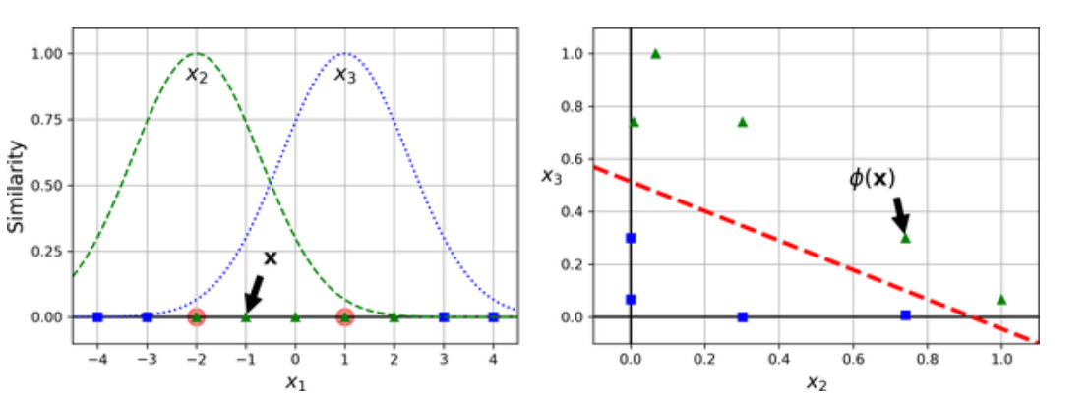
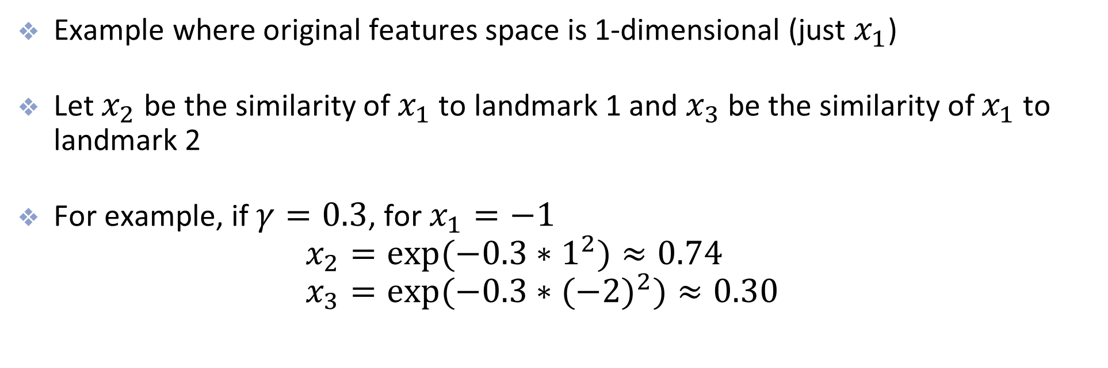
Example of Similarity Features
Example where original features space is 1-dimensional (just $x_{1}$)
Let $x_{2}$ be the similarity of $x_{1}$ to landmark 1 and $x_{3}$ be the similarity of $x_{1}$ to landmark 2
For example, if $γ=0.3$, for $x_{1}=−1$ $x_{2}=exp(−0.3∗1^{2})≈0.74$ $x_{3}=exp(−0.3∗(−2)^{2})≈0.30$

Slide 45
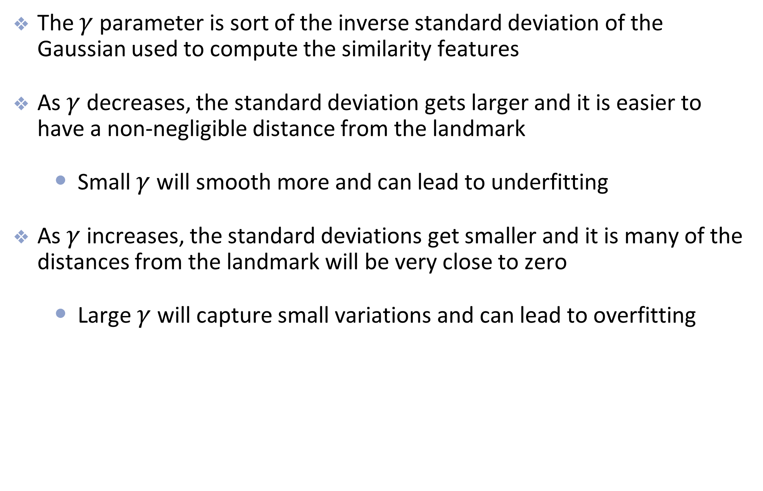
More about the RBF Kernel
The $γ$ parameter is sort of the inverse standard deviation of the Gaussian used to compute the similarity features
As $γ$ decreases, the standard deviation gets larger and it is easier to have a non-negligible distance from the landmark
Small $γ$ will smooth more and can lead to underfitting
As $γ$ increases, the standard deviations get smaller and it is many of the distances from the landmark will be very close to zero
Large $γ$ will capture small variations and can lead to overfitting

Slide 46


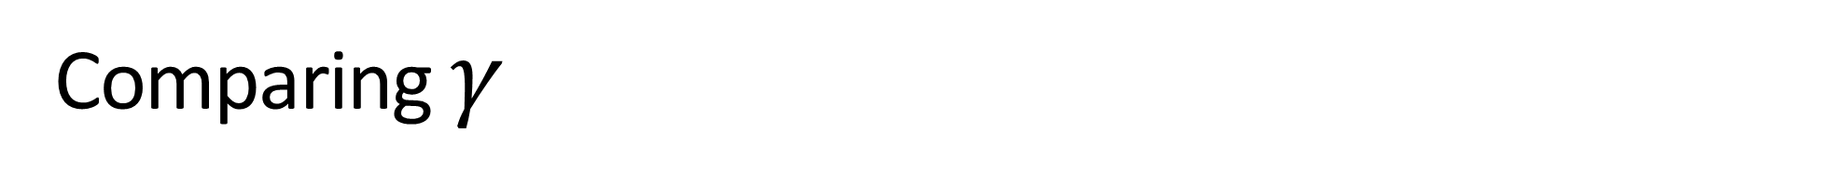

Comparing $γ$
$$γ=0.1$$
$$γ=5$$
$$γ=0.5$$

Slide 47
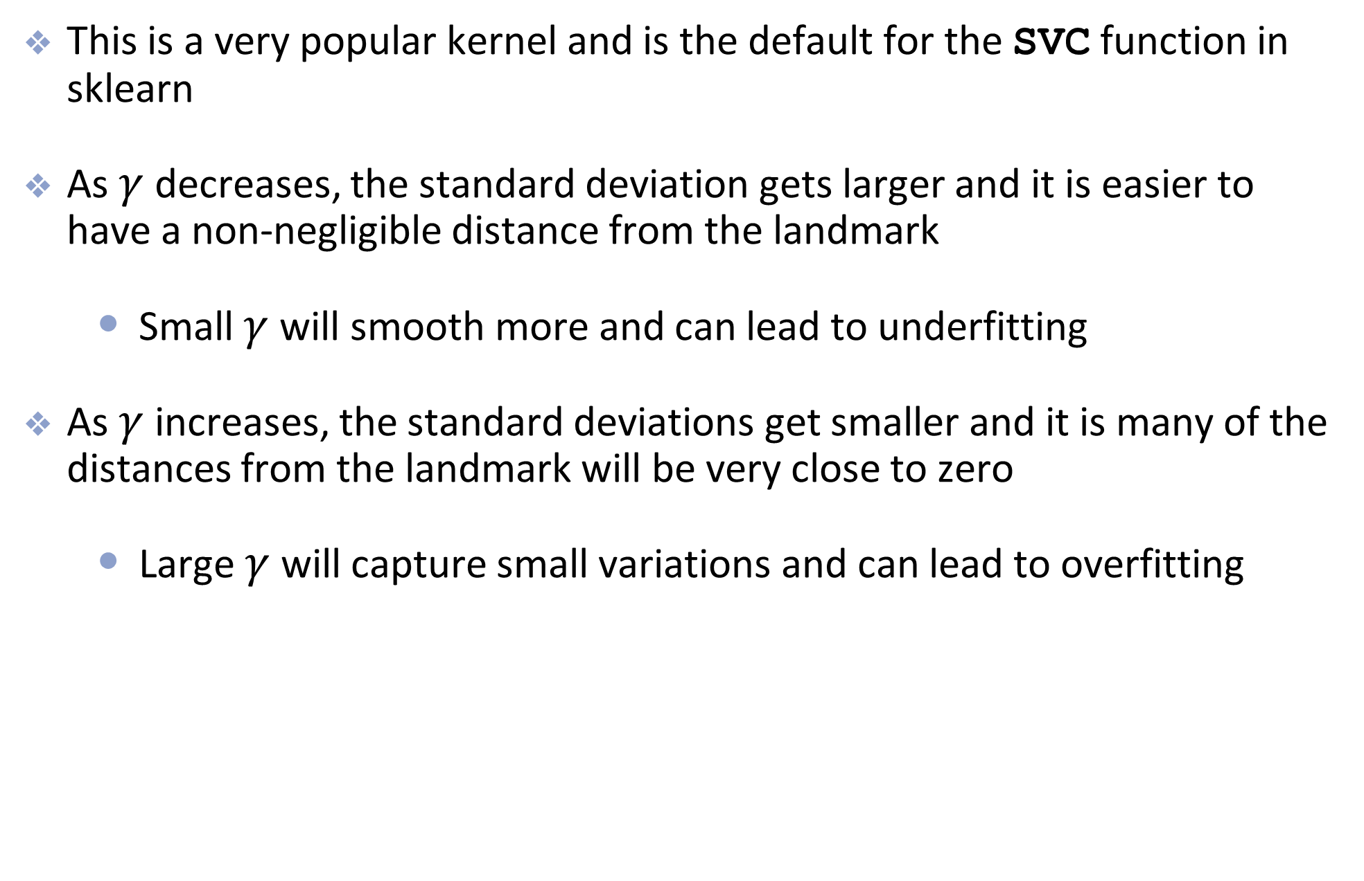
Gaussian RBF Kernel
This is a very popular kernel and is the default for the SVC function in sklearn
As $γ$ decreases, the standard deviation gets larger and it is easier to have a non-negligible distance from the landmark
Small $γ$ will smooth more and can lead to underfitting
As $γ$ increases, the standard deviations get smaller and it is many of the distances from the landmark will be very close to zero
Large $γ$ will capture small variations and can lead to overfitting

Slide 48
SVM Regression

Slide 49

SVR Unpacked
For regression, we find a linear function:
$$f(x)=w⋅x+b$$
We want predictions within $ε$ of the responses, that is:
$$\left|y_{i}​−f\left(x_{i}​\right)\right|≤ε$$
This forms an $ε−tube (width 2ε)$

Slide 50
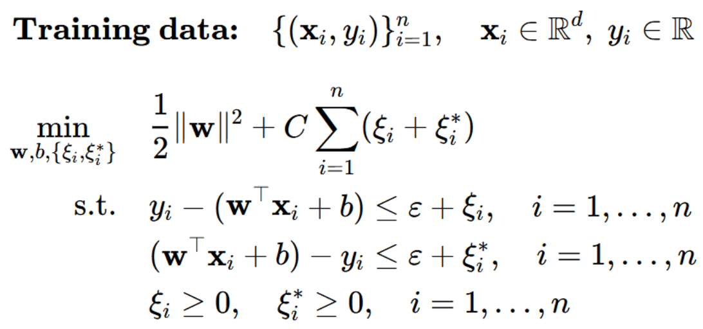
SVR Optimization

Slide 51
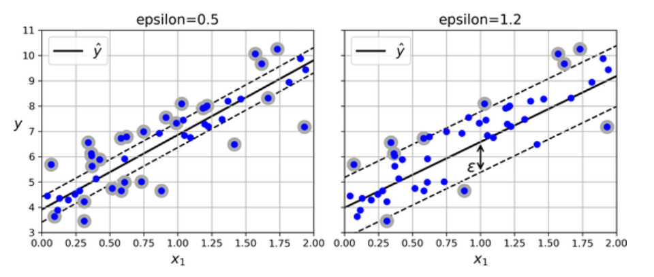
SVM Regression
Here, instead of finding the widest possible road, we want to fit as many observations on the street while limiting the number of points off the street

Slide 52
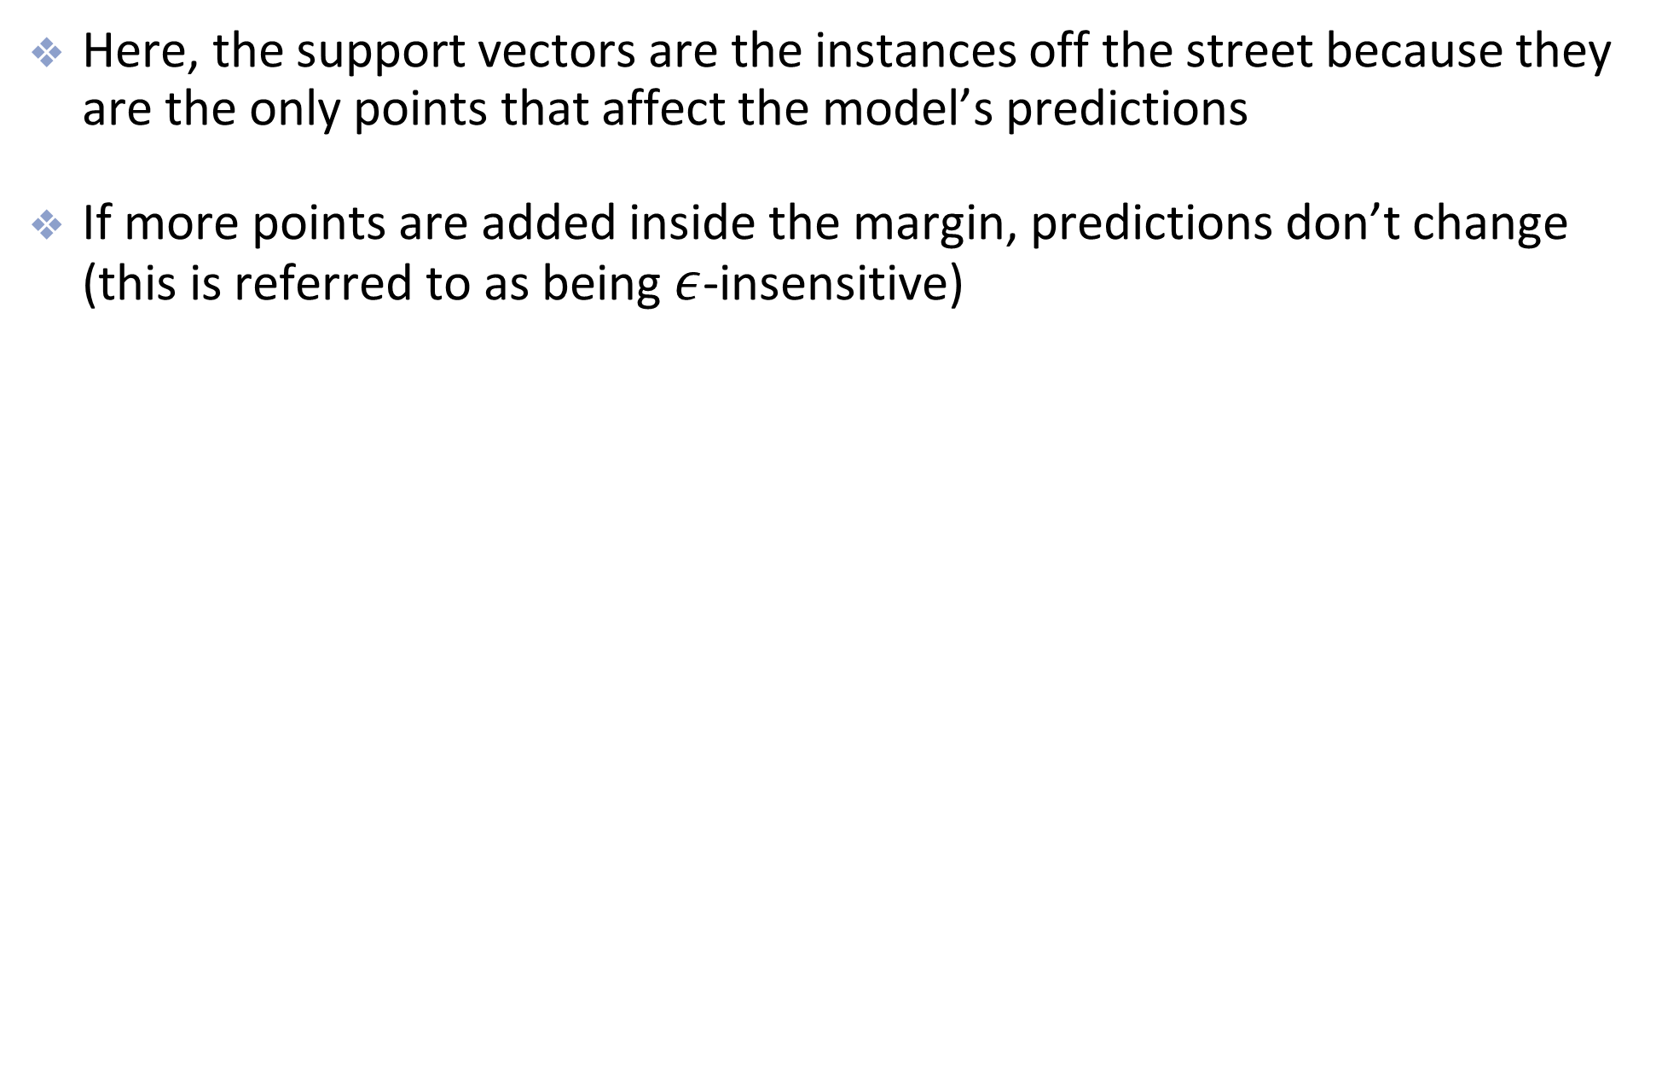
SVM Regression
Here, the support vectors are the instances off the street because they are the only points that affect the model’s predictions
If more points are added inside the margin, predictions don’t change (this is referred to as being $ε$-insensitive)

Slide 53
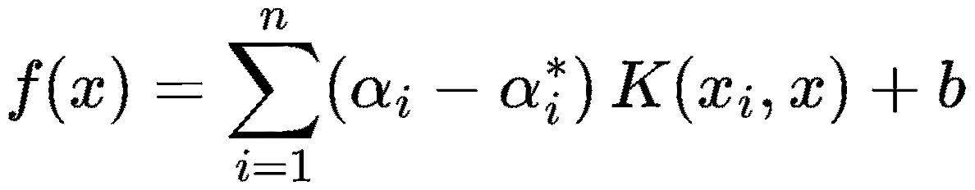

Decision Function (Linear SVR)
For SVR, no thresholding is used.
Each prediction is given by:
$$f\left(x_{i}\right)= w⋅x_{i}+ b$$
For Kernel SVR, it is given by:
The $α_{i}$ values are dual Lagrange multipliers

Slide 54
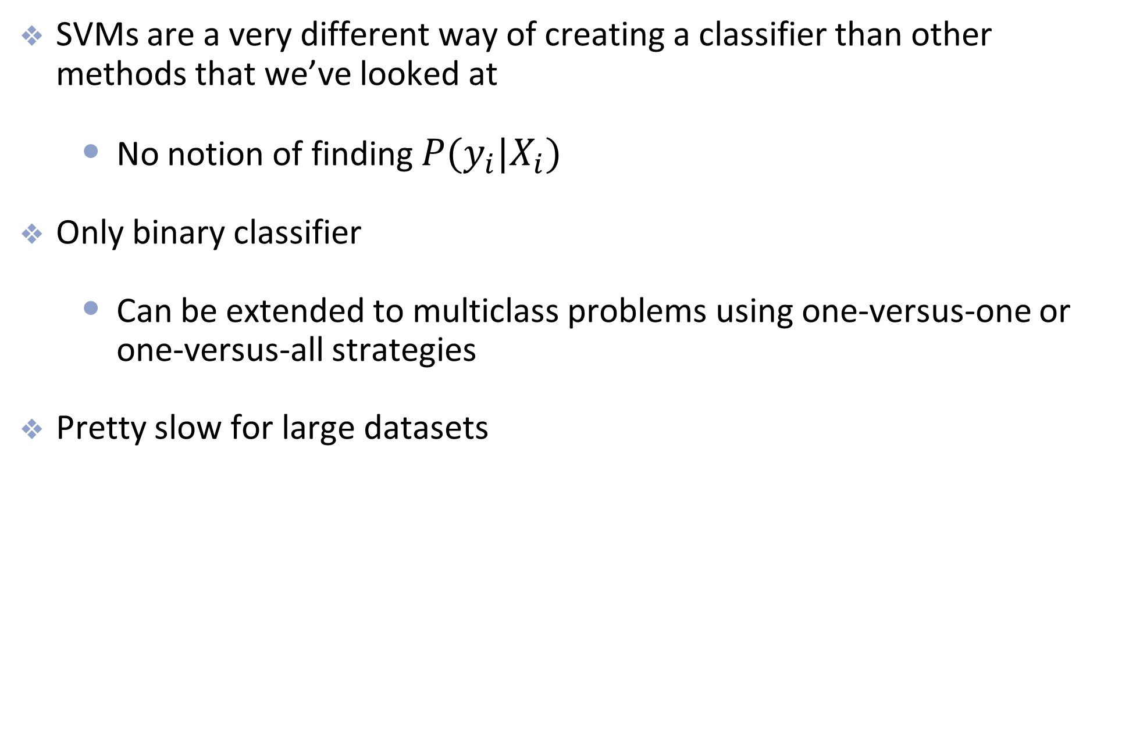
Summary
SVMs are a very different way of creating a classifier than other methods that we’ve looked at
No notion of finding $P(y_{i}|X_{i})$
Only binary classifier
Can be extended to multiclass problems using one-versus-one or one-versus-all strategies
Pretty slow for large datasets

