Slide 1
Dimension Reduction

Slide 2
Curse of Dimensionality
Challenges that arise when data lives in high-dimensional spaces, making distance, density, and learning less reliable
As dimensionality increases:
Data becomes sparse
Points are far apart; local neighborhoods are harder to define
Distances lose meaning
Nearest and farthest points become similar
(low relative contrast → weak nearest-neighbor signals)
Learning becomes harder
Requires exponentially more data to generalize
Requires more computation for many algorithms
Many algorithms rely on meaningful distances—this breaks down in high dimensions

Slide 3
What is Dimension Reduction
Transformation of data from a high-dimensional space to a lower-dimensional space
Goals of dimension reduction:
Simplify the structure of the data
Reduce computational cost
Mitigate the curse of dimensionality
Enable visualization (e.g., 2D or 3D plots)
Two main approaches:
Projection (linear methods)
Manifold learning (nonlinear methods)

Slide 4
Projection
Manifold
Key Assumption: Data can be well-approximated in a lower-dimensional linear subspace
How It Works: Identify axes (or bases) in HD space that capture most variance and discard less informative dimensions
Examples: PCA, LDA, Random Projection
Analogy: Imagine casting a shadow of a 3D object onto a 2D plane. We want to find the shadow that keeps as much structure as possible
Key Assumption: Data lies on a lower-dimensional nonlinear manifold
How It Works: Preserve local relationships and geodesic distances rather than Euclidean distances
Examples: t-SNE, UMAP, Isomap, LLE
Analogy: Imagine a crumpled piece of paper (HD space). If we flatten the paper without tearing, the true lower-dimensional structure is revealed

Slide 5
Principal Components Analysis (PCA)

Slide 6
PCA
Principal Component Analysis (PCA)
One of the most widely used dimension reduction techniques
Dates back to the early 20th century
Transforms data into a new coordinate system:
→ Principal components
idea:
Capture the most important structure (variance) in the data using fewer dimensions
Applications:
Visualization
Feature extraction
Noise reduction
Preprocessing for machine learning models

Slide 7
Basic Idea of PCA
PCA finds a linear transformation of the data such that:
The first principal component maximizes variance
Each subsequent component:
Is orthogonal to previous ones
Captures the next highest variance
Properties:
Components are uncorrelated
Ordered by importance (variance explained)

Slide 8
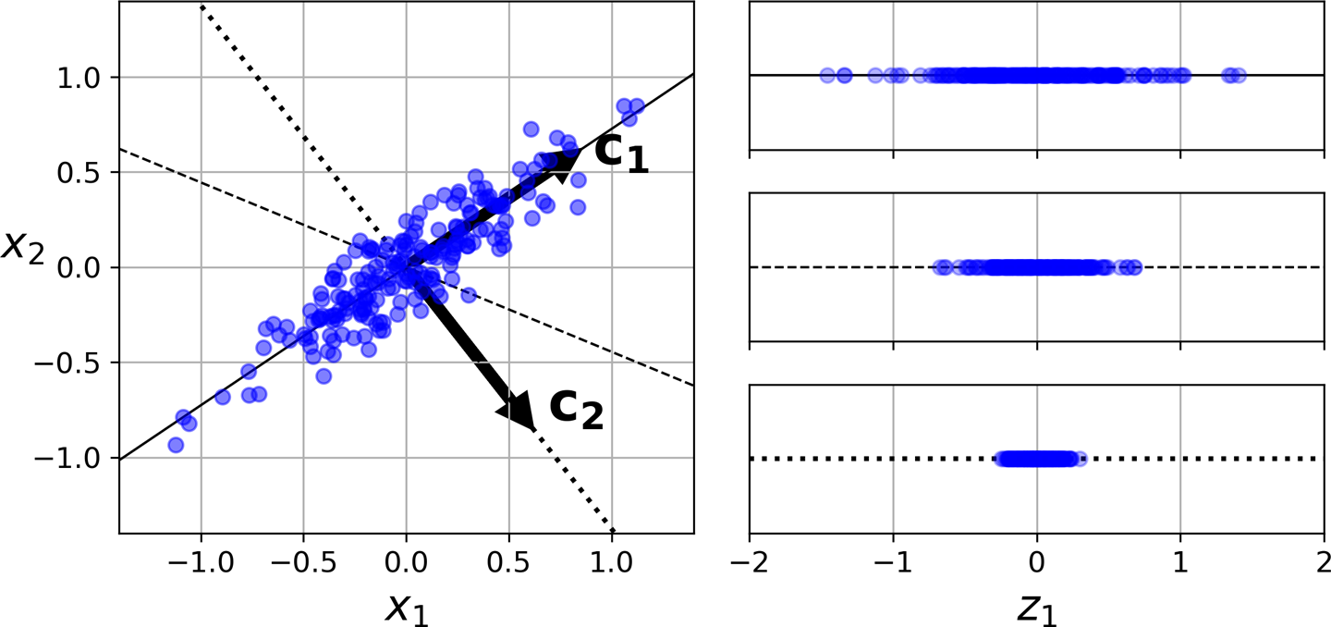
PCA in dimension reduction
Find the hyperplane that perseveres the largest amount of variance
Project data onto that hyperplane
Image from "Hands-On Machine Learning with Scikit-Learn & TensorFlow" by Aurelien Geron

Slide 9
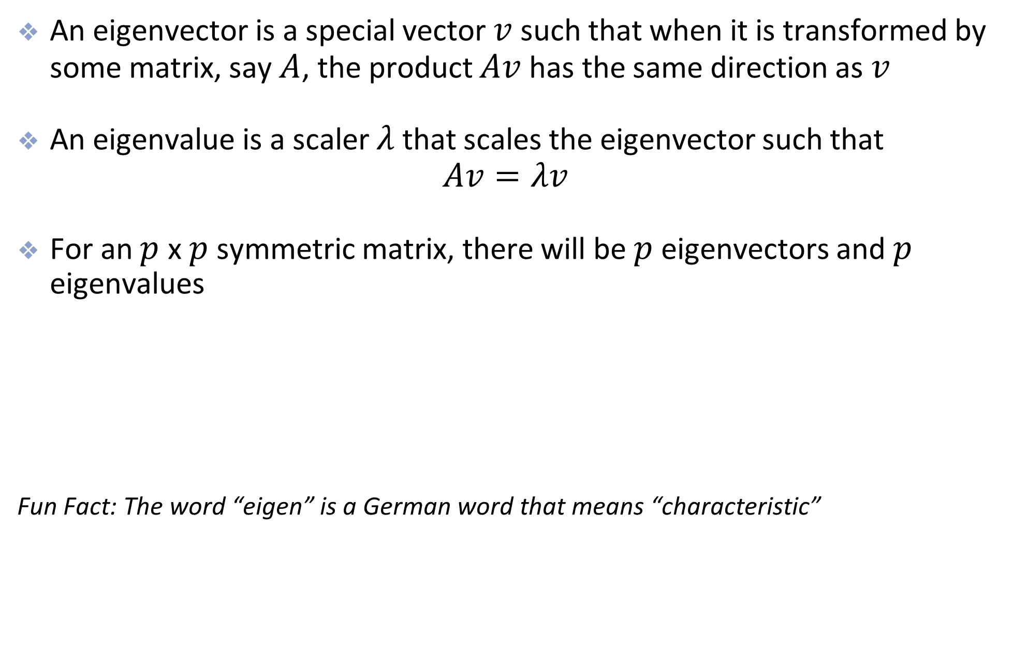
Review of eigenvalues and vectors
An eigenvector is a special vector $v$ such that when it is transformed by some matrix, say $A$, the product $Av$ has the same direction as $v$
An eigenvalue is a scaler $λ$ that scales the eigenvector such that $Av=λv$
For an $p$ x $p$ symmetric matrix, there will be $p$ eigenvectors and $p$ eigenvalues
Fun Fact: The word “eigen” is a German word that means “characteristic”
Computing eigen values and vectors in python:
eigen_values, eigen_vectors = np.linalg.eig(A)

Slide 10
Computing Principal Components
Computing Principal Components
Step 1: Center the data
Subtract the mean from each feature
Step 2: Scale features
Important when features have different units
Step 3: Compute covariance matrix:
Σ = (1/n) XᵀX
Step 4: Compute eigenvalues and eigenvectors of Σ
Eigenvectors → principal directions
Eigenvalues → variance explained by each direction

Slide 11
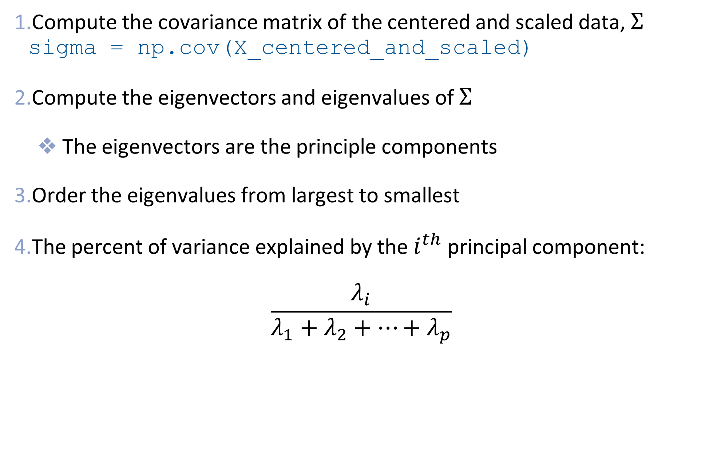
PCA with eigenvalues and vectors
Compute the covariance matrix of the centered and scaled data, $Σ$ sigma = np.cov(X_centered_and_scaled)
Compute the eigenvectors and eigenvalues of $Σ$
The eigenvectors are the principle components
Order the eigenvalues from largest to smallest
The percent of variance explained by the $i^{th}$ principal component: $\frac{λ_{i}}{λ_{1}+λ_{2}+⋯+λ_{p}}$

Slide 12

Projection of original data
Let $U_{k}$ = matrix of top k eigenvectors
Low-dimensional representation:
$$Z = XU_{k}$$
Reconstruction (projection back to original space):
This is the best rank-k approximation (in least-squares sense)

Slide 13

PCA with eigenvalues and vectors
For data visualization, we would plot the first 2-3 principle components
For dimension reduction, we would choose k $<p$ such that the first $k$ principal components explain a sufficient amount of variance
$U_{k}$ could be used as input features for another model

Slide 14
Example: MNIST (just 0s and 1s)

Slide 15
Example: MNIST (just 0s and 1s)

Slide 16
Example: MNIST (just 0s and 1s)

Slide 17

Projecting data to the lower space
From the SVD we have $\underset{n×p}{X}=\underset{n×p}{U}\underset{p×p}{S}{\underset{p×p}{V}}^{T}$
We can approximate $X$ using $r<p$ singular values (and principal components) $\underset{n×p}{X}≈\underset{n×r}{U}\underset{r×r}{S}{\underset{r×p}{V}}^{T}$
This could be useful for image (or other data) compression

Slide 18
Data compression example

Slide 19
Example: MNIST (just 0s and 1s)
Original (784 features)
200 Principal Components
20 Principal Components

Slide 20
Other Uses of PCA
The principal components can be used as the features in another machine learning model
Reduces the feature space and simplifies the model which can reduce overfitting
Identify key features and highlight relationships by seeing which features contribute most to the first few principal components

Slide 21
Limitations of PCA
The principal components are linear combinations of the original variables
PCA works best for finding patterns that can be described by linear relationships
PCA seeks to preserve pairwise distances globally which doesn’t always lead to helpful visualizations

Slide 22
Manifold Learning

Slide 23
Manifold Learning
Manifold learning refers to a group of algorithms that perform non-linear dimension reduction
Some popular manifold learning algorithms:
t-SNE
UMAP
Multidimensional scaling
Isomap
PHATE

Slide 24
t-SNE

Slide 25
Introduction to t-SNE
t-distributed stochastic neighbor embedding (t-SNE)
Introduced in 2008
Non-linear method
Seeks to preserve pairwise similarities locally
Particularly useful for visualizing high-dimensional data

Slide 26
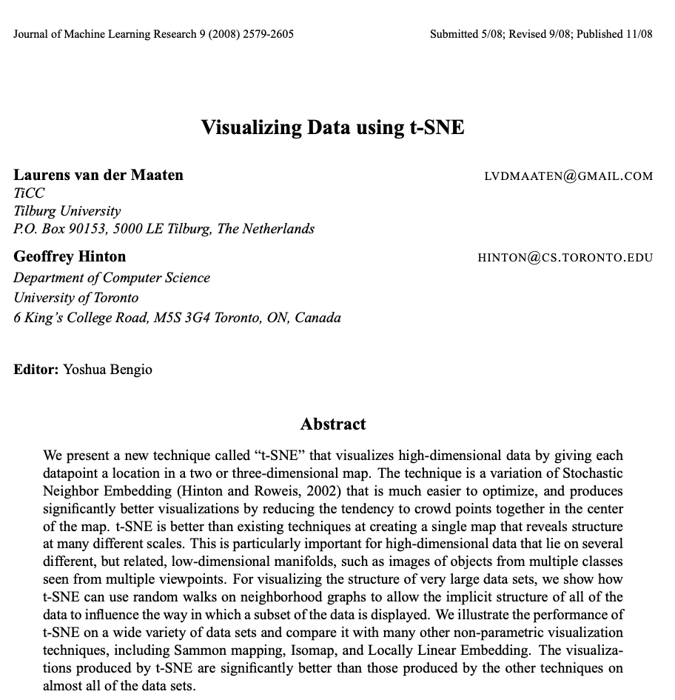

Slide 27
Basic idea of t-SNE
First measure the similarity between data points in high-dimensional space
Then represent the similarities in lower-dimensional space
Preserves the pairwise distance of points in both higher and lower dimensions

Slide 28
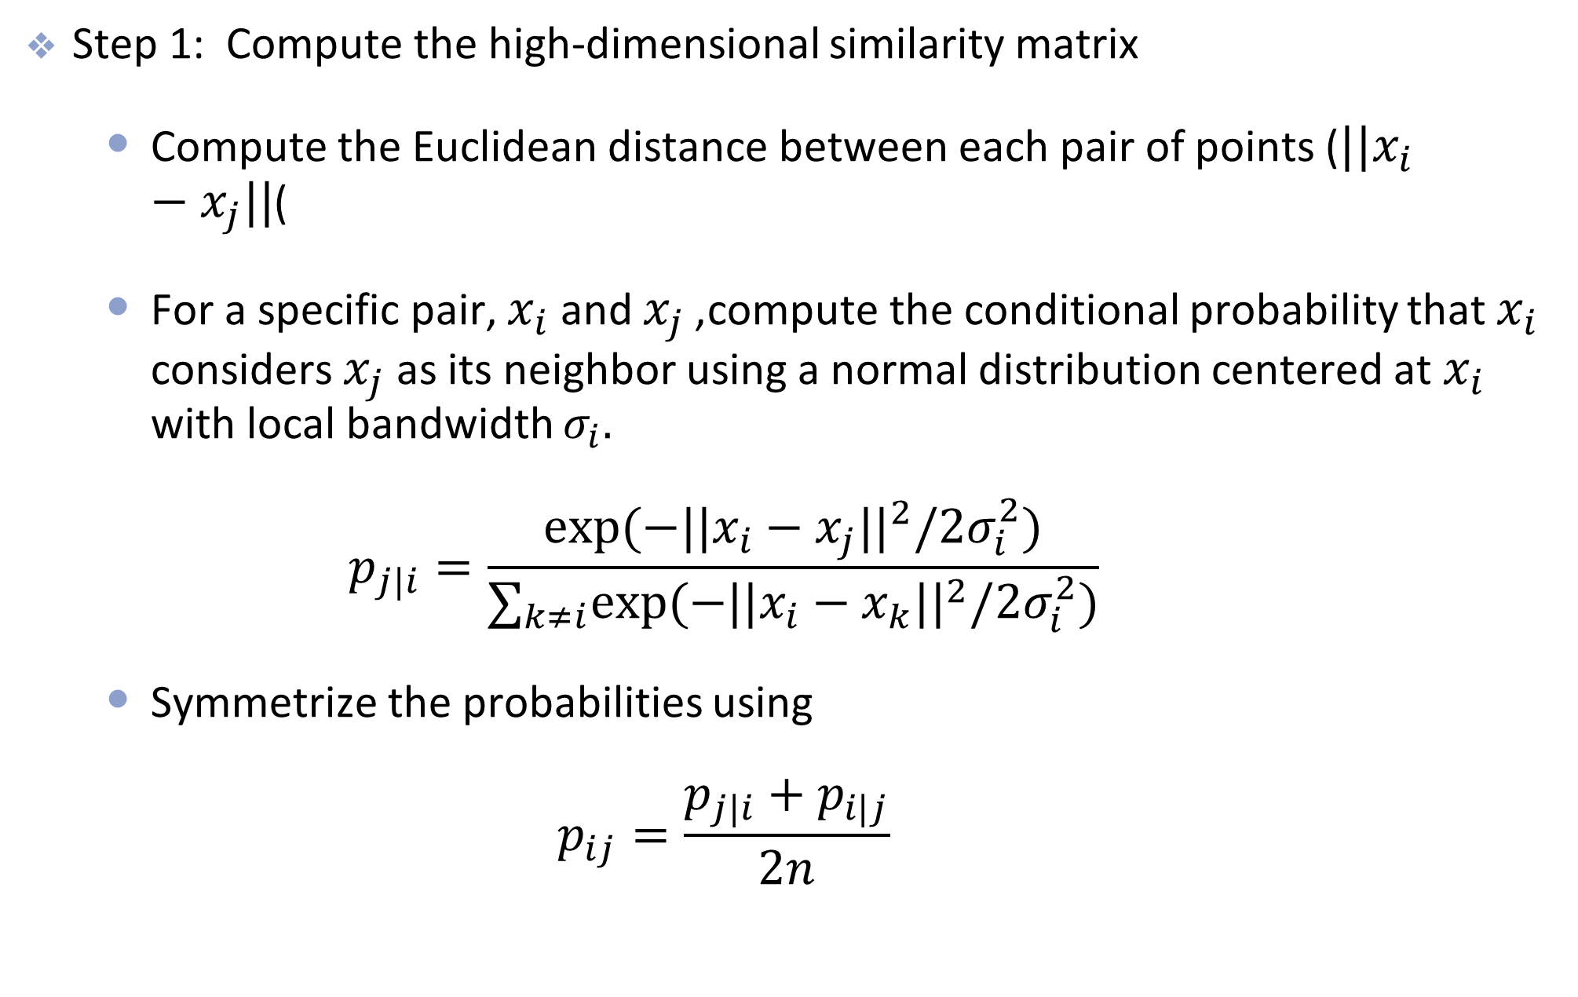
How t-SNE works
Step 1: Compute the high-dimensional similarity matrix
Compute the Euclidean distance between each pair of points ($||x_{i}−x_{j}||$)
For a specific pair, $x_{i}$ and $x_{j}$, compute the conditional probability that $x_{i}$ considers $x_{j}$ as its neighbor using a normal distribution centered at $x_{i}$ with local bandwidth $σ_{i}.$ $p_{j|i}=\frac{exp(−||x_{i}−x_{j}||^{2}/2σ_{i}^{2})}{∑_{k≠i}exp(−||x_{i}−x_{k}||^{2}/2σ_{i}^{2})}$
Symmetrize the probabilities using $p_{ij}=\frac{p_{j|i}+p_{i|j}}{2n}$

Slide 29
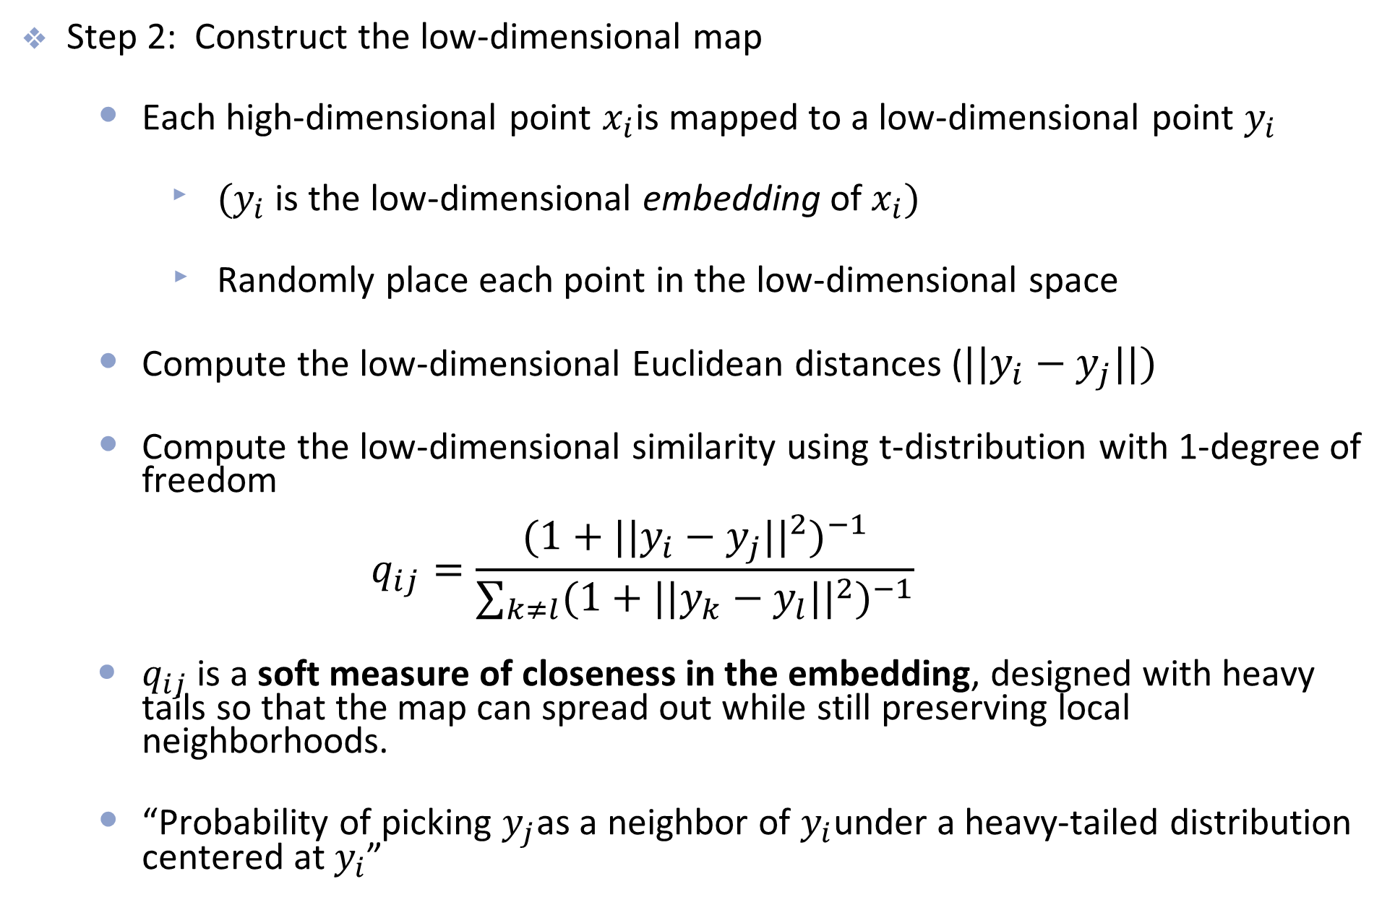
How t-SNE works
Step 2: Construct the low-dimensional map
Each high-dimensional point $x_{i}$is mapped to a low-dimensional point $y_{i}$
$(y_{i}$​ is the low-dimensional embedding of $x_{i})$
Randomly place each point in the low-dimensional space
Compute the low-dimensional Euclidean distances ($||y_{i}−y_{j}||)$
Compute the low-dimensional similarity using t-distribution with 1-degree of freedom $q_{ij}=\frac{(1+||y_{i}−y_{j}||^{2})^{−1}}{∑_{k≠l}(1+||y_{k}−y_{l}||^{2})^{−1}}$
$q_{ij}$ is a soft measure of closeness in the embedding, designed with heavy tails so that the map can spread out while still preserving local neighborhoods.
“Probability of picking $y_{j}$as a neighbor of $y_{i}$under a heavy-tailed distribution centered at $y_{i}$”

Slide 30
Why t?
Note: the t-distribution with 1 df is the same as Cauchy distribution
The t-distribution has thicker tails than the normal distribution
It is used to help alleviate over crowding (where points tend to cluster together in the center of the map)
Allows distant clusters to be more separated
Helps speed optimization

Slide 31
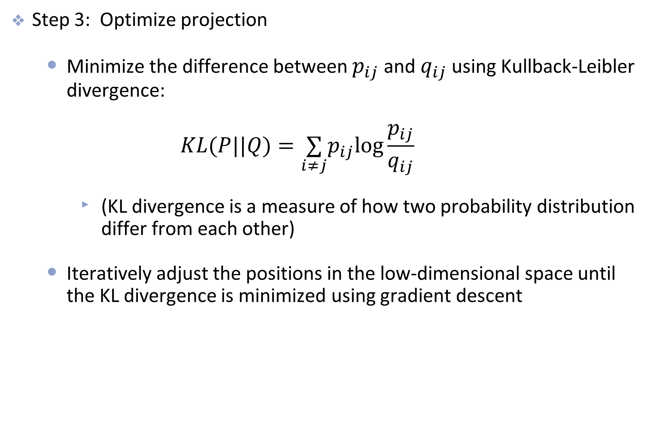
How t-SNE works
Step 3: Optimize projection
Minimize the difference between $p_{ij}$ and $q_{ij}$ using Kullback-Leibler divergence: $KL(P||Q)=\underset{i≠j}{∑}p_{ij}log\frac{p_{ij}}{q_{ij}}$
(KL divergence is a measure of how two probability distribution differ from each other)
Iteratively adjust the positions in the low-dimensional space until the KL divergence is minimized using gradient descent

Slide 32
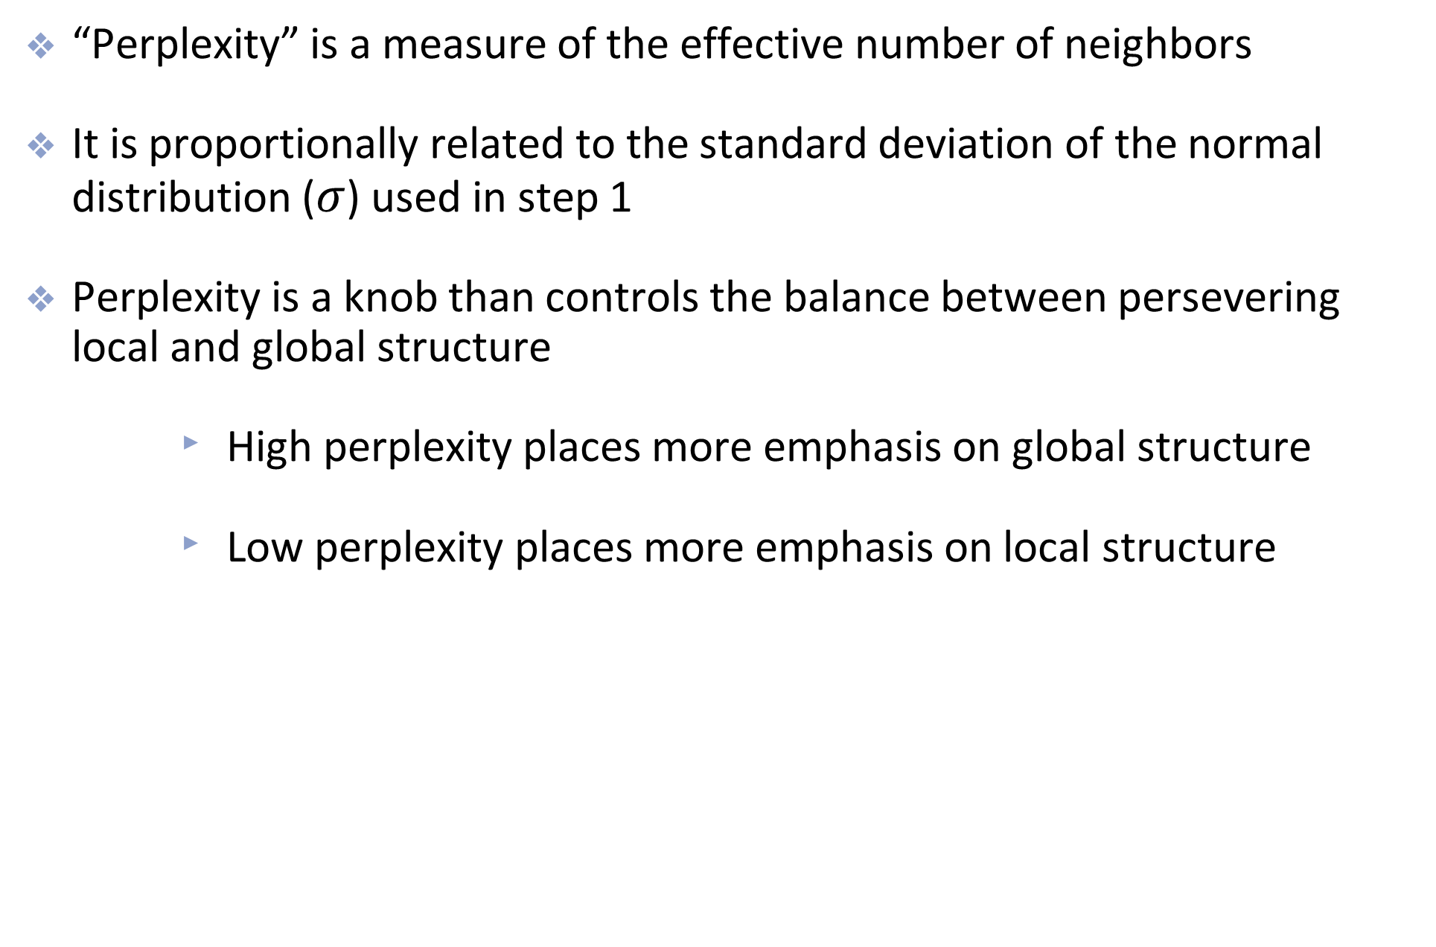
Perplexity
“Perplexity” is a measure of the effective number of neighbors
It is proportionally related to the standard deviation of the normal distribution ($σ$) used in step 1
Perplexity is a knob than controls the balance between persevering local and global structure
High perplexity places more emphasis on global structure
Low perplexity places more emphasis on local structure

Slide 33
Example: MNIST (just 0s and 1s)
t-SNE
PCA

Slide 34
Example: MNIST
t-SNE
PCA

Slide 35
Example: dunes and yardangs
t-SNE
PCA

Slide 36
Affect of perplexity value
Perplexity = 5
Perplexity = 30
Perplexity = 50

Slide 37
Limitations of t-SNE
Slow, especially for large datasets
Computational complexity grows quadratically with the number of data points
Very dependent on the perplexity hyperparameter
Rule of thumb is a value between 5 and 50
Scikit-learn default is 30

Slide 38
UMAP

Slide 39
UMAP
Uniform Manifold Approximation and Projection was first published in 2018
It is gaining popularity due to its efficiency and effectiveness
The mathematical framework is based on Riemannian geometry and algebraic topology

Slide 40
UMAP
The Big Picture of UMAP is very similar to that of t-SNE
Compute similarities in high-dimensional space
Compute similarities in low-dimensional space
Minimize the difference between two sets of similarities
But the computation details are different and turn out to general be more efficient

Slide 41
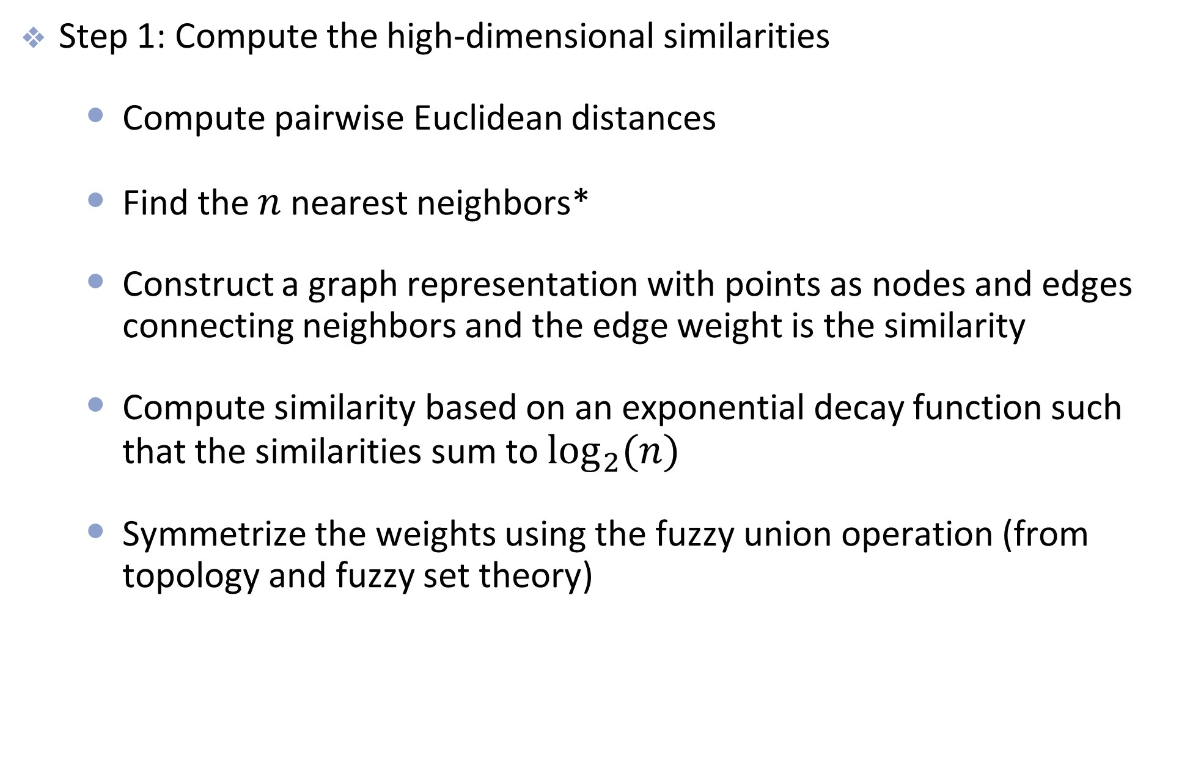
How UMAP works
Step 1: Compute the high-dimensional similarities
Compute pairwise Euclidean distances
Find the $n$ nearest neighbors*
Construct a graph representation with points as nodes and edges connecting neighbors and the edge weight is the similarity
Compute similarity based on an exponential decay function such that the similarities sum to $\log_{2}(n)$
Symmetrize the weights using the fuzzy union operation (from topology and fuzzy set theory)
*$n$ is a hyperparameter that determines the size of the local neighborhood

Slide 42
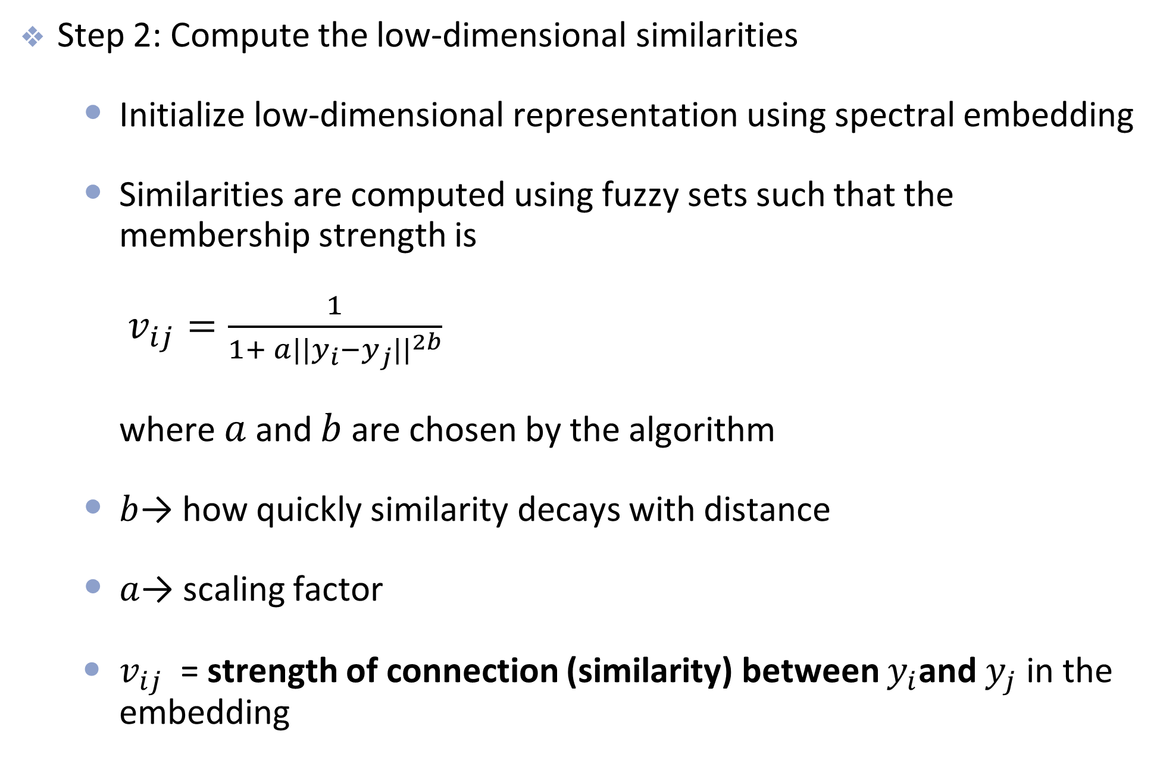
How UMAP works
Step 2: Compute the low-dimensional similarities
Initialize low-dimensional representation using spectral embedding
Similarities are computed using fuzzy sets such that the membership strength is $v_{ij}=\frac{1}{1+ a||y_{i}−y_{j}||^{2b}}$ where $a$ and $b$ are chosen by the algorithm
$b$→ how quickly similarity decays with distance
$a$→ scaling factor
$v_{ij}$​ = strength of connection (similarity) between $y_{i}$and $y_{j}$ in the embedding
Notes:
Spectral embedding places data points in a low-dimensional space using the leading eigenvectors of a graph Laplacian so that strongly connected (similar) points lie close together.

Slide 43
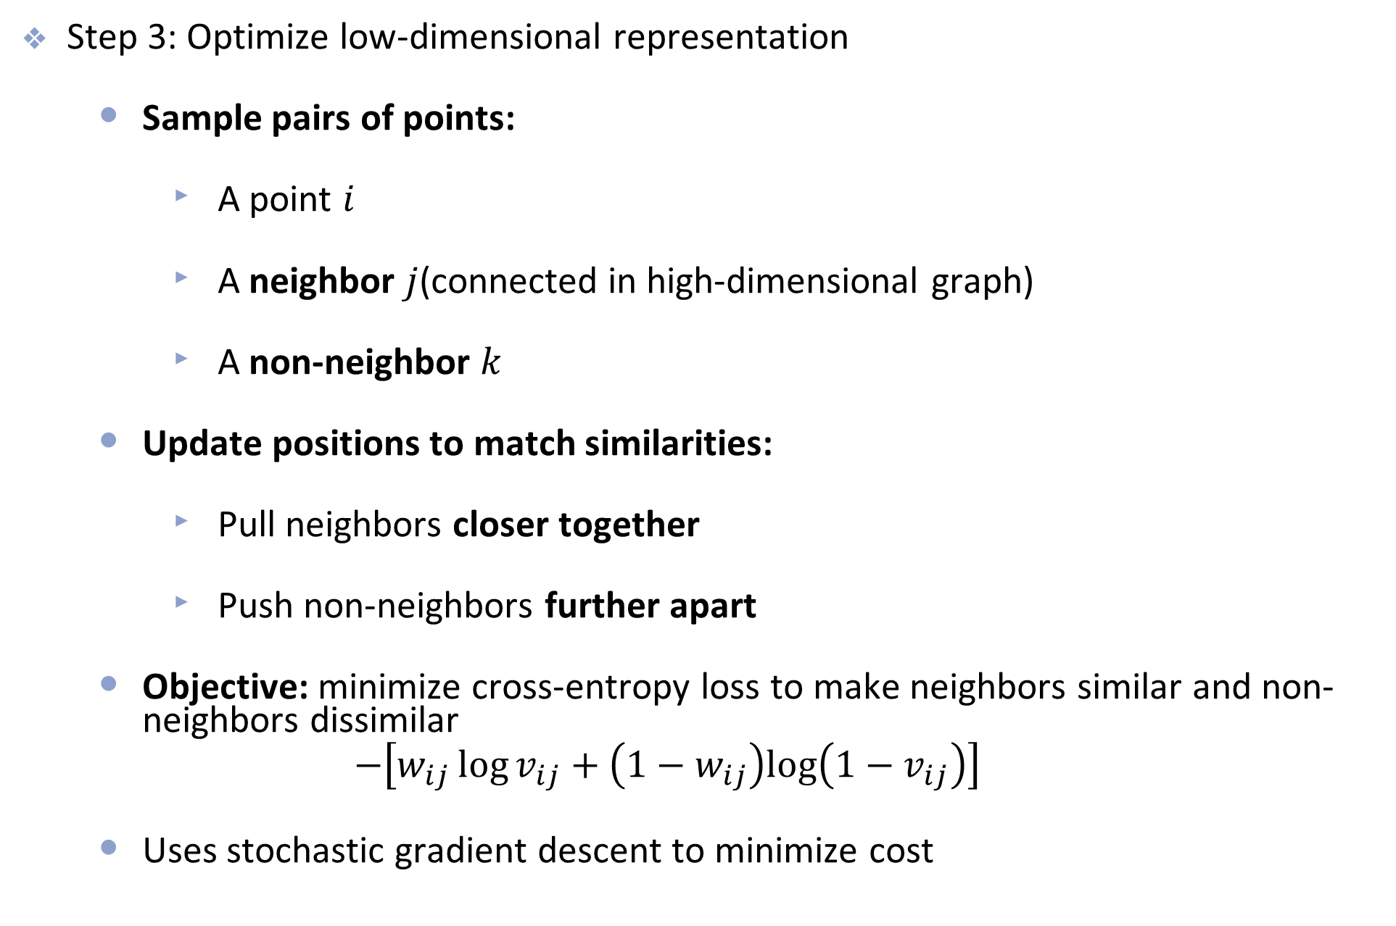
How UMAP works
Step 3: Optimize low-dimensional representation
Sample pairs of points:
A point $i$
A neighbor $j$(connected in high-dimensional graph)
A non-neighbor $k$
Update positions to match similarities:
Pull neighbors closer together
Push non-neighbors further apart
Objective: minimize cross-entropy loss to make neighbors similar and non-neighbors dissimilar
$$−\left[w_{ij}\log{v_{ij}}+\left(1−w_{ij}\right)log⁡\left(1−v_{ij}\right)\right]$$
Uses stochastic gradient descent to minimize cost

Slide 44
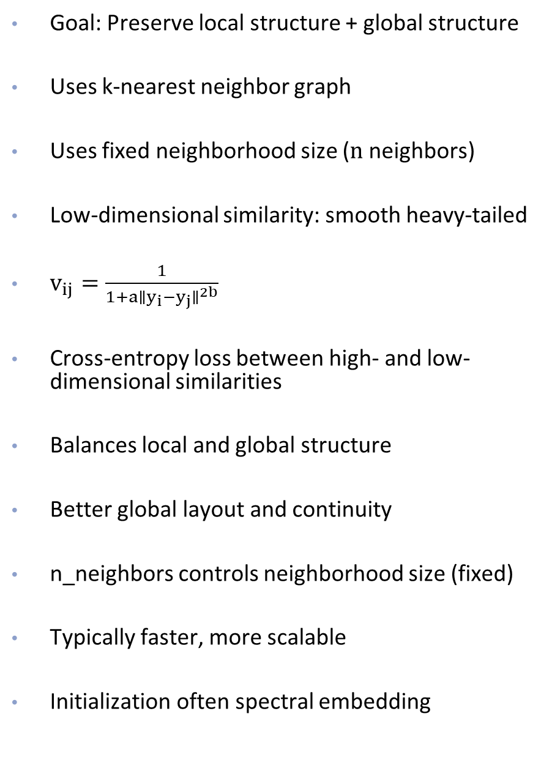
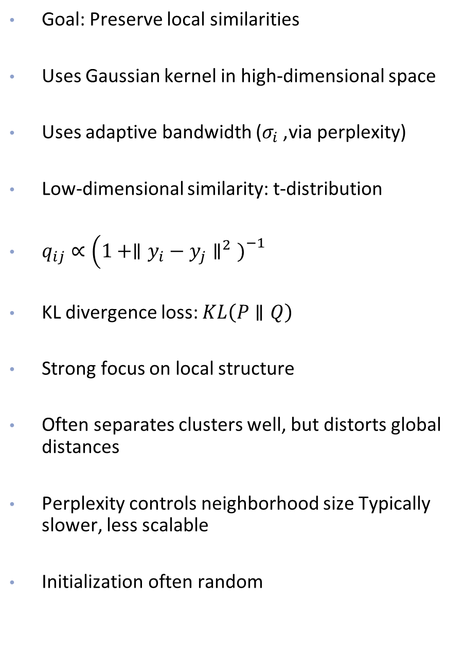
T-SNE
UMAP
Goal: Preserve local similarities
Uses Gaussian kernel in high-dimensional space
Uses adaptive bandwidth ($σ_{i}$, via perplexity)
Low-dimensional similarity: t-distribution
$q_{ij}∝\left(1+∥y_{i}−y_{j}∥^{2}{\left.)\right.}^{−1}\right.$
KL divergence loss: $KL\left(P∥Q\right)$
Strong focus on local structure
Often separates clusters well, but distorts global distances
Perplexity controls neighborhood size Typically slower, less scalable
Initialization often random
Goal: Preserve local structure + global structure
Uses k-nearest neighbor graph
Uses fixed neighborhood size ($n$ neighbors)
Low-dimensional similarity: smooth heavy-tailed
$v_{ij}=\frac{1}{1+a∥y_{i}−y_{j}∥^{2b}}$
Cross-entropy loss between high- and low-dimensional similarities
Balances local and global structure
Better global layout and continuity
n_neighbors controls neighborhood size (fixed)
Typically faster, more scalable
Initialization often spectral embedding

Slide 45
Advantages of UMAP (over tSNE)
Faster, especially for large datasets
Preserves more global structure
Easier to parallelize

Slide 46
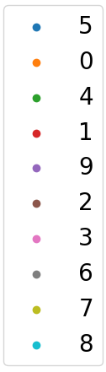
MNIST: PCA vs tSNE vs UMAP
PCA
t-SNE
UMAP
Time:
1.2 seconds
Time:
198.3 seconds
(~3.3 minutes)
Time:
28.7 seconds
Note: First two PC only explain 17% of total variance

