Slide 1
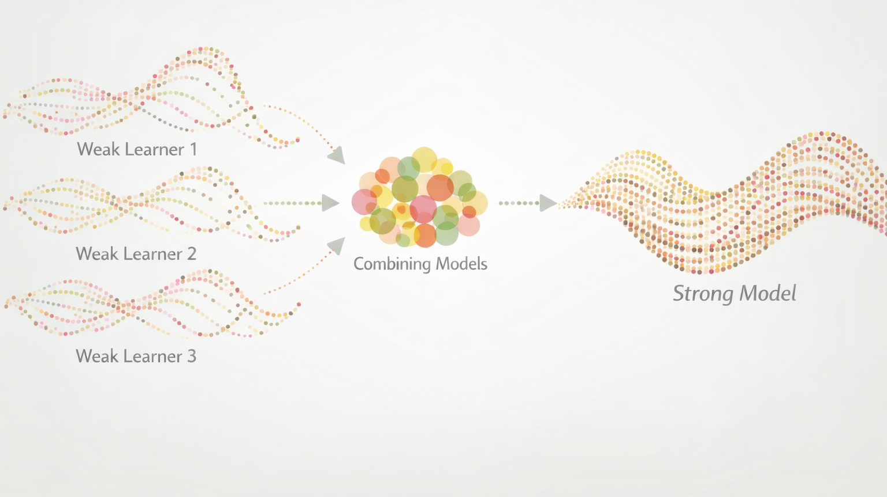
Boosting

Slide 2
Boosting
Boosting is a technique that was developed to improve weak learners
Models that are just barely better than random guessing
Simple (few tuning parameters) and fast to train
Decision “stumps” are commonly used weak learners
The general idea of boosting methods is to train models sequentially and try to “fix the mistakes” of the preceding model

Slide 3
Common Boosting Algorithms
Adaptive Boosting (AdaBoost) — increase the weight of misclassified observations
Gradient Boosting — learn and then correct the mistakes of the previous step
More efficient implementations:
XGBoost (Extreme gradient boosting)
LightGBM (Light gradient boosting machine)

Slide 4
AdaBoost

Slide 5
AdaBoost
Adaptive Boosting (AdaBoost)
Introduced in 1997
The main idea is to “pay more attention” to instances that were misclassified or had large errors in the previous model
Focus learning on difficult instances
“Study” topics you missed last time

Slide 6
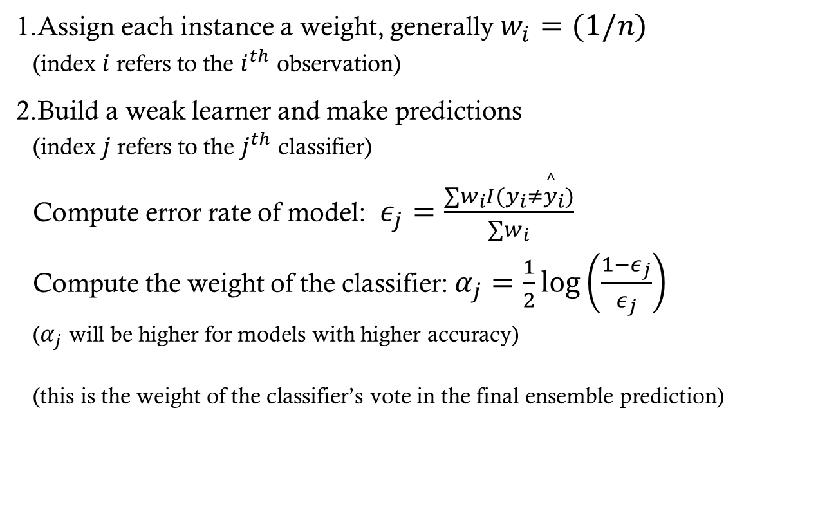
AdaBoost
Assign each instance a weight, generally $w_{i}=(1/n)$ (index $i$ refers to the $i^{th}$ observation)
Build a weak learner and make predictions (index $j$ refers to the $j^{th}$ classifier) Compute error rate of model: $ε_{j}=\frac{∑w_{i}I(y_{i}≠{\overset{^}{y}}_{i})}{∑w_{i}}$ Compute the weight of the classifier: $α_{j}=\frac{1}{2}log\left(\frac{1−ε_{j}}{ε_{j}}\right)$ ($α_{j}$ will be higher for models with higher accuracy) (this is the weight of the classifier’s vote in the final ensemble prediction)

Slide 7
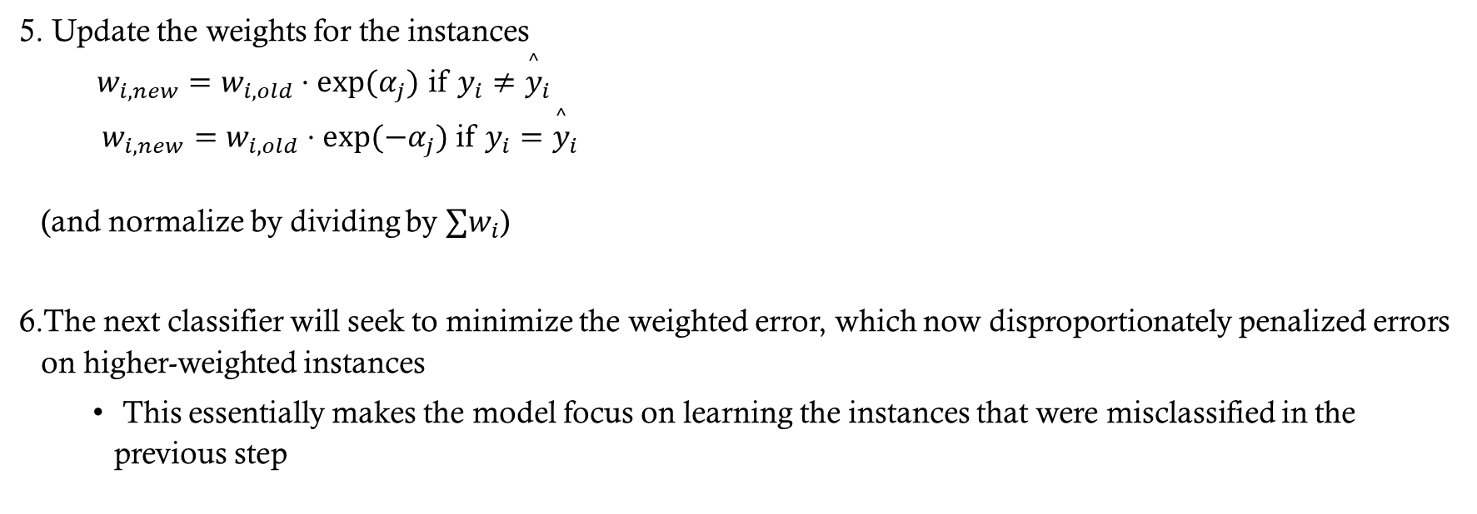
AdaBoost
Update the weights for the instances $w_{i,new}=w_{i,old}⋅exp(α_{j})$ if $y_{i}≠{\overset{^}{y}}_{i}$ $w_{i,new}=w_{i,old}⋅exp(−α_{j})$ if $y_{i}={\overset{^}{y}}_{i}$ (and normalize by dividing by $∑w_{i}$)
The next classifier will seek to minimize the weighted error, which now disproportionately penalized errors on higher-weighted instances
This essentially makes the model focus on learning the instances that were misclassified in the previous step

Slide 8
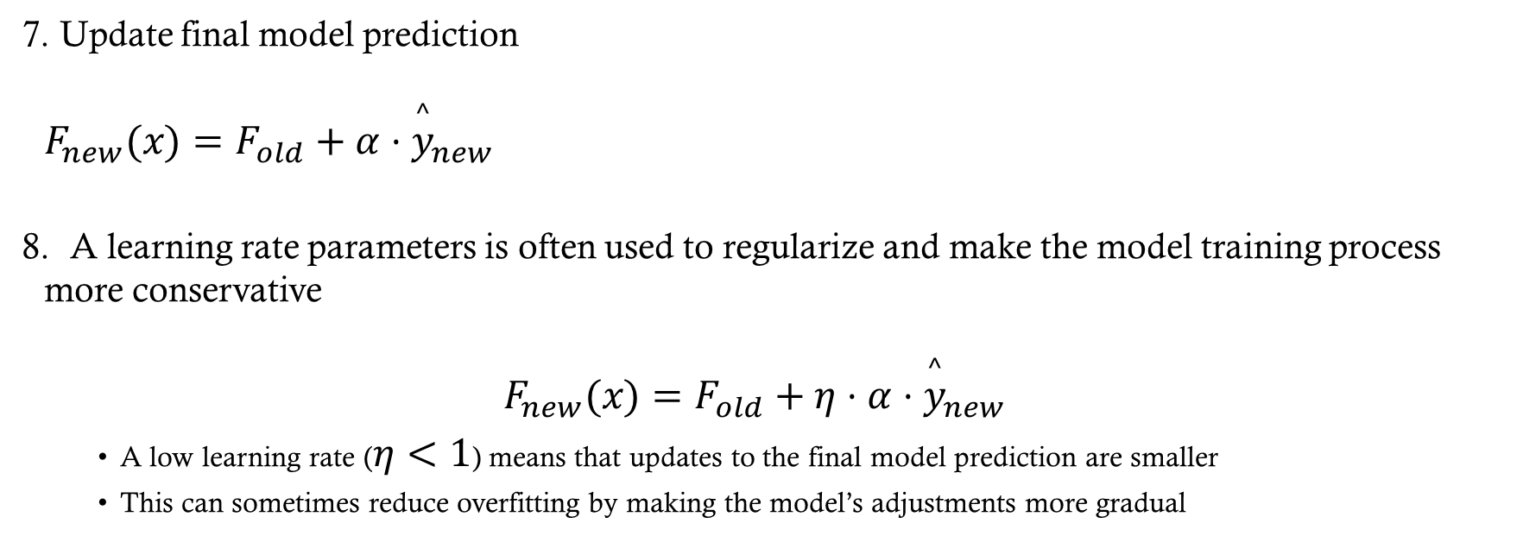
AdaBoost
Update final model prediction $F_{new}(x)=F_{old}+α⋅{\overset{^}{y}}_{new}$
A learning rate parameters is often used to regularize and make the model training process more conservative $F_{new}(x)=F_{old}+η⋅α⋅{\overset{^}{y}}_{new}$
A low learning rate ($η<1$) means that updates to the final model prediction are smaller
This can sometimes reduce overfitting by making the model’s adjustments more gradual

Slide 9
AdaBoost

Slide 10
Gradient Boosting

Slide 11
Gradient Boosting
Gradient Boosting directly targets the residuals (regression) or gradient of the loss function (classification)
At each step, a new weak learner is fit to the residual or pseudo-residuals

Slide 12
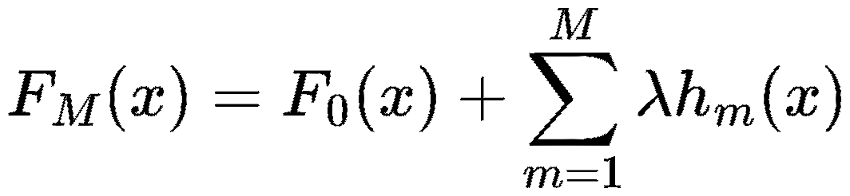
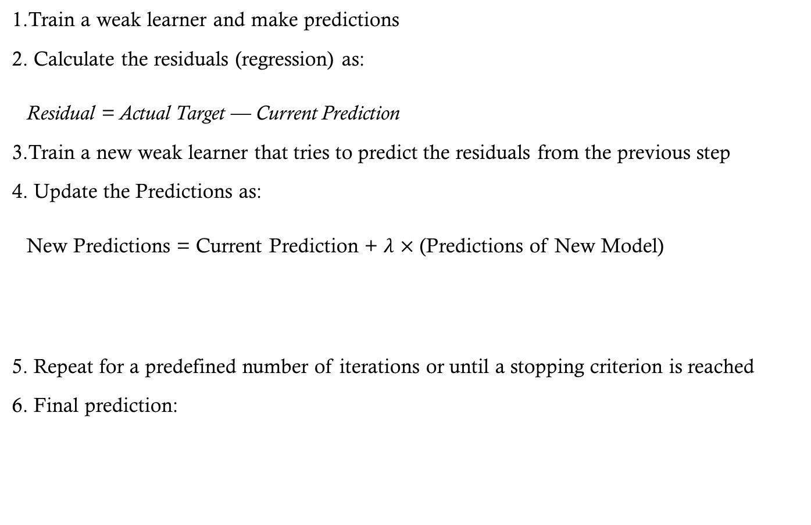
Gradient Boosting
Train a weak learner and make predictions
Calculate the residuals (regression) as: Residual = Actual Target — Current Prediction
Train a new weak learner that tries to predict the residuals from the previous step
Update the Predictions as: New Predictions = Current Prediction + $λ$ $×$ (Predictions of New Model)
Repeat for a predefined number of iterations or until a stopping criterion is reached
Final prediction:
“Predicted Residuals”
Learning Rate

Slide 13
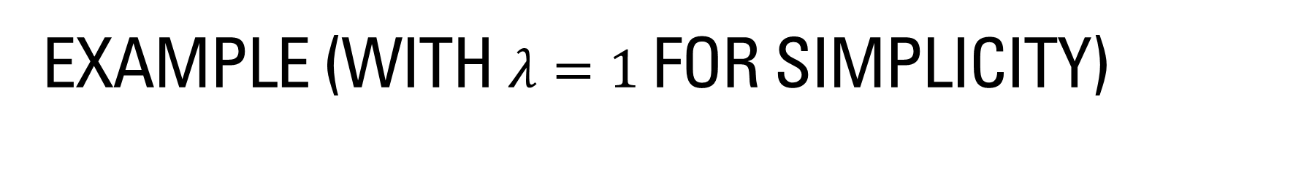
Example (with $λ=1$ for simplicity)
Step 1
Current Target
Current Predictions
Y | Yhat 1 | Resid-1 | Yhat-2 | Resid-2 | Yhat-3 | Final Prediction
0.05 | 0.12 | -0.07 | -0.09 | 0.02 | 0.01 | 0.04
0.59 | 0.53 | 0.07 | 0.04 | 0.03 | -0.07 | 0.5
0.17 | 0.12 | 0.04 | 0.04 | 0.0 | 0.01 | 0.17
-0.07 | 0.12 | -0.19 | -0.09 | -0.1 | 0.01 | 0.04
0.34 | 0.12 | 0.22 | 0.16 | 0.06 | 0.01 | 0.29

Slide 14
Example in a Table
Step 2
Current Target
Y | Yhat 1 | Resid-1 | Yhat-2 | Resid-2 | Yhat-3 | Final Prediction
0.05 | 0.12 | -0.07 | -0.09 | 0.02 | 0.01 | 0.04
0.59 | 0.53 | 0.07 | 0.04 | 0.03 | -0.07 | 0.5
0.17 | 0.12 | 0.04 | 0.04 | 0.0 | 0.01 | 0.17
-0.07 | 0.12 | -0.19 | -0.09 | -0.1 | 0.01 | 0.04
0.34 | 0.12 | 0.22 | 0.16 | 0.06 | 0.01 | 0.29

Slide 15
Example in a Table
Step 2
Current Target
Current Predictions
Y | Yhat 1 | Resid-1 | Yhat-2 | Resid-2 | Yhat-3 | Final Prediction
0.05 | 0.12 | -0.07 | -0.09 | 0.02 | 0.01 | 0.04
0.59 | 0.53 | 0.07 | 0.04 | 0.03 | -0.07 | 0.5
0.17 | 0.12 | 0.04 | 0.04 | 0.0 | 0.01 | 0.17
-0.07 | 0.12 | -0.19 | -0.09 | -0.1 | 0.01 | 0.04
0.34 | 0.12 | 0.22 | 0.16 | 0.06 | 0.01 | 0.29

Slide 16
Example in a Table
Step 3
Current Target
Y | Yhat 1 | Resid-1 | Yhat-2 | Resid-2 | Yhat-3 | Final Prediction
0.05 | 0.12 | -0.07 | -0.09 | 0.02 | 0.01 | 0.04
0.59 | 0.53 | 0.07 | 0.04 | 0.03 | -0.07 | 0.5
0.17 | 0.12 | 0.04 | 0.04 | 0.0 | 0.01 | 0.17
-0.07 | 0.12 | -0.19 | -0.09 | -0.1 | 0.01 | 0.04
0.34 | 0.12 | 0.22 | 0.16 | 0.06 | 0.01 | 0.29

Slide 17
Example in a Table
Step 3
Current Target
Current Predictions
Y | Yhat 1 | Resid-1 | Yhat-2 | Resid-2 | Yhat-3 | Final Prediction
0.05 | 0.12 | -0.07 | -0.09 | 0.02 | 0.01 | 0.04
0.59 | 0.53 | 0.07 | 0.04 | 0.03 | -0.07 | 0.5
0.17 | 0.12 | 0.04 | 0.04 | 0.0 | 0.01 | 0.17
-0.07 | 0.12 | -0.19 | -0.09 | -0.1 | 0.01 | 0.04
0.34 | 0.12 | 0.22 | 0.16 | 0.06 | 0.01 | 0.29

Slide 18
Example in a Table
Y | Yhat 1 | Resid-1 | Yhat-2 | Resid-2 | Yhat-3 | Final Prediction
0.05 | 0.12 | -0.07 | -0.09 | 0.02 | 0.01 | 0.04
0.59 | 0.53 | 0.07 | 0.04 | 0.03 | -0.07 | 0.5
0.17 | 0.12 | 0.04 | 0.04 | 0.0 | 0.01 | 0.17
-0.07 | 0.12 | -0.19 | -0.09 | -0.1 | 0.01 | 0.04
0.34 | 0.12 | 0.22 | 0.16 | 0.06 | 0.01 | 0.29

Slide 19
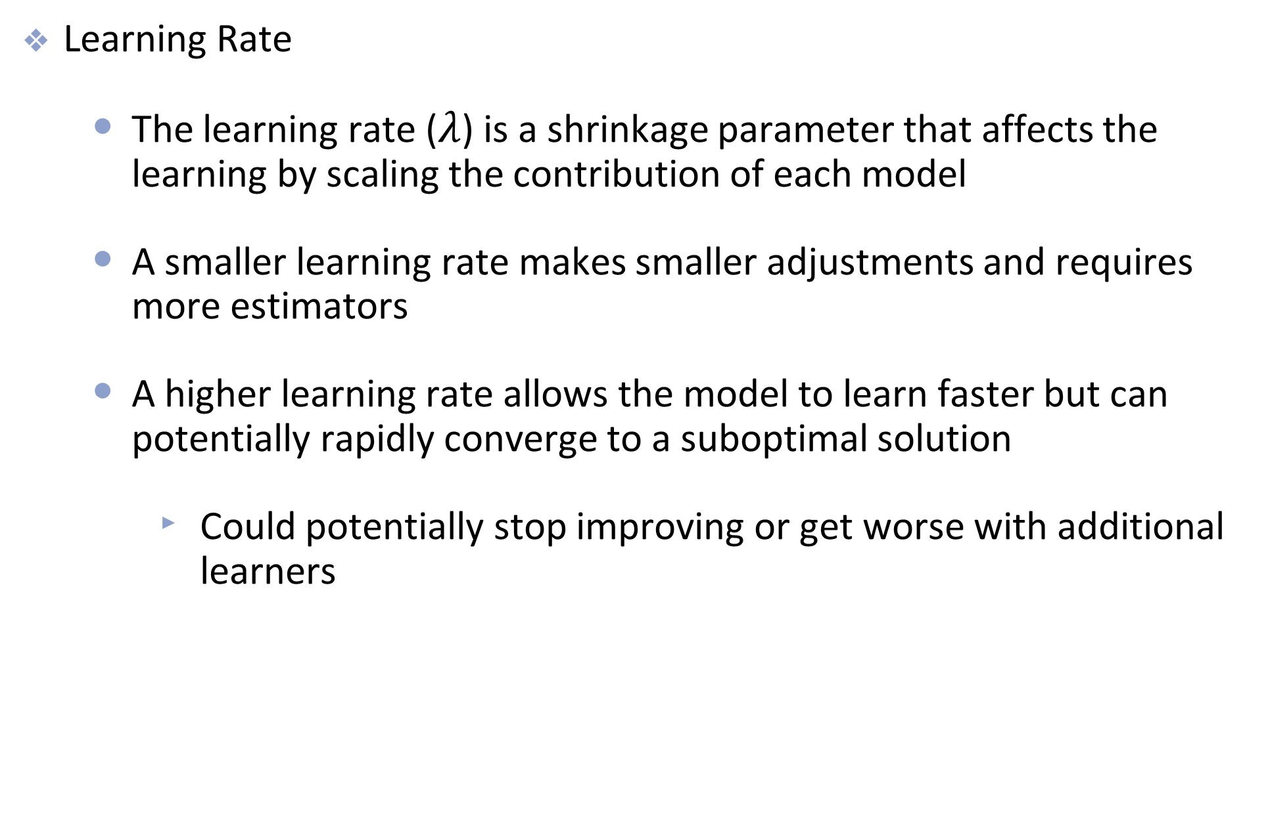
Tuning Parameters
Learning Rate
The learning rate ($λ$) is a shrinkage parameter that affects the learning by scaling the contribution of each model
A smaller learning rate makes smaller adjustments and requires more estimators
A higher learning rate allows the model to learn faster but can potentially rapidly converge to a suboptimal solution
Could potentially stop improving or get worse with additional learners

Slide 20
Tuning Parameters
Number of estimators
Number of sequential learners added to the models
Too few estimators → underfitting (model has not reduced training loss sufficiently)
Too many estimators → overfitting (model begins fitting noise in the training data)
Early stopping can help select an appropriate number
Learning Rate
Controls how much each new tree contributes to the overall model
Smaller learning rate → requires more trees, but typically improves generalization
Larger learning rate → requires fewer trees, but increases risk of overfitting or unstable updates
Trade-off
Lower learning rate + more trees → slower, more stable learning
Higher learning rate + fewer trees → faster, more aggressive learning
Effective model complexity depends on both parameters together

Slide 21
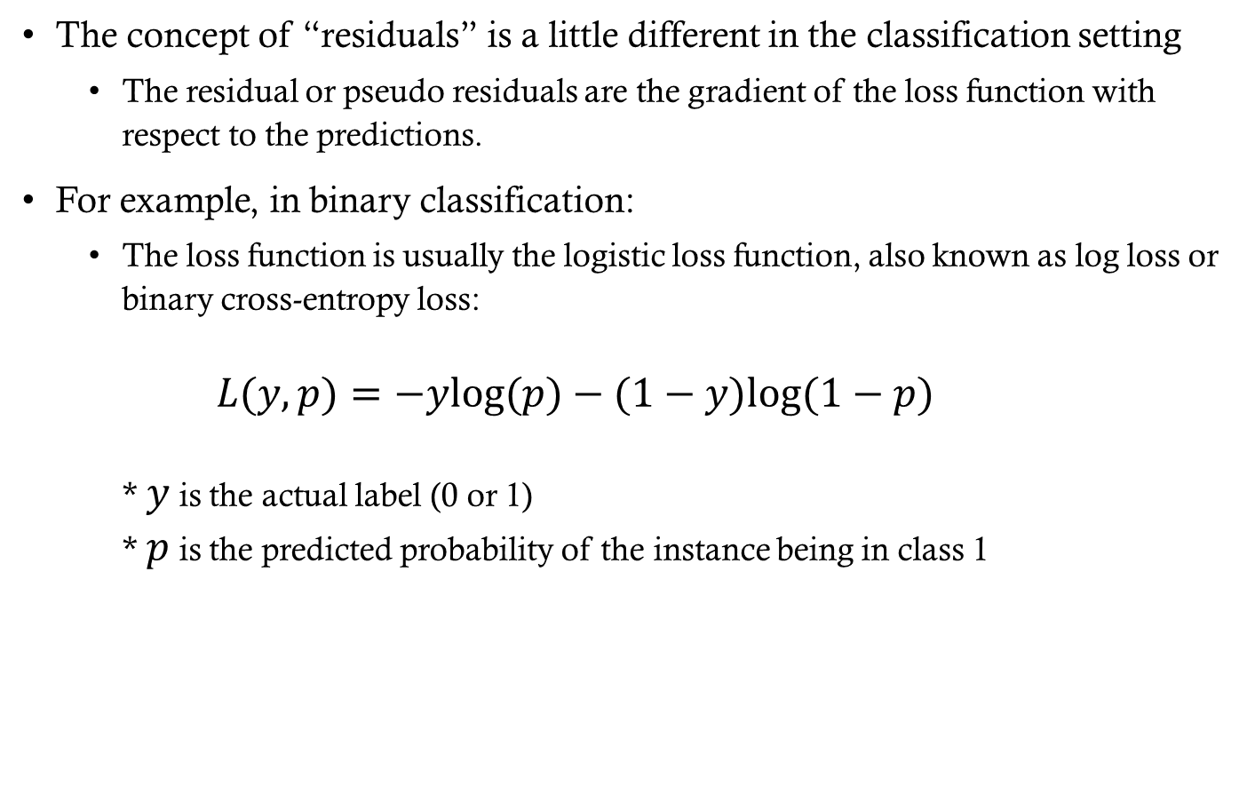
Gradient Boosting for Classification
The concept of “residuals” is a little different in the classification setting
The residual or pseudo residuals are the gradient of the loss function with respect to the predictions.
For example, in binary classification:
The loss function is usually the logistic loss function, also known as log loss or binary cross-entropy loss: $L(y,p)=−ylog(p)−(1−y)log(1−p)$ * $y$ is the actual label (0 or 1) * $p$ is the predicted probability of the instance being in class 1

Slide 22
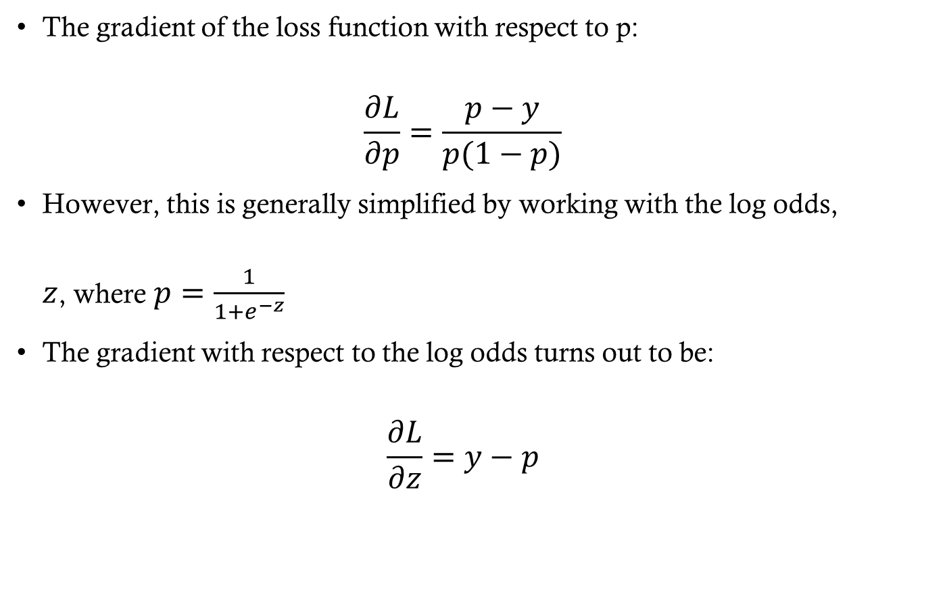
Gradient Boosting for Classification
The gradient of the loss function with respect to p: $\frac{∂L}{∂p}=\frac{p−y}{p(1−p)}$
However, this is generally simplified by working with the log odds, $z$, where $p=\frac{1}{1+e^{−z}}$
The gradient with respect to the log odds turns out to be: $\frac{∂L}{∂z}=y−p$

Slide 23
Implementations of Gradient Boosting
Scikit-Learn
GradientBoostingClassifier / GradientBoostingRegressor
Easy to use and integrates well with sklearn pipelines
Can be slower on large datasets
HistGradientBoosting provides a faster, histogram-based implementation
XGBoost (Extreme Gradient Boosting)
Highly optimized and efficient
Supports L1 and L2 regularization
Handles missing values automatically
Parallelized and widely used in industry
LightGBM (Light Gradient Boosting Machine)
Very fast for large datasets
Histogram-based learning for efficiency
Leaf-wise tree growth strategy
Native handling of categorical features
Memory efficient
CatBoost
Strong performance with minimal tuning
Excellent handling of categorical variables
Reduces preprocessing requirements

Slide 24
Installing boosting libraries
XGBoost
Using pip: pip install xgboost
Using conda: conda install -c conda-forge py-xgboost
LightGBM
Using pip: pip install lightgbm
Using conda: conda install -c conda-forge lightgbm
CatBoost
Using pip: pip install catboost
Using conda: conda install -c conda-forge catboost

