Slide 1

Classification – Naïve Bayes

Slide 2
Bayes Classifier
In statistical classification, the Bayes Classifier minimizes the probability of misclassification
It is possible to show that the test error rate is minimized (on average) by a classifier that assigns each observation to the most likely class given its predictor values

Slide 3
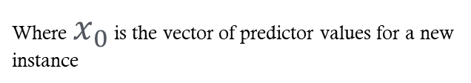
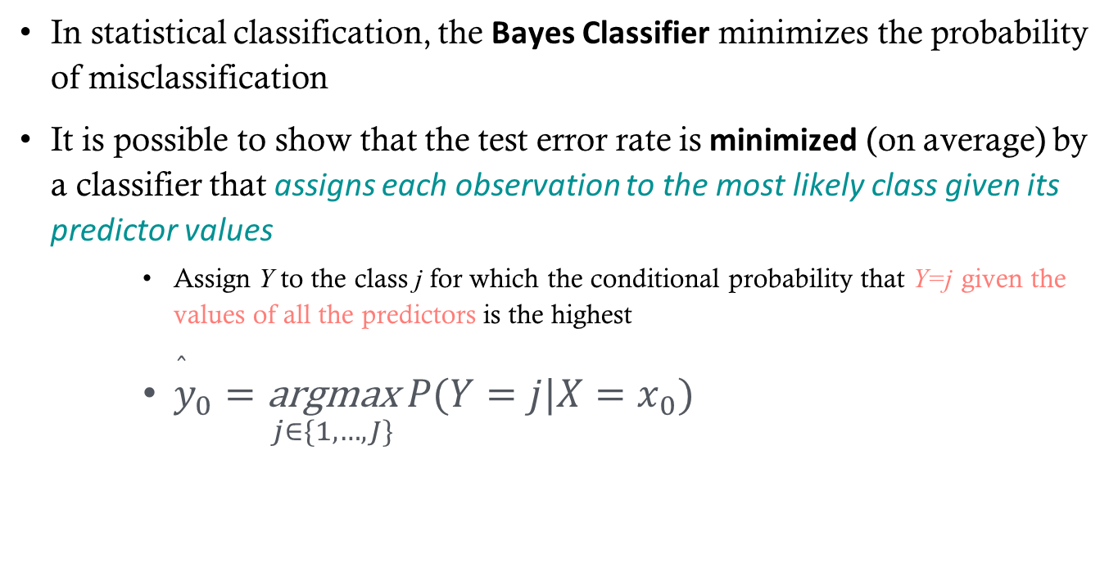
Bayes Classifier
In statistical classification, the Bayes Classifier minimizes the probability of misclassification
It is possible to show that the test error rate is minimized (on average) by a classifier that assigns each observation to the most likely class given its predictor values
Assign Y to the class j for which the conditional probability that Y=j given the values of all the predictors is the highest
${\overset{̂}{y}}_{0}=\underset{j∈\{1,…,J\}}{\text{argmax}} P(Y=j|X=x_{0})$
Where $x_{0}$ is the vector of predictor values for a new instance

Slide 4
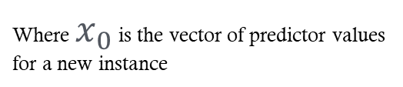
Bayes Classifier
Example:
In a two-class problem (classes 0 and 1):
Assign:
Where $x_{0}$ is the vector of predictor values for a new instance

Slide 5
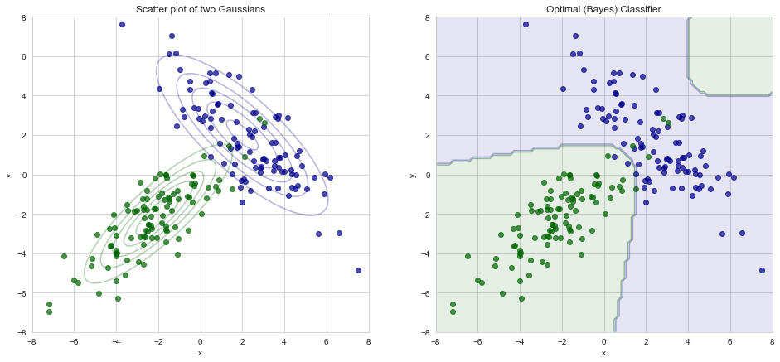
Illustration of Optimal Classifier
(From ISLR)

Slide 6
One small problem…
It is impossible to know the probability of Y given X, so computing the Bayes classifier is impossible for real problems
Many approaches attempt to estimate the conditional distribution of Y given X and then classify a given observation to the class with the highest estimated probability

Slide 7

KNN again
We’ve already seen how the KNN Classifier estimates this probability
$P(Y=j|X=x_{0})=\frac{1}{k}\underset{x_{i}∈𝒩_{0}}{∑}ℐ(y_{i}=j)$

Slide 8
Naive Bayes

Slide 9
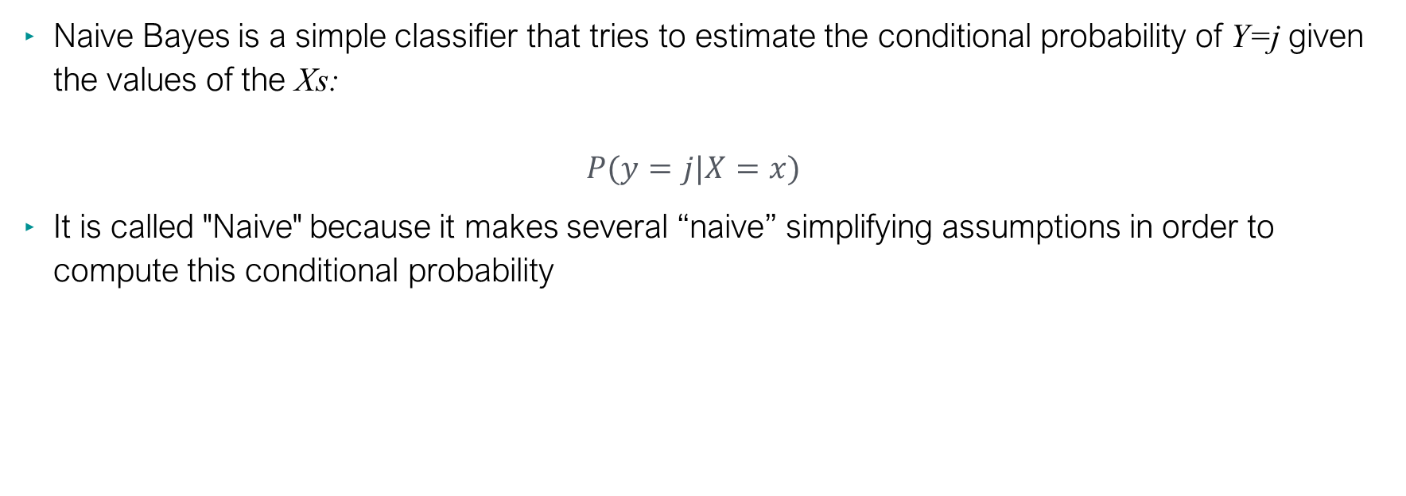
Naive Bayes Classifier
Naive Bayes is a simple classifier that tries to estimate the conditional probability of Y=j given the values of the Xs: $P(y=j|X=x)$
It is called "Naive" because it makes several “naive” simplifying assumptions in order to compute this conditional probability

Slide 10

Bayes Rule
$$P(Y=j|X=x)=$$

Slide 11


Bayes Rule
Proportional to
Likelihood
Prior
Likelihood
Prior
$$P(Y=j|X=)=\frac{P(X=x|Y=j)P(Y=j)}{P(X=x)}∝P(X=x|Y=j)P(Y=j)$$
Normalizing constant
Joint pdf of X given Y=j

Slide 12
Bayes Rule
Likelihood
Prior
$$P(Y=j|X=x)∝P(X=x|Y=j)P(Y=j)$$

Slide 13

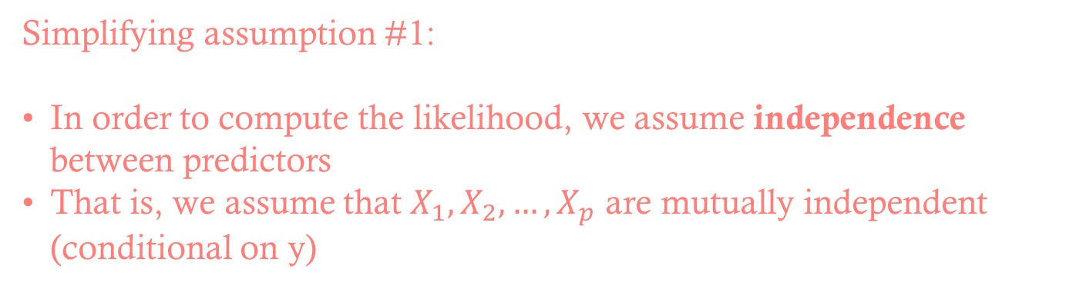
Naive Bayes Simplifying Assumptions
Likelihood
Prior
$$P(Y=j|X=x)∝P(X=x|Y=j)P(Y=j)$$
Simplifying assumption #1:
In order to compute the likelihood, we assume independence between predictors
That is, we assume that $X_{1},X_{2},…,X_{p}$ are mutually independent (conditional on y)

Slide 14

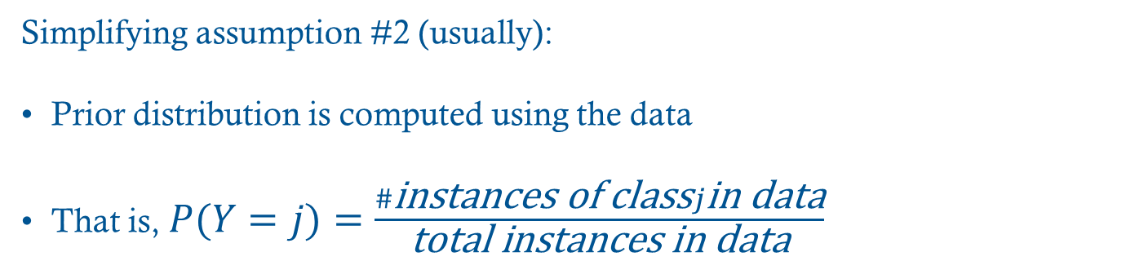
Naive Bayes Simplifying Assumptions
Likelihood
Prior
$$P(Y=j|X=x)∝P(X=x|Y=j)P(Y=j)$$
Simplifying assumption #2 (usually):
Prior distribution is computed using the data
That is, $P(Y=j)=\frac{\#\text{instances} \text{of} \text{class}j\text{in} \text{data}}{\text{total} \text{instances} \text{in} \text{data}}$

Slide 15

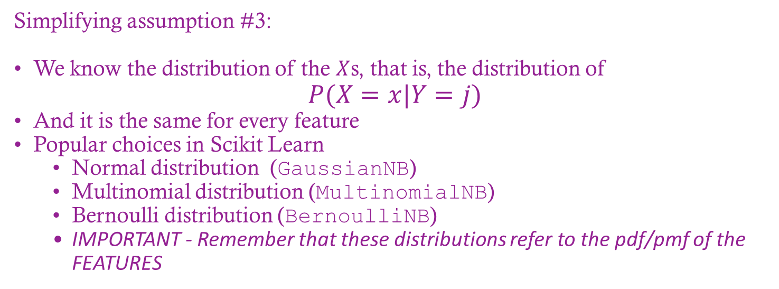
Naive Bayes Simplifying Assumptions
Likelihood
Prior
$$P(Y=j|X=x)∝P(X=x|Y=j)P(Y=j)$$
Simplifying assumption #3:
We know the distribution of the $X$s, that is, the distribution of $P(X=x|Y=j)$
And it is the same for every feature
Popular choices in Scikit Learn
Normal distribution (GaussianNB)
Multinomial distribution (MultinomialNB)
Bernoulli distribution (BernoulliNB)
IMPORTANT - Remember that these distributions refer to the pdf/pmf of the FEATURES

Slide 16
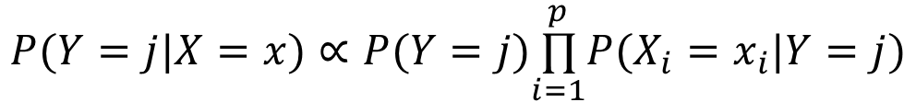
Naive Bayes Simplifying Assumptions
$$P(Y=j|X=x)∝P(Y=j)\overset{p}{\underset{i=1}{∏}}P(X_{i}=x_{i}|Y=j)$$
Assume to be Normal when Xs are numerical
Assumed to be Multinomial or Bernoulli otherwise
Estimated with frequencies from the training data
Main naive assumptions: Xs are all conditionally independent, so the joint distribution is the product of the marginals

Slide 17
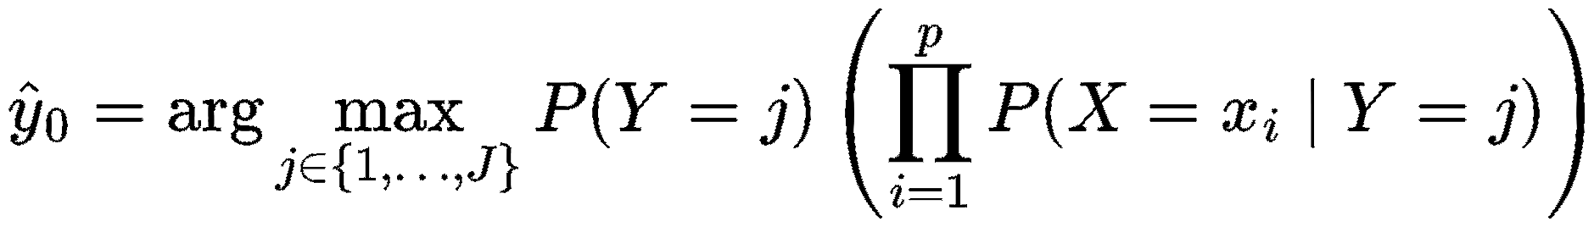
Naive Bayes Classifier

Slide 18
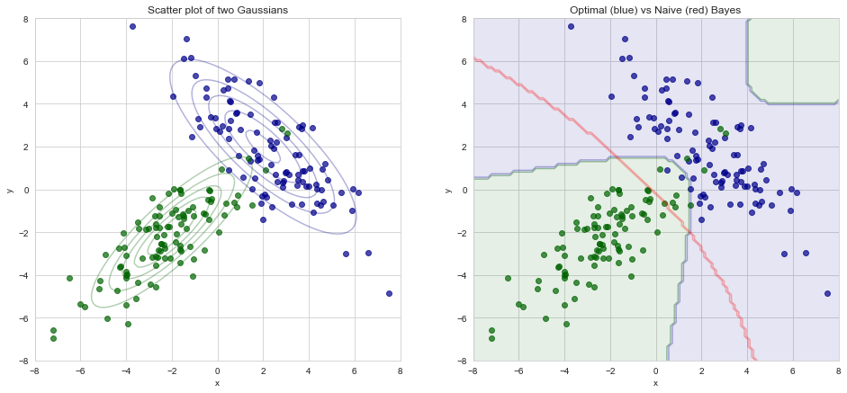
Bayes vs Naive Bayes
(From ISLR)

Slide 19
When to use NB
Because NB classifiers make such stringent assumptions, they are often not as good as more complicated models
NB classifiers are a good choice for an initial baseline classification
Some advantages of NB classifiers:
They are very fast for both training and prediction
They are easily interpretable
There are few (if any) tunable parameters

Slide 20
When to use NB
NB classifiers tend to work in the following situations:
The naive assumptions actually match the data (rare)
For well-separated categories, when model complexity is less important
For very high-dimensional data, when model complexity is less important

Slide 21
Common Scikit-Learn NB commands
Module: sklearn.naive_bayes
Estimators: GaussianNB, MultinomialNB, BernoulliNB (use the model that corresponds to the features)
Fitting: call .fit(Xtrain,ytrain) method off the estimator
Prediction: Two possible methods (true for most classification estimators)
# predicted class - 1d array .predict(Xtest)
# predicted P(Y=j|X) - 2d array (rows=n, columns=#classes) .predict_proba(Xtest)

