Slide 1
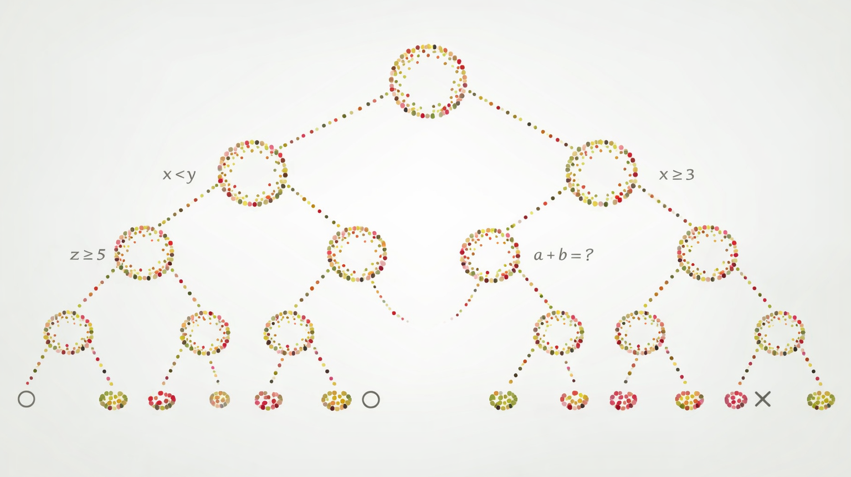
Decision Trees

Slide 2
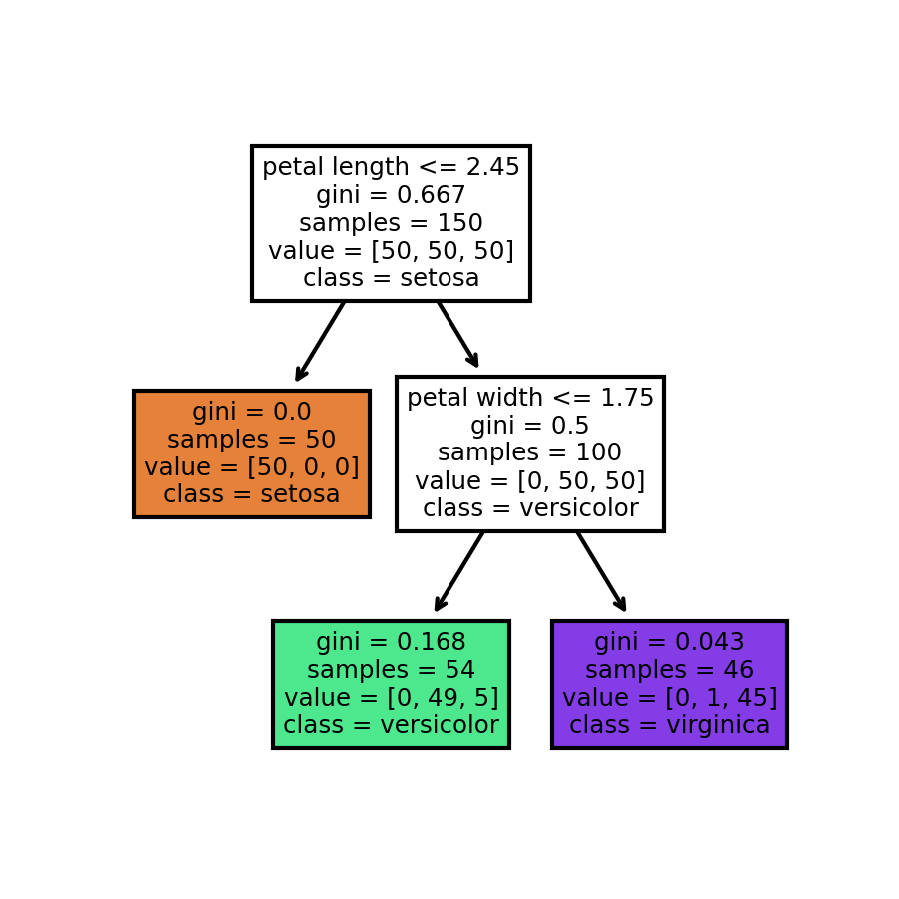
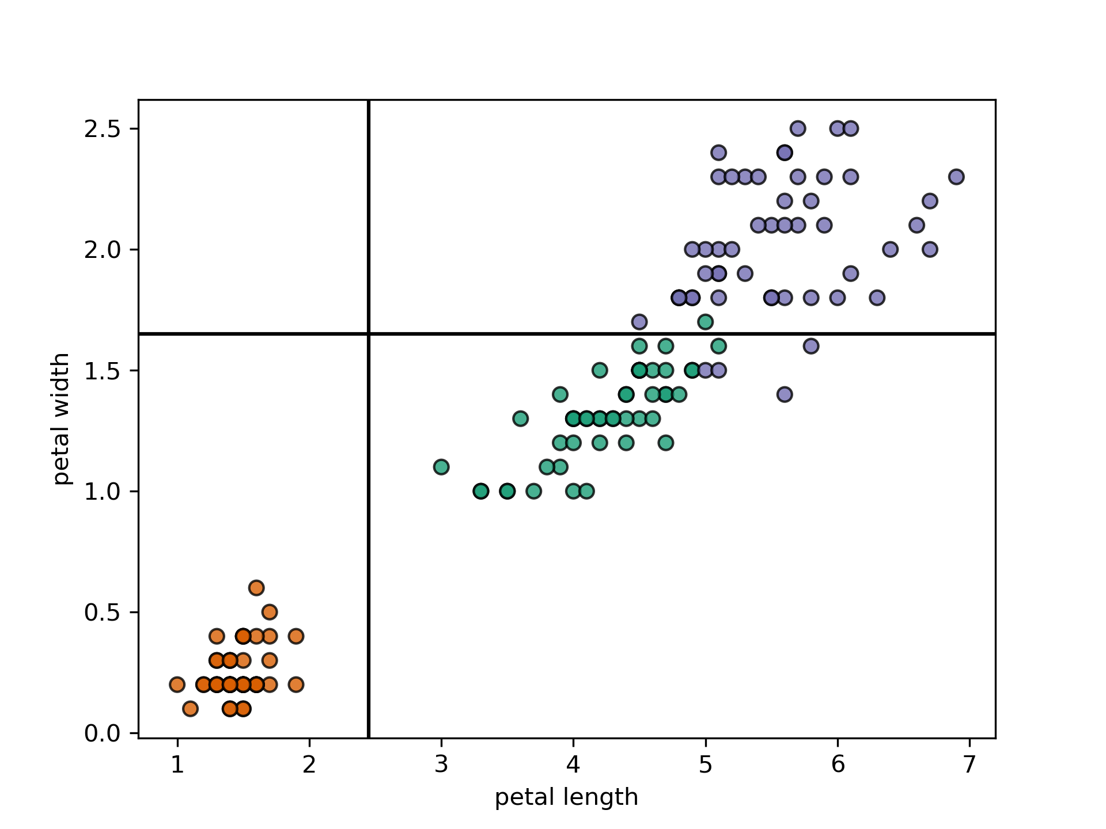
Example Decision Tree

Slide 3
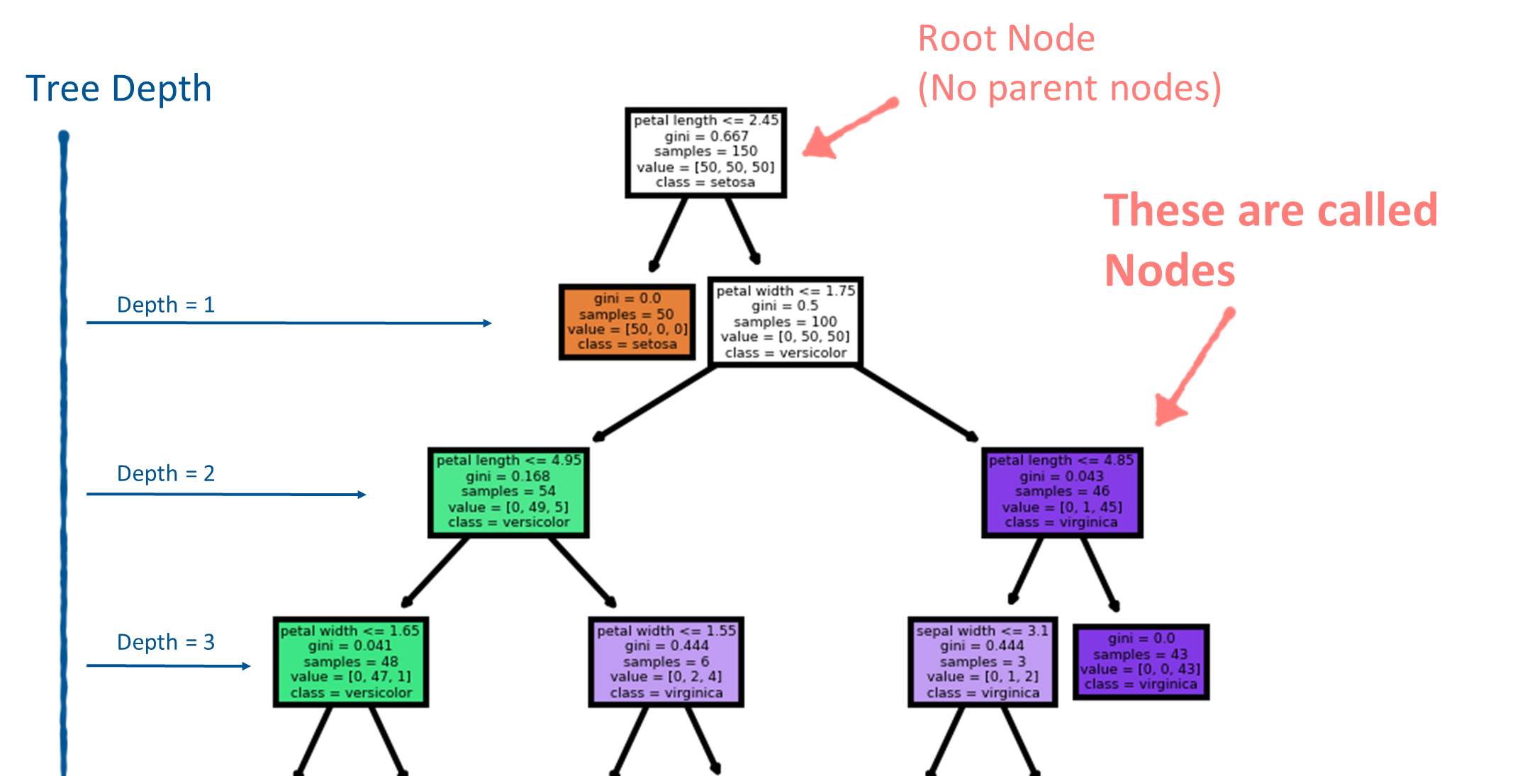

Slide 4
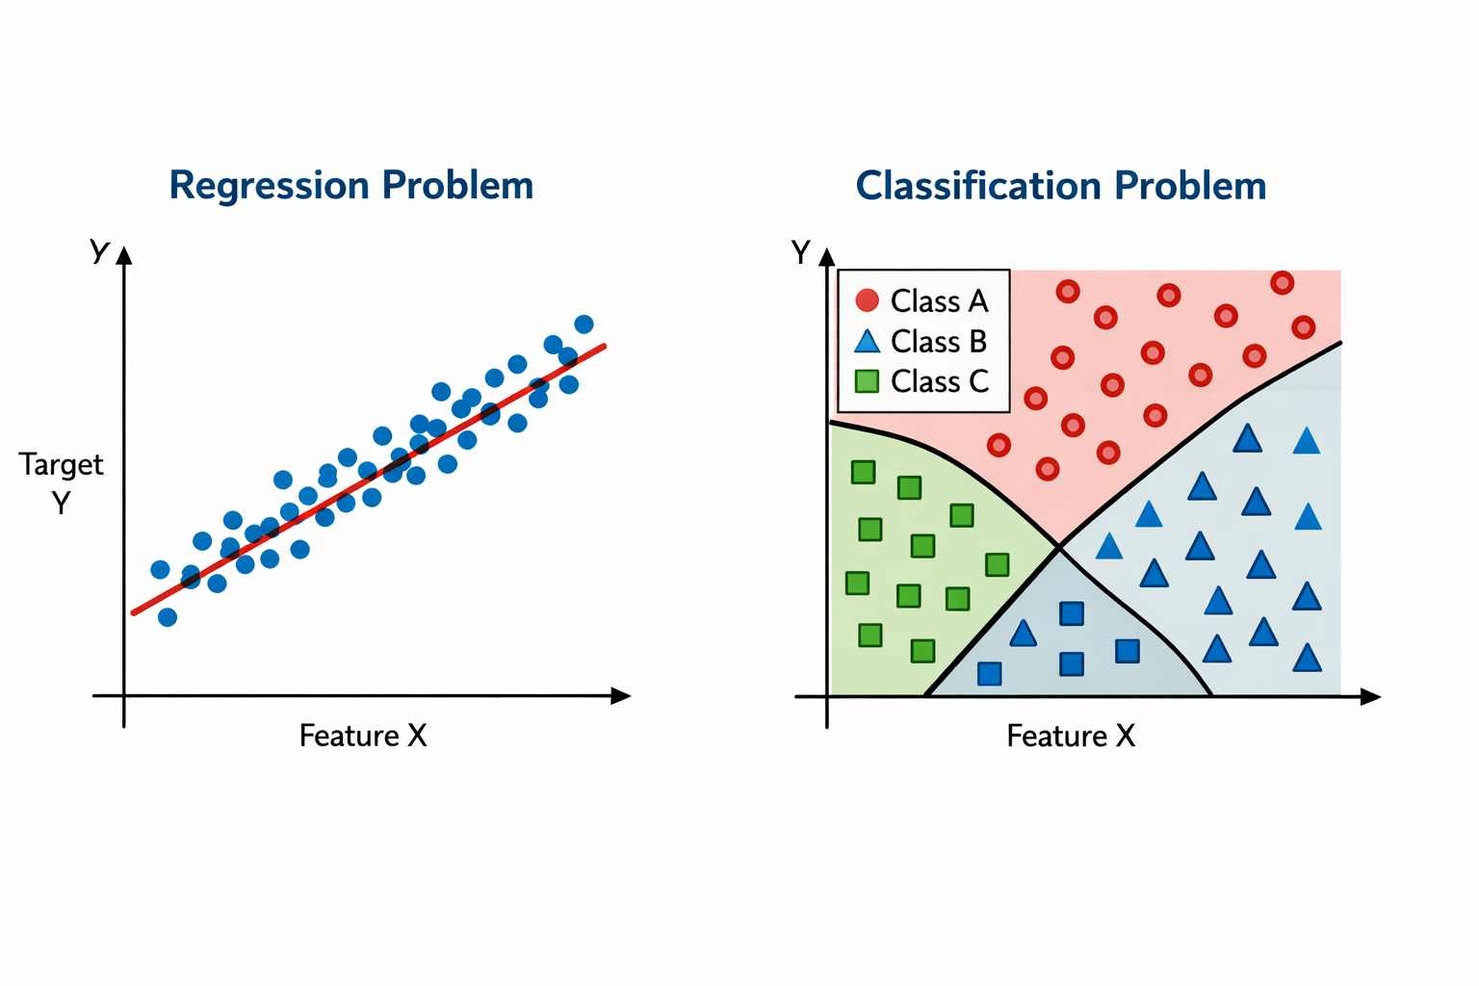
How To fit?
Binary decision search algorithm.
Partition (split) data to optimize some objective.
What might that objective be?

Slide 5
Decision Tree Algorithms
CART is one of the most popular decision tree algorithms
Binary splitting - trees are constructed by splitting the data into two subsets using the feature and threshold that results in the “best” split
Best split - the best split is the split that produces the most homogeneous groups
Recursive splitting - the process of splitting is applied recursively to each derived subset
Pruning - trees are pruned to obtain a smaller tree to help prevent overfitting

Slide 6


Node Impurity Measures (Classification)
Define $p_{ik}$ as the proportion of instances in the $i^{th}$ node that are from class $k$
Gini index $G_{i}=1−\overset{K}{\underset{k=1}{∑}}p_{ik}^{2}=\overset{K}{\underset{k=1}{∑}}p_{ik}(1−p_{ik})$
Cross Entropy $H_{i}=−\overset{K}{\underset{k=1}{∑}}p_{ik}\log_{2}(p_{ik})$
$$\text{if}p_{ik}≠0$$

Slide 7

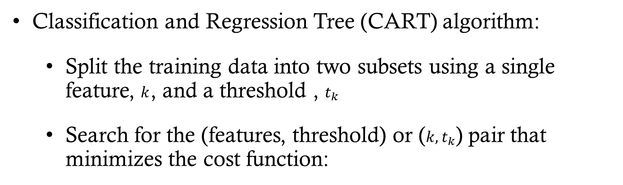


Growing the Tree (Fitting)
Classification and Regression Tree (CART) algorithm:
Split the training data into two subsets using a single feature, $k$, and a threshold , $t_{k}$
Search for the (features, threshold) or ($k,t_{k}$) pair that minimizes the cost function:
CLASSIFICATION
$$\frac{n_{left}}{n}G_{left}+\frac{n_{right}}{n}G_{right}$$
Where $G$ is a measure of node impurity
REGRESSION
$$\frac{n_{left}}{n}MSE_{left}+\frac{n_{right}}{n}MSE_{right}$$

Slide 8


Node Impurity Measures (Classification)
Gini index : $G_{i}=1−\overset{K}{\underset{k=1}{∑}}p_{ik}^{2}$
For the “green” node $p_{i1}=(0/54); p_{i2}=(49/54); p_{i3}=(5/54)$ $G_{i}=1−\left((0/54)^{2}+(49/54)^{2}+(5/54)^{2}\right)$ $=0.168$
For the “purple” node $p_{i1}=(0/46); p_{i2}=(1/46); p_{i3}=(45/46)$ $G_{i}=1−\left((0/46)^{2}+(1/46)^{2}+(45/46)^{2}\right)$ $=0.043$

Slide 9

Node Impurity Measures (Classification)
Entropy : $H_{i}=−\overset{K}{\underset{k=1}{∑}}p_{ik}\log_{2}(p_{ik})$
For the “green” node $p_{i1}=(0/54); p_{i2}=(49/54); p_{i3}=(5/54)$ $H_{i}=−\left((49/54)\log_{2}(49/54)+(5/54)\log_{2}(5/54)\right)$ $=0.445$
For the “purple” node $p_{i1}=(0/46); p_{i2}=(1/46); p_{i3}=(45/46)$ $H_{i}=−\left((1/46)\log_{2}(1/46)+(45/46)\log_{2}(45/46)\right)$ $=0.151$

Slide 10
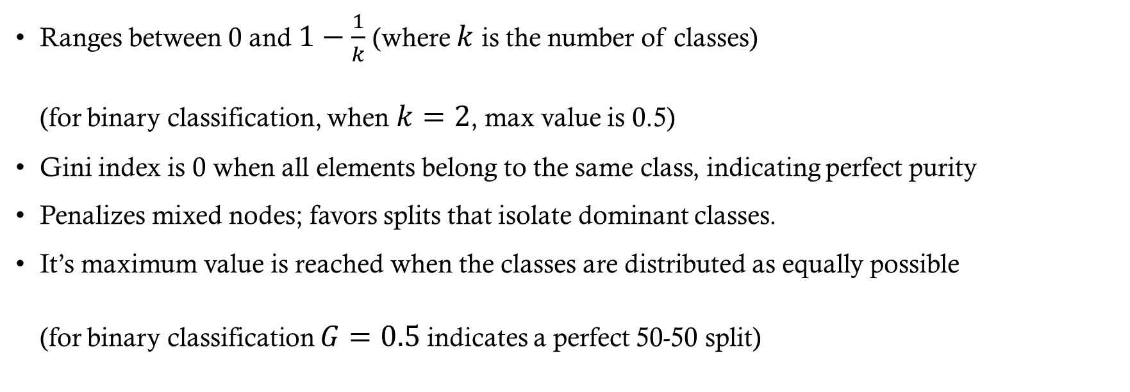
Gini Index
Ranges between 0 and $1−\frac{1}{k}$ (where $k$ is the number of classes) (for binary classification, when $k=2$, max value is 0.5)
Gini index is 0 when all elements belong to the same class, indicating perfect purity
Penalizes mixed nodes; favors splits that isolate dominant classes.
It’s maximum value is reached when the classes are distributed as equally possible (for binary classification $G=0.5$ indicates a perfect 50-50 split)

Slide 11
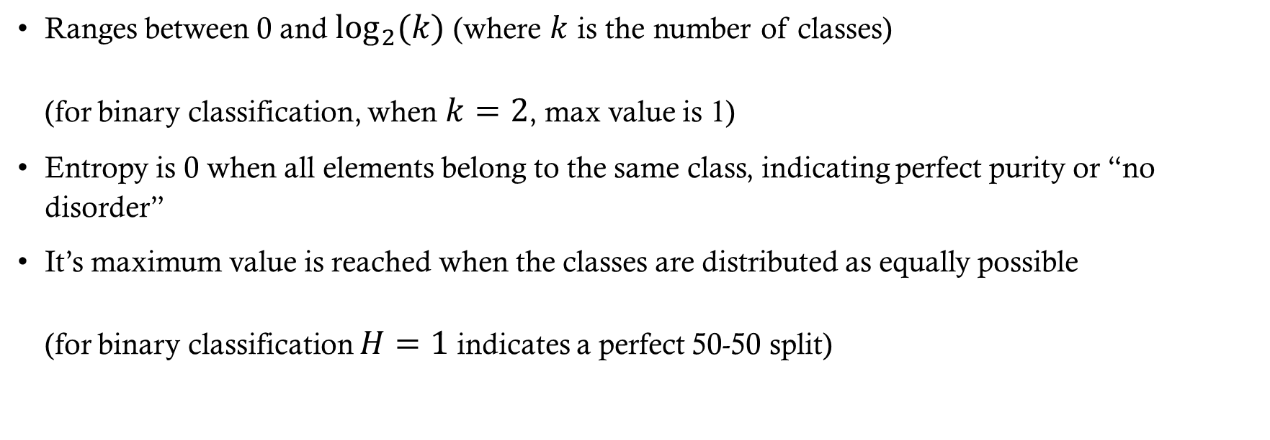
Entropy
Ranges between 0 and $\log_{2}(k)$ (where $k$ is the number of classes) (for binary classification, when $k=2$, max value is 1)
Entropy is 0 when all elements belong to the same class, indicating perfect purity or “no disorder”
It’s maximum value is reached when the classes are distributed as equally possible (for binary classification $H=1$ indicates a perfect 50-50 split)

Slide 12
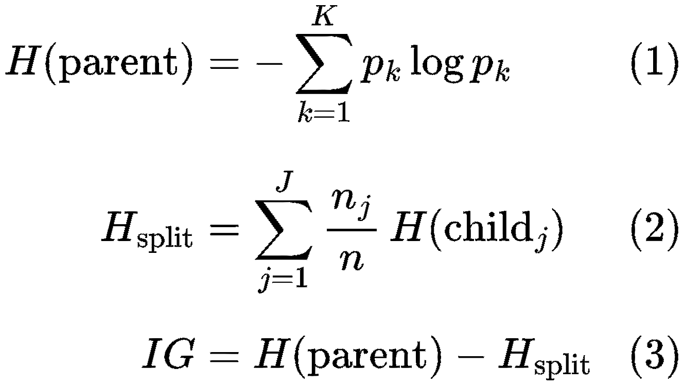
Information Gain
Entropy is used to calculate the information gained from the split
Information gain:
Entropy(parent) – Entropy(split)

Slide 13
Gini Impurity vs Entropy
The default in Scikit-Learn is Gini because it is faster to compute
For decision tree construction, most of the time they lead to similar trees
If they differ:
Entropy tends to produce more balanced trees
Gini Impurity tends to isolate the most frequent class onto its own branch
(See https://homl.info/19 for more details)

Slide 14
The CART Algorithm
There are other tree algorithms that can produce nodes with more than two children
Binary
Nodes can only split into two groups
Top down
Start at the top of the tree
Efficient Split Finding
Consider only the midpoint between consecutive unique values
Greedy
Finds the optimal split at the current level

Slide 15
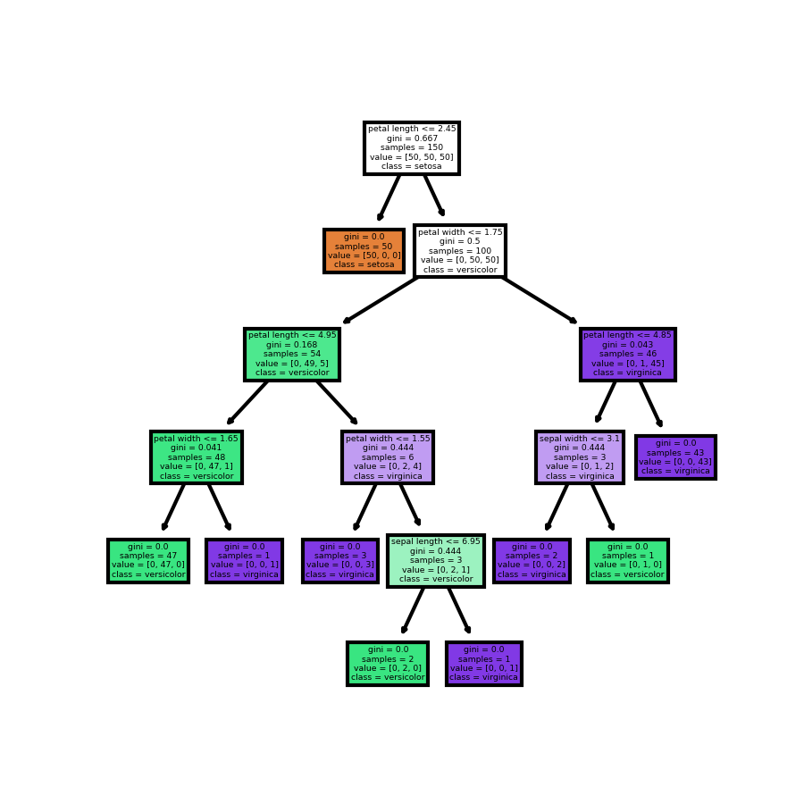
Trees can grow very large if left unconstrained

Slide 16
Regularization
Recall that regularization means constraining the model to prevent overfitting
Decision Trees can be regularized by
Constraining growth (pre-pruning)
Post-pruning the unconstrained tree (cost complexity pruning)

Slide 17
Pre-pruning regularization
Stop tree growth before it perfectly classifies the training data
max_depth: maximum depth of tree
min_samples_split: minimum number of samples required to split an internal node.
min_samples_leaf: minimum number of sample required to be at a leaf node
max_leaf_nodes: maximum number of leaf nodes
min_impurity_decrease: a node will be split if the split induces a decrease of impurity greater than or equal to this value
reduce “max” parameters and/or increase “min” parameters if tree is overfitting

Slide 18
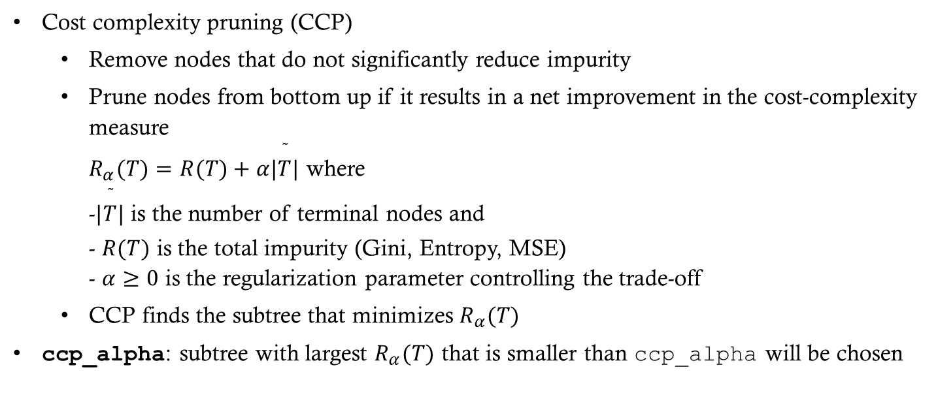
Post-pruning regularization
Cost complexity pruning (CCP)
Remove nodes that do not significantly reduce impurity
Prune nodes from bottom up if it results in a net improvement in the cost-complexity measure $R_{α}(T)=R(T)+α|\overset{˜}{T}|$ where -$|\overset{˜}{T}|$ is the number of terminal nodes and - $R(T)$ is the total impurity (Gini, Entropy, MSE) - $α≥0$ is the regularization parameter controlling the trade-off
CCP finds the subtree that minimizes $R_{α}(T)$
ccp_alpha: subtree with largest $R_{α}(T)$ that is smaller than ccp_alpha will be chosen

Slide 19
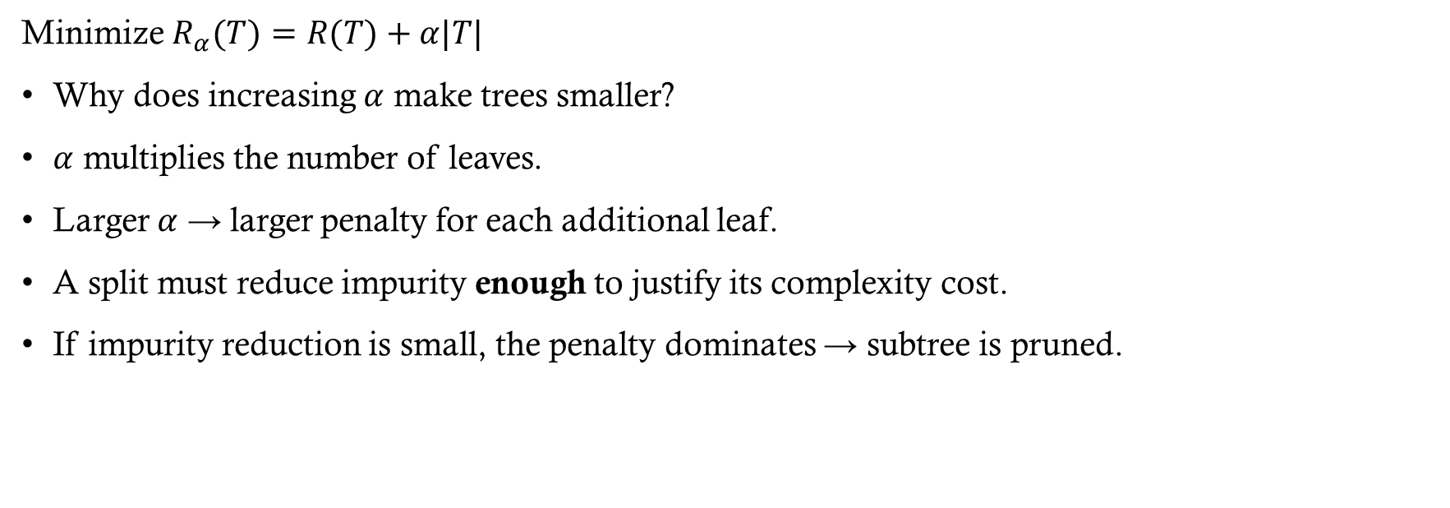
Cost-Complexity Pruning (CCP): Intuition
Minimize $R_{α}​(T)=R(T)+α|T|$
Why does increasing $α$ make trees smaller?
$α$ multiplies the number of leaves.
Larger $α$ → larger penalty for each additional leaf.
A split must reduce impurity enough to justify its complexity cost.
If impurity reduction is small, the penalty dominates → subtree is pruned.

Slide 20
Pre- versus Post-Pruning
Choice depends on:
Specific dataset and overfitting behavior observed
Domain knowledge
Model performance on a validation set
Personal preference

Slide 21
Making Predictions
We can predict the target of a new instance by following the tree from top to bottom
At the terminal (leaf) nodes predict using:
Classification: The majority class in the node
Regression: The mean target value of the training values in the node

Slide 22
Making Predictions (Classification)
We can predict the target of a new instance by following the tree from top to bottom
At the terminal (leaf) nodes predict using:
Classification: The majority class in the node

Slide 23
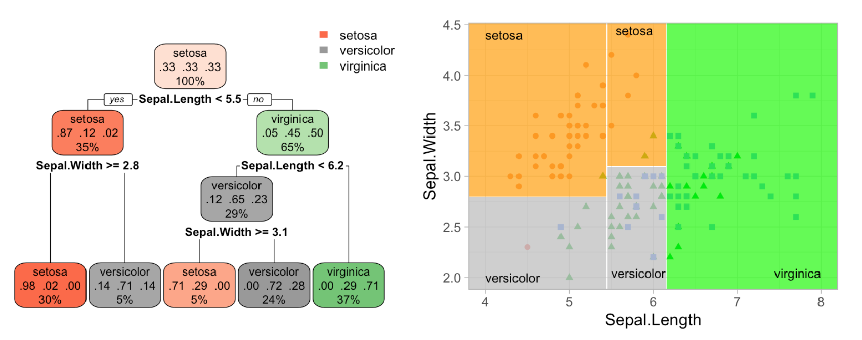
Classification Boundary Example
HOML R

Slide 24
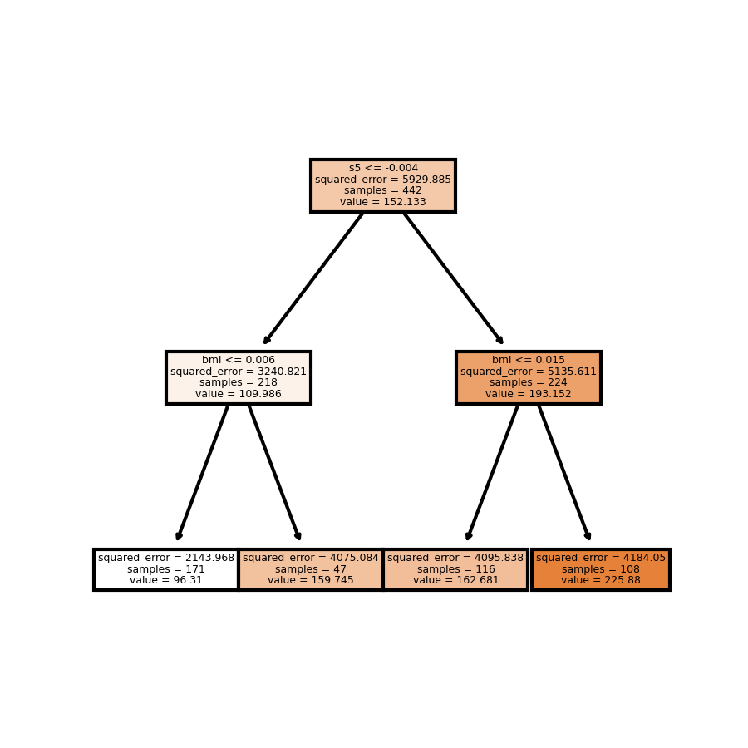
Making Predictions (Regression)

Slide 25
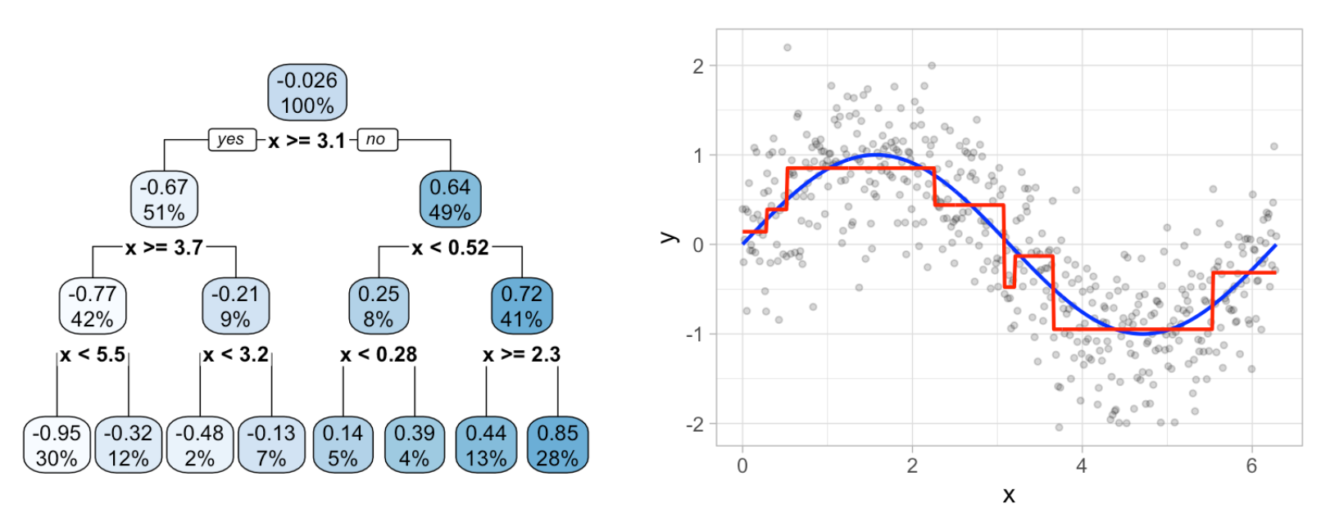
Example: Regression Decisions
HOML R

Slide 26
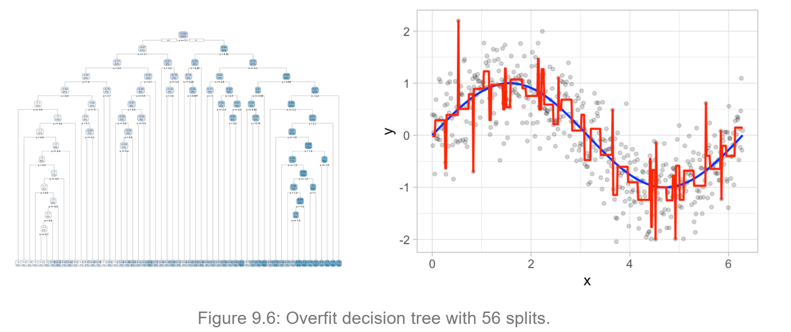
Example: Regression Decisions
HOML R

Slide 27
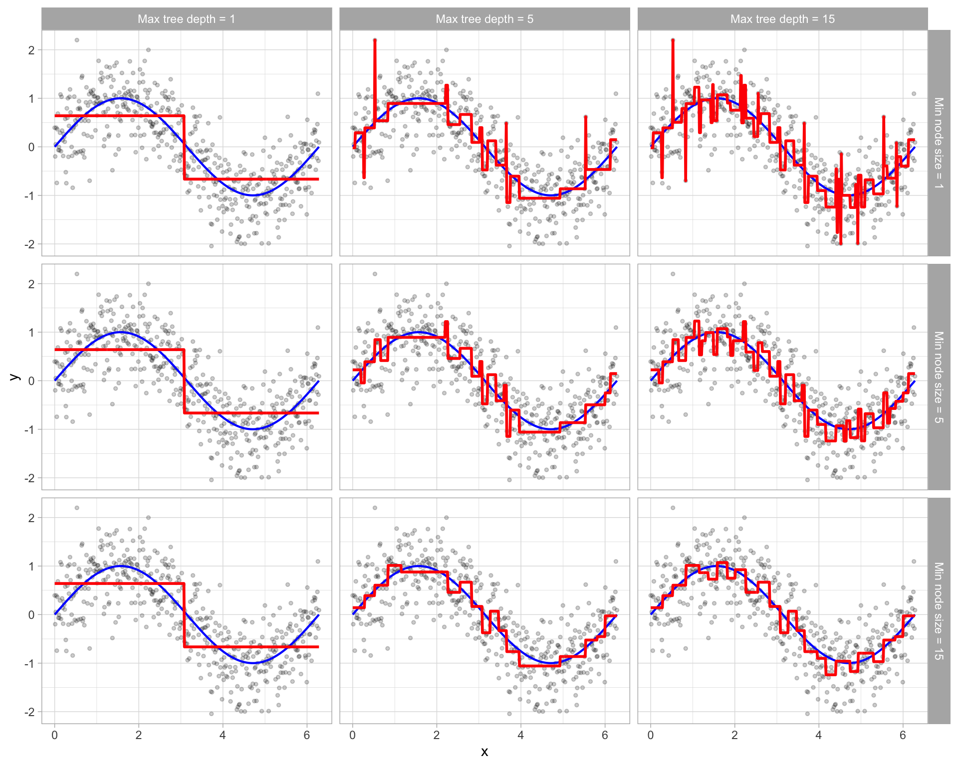

Slide 28
Other Decision Tree Algorithms
CART is a very popular tree algorithm but it isn’t the only one (though it is the only one in scikit-learn)
Other algorithms:
ID3 - designed for classification problems - Uses information gain to select the feature that best splits the set of items - Works only with categorical features - More than two branches can be created from a node
C4.5 - extension of ID3 that handles both continuous and discrete features
C5.0 - improved version of C4.5
CHAID - uses chi-square tests to determine the best split

Slide 29
Pros and Cons of Trees
Pros
Easy to build and explain
Non-parametric and can easily capture non-linear relationships
Very little data preprocessing is required
Cons
Tendency to overfit
Difficulty with linear relationships
High variance models (training set selection has a huge impact on the resulting tree!)

