Slide 1

Random FOrests

Slide 2
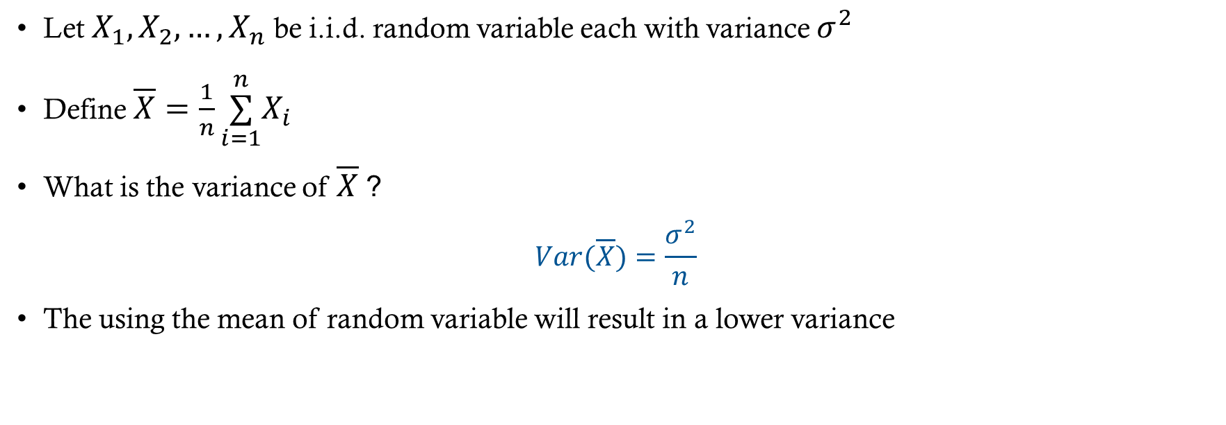
Improving Variance
Let $X_{1},X_{2},…,X_{n}$ be i.i.d. random variable each with variance $σ^{2}$
Define $\overline{X}=\frac{1}{n}\overset{n}{\underset{i=1}{∑}}X_{i}$
What is the variance of $\overline{X}$ ?
$$Var(\overline{X})=\frac{σ^{2}}{n}$$
The using the mean of random variable will result in a lower variance

Slide 3
Applying this principle to trees
Reduce the variance in the predictions by building a lot trees and averaging the results to produce a final prediction
But how can we get more data to build a new trees?
Well maybe we don’t have to…

Slide 4
Bootstrap Aggregation (ing)
Bagging is an ensemble* method which uses bootstrap sampling to generate multiple predictions and
Take a random sample of the training data with replacement
Build a tree using the sampled data
Make predictions with the model
Repeat B times
Average predictions across all models for final prediction
*An ensemble method an any method that involves aggregating predictions over multiple models

Slide 5
More about bagging
Bagging can be using for both regression and classification
Regression predictions are the mean
Classification predictions are the majority vote
Bagging can also be used with models that aren’t decision trees

Slide 6
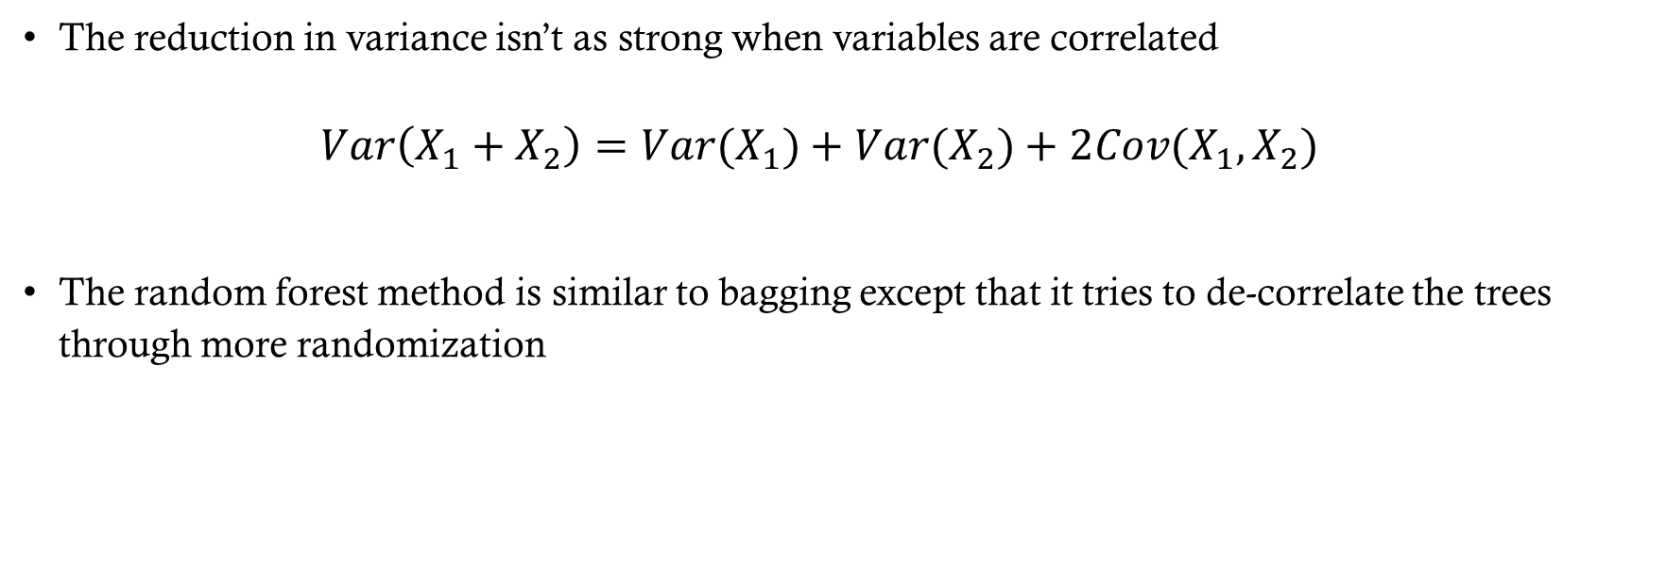
What if the predictions aren’t independent?
The reduction in variance isn’t as strong when variables are correlated $Var\left(X_{1}+X_{2}\right)=Var(X_{1})+Var(X_{2})+2Cov(X_{1},X_{2})$
The random forest method is similar to bagging except that it tries to de-correlate the trees through more randomization

Slide 7
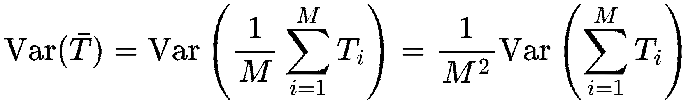

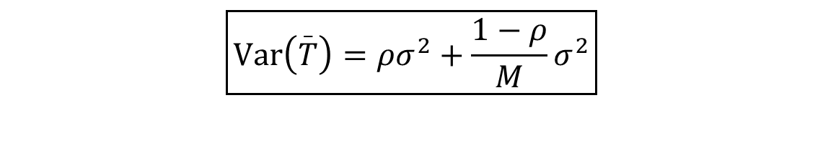
Ensemble variance
Let $T_{1},…,T_{M}$be predictions from $M$ tree predictors (for a fixed input $x$). Denote
$μ=E\left[T_{i​}\right]$ (assumed same for all trees),
$σ^{2}=Var⁡\left(T_{i}\right)$ (same for all trees),
$ρ=Corr⁡\left(T_{i} , T_{j}\right)$for $i≠j$ (average pairwise correlation).
$Cov⁡\left(T_{i} , T_{j}\right)=ρσ^{2}$
$$\boxed{Var⁡\left(\overset{_}{T}\right)=ρσ^{2}+\frac{1−ρ}{M}σ^{2}}$$
Notes:
Now substitute:
$$Var⁡\left(T_{i}\right)=σ^{2}$$
$$Cov⁡\left(T_{i} , T_{j}\right)=ρσ^{2}$$
There are:
$M$variance terms
$M\left(M−1\right)$covariance terms
So:
$$=Mσ^{2}+M\left(M−1\right)ρσ^{2}$$
Divide by $M^{2}$:
$$Var⁡\left(\overset{ˉ}{T}\right)=\frac{Mσ^{2}}{M^{2}}+\frac{M\left(M−1\right)ρσ^{2}}{M^{2}}$$
Simplify:
$$=\frac{σ^{2}}{M}+ρσ^{2}\frac{M−1}{M}$$
Rearrange:
$$\boxed{Var⁡\left(\overset{ˉ}{T}\right)=ρσ^{2}+\frac{1−ρ}{M}σ^{2}}$$

Slide 8
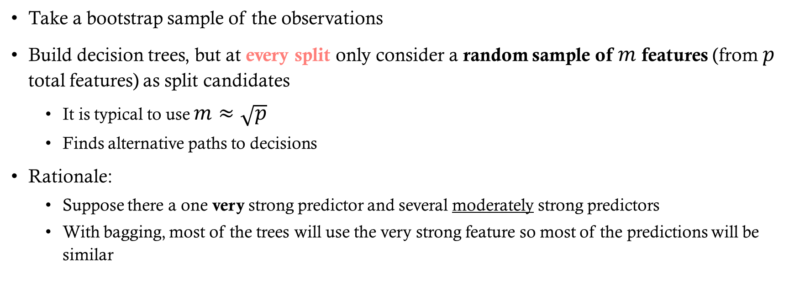
Random Forest Splits
Take a bootstrap sample of the observations
Build decision trees, but at every split only consider a random sample of $m$ features (from $p$ total features) as split candidates
It is typical to use $m≈\sqrt{p}$
Finds alternative paths to decisions
Rationale:
Suppose there a one very strong predictor and several moderately strong predictors
With bagging, most of the trees will use the very strong feature so most of the predictions will be similar

Slide 9
Model Interpretation
The bad news: The increase in predictive ability decreases the interpretability of the model (compared to one tree)
We can’t just draw the tree anymore
The good news: We can get an overall idea of feature importance measured by:
Finding splits using a particular feature
Computing the average impurity reduction across all trees
Features with the largest average decrease in impurity (Gini or entropy) are the most important
Scikit-learn scales so that feature importances sum to 1

Slide 10
Example of Feature Importance

Slide 11
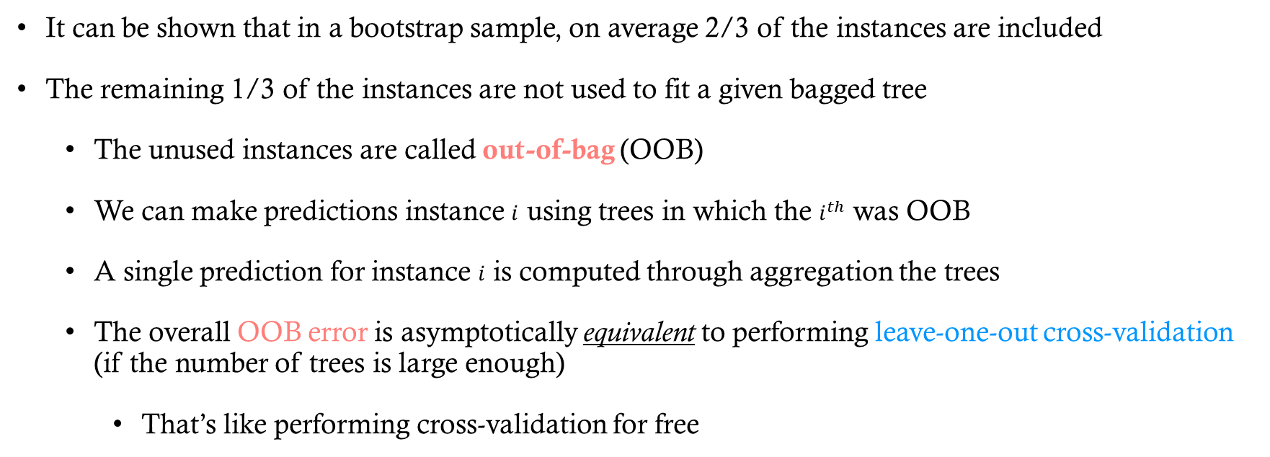
Out of Bag Error Estimation
It can be shown that in a bootstrap sample, on average 2/3 of the instances are included
The remaining 1/3 of the instances are not used to fit a given bagged tree
The unused instances are called out-of-bag (OOB)
We can make predictions instance $i$ using trees in which the $i^{th}$ was OOB
A single prediction for instance $i$ is computed through aggregation the trees
The overall OOB error is asymptotically equivalent to performing leave-one-out cross-validation (if the number of trees is large enough)
That’s like performing cross-validation for free

Slide 12
Tuning Parameters (Bagging and RF)
n_estimators: number of trees in forest
Increasing does not lead to overfitting
criterion: Gini impurity or entropy
max_features: Number of features to consider at each split
Tuning parameters associated with base estimator

Slide 13
Other variations
Pasting
Like bagging, except sample is taken without replacement
Random patches
Like bagging, except a random sample of instances and features is used in training base estimator
Random subspaces
Like bagging, except a random sample of features used is training base estimator
Extremely random trees
Like RF, except use random splits (instead of best threshold)

